Slide 1
Unit 1
Work 9 to 5
Mega Goal 2.2
Reading
Done by: Entisar Al-Obaidallah

Slide 2
Lesson Goals
01
02
03
04
Name some unusual jobs
Read for specific information
Answer some questions about the reading passage
Find the meaning of new words in the article

Slide 3

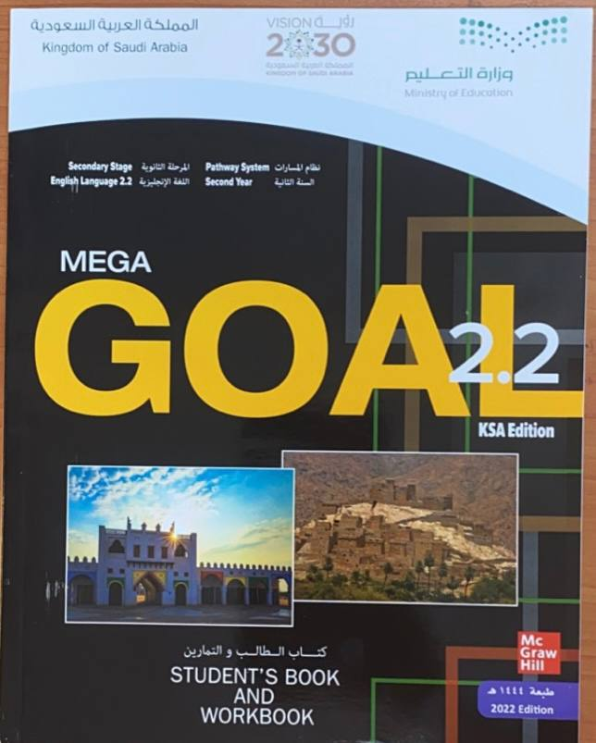
Open Book
Pages ( 8-9 )

Slide 4
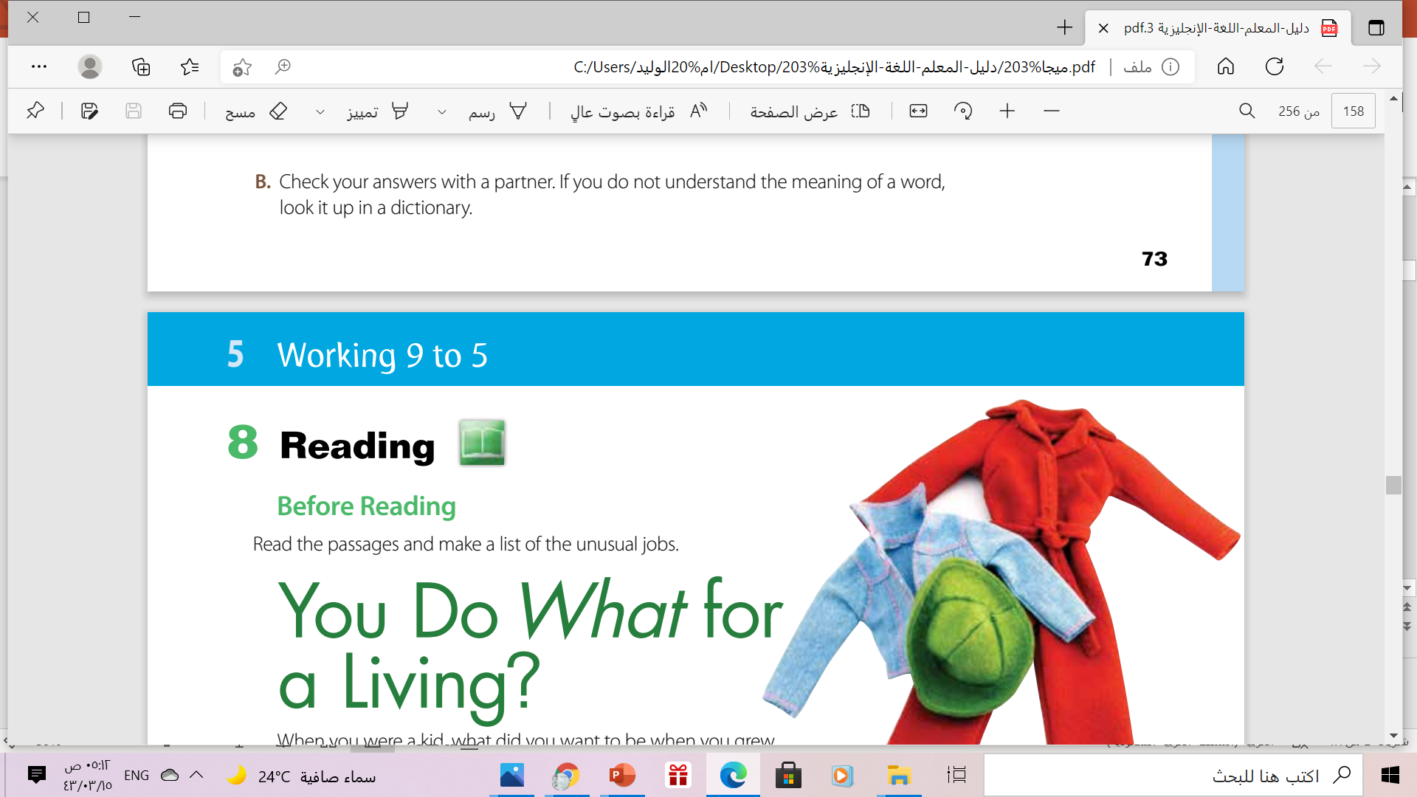

Slide 5
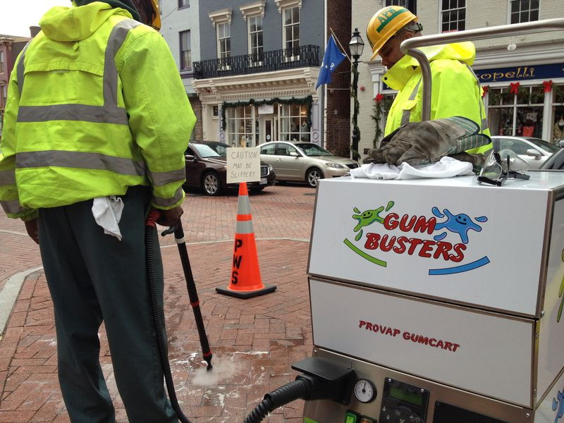
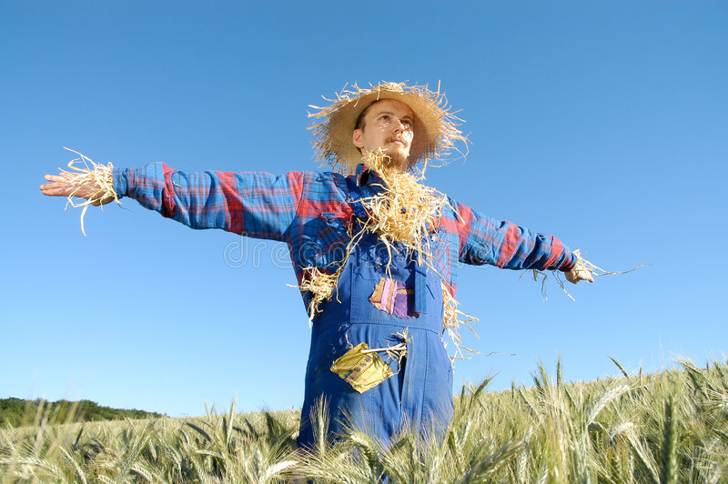
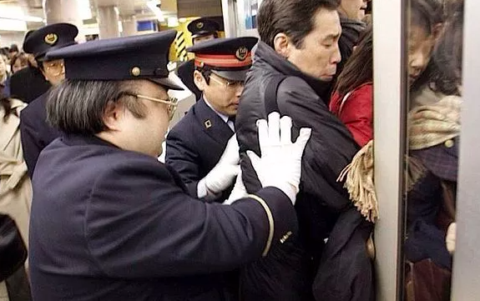
SOME unusual jobs
Gum buster
Human Scarecrows
Professional Pusher

Slide 6
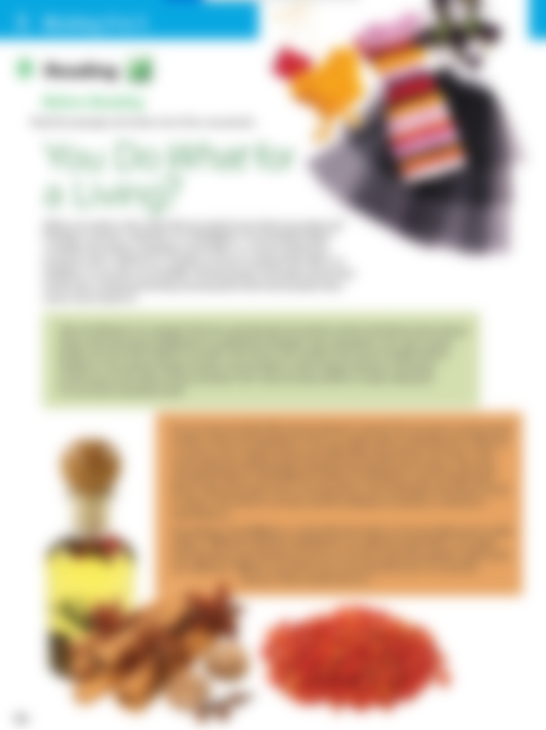
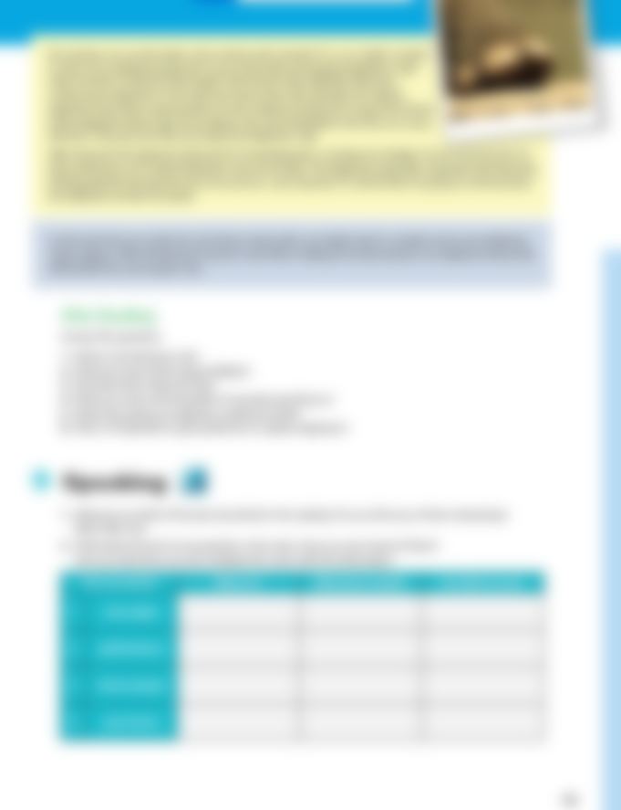

What is the title of the text?

Slide 7
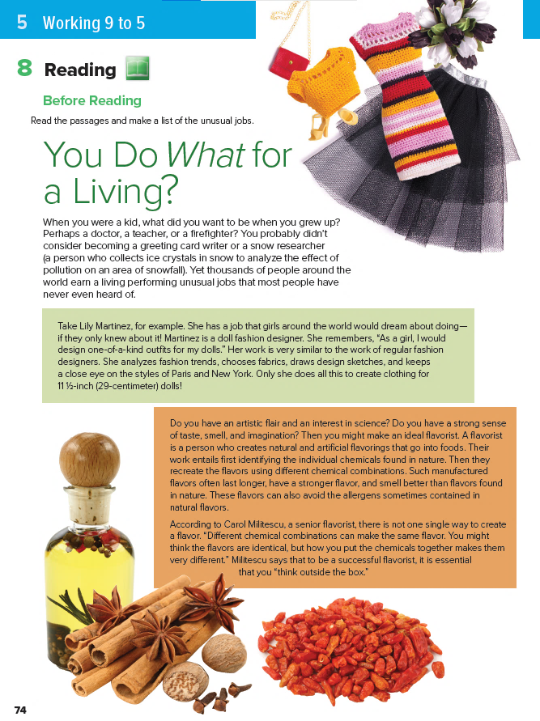
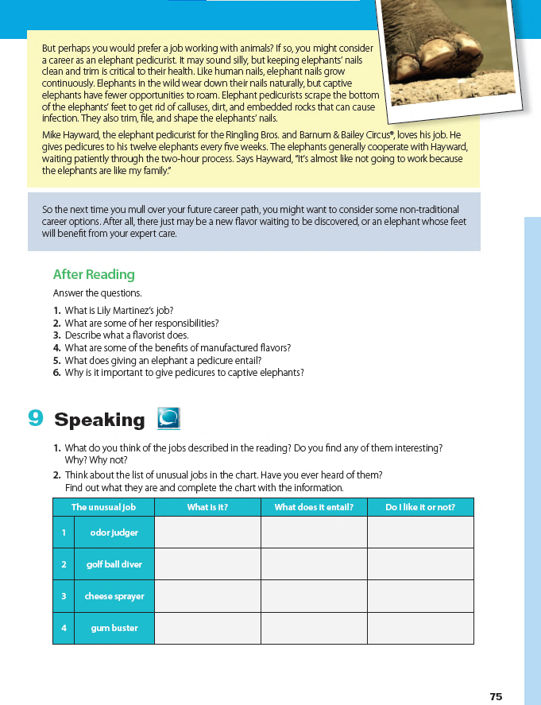


……What !!!
people usually ask a question in this way when they are surprised by something they’ve heard
e.g. You play What !!!
e.g. You travel Where !!!

Slide 8
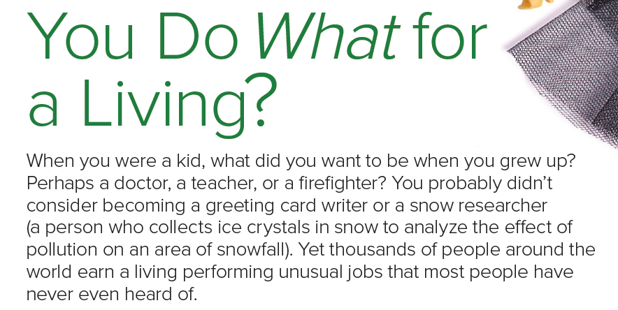

introduction
What are the
jobs mentioned?

Slide 9



3
Lily Martinez
Mike Hayward
1
What is the person’s name in each paragraph?
2
Carol Militescu

Slide 10
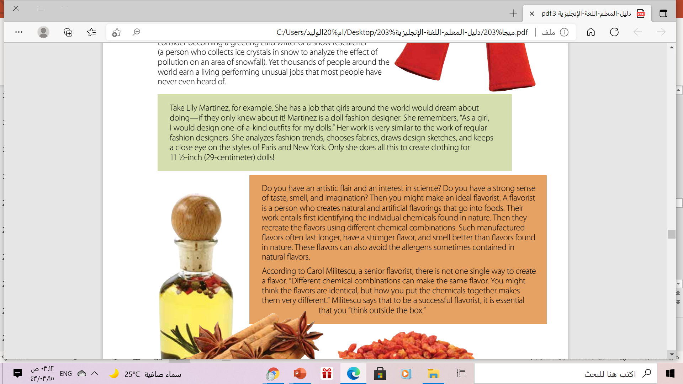
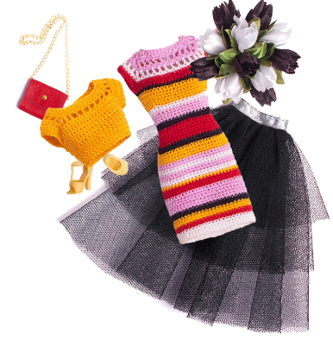
1
What does the person do?
What does the person say about their job?
What does their job entail?

Slide 11
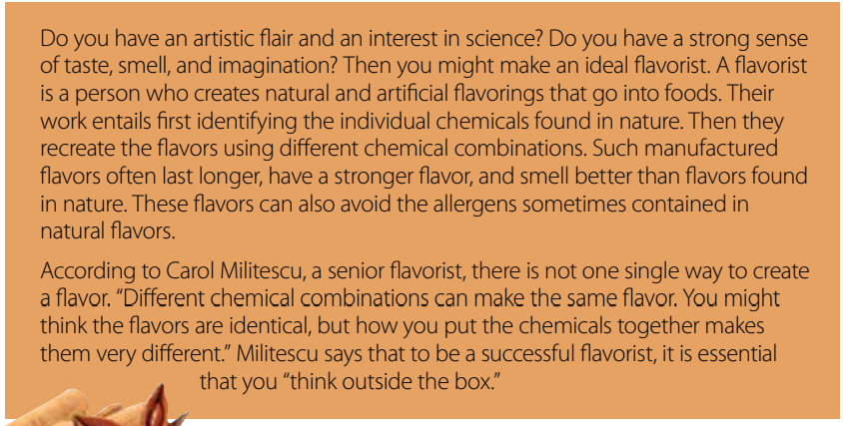
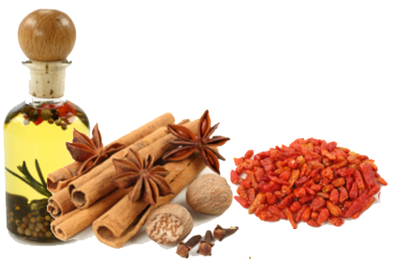
2
What does the person do?
What does their job entail?
What does the person say about their job?

Slide 12
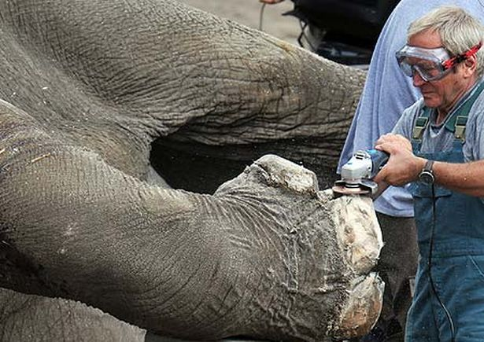
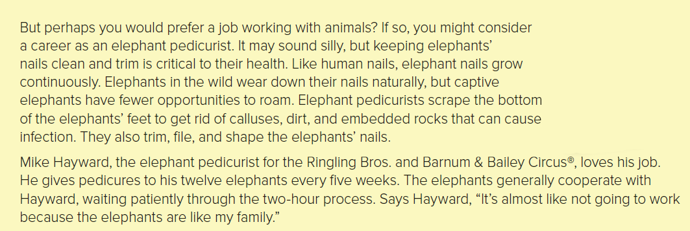
3
What does the person do?
What does their job entail?
What does the person say about their job?

Slide 13
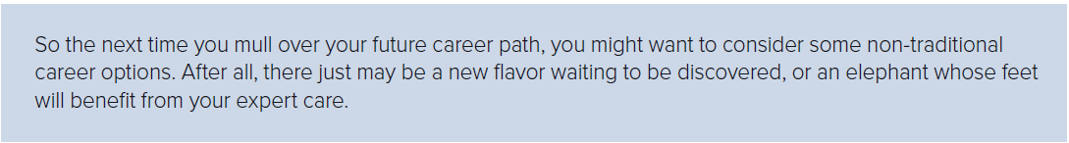
an expression that means
to think about something carefully and for a long time .
Conclusion

Slide 14
Book Open
Pages (9 )

Slide 15
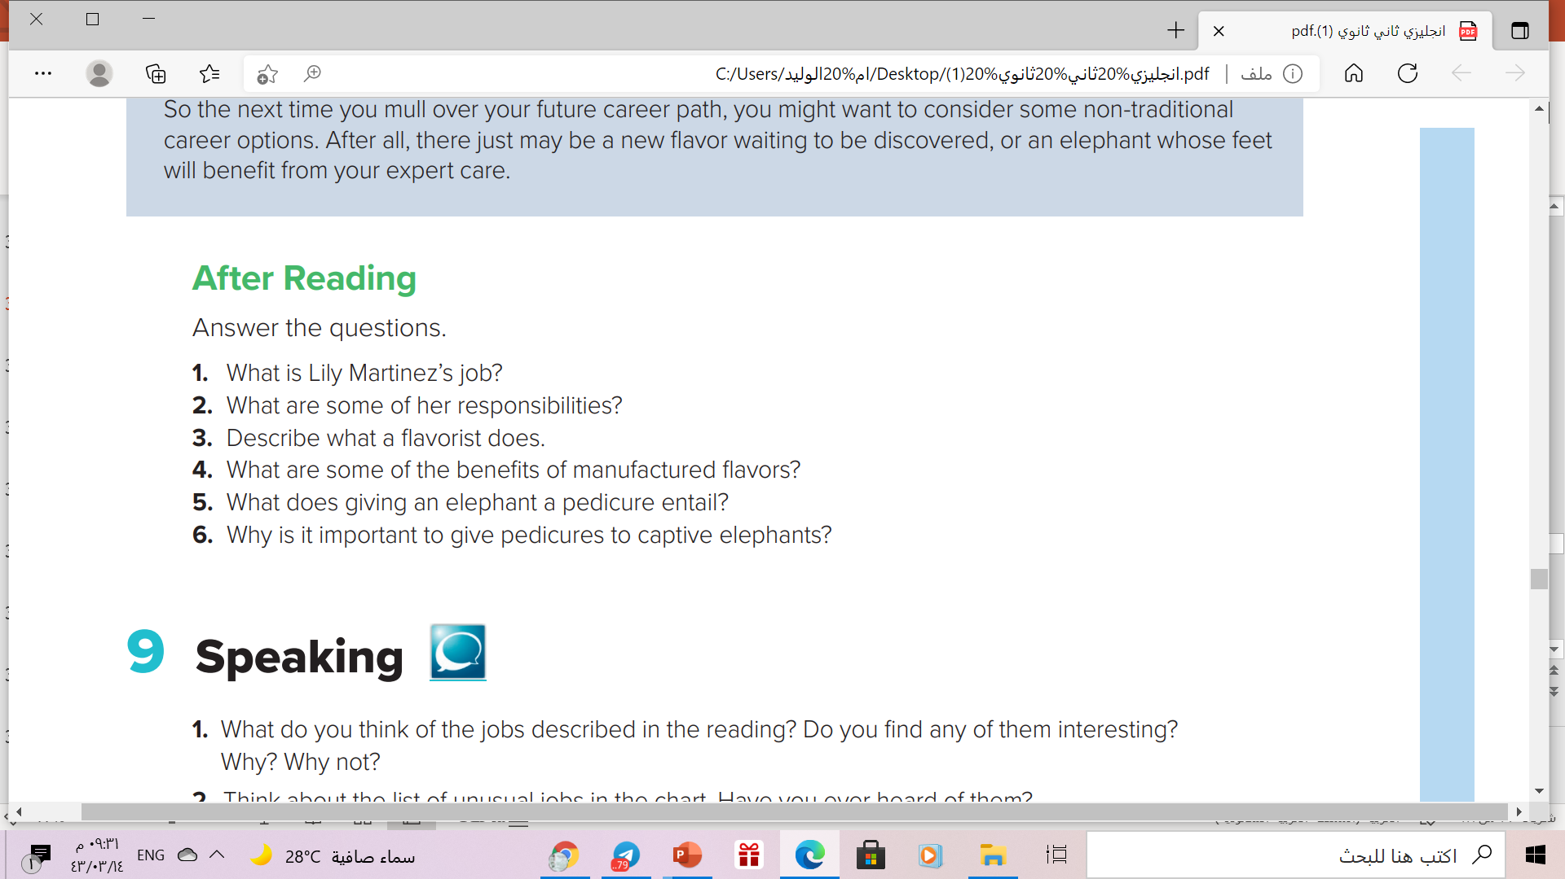
1. She is a fashion designer for doll clothing.
2. She studies fashion trends, chooses fabrics, draws pictures of her designs, and watches fashion shows.
3. A flavorist makes natural and artificial flavorings to put into food.
4. Manufactured flavors last longer, have stronger flavor, smell, better, and have fewer allergens.
5. An elephant pedicure entails scraping the bottom of the elephant’s feet to get rid of calluses, dirt, and rocks, and trimming, filing, and shaping the nails.
6. Captive elephants cannot wear down their nails naturally, and rocks and dirt in their feet can cause infections

Slide 16
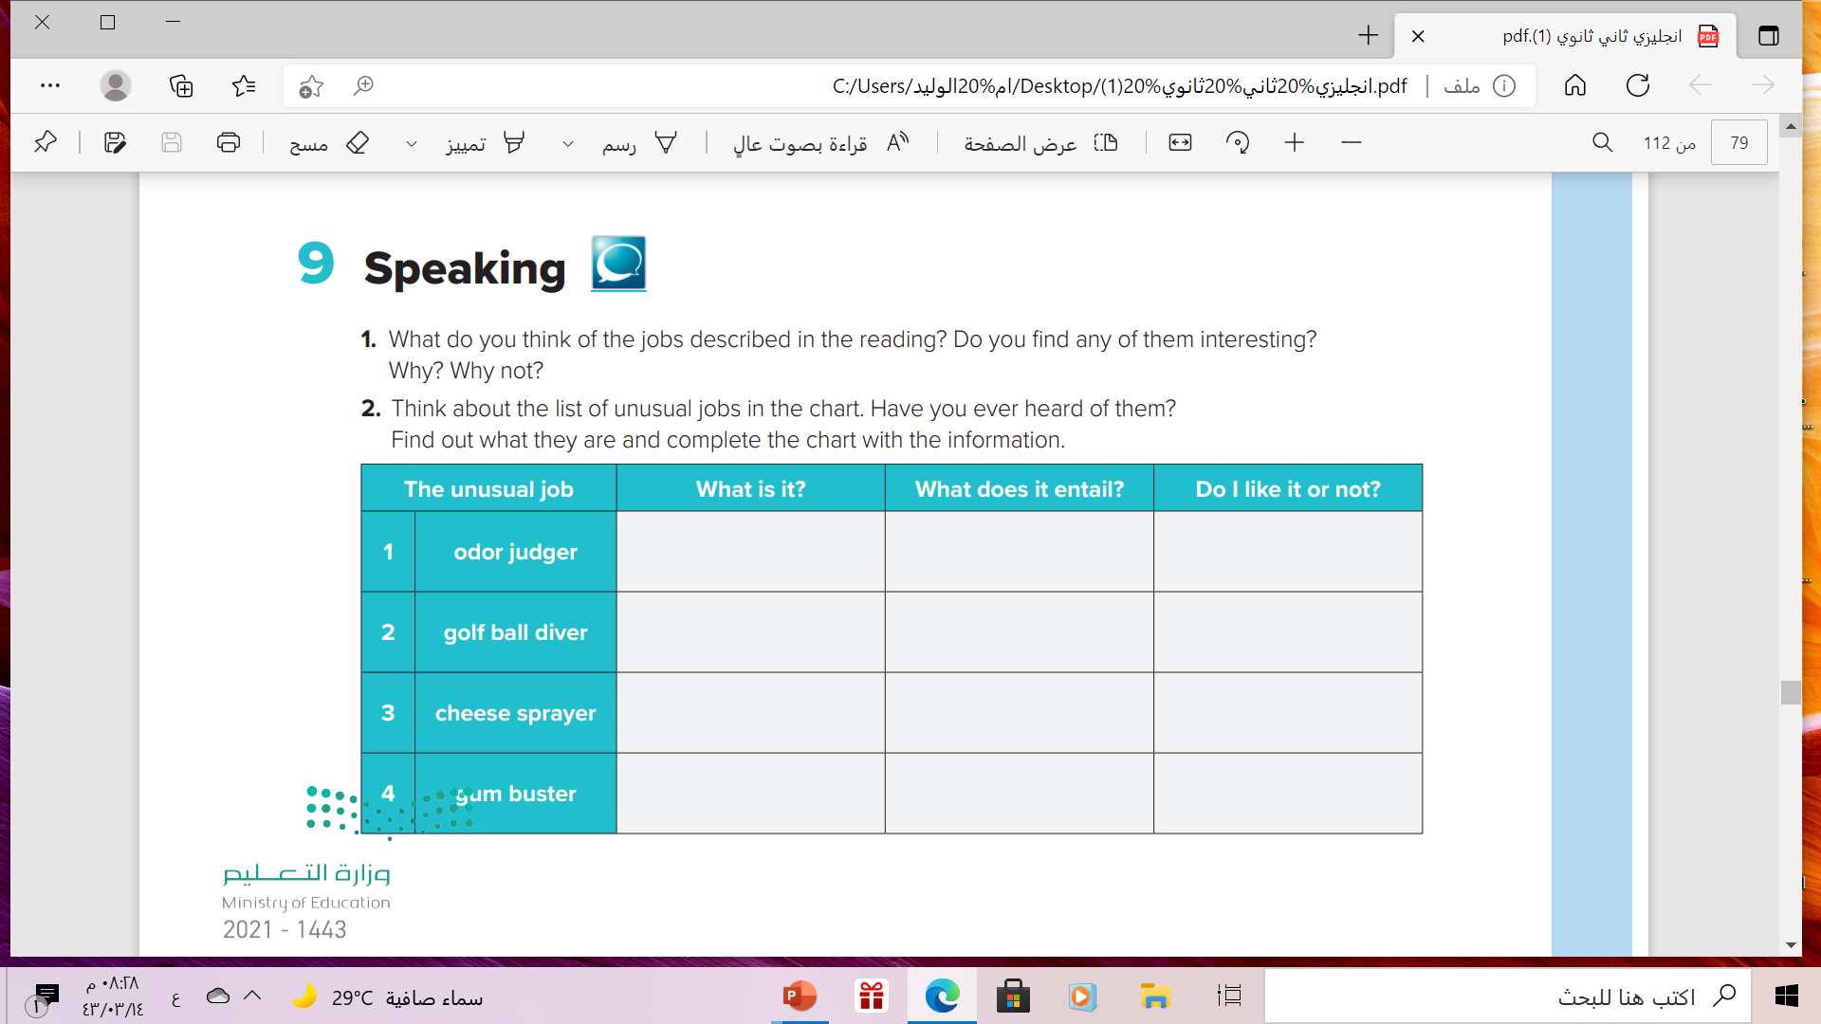

People who can distinguish and compare smells
successfully
testing odors coming from people’s armpits, mouths, or feet
A person who collects golf ball from under water
Diving into ponds and lakes on golf courses looking for golf balls
A person who give people their popcorn with butter and salt
spraying popcorn or similar foods with melted cheese
A person who clean gum off the public places
removing chewing gum from sidewalks, streets, and other areas

Slide 17

Remember

Slide 18
Homework
Work book page ( 81) , exercise ( I )

Slide 19

Thank you!

