Slide 1
Mega Goal 2.2
Unit 1
Going Green
Listen & Discuss
Done by : Entisar Al-Obaidallah

Slide 2
Lesson Objectives
Explain the main idea of Going Green.
Listen for specific information
Identify the meanings of the new words
Answer some questions correctly

Slide 3




What does this green symbol mean ?
Where can you see this green symbol ?
What is it for ?
The three arrows represent 'reducing', 'reusing', and 'recycling'
It appears on all sorts of packaging
This indicates that an object is capable of being recycled

Slide 4

What does
Go GREEN mean?
To do things in a way that protects the natural environment

Slide 5


List some ways help you to be GREEN

Slide 6
Some Ways to be Green…..
Using renewable energy
Conserving water
turning devices off after using
Recycling garbage
Eating organic
Reduce using plastic
Sitting AC fairly

Slide 7
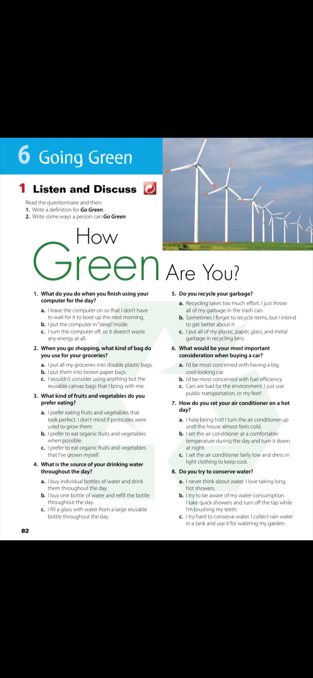
Open UR book p.(82)
What is the title?
What does the picture show?
a wind farm, a non-polluting way of generating electricity
Are there any wind farms near where we live?

Slide 8


Open UR book p.(82)
Read and circle your answer
Questionnaire

Slide 9
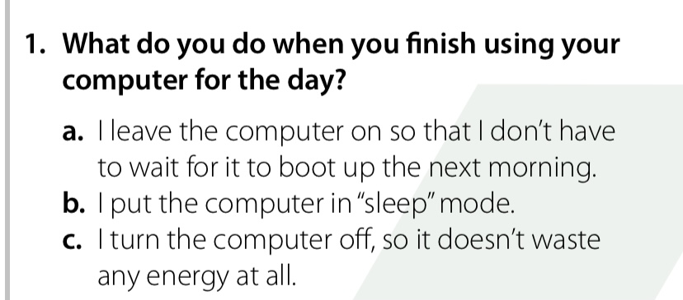


Turn on \off
computer

Slide 10
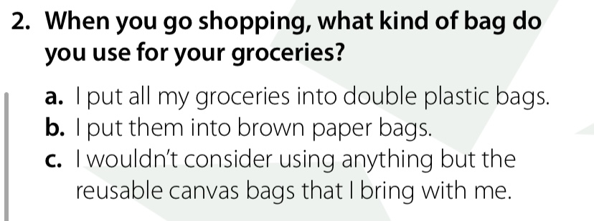
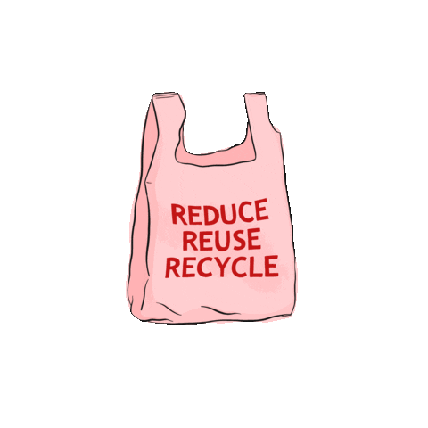
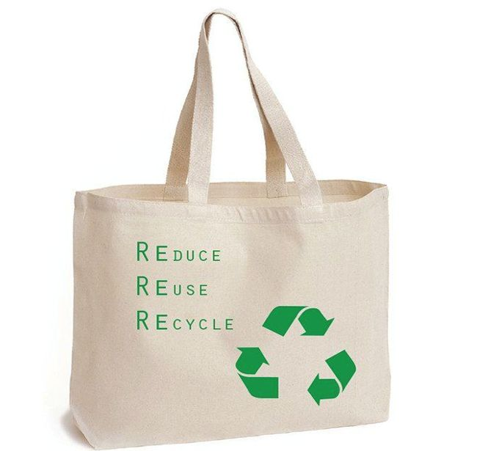
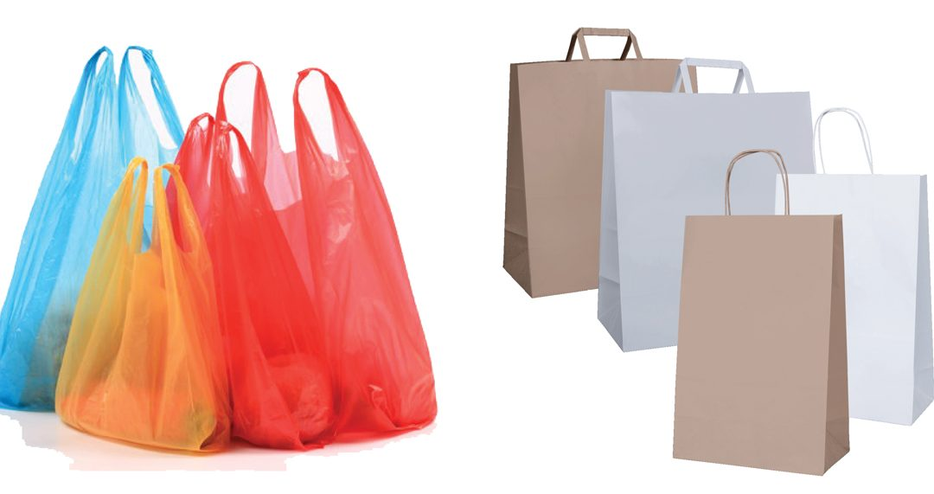
Plastic Bags
Reusable Canvas Bags

Slide 11
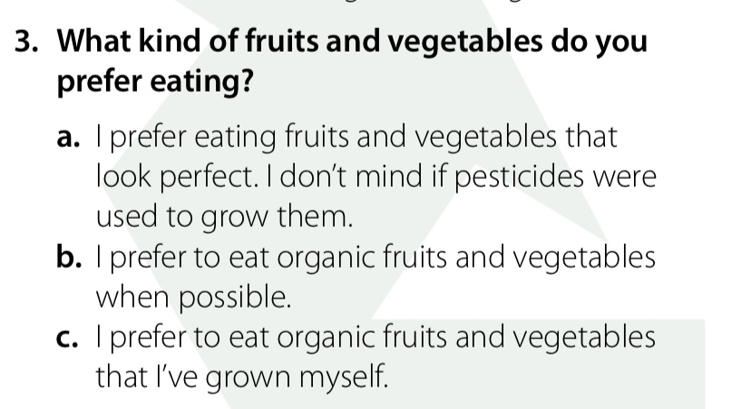
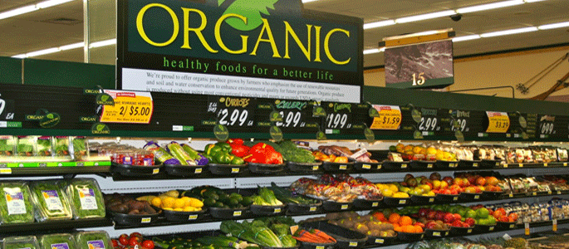

Organic fruits
pesticides

Slide 12
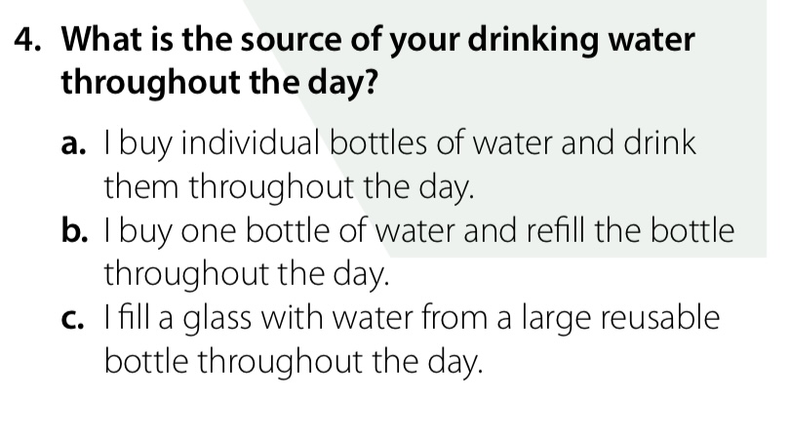


Large Reusable Bottle
Bottle of water

Slide 13
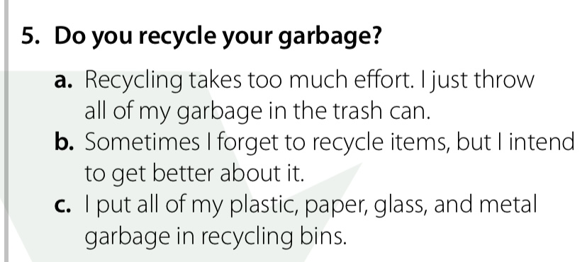
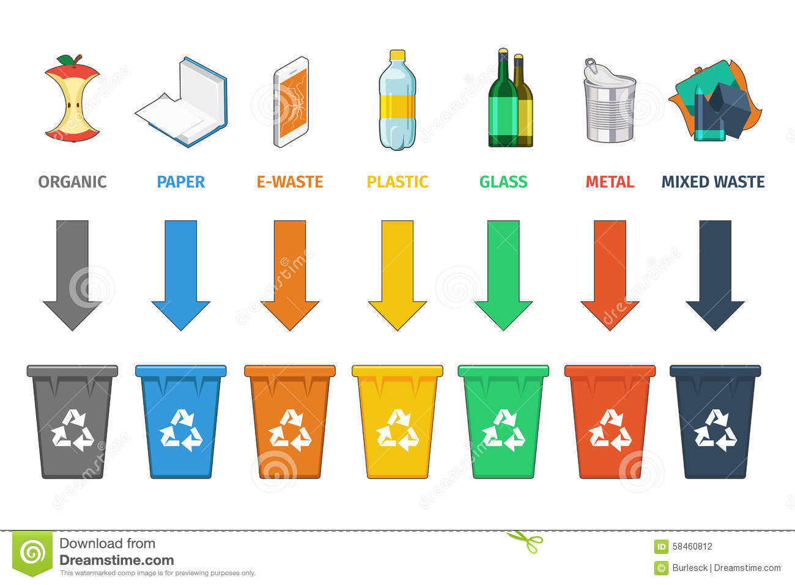
Recycling Bins
Recycle Symbol

Slide 14
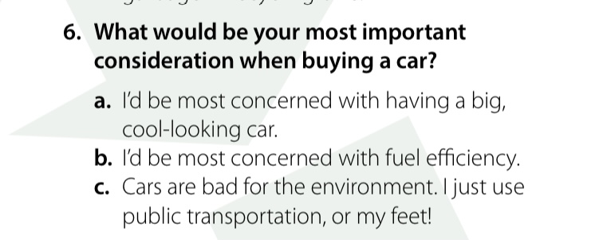
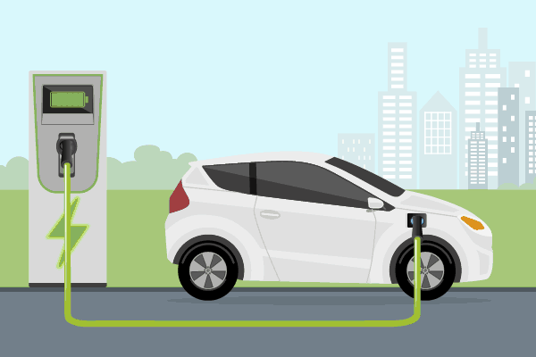
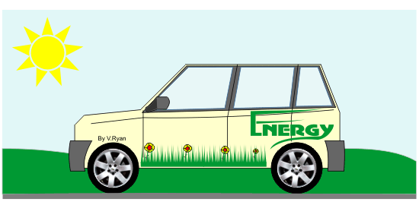
Environmentally Friendly Car
Electric Car

Slide 15
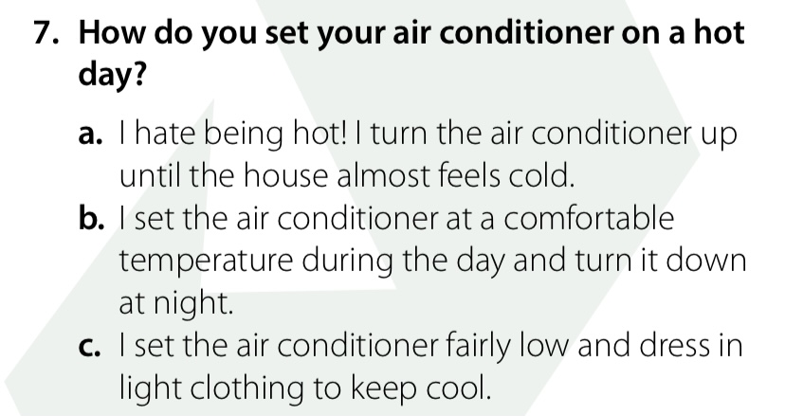


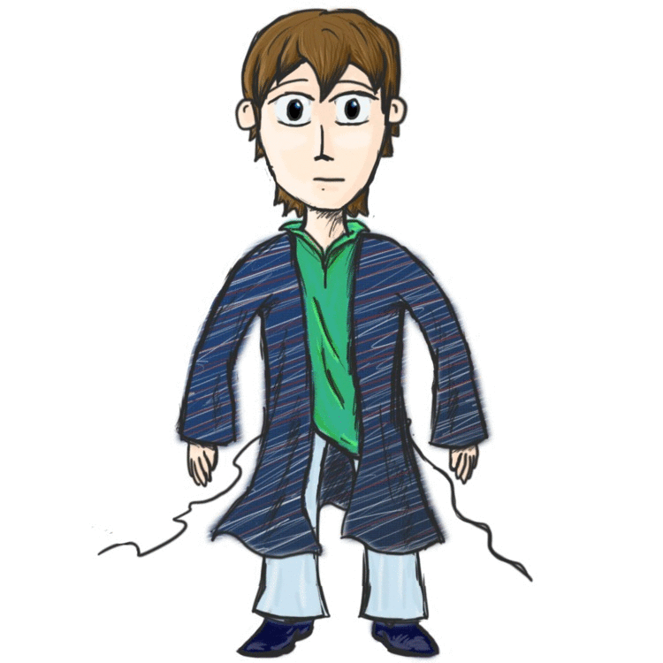
light clothing
set AC
Hot - Cold

Slide 16
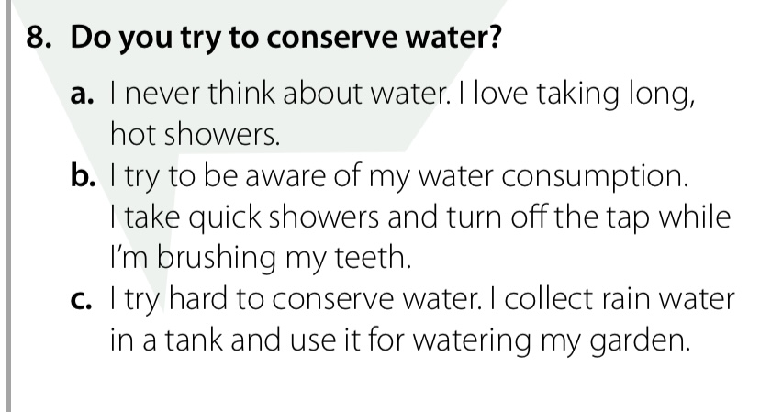
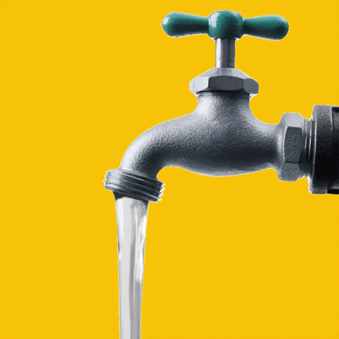


a tank
water tap
take shower

Slide 17
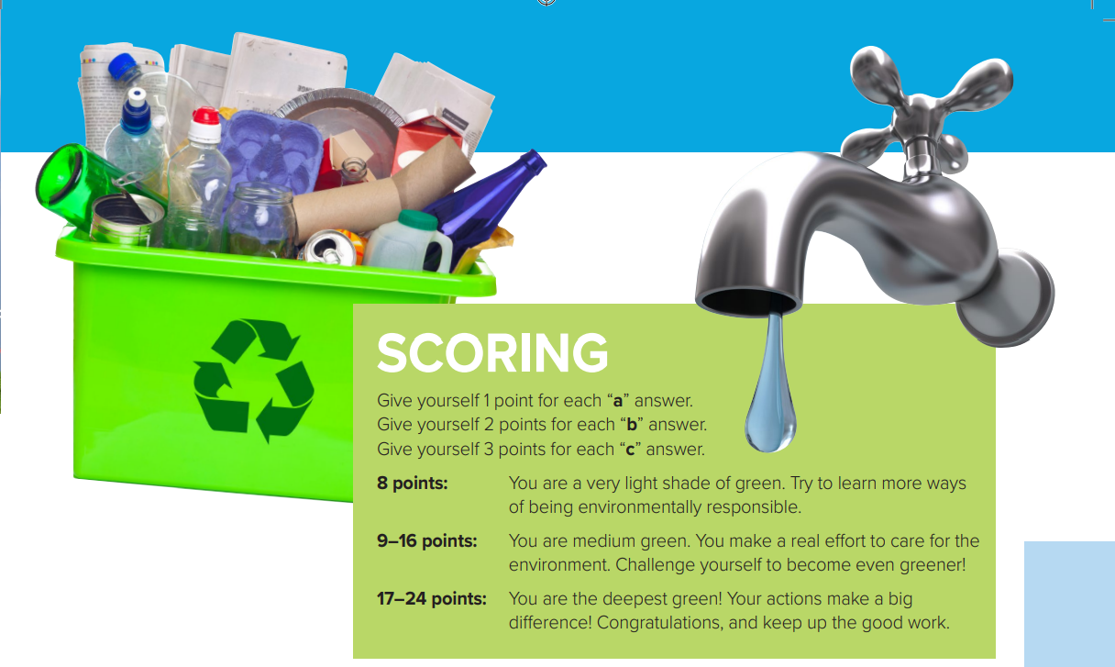

Slide 18
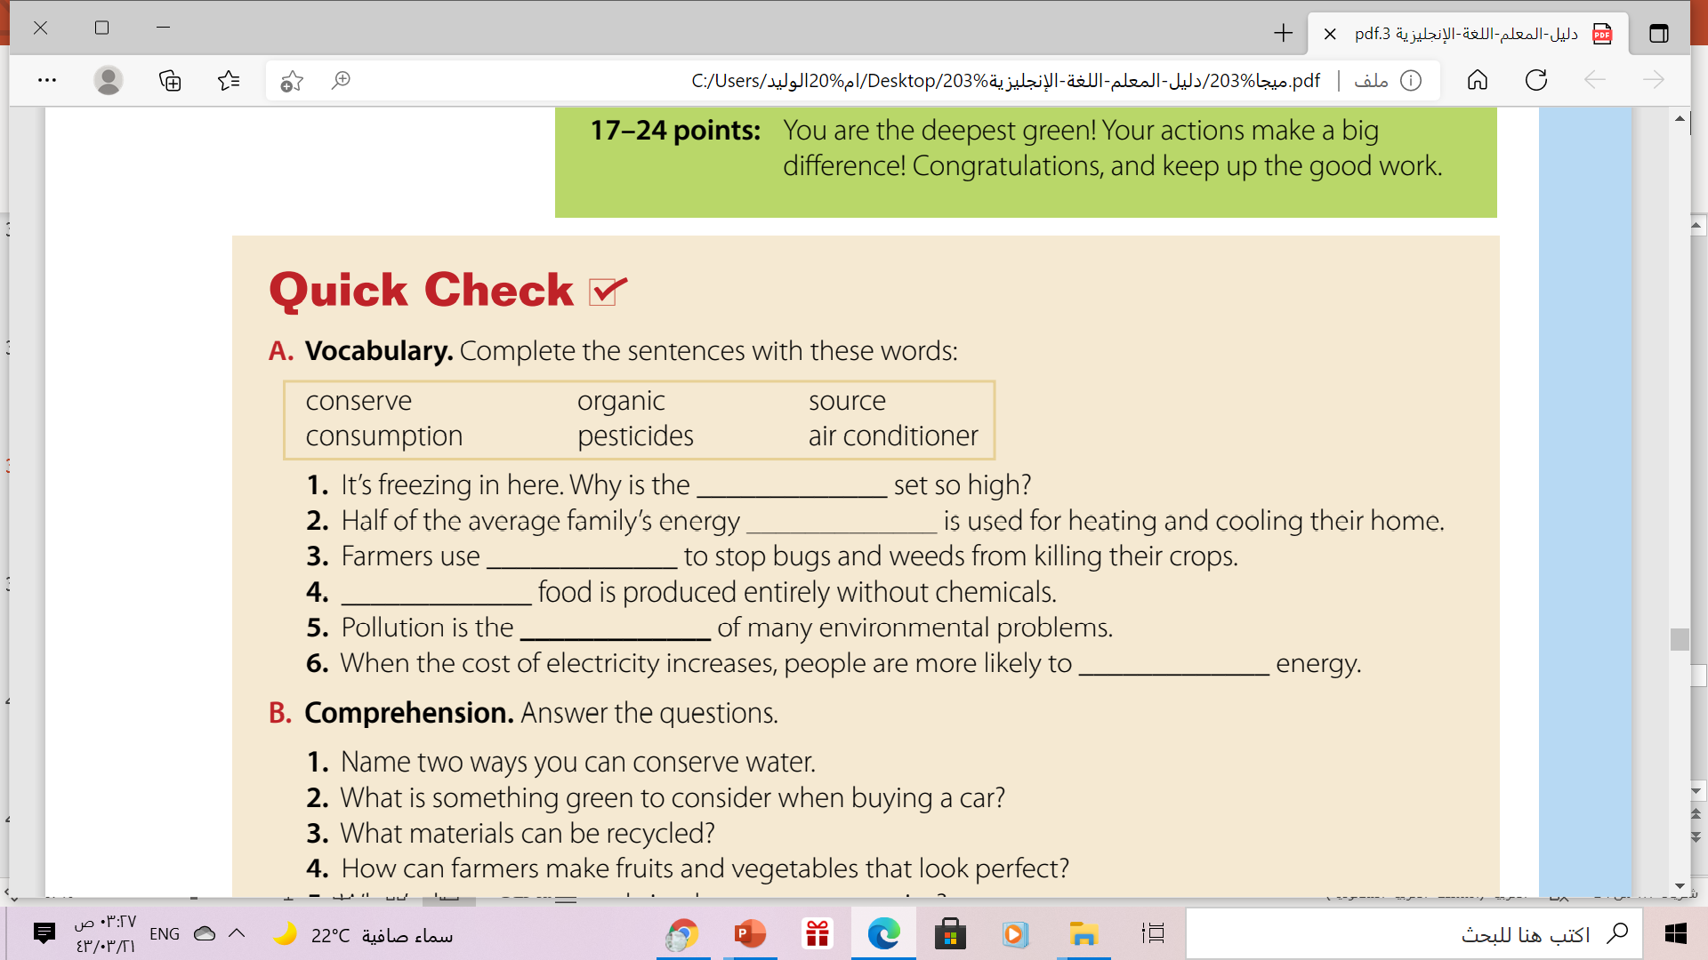
air conditioner
consumption
pesticides
Organic
source
conserve

Slide 19
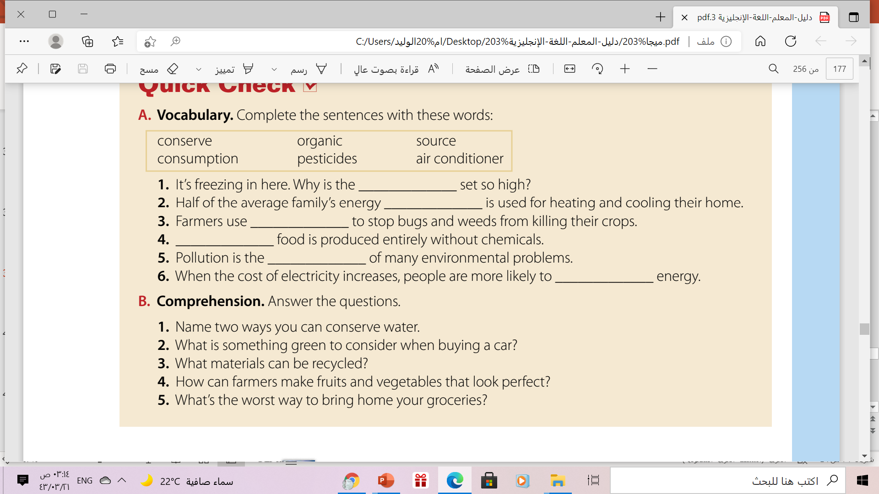
Comprehension
1. collect rainwater for use; not leave the water running;
take quick showers
2. fuel efficiency
3. plastic, paper, glass, and metal
4. They can use pesticides.
5. in plastic bags

Slide 20
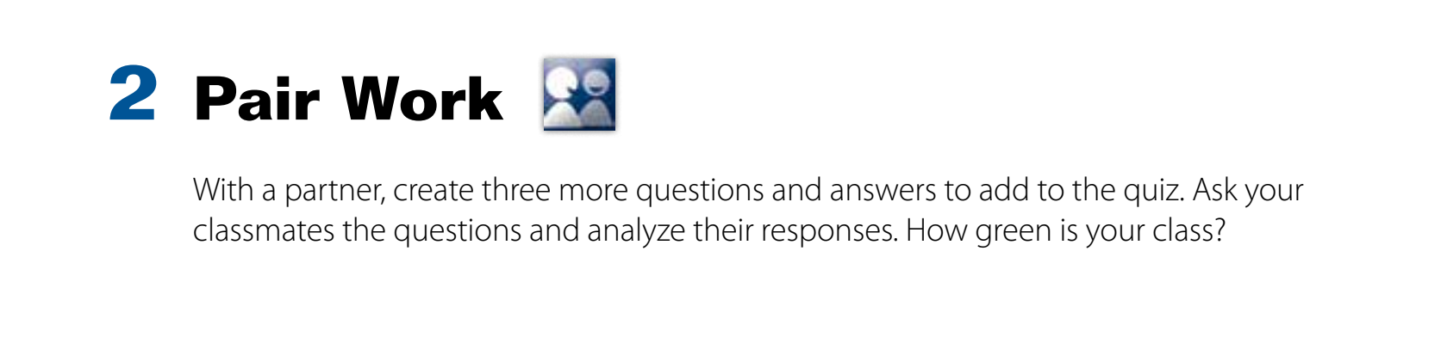


Slide 21
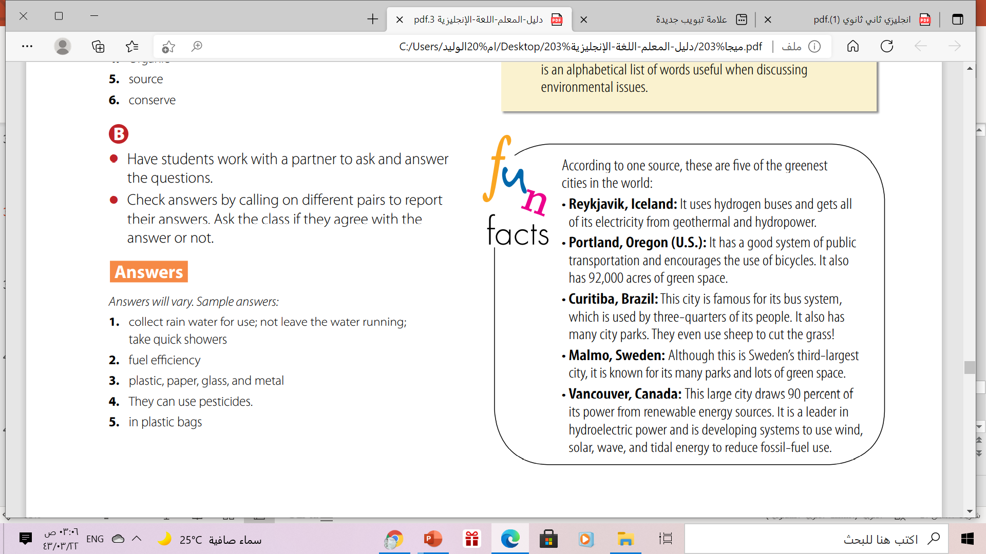

Slide 22
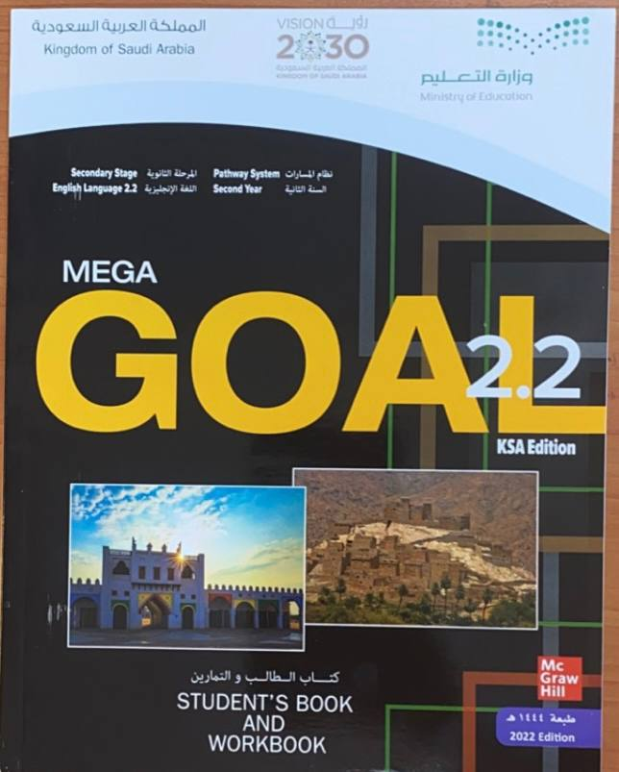
Homework
Workbook page (87)
exercise ( A )

Slide 23
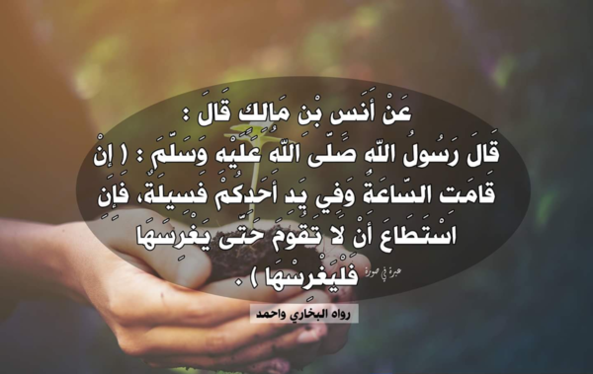

Slide 24
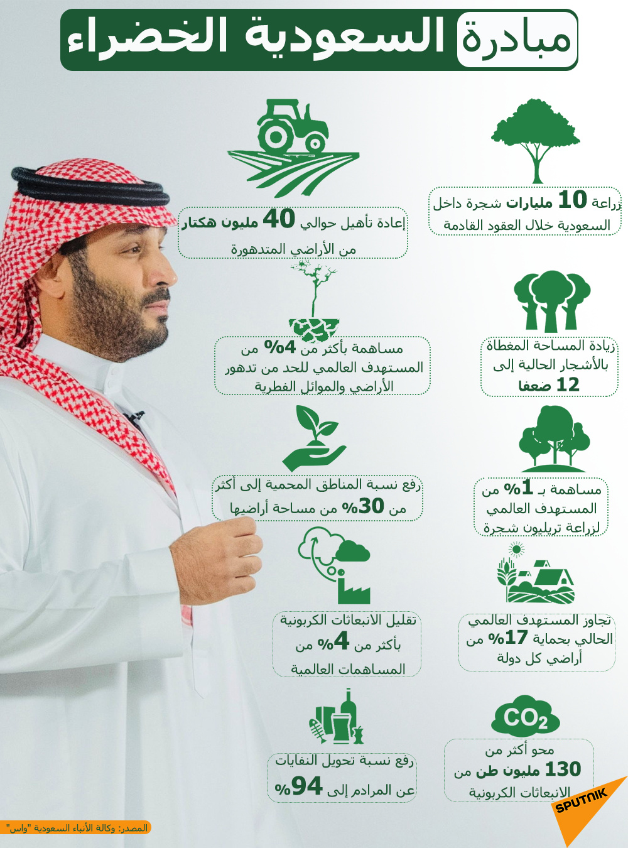


Slide 25

Thanks!

