Slide 1


Mega Goal 2.2
U: 1 L:8
Reading
Done by: Essa Al Hussaini

Slide 2

  LESSON GOALS
Name some
unusual jobs
1
Find the meaning of new words in the article
4
List job responsibilities
2
Find expressions in the article
5
Describe
some jobs
3

Slide 3
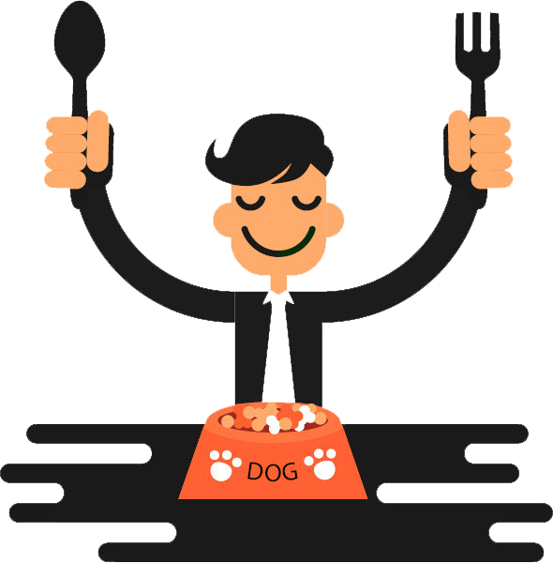

Look & Discover
Unusual thing!!
Odd thing!!
Strange thing!!

Slide 4
Pet Food Tester
… try tasting??
READY to accept the job??
USE Present View
Notes:
Pet Food Tester
tastes pet food to evaluate the flavors and check if it’s up to quality standards

Slide 5
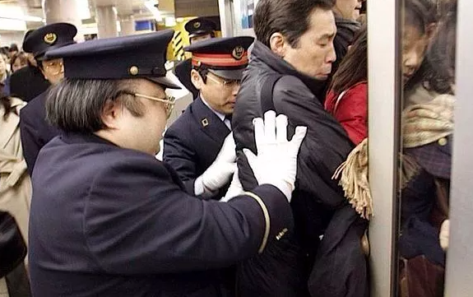
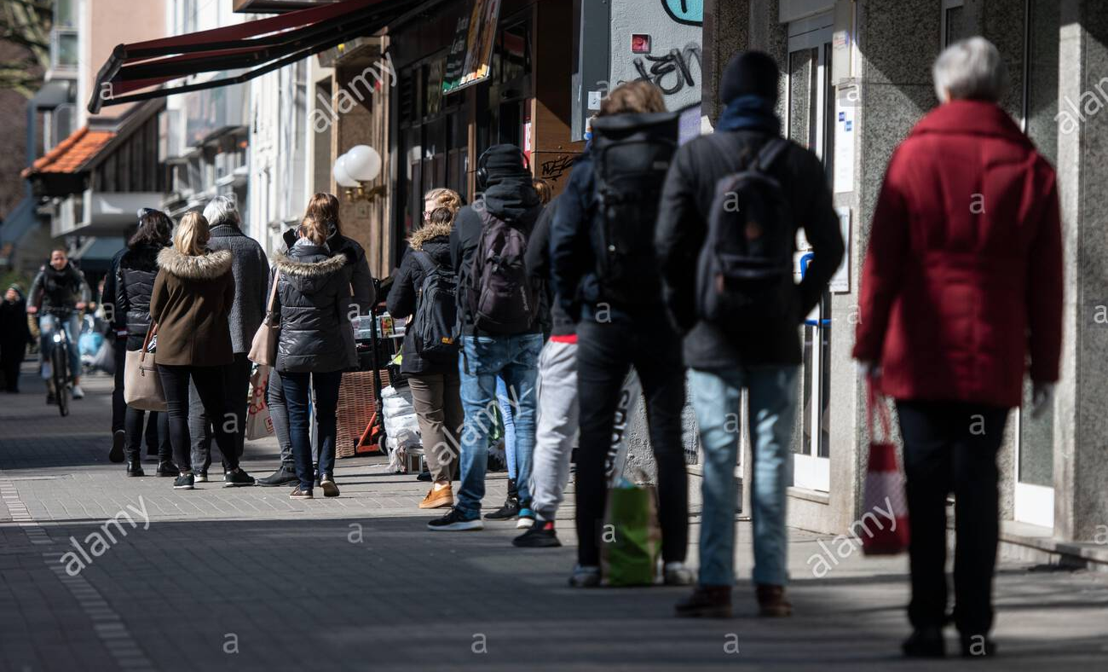
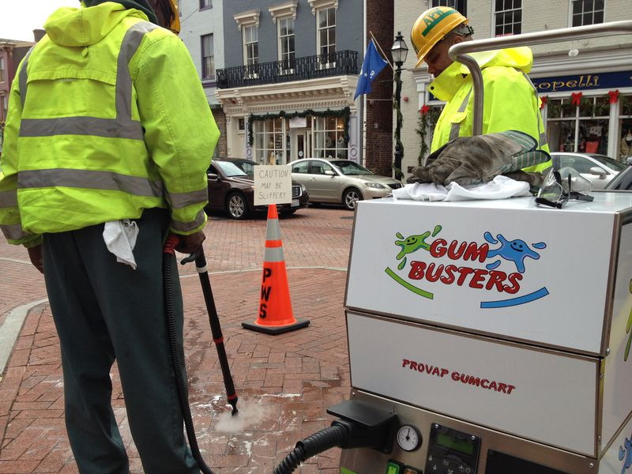
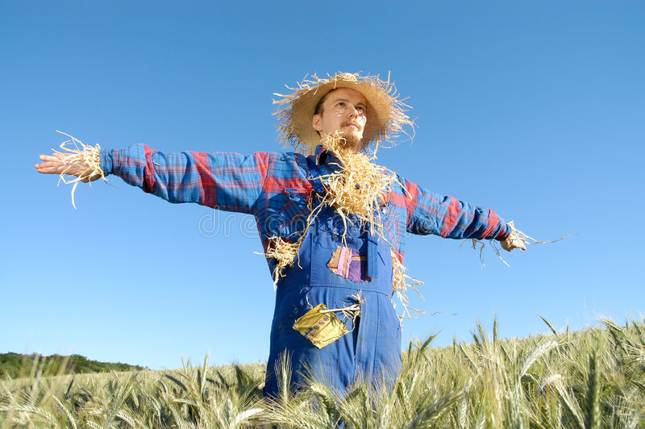
SOME unusual jobs BUT not ALL
Stand in line
Professional Pusher
USE Present View
Human Scarecrows
Gum buster
Notes:
Line Stander
If you don’t like queuing, you hire a professional line stander, a person who will queue for you for a fee.
Human Scarecrows
Standing in a field scaring away the animals when they get too close
Professional Pusher
to push others onto trains so that nobody's late for work.
Gum buster
To remove gum from city streets and walls

Slide 6

What are the most
UNUSUAL JOBS you’ve ever heard of?

Slide 7
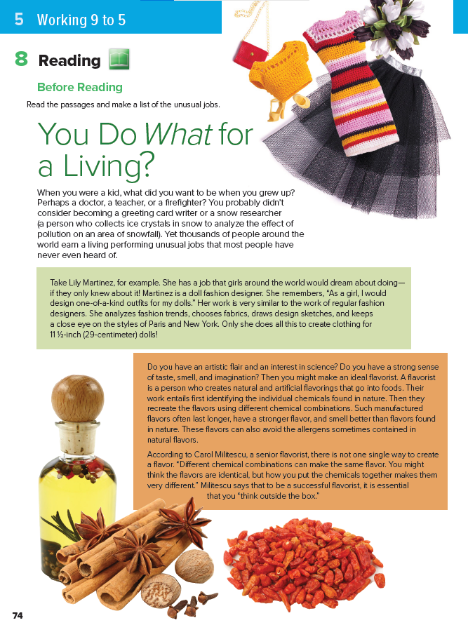
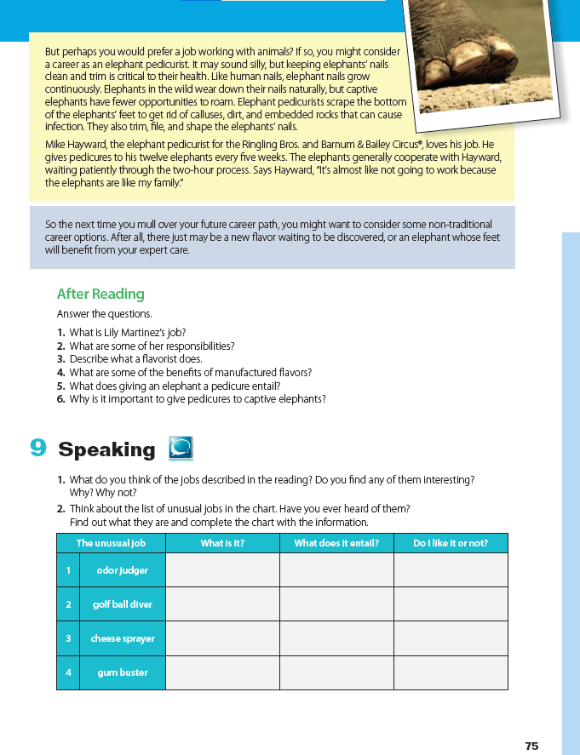
1
The title?
8 - 9

Slide 8
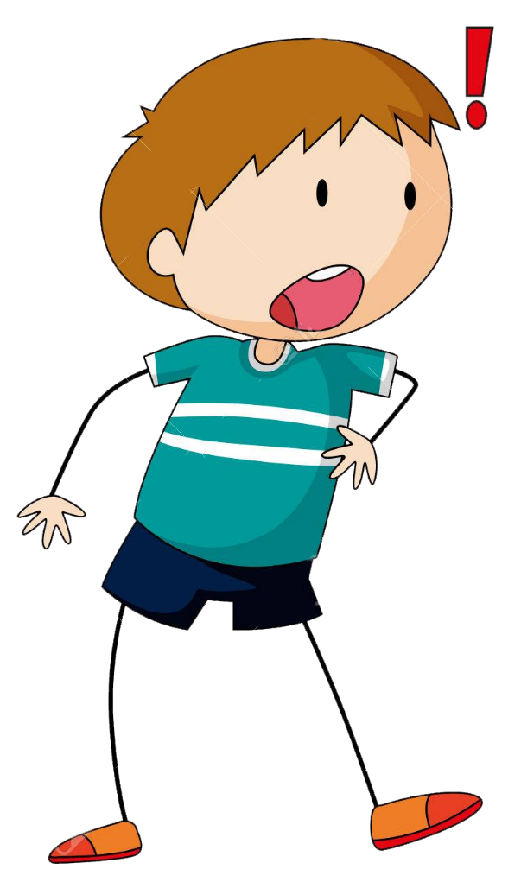

1
… WHAT?!!
You play WHAT?!
people sometimes ask a question in this way when they are surprised by something they’ve heard
You stay WHERE?!

Slide 9

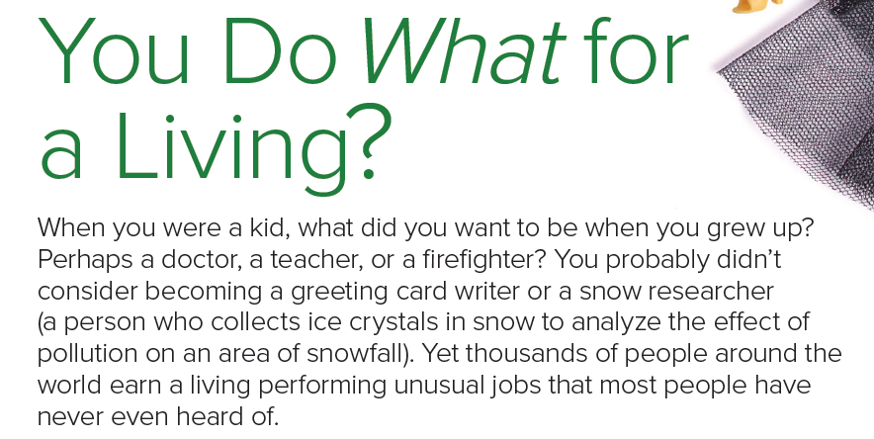

1
intro
1 min Reading
What are the
jobs mentioned?

Slide 10
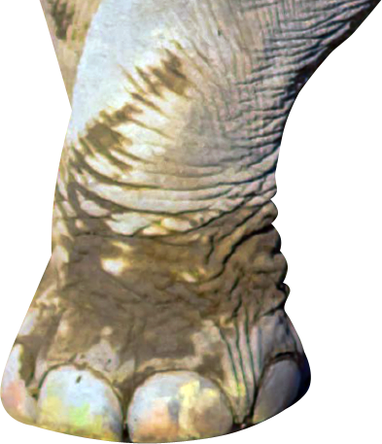
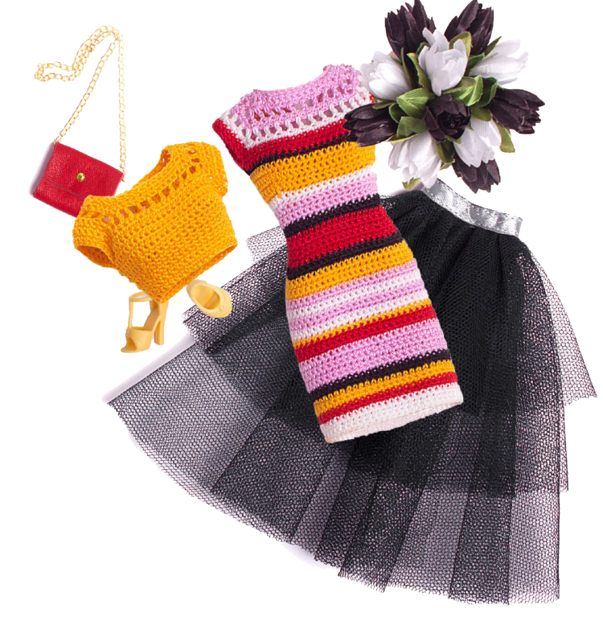

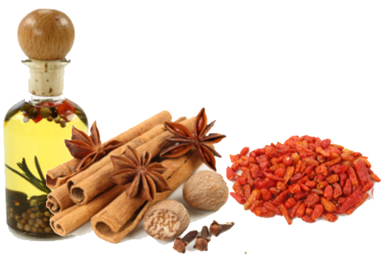
1
Think unusual
What kind of job does the picture shows ?

Slide 11
1
3
Mike Hayward
Person’s NAME
in each section?
1
Lily Martinez
2
Carol Militescu

Slide 12
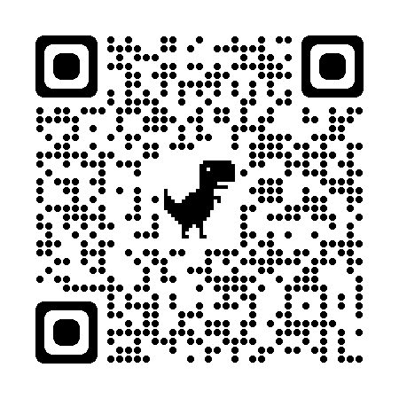
1
Each student will read ONLY ONE Section
3
Mike Hayward
THEN answer the followings
What does each person do?
What does each person's job entail?
What does each person say about the job?
Jigsaw Reading
1
Lily Martinez
4-5 mins
individual Reading
2
Carol Militescu
Scan QR code to download ACTIVITY sheet

Slide 13

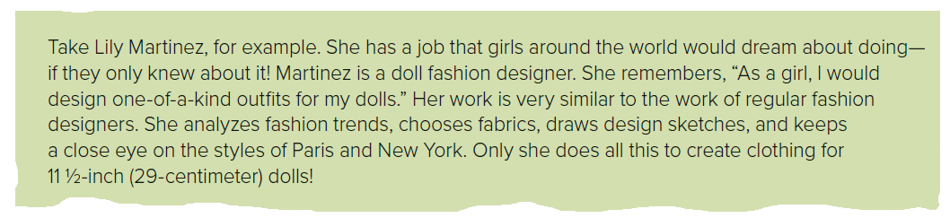
1- Lily Martines’s job
2 - Lily's job requirements
3 -About the job
1
Each student will read ONLY ONE Section

Slide 14
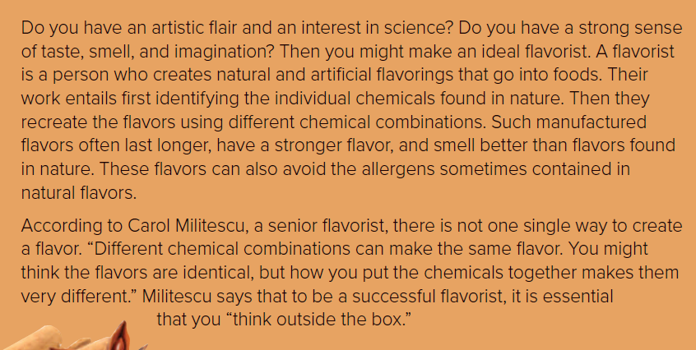
1- Carol Militescu’s job
2 – Carol’s job requirements
3 -About the job
2

Slide 15
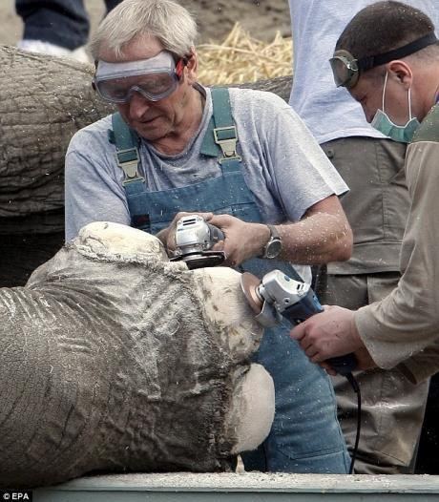
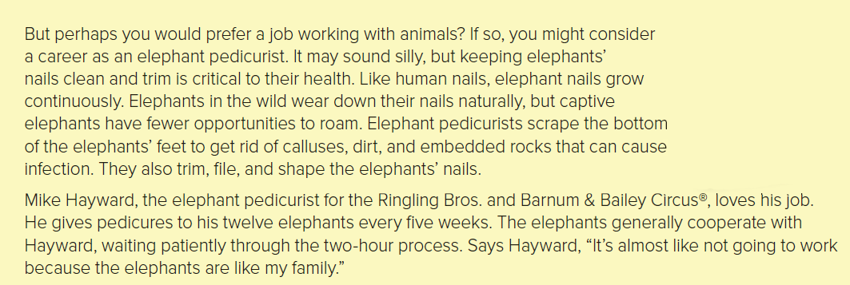
1- Mike Hayward’s job
2 – Mike’s job requirements
3 -About the job
3

Slide 16
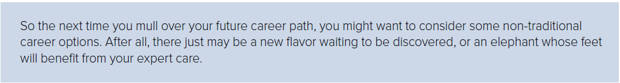
Conclusion

Slide 17

Additional Vocabulary
Activity

Slide 18


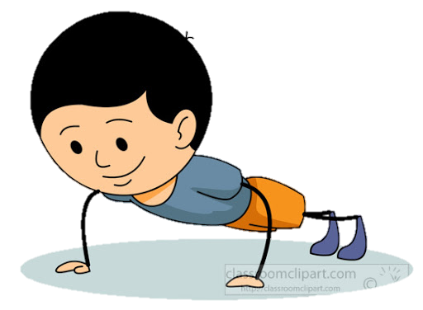
After Reading

Slide 19
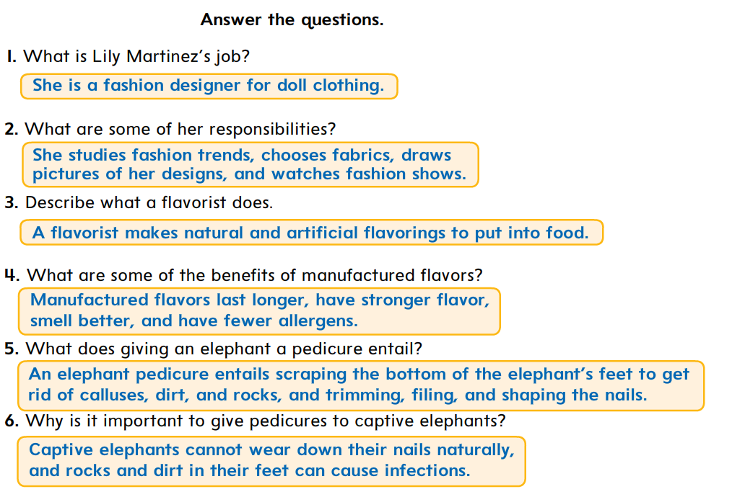

Slide 20
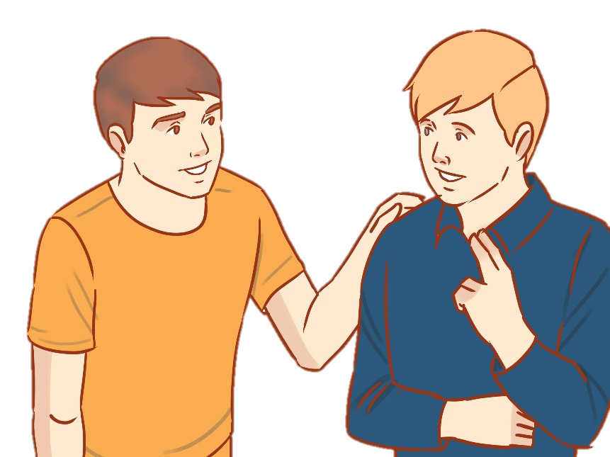
CHOOSE
I think I will become a flavorist one day
be good at math
Great.
You need to
………..
be good at chemistry
be good at cooking

Slide 21
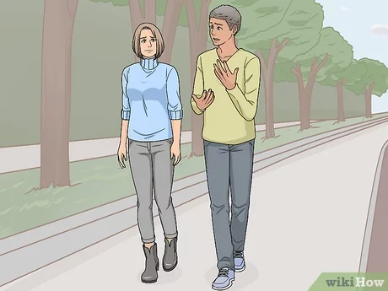
CHOOSE
WHAT!
Your ….. is so bad.
A doll dress designer is my dream
drawing
driving
handwriting

Slide 22
CHOOSE
If you can ……. , you can be an elephant pedicurist
deal with the
smell of animals
use the hammer
feed your cat

Slide 23

Lesson done by: Essa Al Hussaini

Slide 24

Additional Vocabulary Activity
Find 4 nouns relate to the work a fashion designer does.
Find an expression
that means unique
BACK to After Reading Questions

Slide 25
Additional Vocabulary Activity
Find 3 adj used to
describe flavors
Find an expression that means to come up with unusual ideas
BACK to After Reading Questions

Slide 26
Additional Vocabulary Activity
Find 4 verbs used to describe what a pedicurist does to an elephant’s feet and nails
Find a two-word verb that means to become smaller because of use
BACK to After Reading Questions

Slide 27
Additional Vocabulary Activity
Find an expression that means
to think about something carefully and for a long time .
BACK to After Reading Questions

