Slide 3
Unit -1-
Working 9 to 5

Slide 4
10 Writing

Slide 5
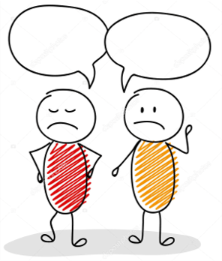
Would you rather never use social media sites and apps again or never watch another movie or TV show?
Would you rather have a horrible short-term memory or a horrible long-term memory?
Would you rather only have summer or winter for the rest of your life?
Would you rather go on a hike or see a movie?

Slide 6
Lesson Objectives
The students will be able to :
1 – Complete a job title using giving information.
2 – Find information about the arborist job.
3 Write which person is used in each paragraph: I, you, he or she, and so on.
4 – Notice what each paragraph provides
5-Find elements of writing an essay, through a picture.

Slide 7
Brainstorm on more unusual jobs.

Slide 8
S.B.P.10-11
Noise
Art/Painting
riding

Slide 9
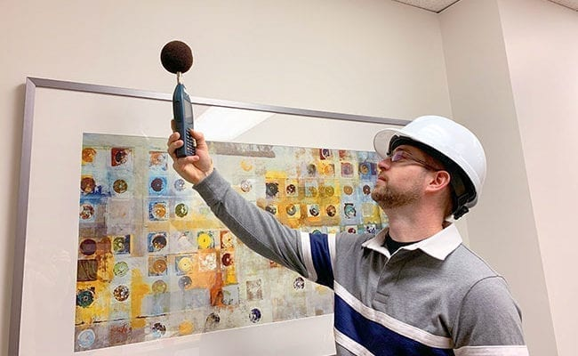
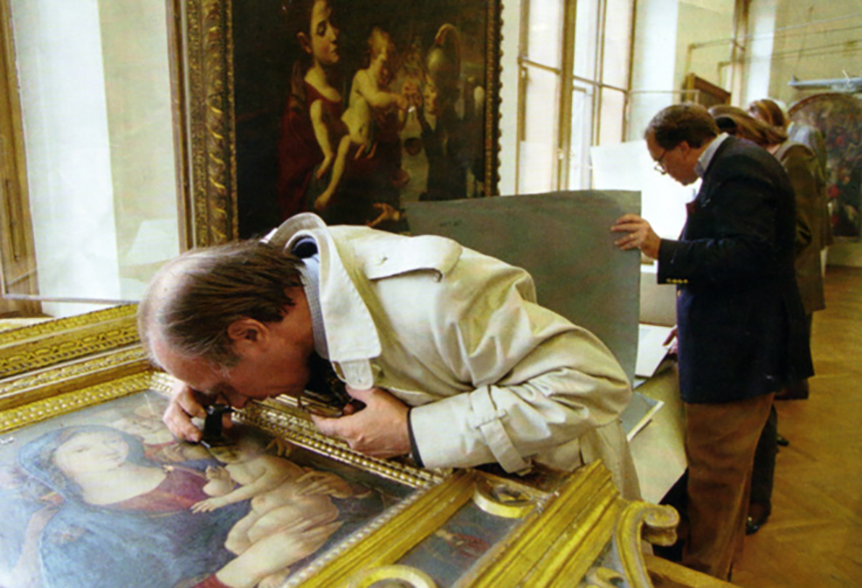
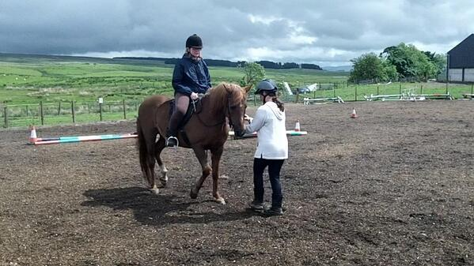
Noise
Art/Painting
riding

Slide 10
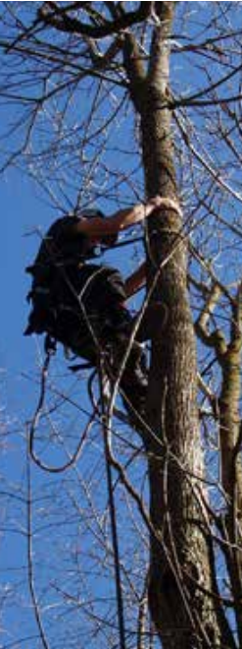
What can you see in the picture ?
What’s the title ?
What would his parents like him to be ?
What would he like to be ?

Slide 11
An arborist is a kind of official “tree carer” or tree doctor. He fertilizes, prunes, plants , and cures trees.
An arborist needs to have a related bachelor’s degree, for example in forestry and attend seminars and workshops throughout his career.
He should be patient, methodical, and hard working. He should also be interested in working in nature and taking care of things.
His employment prospects are quite promising due to current trends and greener alternatives .

Slide 12
Yes, ideas and information are presented clearly .
Yes, he does. For example, … a related bachelor’s degree, for example in forestry , as the more you know about trees the better you will be able to do what is expected of you
Yes.

Slide 13
I
Arborists / they
you ( to mean one, someone )
I

Slide 14
The writer’s view and opinion are presented in paragraphs 1 and 4 .
Objective information is presented in paragraphs 2 and 3.

Slide 15
Passive forms are used to present objective/impersonal information .
Ideas are connected with:
Conjunctions: for example : although , and , in other words
Combined clauses/sentences: to become an arborist, it is essential that … given current trends towards greener alternatives, I think …

Slide 16
Let’s find the prefect unusual job for you:
What do you like doing ?
What kind of places do you like ?
Do you like spending more time inside or outside ?
Which room / place do you spend more time in at home ?
What are you good at ?
What would you like to develop / learn ?

Slide 17
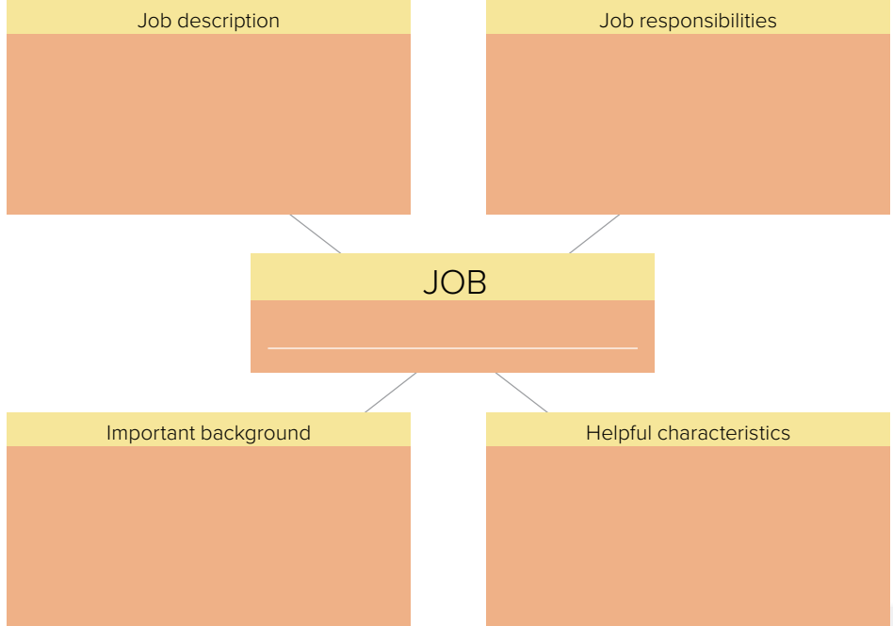

Slide 20
Introduction
Paragraph 1
Hook / state your opinion
Present topic 1
Paragraph 2
Explaining it clearly and supporting it with reasons or examples
Present topic 2
Paragraph 3
Explaining it clearly and supporting it with reasons or examples
Summarize your points
Restate your opinion
Paragraph 4

