Slide 1


Slide 2



    Unit -2-
    Going Green

Slide 3
    Conversation

Slide 4
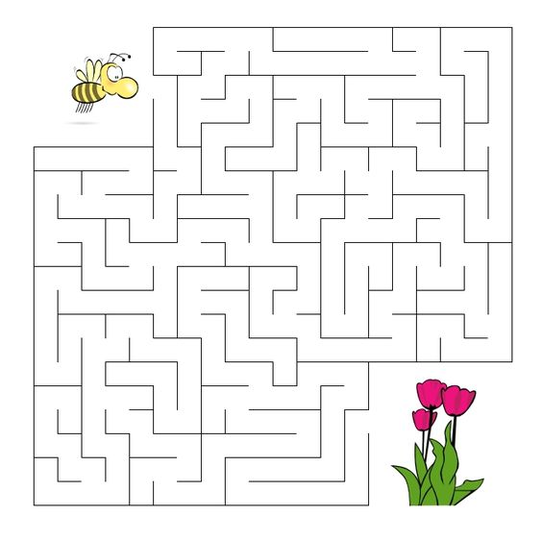

Break

Slide 5

Goals
1
Explain the main idea of Going Green
2
Form a correct suggestion
3
Find the meaning of new words.
4
Use the (real talk) phrases in new sentences
5
List the reasons for recycling

Slide 6
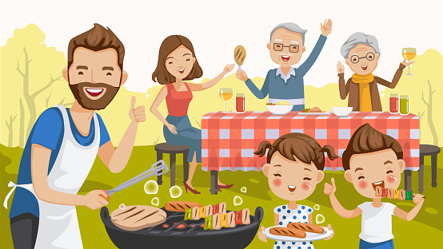
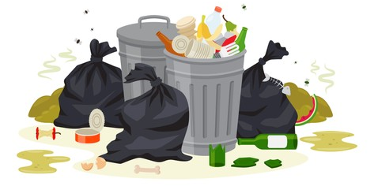
What do you think has been happening here?
What do should they do after eating?
Notes:
Maybe people were having a barbecue or a picnic and threw all the cans and bottles in the trash.)

Slide 7
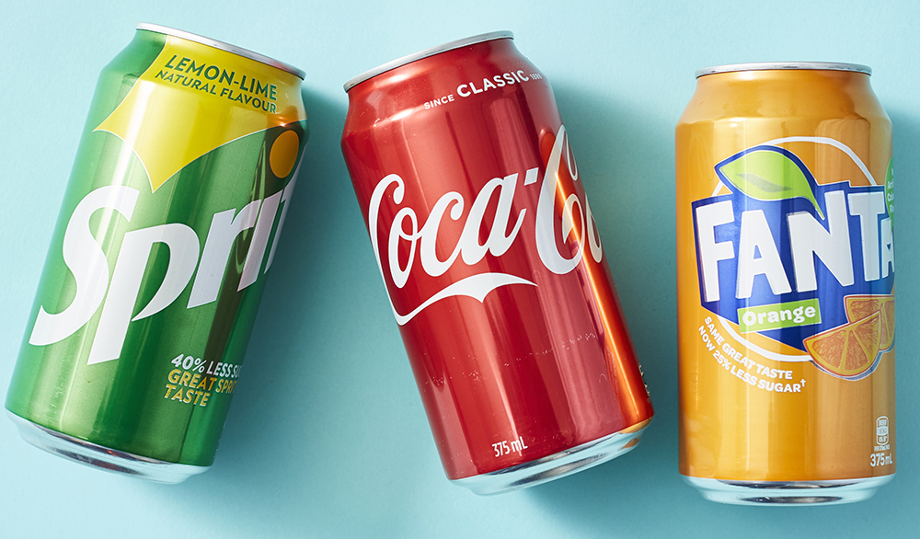
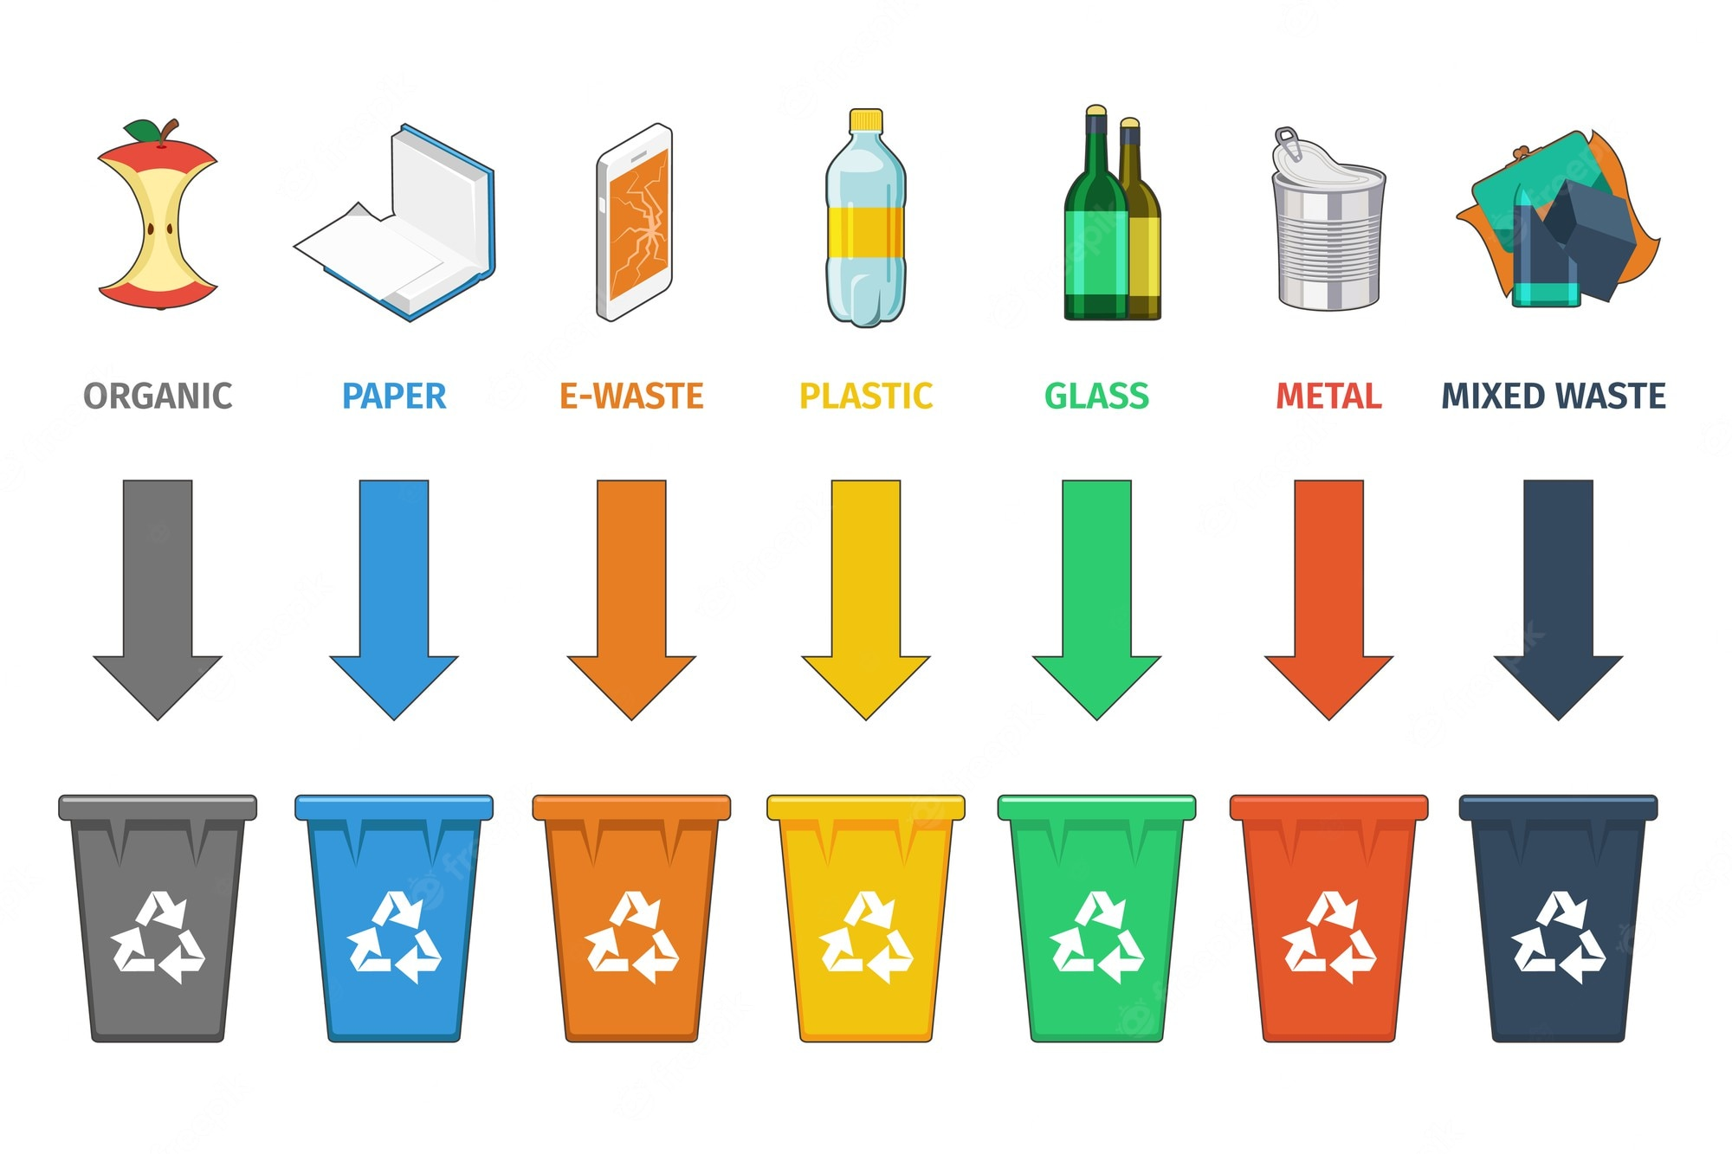
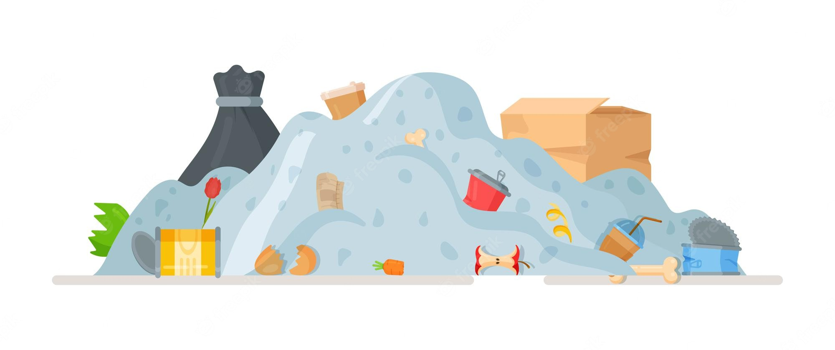
cans
Recycling bins
landfill space

Slide 8

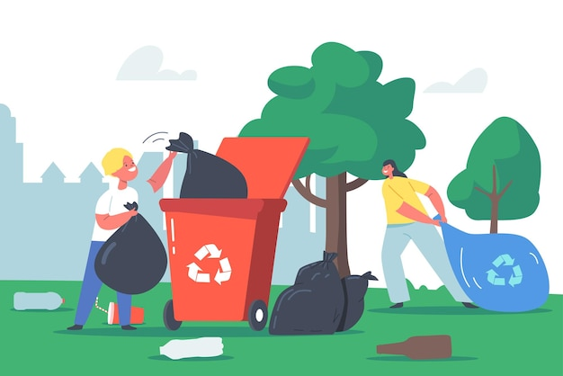



BOOKS CLOSED
You are going to listen to a conversation between two friends cleaning up after a party.

Slide 9
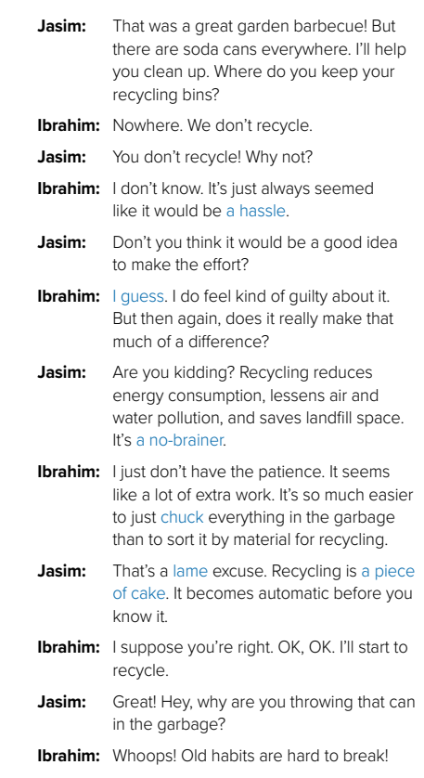
Listen & Read along

Slide 10
Real Talk
a hassle
A
no-brainer
something that is inconvenient to do
a question or problem that has an obvious answer or solution
I guess.
an unenthusiastic way of agreeing with someone

Slide 11
Real Talk
chuck
a piece of cake
throw out
very easy
lame
bad, inadequate

Slide 12
It was such a hassle trying to get my bank account changed that I nearly gave up .
I guess (that) things are pretty hard for you now.
The decision was a complete no-brainer .
Ali chucked a bottle at the stage .
He gave them a lame excuse .
How do you do that ? “ It’s a piece of cake! Watch!.

Slide 13
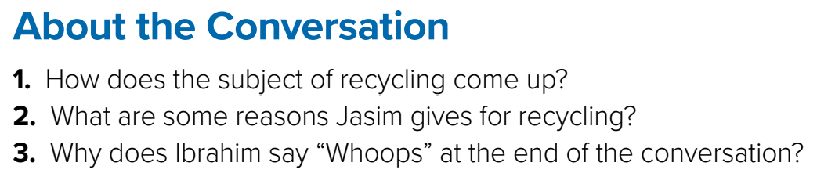
1- Jasim and Ibrahim are cleaning up after a party and there are soda cans everywhere.
2- Jasim says that recycling reduces energy consumption, lessens air and water pollution, and saves landfill space .
3- Because Ibrahim accidentally threw a can into the garbage rather than recycling it .

Slide 14

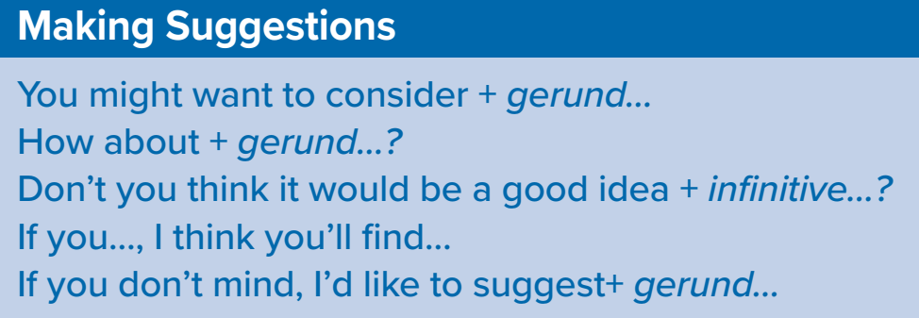

Role-play with a partner. What is something you do that is good for the environment? Suggest to your partner that he/she do this, too. Give reasons and use phrases for making suggestions.

Slide 15




Quiz Time

Slide 16



