Slide 1
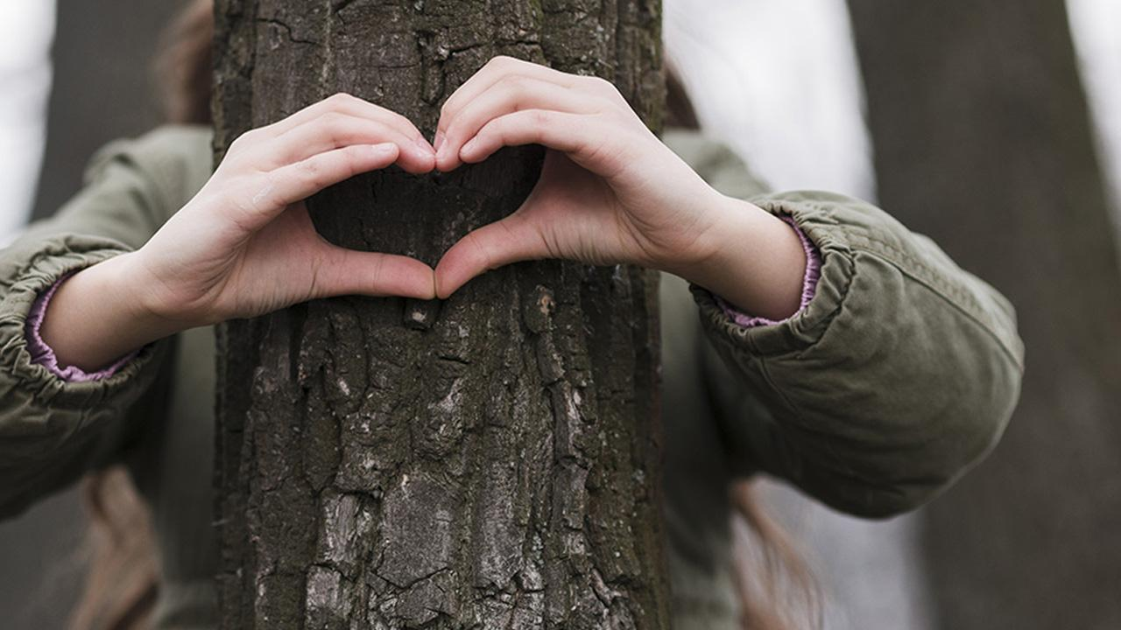

Done by:
Ohoud Al-Mughathawi
عهود المغذوي

Slide 2
Going Green
Unite 6

Slide 3
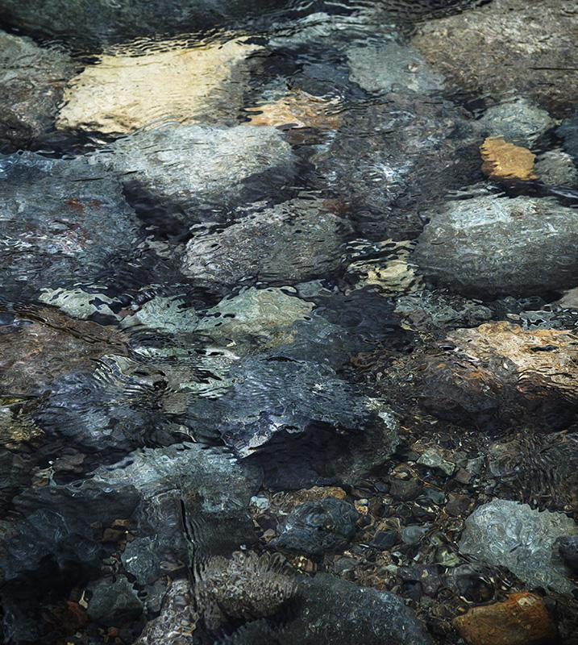


Answer the questions
Revision
https://wordwall.net/resource/7168827

Slide 4
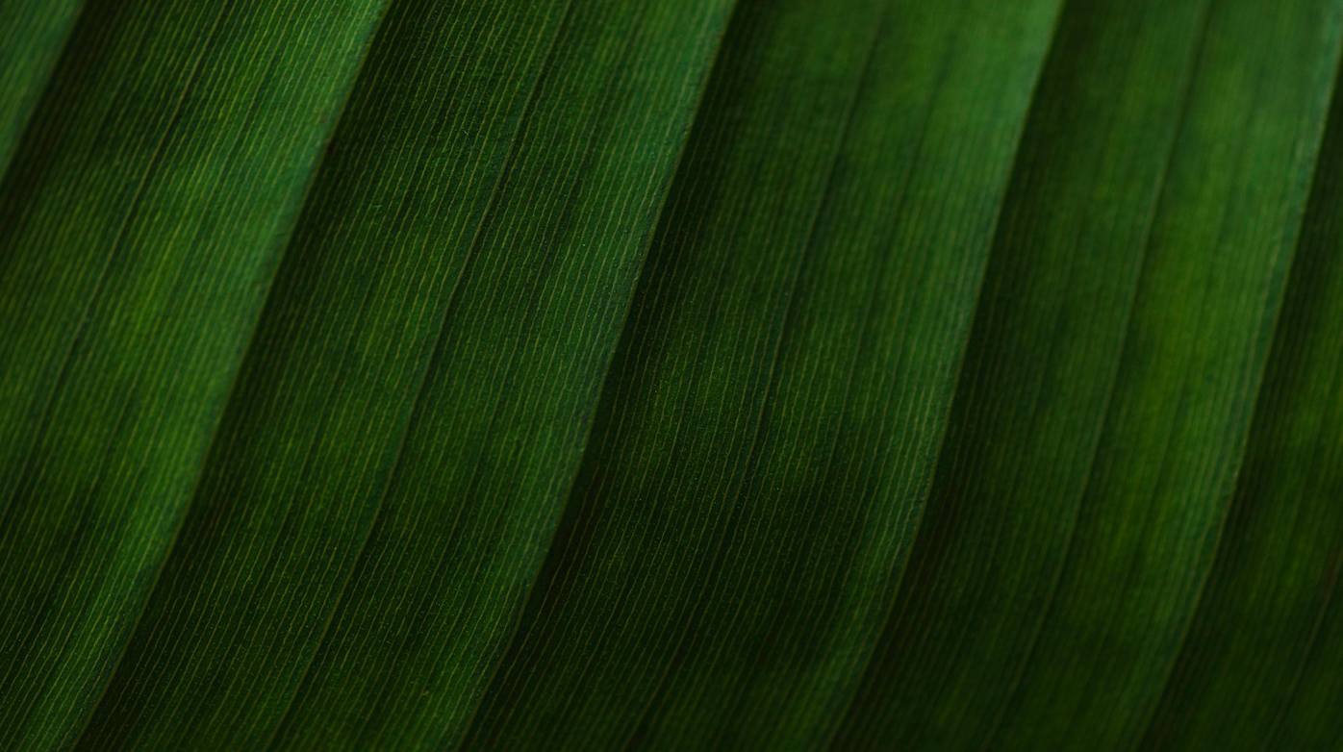


If you had a choice, which time would you choose to live in:
Future?
at the moment?
past?
Why?

Slide 5
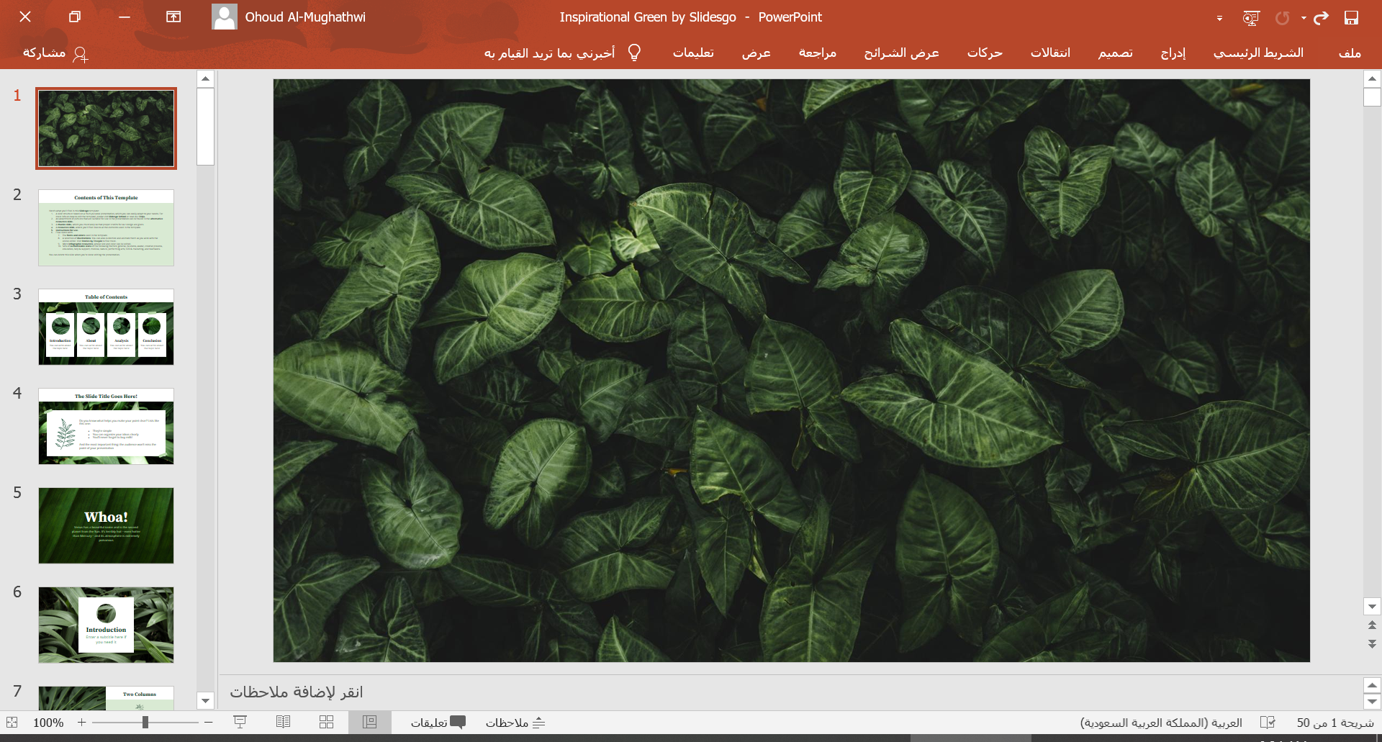
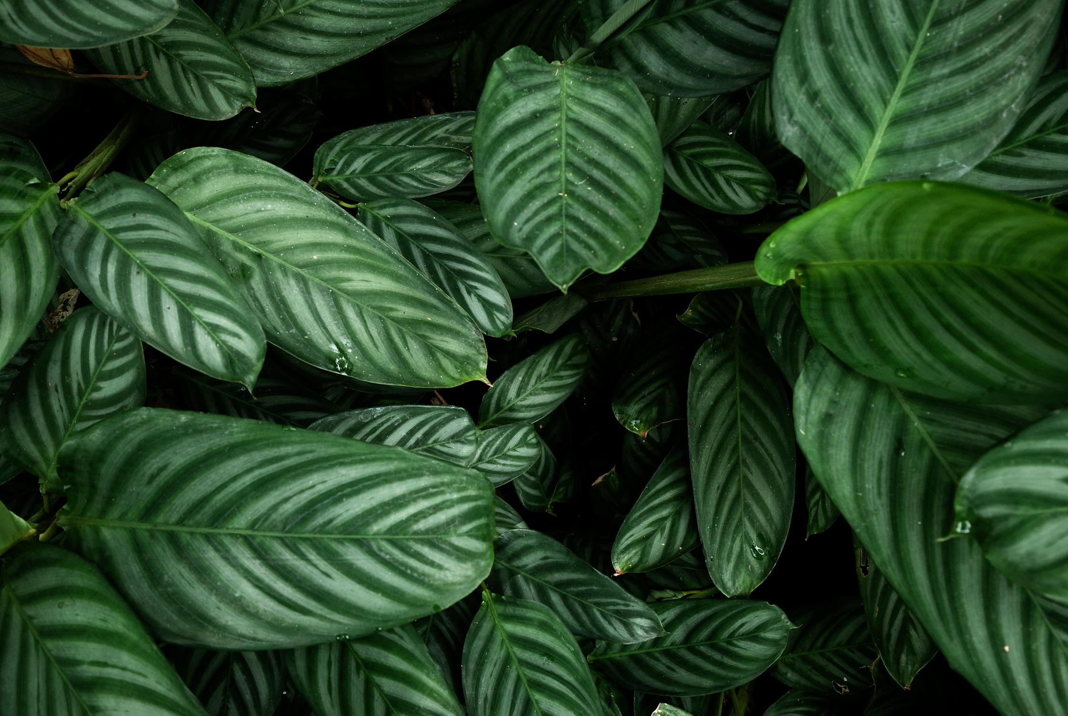
Objectives
01
02
03
04
05
About
Use would rather correctly.
Use present simple & progressive.
Answer the questions correctly.
Write sentences using present simple & progressive.
Use conditional sentences correctly.

Slide 6
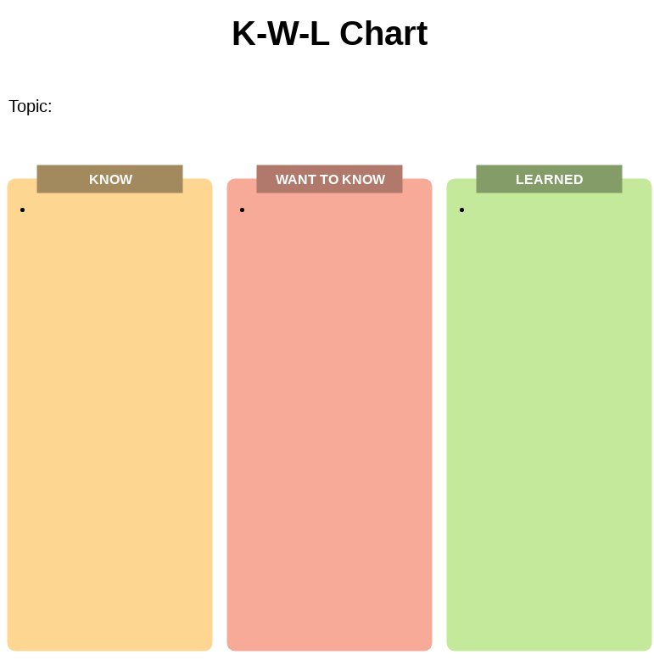

Present simple VS. present progressive
92

Slide 7
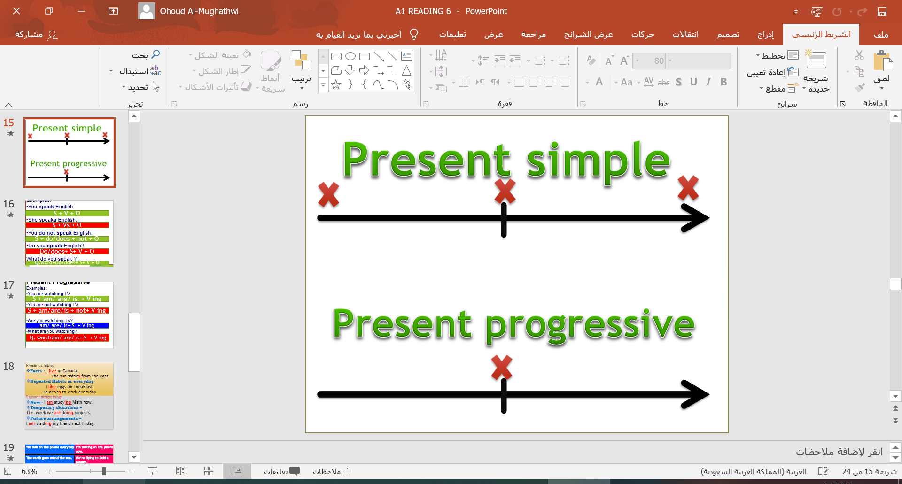
Present simple:
Facts - I live in Canada
The sun shines from the east
Repeated Habits or everyday-
I like eggs for breakfast
He drives to work everyday
Time Expressions currently
these days
at present
now.
Present progressive:
Now - I am studying Math now.
Temporary situations –
This week we are doing projects.
Future arrangements –
I am visiting my friend next Friday.
92

Slide 8
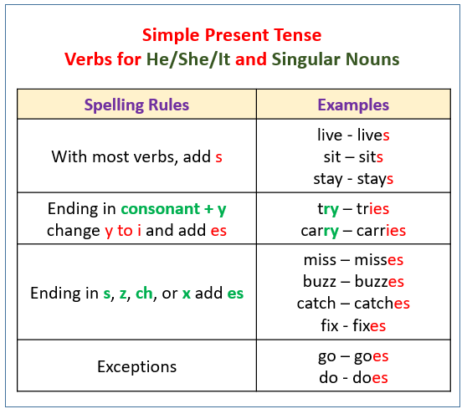
92

Slide 9
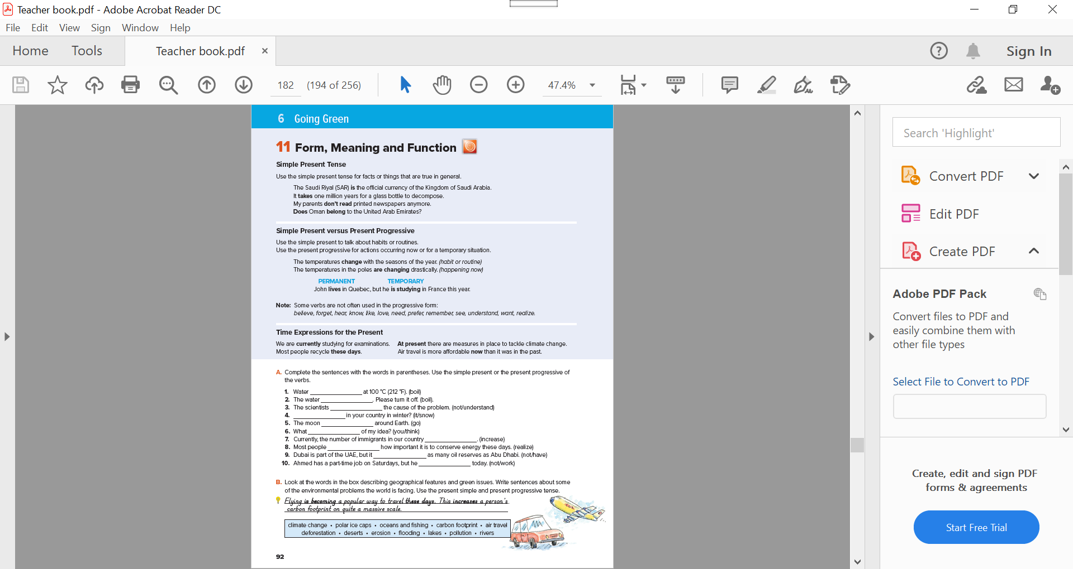
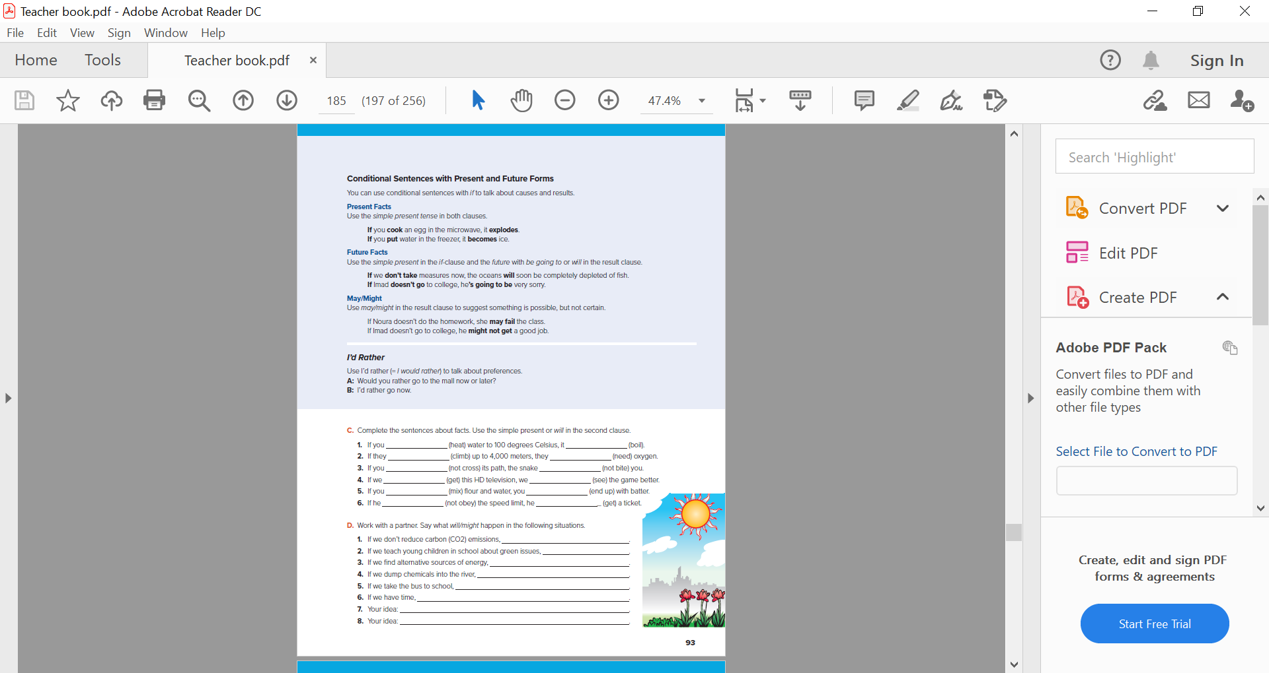
What do you think this is?
92-93

Slide 10
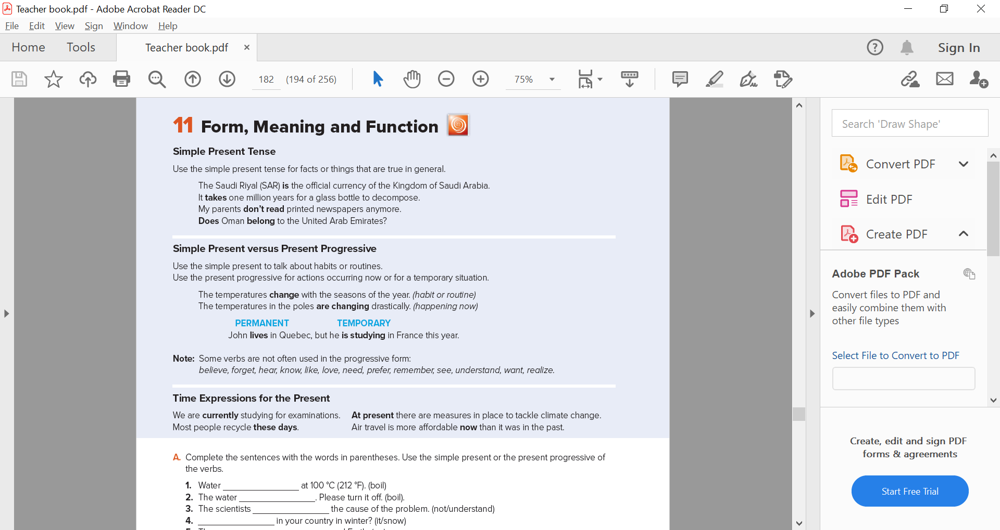
92

Slide 11

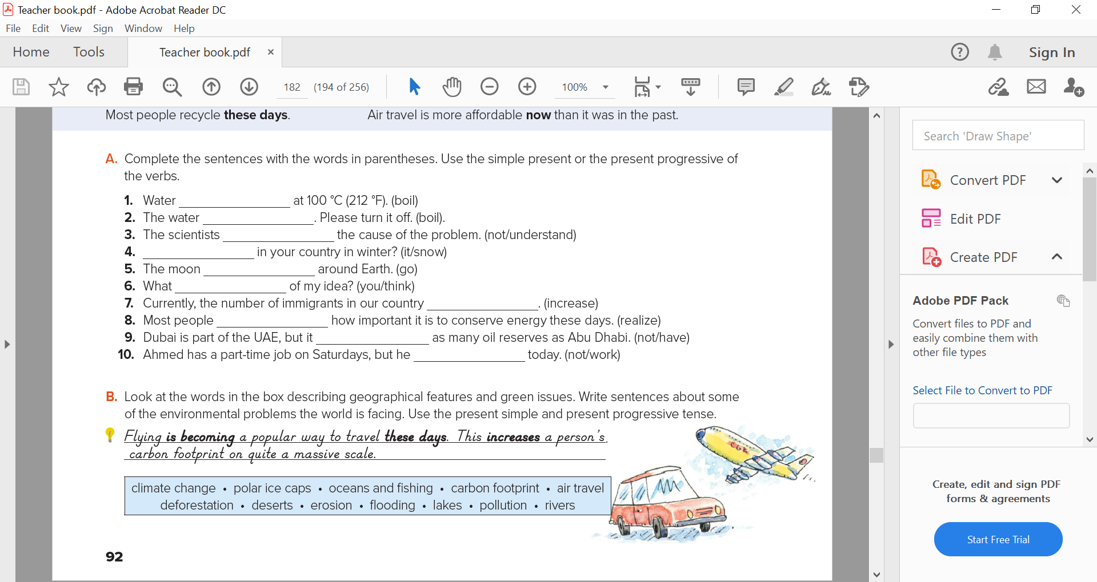
boils
is boiling
don’t understand
Does it snow
goes
Do you think
Is increasing
realize
doesn’t have
Isn’t working
92

Slide 12


92

Slide 13
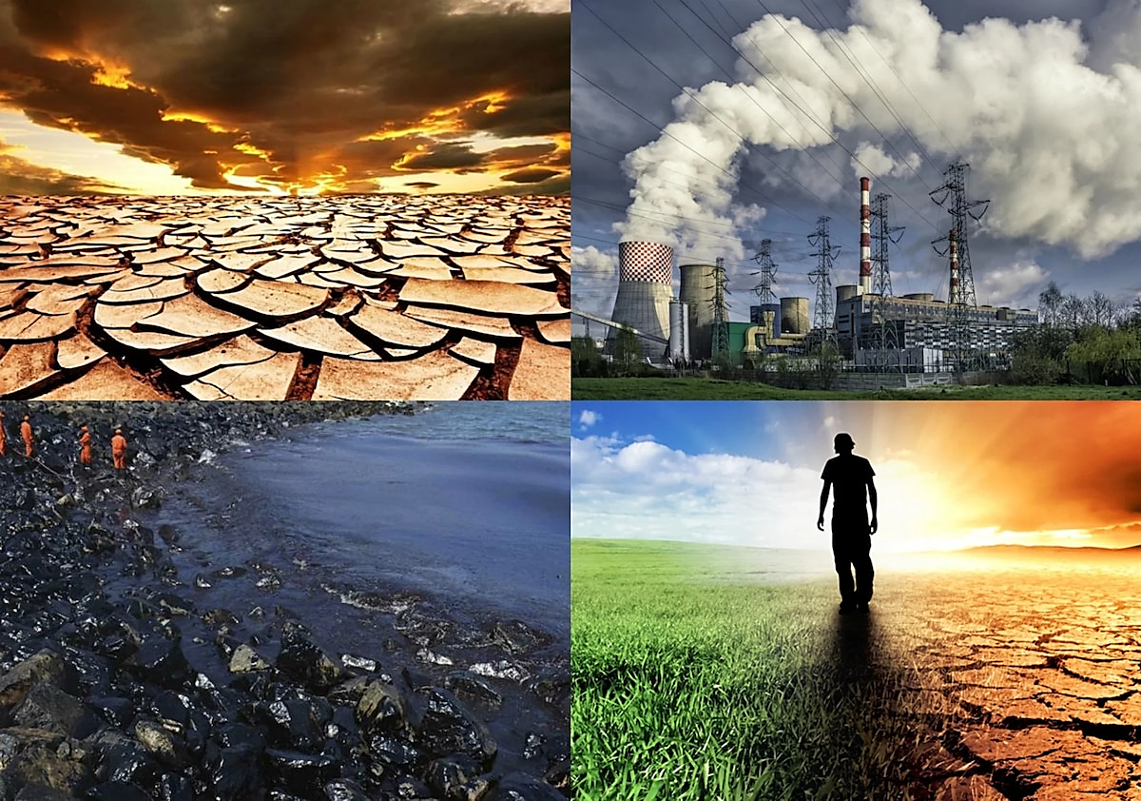
(وَلَا تُفْسِدُوا فِي الْأَرْضِ بَعْدَ
إِصْلَاحِهَا)
93

Slide 14
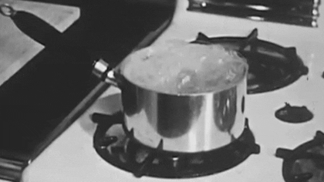
Zero conditional
If clause | Main clause
If you heat water , | it boils
If + present simple, present simple
General truth / causes & results

Slide 15
Conditional sentence type 1
If clause | Main clause
If I call you , | I will tell you a secret.
If + present simple, will
Possible or result

Slide 16
Conditional sentence type 1
If clause | Main clause
If you want to use my camera , | You must take care of it.
If + present simple, (can, may, might, must , should)
Suggest something possible

Slide 17

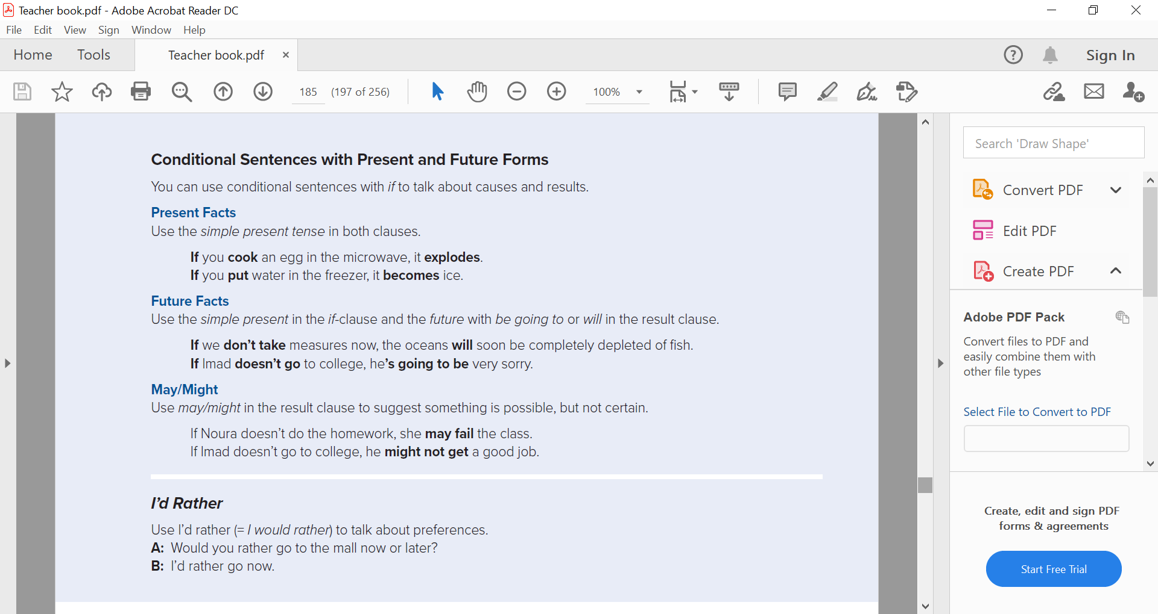
93

Slide 18

If vision 2030 achieves its goals, We …….
Will have better education
If you want to be a part of vision 2030 , you
Must support your government.

Slide 19
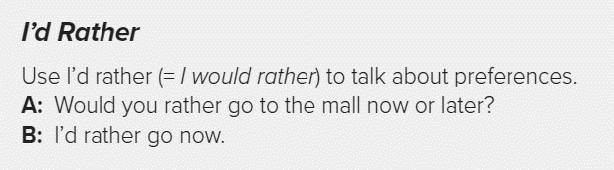

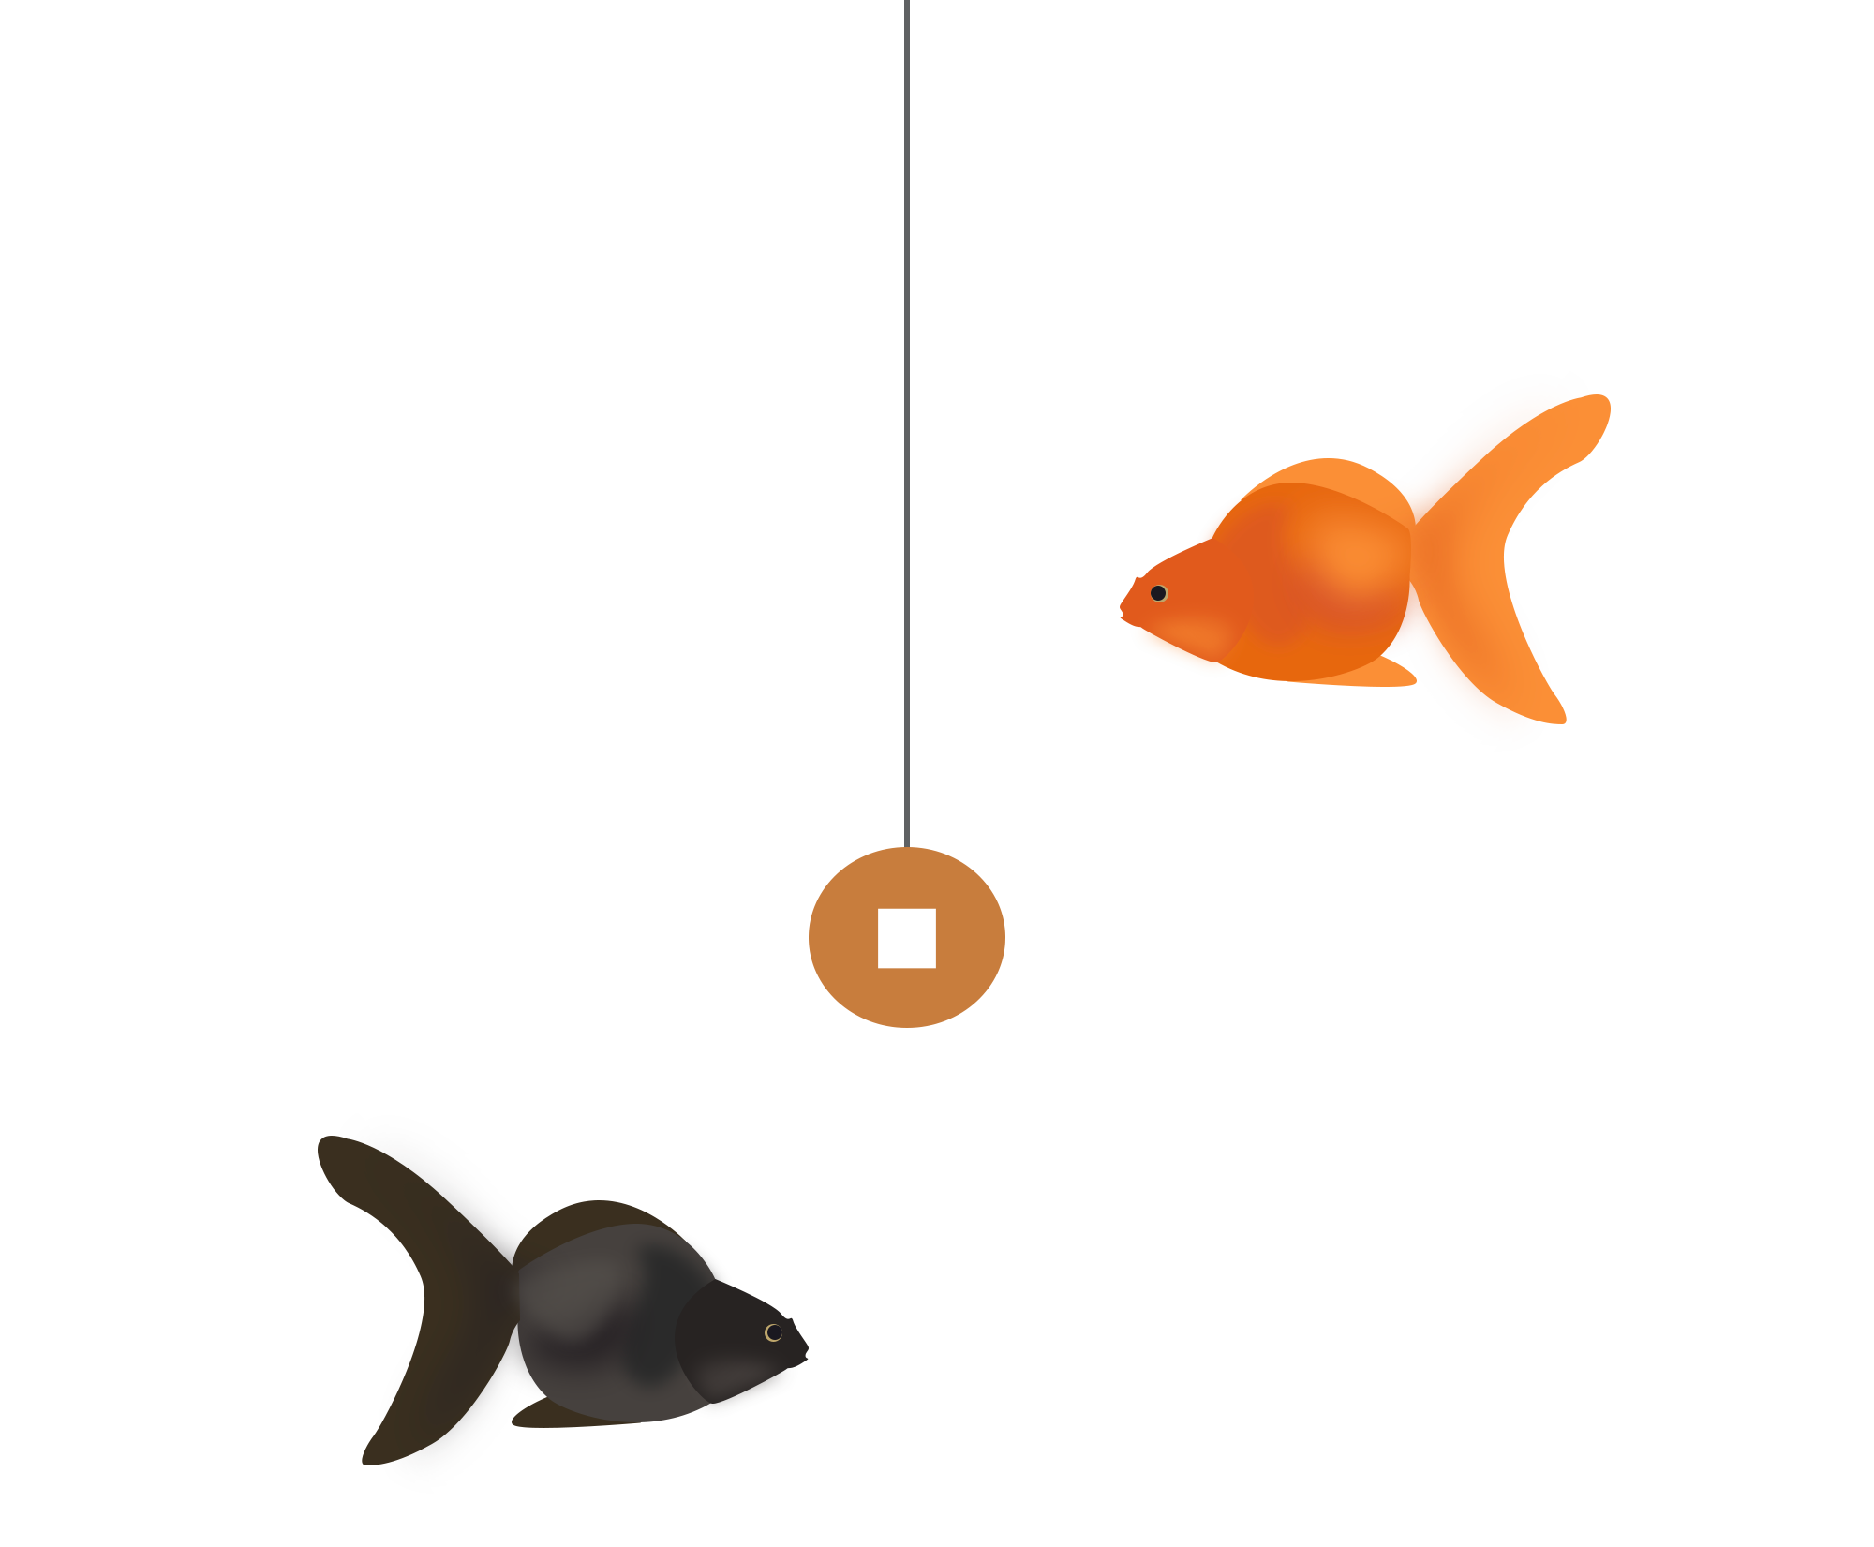
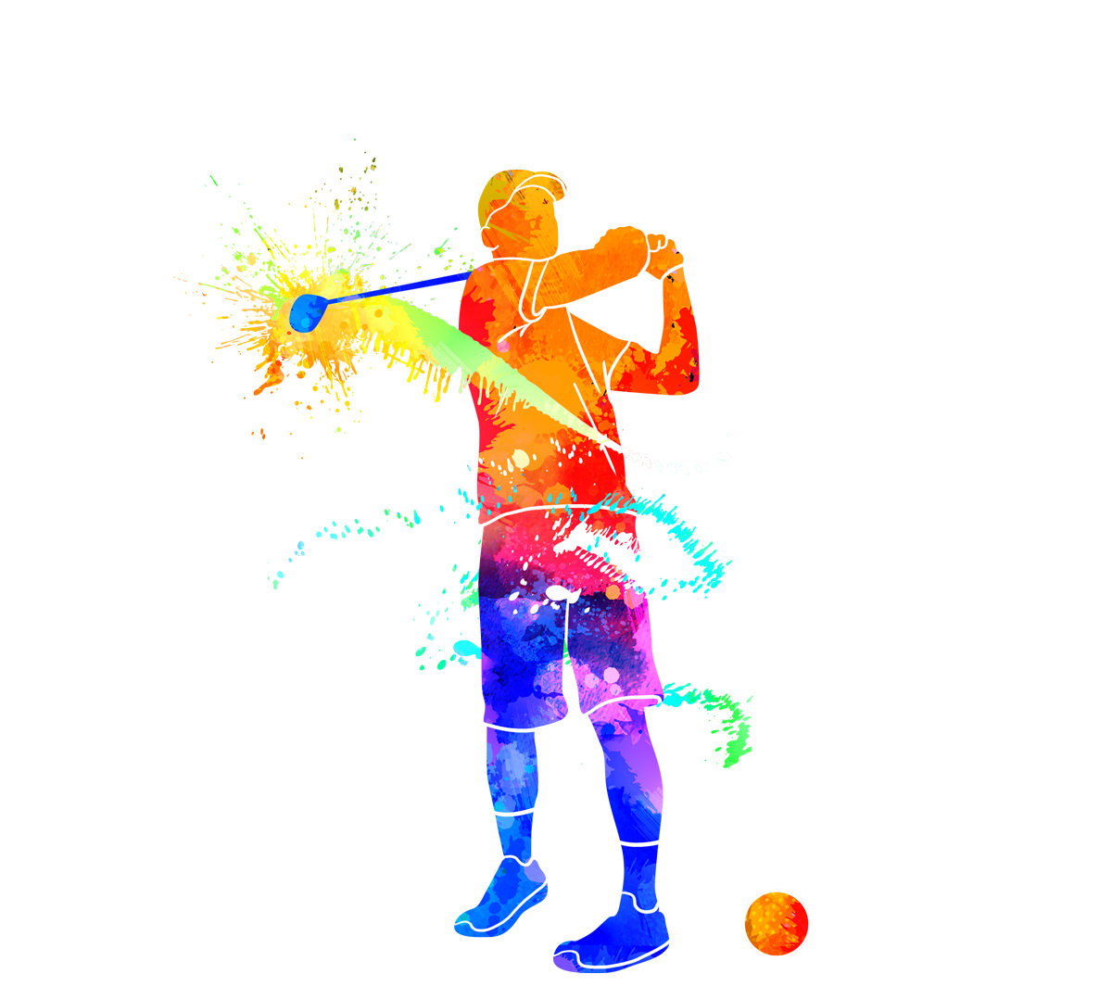
93
I’d rather play tennis than golf.

Slide 20
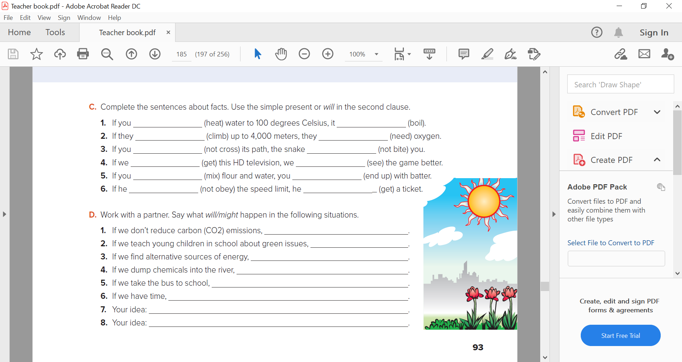

heat
boils
climb
Will need
Don’t cross
Will not bite
get
Will see
mix
end up
doesn’t obey
Will get
93

Slide 21
global warming will get worse.
they will know better how to protect the environment.
we will reduce our carbon emissions
the fish will die.
we will save money on petrol.
93

Slide 22

Answer the questions
https://kahoot.it/challenge/0506533?challenge-id=332c35da-fa63-4353-91fa-c769137228c0_1606315533697

Slide 23

What have you learned?

Slide 24
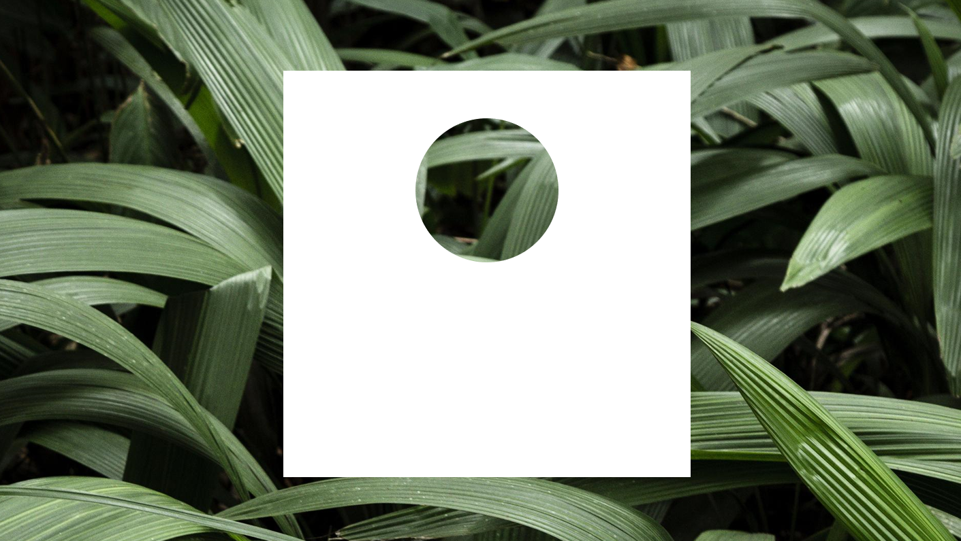
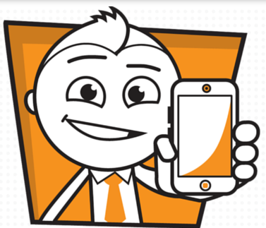
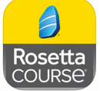
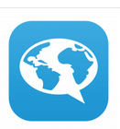
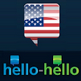

Page 64
M
N 1-6
O 1-3
P 1-6
Q 1-3
Homework
UFluent

