Slide 1



Slide 2

    Unit -3-
    There is No Place Like Home

Slide 3
    5 Listening
    6 Pronunciation
    7 Vocabulary Building

Slide 4
Objectives
The students will be able to :
1 – List house characteristics mentioned in the audio.
2 – Determine the stress in a word.
3 – Match the new vocabulary with its meaning.
4 - Stress on two-syllable nouns and verbs.
5- Share positively in pair work
.

Slide 5
    5 Listening

Slide 6
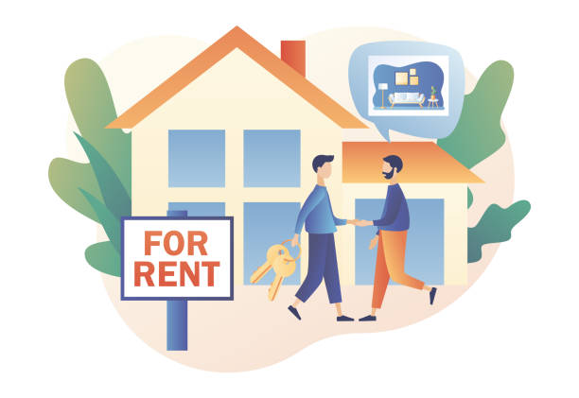

What are things that you would hope to find in a rental apartment?

Slide 7

neighborhood
Convenient
Write on the board things that you would hope to find in a rental apartment.
floor
rooms
Neighbor
Cheap
windows
modern

Slide 8



Listen to the real estate agent talk about important factors to consider when looking for an apartment to rent.

Slide 9
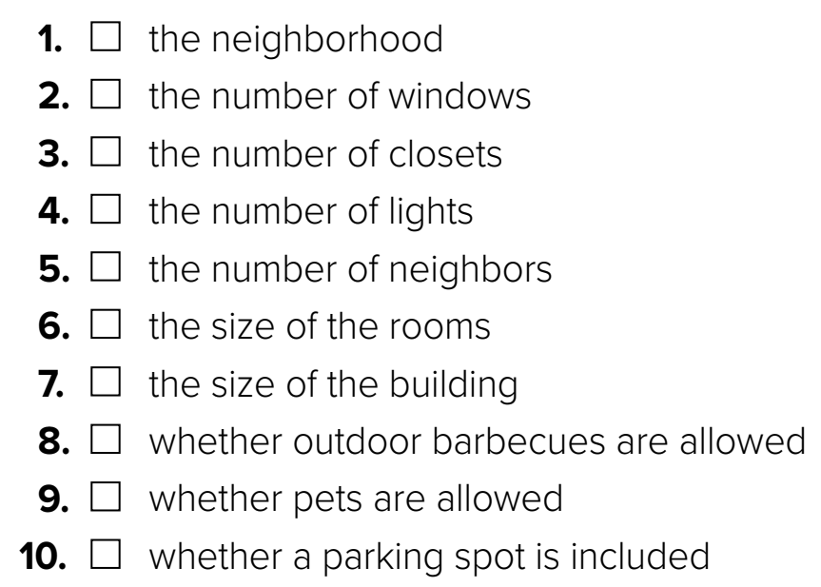
Listen to the real estate agent talk about important factors to consider when looking for an apartment to rent. Tick the factors mentioned
√
√
√
√
√
√
√

Slide 10
    6 Pronunciation

Slide 11
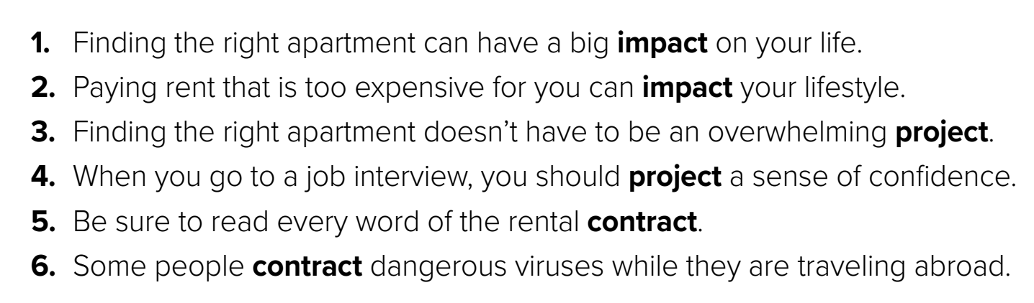
In English, there are many two-syllable words whose part of speech and meaning change if you change the stress. Stress the first syllable of most two-syllable nouns. Stress the last syllable of most two-syllable verbs. Listen and practice.
In English, there are many two-syllable words whose part of speech and meaning change if you change the stress. Stress the first syllable of most two-syllable nouns. Stress the last syllable of most two-syllable verbs. Listen and practice.

Slide 12
    7 Vocabulary Building

Slide 13
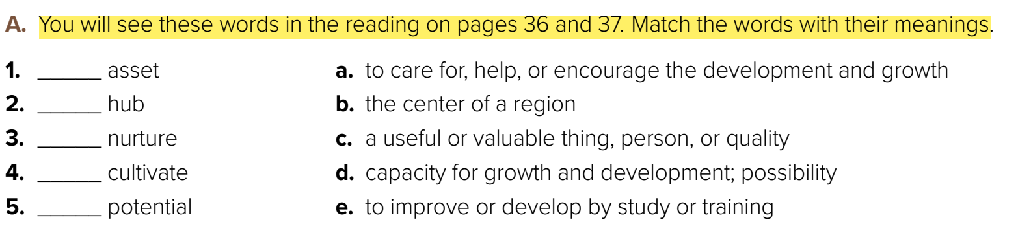

c
b
a
e
d
B. Check your answers with a partner. If you do not understand the meaning of a word, look it up in a dictionary

Slide 14
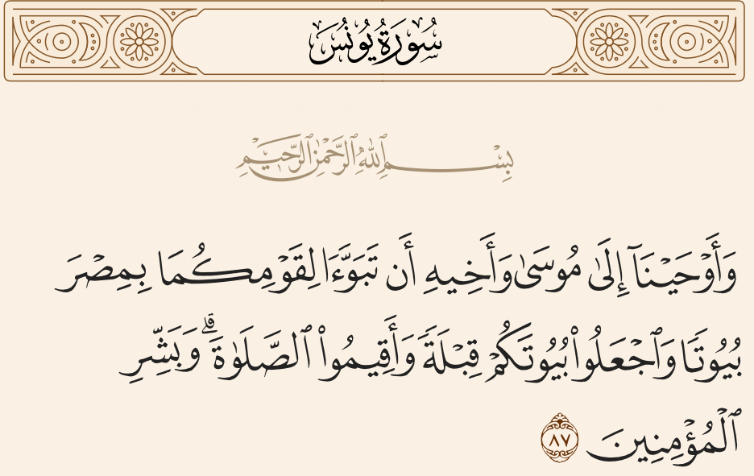

Slide 15


Quick Check

Slide 16


