Slide 1
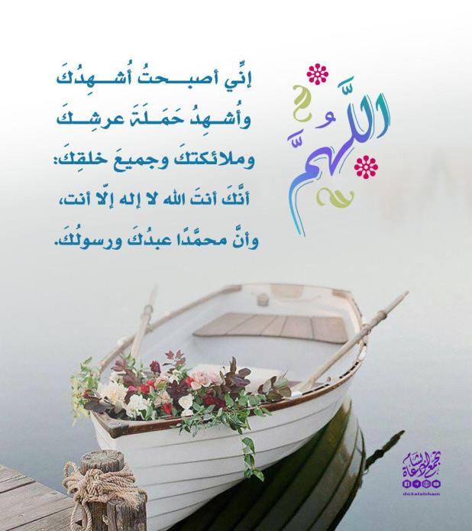


Slide 2

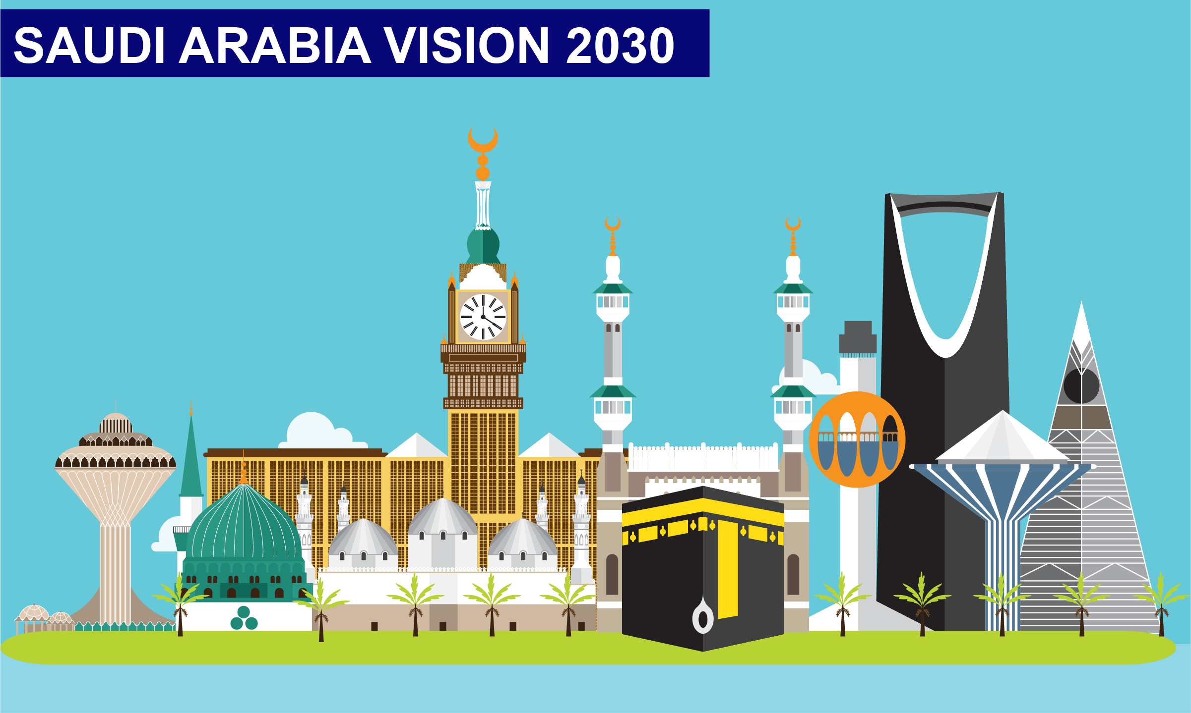
    Unit -3-
    There is No Place Like Home

Slide 3
    8 Reading

Slide 4
Objectives
The students will be able to :
1 – Discuss the topic of vision 2030 Kingdom of Saudi Arabia .
2 – Read the text for specific information .
3 – Answer some comprehension questions correctly .
4 – Match the words with their meanings correctly .
5 – complete chart about an imaginary family in your city/town in 2030.
6 – Talk about the advantages of 2030 vision .
.

Slide 5


Quick Check

Slide 6
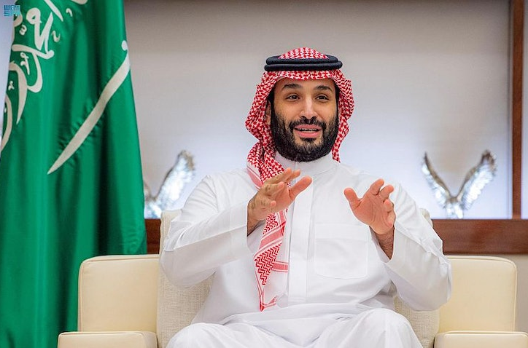

Whose idea is 2030Vision?

Slide 7
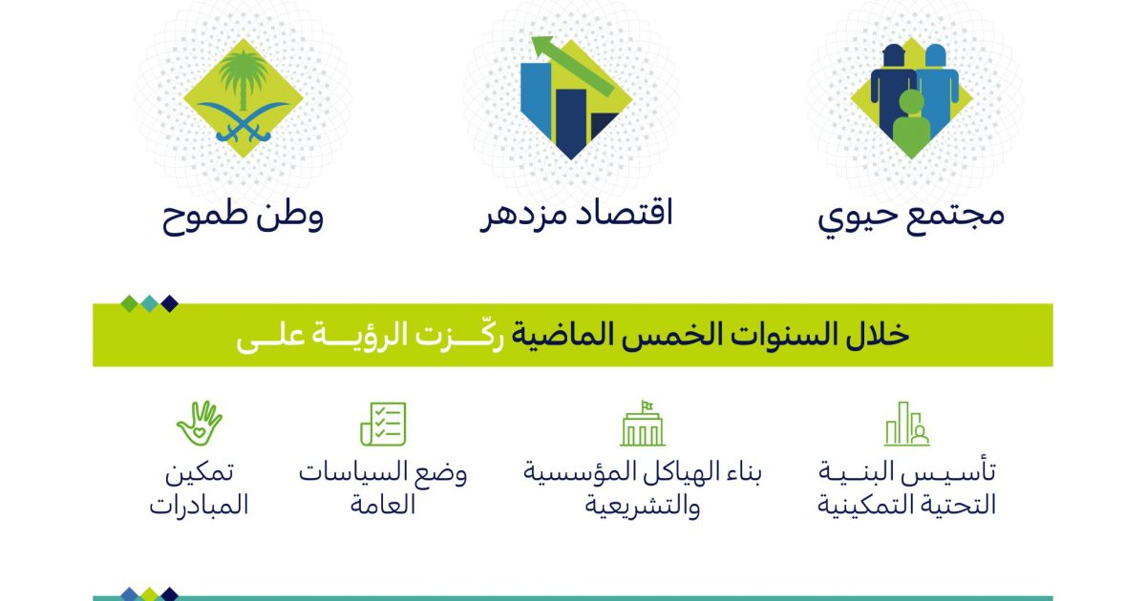
What are the 3 area of 2030Vision?
an ambitious People
a vibrant Society
a thriving Economy

Slide 8
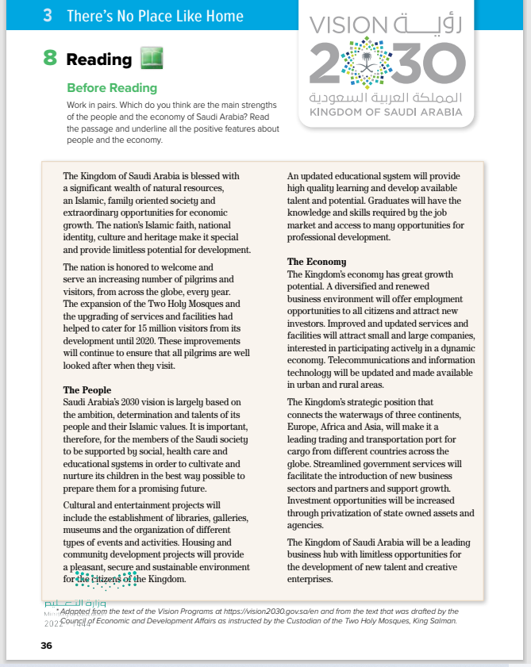
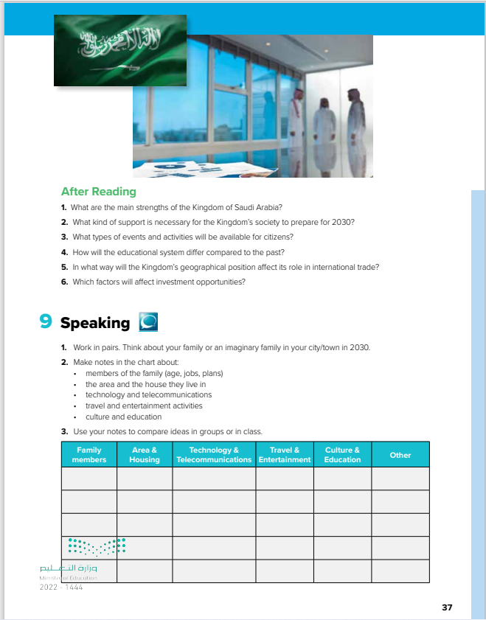
Students Book
P.36-37

Slide 9
1
5
2
6
.. the 2 subtitles ?
3
7
.. # of paragraphs ?
4
8

Slide 10
1
5
What are the main strengths of the people and the economy of Saudi Arabia?
2
6
3
7
4
8

Slide 11


Read along as you listen

Slide 12
Which factors make the Kingdom of Saudi Arabia special ?
How many visitors did the expansion of the Two Holy mosques provide with in 2020 ?

Slide 13
What is Saudi Arabia’s 2030 vision based on ?
What will cultural and entertainment projects include ?
What will an updated educational system provide ?

Slide 14
How will the renewed business environment benefit the Economy ?
What about telecommunications and information technology ?
Does the kingdom have a strategic position ?
Explain ?
How will streamlined government services benefit business ?

Slide 15
What does ……………mean ?
very important
Provide with
To be mentioned for a long period time .
different; various.
Properties of certain value .

Slide 16
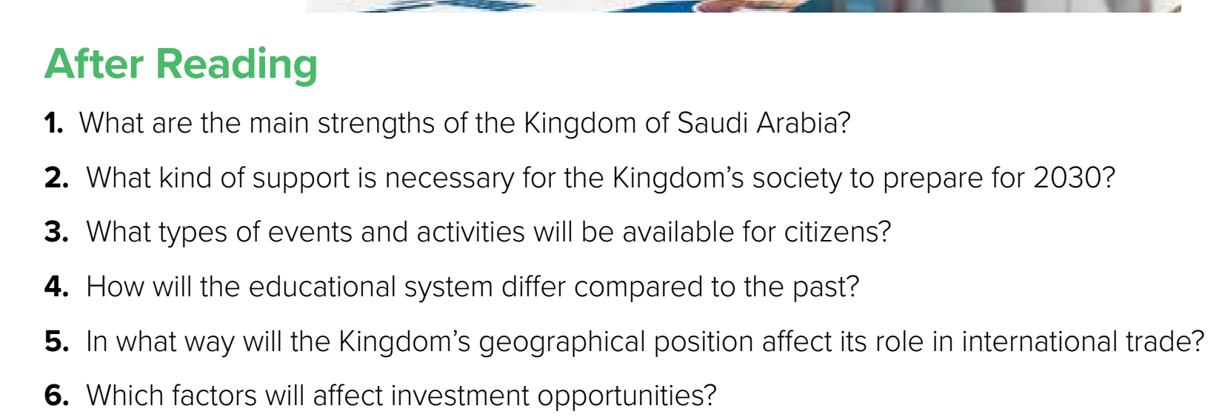
4- It will be updated to provide high quality learning and develop available talent and potential. It will provide the knowledge and skills required by the job market.
1- Wealth of natural resources, its Islamic, family oriented society, its strategic position and opportunities for economic growth.
5- The Kingdom’s position connects the waterways of three continents, Europe, Africa and Asia. This give it a unique advantage as a trading and transport hub.
2- Social, health care and educational systems that will help it raise its children in the best way possible to prepare them for the future.
6-
a)streamlined government services
b) the privatization of state owned assets and agencies.
3- Cultural and entertainment events, libraries, galleries, museums, community projects.

Slide 17

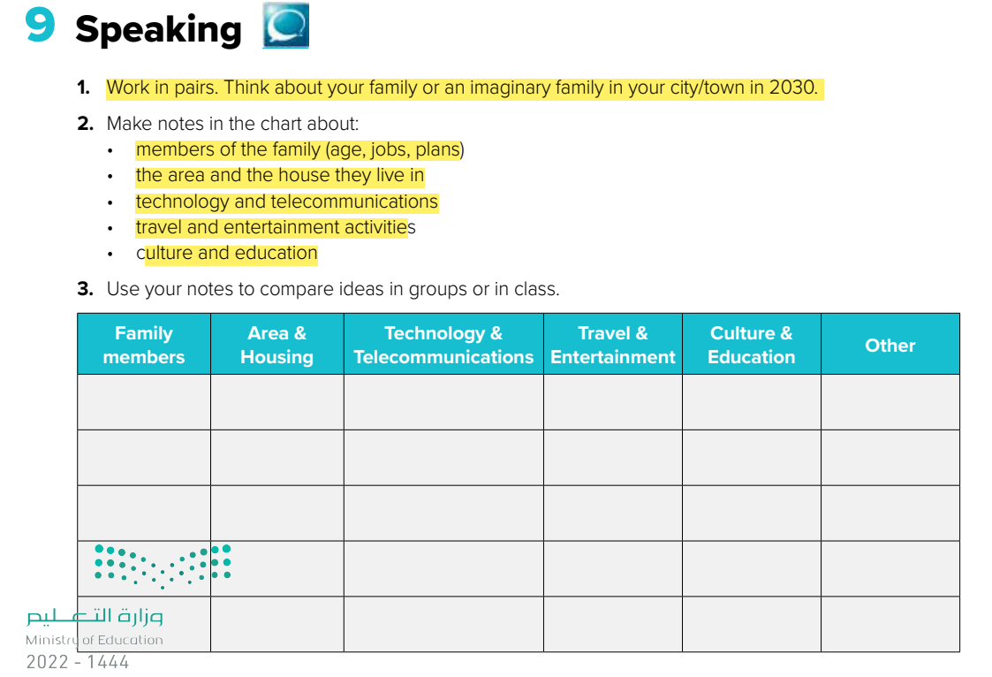

Slide 18



Slide 19


