Slide 1
Unit 5
Amazing Animals
Listen & Discuss
By: Entisar Al-Obaidallah

Slide 2
Goals of Lesson
01.
02.
03.
Recognize
Discuss
Read
04.
05.
06.
Match
Answer
Guess
the kinds of the animals in the text
The topic of amzing animals
for specific information
The words with their meanings correctly
Questions about the text correctly
The names of animals from their description

Slide 3

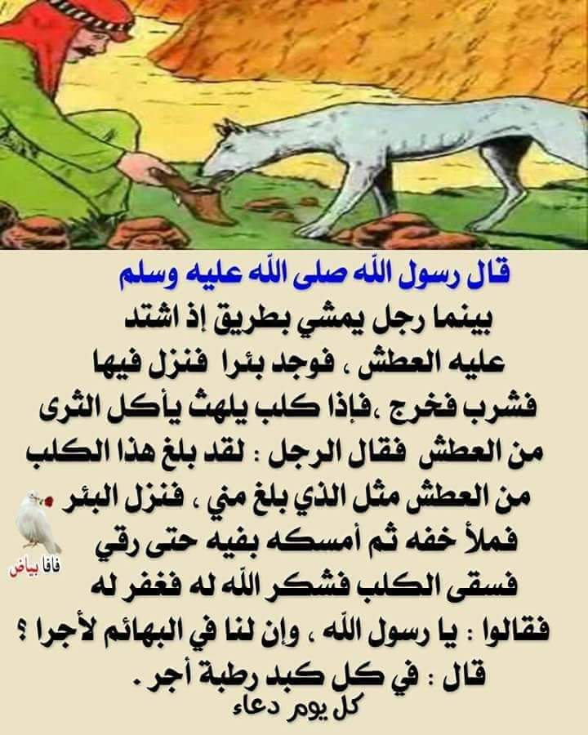
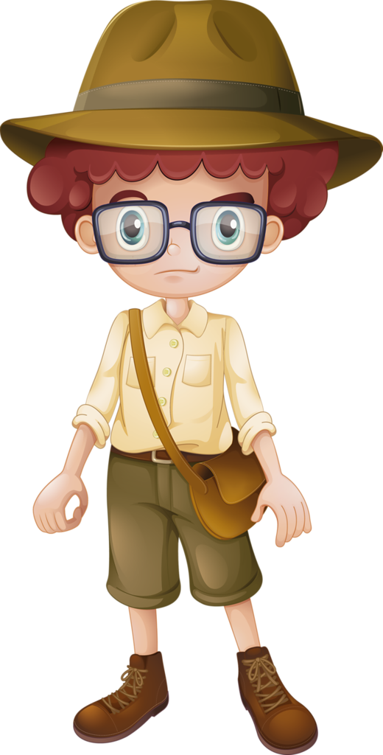
Warm up
Have you had any experience like this with animals?

Slide 4
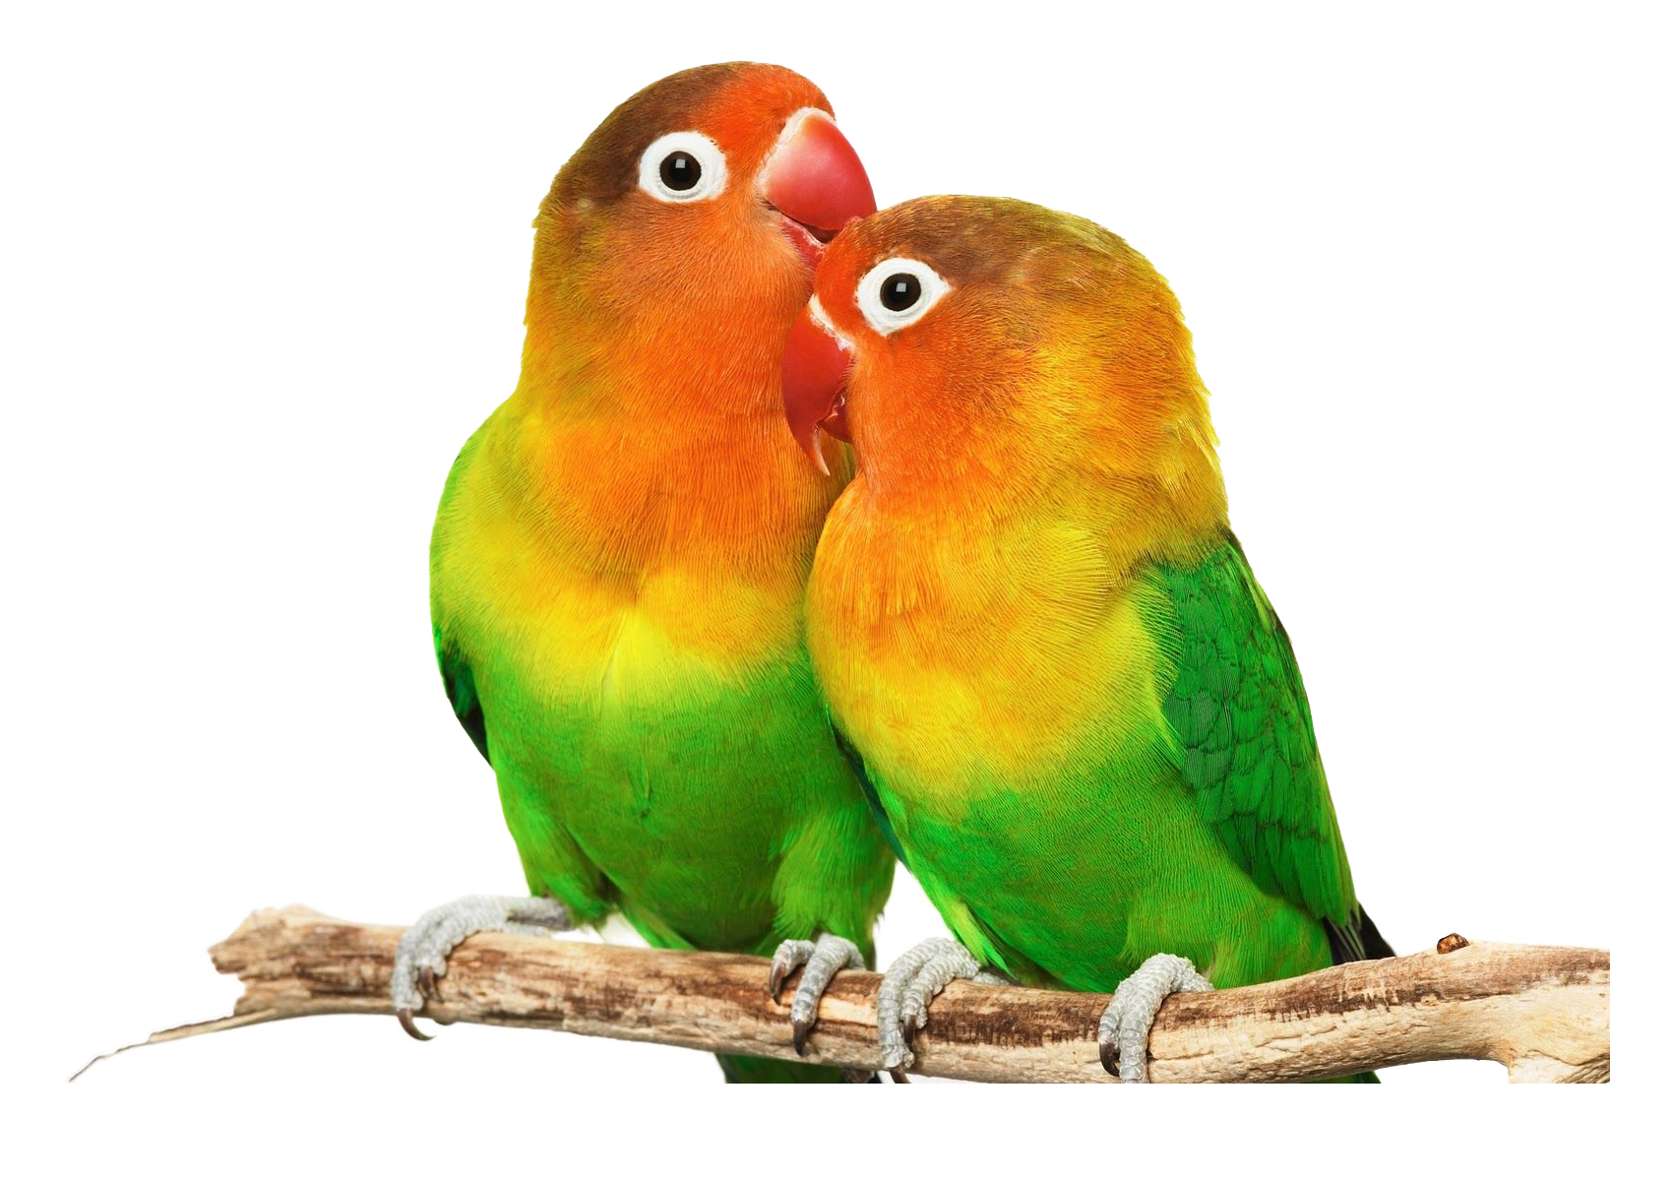
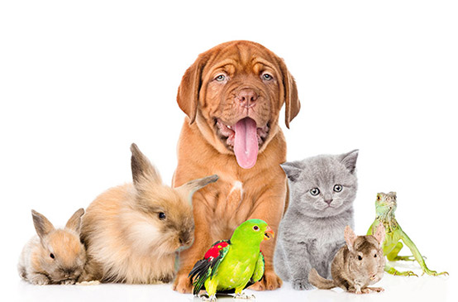
Warm up
Do you have any pets in your house ?

Slide 5
Warm up
Can you Guess the topic of our new unit?

Slide 6
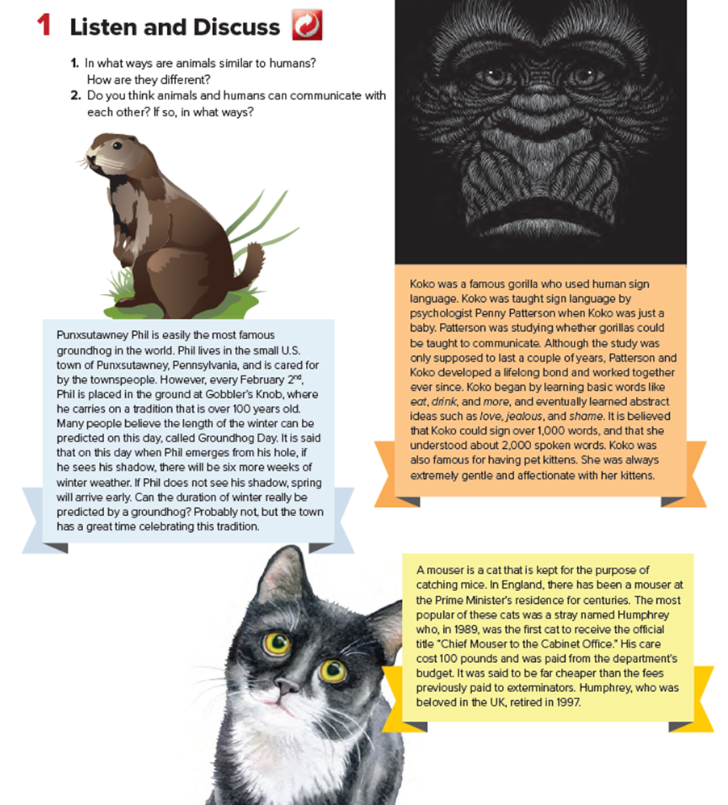

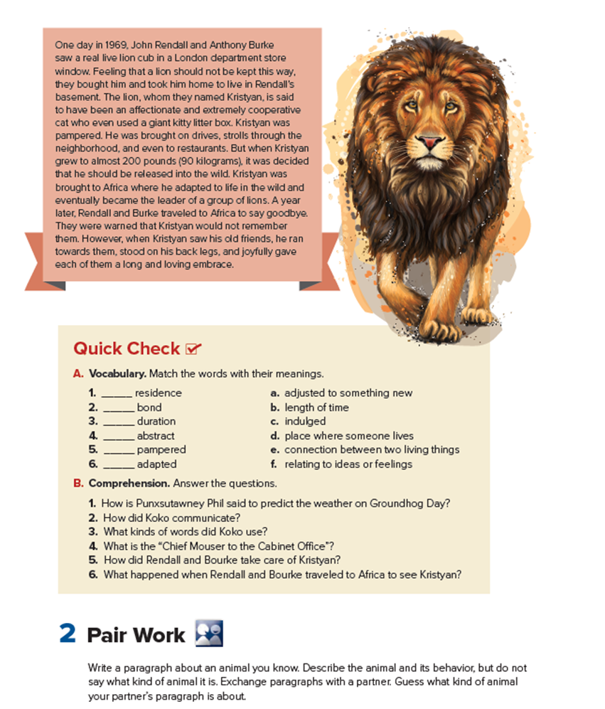

Book Open
pages (68 - 69)

Slide 7
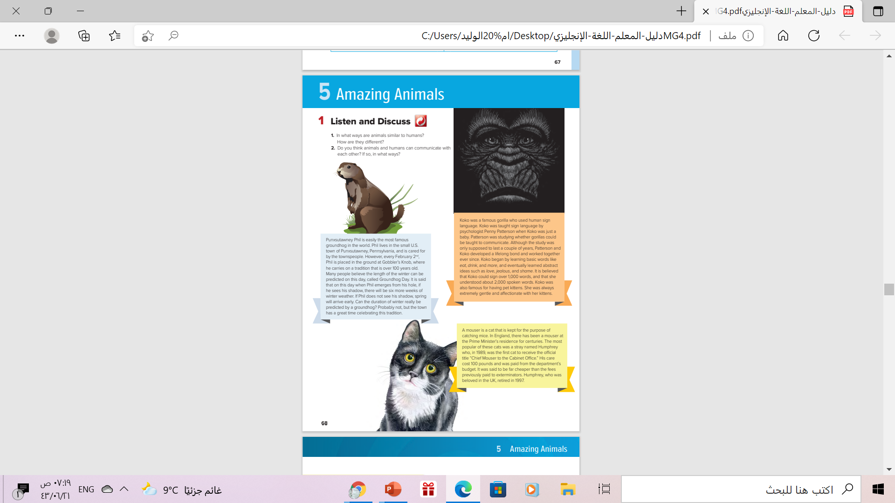
4
2
1
What is the title of the unit?
Amazing Animals
3
How many paragraphs are there?
4 paragraphs

Slide 8
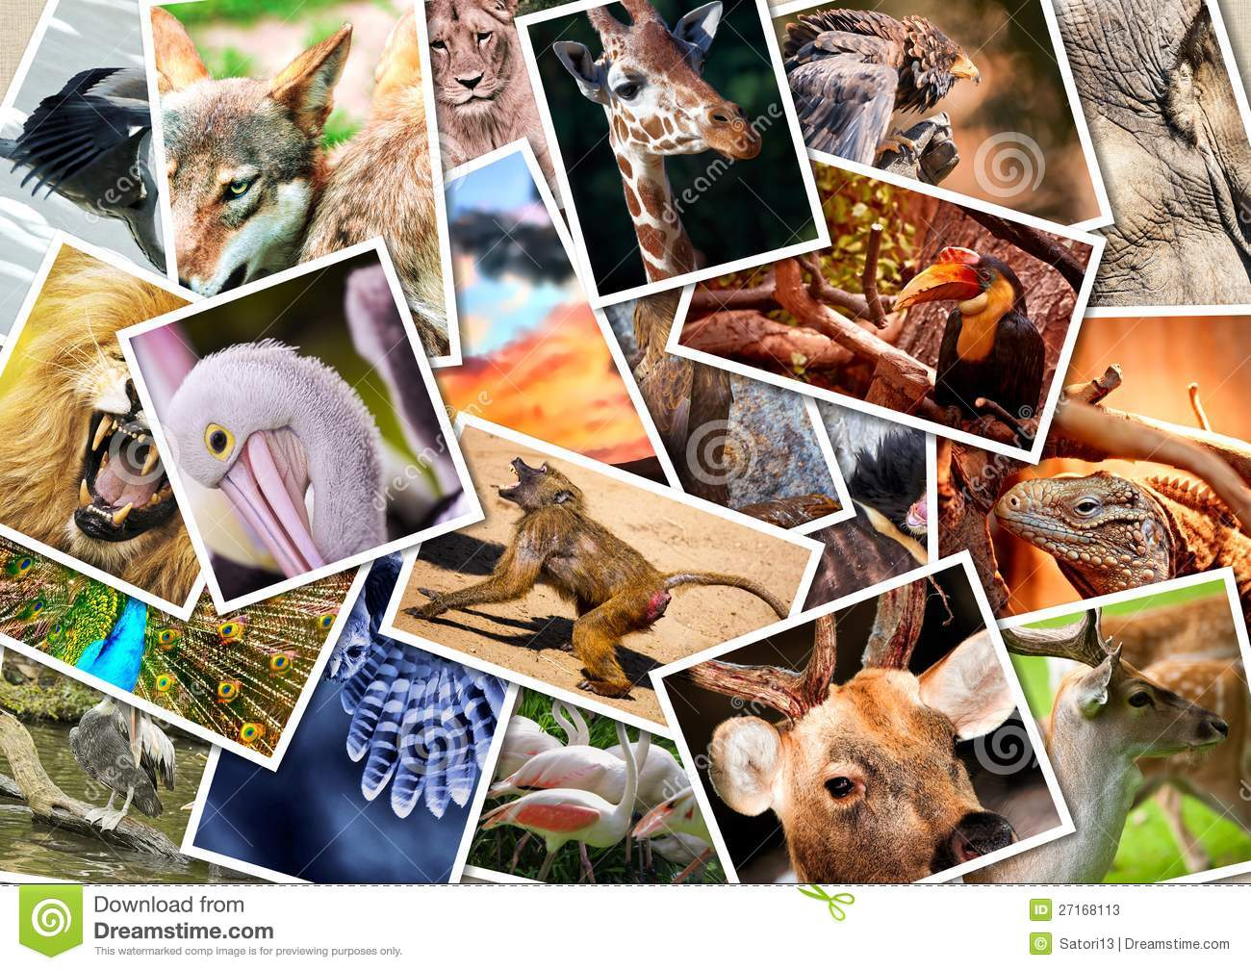

Amazing Animals
Listen & read along

Slide 9

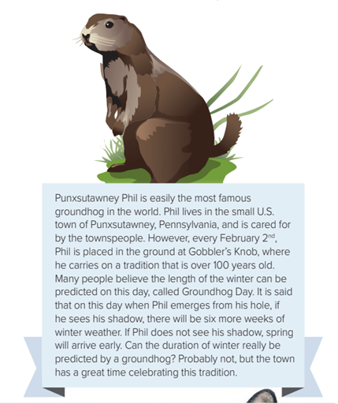
What kind of animal is that
a groundhog
What’s his name?
Punxsutawney [punk-sa-taw-ney] Phil
What kind of day is it if Punxsatawney Phil can see his shadow—sunny or cloudy?
It’s sunny because you can’t see a shadow when it’s cloudy

Slide 10
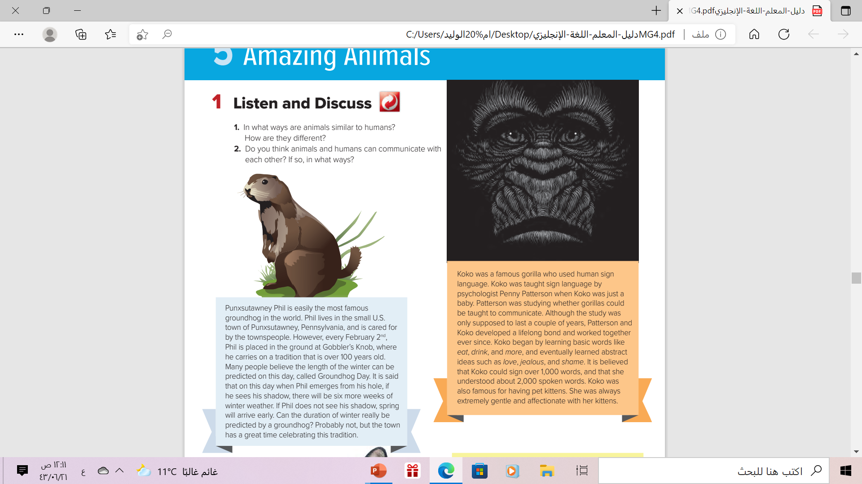
What kind of animal is that
gorilla
What’s his name?
Koko
What was Koko famous for?
Koko gorilla who was a famous used human sign language

Slide 11
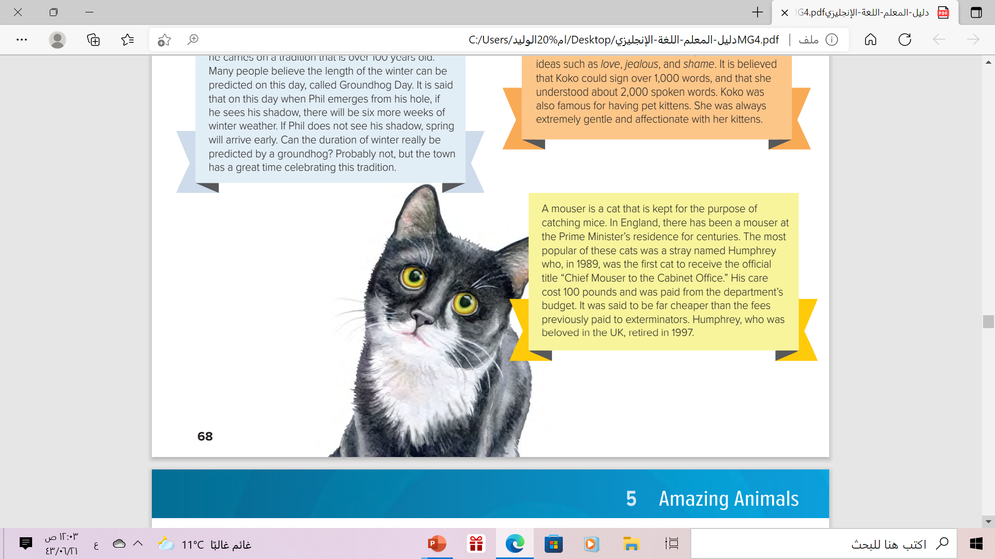
What kind of animal is that
cat
What’s his name?
Humphrey
Where does the cat live?
in England, at the Prime Minister’s residence

Slide 12
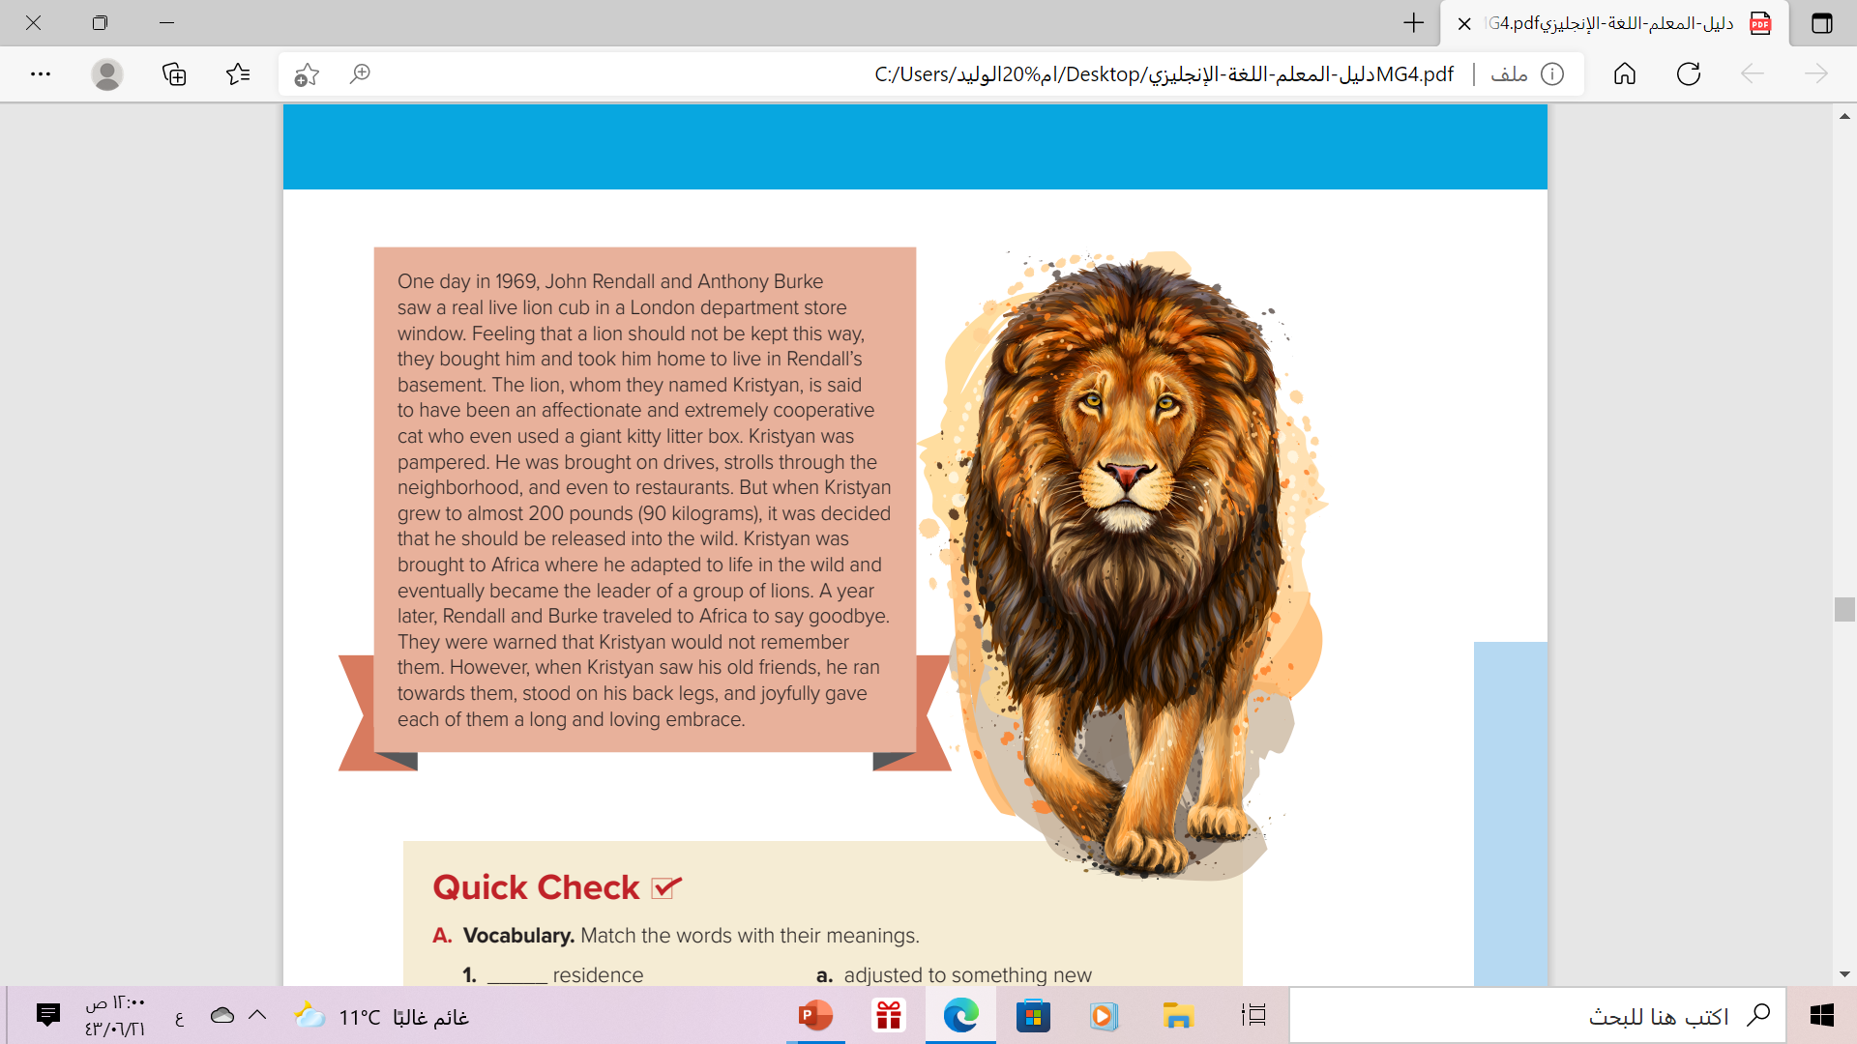
What kind of animal is that
Lion
What’s his name?
Kristyan
When did John Rendall and Anthony Burke first adopt the lion?
In 1969

Slide 13
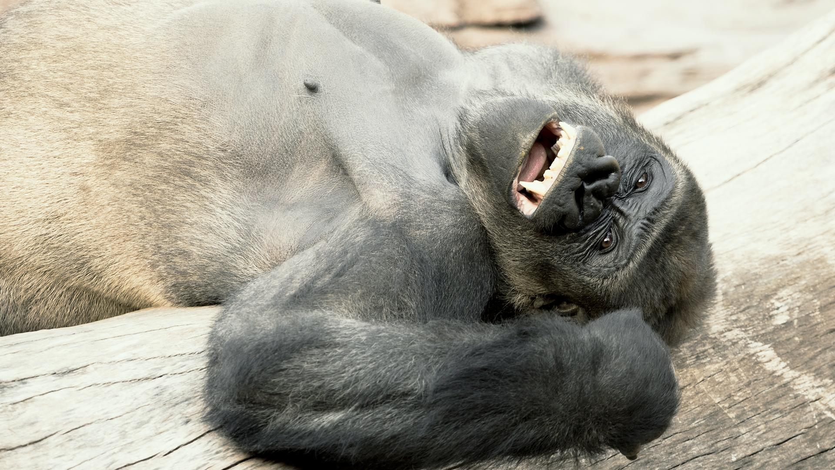
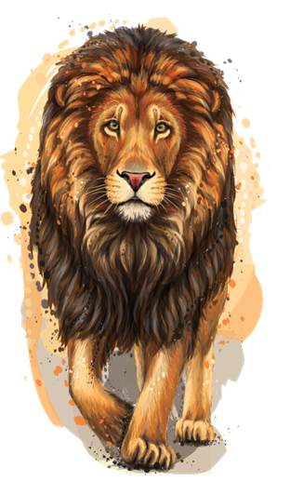
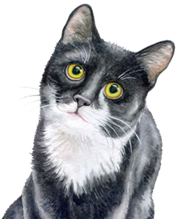
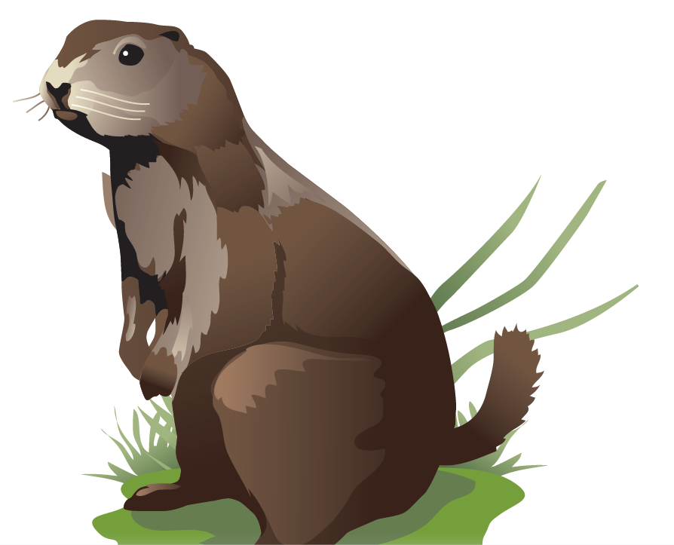
Which story do you think is the most interesting? Why?

Slide 14
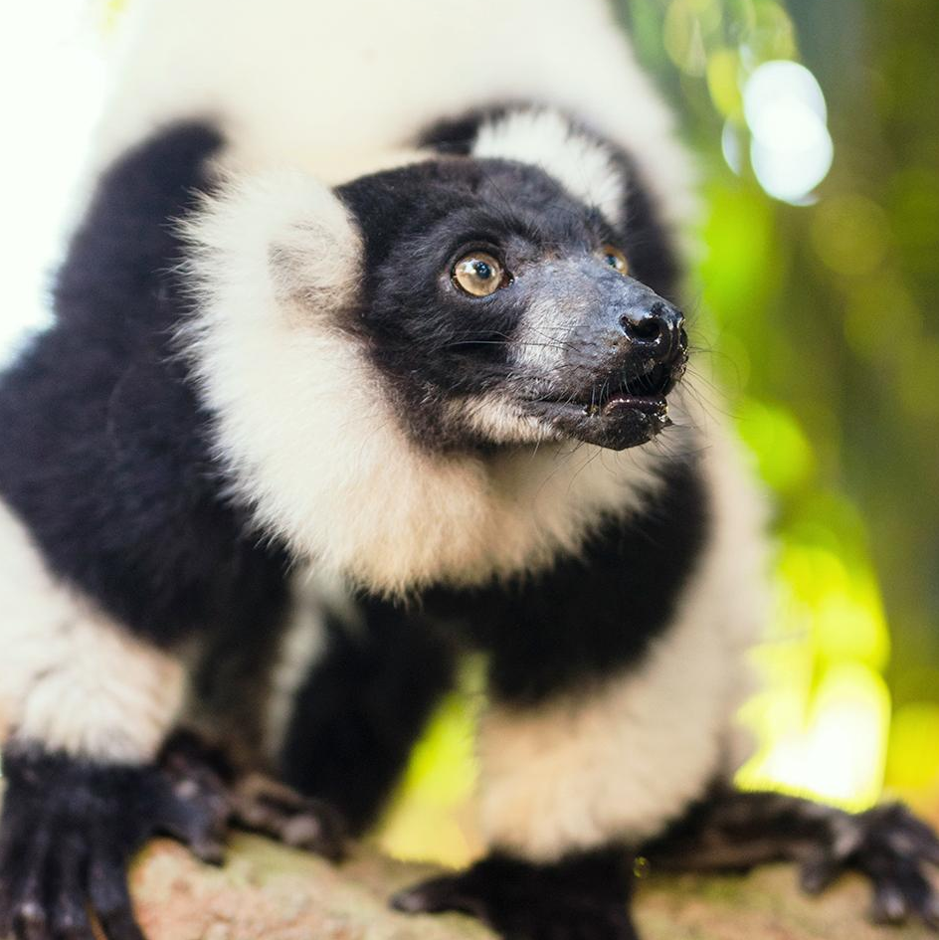
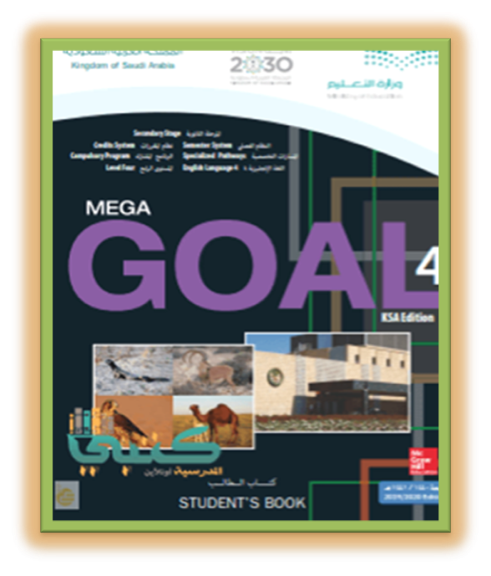
Book Open
Page ( 69)

Slide 15


Slide 16
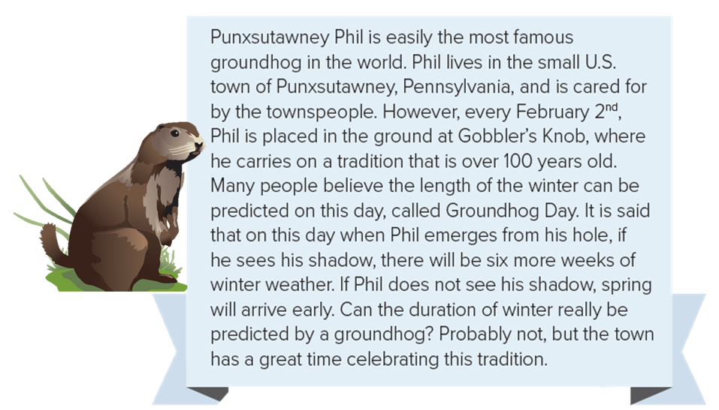



Find a word means….
. length of time
duration

Slide 17
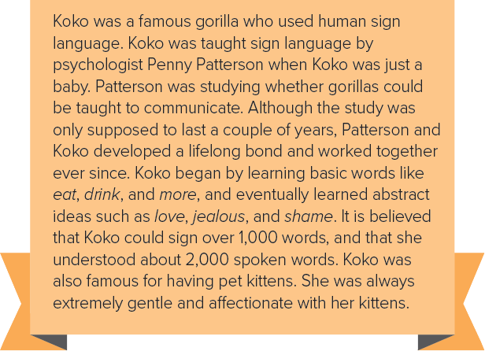
Find a word means….
. connection between two living things
Find a word means….
. relating to ideas or feelings
bond
abstract

Slide 18
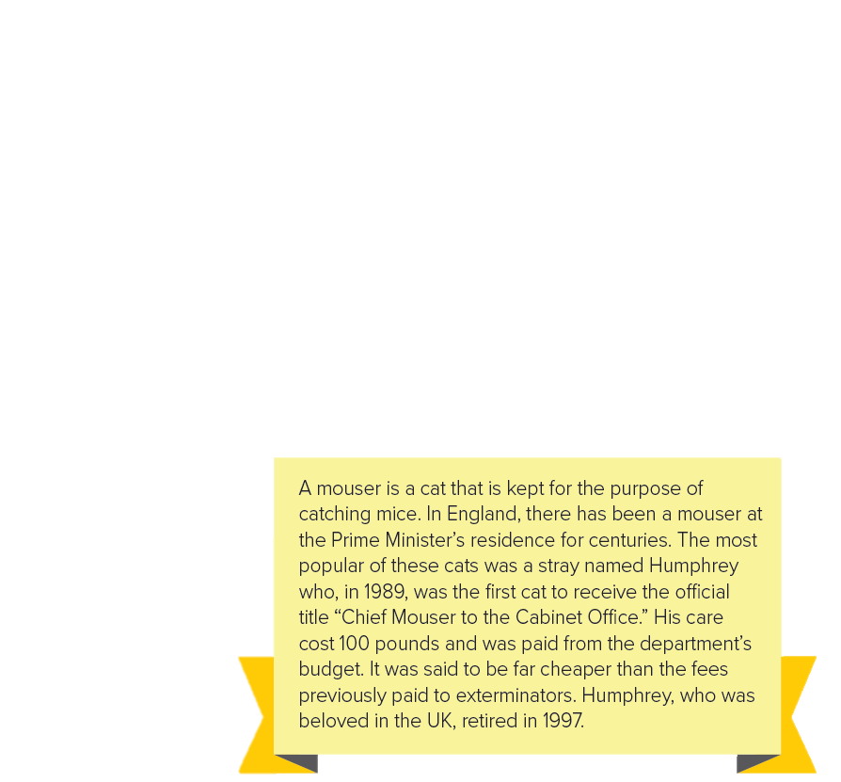
Find a word means….
. place where someone lives
residence

Slide 19
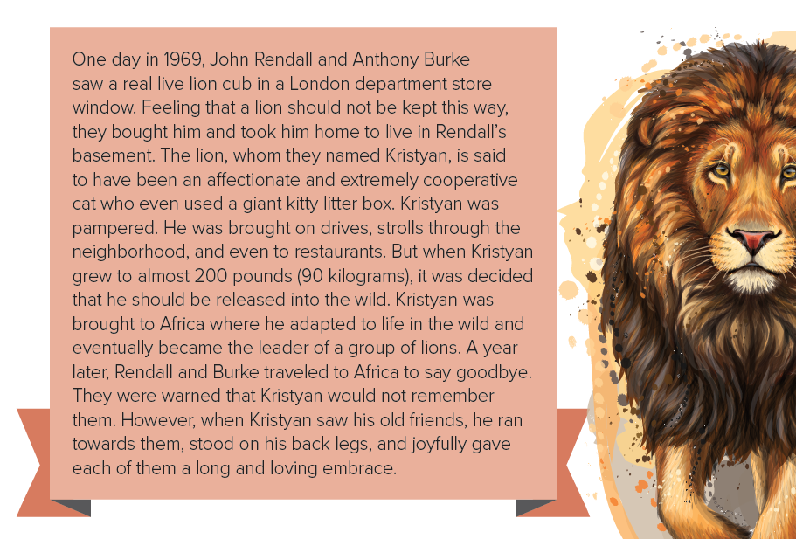
Find a word means….
indulged
Find a word means….
adjusted to something new
pampered
adapted

Slide 20
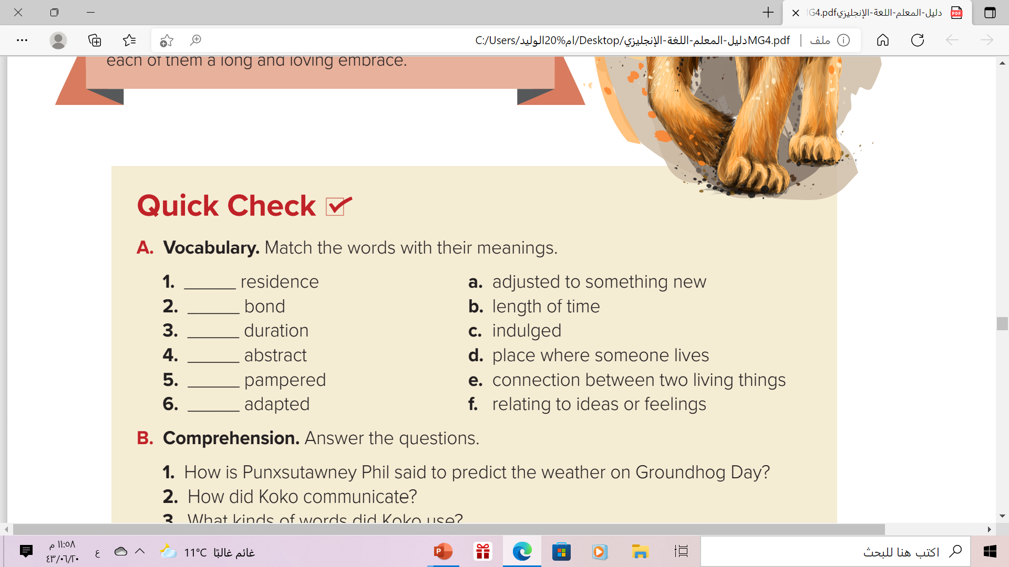
d
e
b
f
c
a

Slide 21
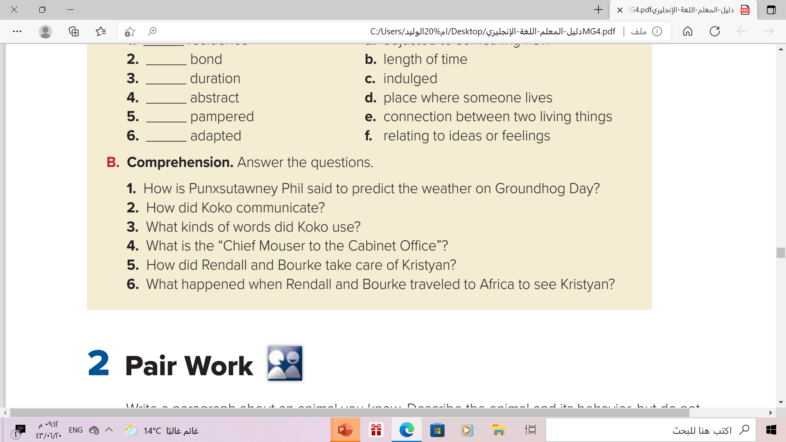
1. If he sees his shadow, there will be six more weeks of winter. If he does not see his shadow, then spring will arrive early.
2. Koko communicated using human sign language.
3. Koko used both basic and abstract words.
4. It’s a cat that lives in the Prime Minister’s residence. The cat’s job is to catch mice.
5. They kept Kristyan in their basement in London. They took him everywhere and pampered him.
6. Kristyan remembered them and was very happy to see them

Slide 22


Slide 23
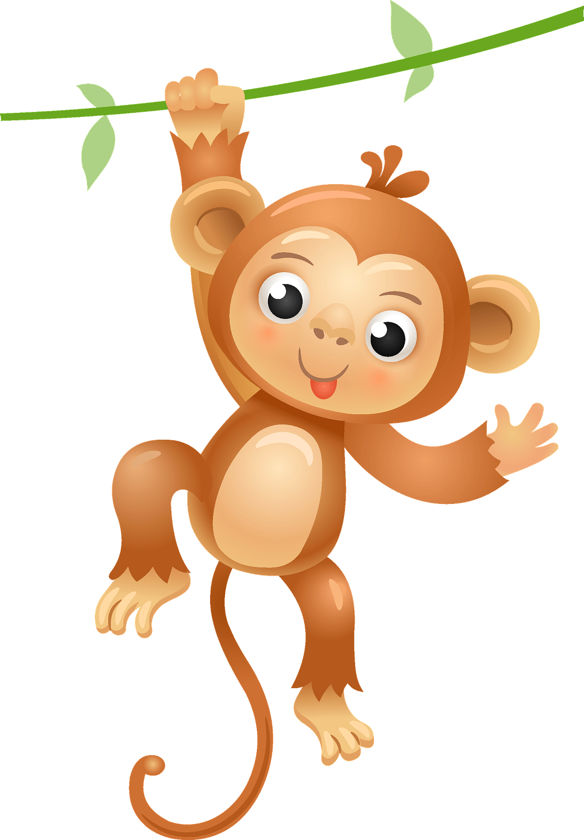
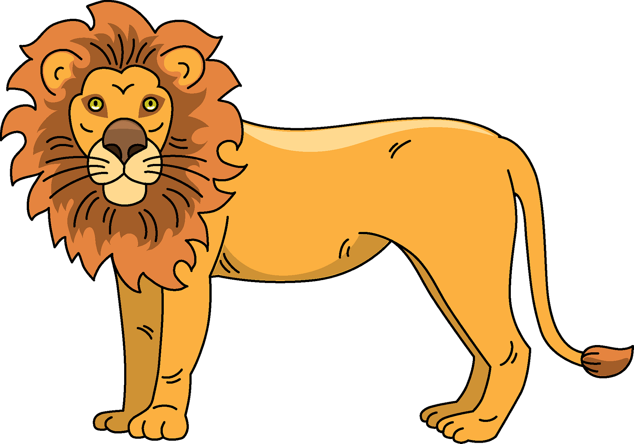
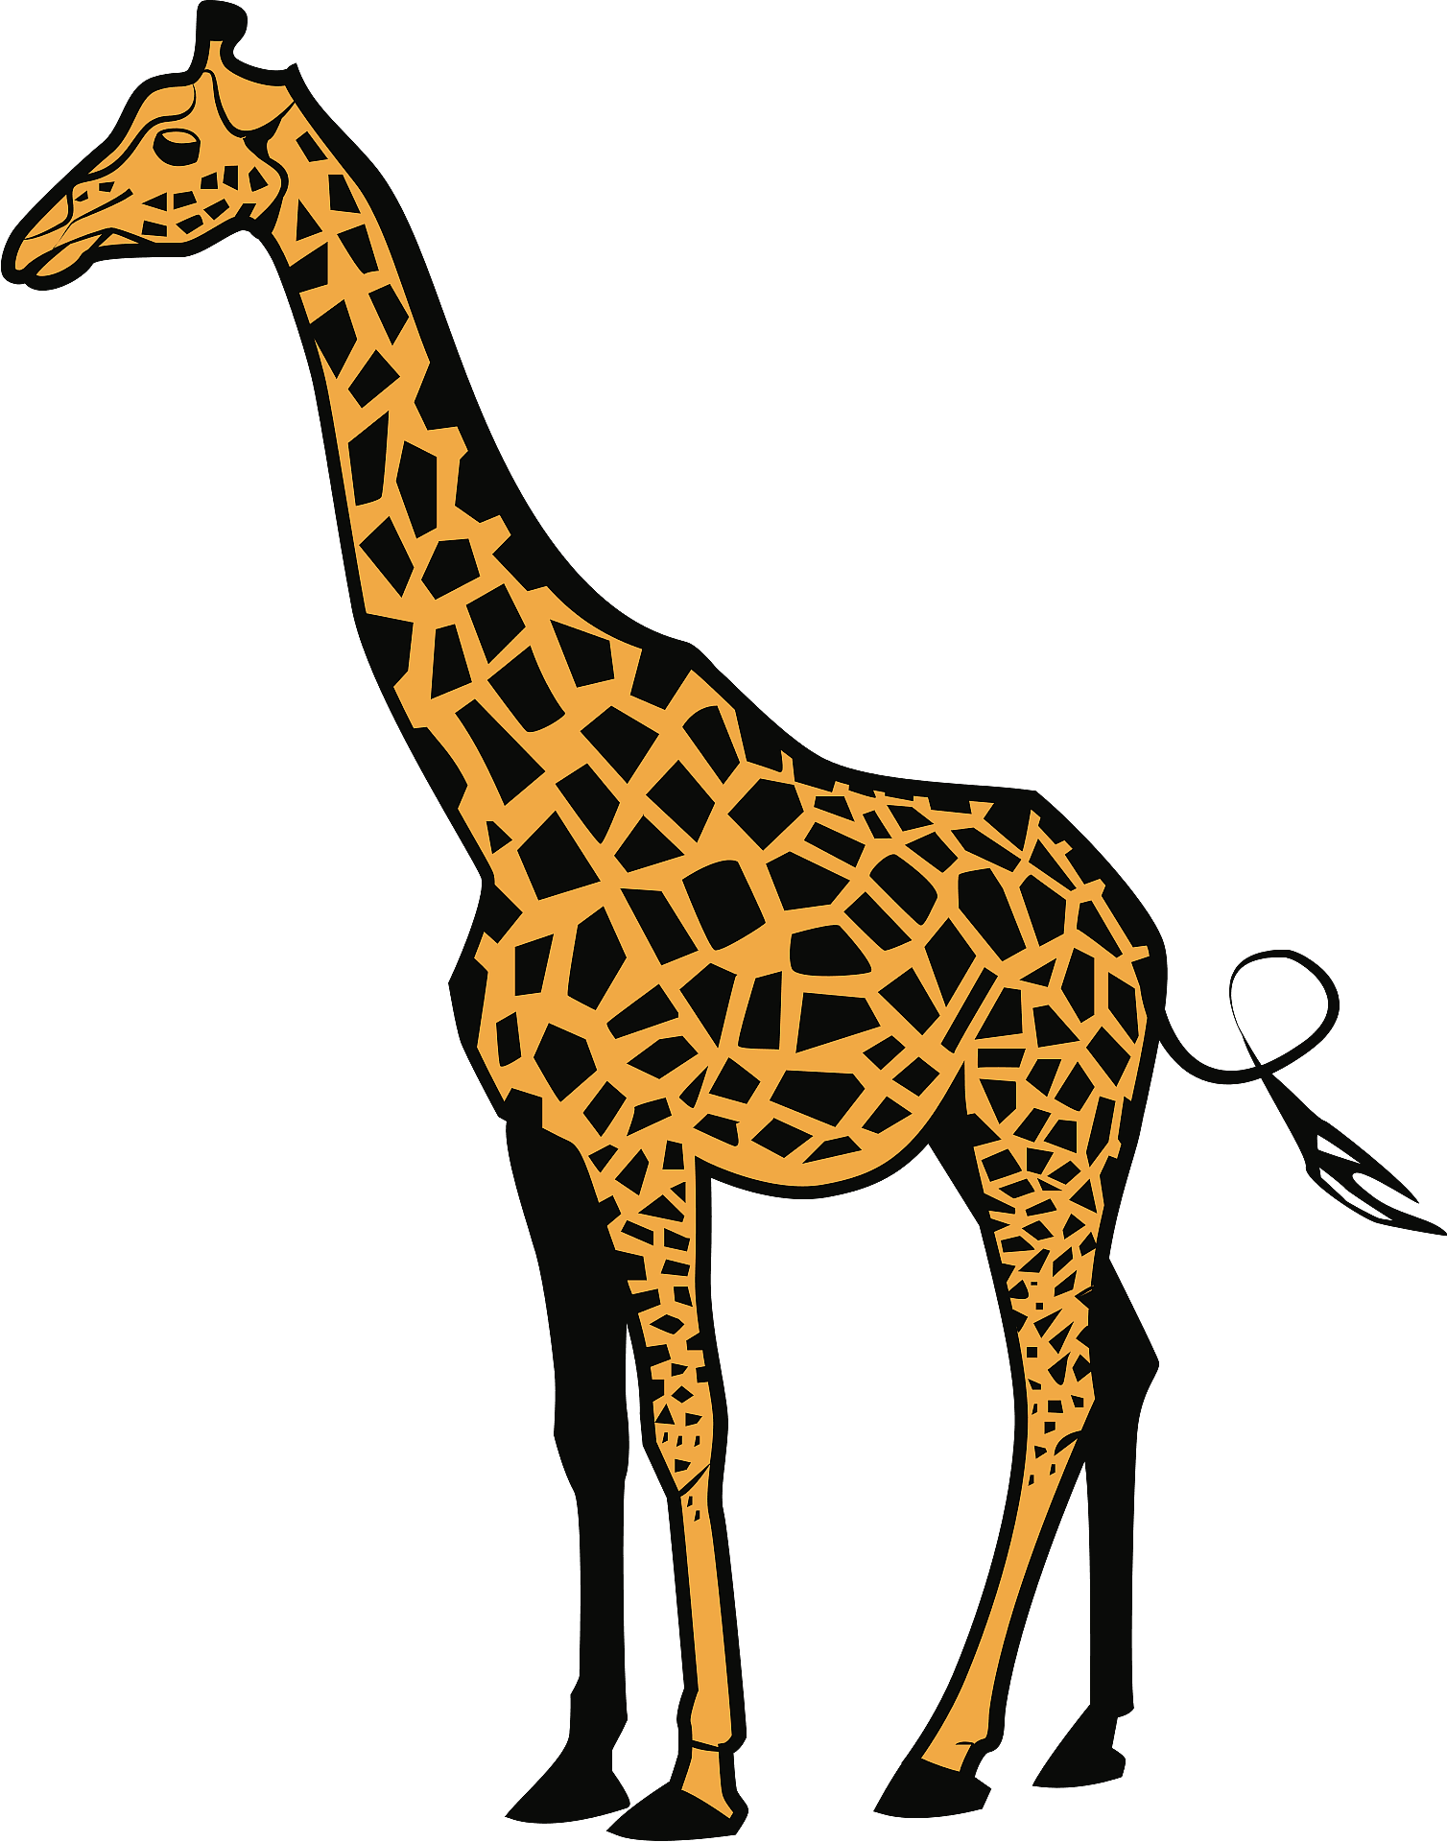
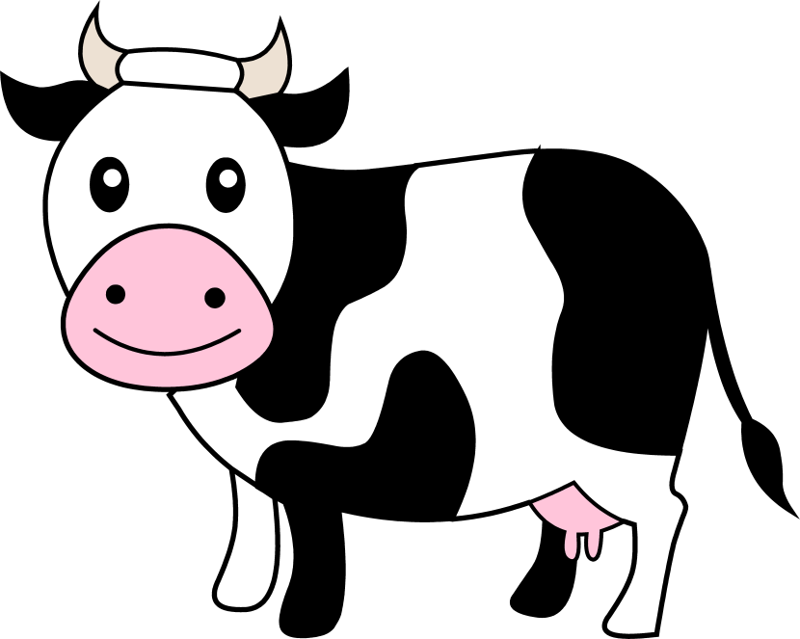
Wich Anima Am I ?
I live on land. I ‘ve got sharp teeth. I’m a wild mammal. I eat meat. People call me ”The King of Jungle”. Which animal am I ?
I live on the trees and like to climb . I like to eat bananas .I have brown fur . Which animal am I ?
Lion
monkey
I live on farm. I’m a mammal. I’ve black and white fur. People milk me and eat my meat. I eat grass.
Which animal am I ?
I live on land. I ‘ve long neck. I have orange and yellow skin. Which animal am I ?
cow
giraffe

Slide 24
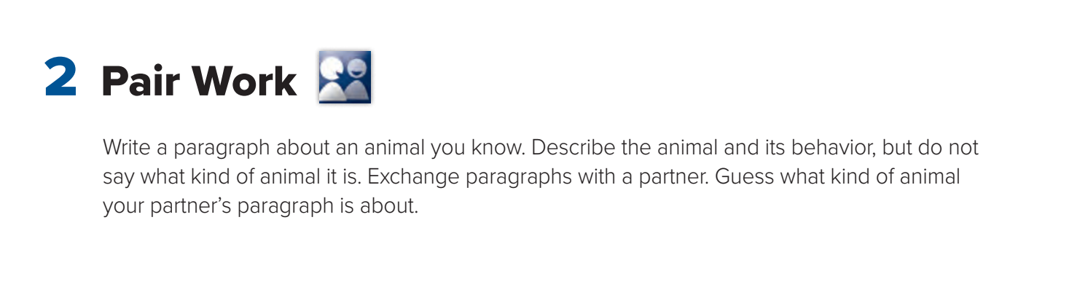


Slide 25
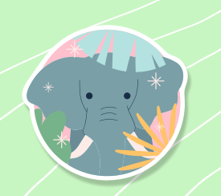
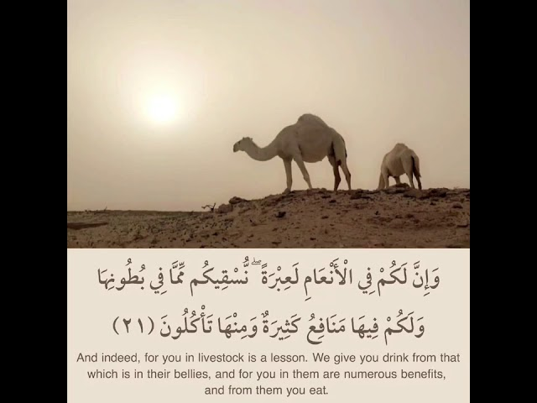
Meditate ..

Slide 26
Homework
On workbook , Page ( 47 ) ,
exercise ( A )

Slide 27
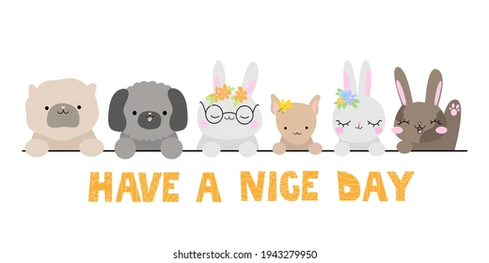
thanks!

