Slide 1
Unit 5
Do You Really Need It?
Listen & Discuss
Mega Goal 3-2
Done by: Entisar Al-Obaidallah

Slide 2
Lesson Objectives
01
04
02
05
03
Discuss
Answer
the influence of advertising
Some questions about the advertisment
Listen
Create
For soecific information
an advertisement for a product
Match
The words with their correct definition

Slide 3

Warm Up
Do you really need it ?
What do
you think the unit will be about?

Slide 4

Open your student’s book p. ( 68 )

Slide 5
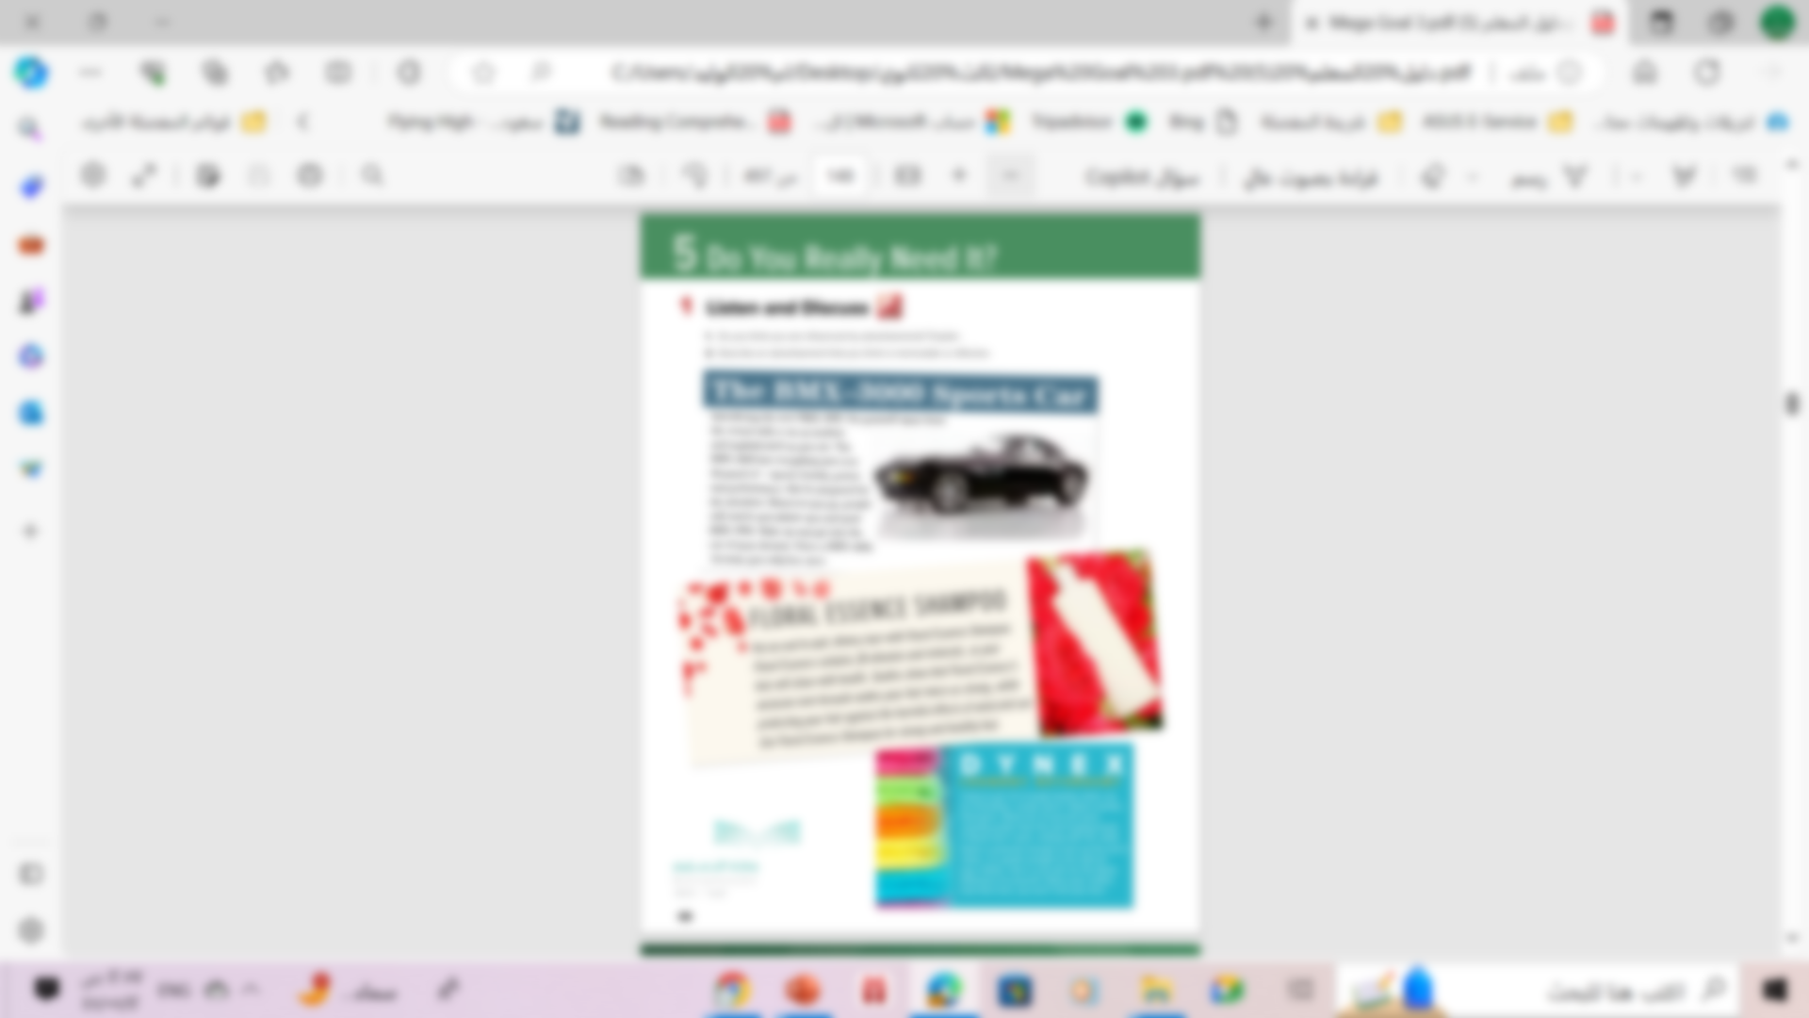
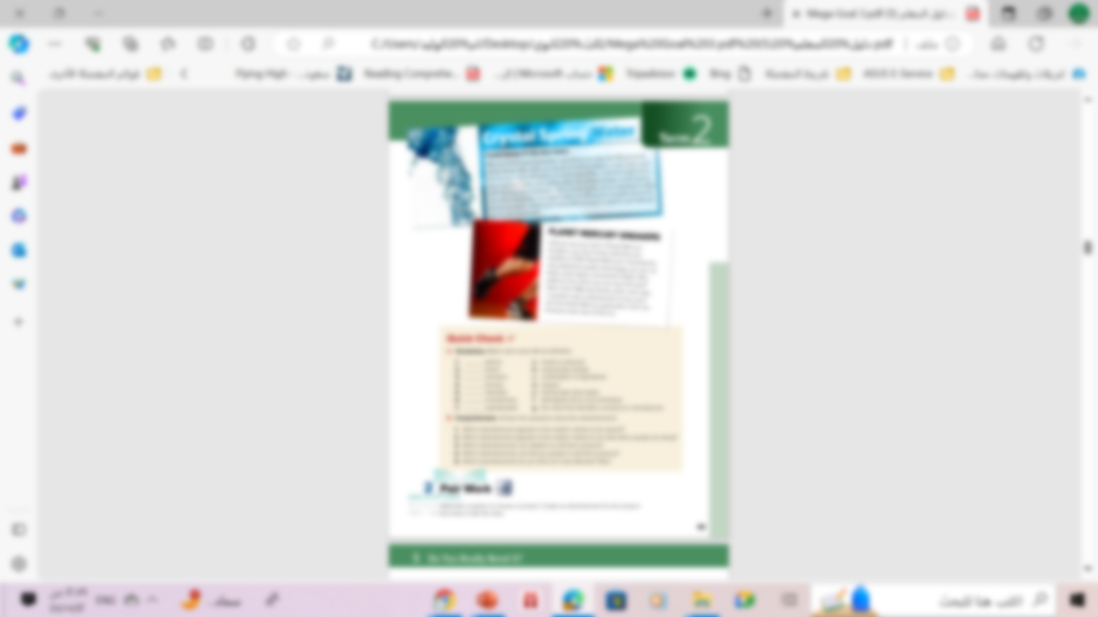
Scan the pictures.
Now ,what do you think
the unit will be about?

Slide 6
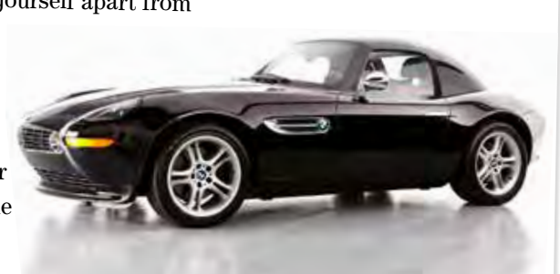
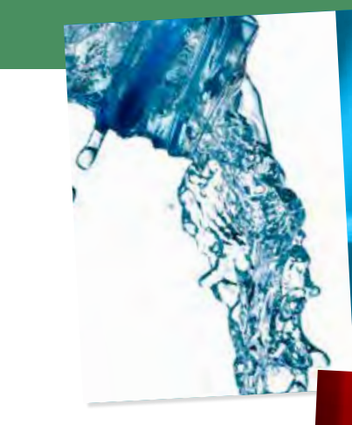
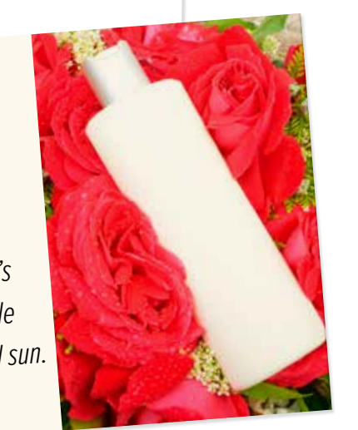
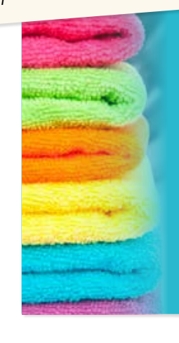
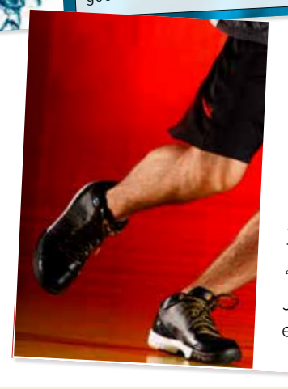
What does each picture show ?
Spoort car
Sneakers
Spring Water
Floral shampoo
Laundry Detergent

Slide 7

Now ,what do you think
the unit will be about?
advertising and consumer
products

Slide 8
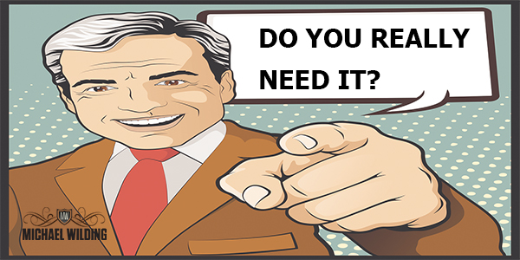
When you want to buy something , do you ever ask yourself:

Slide 9


What is the purpose of advertisements??
to make
people buy things

Slide 10
01
Before Reading

Slide 11
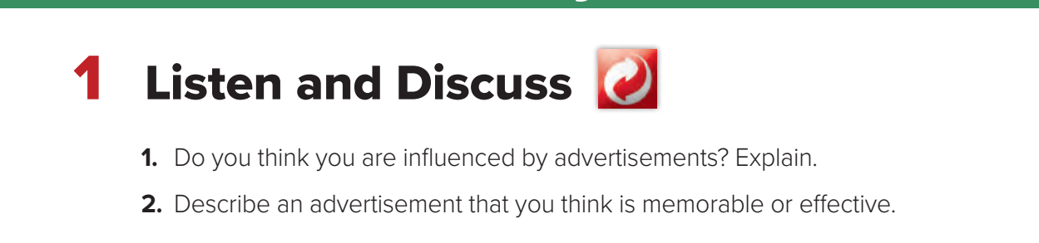

Slide 12
02
Listen and Disuss

Slide 13
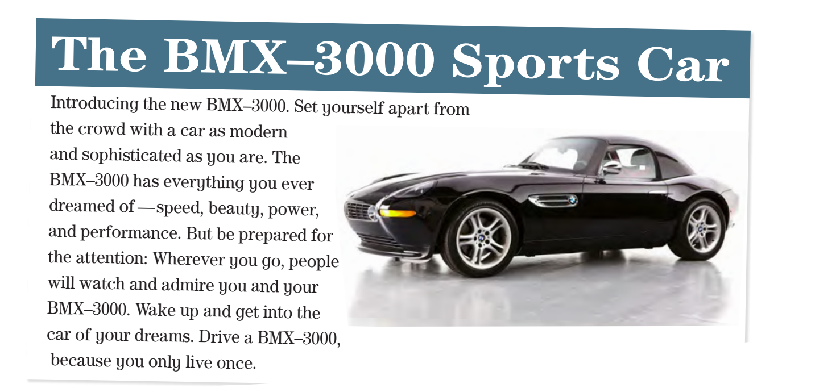

What kind of car is this?
A fast , beautiful sports car
Everyone will watch and admire you
What will happen if you drive this car?

Slide 14
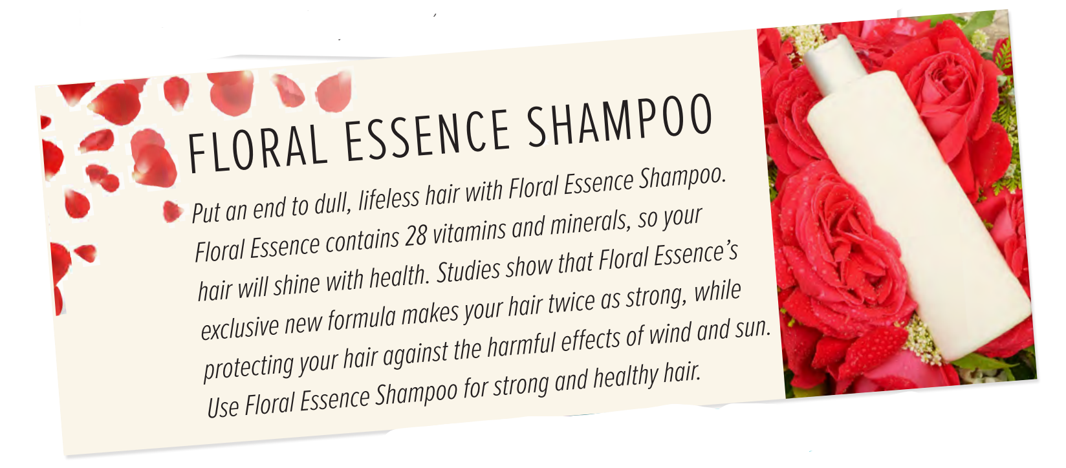
What will happen if you use this shampoo?
Your hair will be shiny and strong
It makes your hair twice as strong, protects your hair against wind and sun
What have the studies shown?

Slide 15
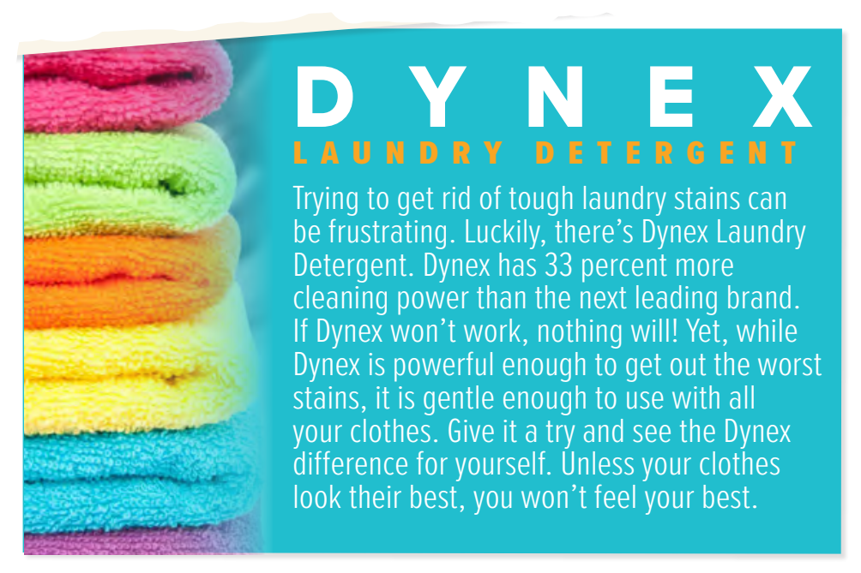
Why is this detergent better than others?
Because it contains more cleaning power.
They get out the worst stains
What can this detergent do?

Slide 16
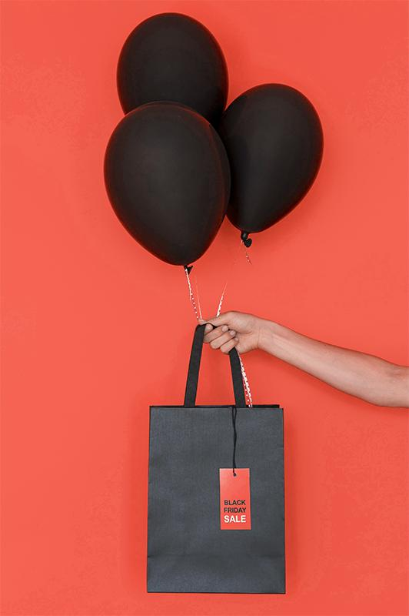
Open
your student’s book
p. ( 69)

Slide 17
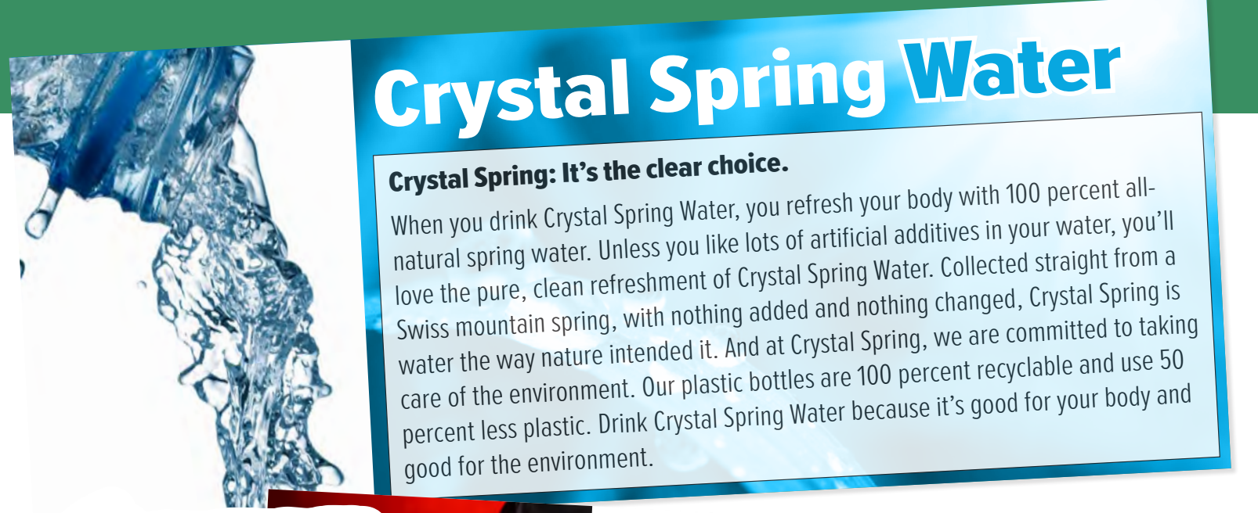
How is Crystal Spring Water different?
It is all-natural with no additives
Where does it come from?
Swiss mountain
It is good for the environment
What else is special about it?

Slide 18
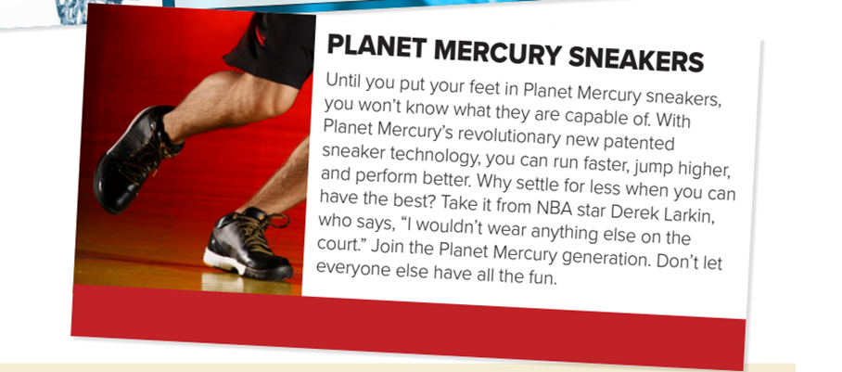
If you wear these sneakers, what will you be able to do?
run faster, jump higher, and perform better
Culture Note
NBA stands for National Basketball Association. It is a league made up of professional basketball teams from the United States and one from Canada.
Who wears these sneakers?
an NBA star

Slide 19
03
After Reading

Slide 20
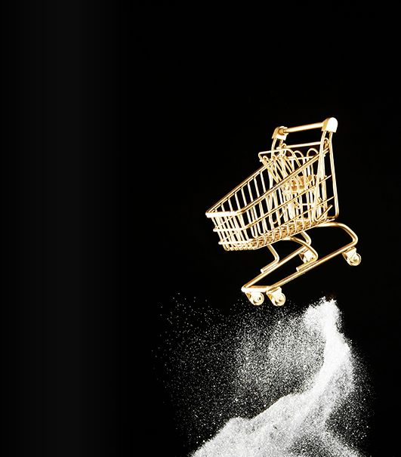
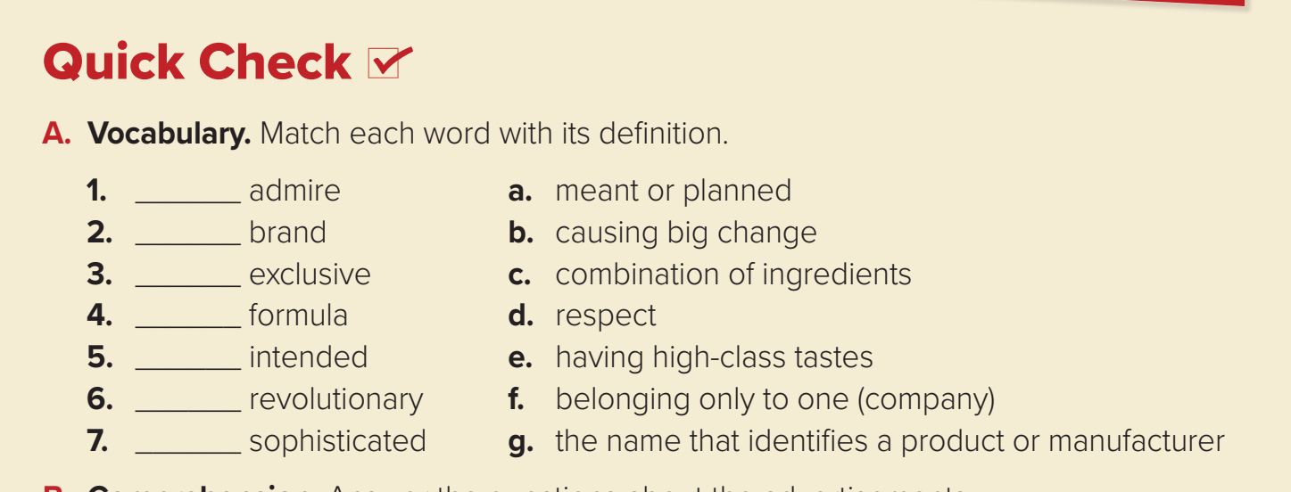
Quick Check
d
g
f
c
a
b
e

Slide 21
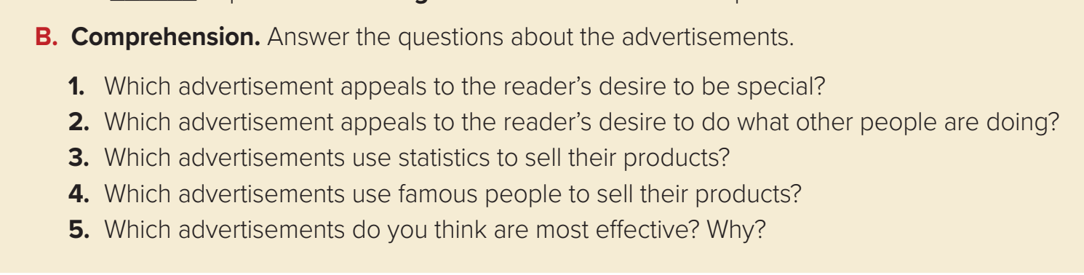
4
5
1
2
3
BMX–3000 Sports Car
Planet Mercury Sneakers
Dynex Laundry Detergent and Crystal Spring Water
Planet Mercury Sneakers
I think the ad for the BMX–3000 Sports Car is the best because it
makes me want to buy one.

Slide 22
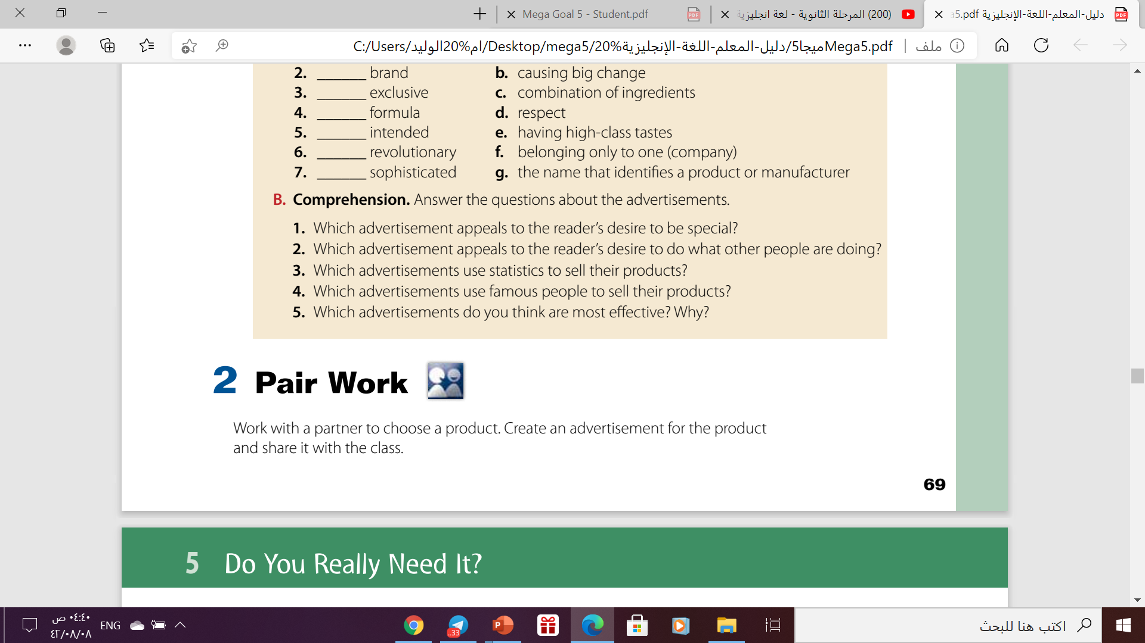

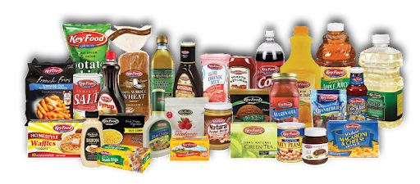

Slide 23



Let’s Practice
https://wordwall.net/play/12631/049/546

Slide 24
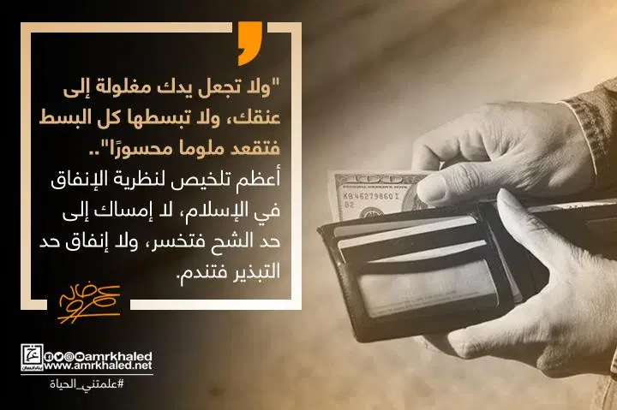
From The Holy Quraan

Slide 25
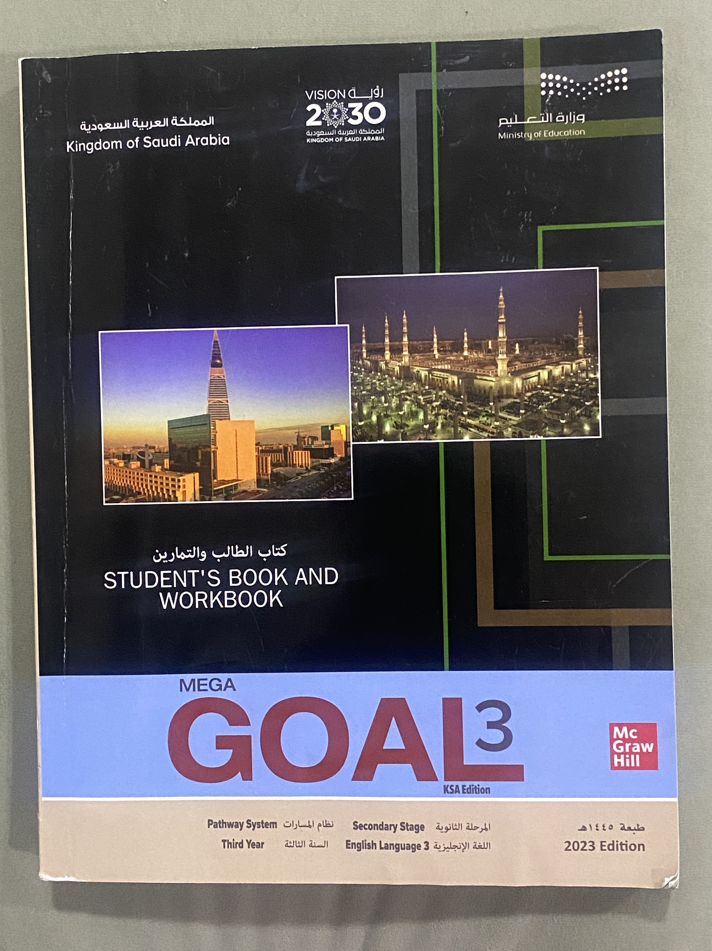
Homework
on work book
Exercise ( A) , Page.(269)

Slide 26

Thanks!

