Slide 1
Mega Goal 2.2
Unit 1
Working 9 to 5
Listen & Discuss
Done by: Entisar Al-Obaidallah

Slide 2
Lesson Objectives
01
03
02
04
Discuss
Match
the qualities of a good job.
words with their meaning.
Match
Name
the job descriptions with the photos.
the job according to a description

Slide 3

Book Open
Pages ( 72-73 )

Slide 4
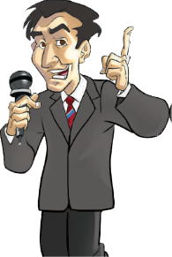
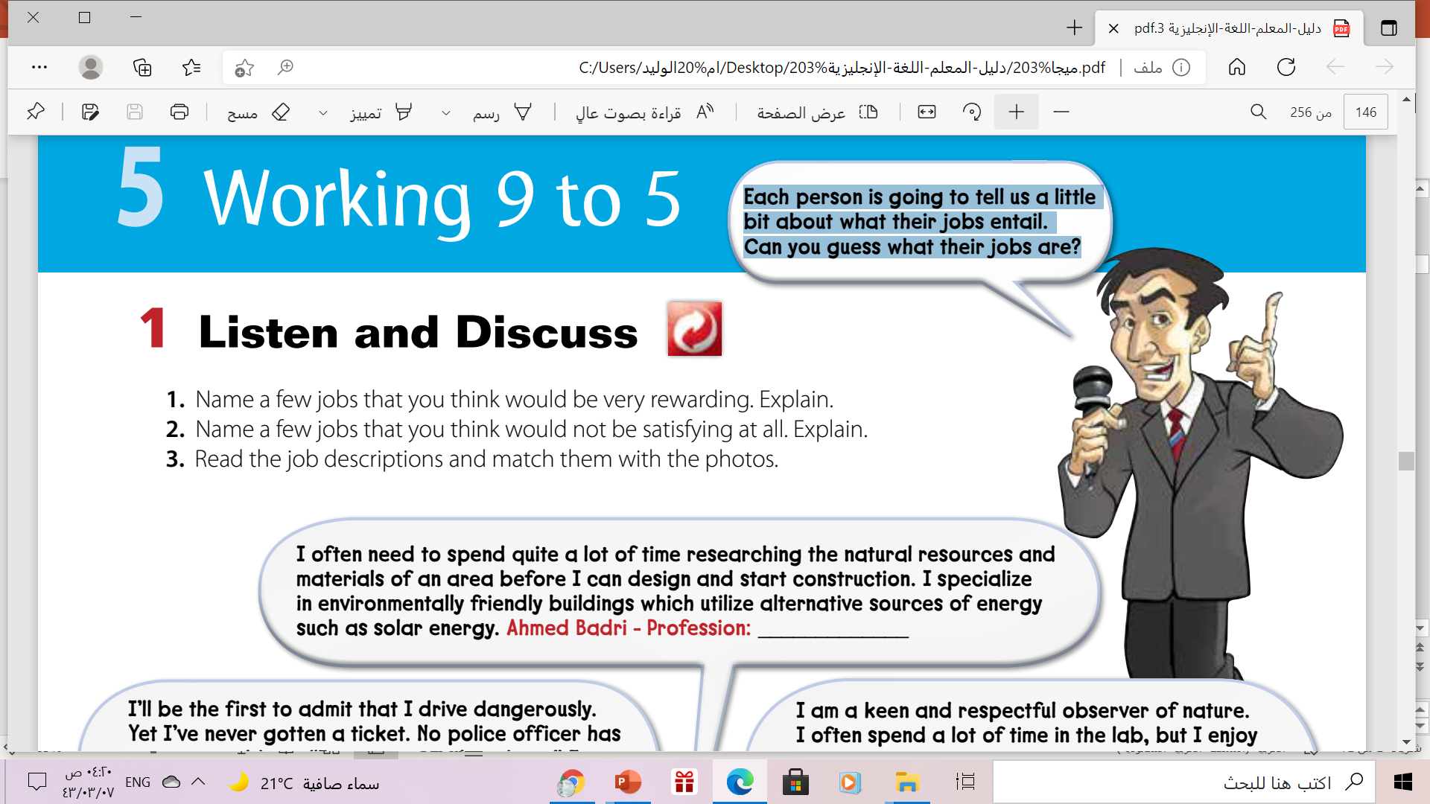
Let’s answer some questions

Slide 5


Slide 6


Book Closed
Each person is going to tell us a little bit about what their jobs entail.
Can you Guess what their jobs are?
Entail = first , premier

Slide 7

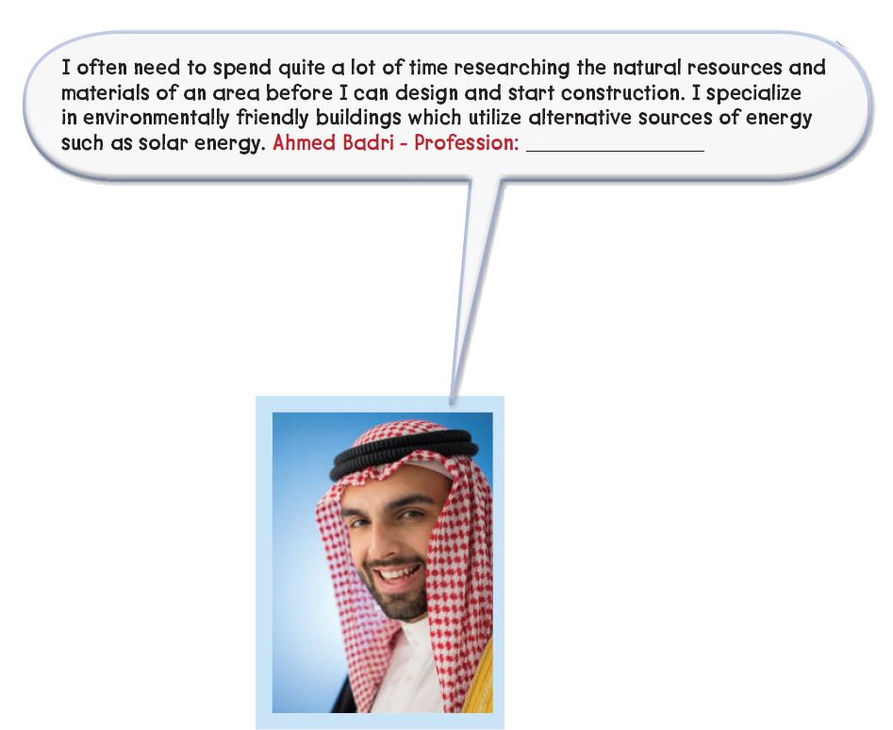
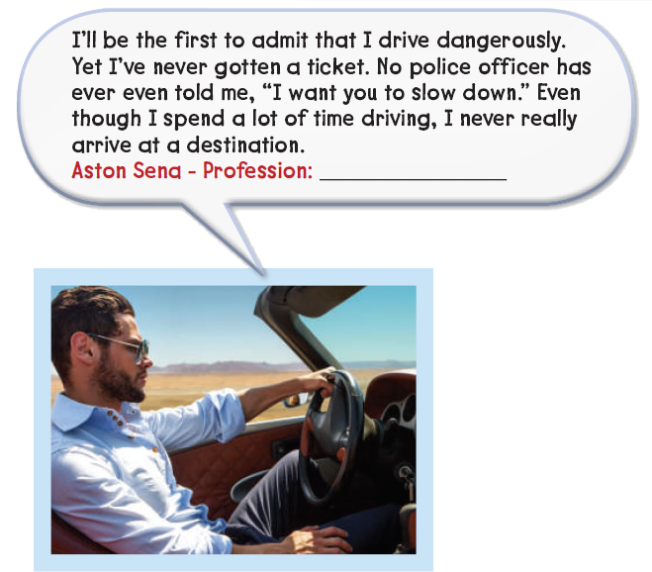
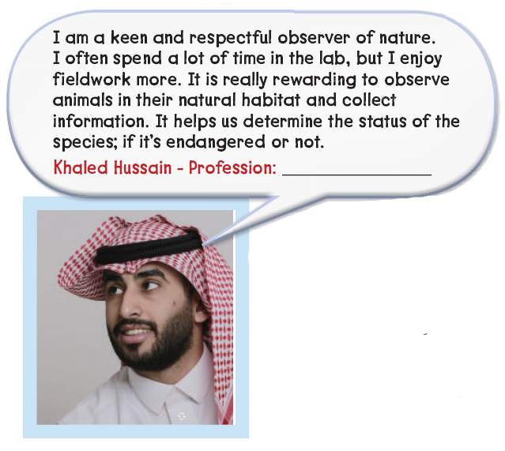
2006
engineer
race car driver
zoologist
Position title here
Company
here

Slide 8
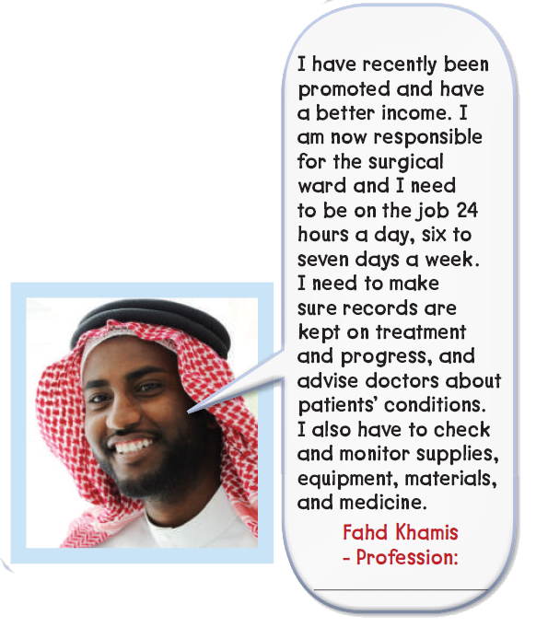
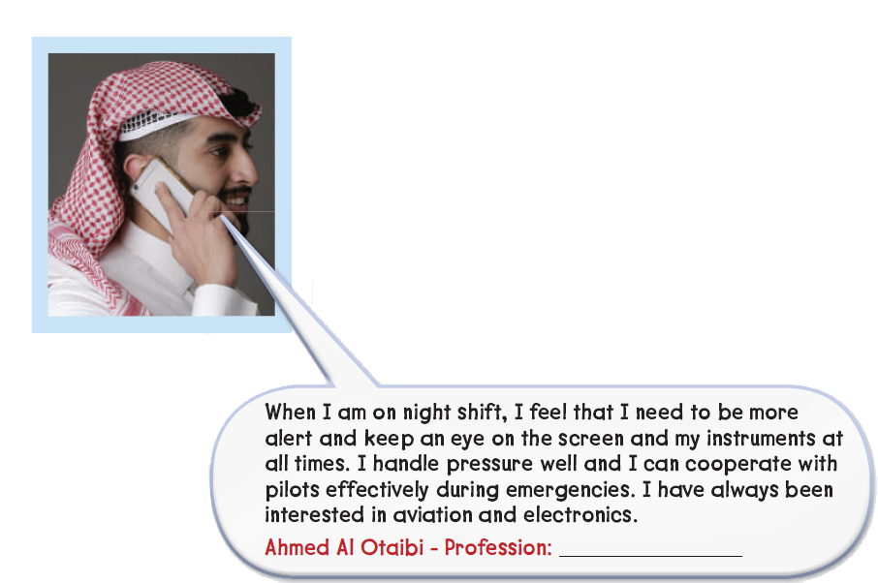
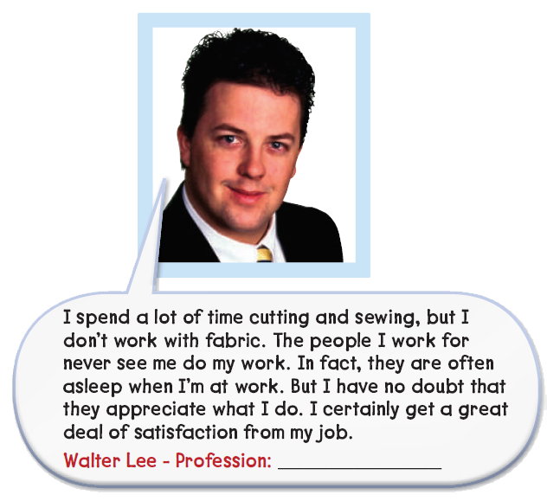
nurse
surgeon
air traffic controller

Slide 9
New Words

Slide 10
B
Find the word that means……..
the place where a person is going

Slide 11
B
Find the word that means……..
the natural environment where an animal or plant lives or grows

Slide 12
B
Find the word that means……..
to carefully watch or check a situation or something that changes

Slide 13
B
Find the word that means……..
cloth; material that most clothes are made of

Slide 14
B
Find the word that means……..
action of putting pieces of clothes with a needle and thread

Slide 15



Slide 16
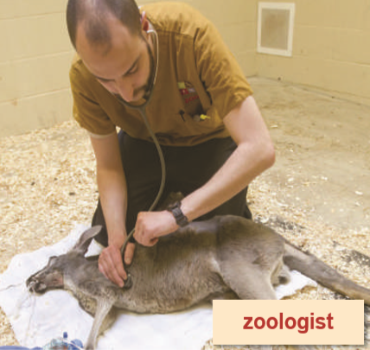
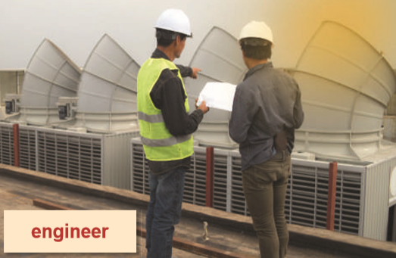
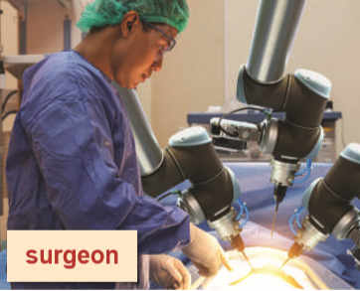

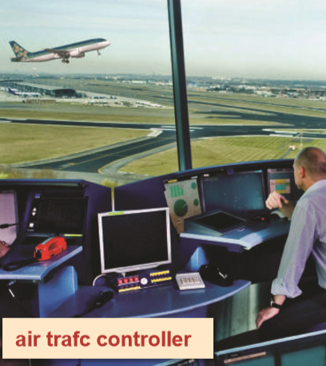
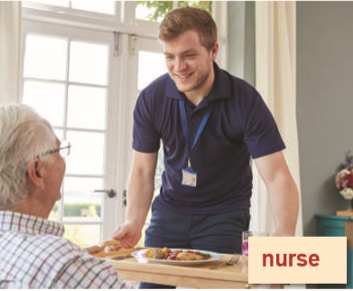
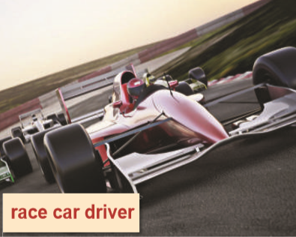
Match
race car driver engineer zoologist surgeon air traffic controller nurse

Slide 17

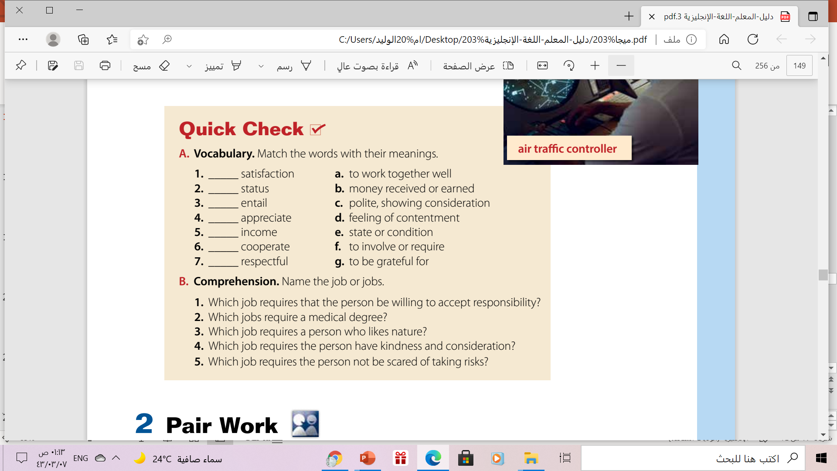
. d
. e
f
g
b
a
c

Slide 18

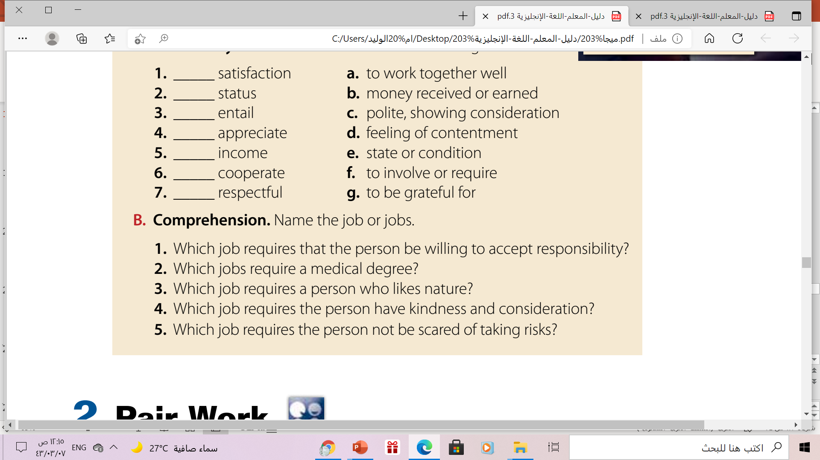
Quick Check
1. air traffic controller
2. surgeon
3. zoologist
4. nurse
5. race car driver

Slide 19

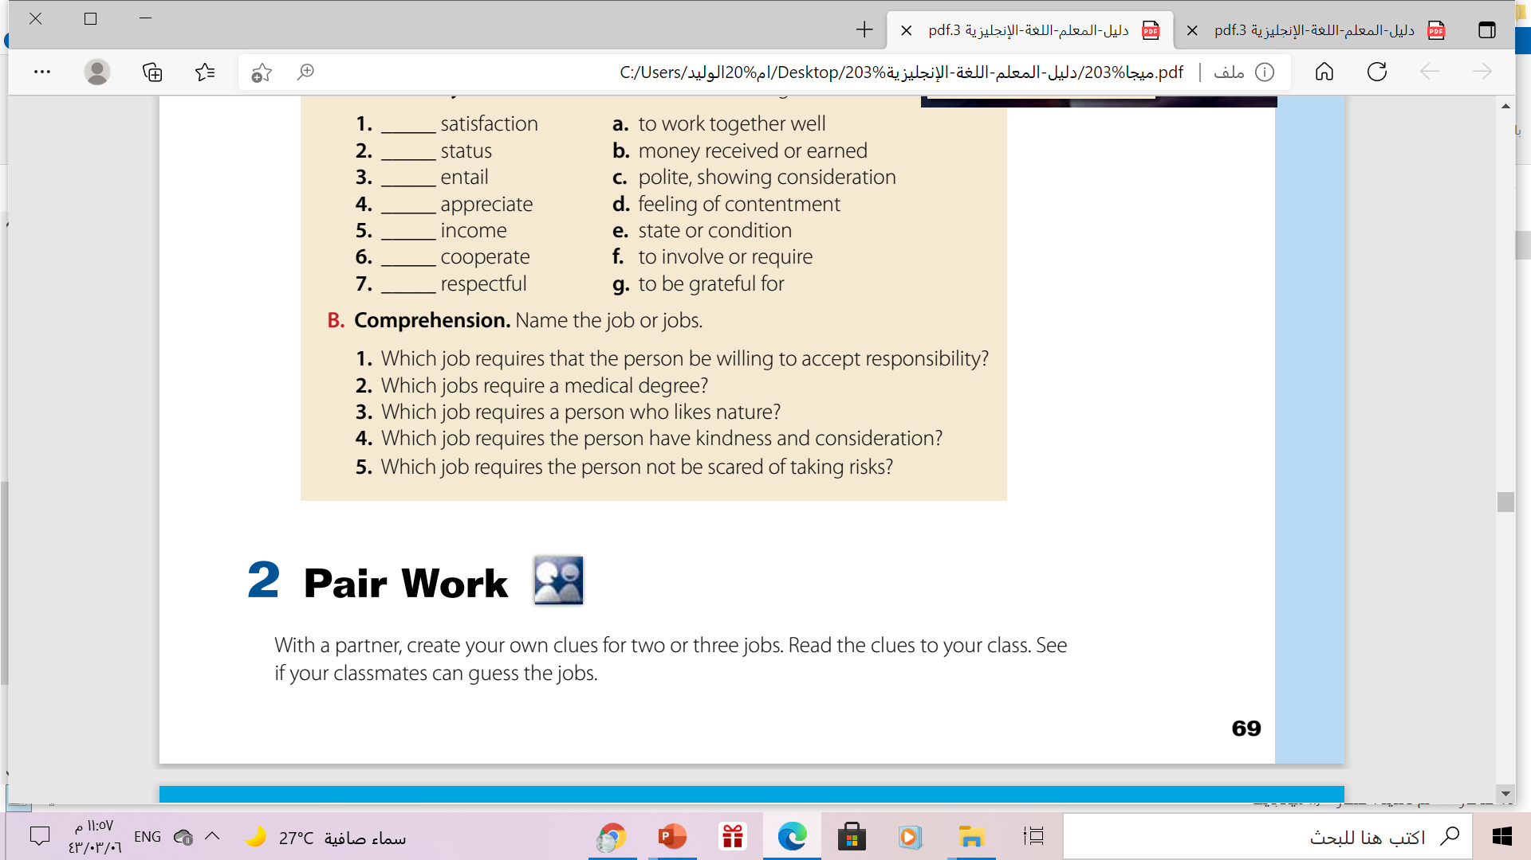


Slide 20
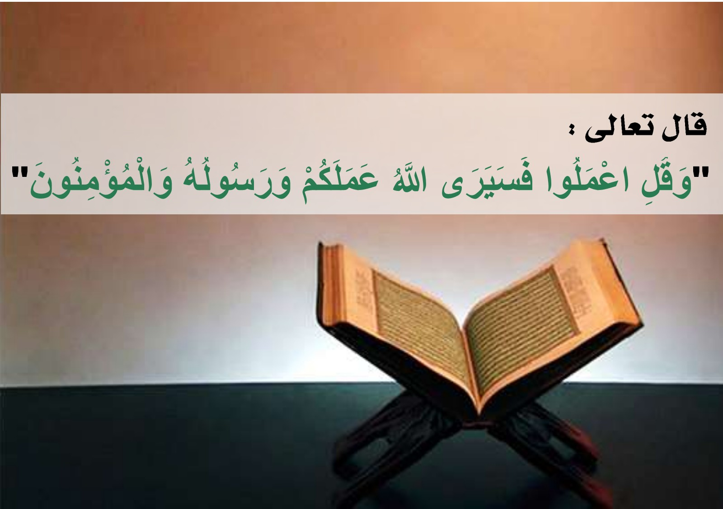
Remember

Slide 21
Homework
Workbook p.( 265) ,
exercise( A-B)

Slide 22

Thanks !

