Slide 1


Slide 2


Slide 3

    Unit -1-
    Working 9 to 5

Slide 4
5 Listening
6 Pronunciation
7 Vocabulary Building

Slide 5

Lesson Objectives
The students will be able to :
1 – listen for specific information.
2 – answer some comprehension questions .
3 – pronounce words ending with
(-tion /-cian /-sion ) .
4 – match the words with their meanings .

Slide 6
5 Listening

Slide 7

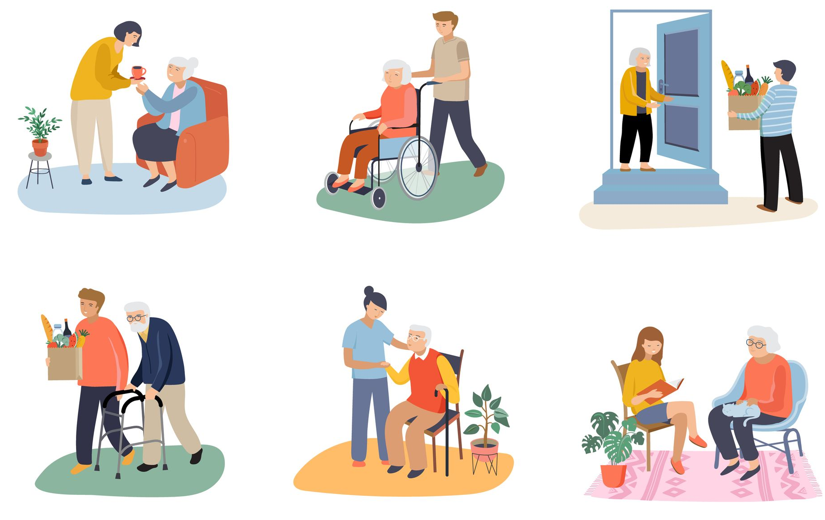
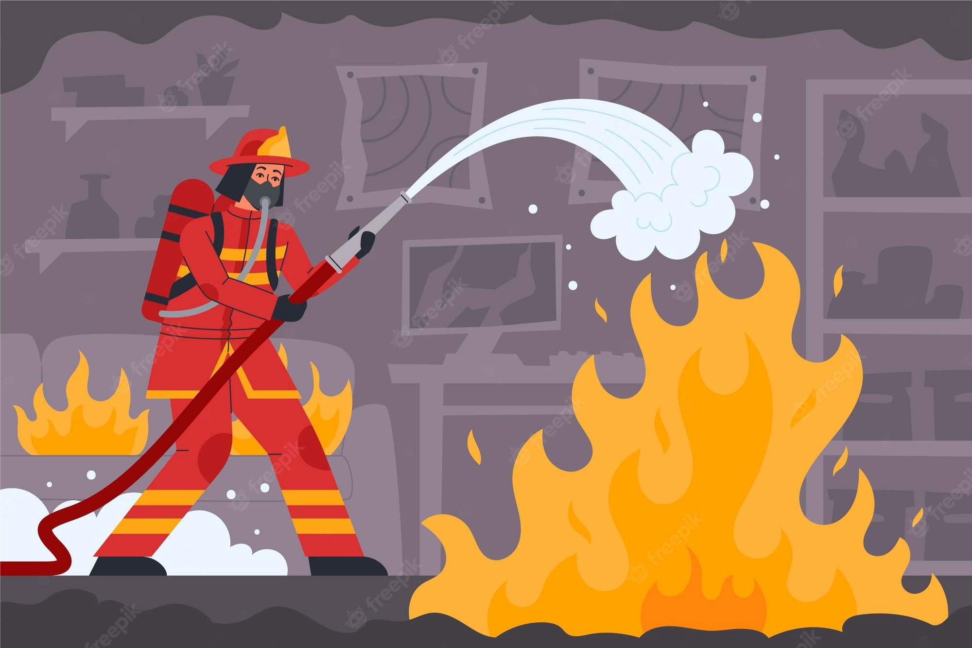

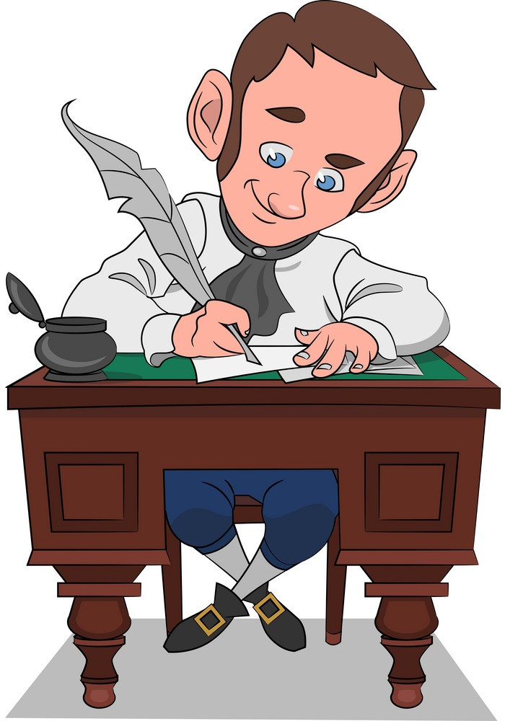
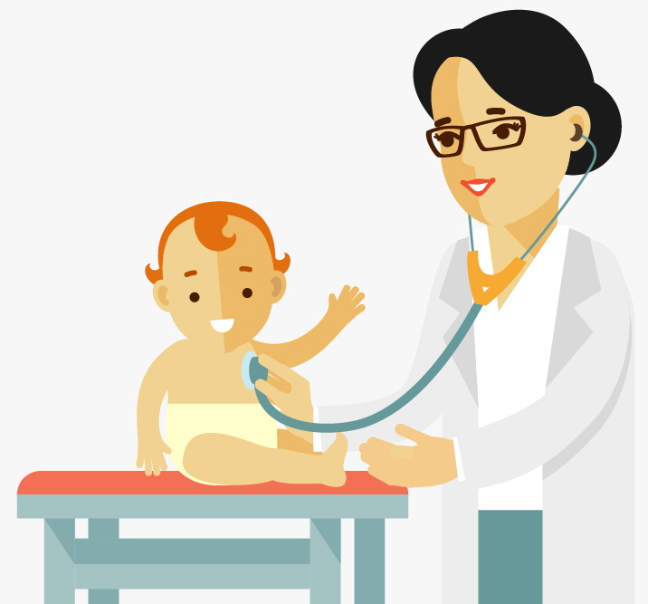
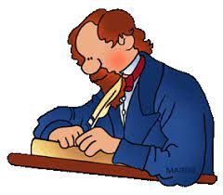
Let’s know what you know
firefighters
Social workers
telemarketers
authors
pediatricians

Slide 8


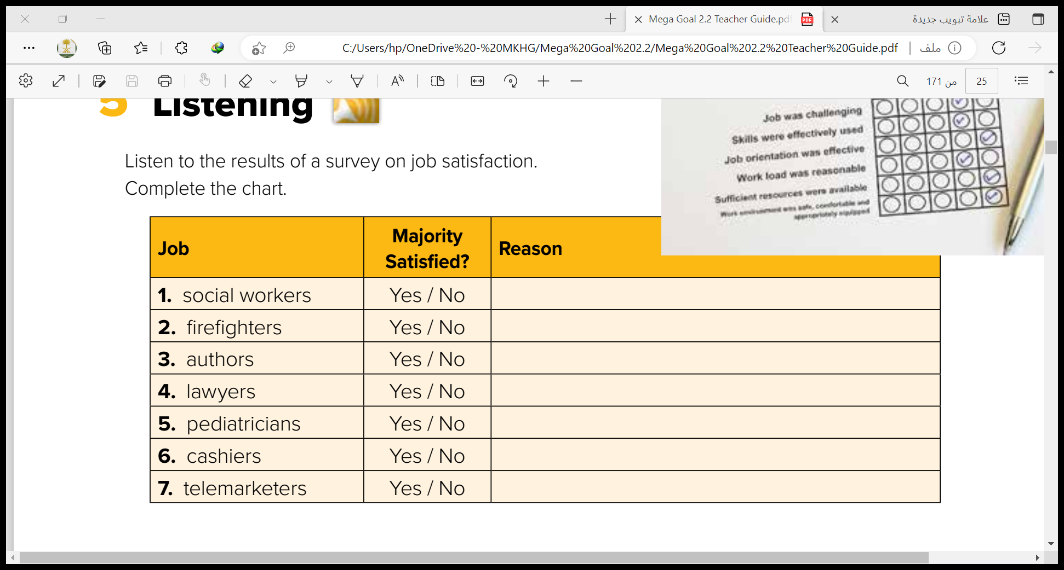
Listen to the results of a survey on job satisfaction. Complete the chart.
Satisfaction from helping others
Exciting, & protecting others is satisfying
Creativity & flexibility
High stress & great responsibility
Helping children & watching them grow up
Repetitive & efforts aren’t appreciated
Repetitive & efforts aren’t appreciated

Slide 9
6 Pronunciation

Slide 10
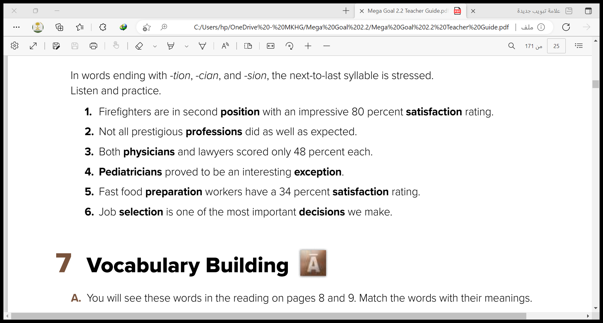

Slide 11
7 Vocabulary Building

Slide 12
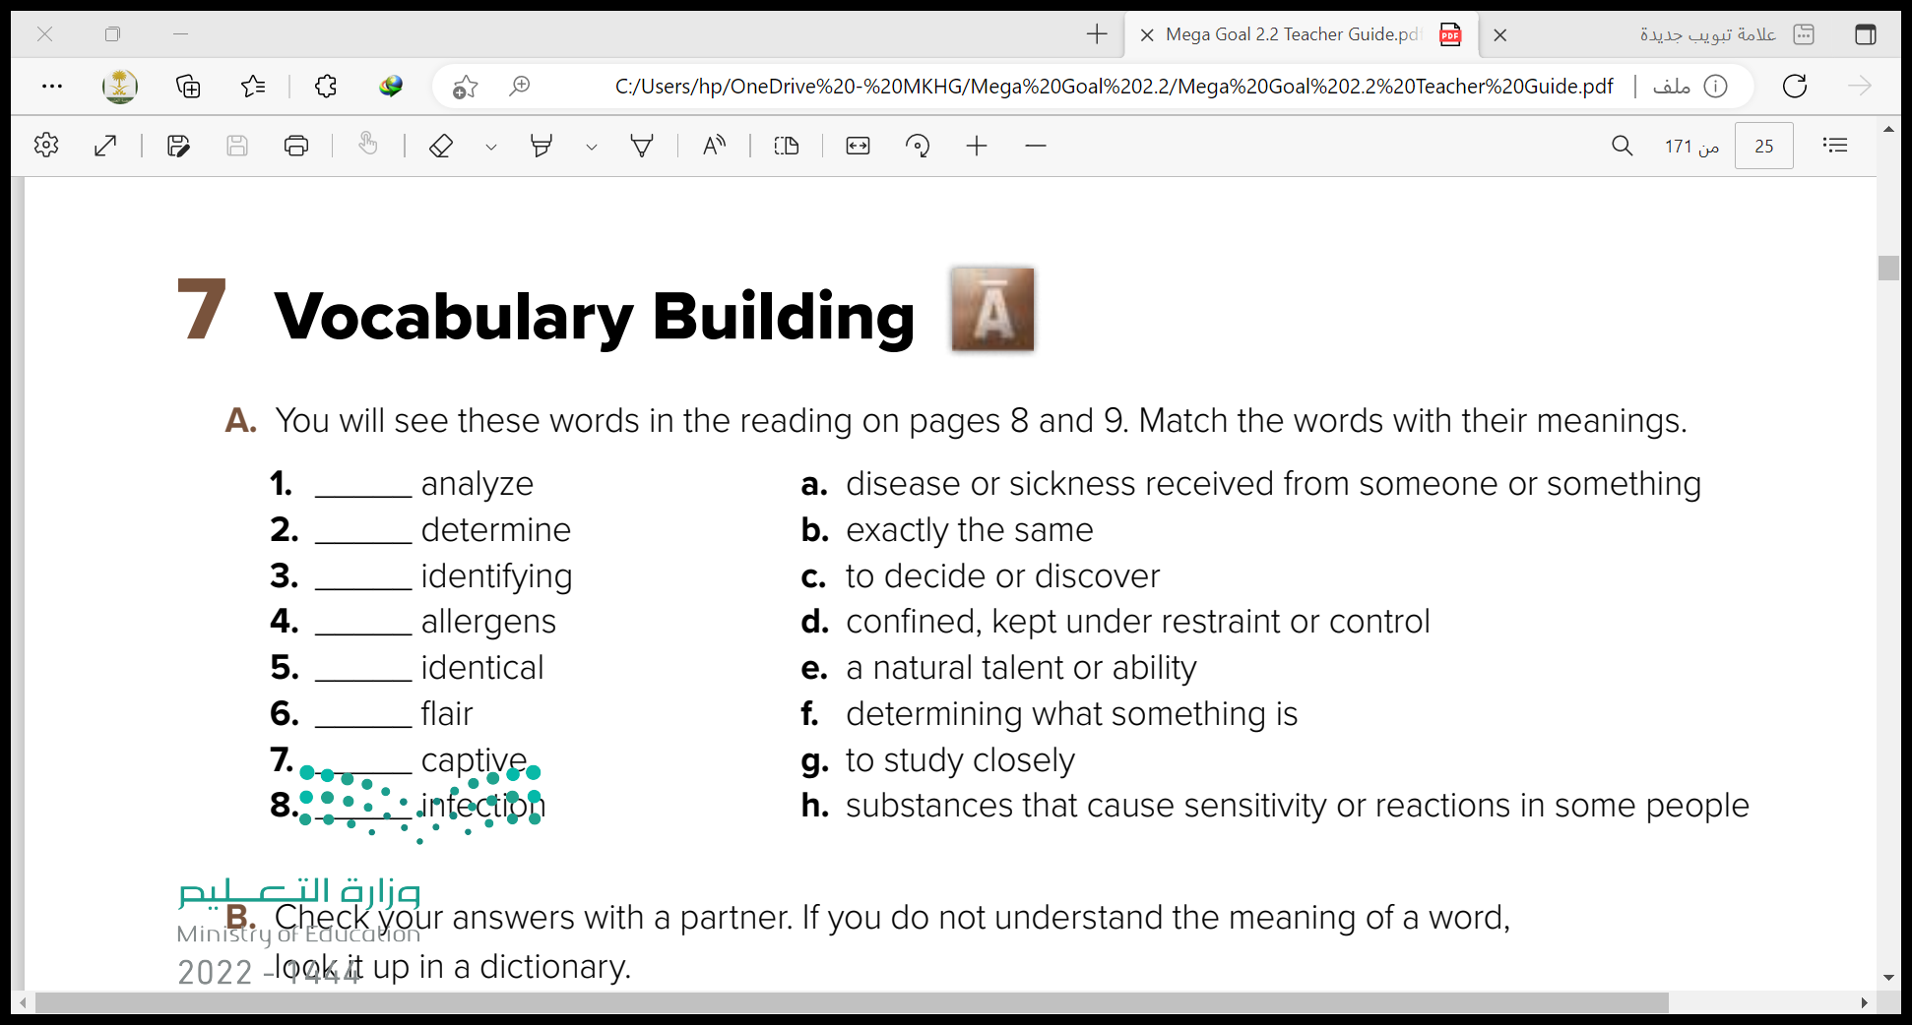
g
c
f
h
b
e
d
a

Slide 13


