Slide 1

Unit 5
Since When?
Grammar
Page 50

Slide 2




Present Perfect Vs Past Simple
How Long
For Since

Slide 3



Present
Past
Future
Simple
Simple
Simple
Progressive
Progressive
Progressive
Perfect
Perfect
Perfect

Slide 4

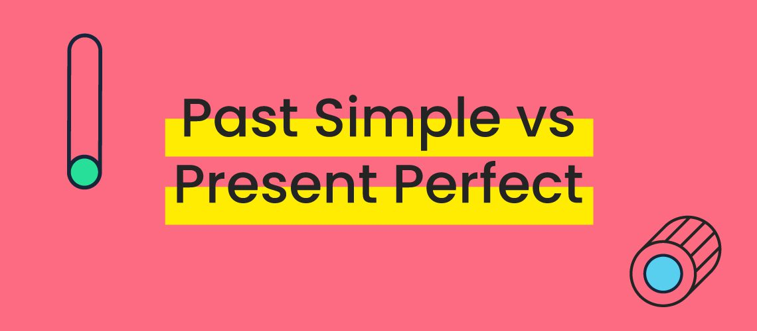

Slide 5
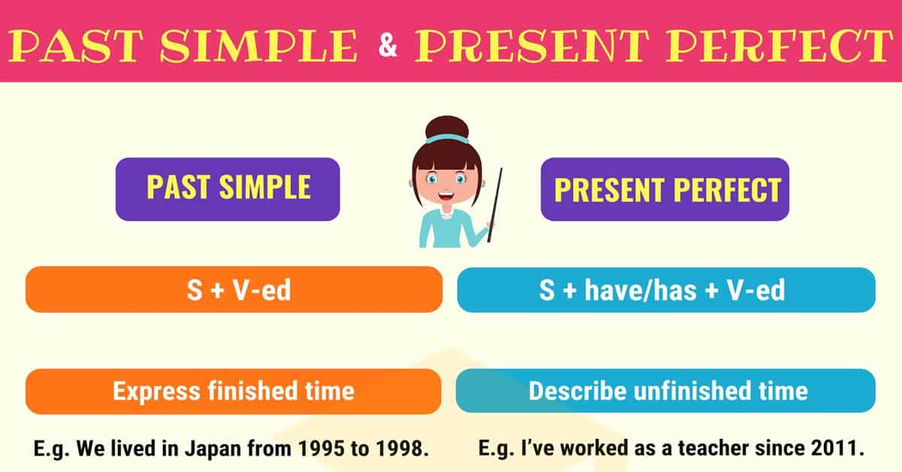

Slide 6
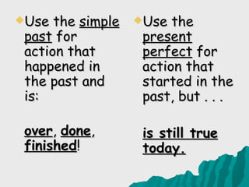
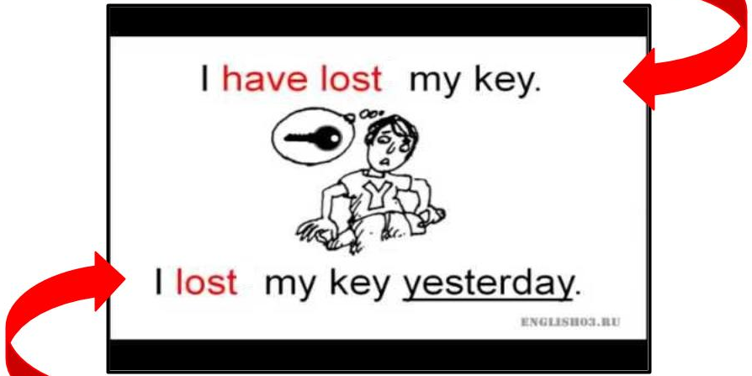

Present Perfect
Past Simple
We use the Present Perfect to talk about past actions when the exact time isn’t known. We use the Past Simple when the time is given.

Slide 7
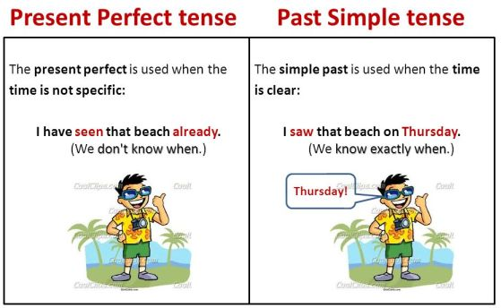

Slide 8
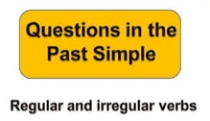


What did they eat for dinner ?
What did they watch last night ?
They ate pizza
They watched cartoons

Slide 9



Slide 10

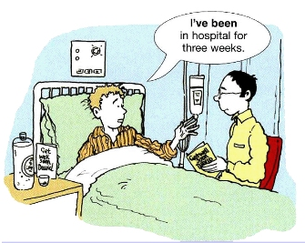

I’ve been in hospital since October
I’ve been in hospital for two weeks

Slide 11
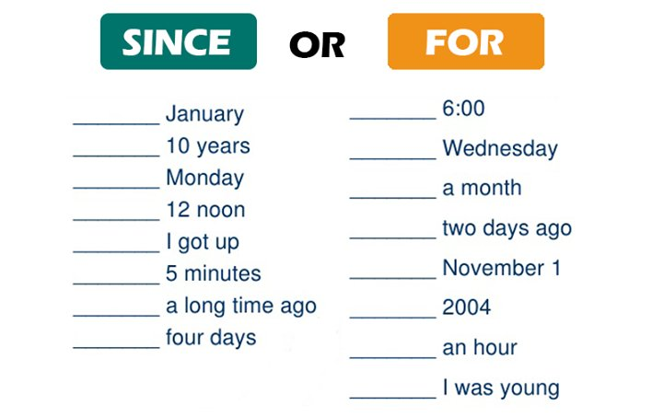


Slide 12
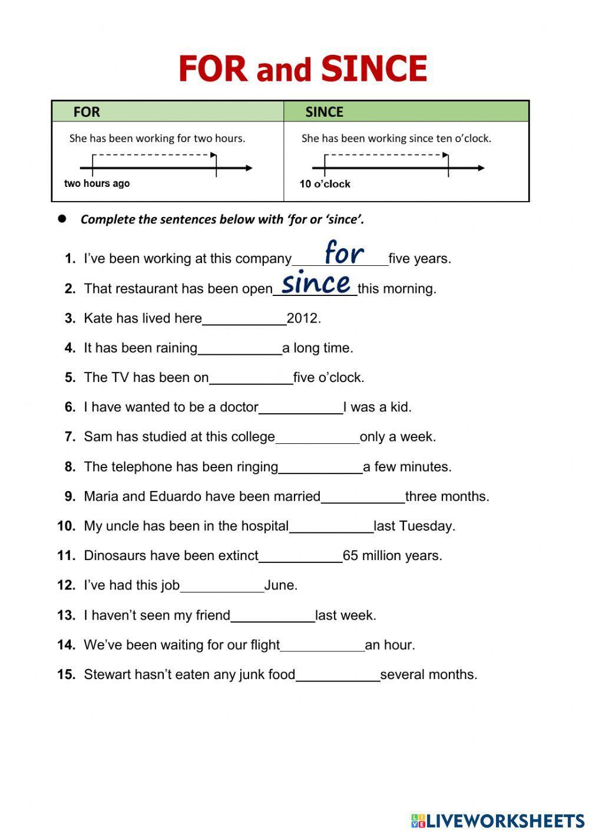


Slide 13



How Long

Slide 14
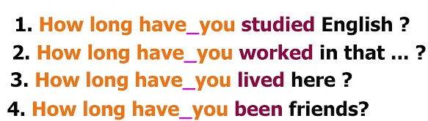


I have studied English…..
I have worked in this…..
I have lived here…..
We have been
friends…..

Slide 15


Page 198 B, C
Page 199 E, F
Tr.Kholud

Slide 16
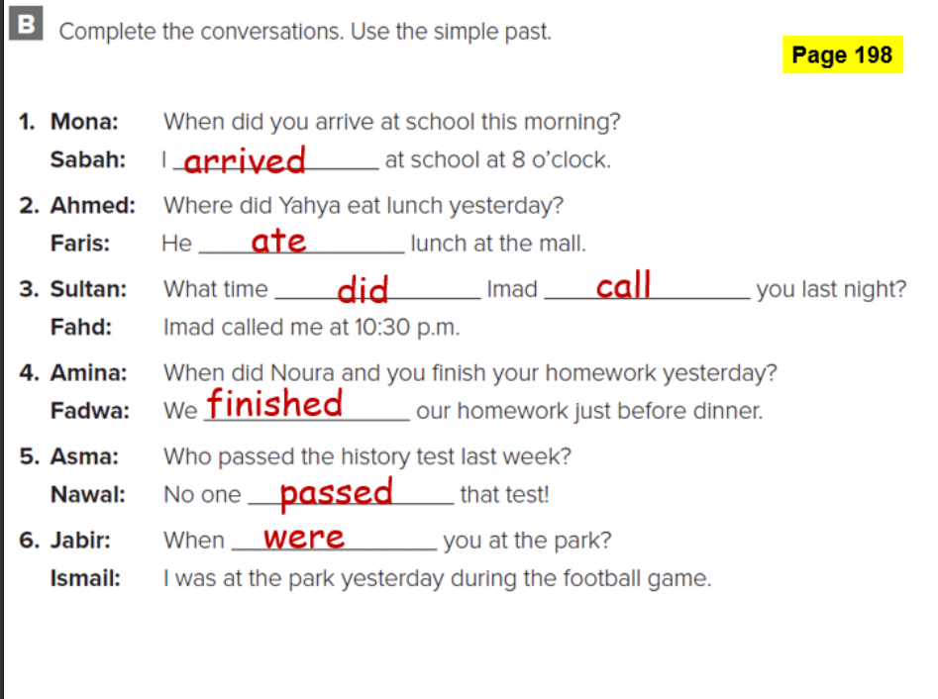
الحاميها

Slide 17
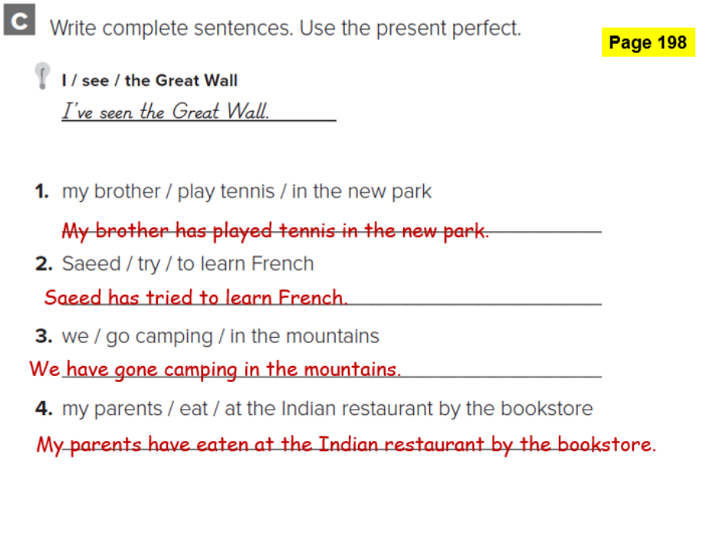
الحاميها

Slide 18
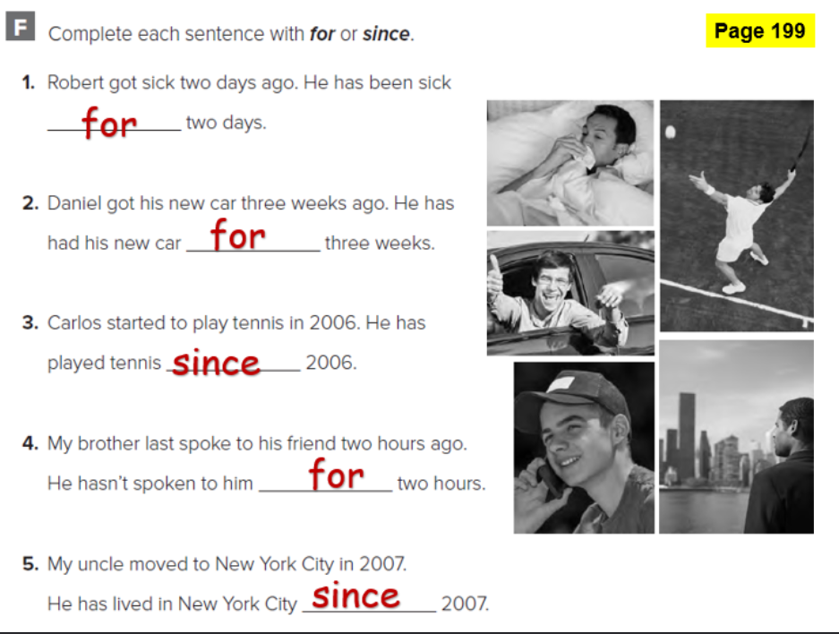
الحاميها

