Slide 1

Unit 5
Since When?
Page 48, 49

Slide 2


Slide 3


Learning Objectives
Find out technology Vocabulary
Name the invention in each picture
Skim for some dates
Answer questions after listening

Slide 4
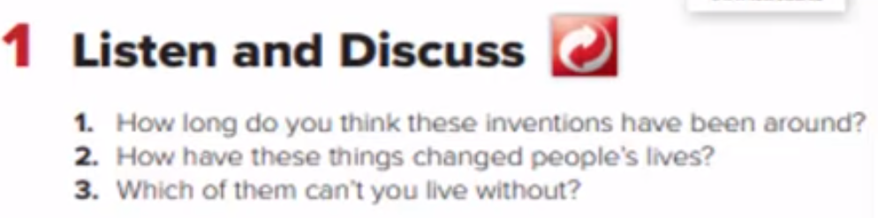
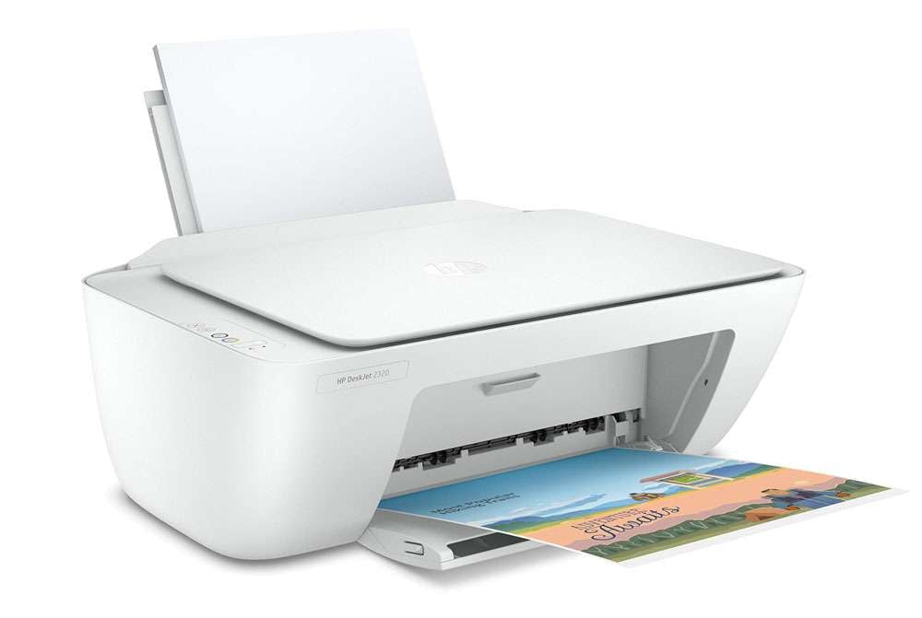
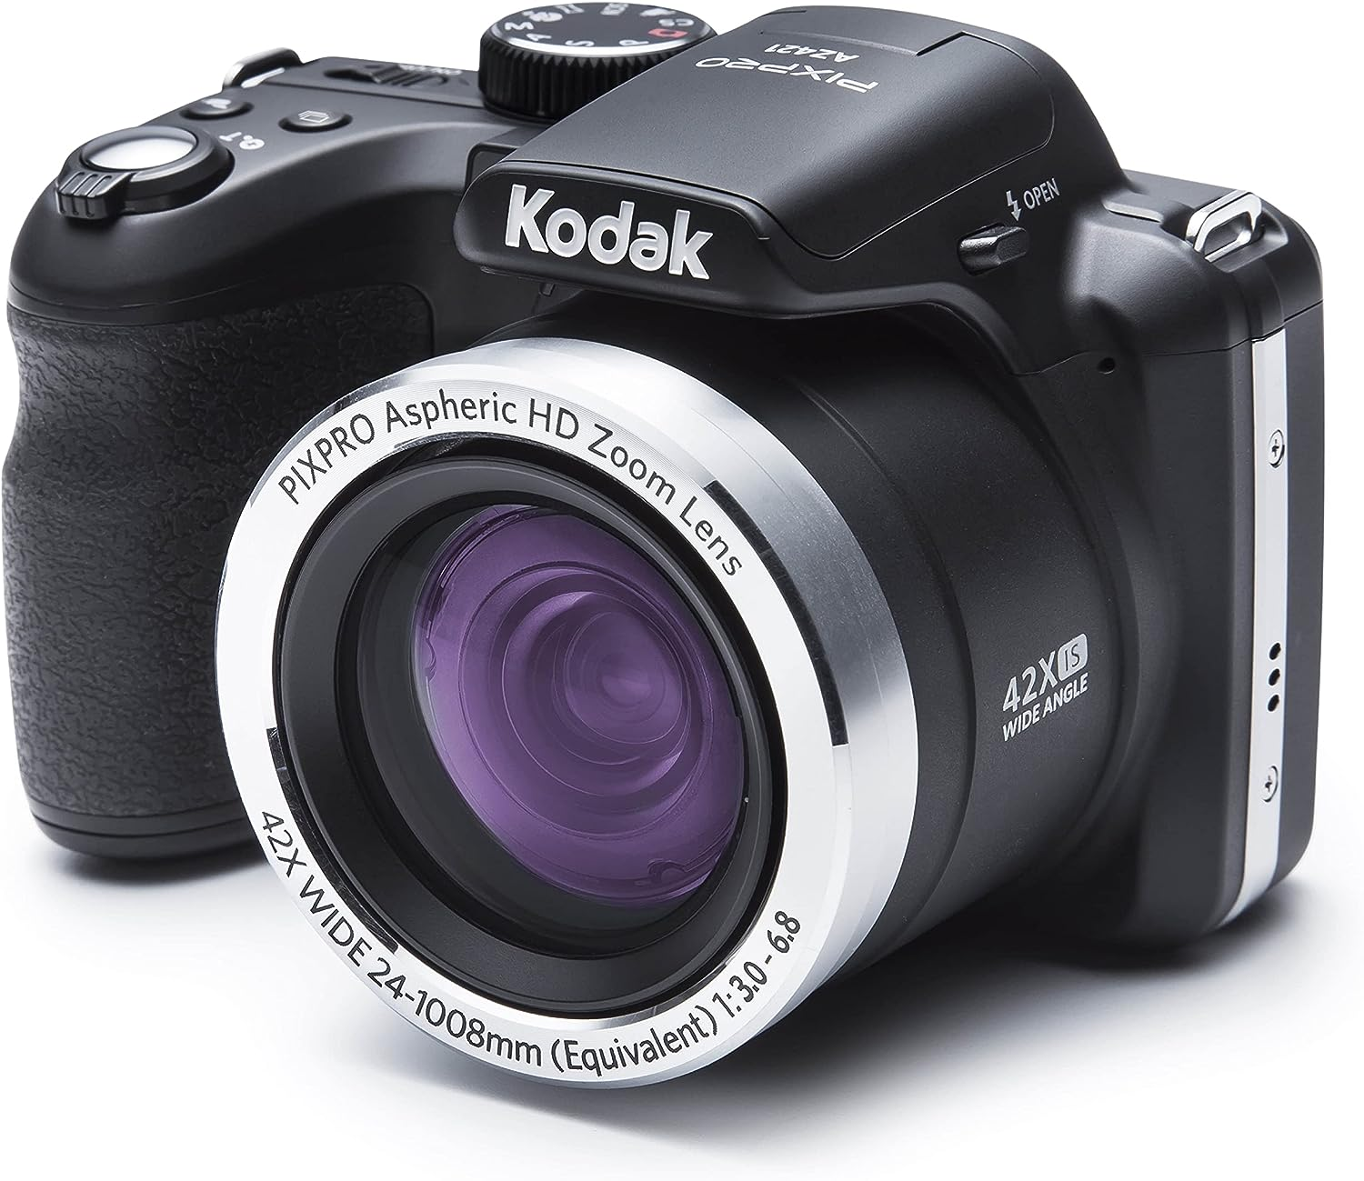
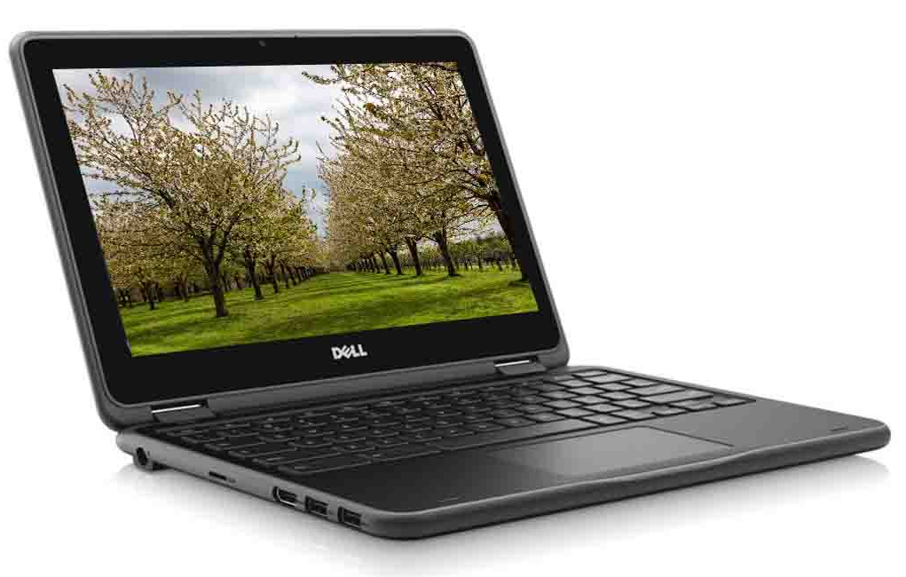
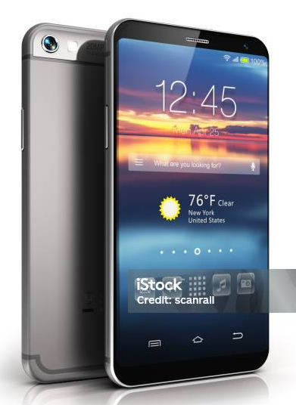
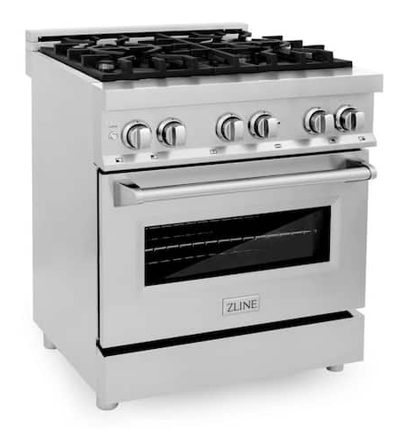
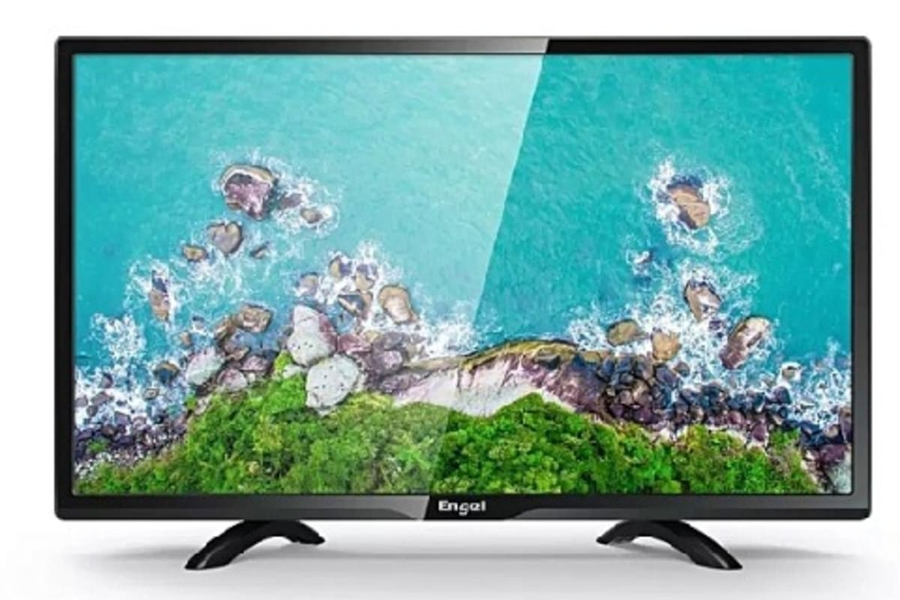
Printers
Computers
Cameras
Stoves & Ovens
Televisions
Cell Phones

Slide 5
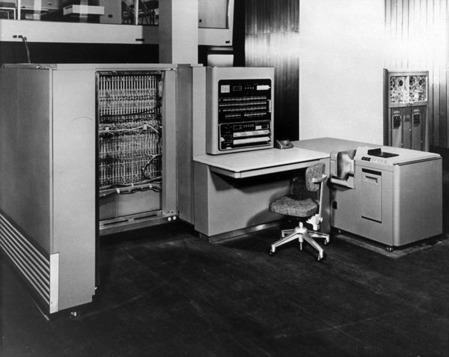
Computers
huge
light
1.How long has IBM produced successful computers ?
Since 1953
huge
The IBM computer was ……………… and……………….
but now laptop computers have become ………………., ……………… and ………………
slow
smaller
faster
lighter

Slide 6
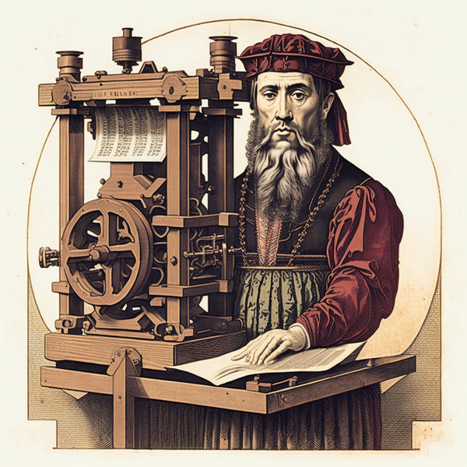
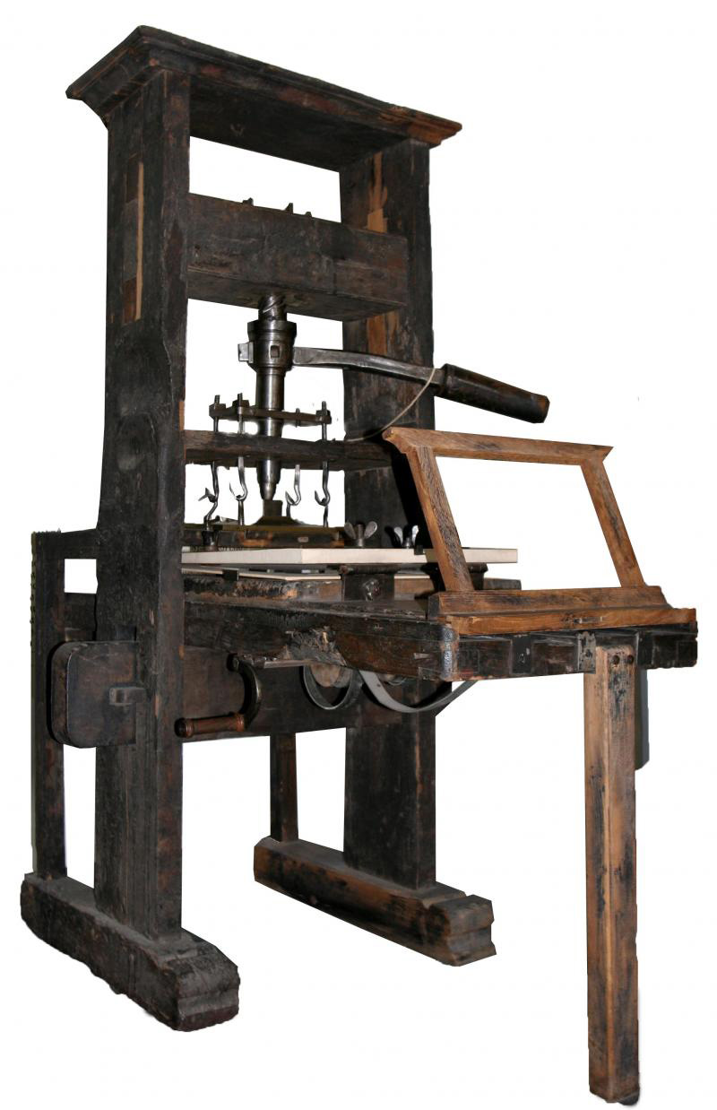
Printers
portable
high-tech
2.How long has printers been around ?
Since 1440
small
portable
Nowadays,……………… and……………….,
……………………… printers can be found in offices and homes.
high-tech

Slide 7
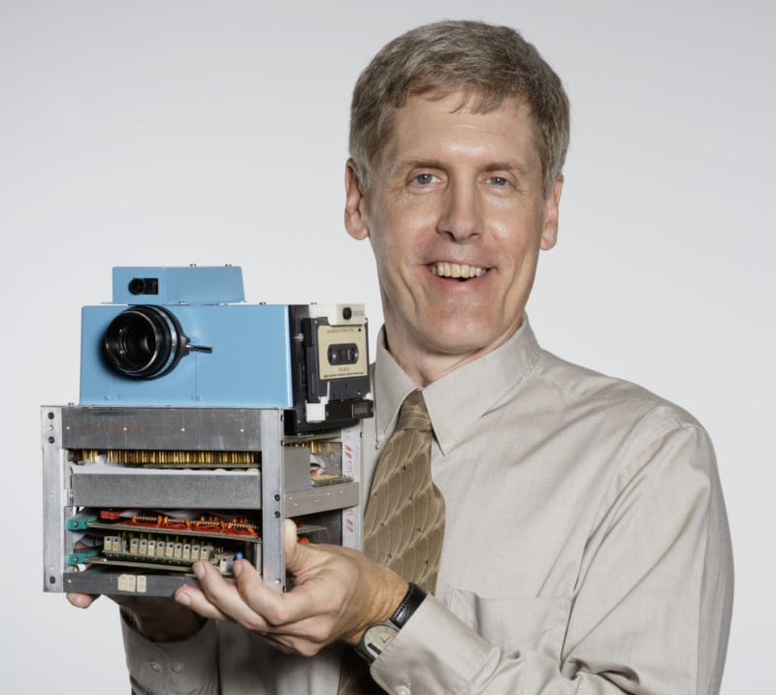
Cameras
digital
image
5.How long have cameras been on the market?
Since 1975
Which colour was the image captured by Sasson ?
Black-and-white image

Slide 8
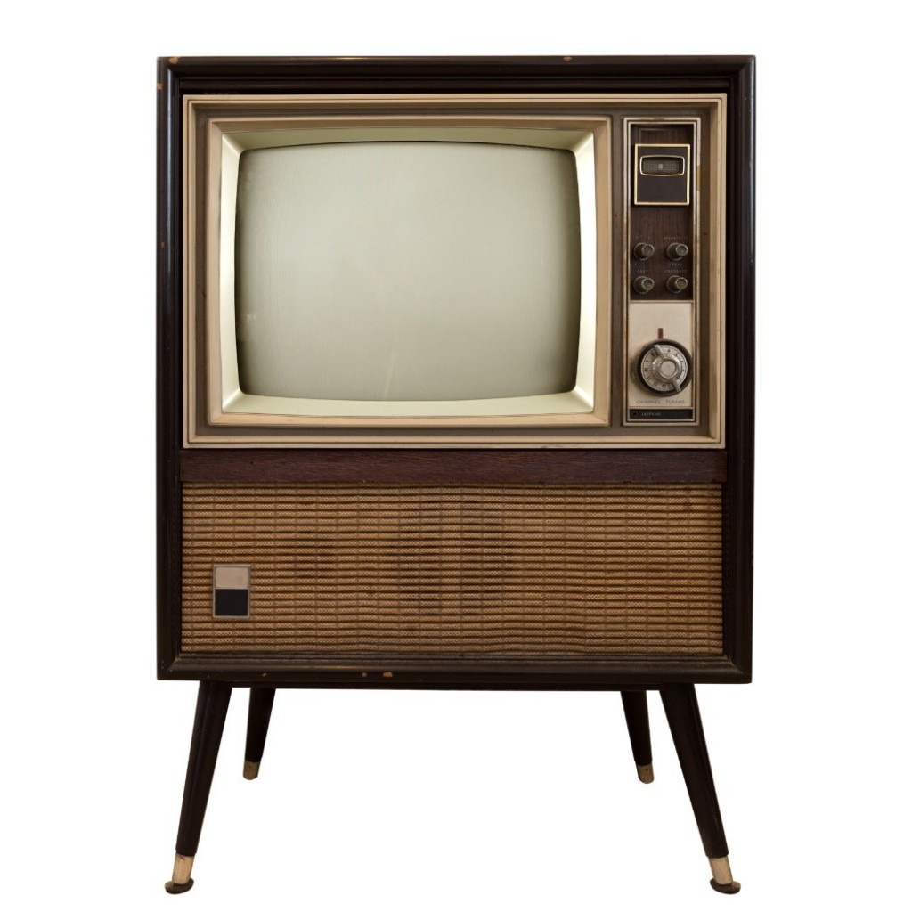
Televisions
household
device
3.How long have TVs been common in homes?
Since 1960
The television set has become a common …………………. ………………………
household
device

Slide 9
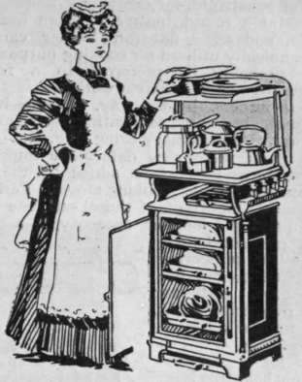
Stoves & Ovens
conventional
4.How long ago did the first microwave appear in homes ?
In 1967 /56 years ago
faster
The microwaves could cook food ………… than conventional ovens

Slide 10
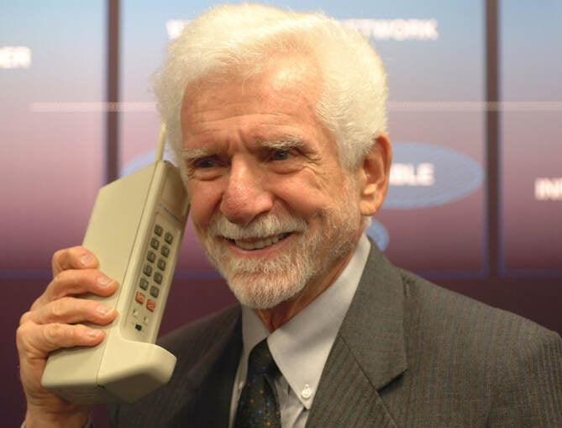
Cell Phones
clumsy
6.For how many years have people had cell phones?
Since 1970 / 53 years
What was the first model called ?
The brick

Slide 11
huge
not heavy
light
picture
high-tech
normal
image
very big
household
for the house
device
not good
conventional
best technology
clumsy
appliance

Slide 12
huge
very big
light
not heavy
high-tech
best technology
image
picture
household
for the house
device
appliance
conventional
normal
clumsy
not good

Slide 13


Work Book page 197
Tr.Kholud

Slide 14
