Slide 1
Unit4 lesson1
p.P by teacher: Huda alatwi

Slide 2
هنا حطيت فيديو لكن حذفته عشان الموسيقى
انتو اختاروا بكيفكم

Slide 3
Today we gonna talk about how you can ask any body about his age?
How old are you?

Slide 4




Hello nice to meet you my name is Huda I will told you my family ages

Slide 5

















This is my mom
She is thirty-four years old

Slide 6

This is my dad
He is forty years old

Slide 7
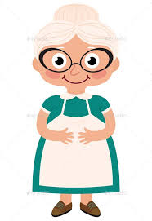
This is my grandma
He is seventy years old

Slide 8
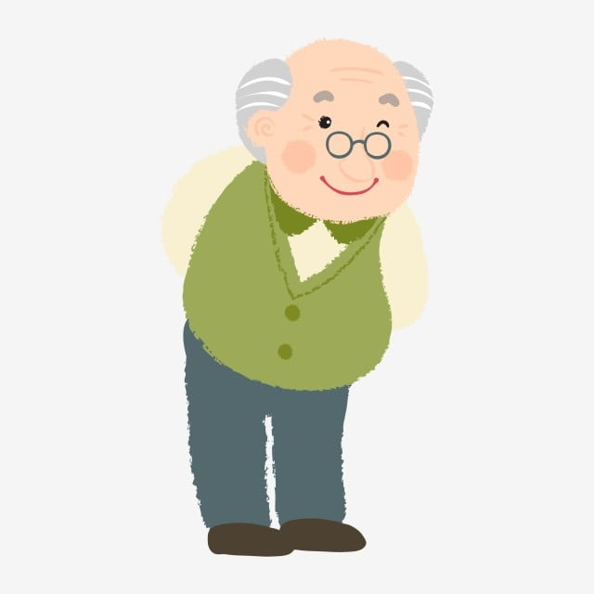
This is my grandpa
He is seventy five years old

Slide 9

This is my big sister
Her name is Sara
She is sixteen years old

Slide 10

This is my little brother
His name is mohammed
He is one years old

Slide 11
Ok this was my family ages , now can you tell me
How old are you ?

Slide 12
الهدف الديني
قال رسول الله ﷺ: لا تزول قدما عبد يوم القيامة حتى يسأل عن عمره فيم أفناه؟ وعن علمه فيم فعل فيه؟ وعن ماله من أين اكتسبه؟ وفيم أنفقه؟ وعن جسمه فيم أبلاه؟[1

Slide 13

Homework
Draw your family and tell me your family ages in video

