Slide 1


Welcome to class
T.

Slide 2

1
Unit 1

Slide 3




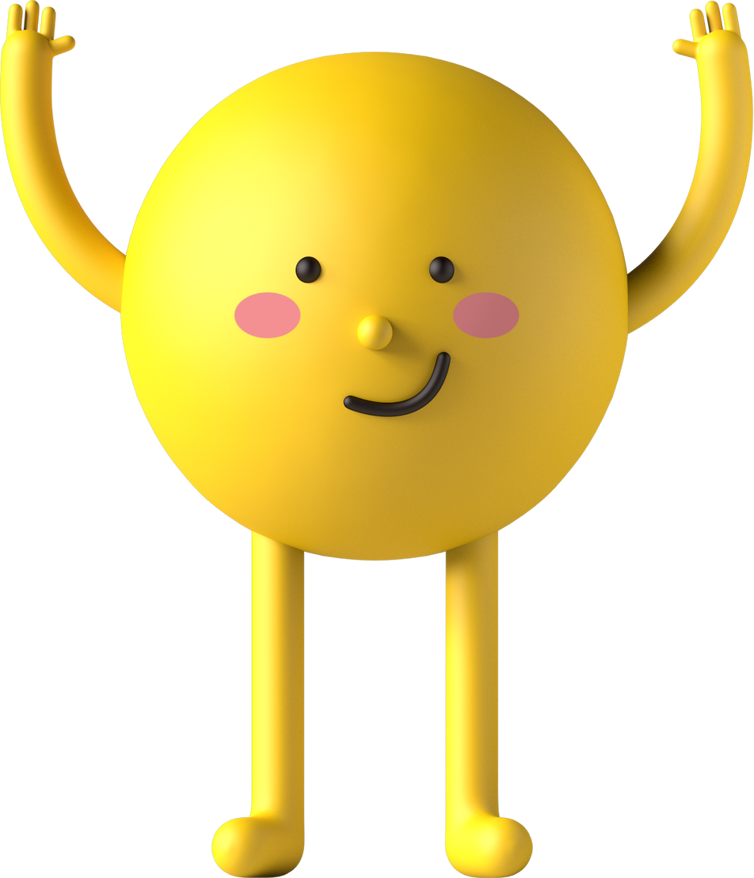
workbook
Pages 49 , 50

Slide 4

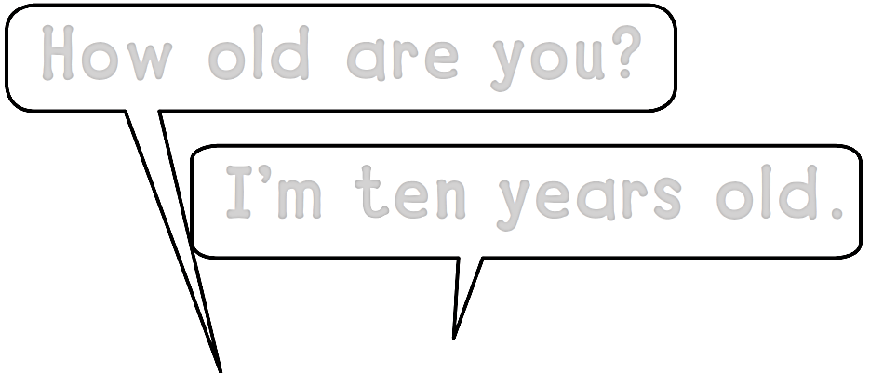
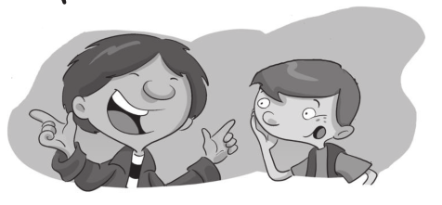

How old are you?
I΄m ten years old.
I΄m nine years old.

Slide 5

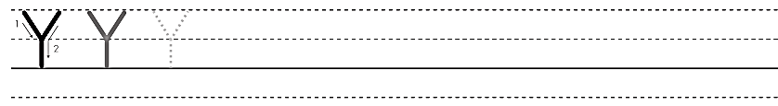
Y Y Y Y Y Y Y Y

Slide 6
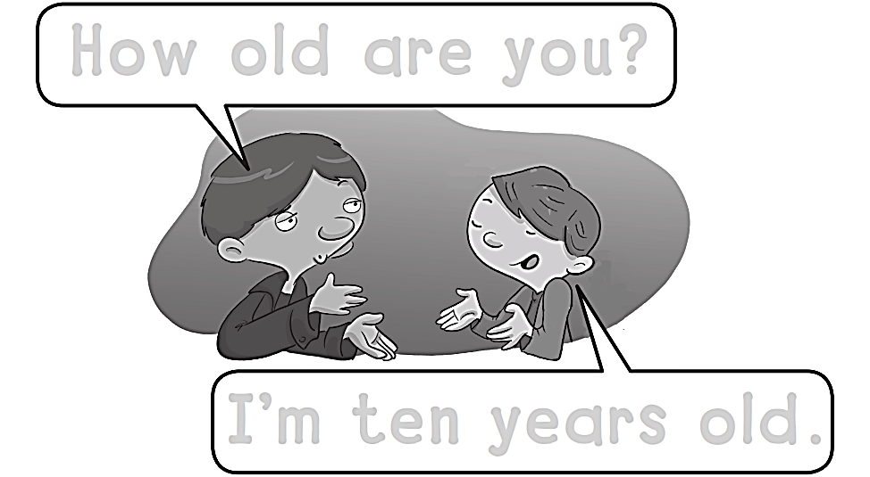
How old are you?
I΄m ten years old.

Slide 7

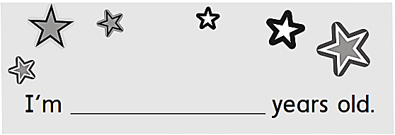
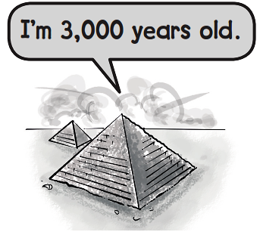
TEN

Slide 8
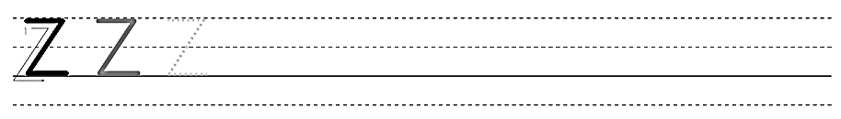
Z Z Z Z Z Z Z

Slide 9
workbook
Pages 51 , 52

Slide 10


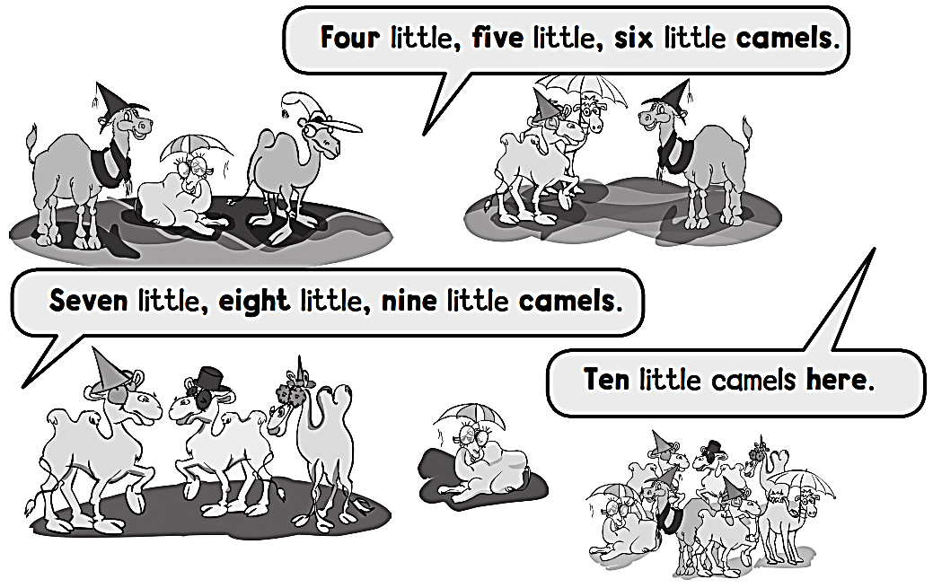
One little , two little,
Three little camels.

Slide 11
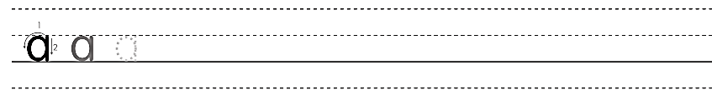
a a a a a a a a a a

Slide 12

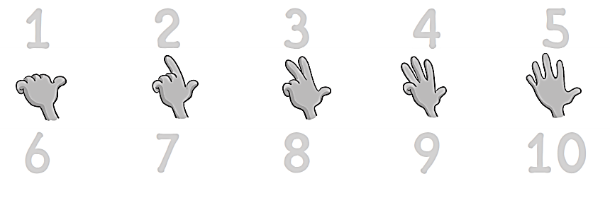
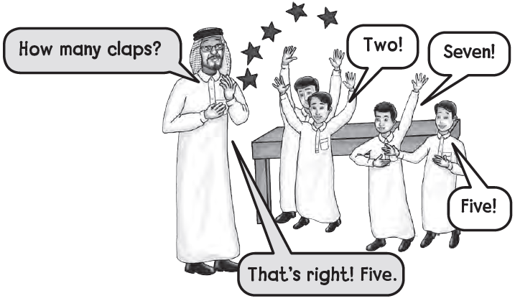
1
2
3
4
5
6
7
8
9
10

Slide 13
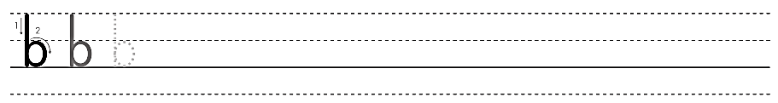
b b b b b b b b b

Slide 14
workbook
Pages 53 , 54

Slide 15
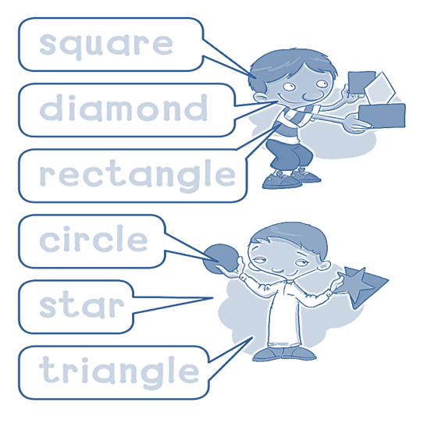

square
diamond
rectangle
circle
star
triangle

Slide 16
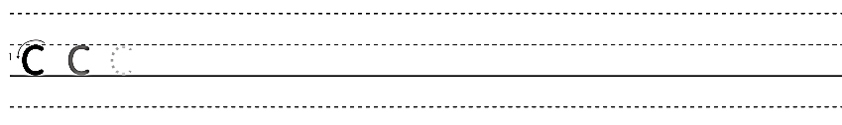
c c c c c c c c c c

Slide 17

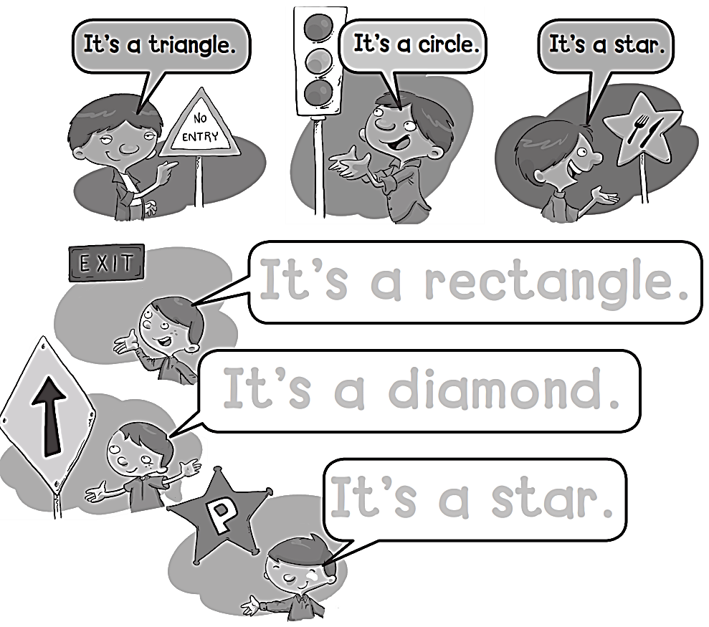
It’s a rectangle .
It’s a diamond .
It’s a star .

Slide 18
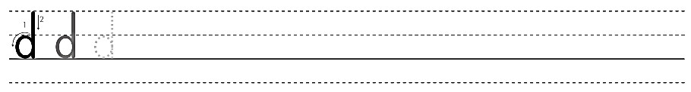
d d d d d d d d d

Slide 19
workbook
Pages 55 , 56

Slide 20

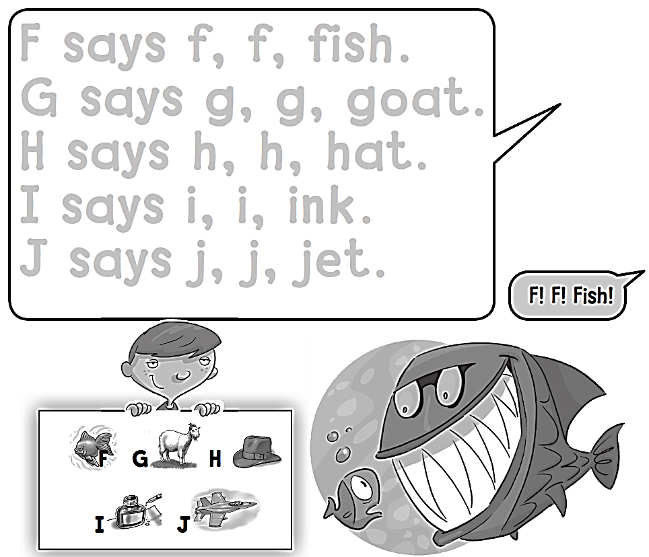
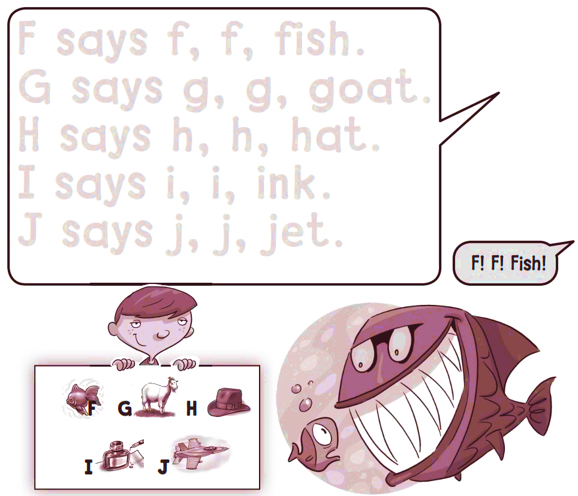

Slide 21
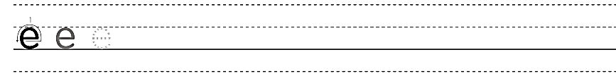
e e e e e e e e e e

Slide 22

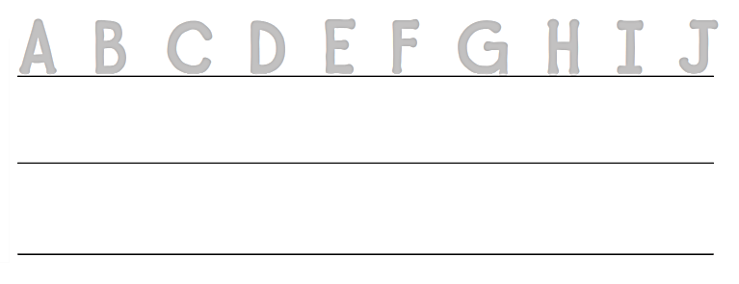
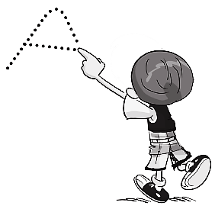
A B C D E F G H I J
A B C D E F G H I J

Slide 23
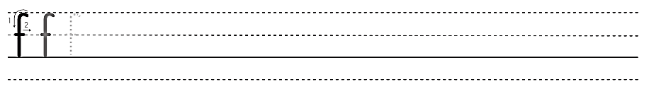
f f f f f f f f f f f f f f

Slide 24


