Slide 1
Welcome to class
T.

Slide 2
1
Unit 3

Slide 3
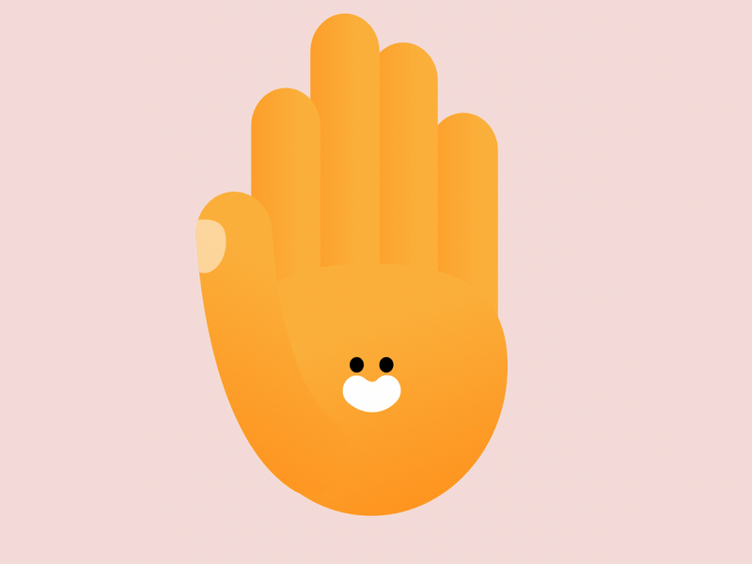
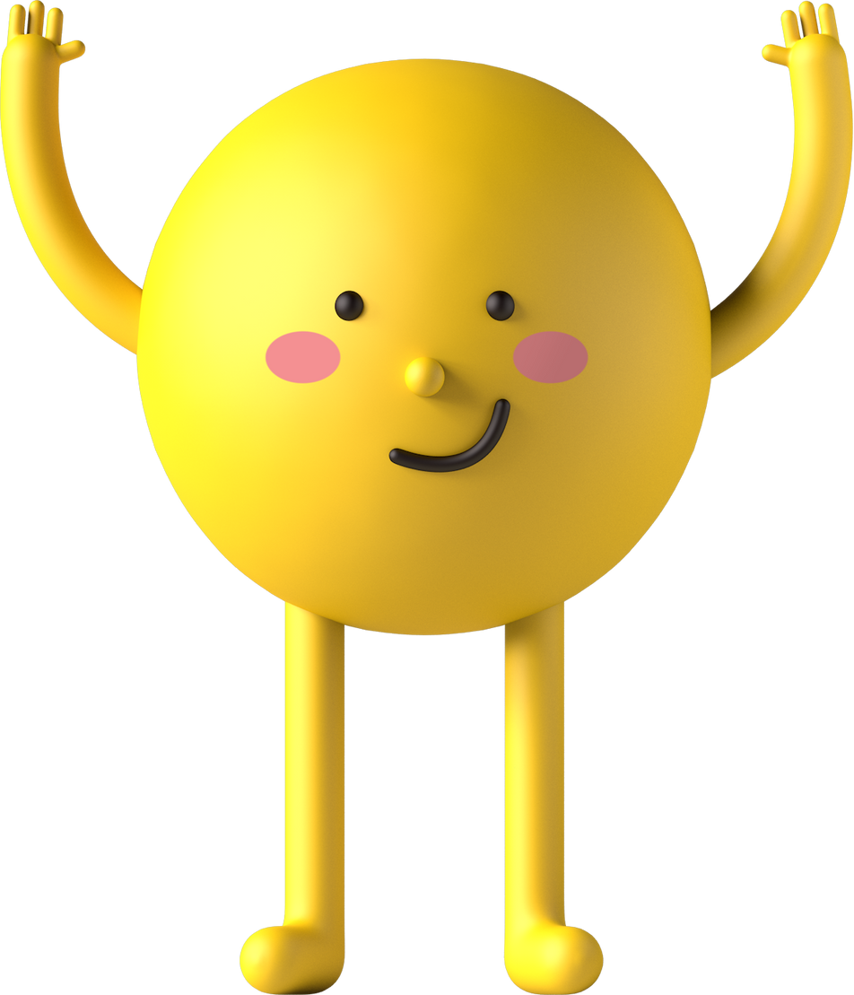
workbook
Pages 65 , 66

Slide 4
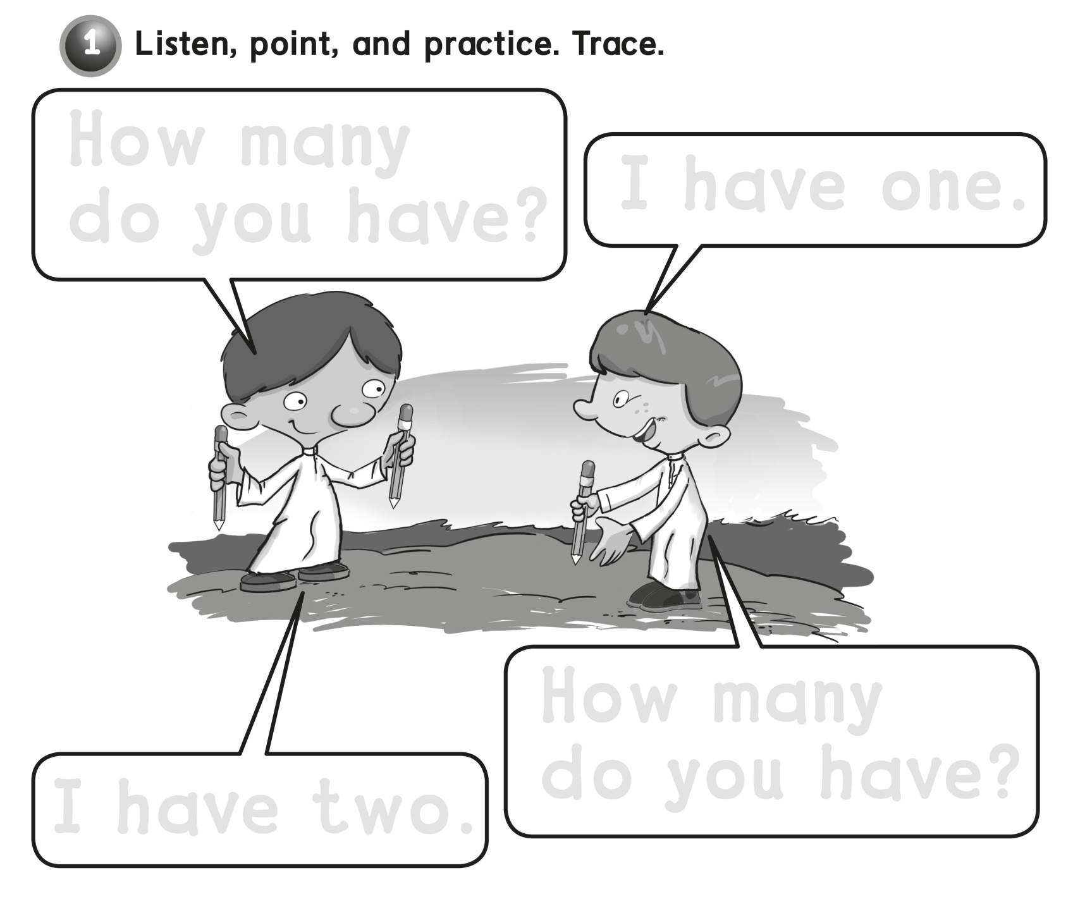
How many
do you have ?
I have one .
How many
do you have ?
I have two .

Slide 5
g g g g g

Slide 6
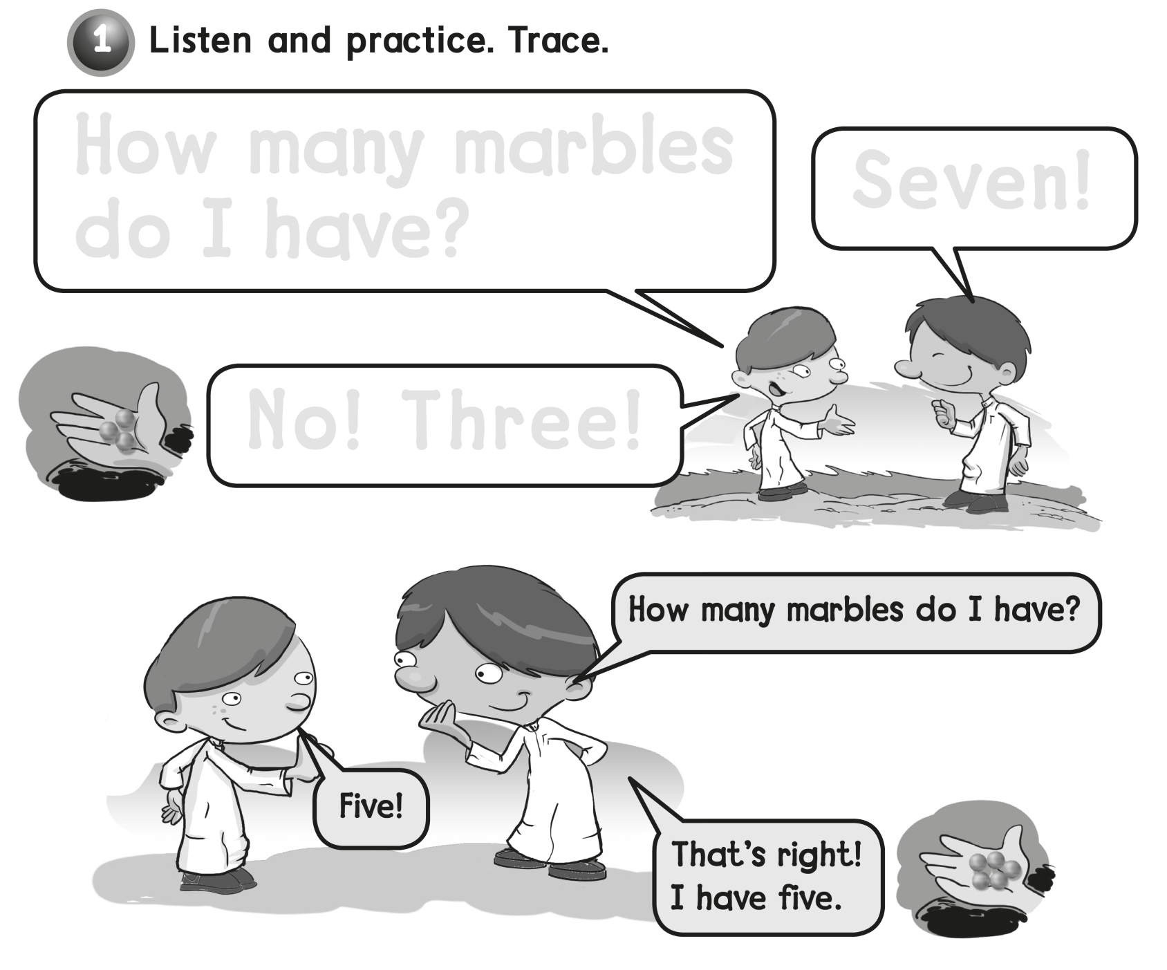
How many marbles
do I have ?
Seven !
No ! Three !

Slide 7
h h h h h

Slide 8
workbook
Pages 67 , 68

Slide 9
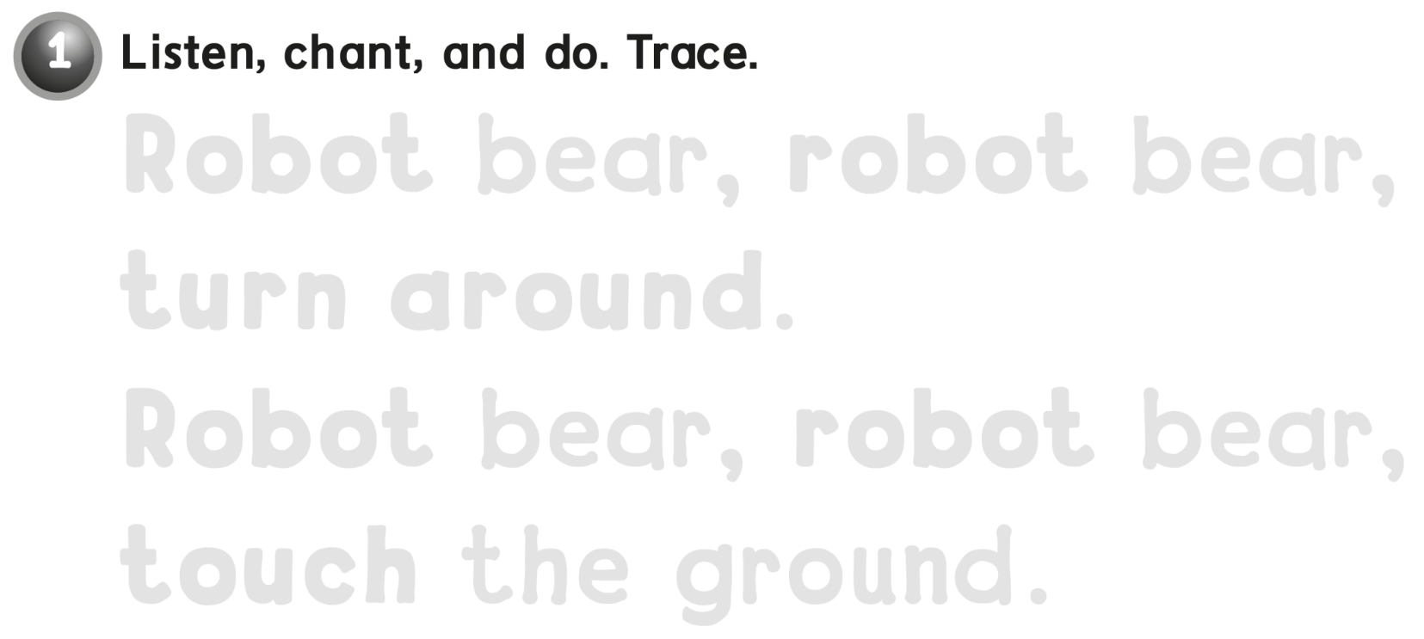
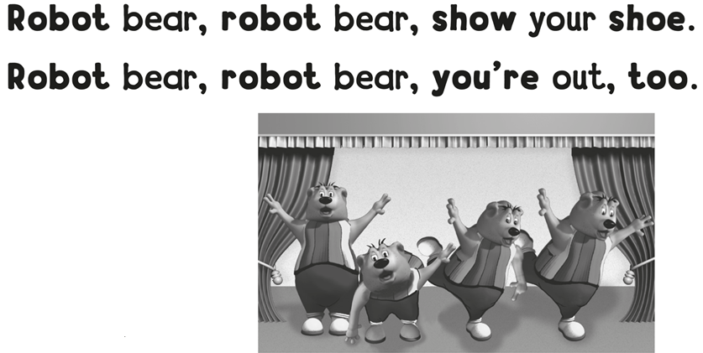
Robot bear , robot bear ,
turn around .
Robot bear , robot bear ,
touch the ground .

Slide 10
i i i i

Slide 11
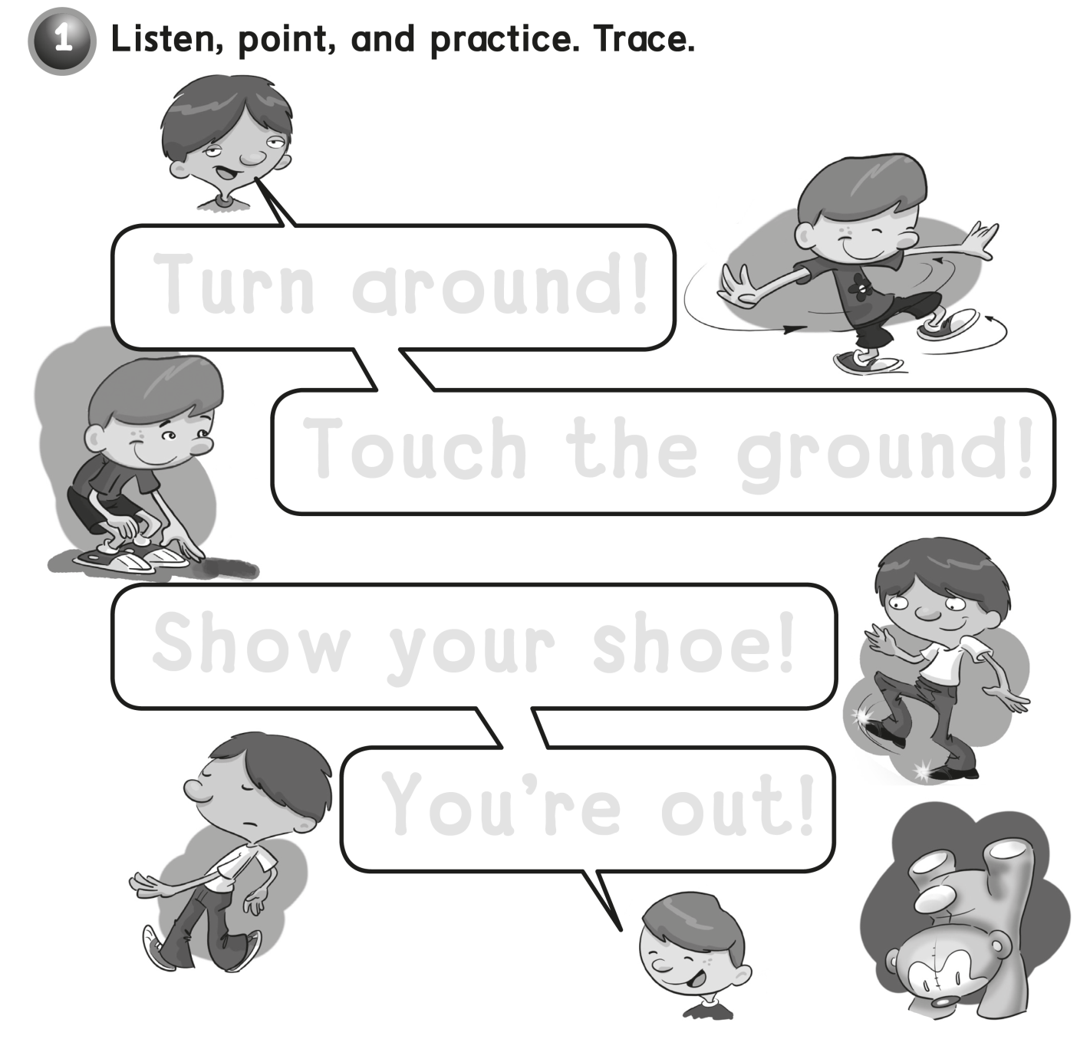
Turn around !
Touch the ground !
Show your shoe !
You’re out !

Slide 12
j j j j

Slide 13
workbook
Pages 69 , 70

Slide 14
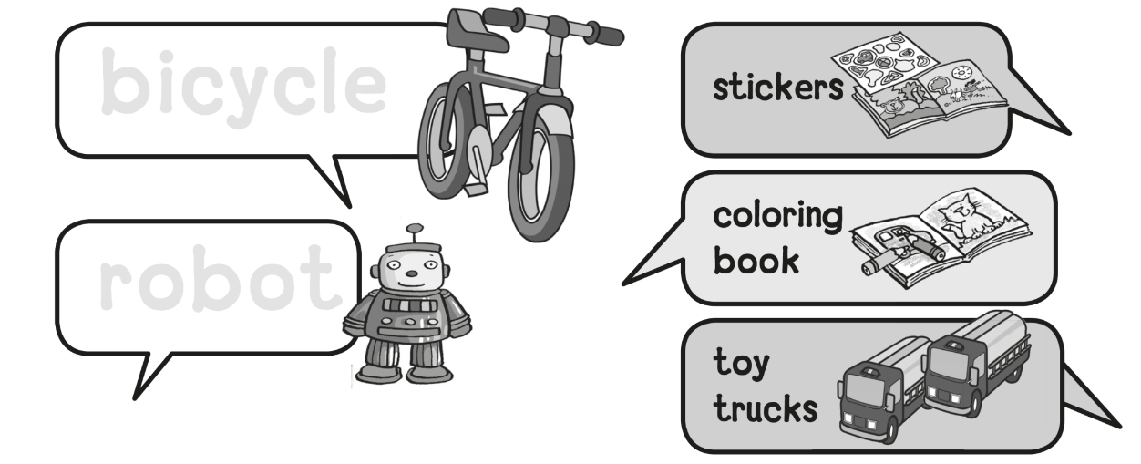
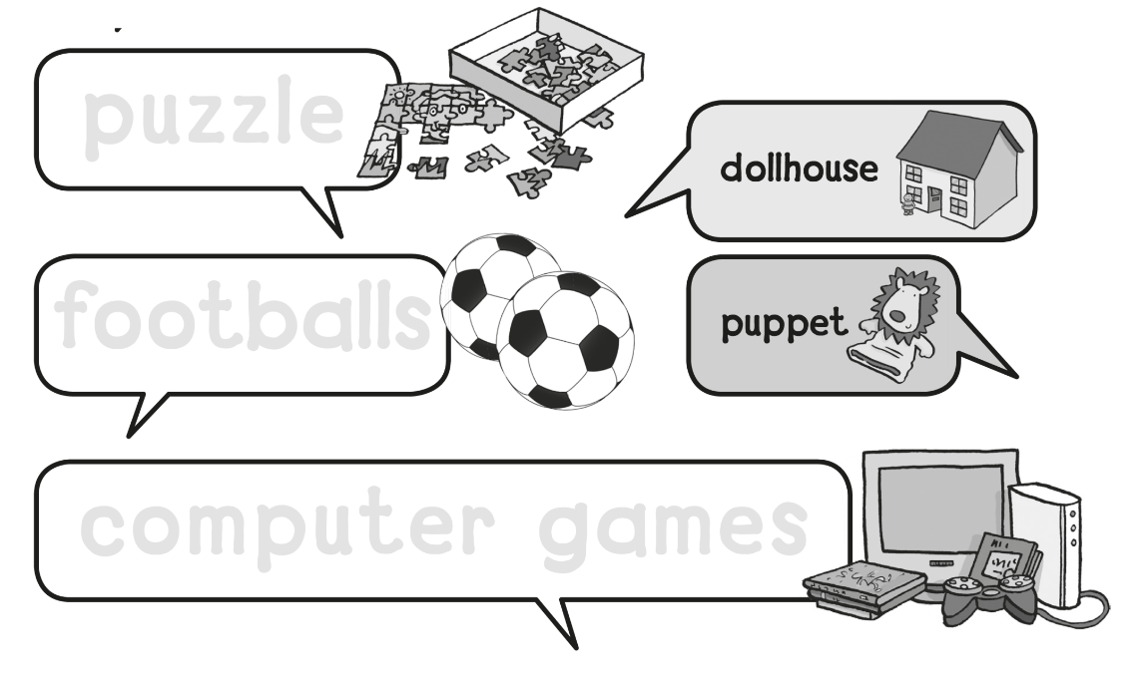
bicycle
robot
puzzle
Footballs
computer games

Slide 15
k k k k

Slide 16
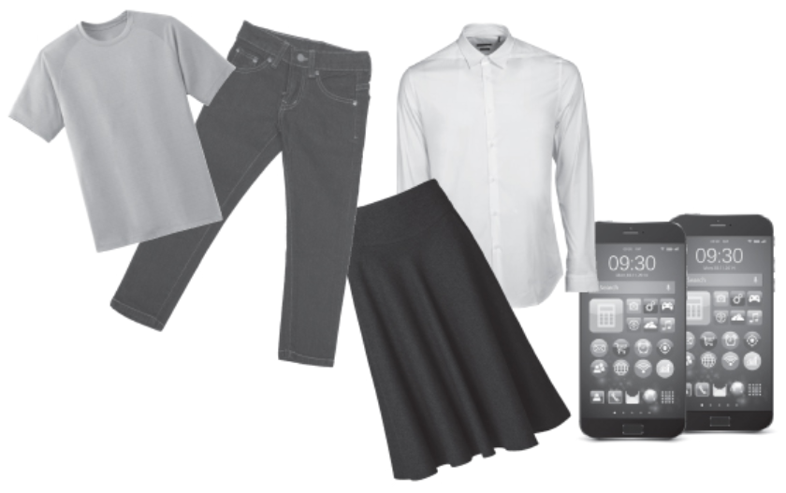
a shirt , a skirt , a T-shirt,
trousers, and cell phones

Slide 17
l l l l

Slide 18
workbook
Pages 71 , 72

Slide 19
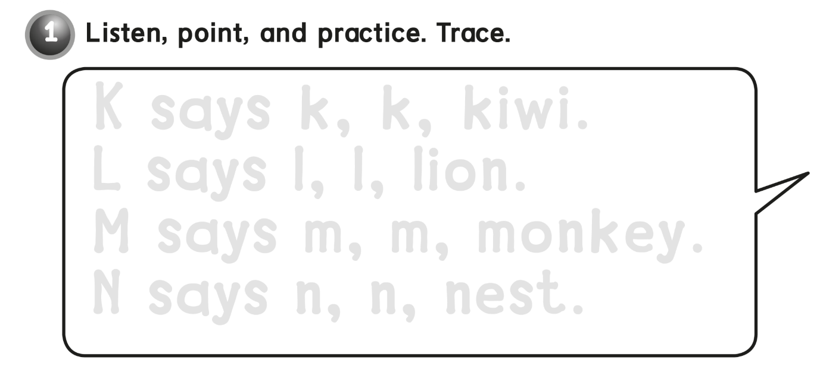
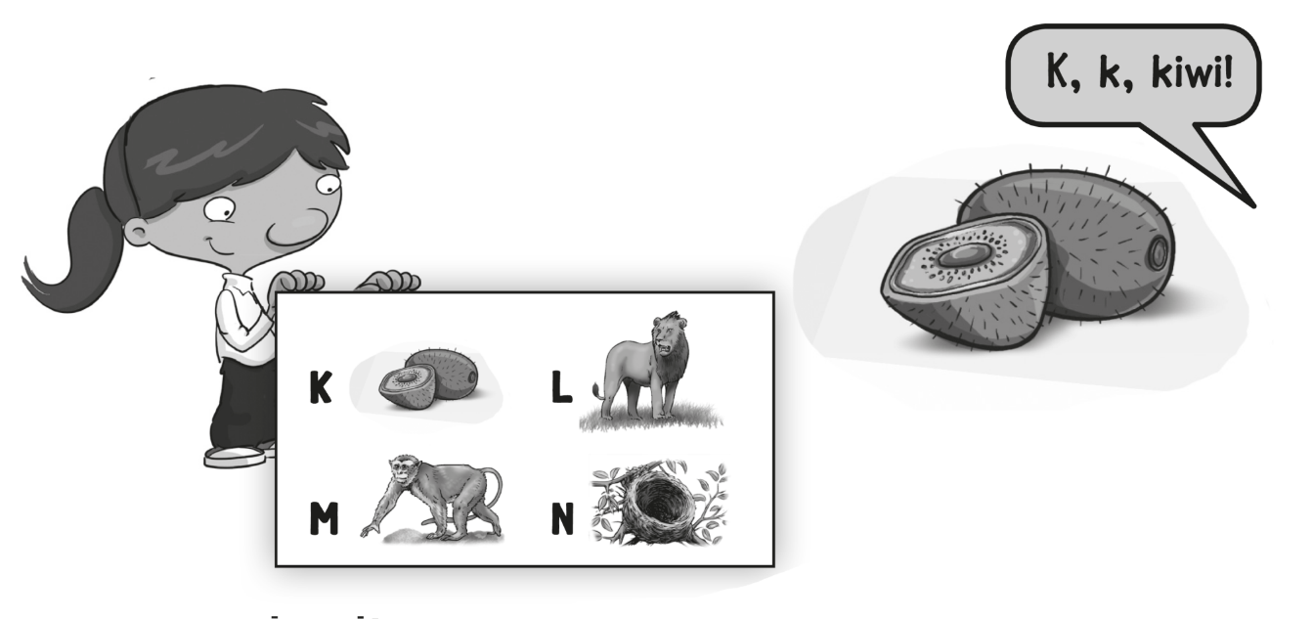
K says k , k , kiwi .
L says l , l , lion .
M says m , m , monkey .
N says n , n , nest .

Slide 20
m m m m

Slide 21
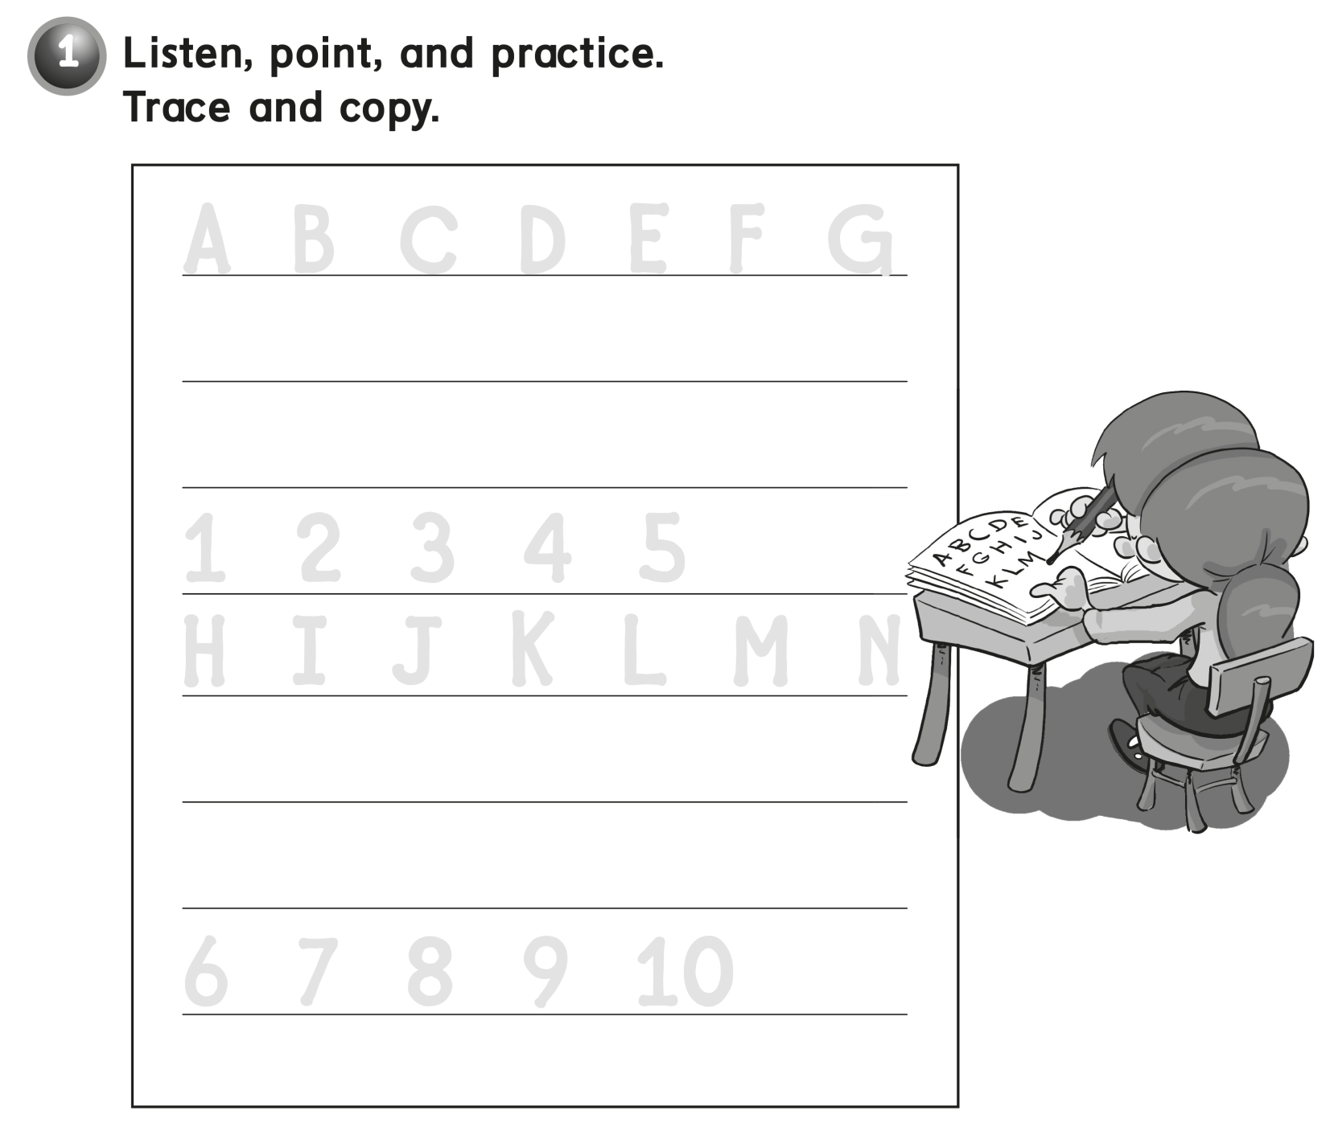
A B C D E F G
1 2 3 4 5
H I J K L M N
6 7 8 9 10

Slide 22
n n n n

