Slide 1


Welcome to class
T.

Slide 2

1
Unit 4

Slide 3





workbook
Pages 73 , 74

Slide 4

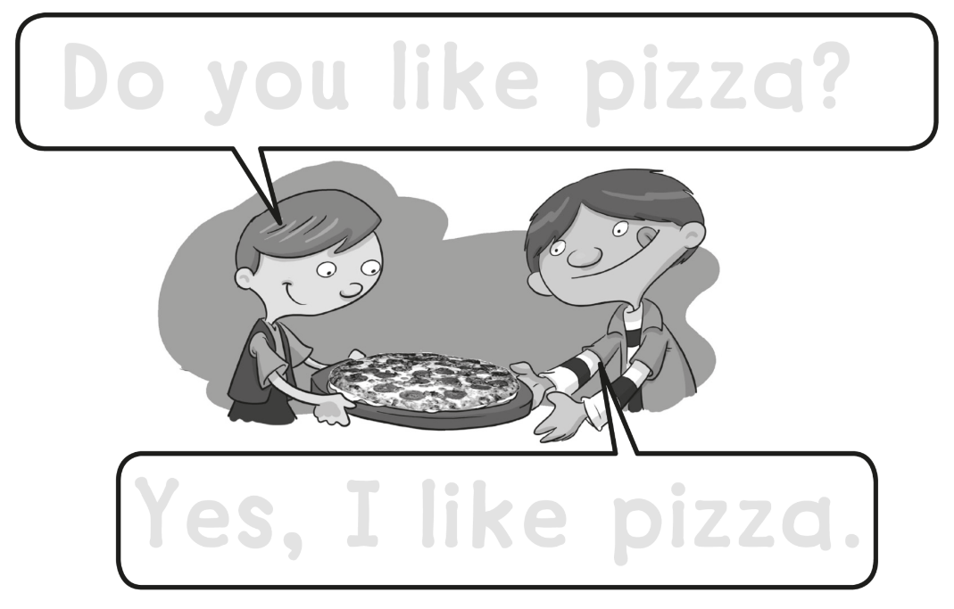
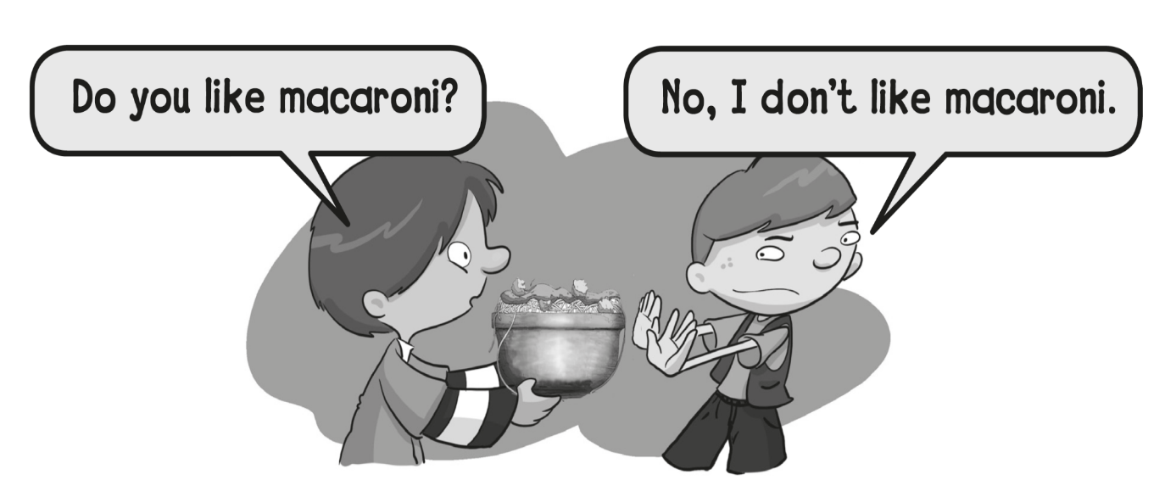
Do you like pizza ?
Yes , I like pizza .

Slide 5
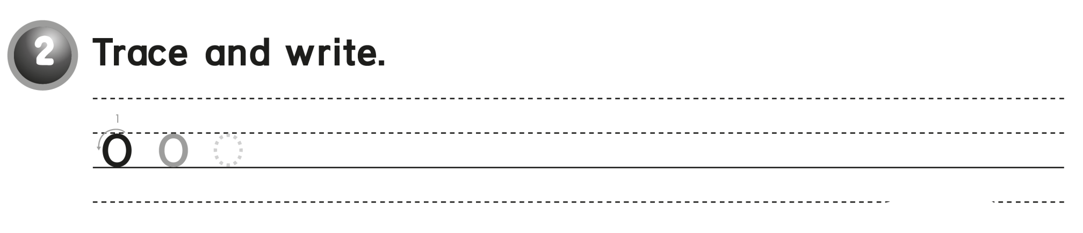
o o o o

Slide 6

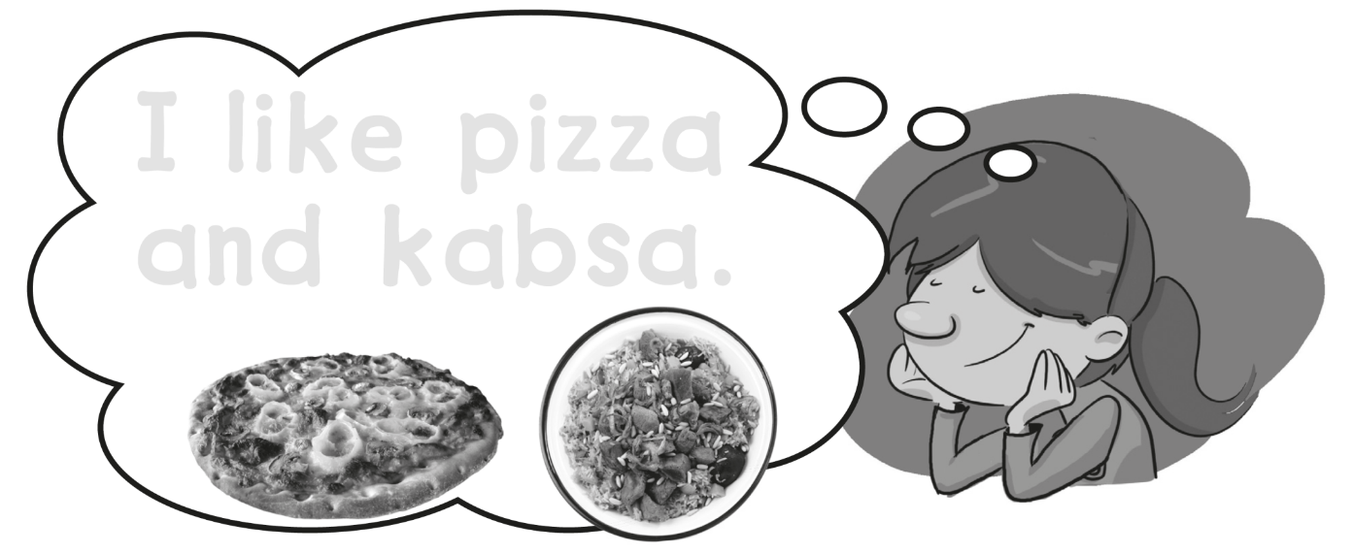
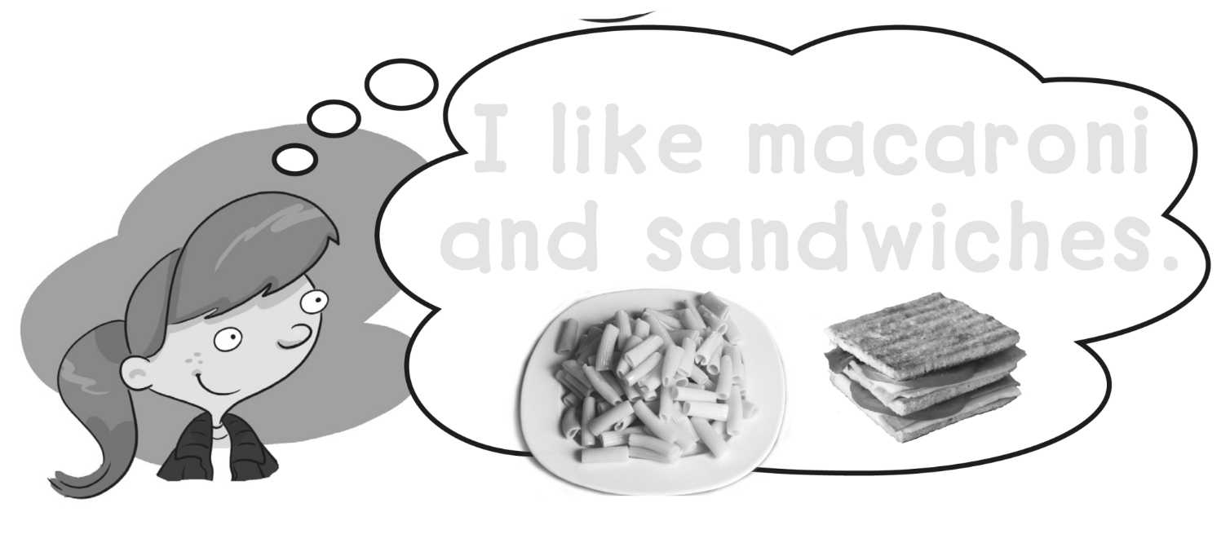
I like pizza
and kabsa .
I like macaroni
and sandwiches .

Slide 7
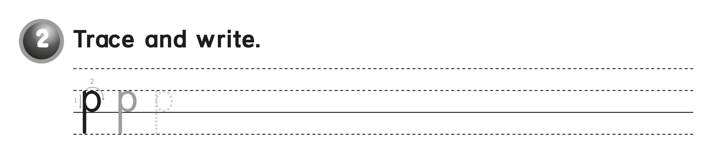
P P P P

Slide 8
workbook
Pages 75 , 76

Slide 9
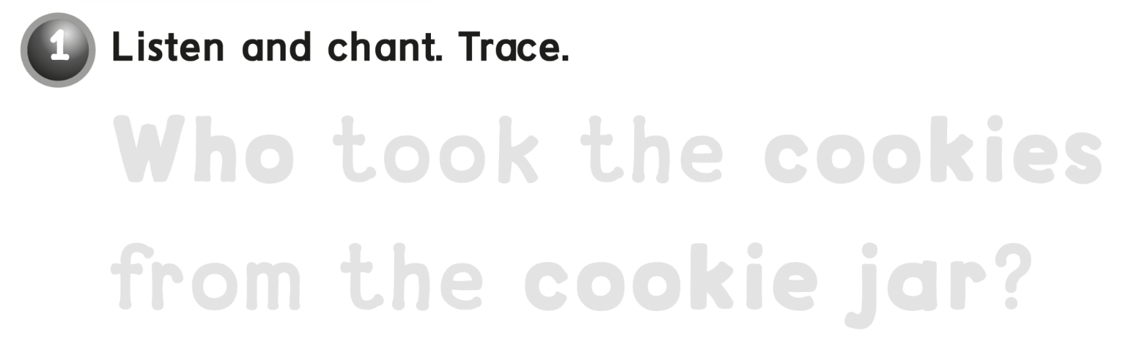
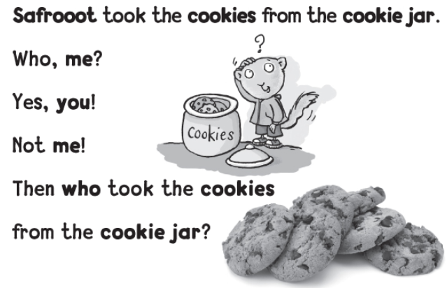
Who took the cookies
from the cookie jar ?

Slide 10
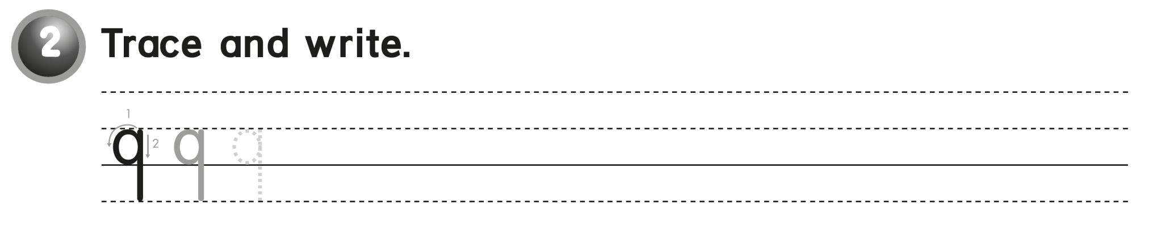
q q q q

Slide 11
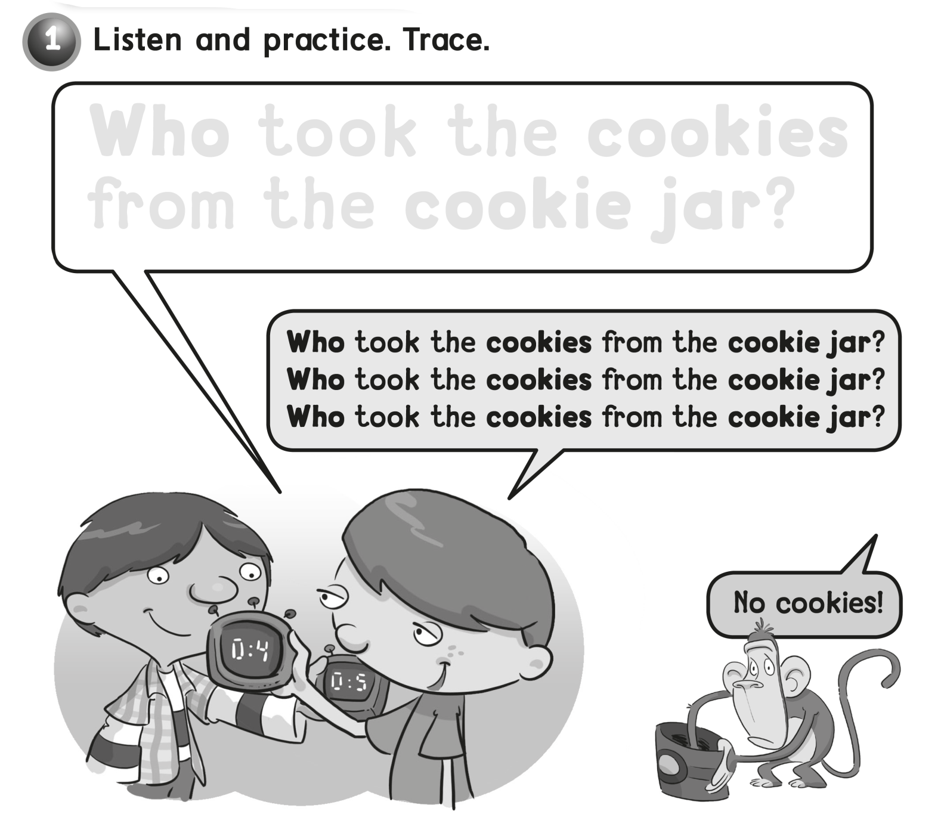
Who took the cookies
from the cookie jar ?

Slide 12
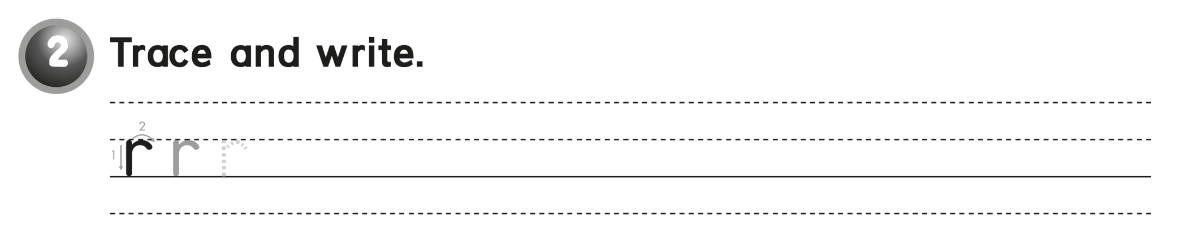
r r r r

Slide 13
workbook
Pages 77 , 78

Slide 14

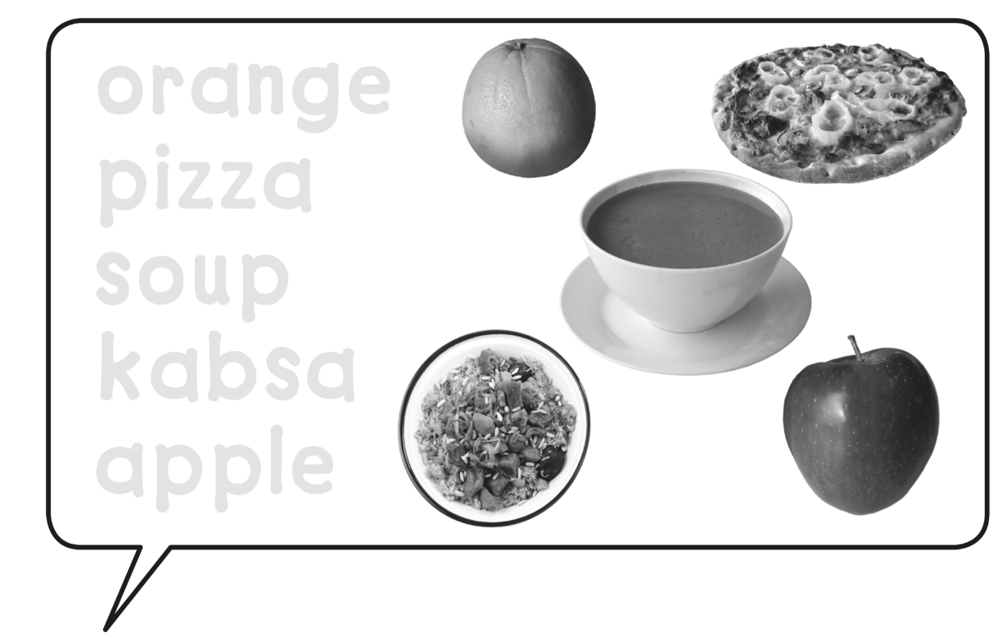
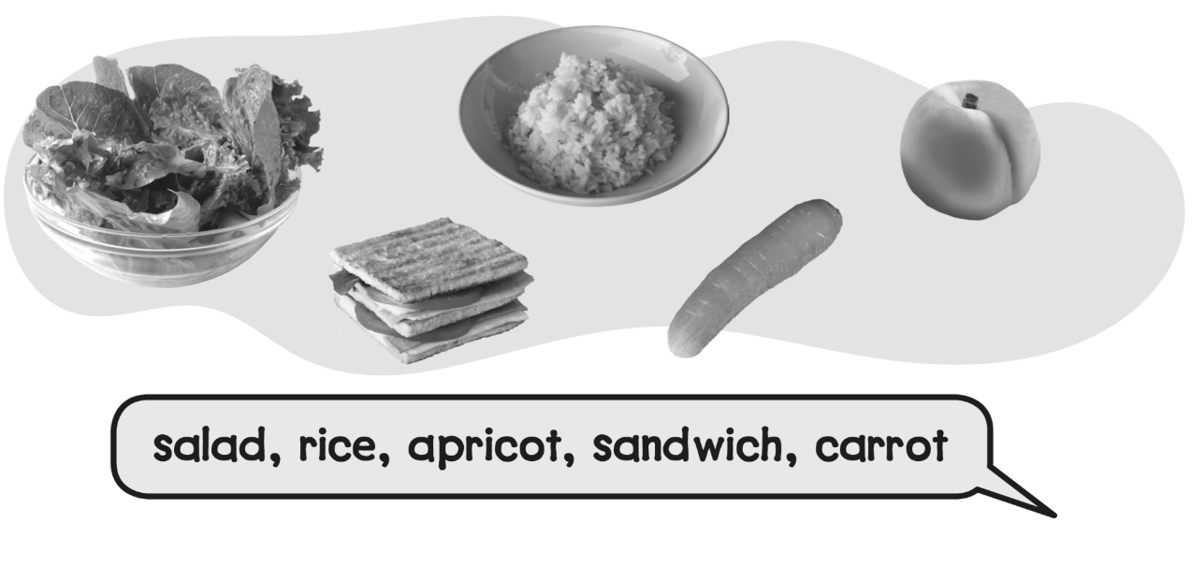
Orange
Pizza
Soup
Kabsa
Apple

Slide 15
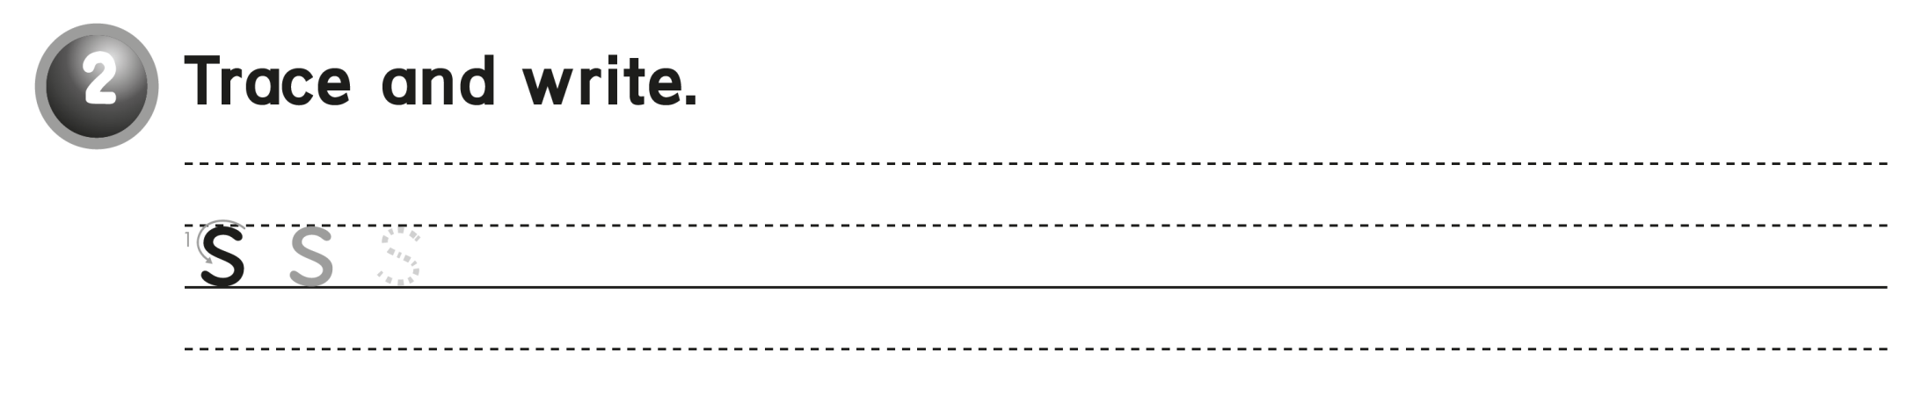
s s s s

Slide 16
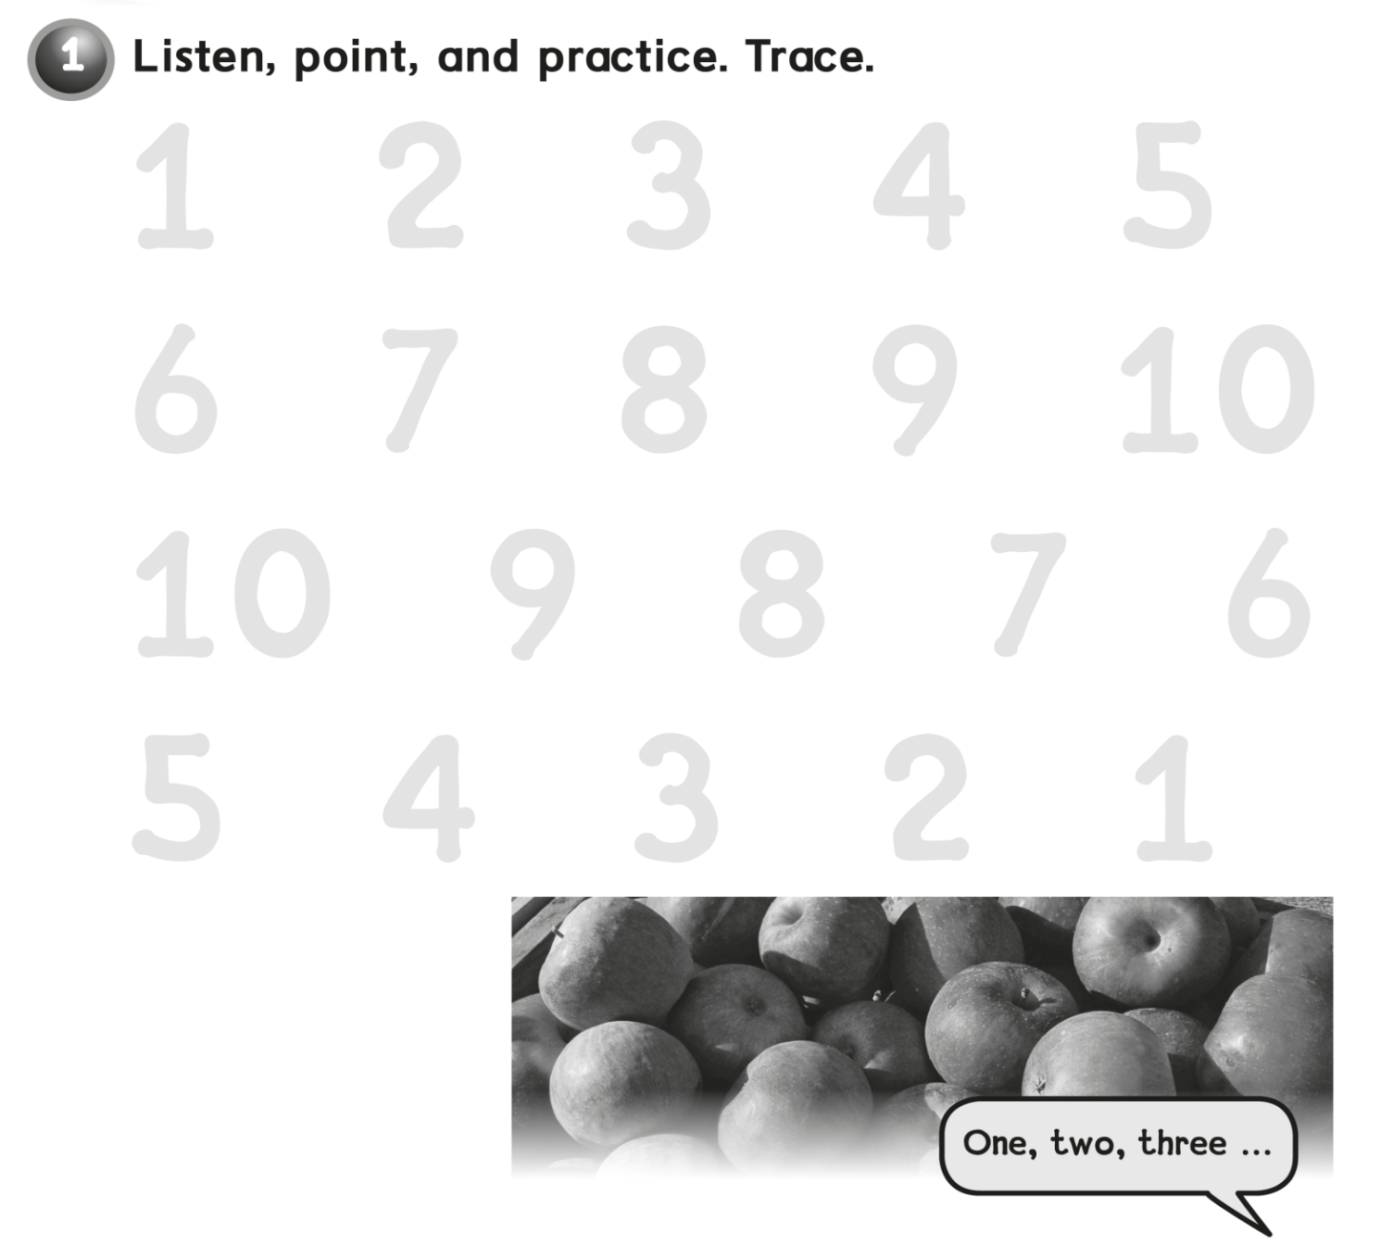
1 2 3 4 5
6 7 8 9 10
10 9 8 7 6
5 4 3 2 1

Slide 17
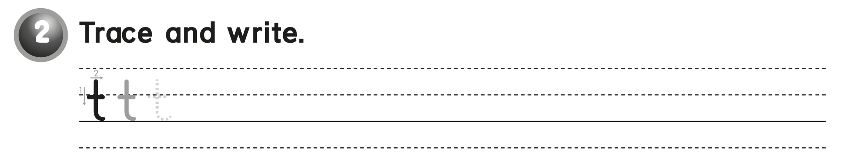
t t t t

Slide 18
workbook
Pages 79 , 80

Slide 19
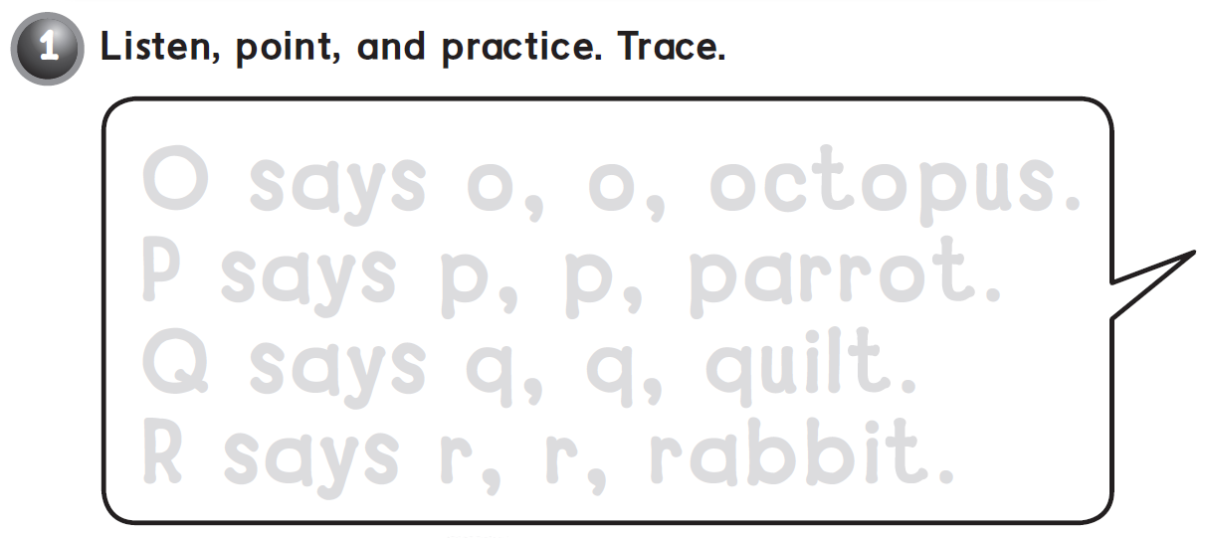
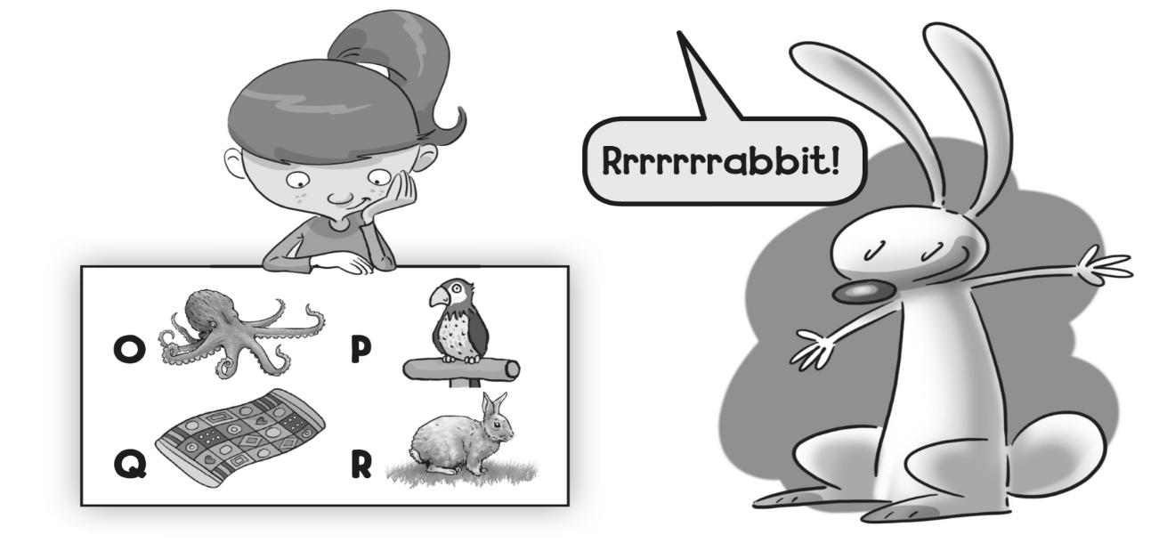
O says o , o , octopus .
P says p , p , parrot .
Q says q , q, quilt .
R says r, r, rabbit .

Slide 20
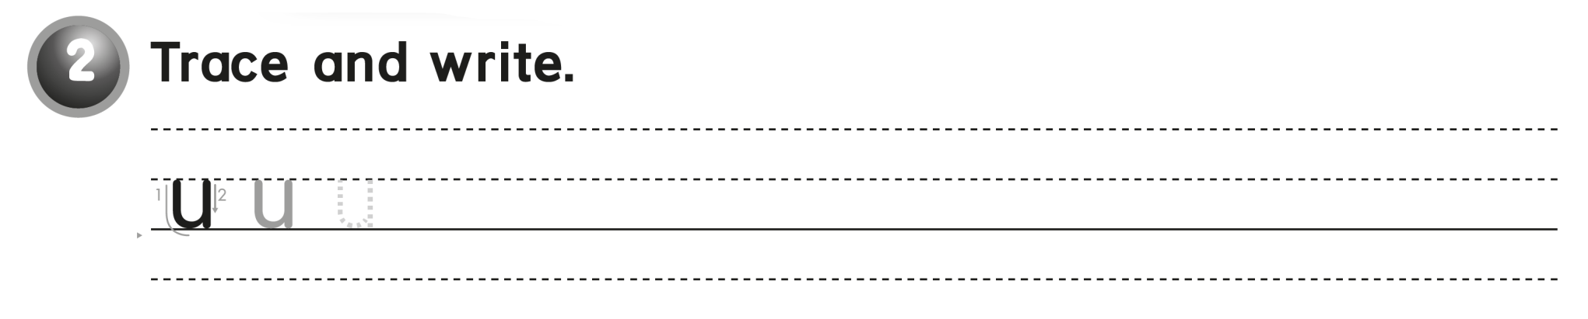
u u u u

Slide 21
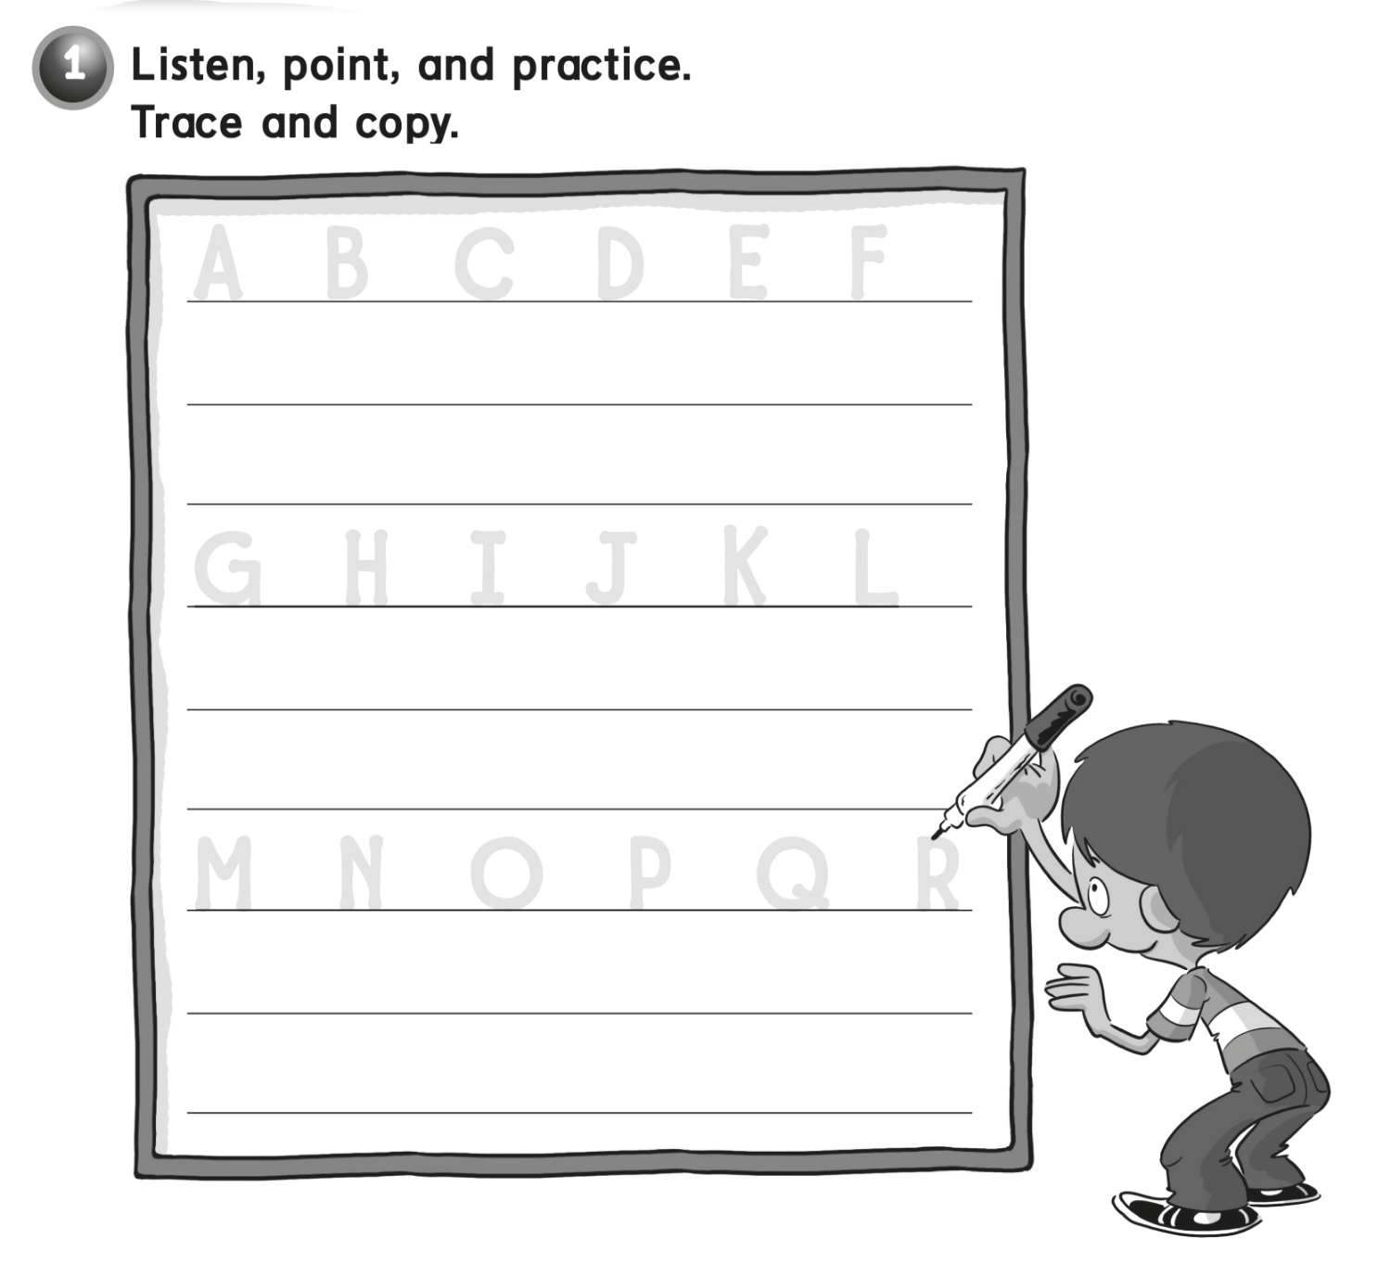
A B C D E F
A B C D E F
G H I J K L
G H I J K L
M N O P Q R
M N O P Q R

Slide 22
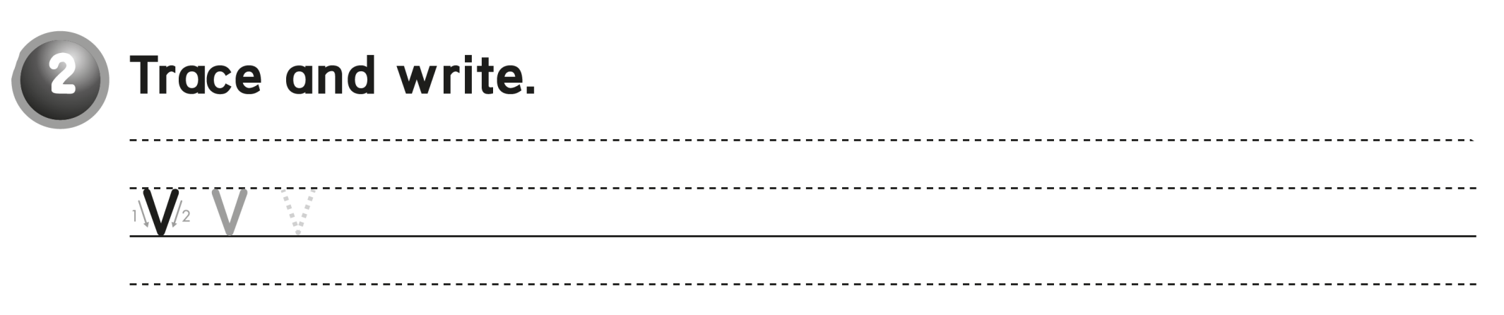
v v v v

Slide 23


