Slide 1


Welcome to class
T.

Slide 2



Slide 3





workbook
Pages 51 , 52

Slide 4
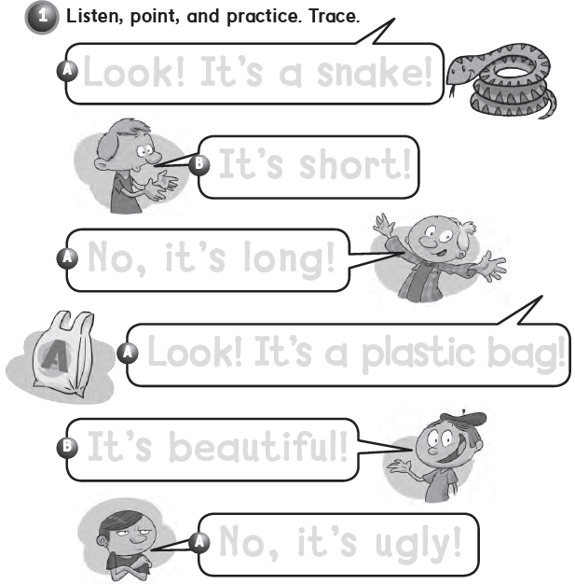
Look ! It’s a snake!
It’s short !
No, it’s long !
Look ! It’s a plastic bag !
It’s beautiful !
No, it’s ugly !

Slide 5
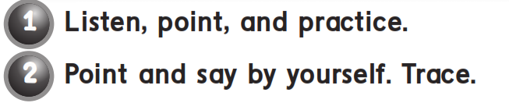

Look ! It’s a …!

Slide 6
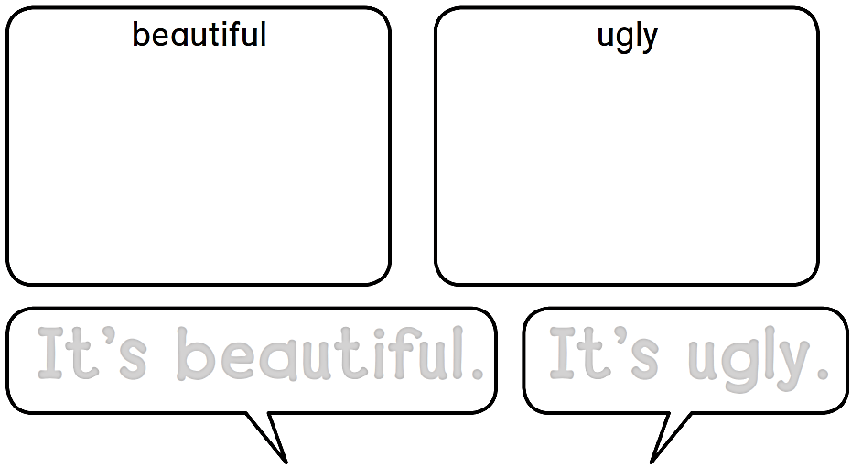


It’s beautiful.
It’s ugly.

Slide 7
workbook
Pages 53 , 54

Slide 8

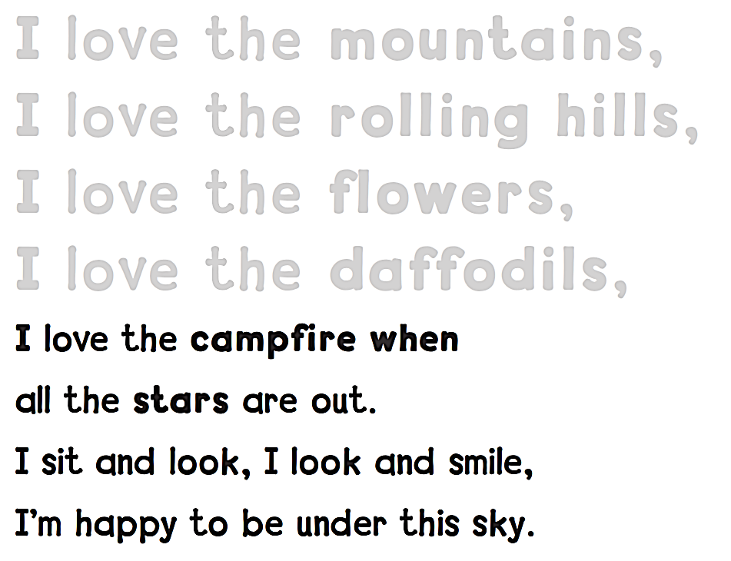
I love the mountains,
I love the rolling hills,
I love the flowers,
I love the daffodils,

Slide 9

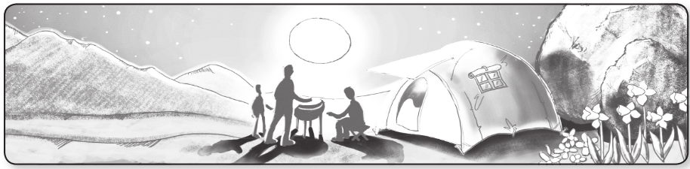
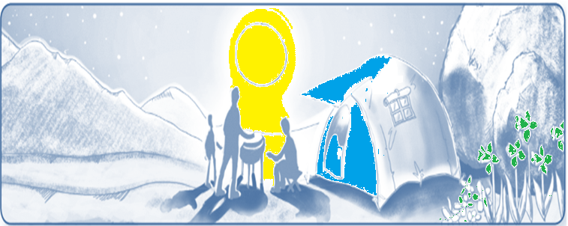

Slide 10

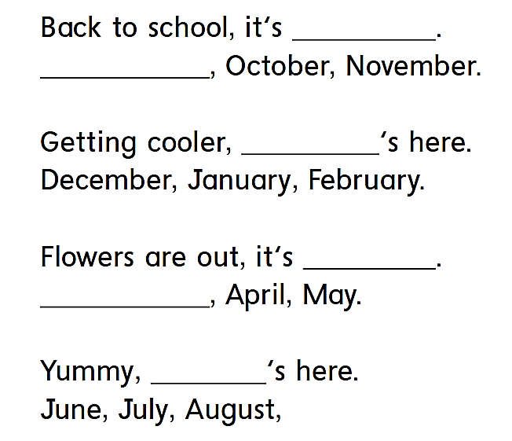

fall
September
winter
spring
March
summer

Slide 11

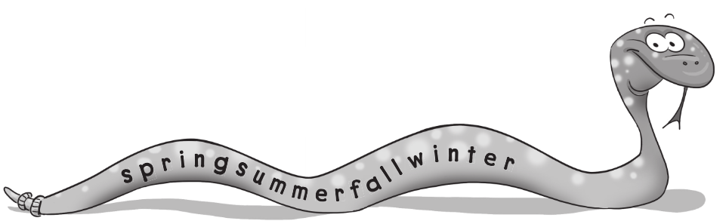
Spring – summer – fall – winter

Slide 12
workbook
Pages 55 , 56

Slide 13

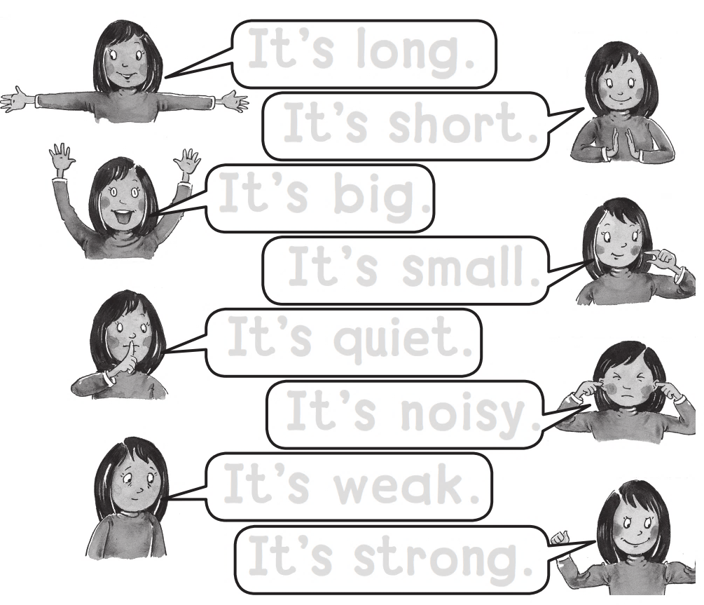
It’s long.
It’s short.
It’s big .
It’s small.
It’s quite.
It’s noisy.
It’s weak.
It’s strong.

Slide 14

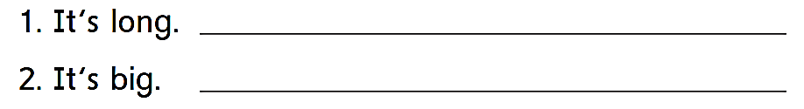
Short
small

Slide 15
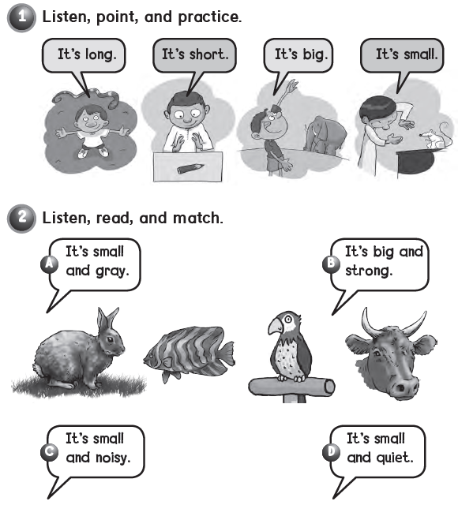

Slide 16
workbook
Pages 57 , 58

Slide 17
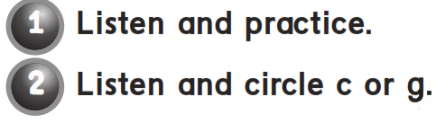
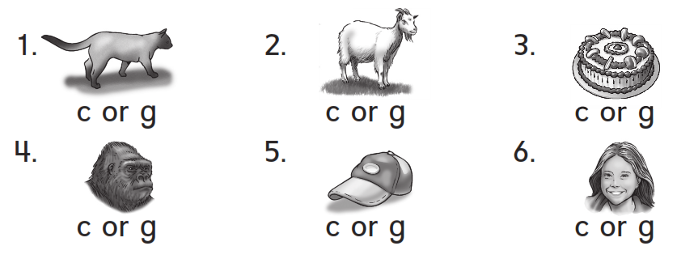

Slide 18
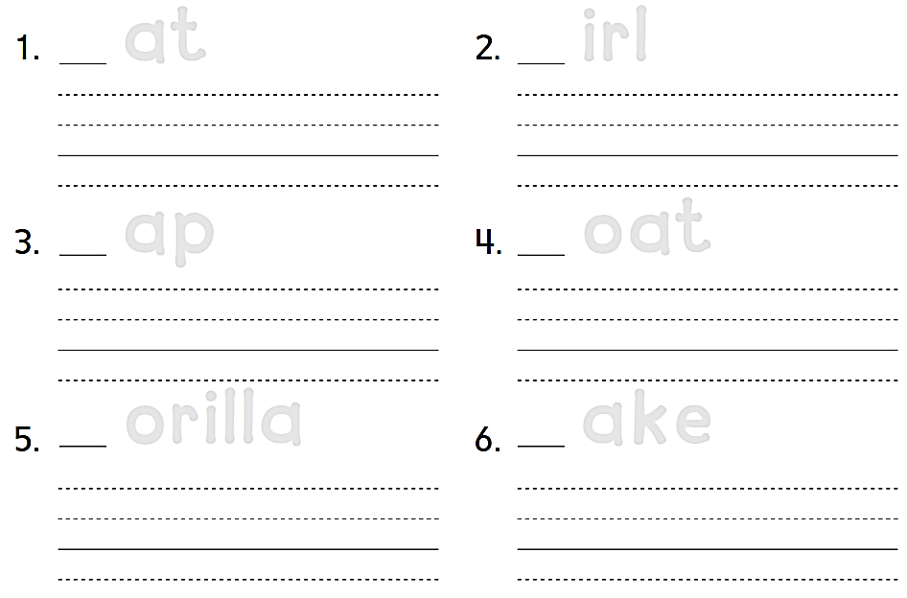
C at
G irl
Cat
Girl
C ap
G oat
Cap
Goat
G orilla
C ake
Gorilla
Cake

Slide 19

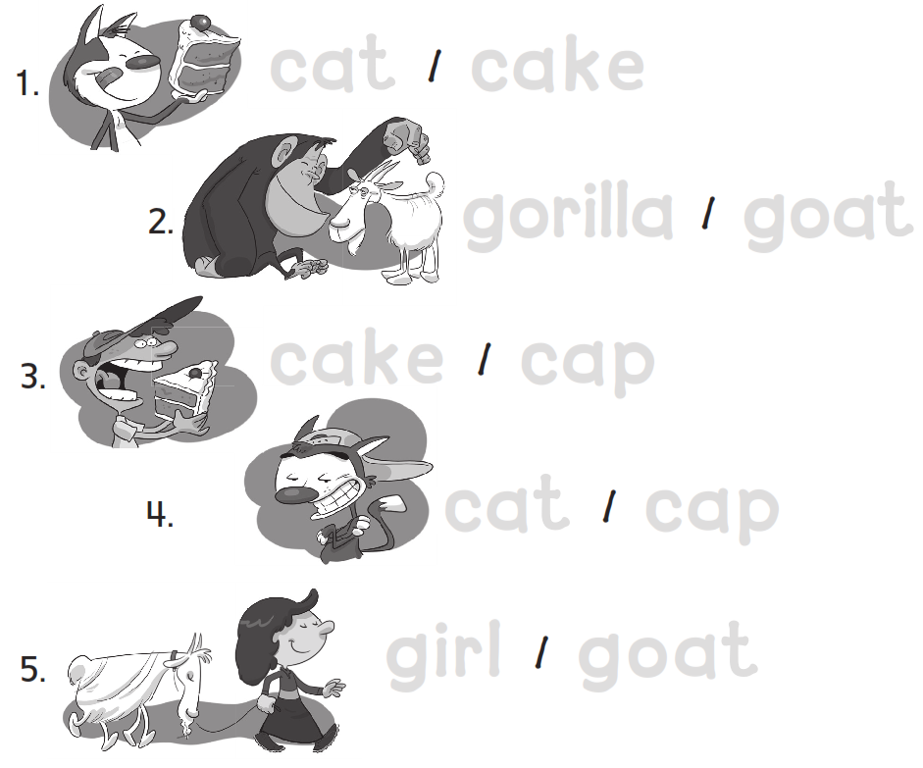
cat cake
gorilla goat
cake cap
cat cap
girl goat

Slide 20



Slide 21


