Slide 1
Welcome to class
T.

Slide 2
3
Unit 7

Slide 3
رابع – خامس – سادس
workbook
Pages 187 , 188
ثالث
workbook
Pages 67 , 68

Slide 4
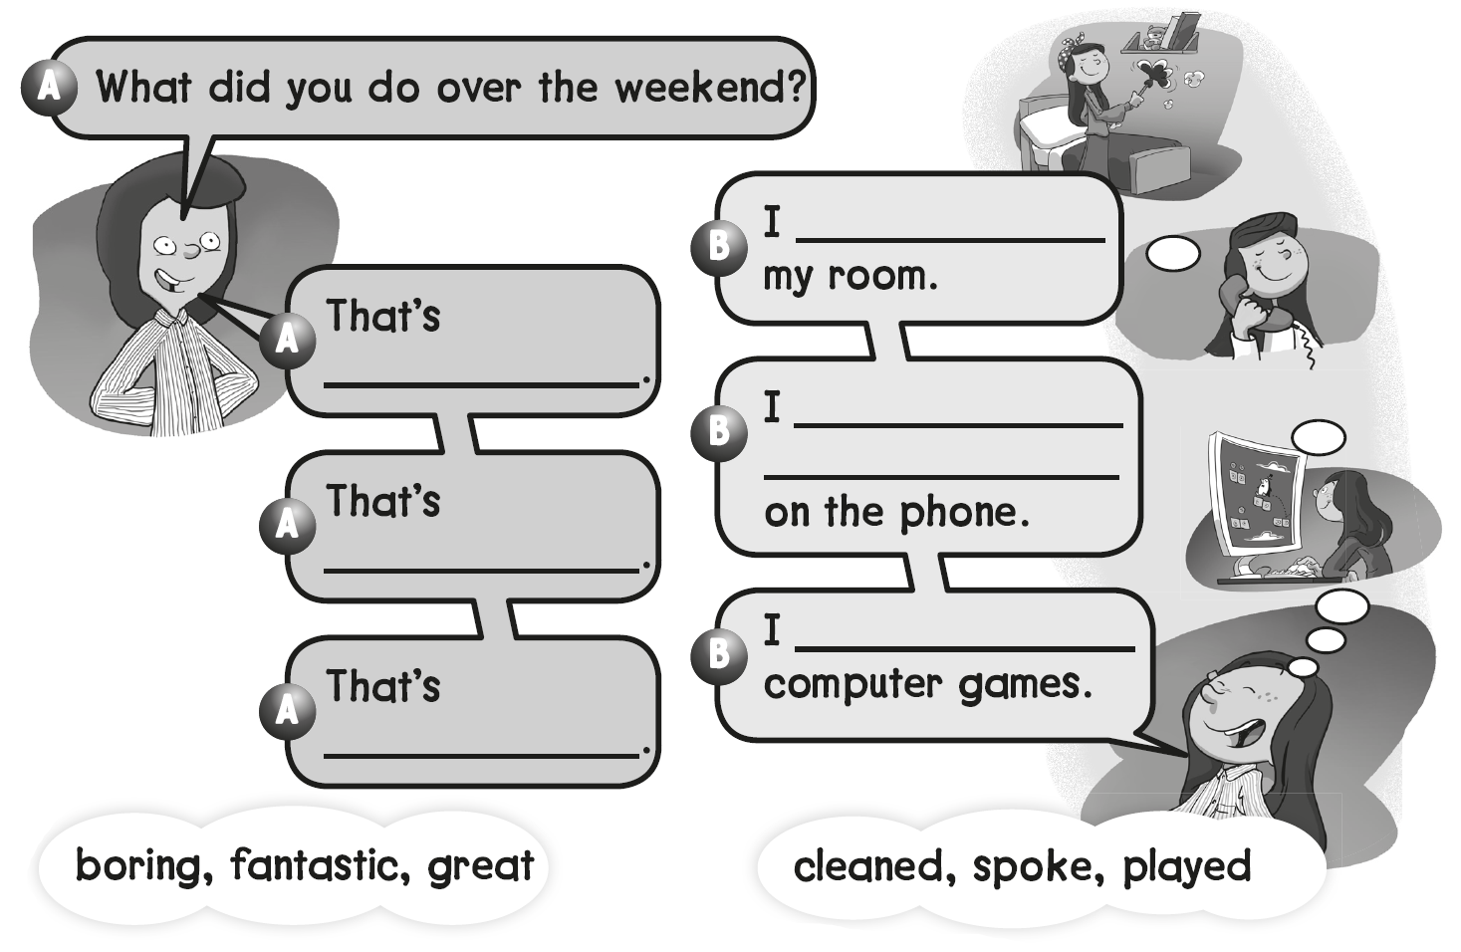
cleaned
boring
spoke with my friends
Fantastic
played
great

Slide 5
B
A
C

Slide 6
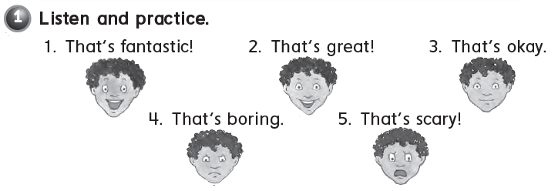

Slide 7
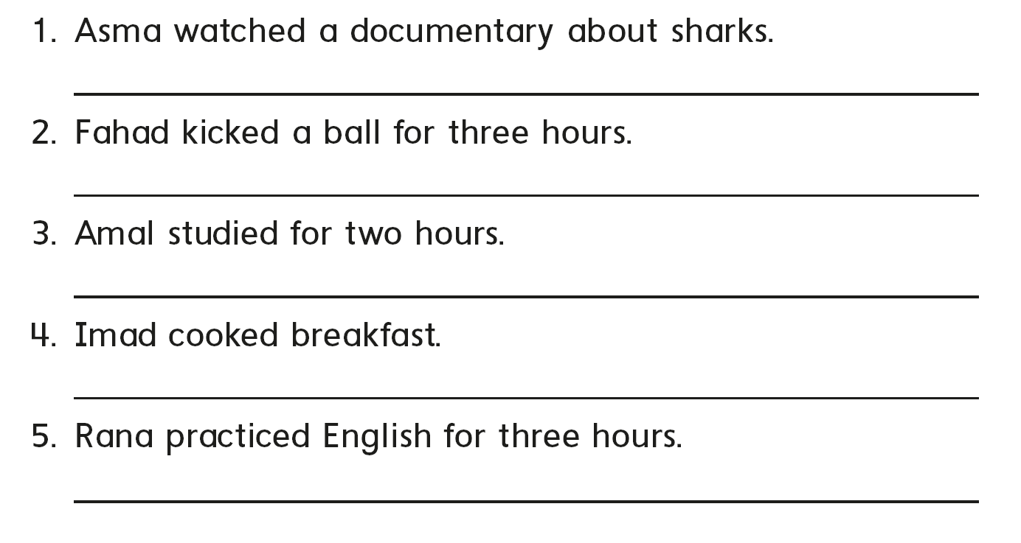
That’s scary
That’s boring
That’s okay
That’s great
That’s fantastic

Slide 8
B
A
C

Slide 9
رابع – خامس – سادس
workbook
Pages 189 , 190
ثالث
workbook
Pages 69 , 70

Slide 11
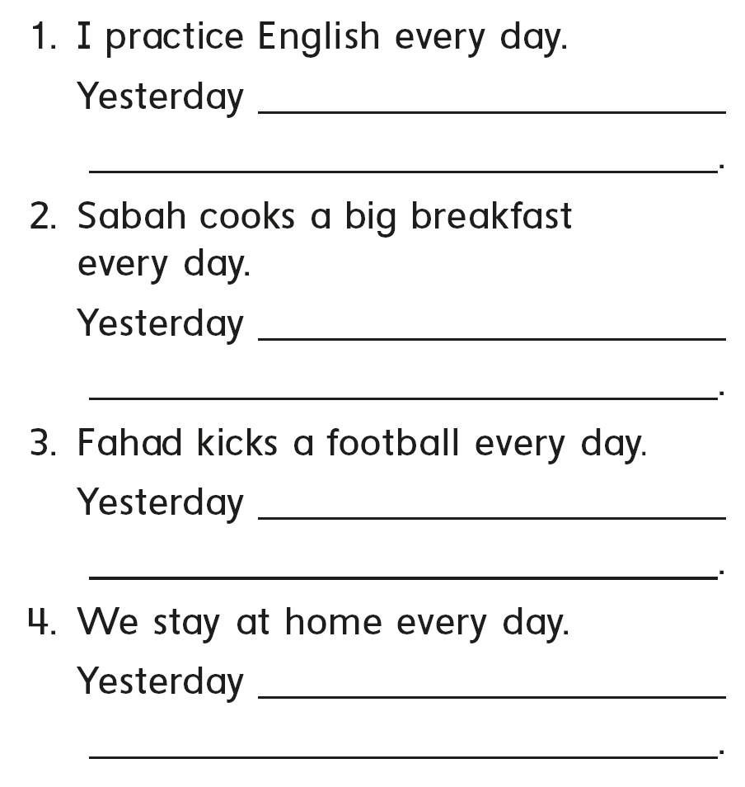
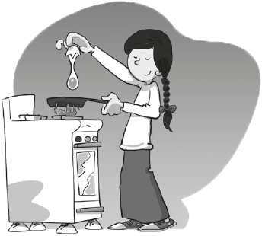
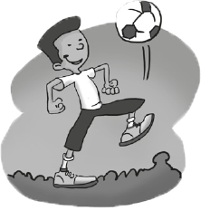
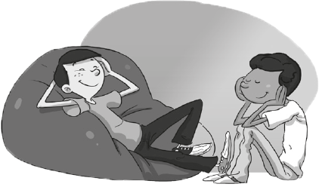
I practiced English
she cooked a big breakfast
he kicked football
We stayed home

Slide 12
B
C
A

Slide 13
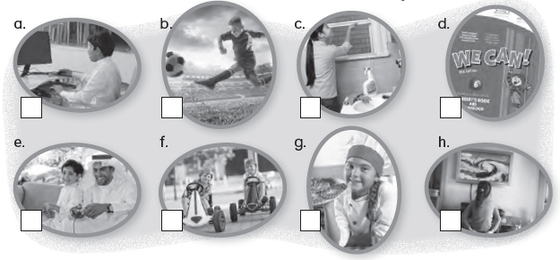
8
4
5
1
6
7
3
2

Slide 14
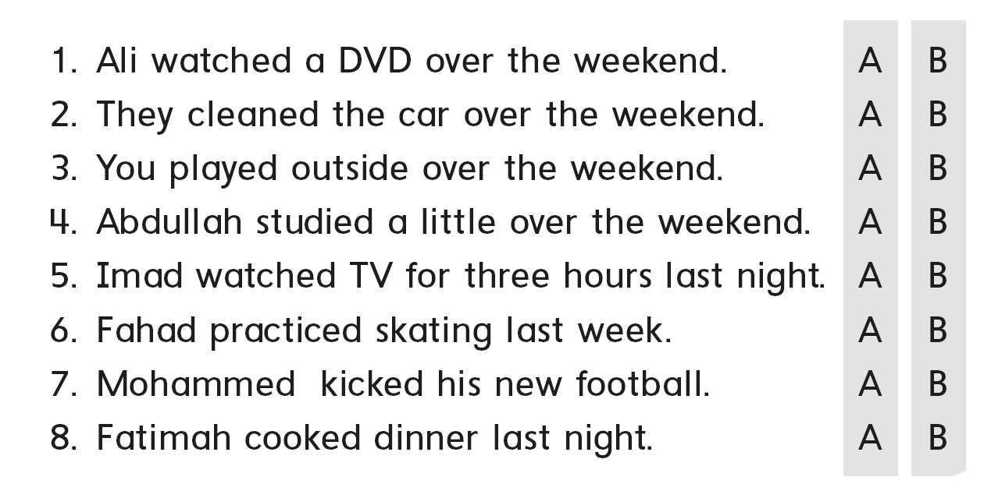

Slide 15
B
A
C

Slide 16
رابع – خامس – سادس
workbook
Pages 191 , 192
ثالث
workbook
Pages 71 , 72

Slide 17
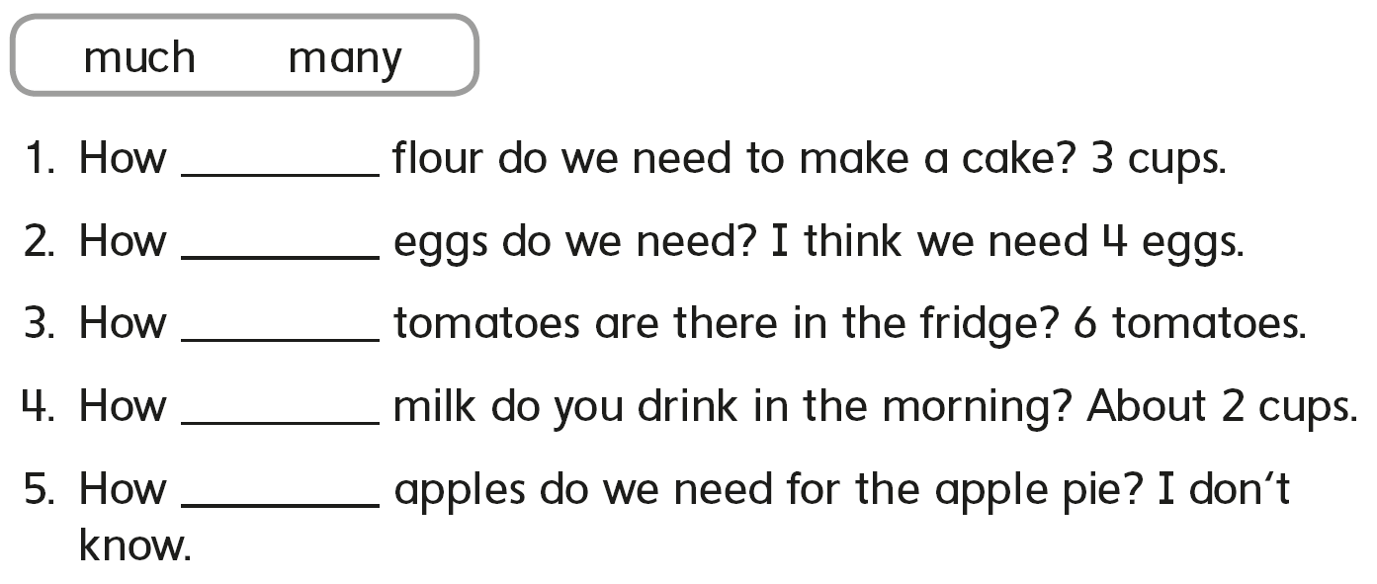
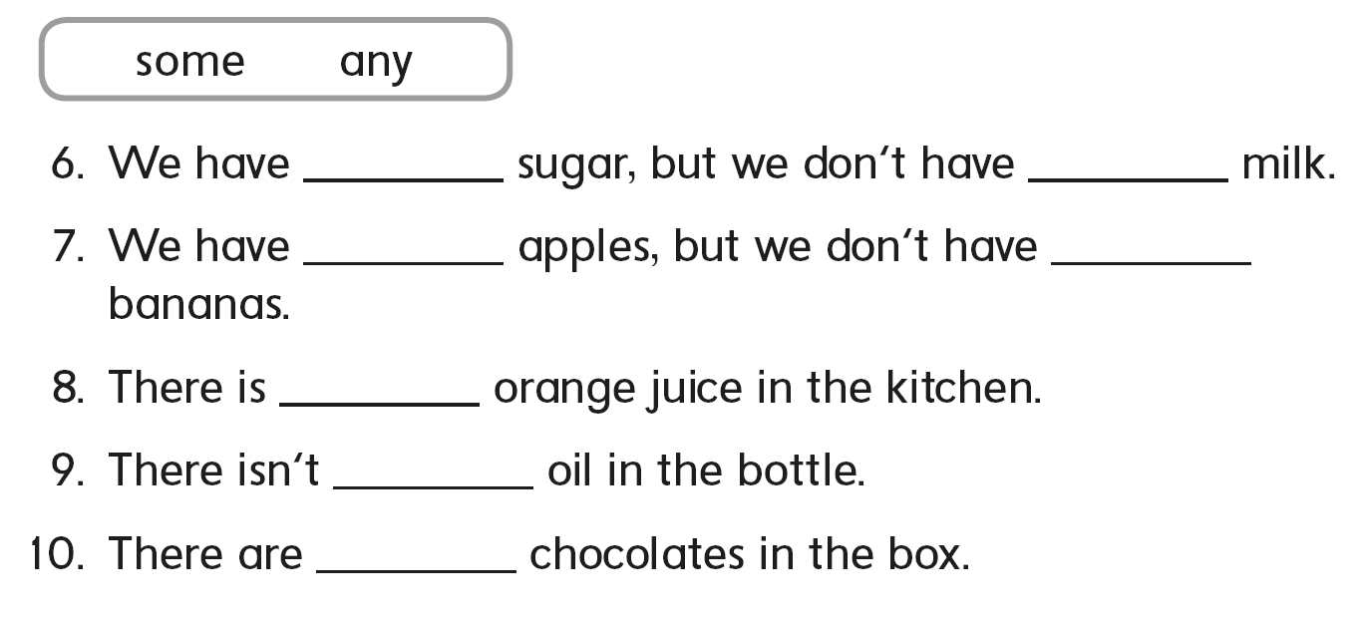
much
many
many
much
many
some
any
some
any
some
any
some

Slide 18
B
A
C

Slide 19
would
burger
fries
moment

Slide 20
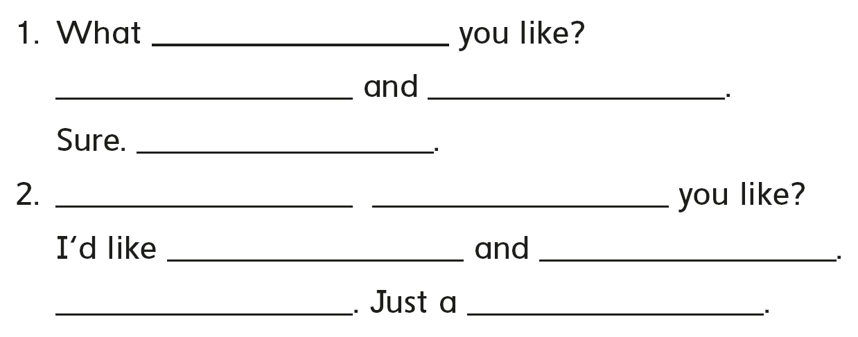
would
I’d like kabsa
soda please
Just a moment
What
would
pizza
a salad please
sure
moment

Slide 21
B
C
A

Slide 22
رابع – خامس - سادس
workbook
Pages 193 , 194
ثالث
workbook
Pages 73 , 74

Slide 23
sand
tent
paint
plant
stand
hand

Slide 24
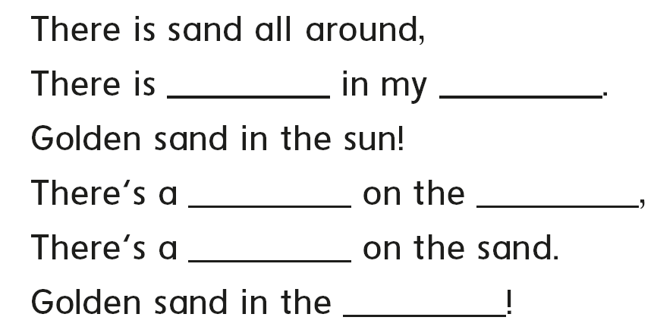
sand
hand
tent
land
tent
land

Slide 25
C
A
B

Slide 27
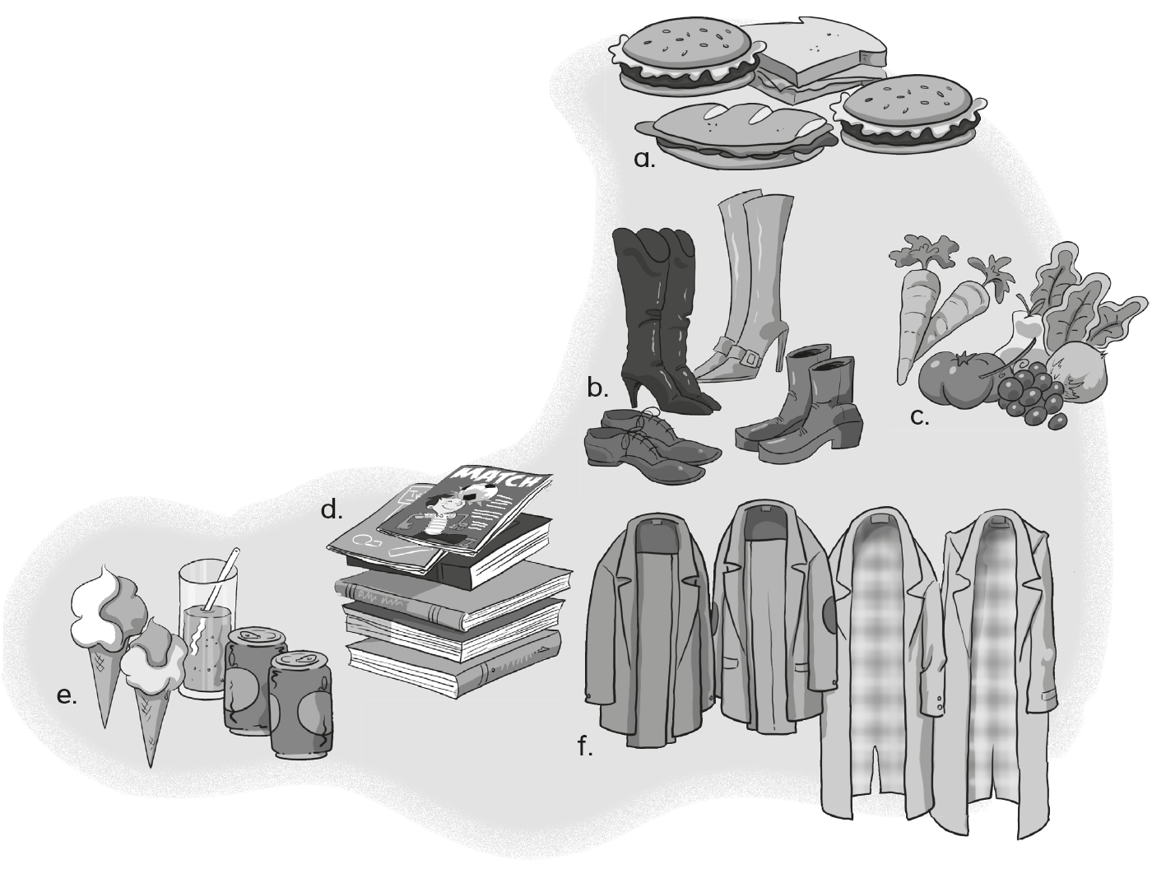
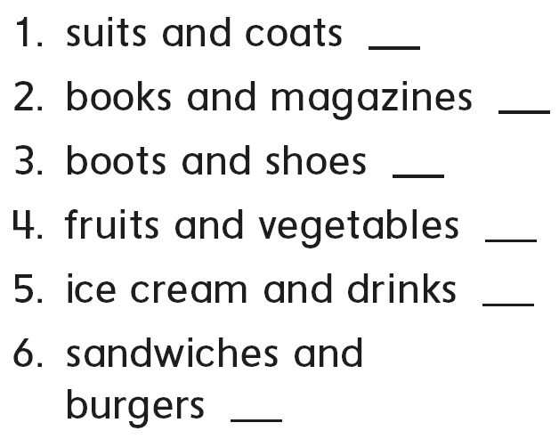
f
d
b
c
e
a

Slide 28
C
B
A

