Slide 1


Welcome to class
T.

Slide 2

3
Unit 8

Slide 3





رابع – خامس – سادس
workbook
Pages 195 , 196
ثالث
workbook
Pages 75 , 76

Slide 4

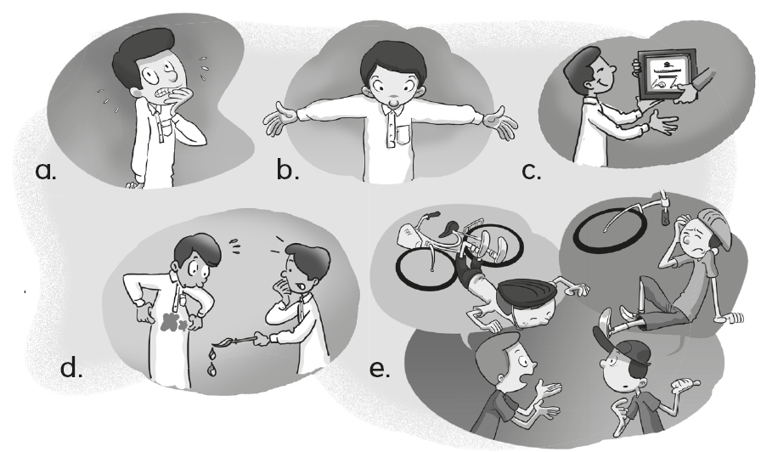
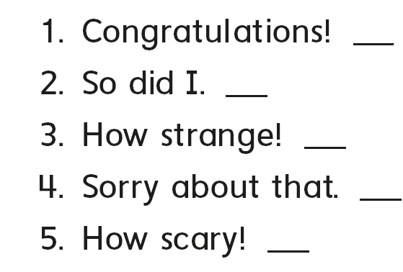
c
e
b
d
a

Slide 5

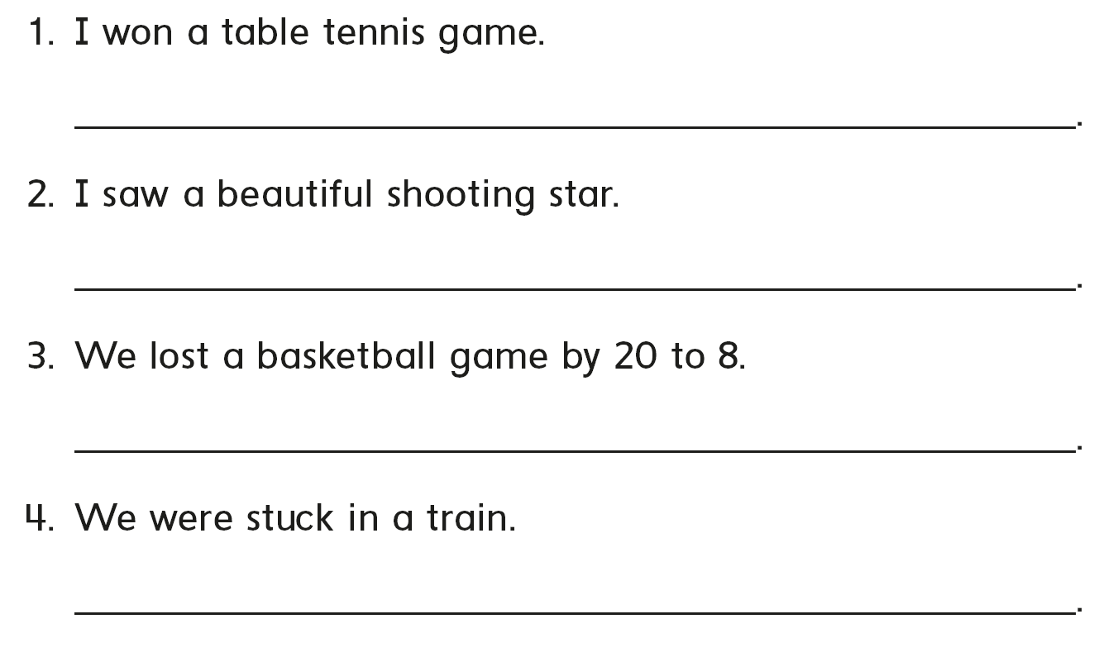
Congratulations!
So did I
Sorry to hear that
How scary

Slide 6

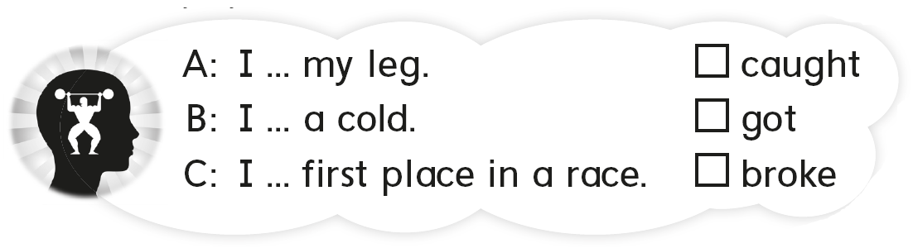
B
C
A

Slide 7

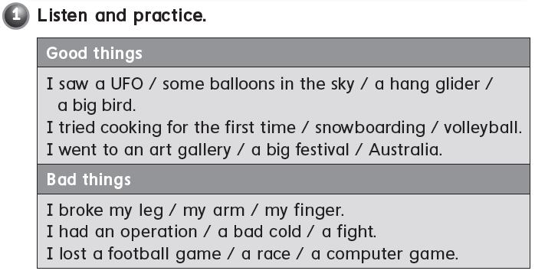

Slide 8
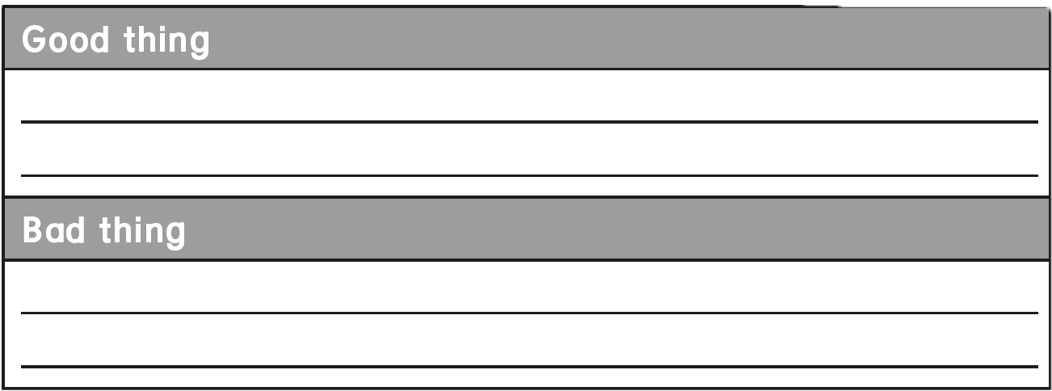
I saw a rainbow
I learned swimming
I lost a basketball game
I broke my arm

Slide 9

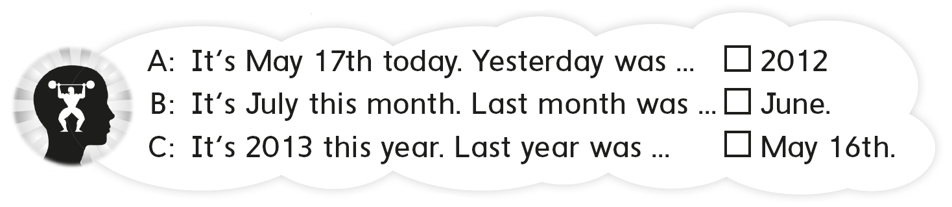
C
2019
B
A
It is 2020 this year . Last year was……………

Slide 10
رابع – خامس – سادس
workbook
Pages 197 , 198
ثالث
workbook
Pages 77 , 78

Slide 11


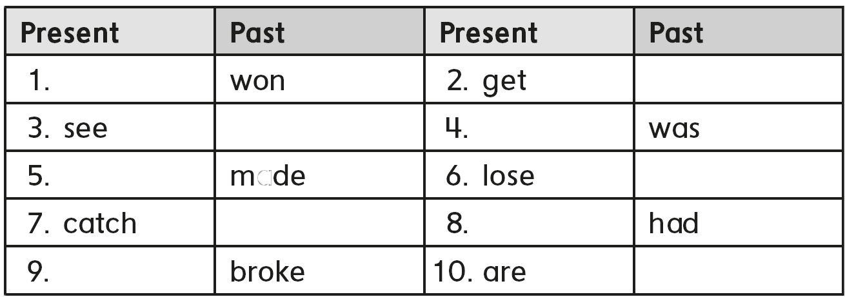
Win
got
Saw
is
Make
Lost
Caught
has
break
Were

Slide 12
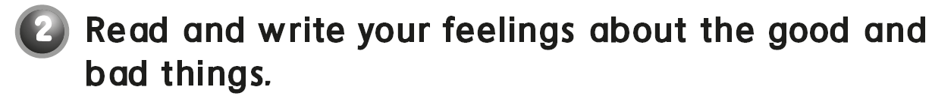
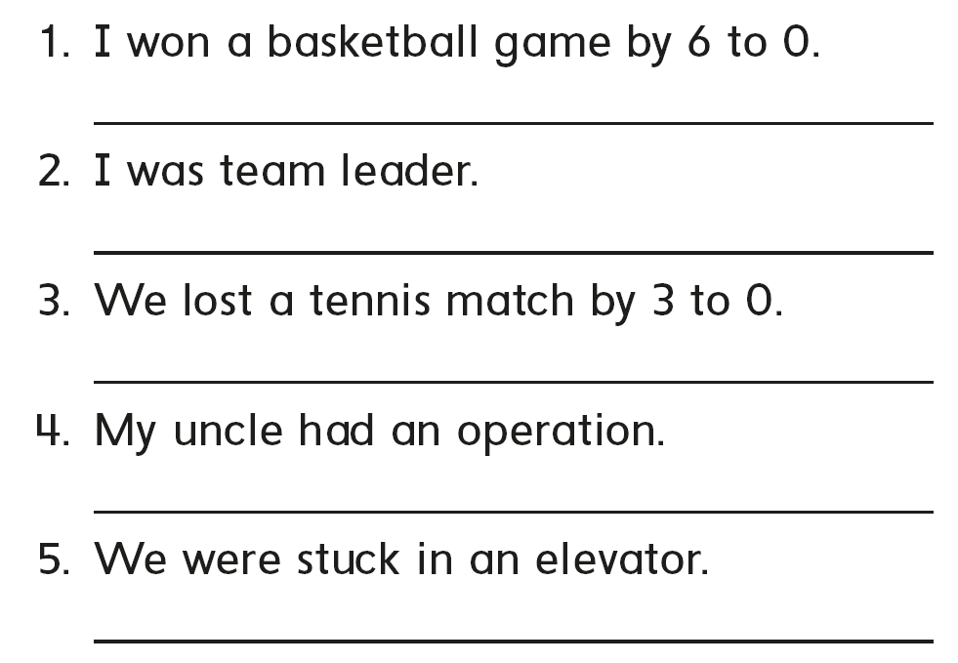

I was happy
I was excited
I was sad
I was worried
I was scared

Slide 13

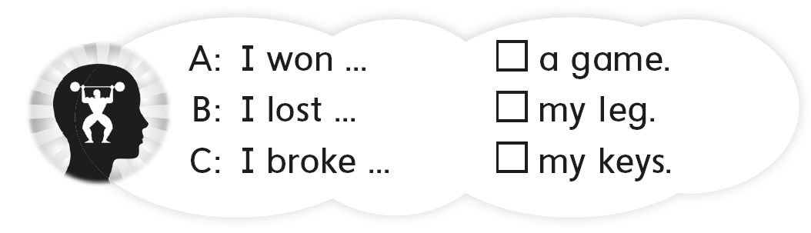
A
C
B

Slide 14

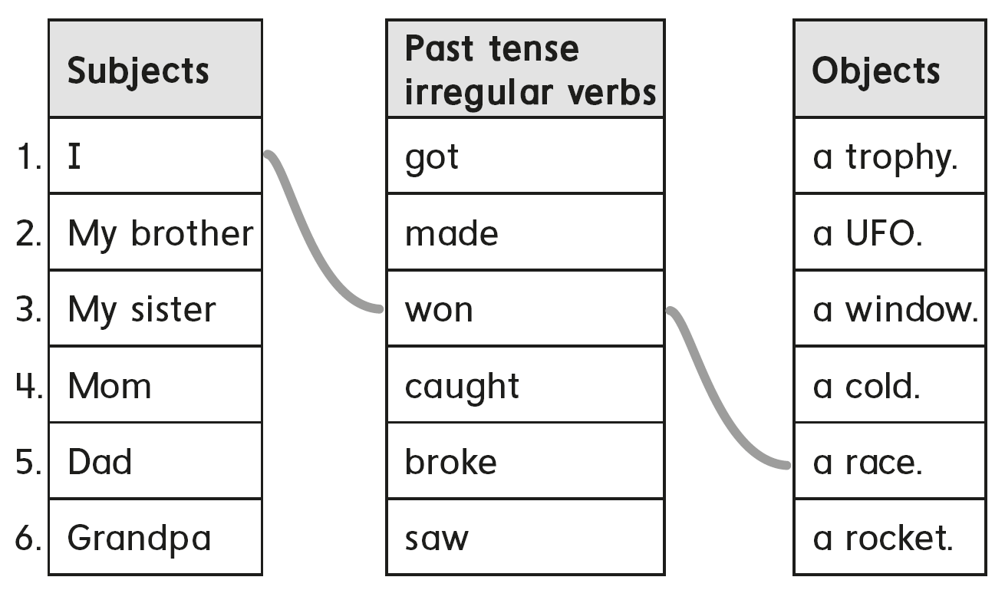

Slide 15
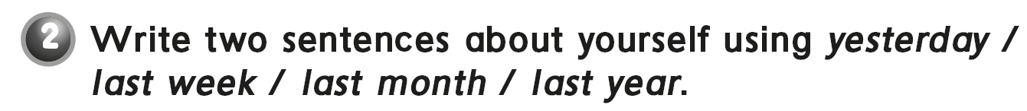
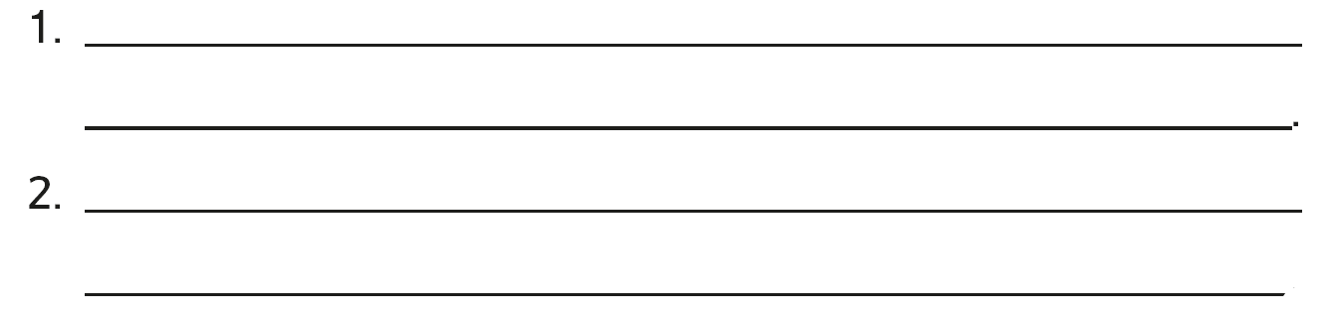
I saw a shooting star yesterday
I played basketball last week.
I broke my laptop , last month.
I went to Dubai , last year.

Slide 16
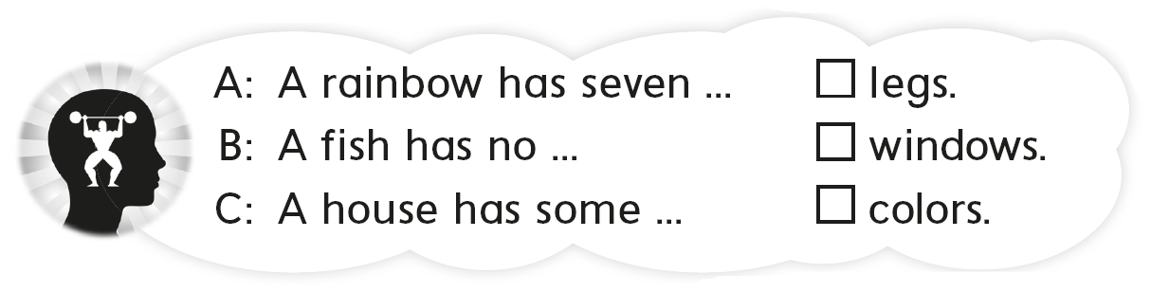
B
C
A

Slide 17
رابع – خامس – سادس
workbook
Pages 199 , 200
ثالث
workbook
Pages 79 , 80

Slide 18
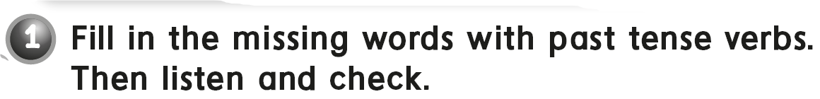

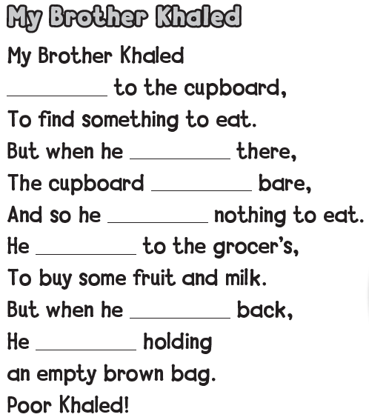
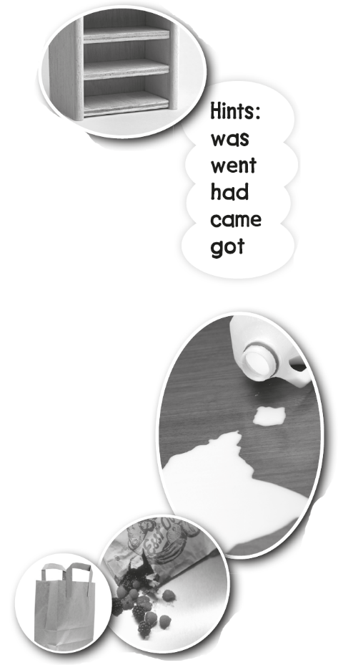
went
got
was
had
went
came
was

Slide 19

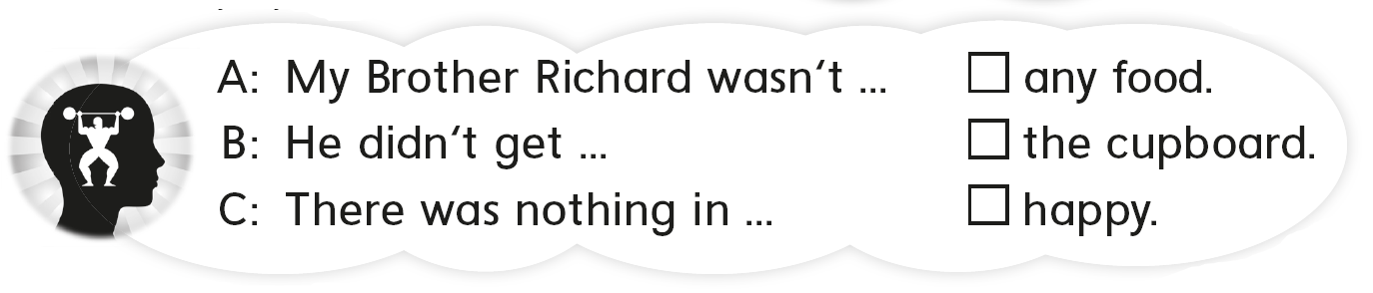
B
C
A

Slide 20

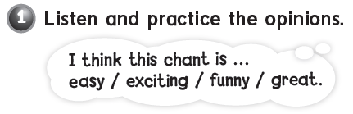

Slide 21
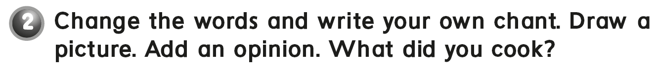
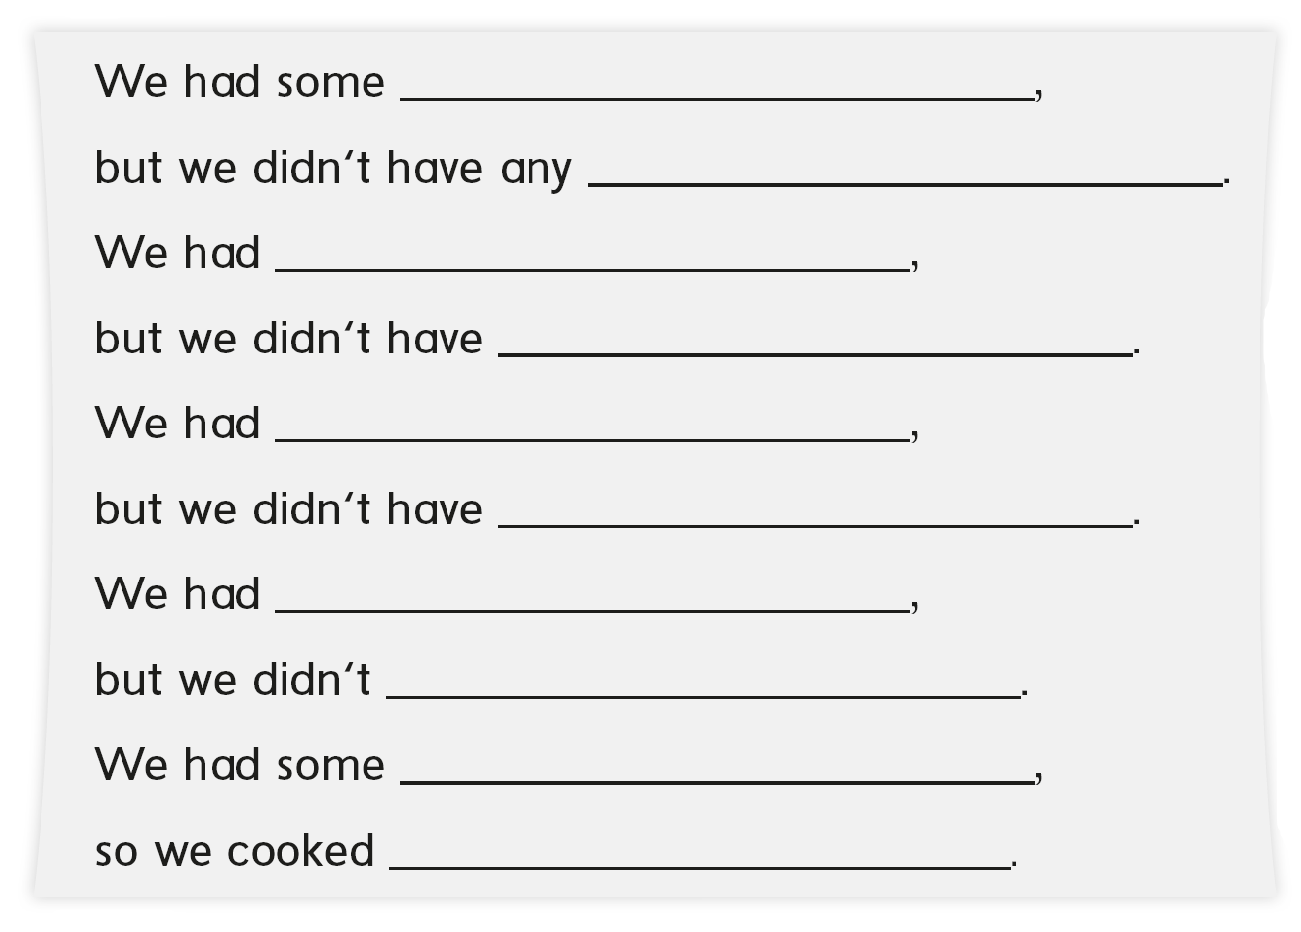
chicken
onions
some rice
any cheese
some tomato
any pepper
some oil
have any cheese
some potato
kabsa

Slide 22

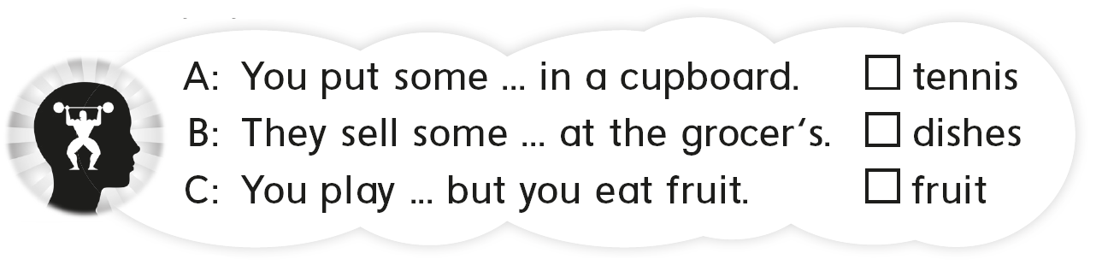
C
A
B

Slide 23
رابع – خامس – سادس
workbook
Pages 201 , 202
ثالث
workbook
Pages 81 , 82

Slide 24

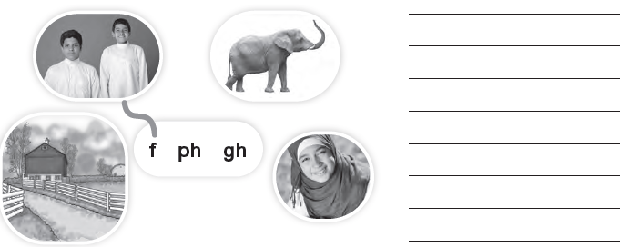
friends
elephant
laugh
farm

Slide 25
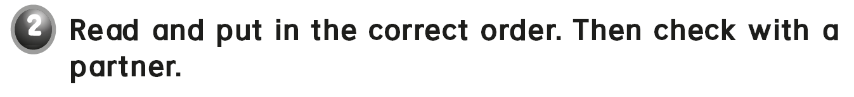
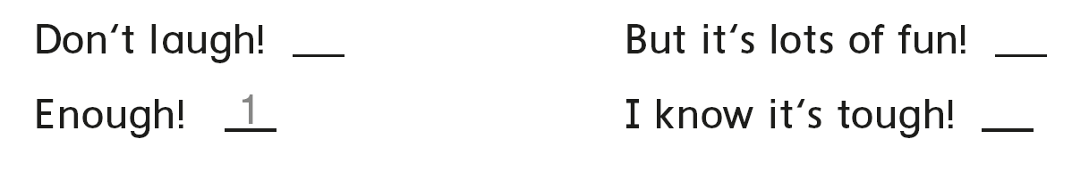

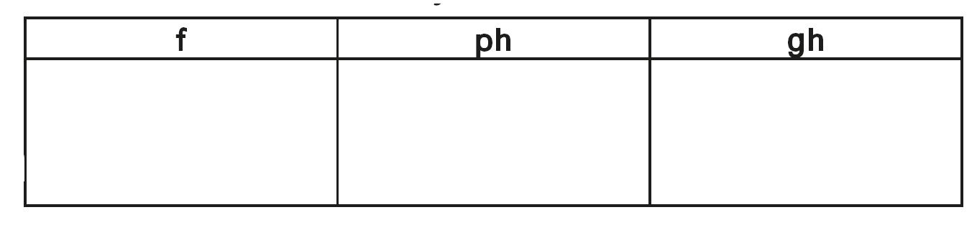
2
4
3
fish
phone
tough
fruit
photo
enough
father
elephant
rough

Slide 26
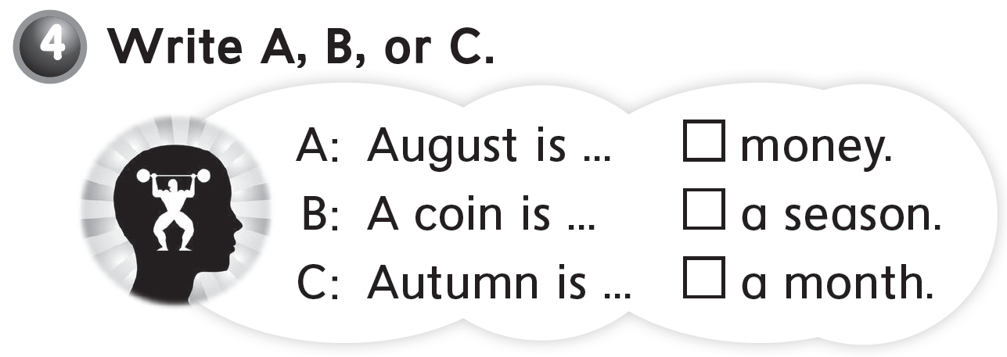
B
C
A

Slide 27
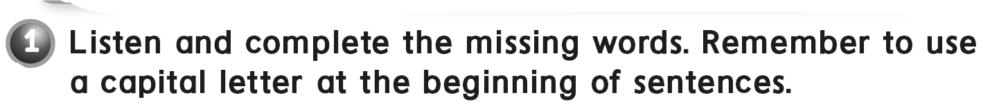

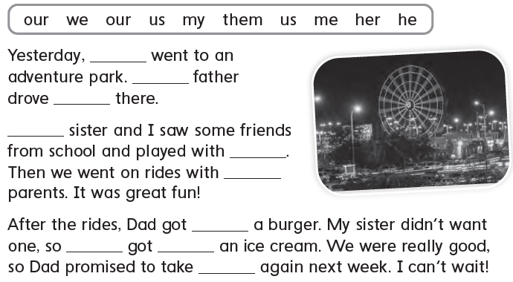
we
our
us
my
them
our
me
he
her
us

Slide 28
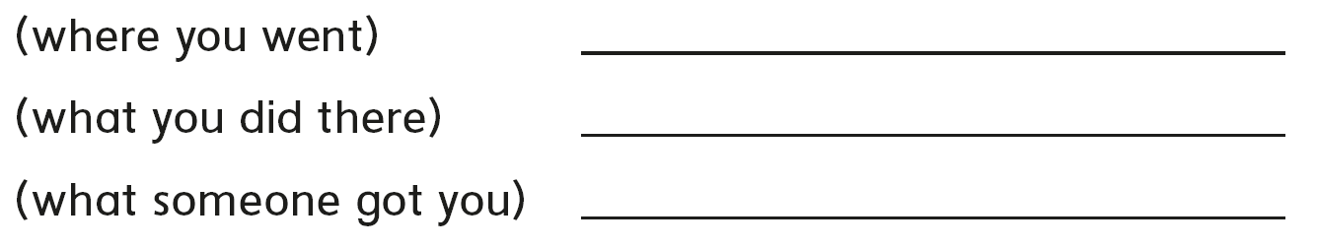

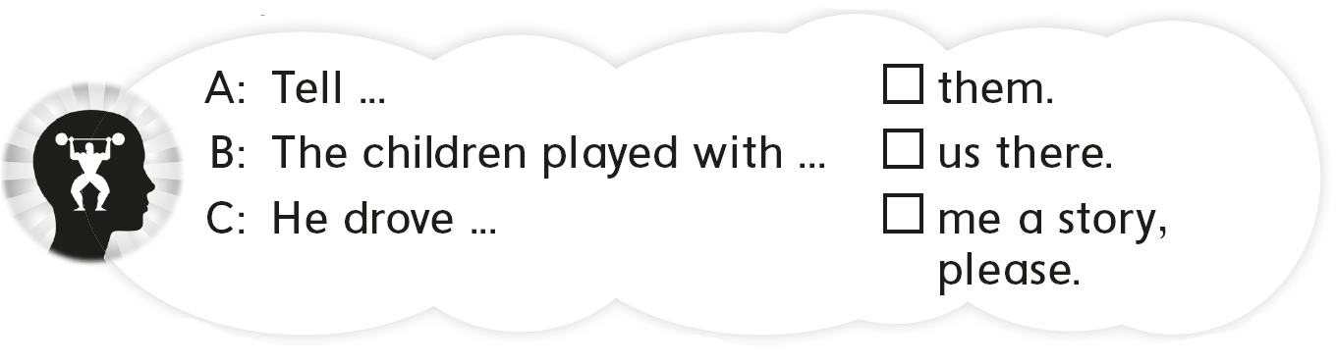
We went to an adventure park
My brother an I played with our friends
We got pizza
B
C
A

Slide 29


