Slide 1
Mega Goal 2 (MG22)
Unit 1
L1: Listen and Discuss
Flash Cards
Working 9 to 5
Designed and done by T. Talal Alhazmi
Done by T. Talal Alhazmi

Slide 2

Satisfaction
feeling of contentment
state or condition
status
to involve or require
entail
appreciate
to be grateful for
income
money received or earned
cooperate
to work together well
polite, showing consideration
respectful

Slide 3
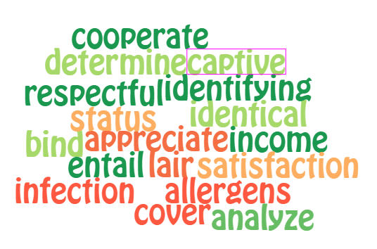
MG2.2 Unit 1 World Cloud

Slide 4
Mega Goal 2 Unit 5 L1
Done By Talal Alhazmi

Slide 5
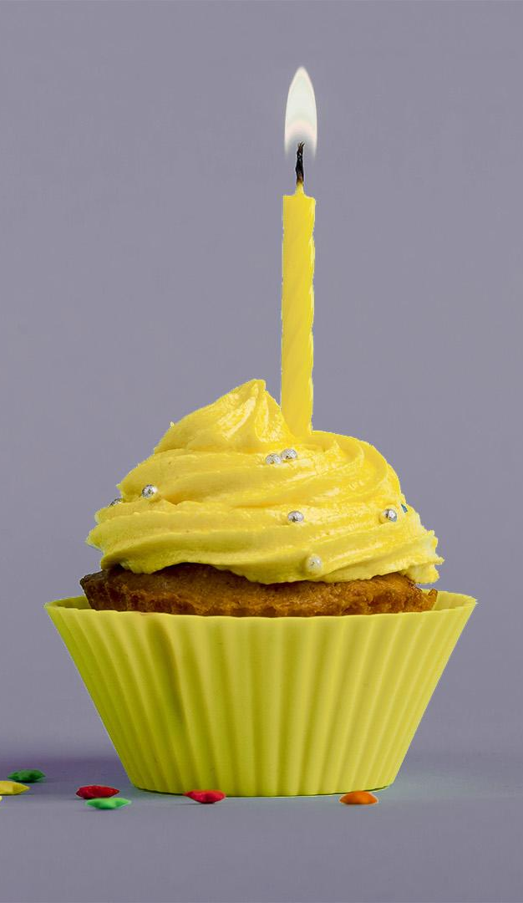
Term of use
License Agreement
This PowerPoint project, including game slides and associated content is a copyrighted to Teacher. Talal Alhazmi.
Do not submit copies or modifications of this project to any website that requires sign in or paid subscription.
You may download the PowerPoint, make archival copies, and customize the project only for your personal use or use within your school and not for resale.
Don’t allow to delete my name.

