Slide 1






9 writing
10 project
11 form, meaning & function
Today:
Date:
- -
Page 54
By: Dalal Al-Juaid

Slide 2


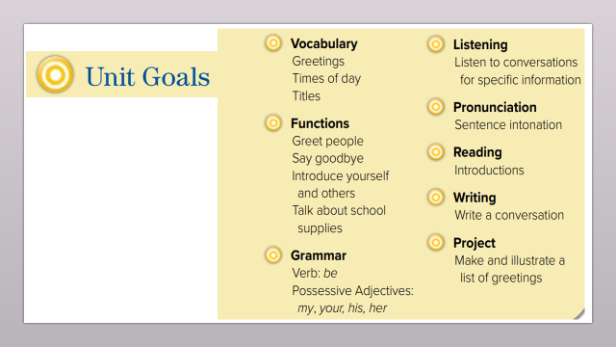
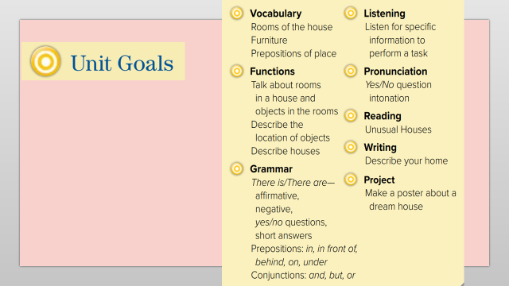
search for adjectives that describe home in a paragraph
write a description of each room in the house
Warm up
1-Listen
use conjunctions AND/BUT/OR to link sentences
Quick check

Slide 3
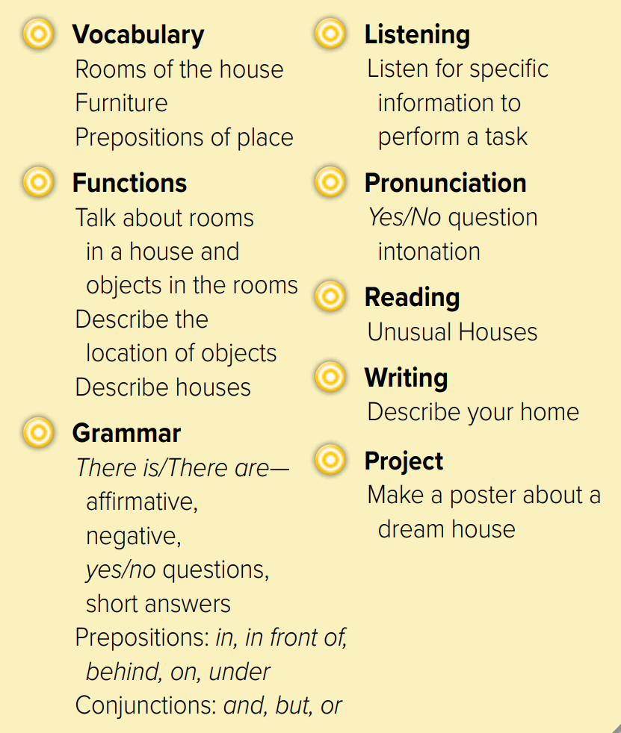
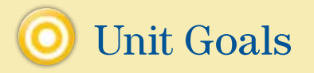

Slide 4
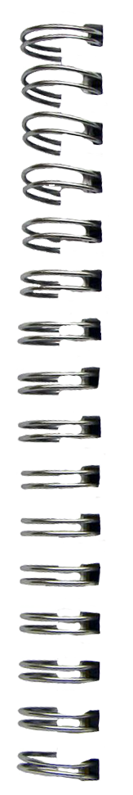

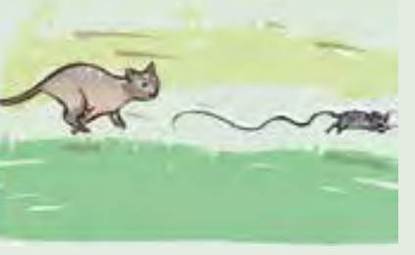



Revision
Is there …..? Are there ……?
Where is the cat?
#
unusual
..........

Slide 5



Where is the shower ?
x-o game
Where is the oven ?
What are there in the garden?
What are there in the bedroom?
Warm up
1-Listen
Is there a sofa in the garage?
What kind of unusual houses?
Quick check
What’s the opposite of upstairs?

Slide 6
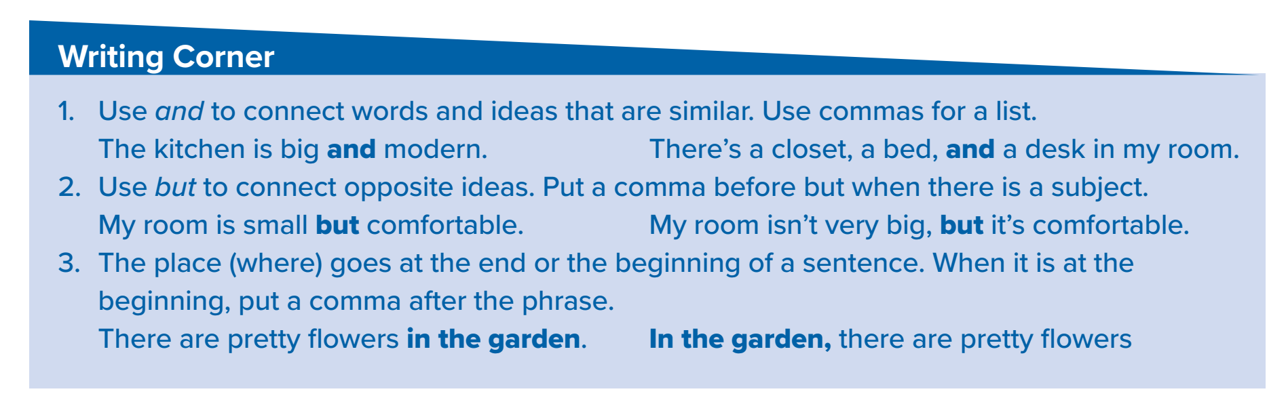











And # but
Page 54
Warm up
1-Listen
on the wall
in the bedroom
Quick check
on the balcony

Slide 7

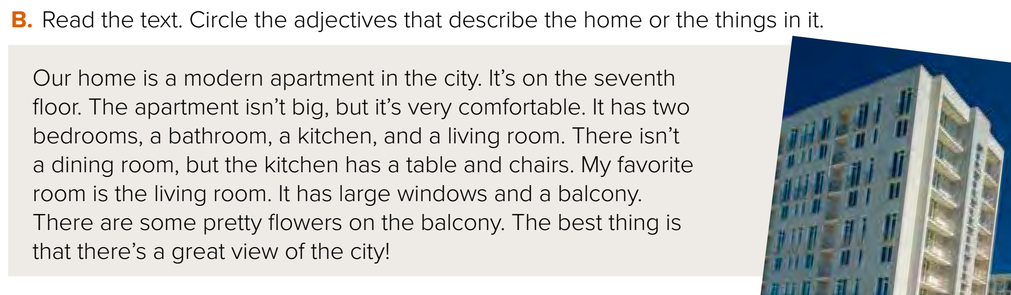











What furniture is in the kitchen?
Page 54
What is the writer’s favorite room? Why?
How many bedrooms are there
Warm up
1-Listen
Where is the apartment?
Quick check
What floor is it on? Is it big

Slide 8


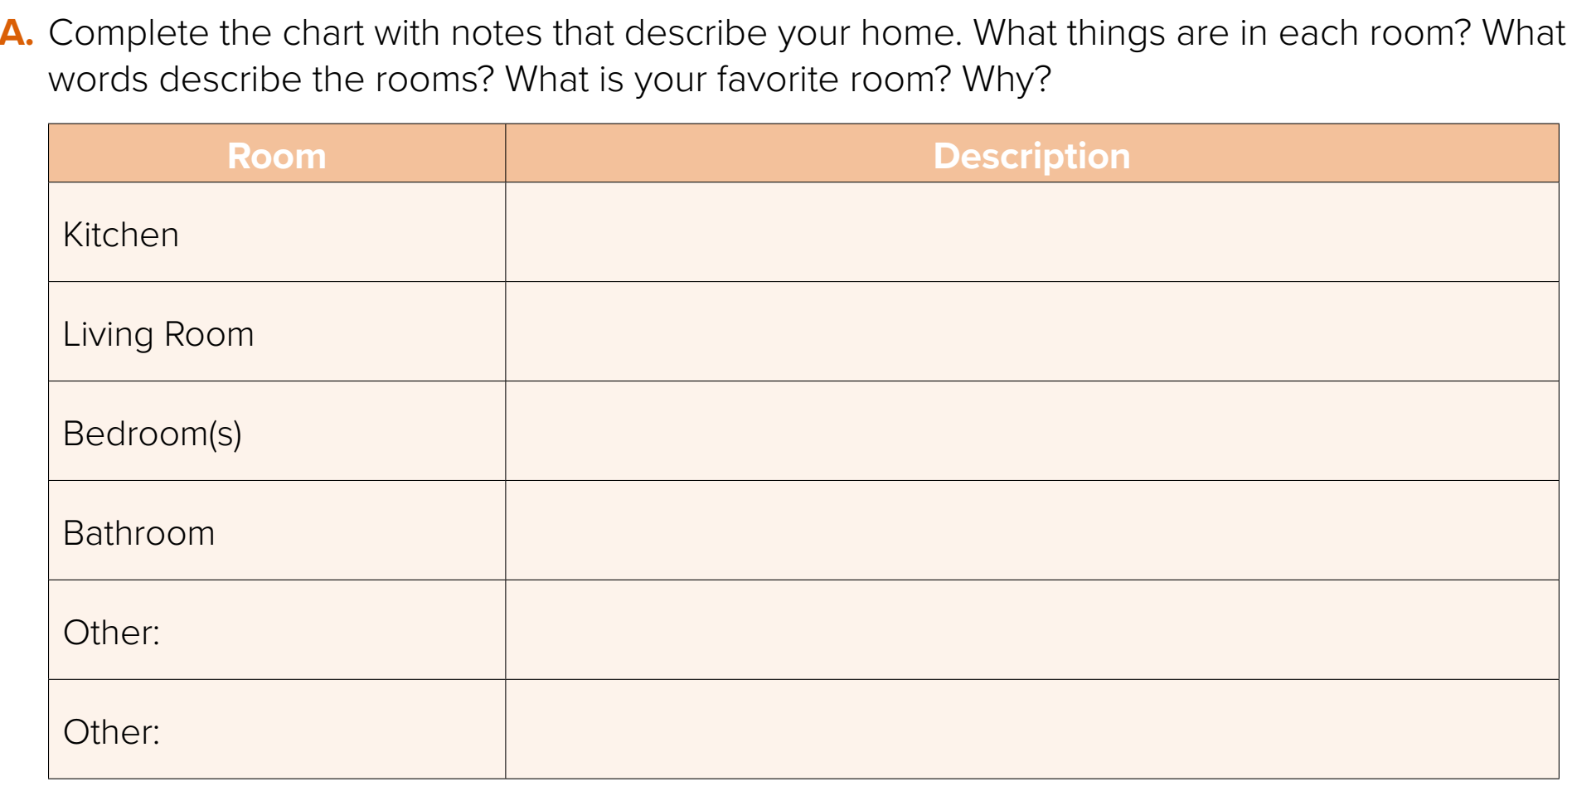
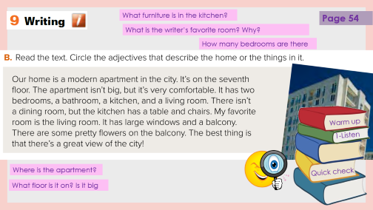
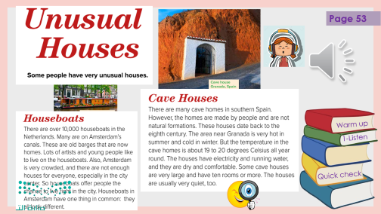
pair work
Big – microwave – oven – table & 2 chairs
Warm up
1-Listen
Quick check

Slide 9
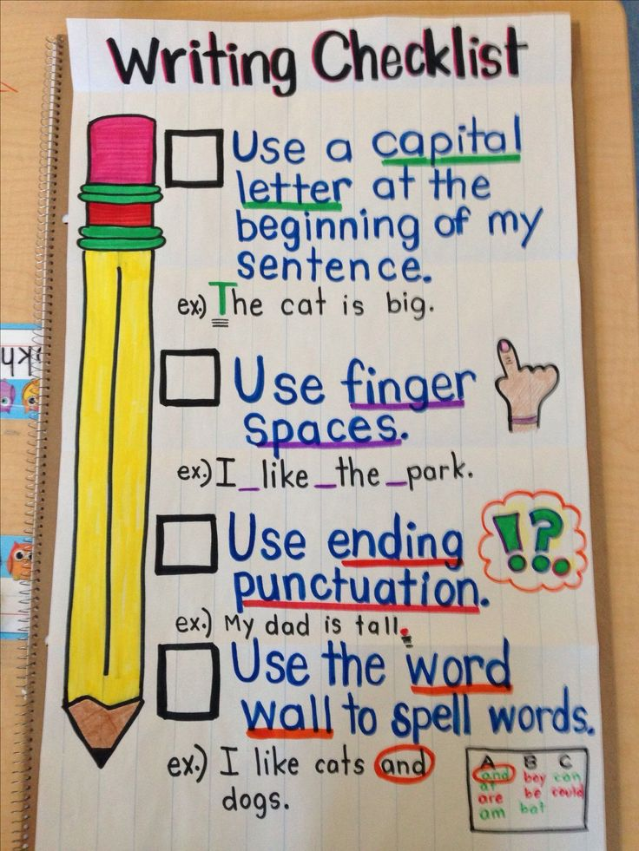
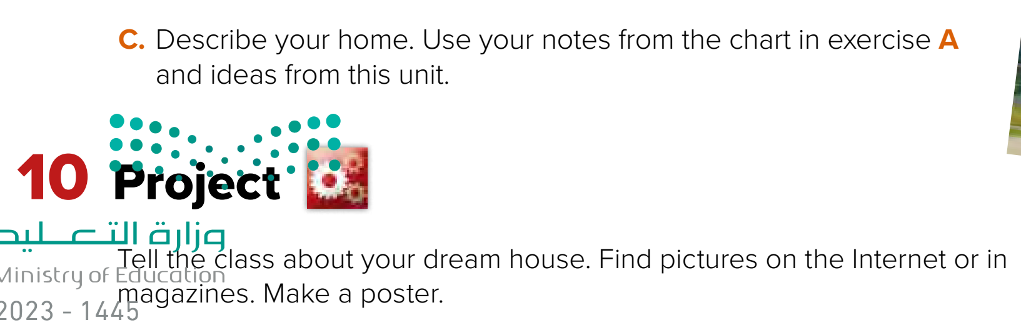

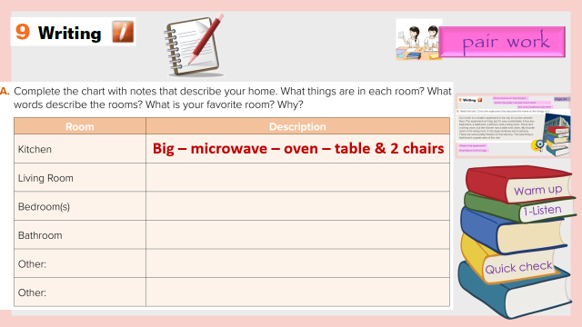
Use (and – but )
Warm up
Quick check

Slide 10
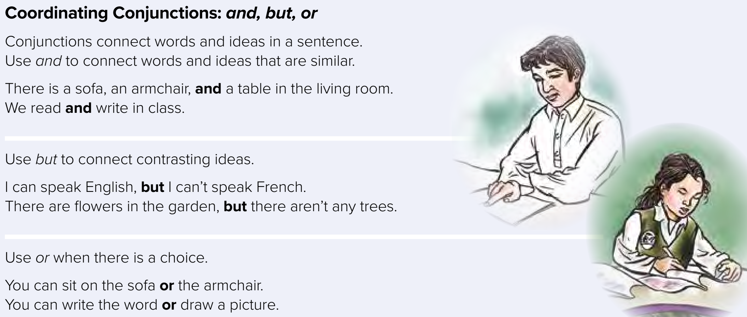











Page 55
Do you write with a pencil or a pen?
Is basketball a sport or a game?
Are you tall or short?
Warm up
1-Listen
Quick check

Slide 11
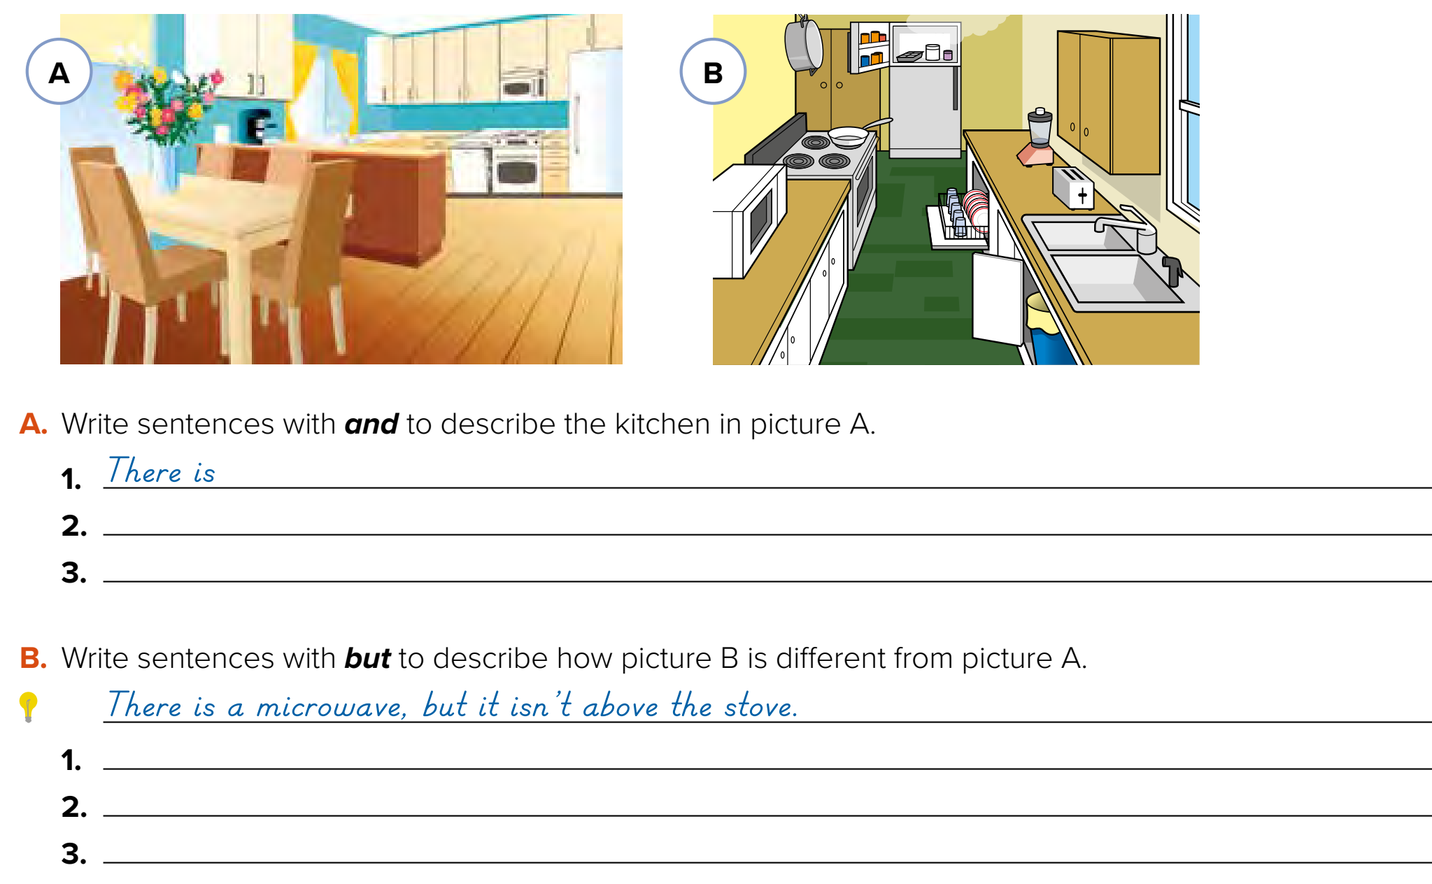


Think pair share
a stove, a dishwasher, and a refrigerator.
There are flowers and a vase on the table.
There is a table and chairs.
There is a window, but there aren’t any curtains.

Slide 12




Lets play
Warm up
1-Listen
Quick check

Slide 13



Write in your notebook
Like final test أسئلة للاختبار النهائي
Choose:
Mmmmmmm ………. mmmmmmm
( ssss – ssss – sssss)
Surprise game
Make a question

Slide 14





page 212 Ex(F)
for practice writing
Warm up
1-Listen
Quick check

Slide 15
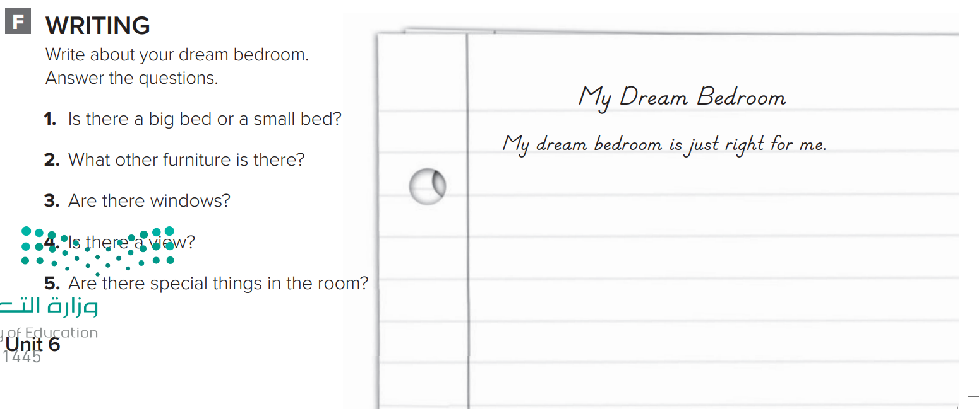
p.212
There is a big bed. There is a desk. There is a big TV with a DVD player. There are lots of windows. There is a beautiful view. There is a big closet in my bedroom. There is a sound system, too.

