Slide 1
Do You Really Need It?
Mega Goal 3.2
Unit 5
Reading
Done by: Entisar AL-Obaidallah

Slide 2
Lesson Objectives
01.
02.
03.
04.
Name
Read
Answer
Talk
Places where they see ads in everyday life
the text for specific information
Some questions about the text
correctly
about techniques used in advertisement

Slide 3
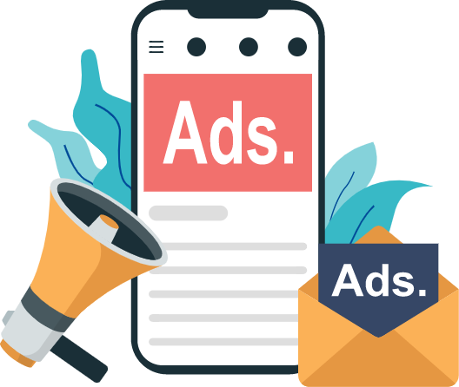
Warm Up
Do you remember this ADS ..
What does it mean?
It means : Advertisement

Slide 4
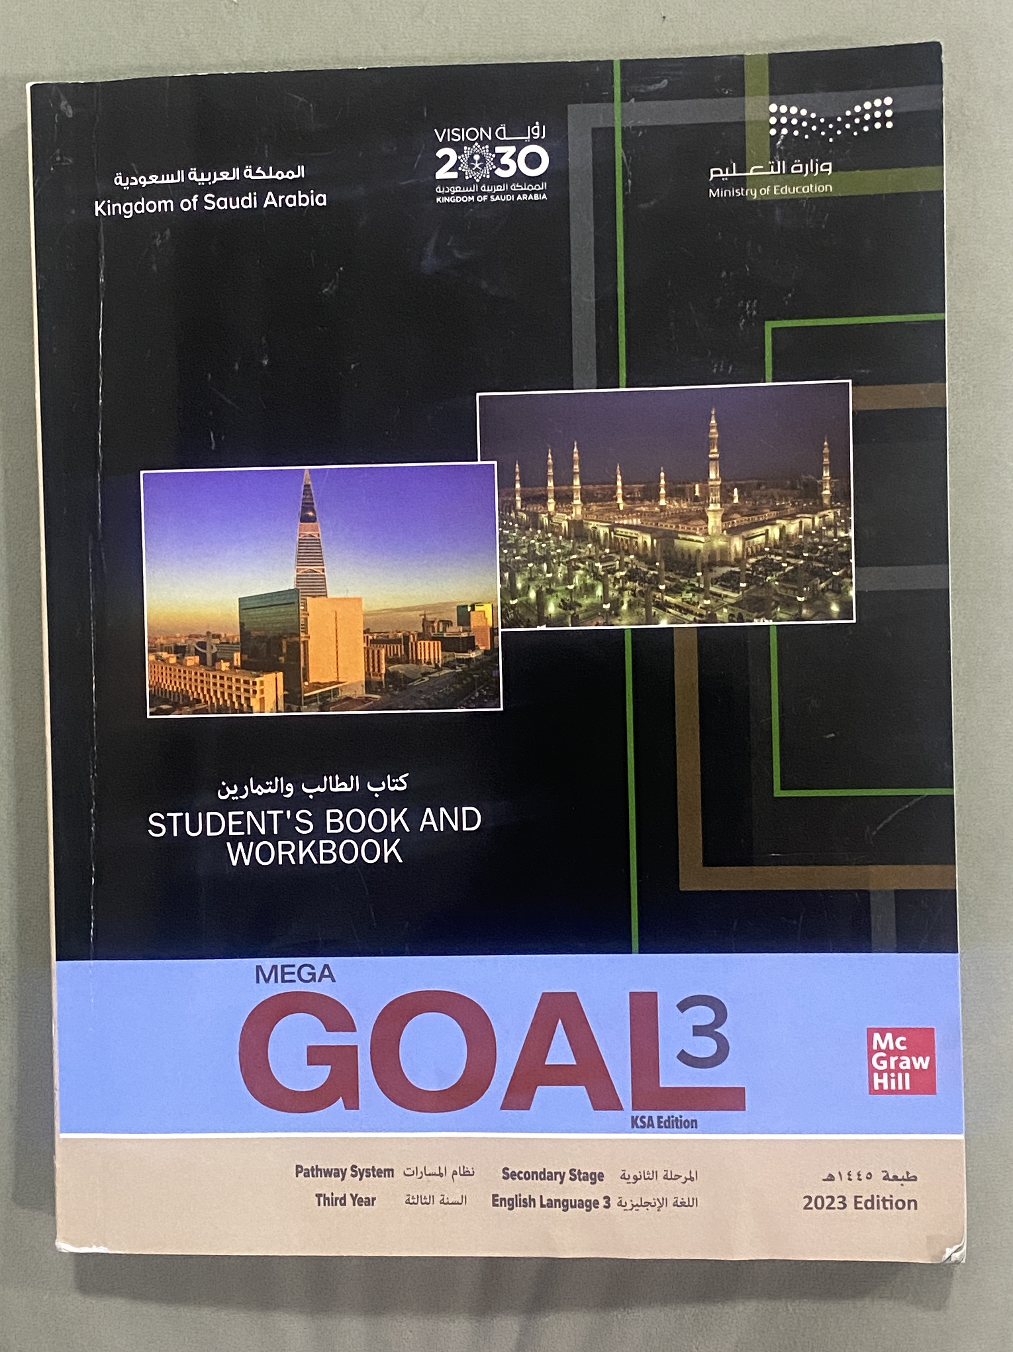
Your studen’s book p.
74
Open

Slide 5
Reading
Before

Slide 6
Brain storm

Slide 7
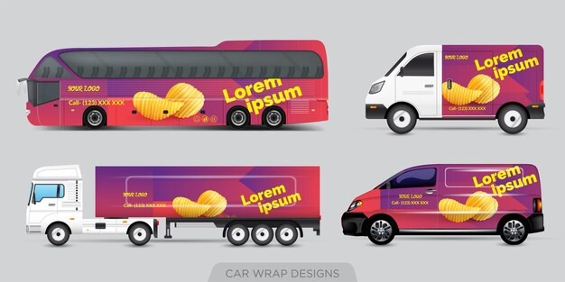
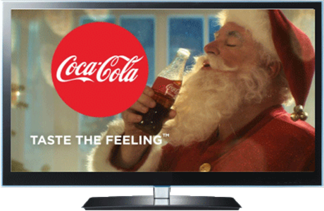
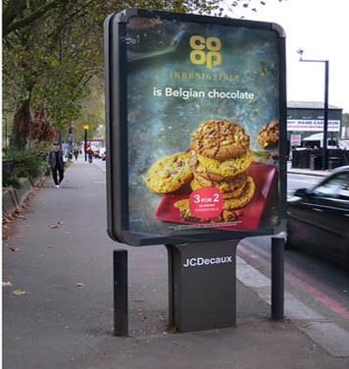
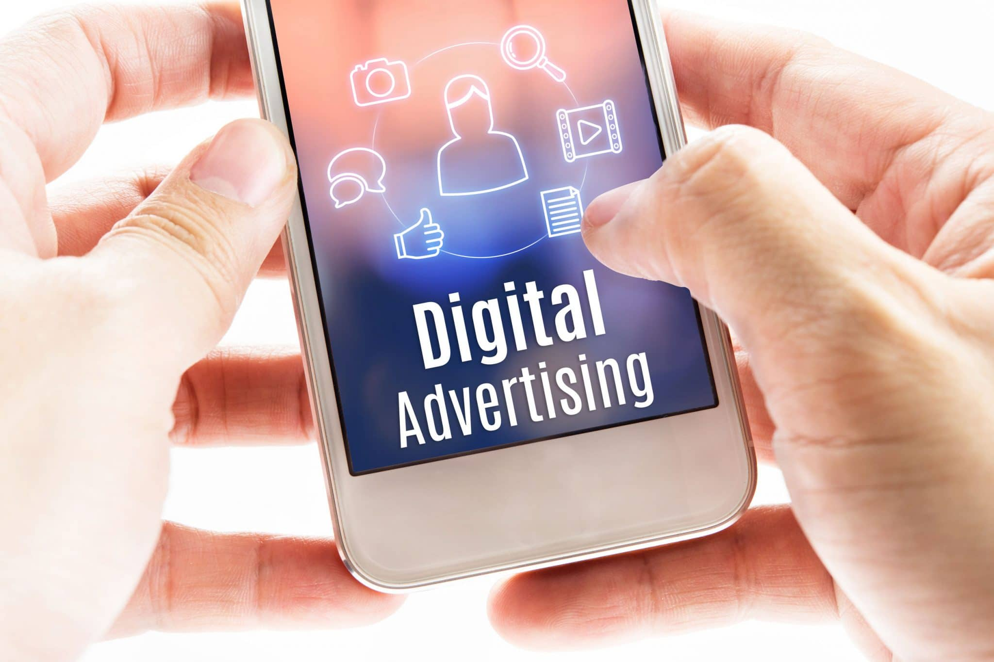
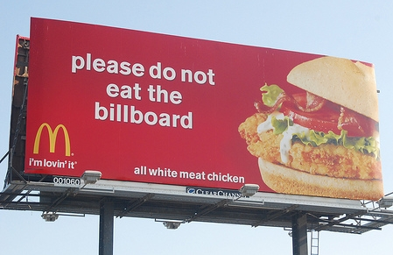
Where do we see or hear ADS ?
internet
Radio
Transport advertising
TV
Social Media
Newspaper
Billboard
phone
magazine

Slide 8
Why is “Buy” in quotation marks?
What is the title of the lesson?
“buy” has two meanings in this title.
to accept, believe, or support something
to purchase something.

Slide 9
What are the two meanings of the title?
Do you buy products that you see advertisements for?
Do you accept the practice
of being exposed to advertisements everywhere?

Slide 10
Do you recognize these cities?
Riyadh
Jeddah

Slide 11
What is the main idea of this paragraph?
It is about the amount of advertisements people see in a day.

Slide 12
What do you think you will learn in this paragraph?
It is about how advertisements reach people today

Slide 13
What do you think you will learn in this paragraph?
It’s about unconventional places of advertisement

Slide 14
What do you think you will learn in this paragraph?
It’s about The best way to get consumer’s attention

Slide 15
What do you think you will learn in this paragraph?
It’s about The strangest development in advertising

Slide 16
What is the main idea of this paragraph?
It’s about buzz marketing

Slide 17
What is the main idea of this paragraph?
It’s about the advertisement everywhere

Slide 18
Your studen’s book p.
75
Open

Slide 19
Reading
After

Slide 20
1. The average person is exposed to between 400 and 600 advertisements each day.
2. TV commercials, newspaper ads, and magazine ads are traditional advertising approaches.
3. Selling advertising space on one’s body is a strange development in advertising.
4. Buzz marketing is considered the sneakiest form of advertising.

Slide 22
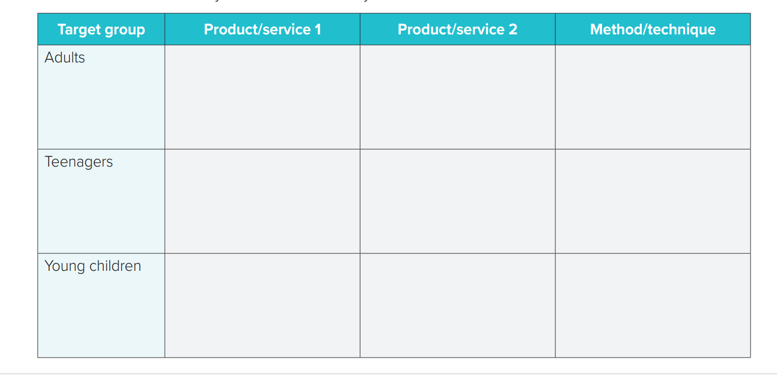
Clothes
&
Perfumes
cars
Social Media
mobiles
Video Games
Social Media
TV
&
Social Media
toys
candies

Slide 23
From The Holy Qura’an

Slide 24
Homework
Workbook p.(274) ,
exercise ( J)
Notes:
لا احلل ولا اسامح من يستخدم العرض لأغراض أخرى ولا احلل من يعيد نسخه والتعديل عليه ويزيل اسمي

Slide 25
Thanks !
Notes:
لا احلل ولا اسامح من يستخدم العرض لأغراض أخرى ولا احلل من يعيد نسخه بحجة التعديل ويزيل اسمي

