Slide 1
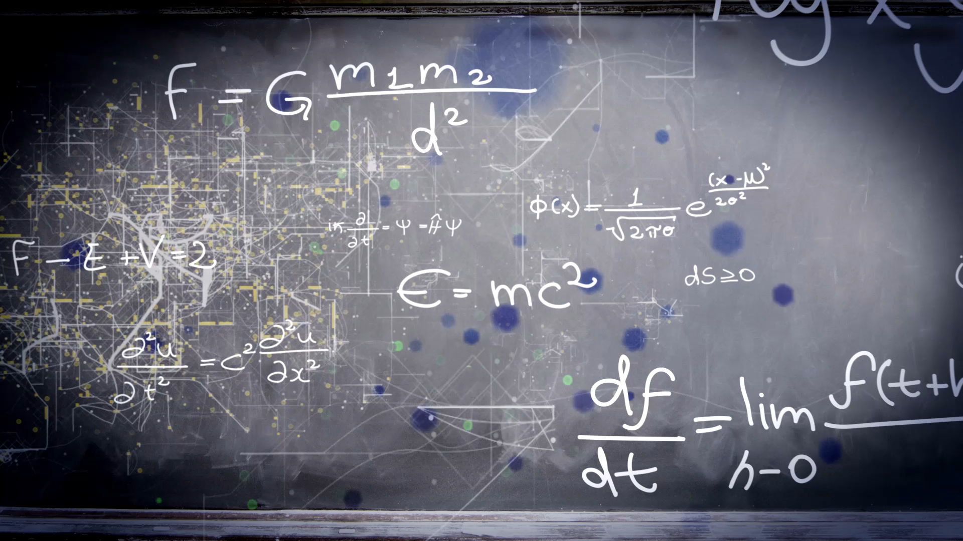
Unit 6
Is there a view?
Workbook pages (209 – 212)

Slide 2
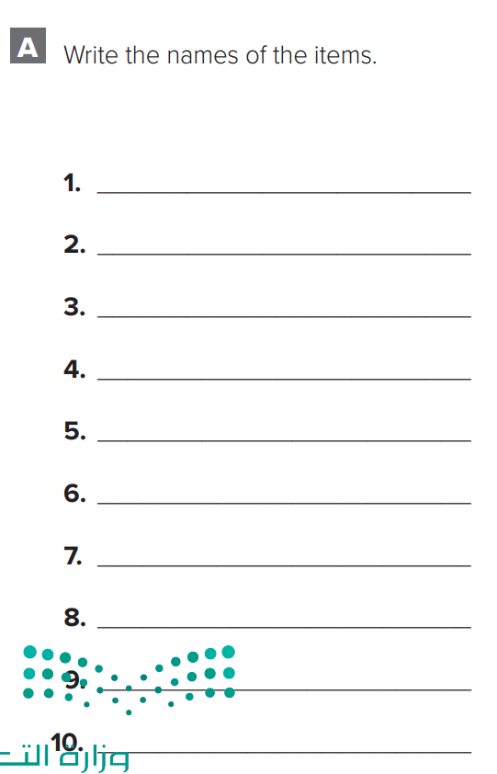
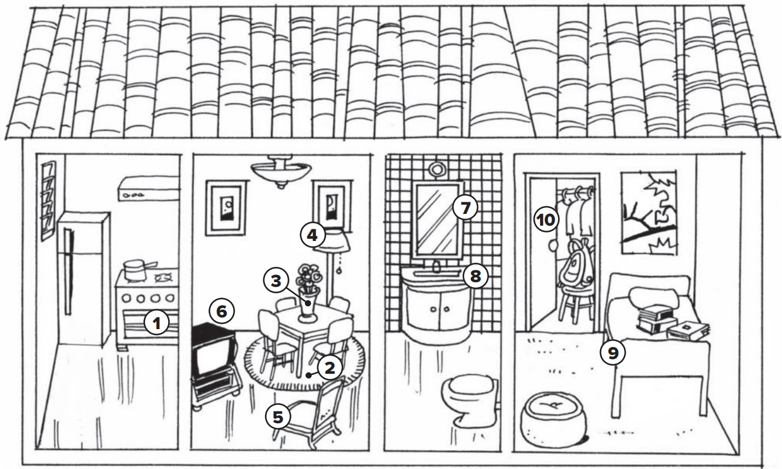

p.209
stove
rug
Vase with flowers
lamp
chair
TV
mirror
sink
bed
closet

Slide 3
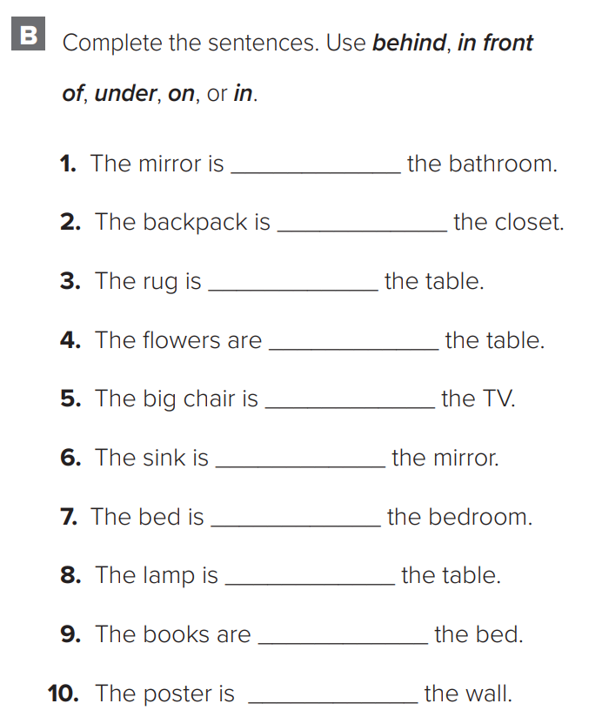

p.209
in
in
under
on
in front of
under
in
behind
on
on

Slide 4
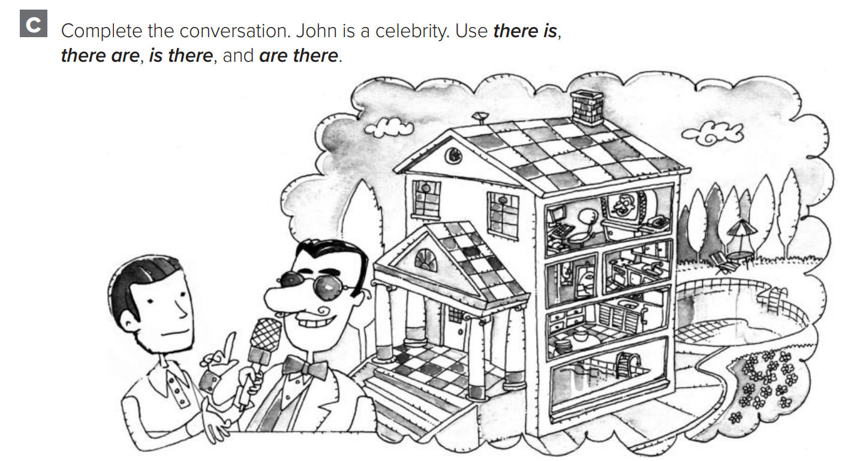
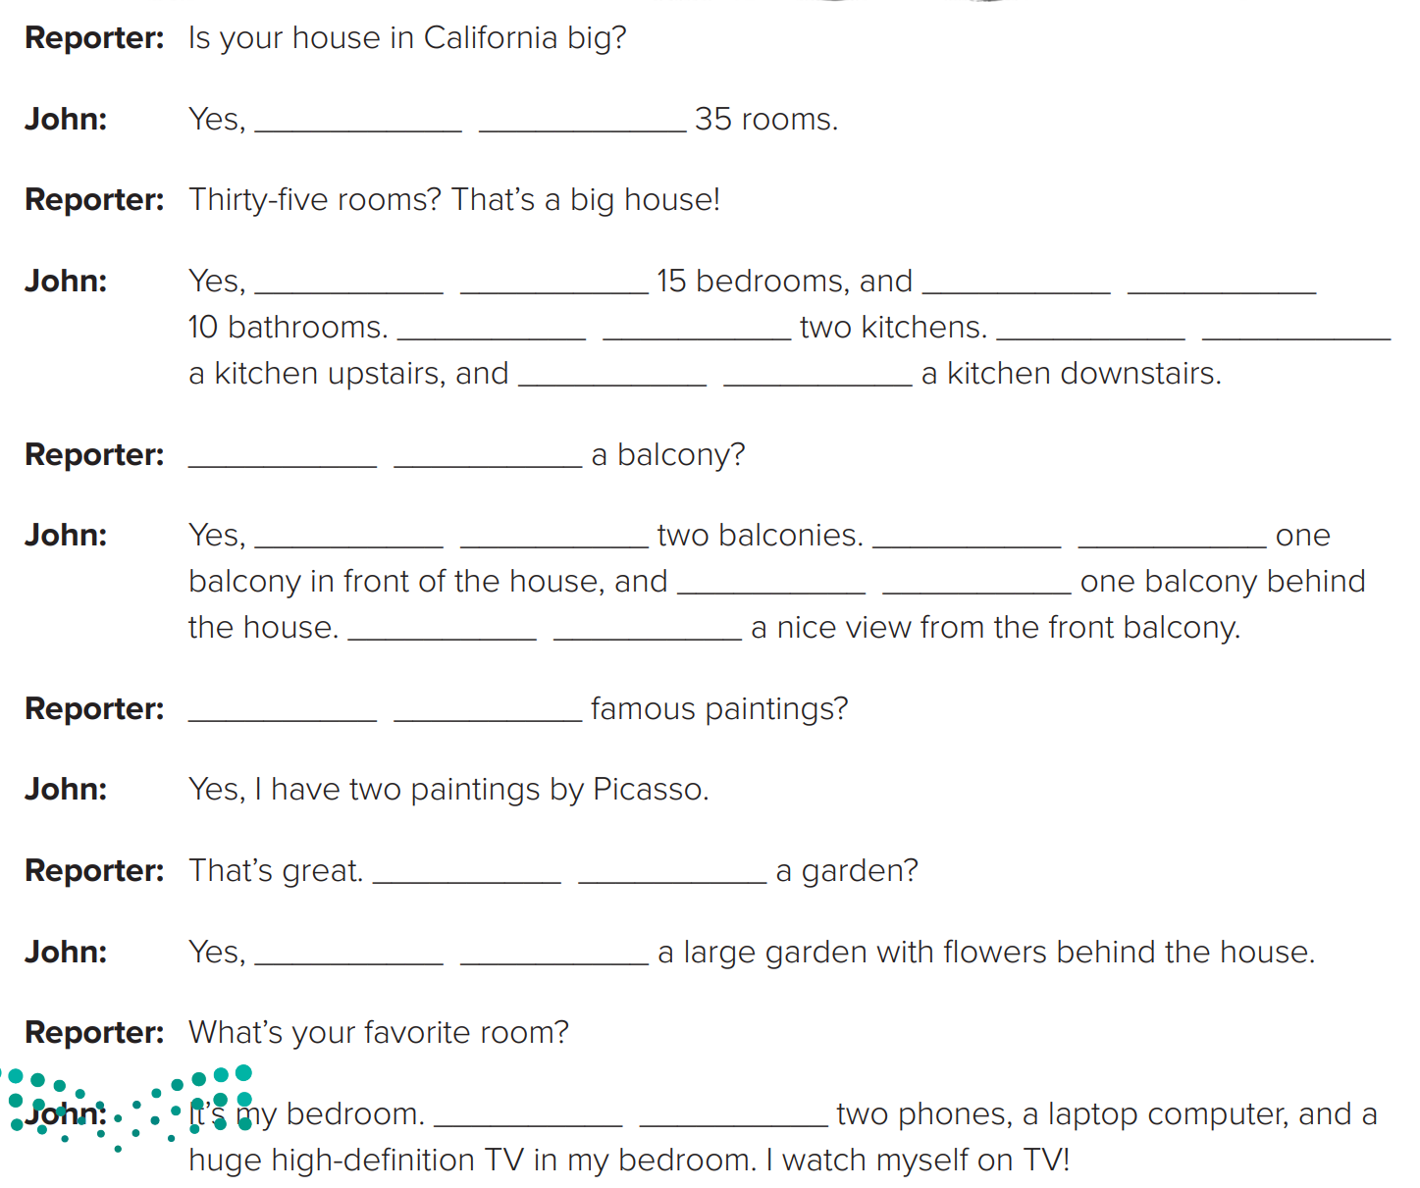

p.210
there are
there are
there are
There are
There is
there is
Is there
there are
There is
there is
There is
Are there
Is there
there is
There are

Slide 5
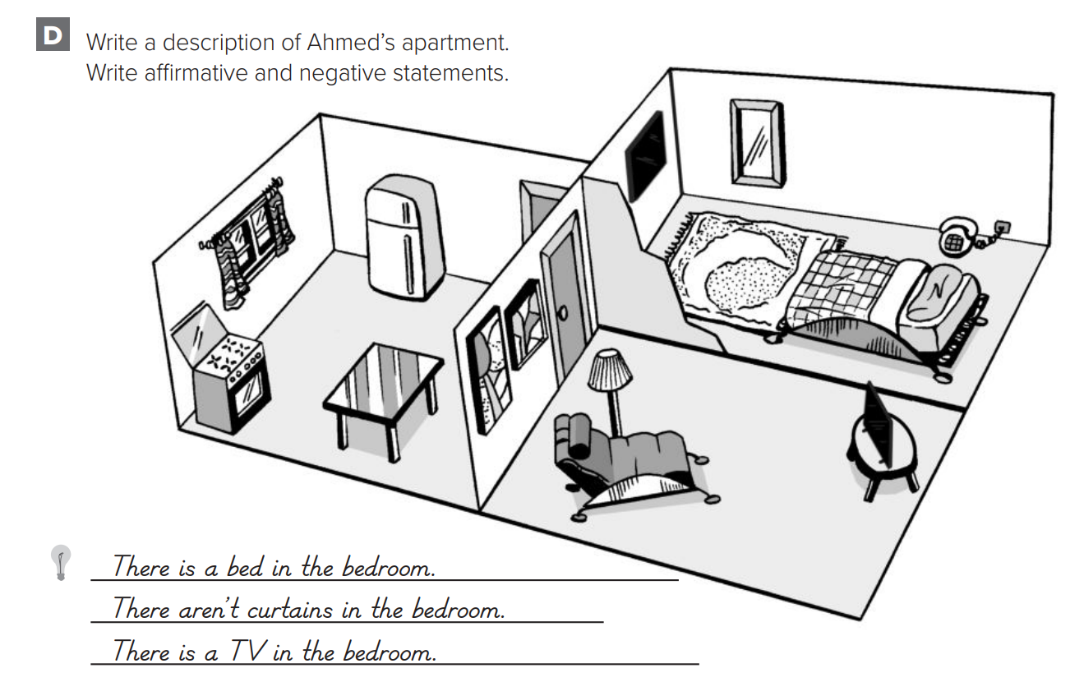
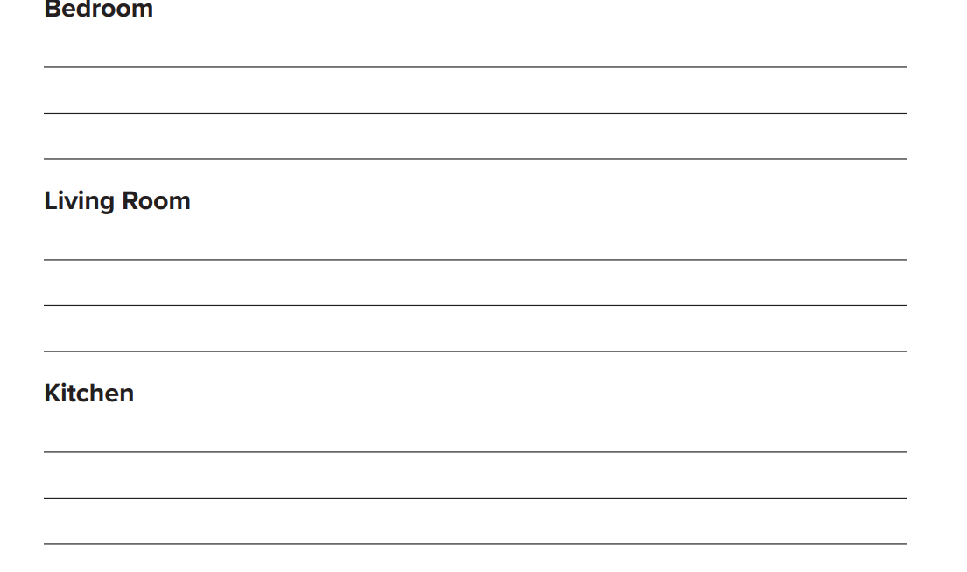

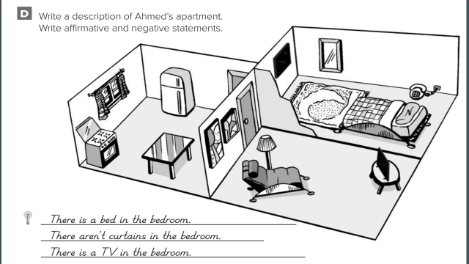
p.211
There is a rug in the bedroom
There is a telephone in the bedroom
There isn’t a closet in the bedroom
There is a lamp in the living room
There are paintings in the living room
There isn’t a rug in the living room
There is a stove in the kitchen
There are curtains in the kitchen
There isn’t a sink in the kitchen

Slide 7
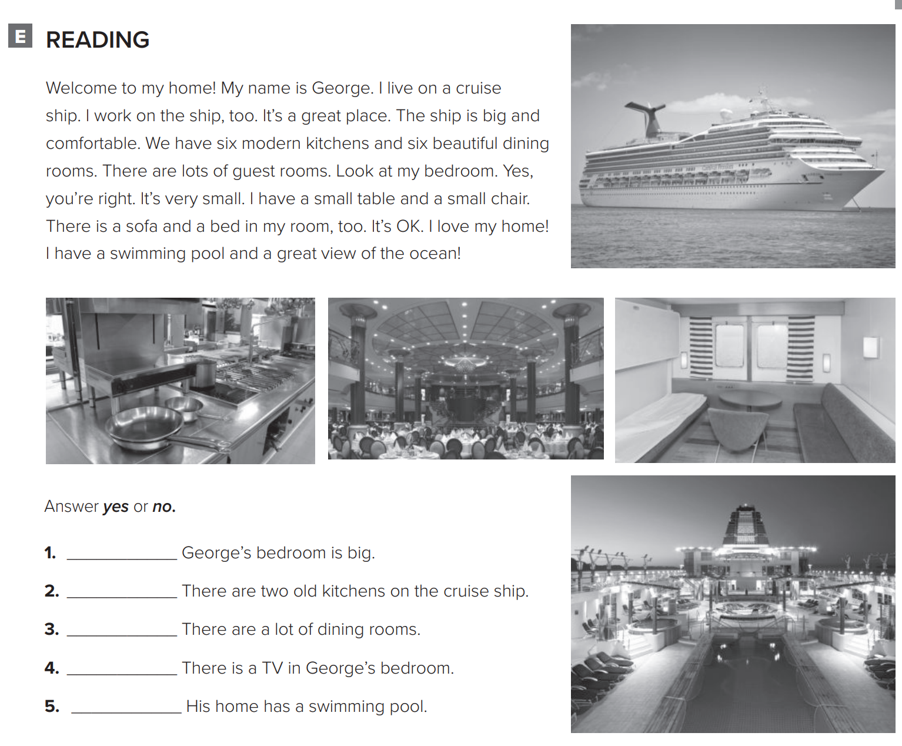

p.212
no
no
yes
no
yes

Slide 8
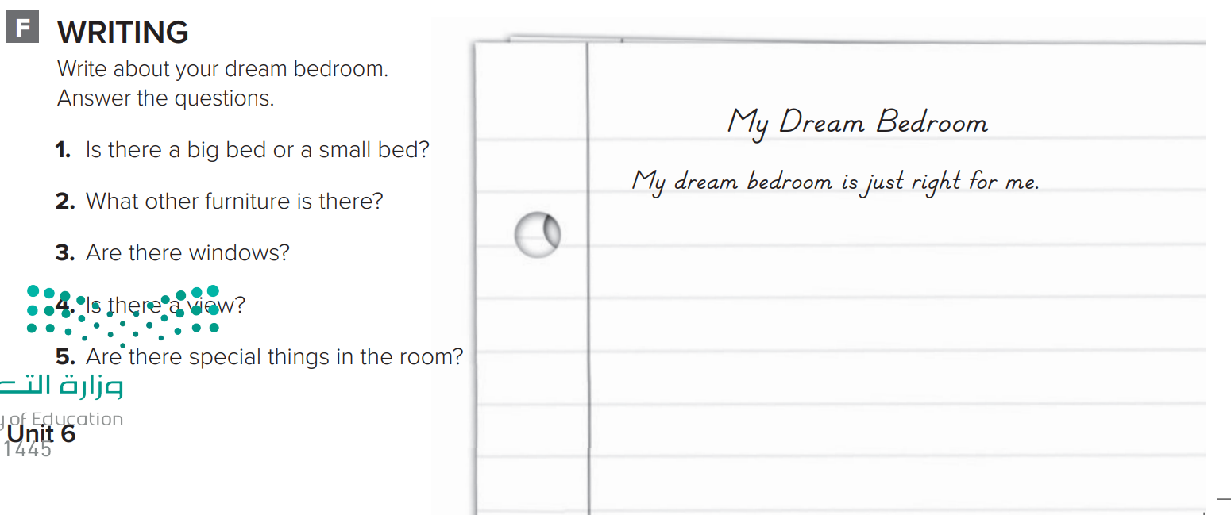

p.212
There is a big bed. There is a desk and a big TV with a DVD player. There are lots of windows. There is a beautiful view. There is a big closet in my bedroom. There is a sound system, too.

