Slide 1

Unit 6
Do you Know Where It Is?
Listen and Discuss

Slide 2
بسم الله الرحمن الرحيم
Day:
Date:

Slide 3
Learning Objectives
02
04
Describe the quality of life using adjectives
Value the good qualities in their places
01
03
identify transportation words.
talk about features of community.

Slide 4
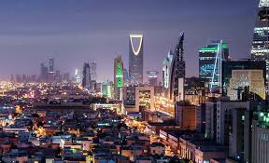
what kinds of services your town or city offers?
Are there good restaurants/hospitals/ cultural events/schools in the town? Is there good transportation/housing?

Slide 5
BEFORE LISTENING
01
02
03
04
05
06
How fast do you think the train goes?
How do people probably describe the train service in this country?
Are the cities in the pictures small, medium-size, or large?
07
What are the largest cities in the world?
What is the population of the largest cities?
What problems do large cities have?
How is the town in picture C different from the city In picture B?
Pages:58 & 59

Slide 6
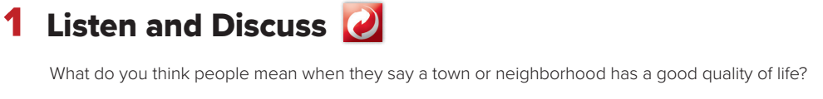
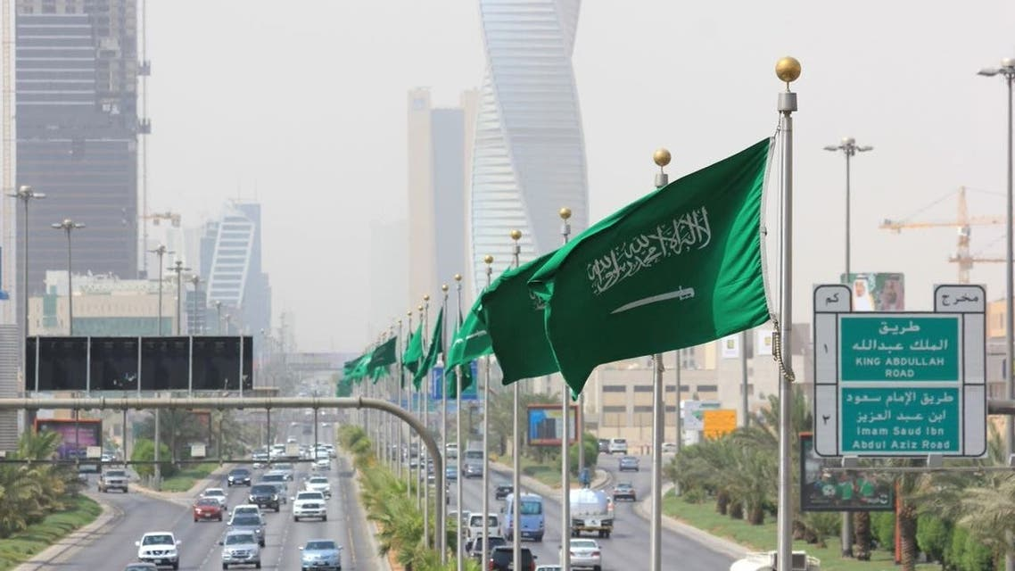
Page:58 & 59

Slide 7
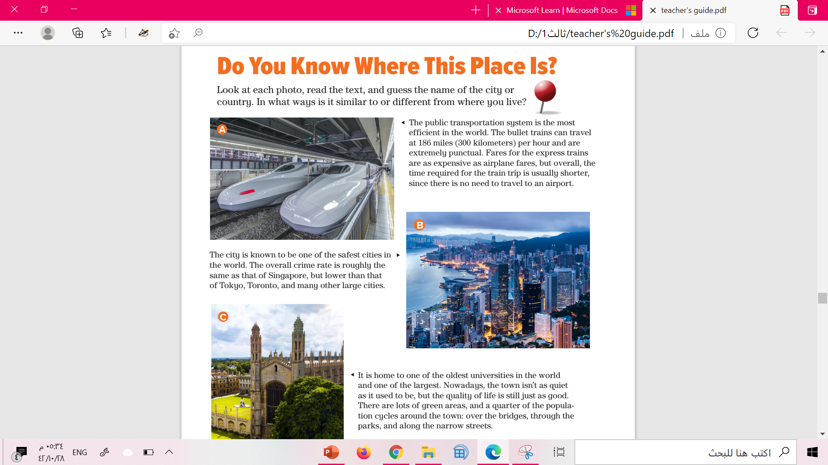


Slide 8
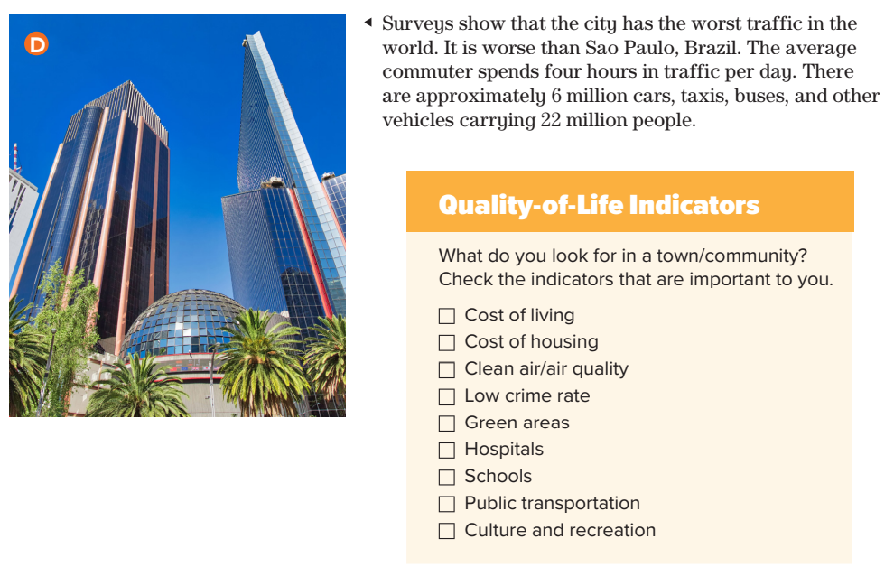


Slide 10
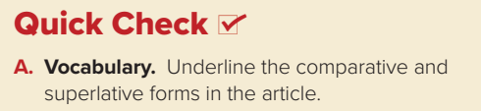
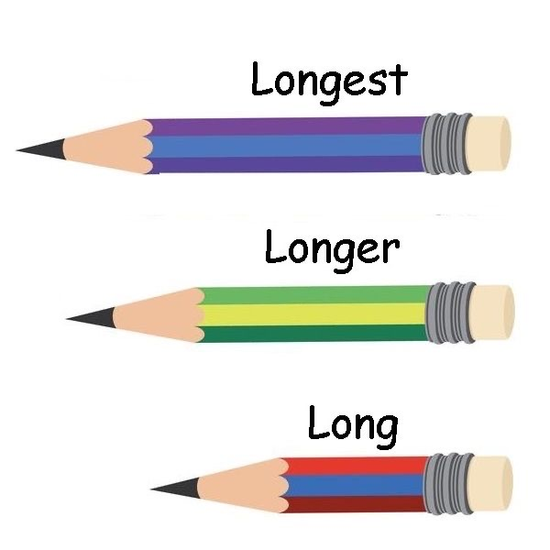
A: the most efficient; as expensive as; shorter
B: the safest; lower
C: the oldest; the largest; as quiet as
D: the worst; worse

Slide 11
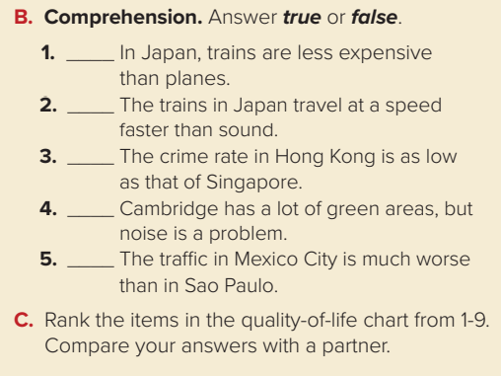
false
false
True
false
True

Slide 12
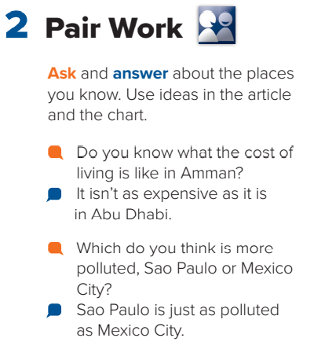


Slide 13
Homework!
Page 203

Slide 14
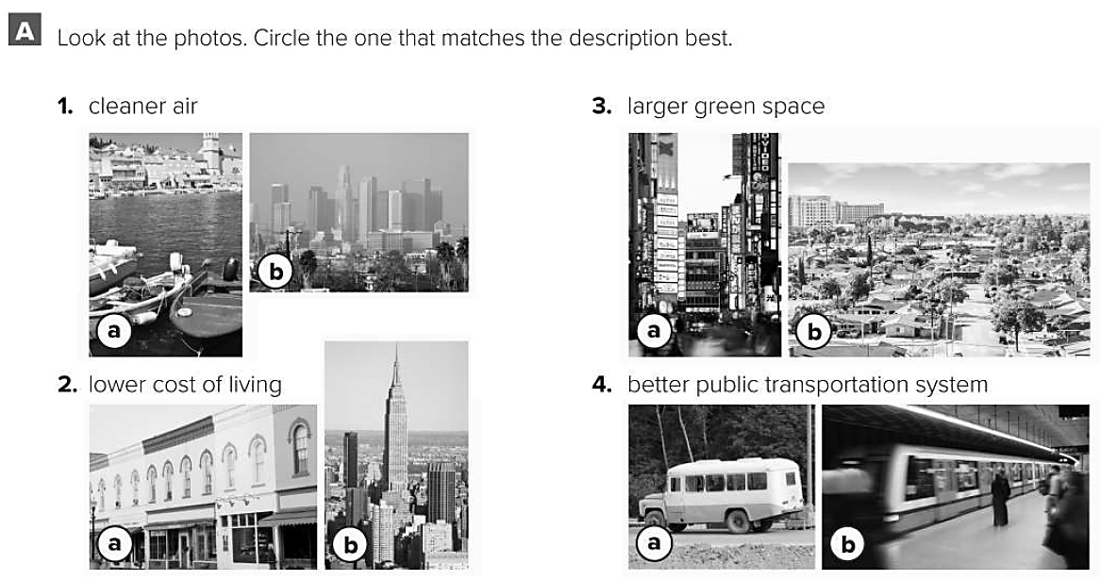

Slide 15
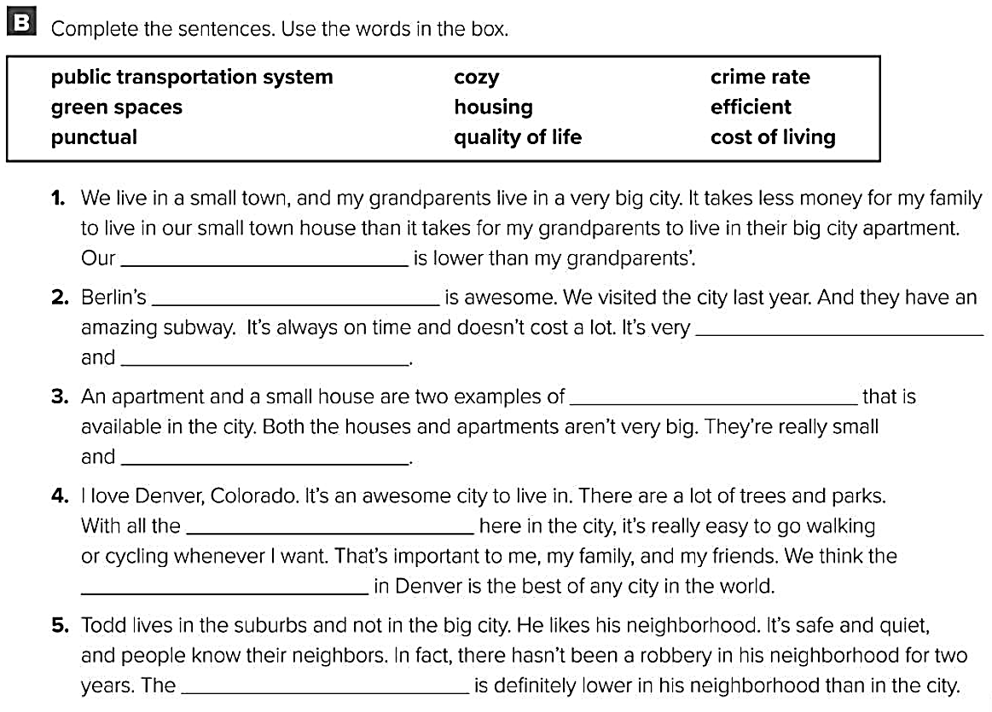
cost of living
public transportation system
punctual
efficient
housing
cozy
green spaces
quality of life
crime rate

