Slide 1




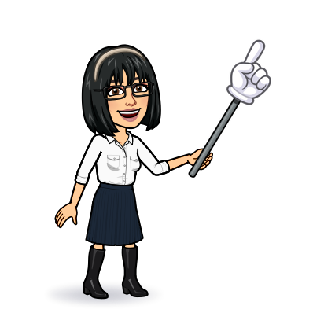

1 Listen & discuss
2 pair work
Today:
Date:
- -
Page 56
By: Dalal Al-Juaid

Slide 2


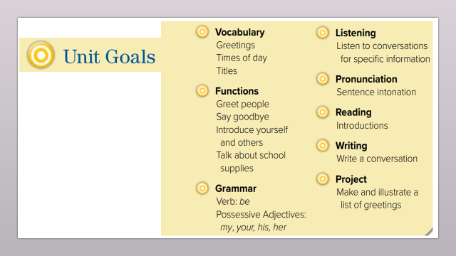
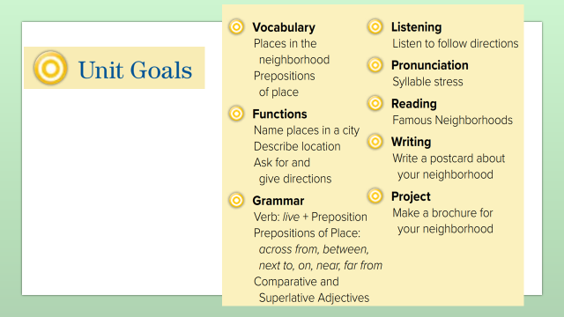
name places in a city
ask about places
Warm up
1-Listen
describe locations
New words
Quick check
Ask & answer about places
2-Pair work

Slide 3
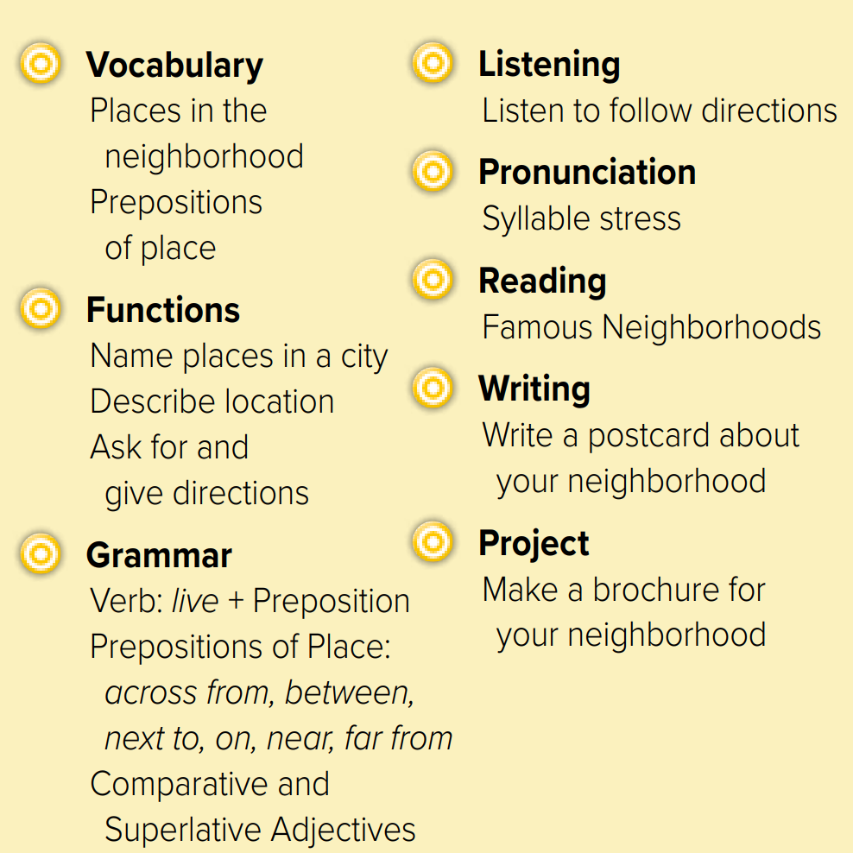
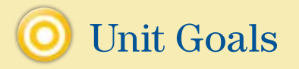

Slide 4


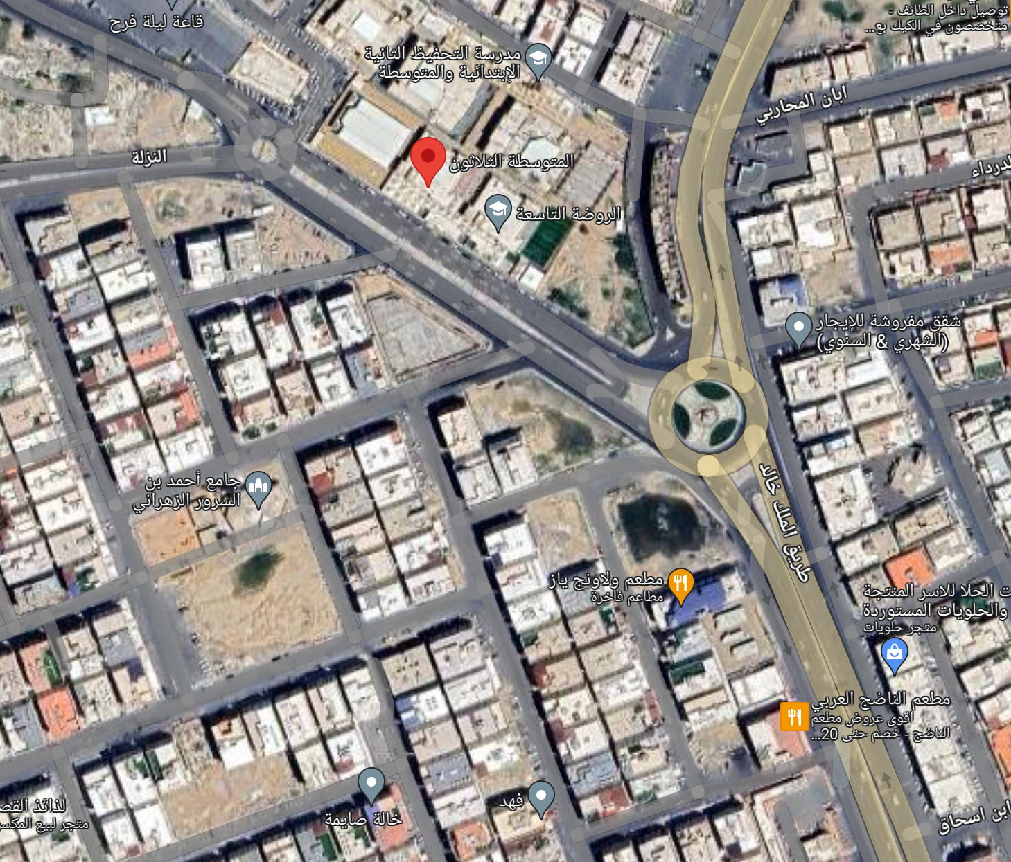


Where is our school ?
neighborhood
Warm up
1-Listen
Is there a park near here?
Are there any good
restaurants in the
neighborhood?
New words
Quick check
2-Pair work

Slide 5
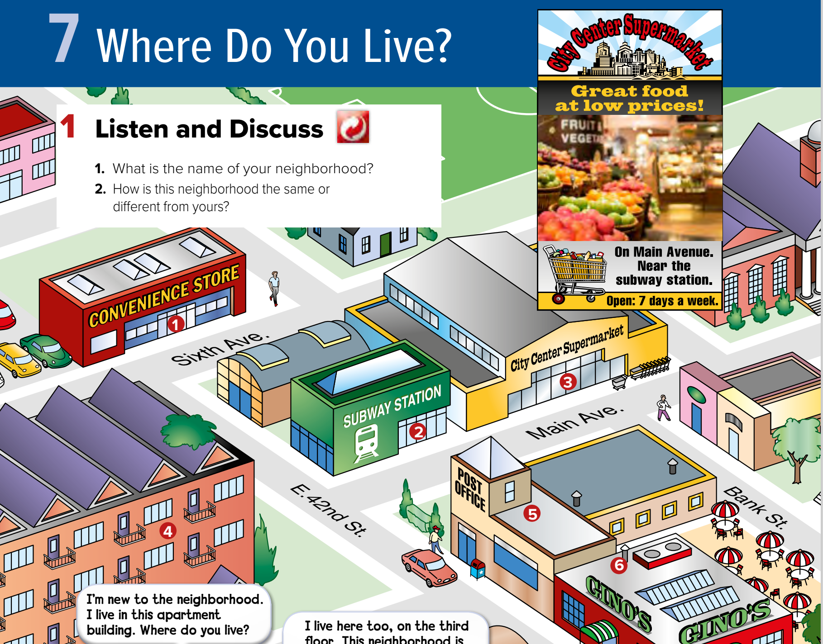


Page 56
Warm up
1-Listen
New words
Quick check
What’s near the post office?
What’s next to the subway station?
2-Pair work

Slide 6
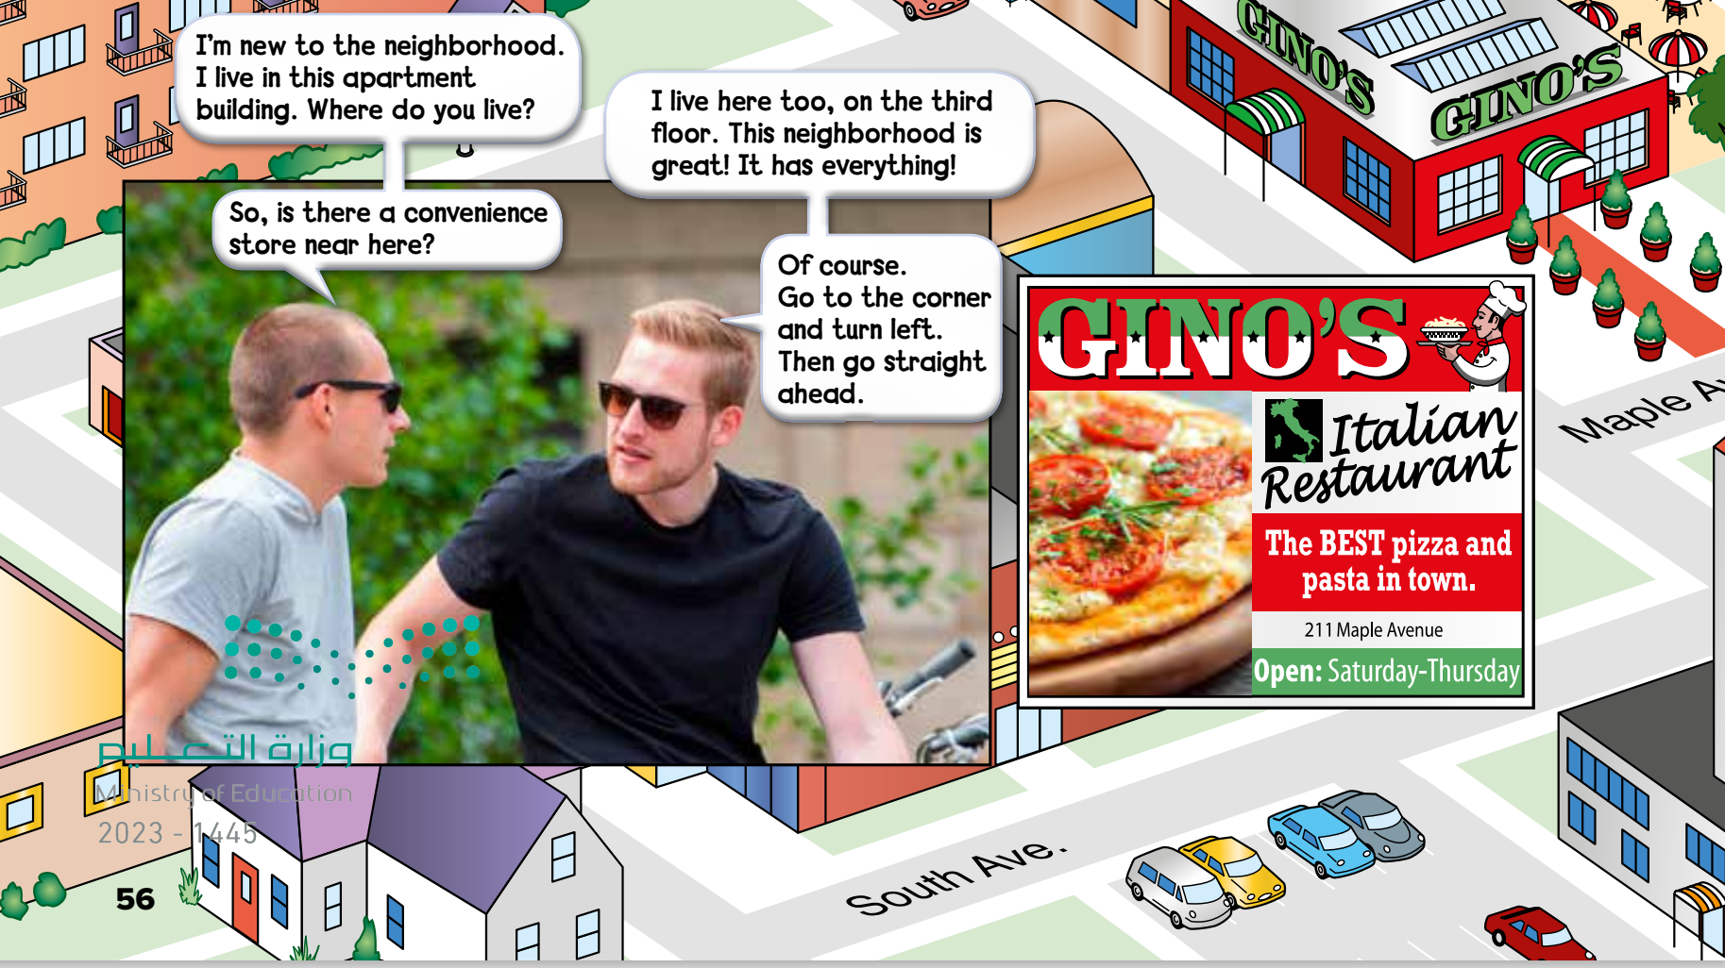
Do the young men live in the same apartment building?
Page 56
Does the boy like the neighborhood?
Warm up
1-Listen
New words
Quick check
2-Pair work

Slide 7
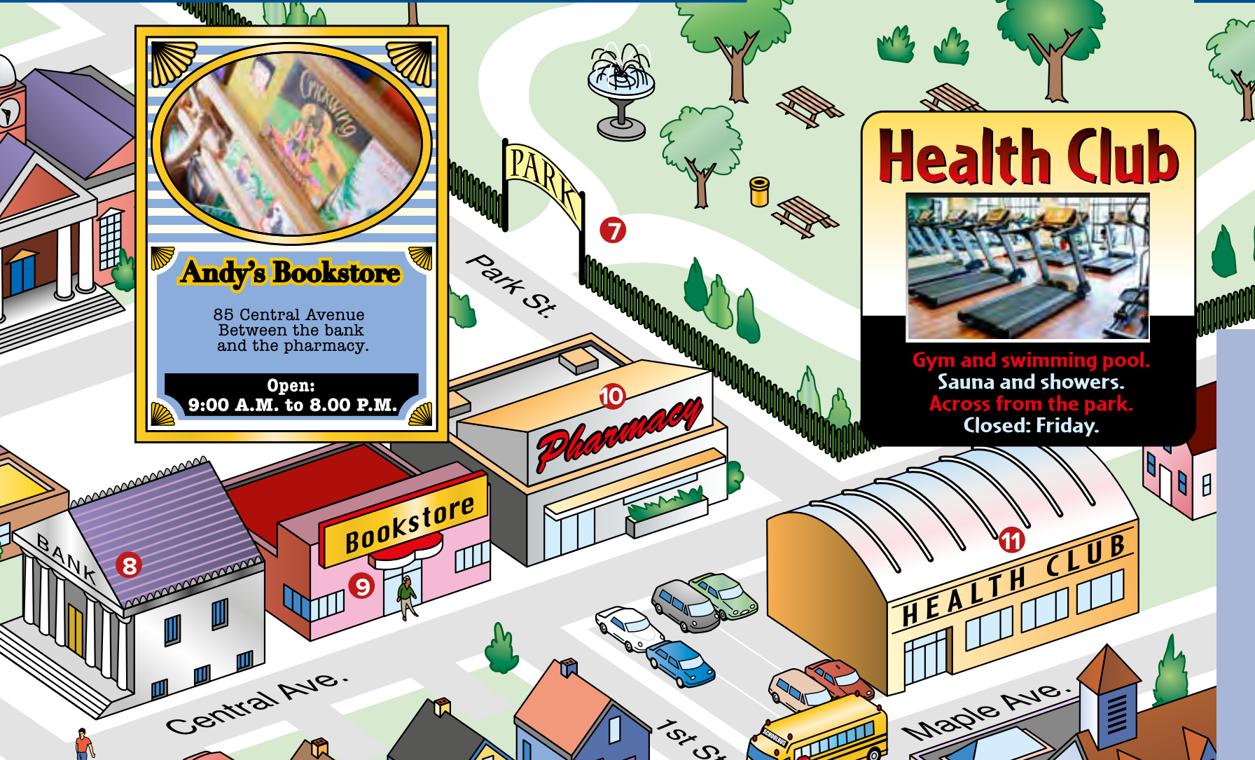
Page 57
St. = Street
Ave. = Avenue
E. = East
W. = West
Warm up
1-Listen
New words
Quick check
2-Pair work

Slide 8
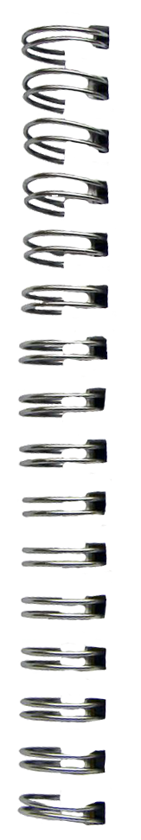
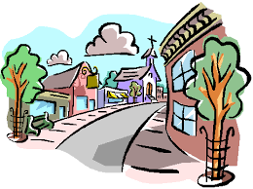

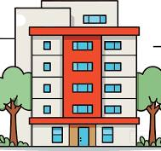


New Words
neighborhood
places in same area
bookstore
park
supermarket
restaurant
building
#
pharmacy
turn left
..........

Slide 9
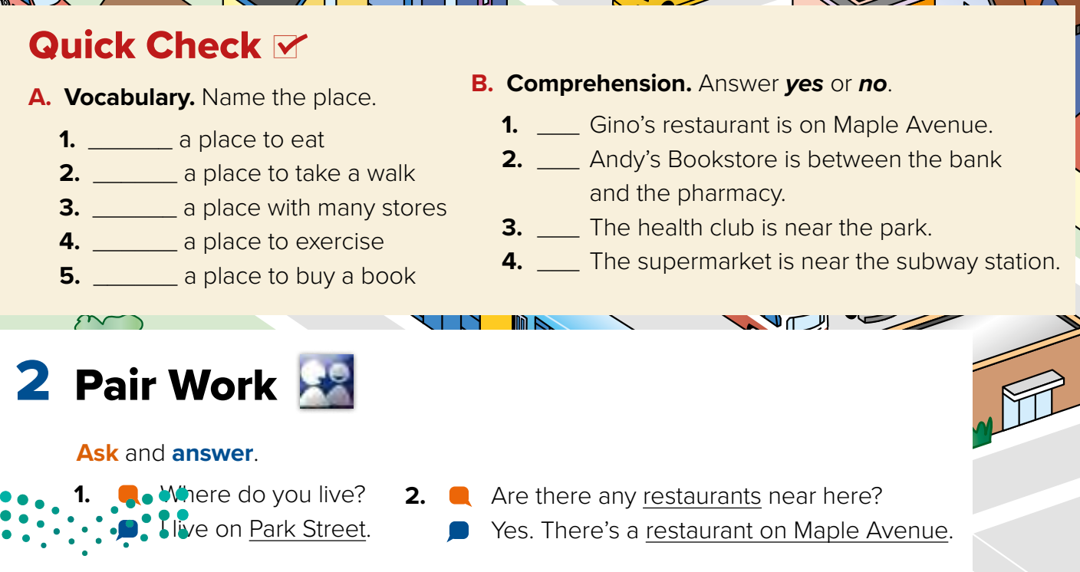

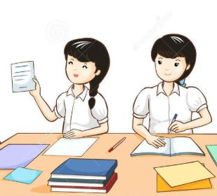
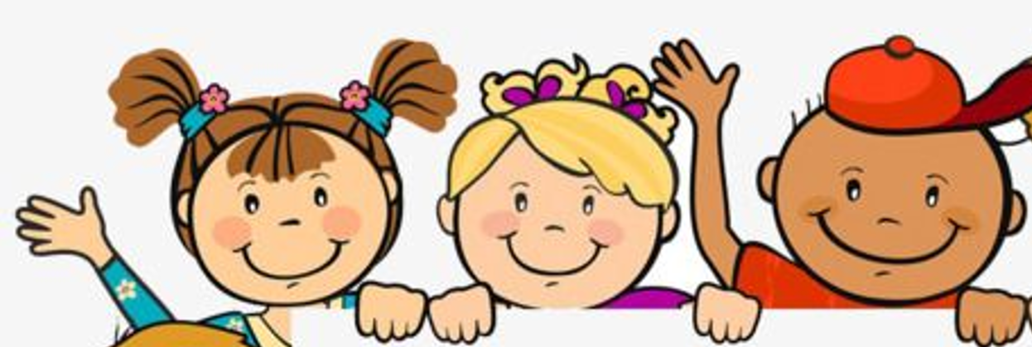
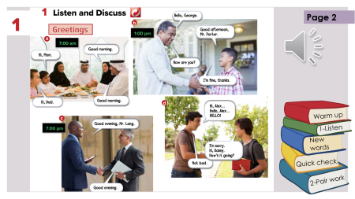
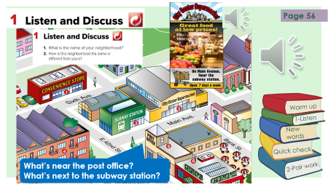
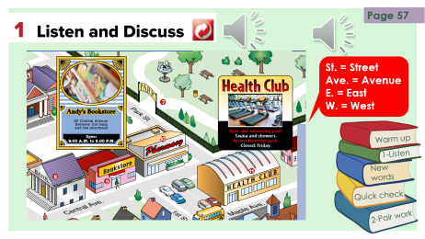
restaurant
The park
mall
Health club
Think pair share
bookstore
Warm up
no
1-Listen
yes
New words
yes
Quick check
yes
2-Pair work

Slide 10

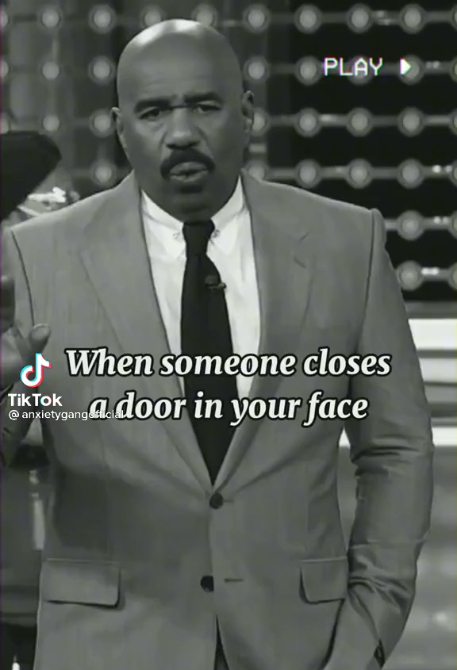
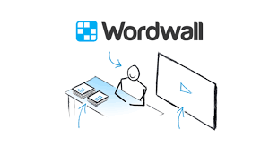
Lets play
Warm up
1-Listen
New words
Quick check
2-Pair work

Slide 11


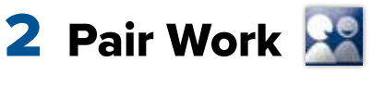
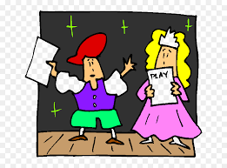
What is the city of the future in KSA?
Role paly
Warm up
1-Listen
New words
Quick check
2-Pair work

Slide 12
Write in your notebook
Like final test أسئلة للاختبار النهائي
Choose:
Mmmmmmm ………. mmmmmmm
( ssss – ssss – sssss)
Make a question

Slide 13





page 213 Ex(A-B)
for practice new words
Warm up
1-Listen
New words
Quick check
2-Pair work

Slide 14
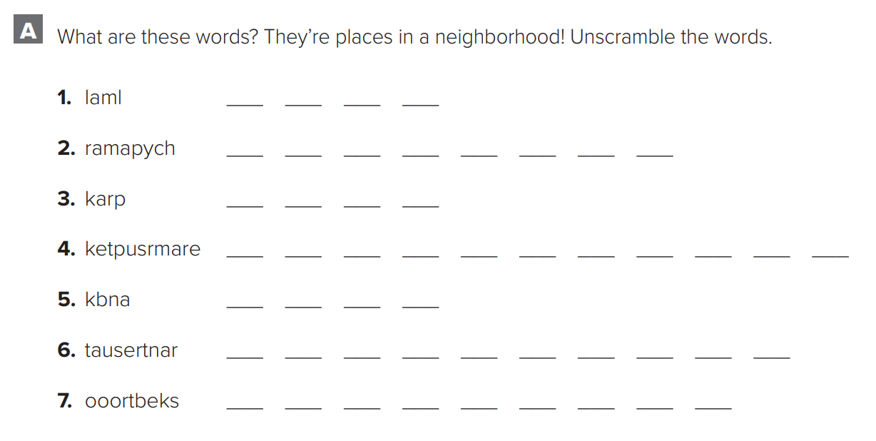
p.213
m
a
l
l
p
h
a
r
m
a
c
y
p
a
r
k
s
u
p
e
r
m
a
r
k
e
t
b
a
n
k
r
e
s
t
a
u
r
a
n
t
Warm up
1-Listen
b
o
o
k
s
t
o
r
e
New words
Quick check
2-Pair work

Slide 15
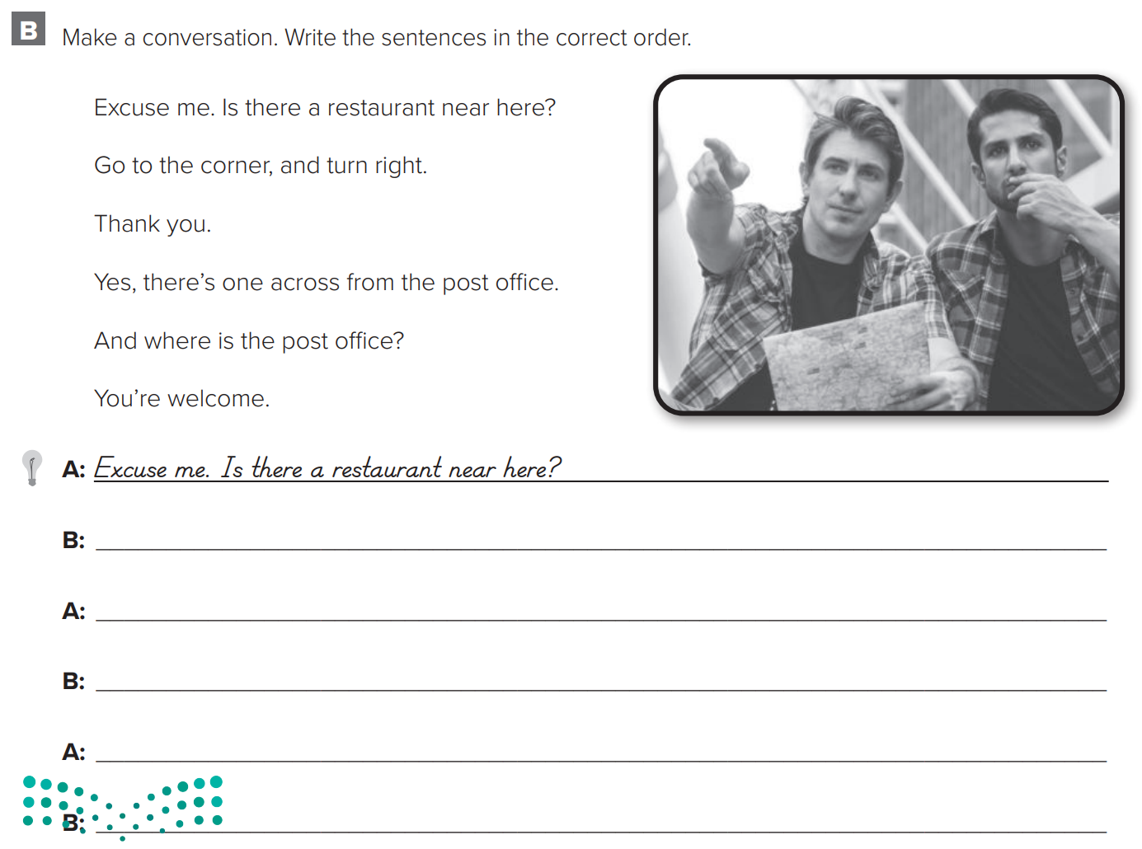
p.213
Yes, there’s one across from the post office
Warm up
1-Listen
And where is the post office?
New words
Go to the corner, and turn right.
Thank you
Quick check
You’re welcome
2-Pair work

