Slide 1
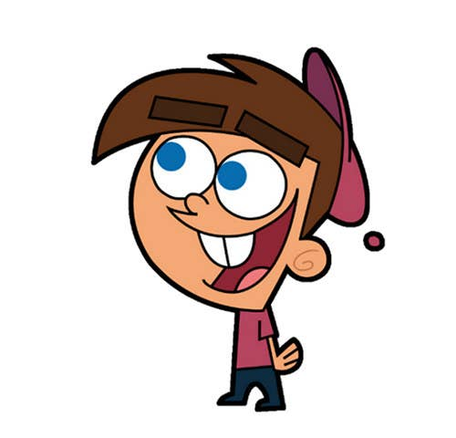


Welcome to class
T.
MOHAMAD
ZAID

Slide 2
Day
Sunday
Date
12th DEC 2021
Subject
We can 3
Unit
6 jobs
Lesson
1 Finding Out Time

Slide 3



PAGE 42

Slide 4




Slide 5

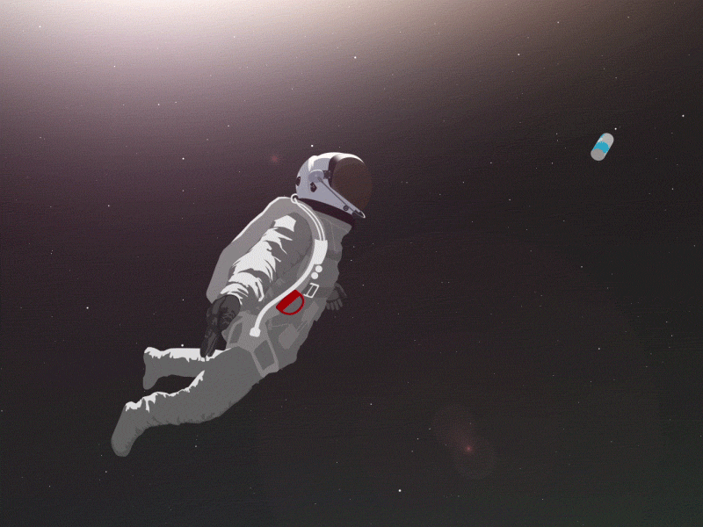
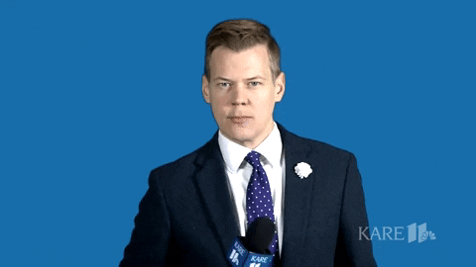
Listen and say
astronaut
reporter

Slide 6


Listen and say
architect
pilot

Slide 7

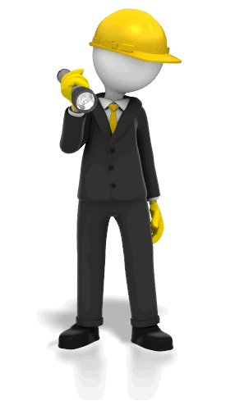
Listen and say
nurse
engineer

Slide 8


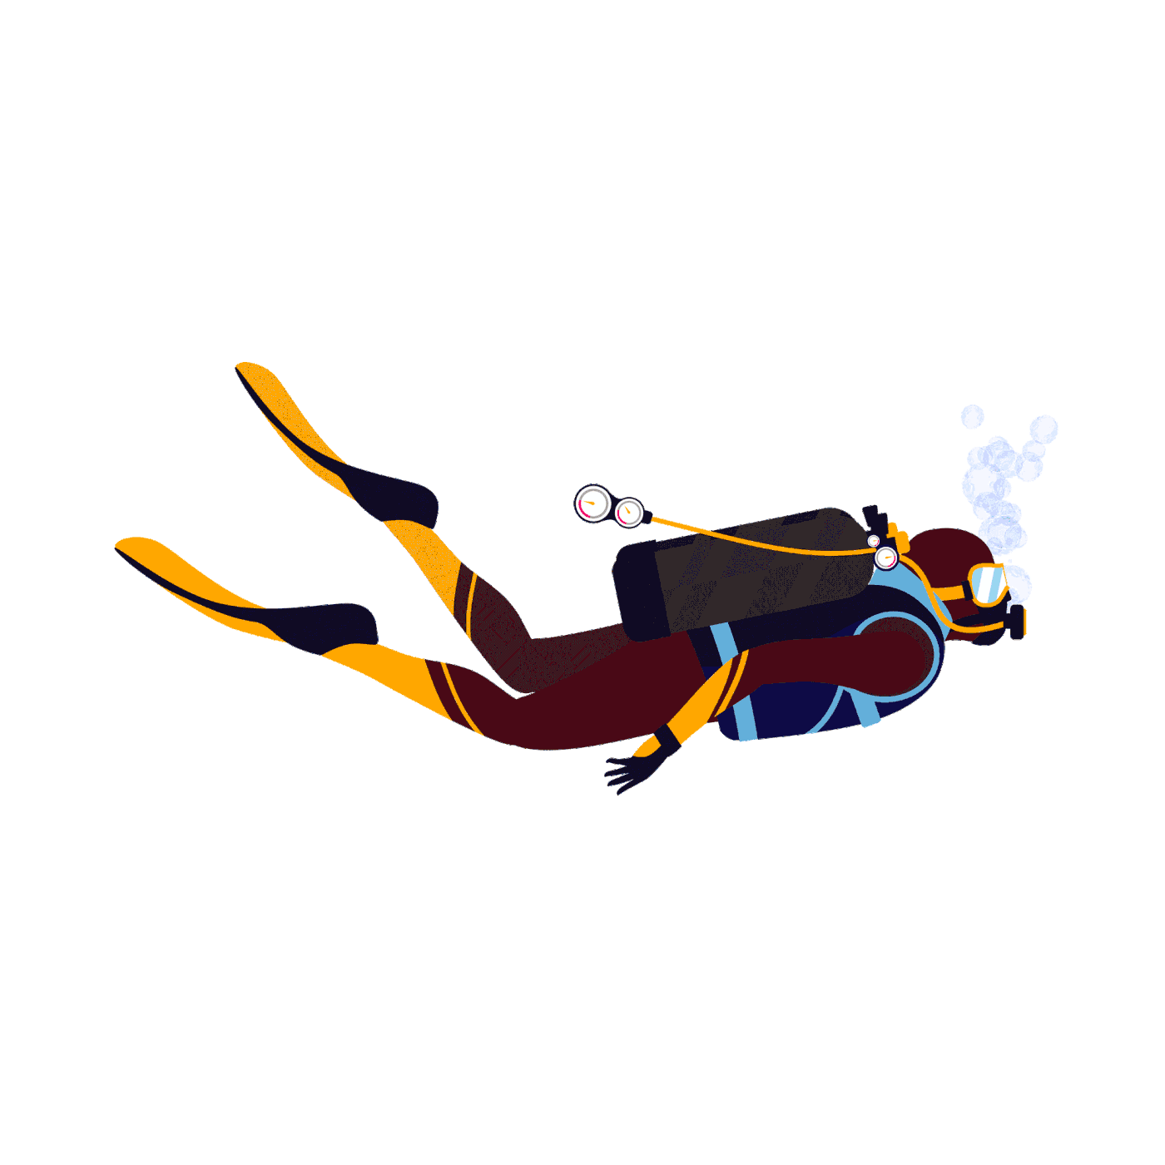
Listen and say
cook
diver

Slide 9
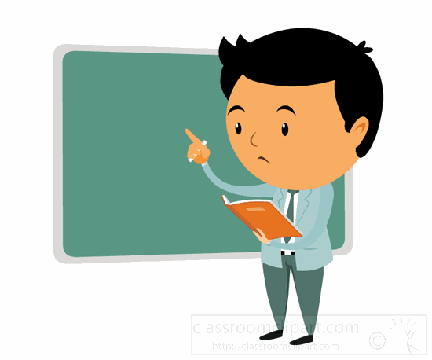
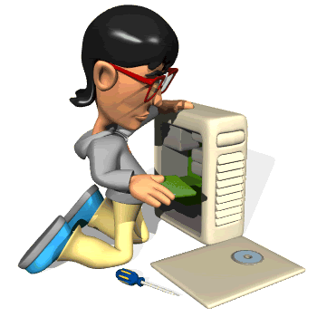
Listen and say
Computer technician
teacher

Slide 10

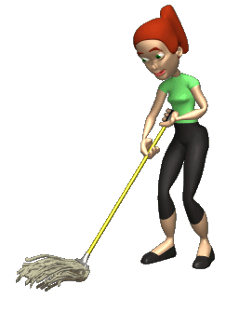
Listen and say
businessman
housewife

Slide 11
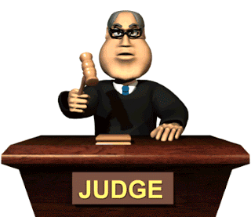

Listen and say
lawyer
doctor

Slide 12

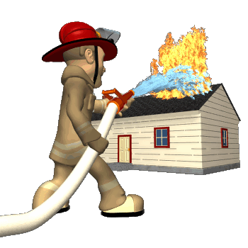
Listen and say
firefighter

Slide 13

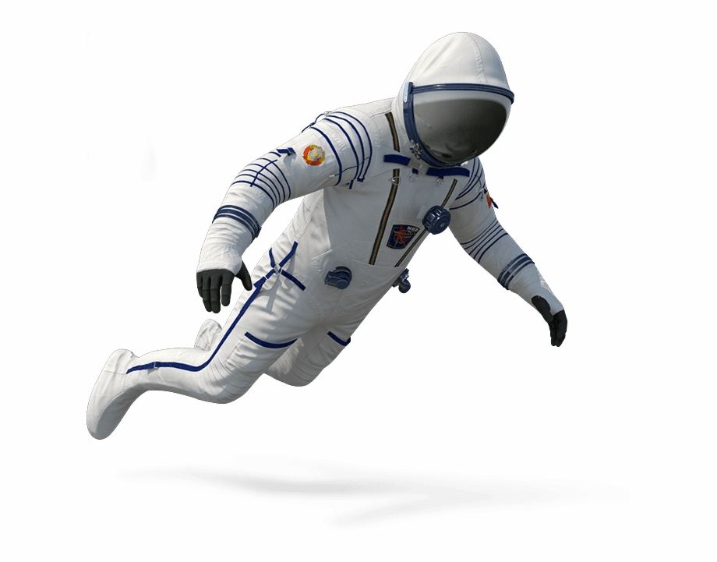

What does he do ?
1.architect
2. doctor
3. astronaut

Slide 14
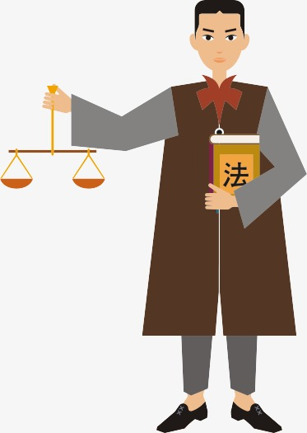
What does he do ?
1. lawyer
2.architect
3. firefighter

Slide 15
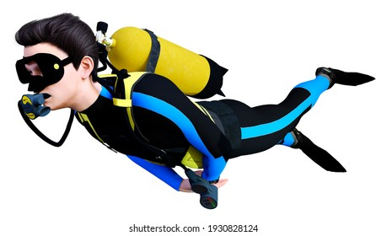
Is he a diver ?
1. Yes, he is
2.No, he isn’t

Slide 16
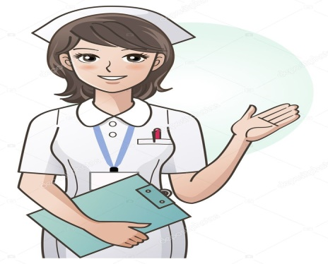

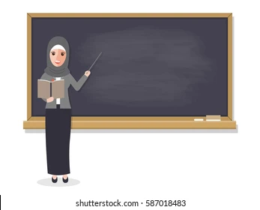
3
2
1
1.teacher
2.engineer
3. nurse

Slide 17


Slide 18
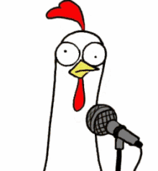


Slide 19



