Slide 1
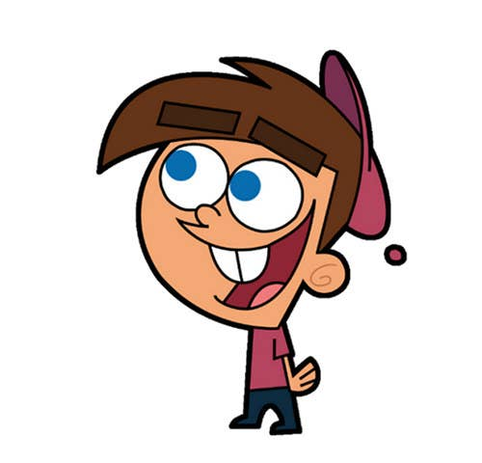


Welcome to class
T.
Mohamad
Zaid

Slide 2
Day
Sunday
Date
2023
Subject
We can 3
Unit
6 jobs
Lesson
2 Grammar in Action

Slide 3

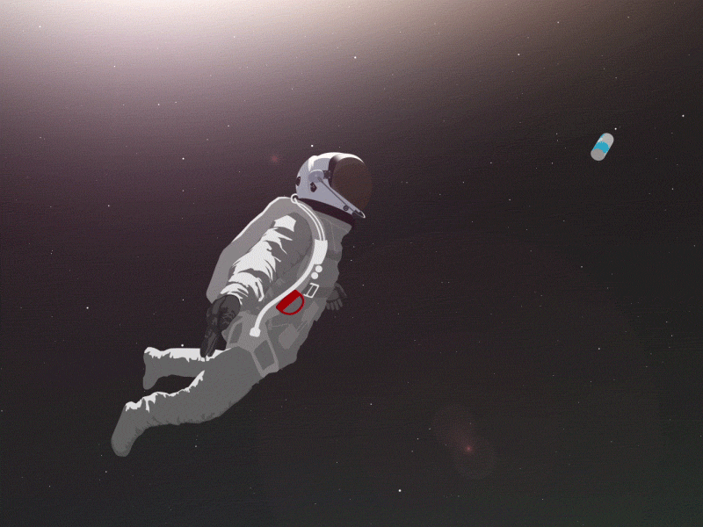
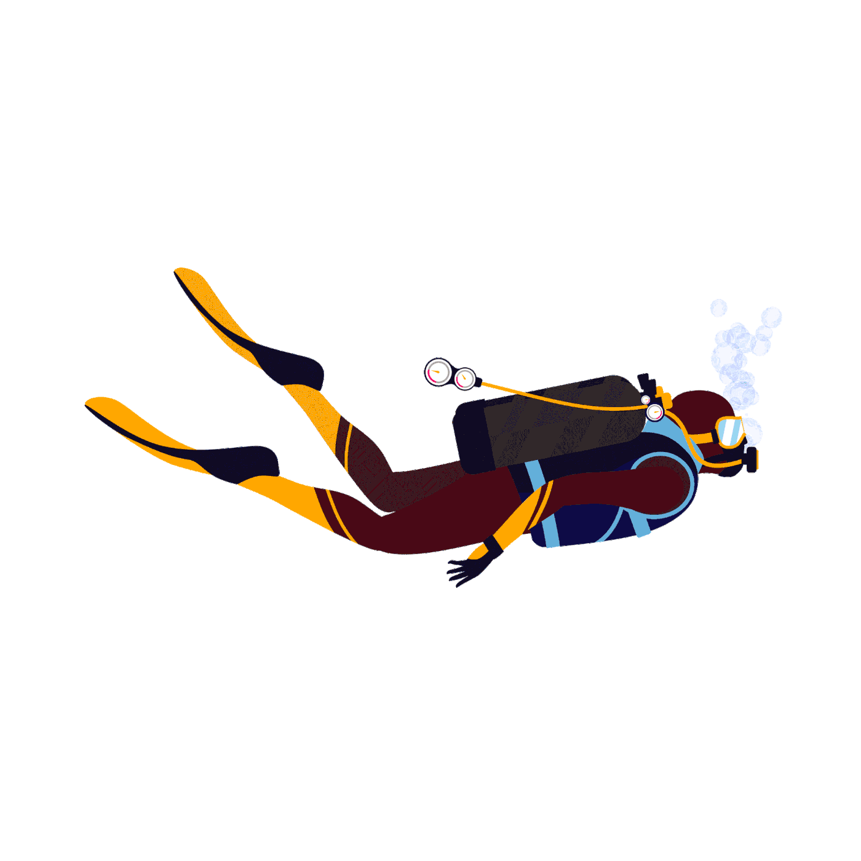
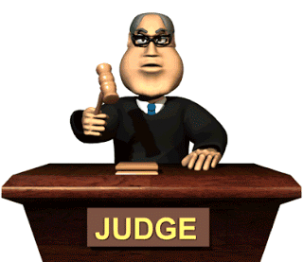
Revision for the previous lesson :
1
2
3
astronaut
diver
lawyer

Slide 4
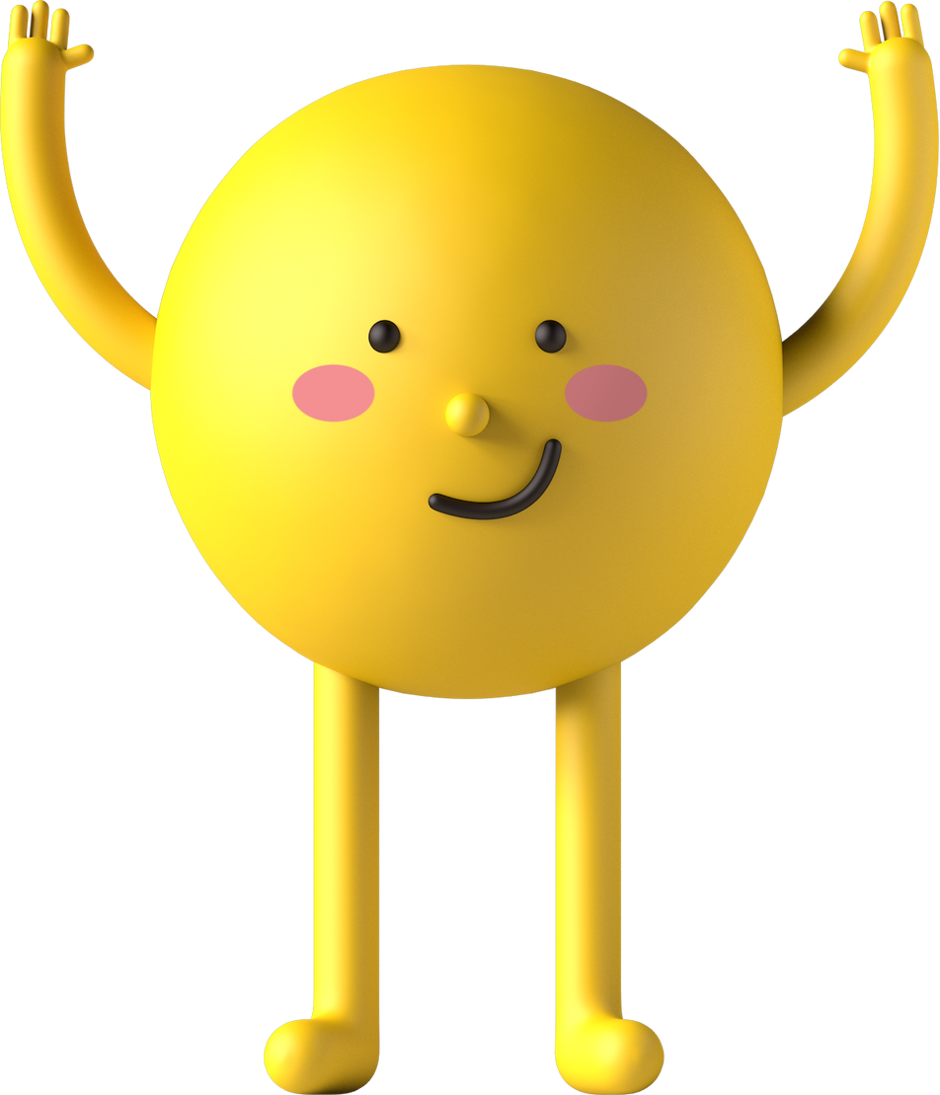


Pages 44 , 45

Slide 5


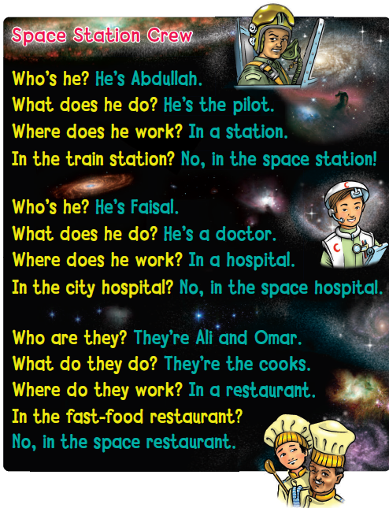
Listen and chant in pairs .
Page 44

Slide 6
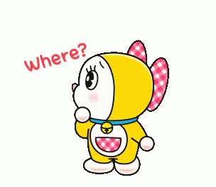
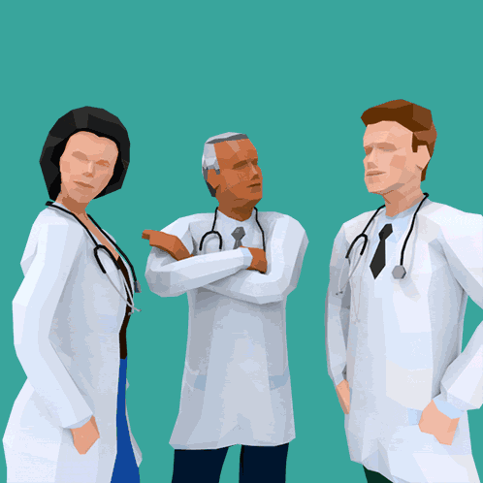
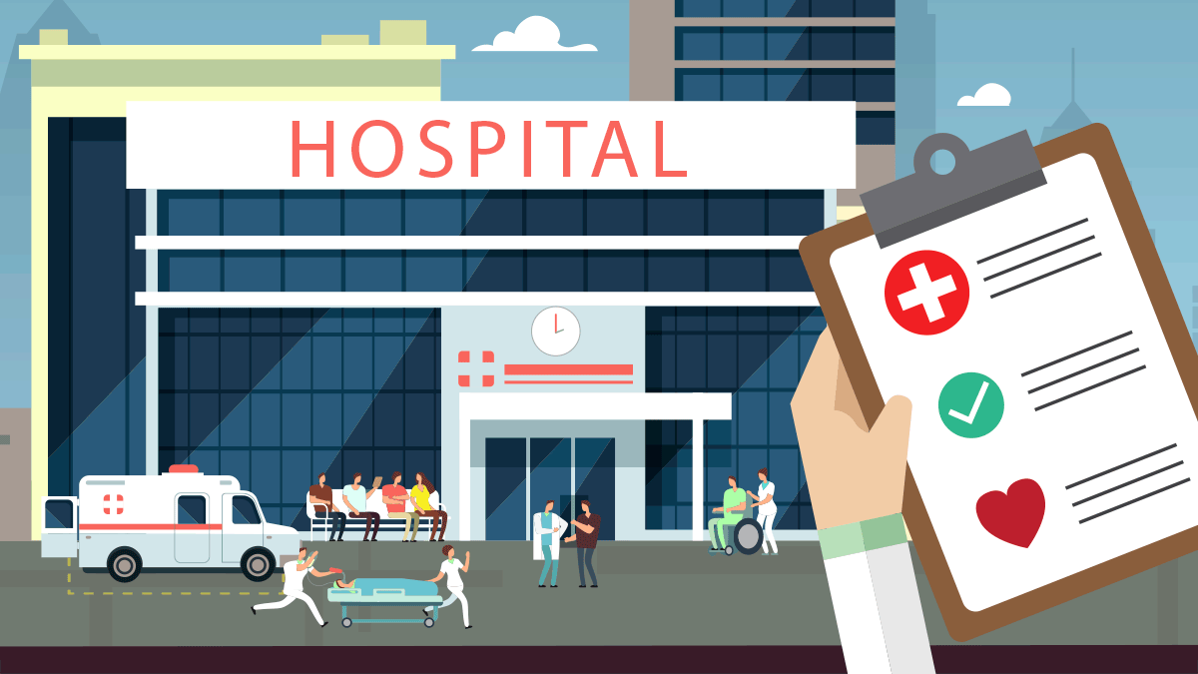
Where do they work ?
They work in
hospital

Slide 7

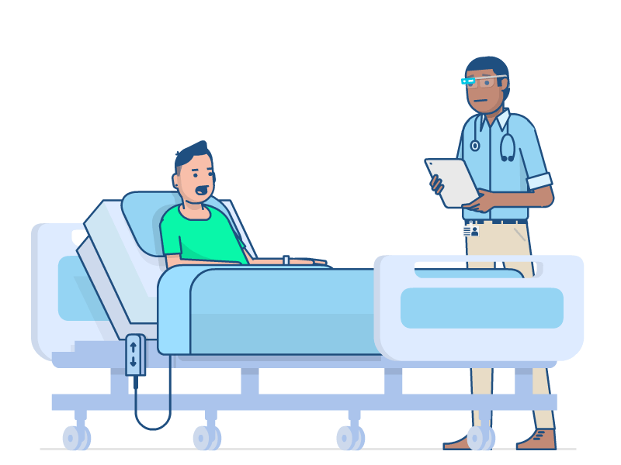
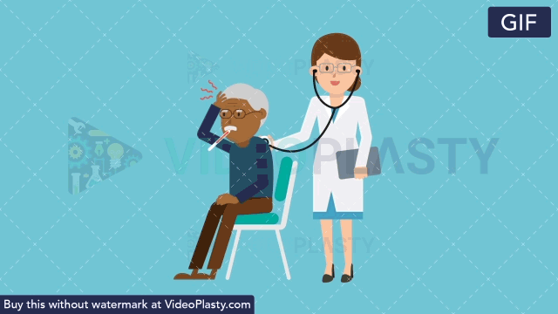
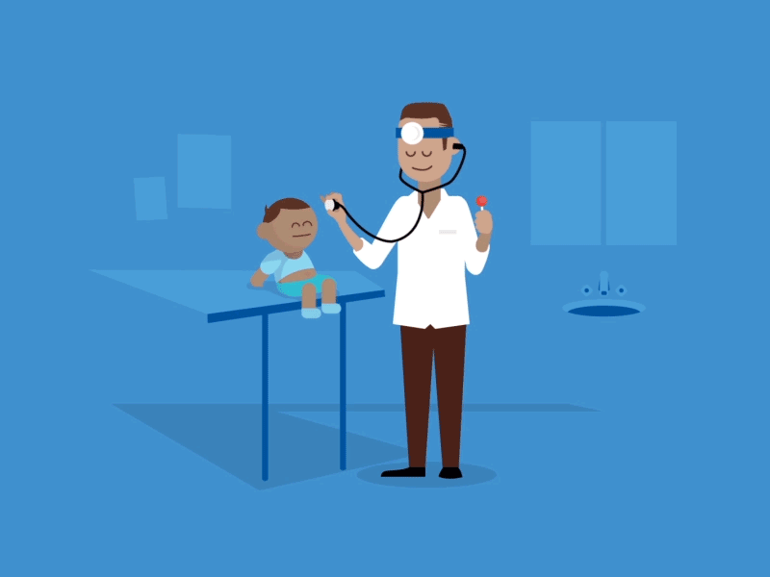
What do they do ?
They help sick people

Slide 8
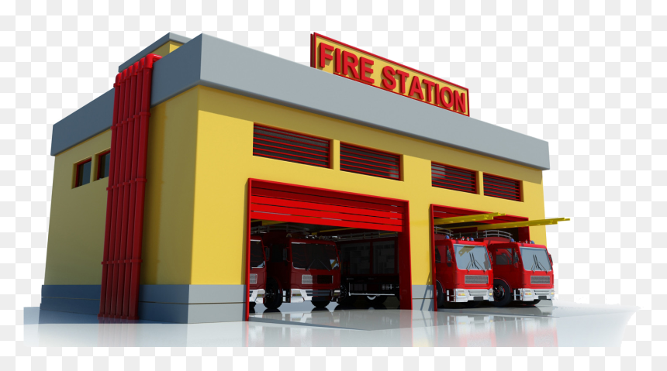
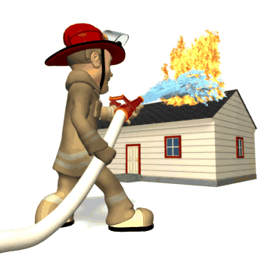
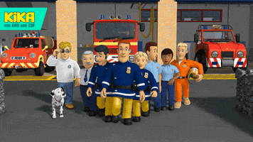
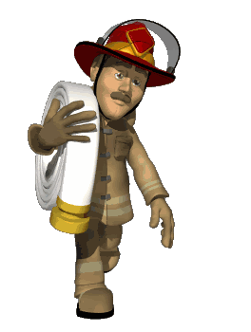

Where do they work ?
They work in
Fire station

Slide 9

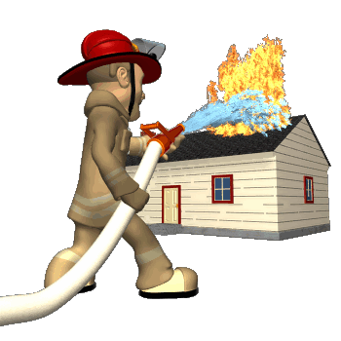
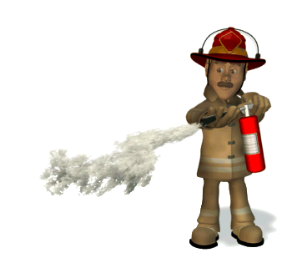
What do they do ?
They put out fires

Slide 10
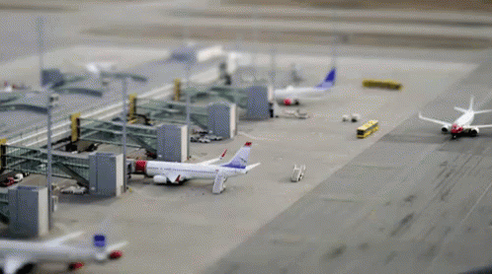
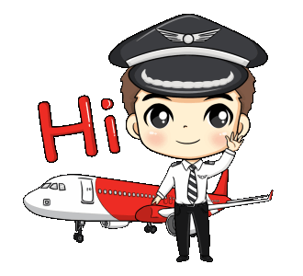

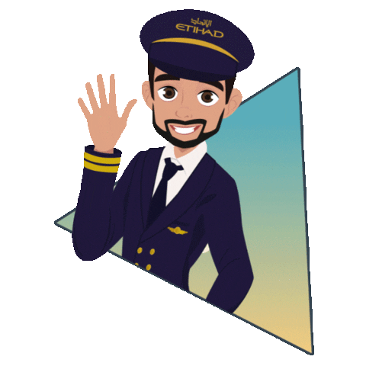
Where do they work ?
They work in
Airport

Slide 11
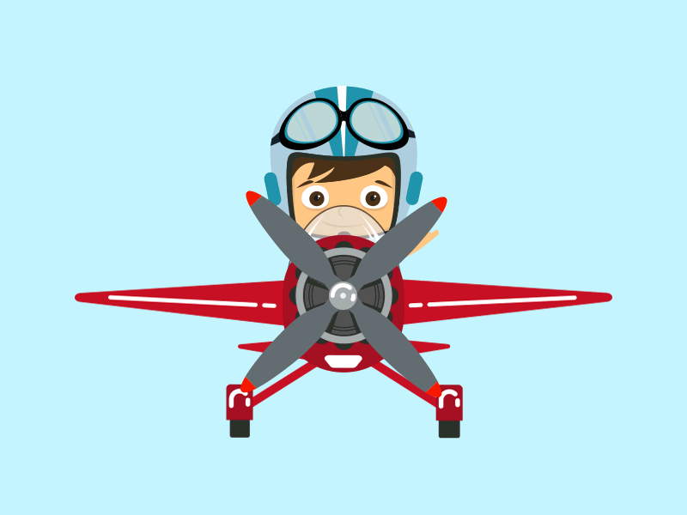
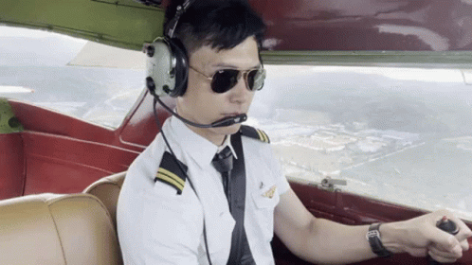

What do they do ?
They fly planes

Slide 12

Choose

Slide 13

What does he do ?
1.He helps sick people
2. He puts out fire
3. He flies plane

Slide 14
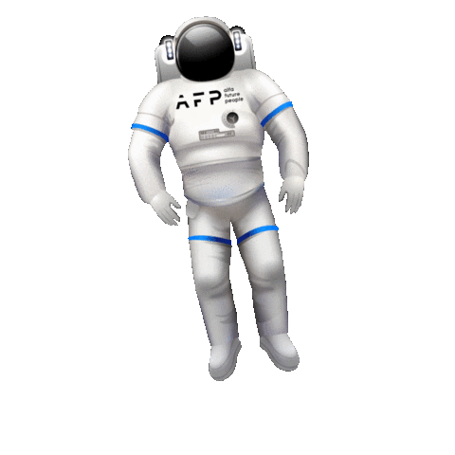
Where does he work ?
1. He works in a fire station
2.He works in a hospital
3. He works in a school

Slide 15
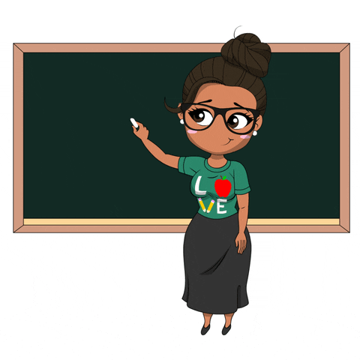
Where does she work ?
1
2
3
She works in a hospital.
He works in a fire station .
She works in a school .

Slide 16
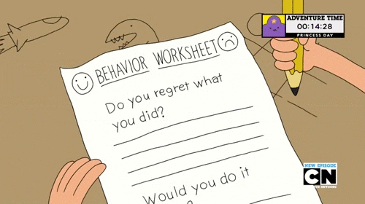


https://www.liveworksheets.com/dh2709832cc

Slide 17


Open your workbook
Page 114

Slide 18
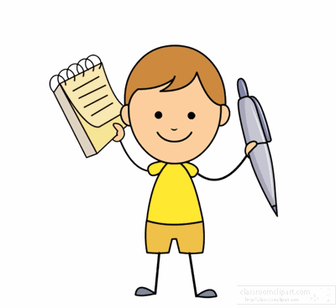

Home work at

Slide 19


Slide 20
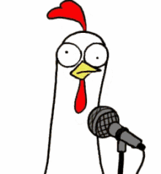


Slide 21



