Slide 1
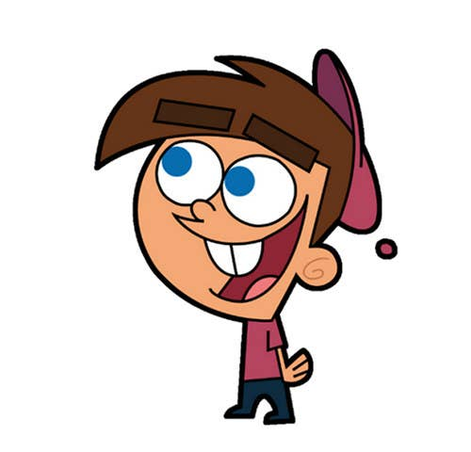


Welcome to class
T.
Mohamad
Zaid

Slide 2
Day
Monday
Date
27th DEC 2021
Subject
We can 5
Unit
6 jobs
Lesson
3 Rhythms and Reading

Slide 3


Revision for the previous lesson :
What’s this?
What do they do ?
Who’re working here?
It’s a hospital.
The doctors.
They help sick people.

Slide 4
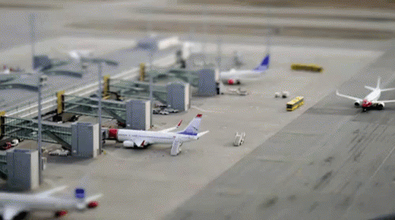
Revision for the previous lesson :
What’s this?
What do they do ?
Who’re working here?
It’s an airport.
The pilots.
They fly planes.

Slide 5
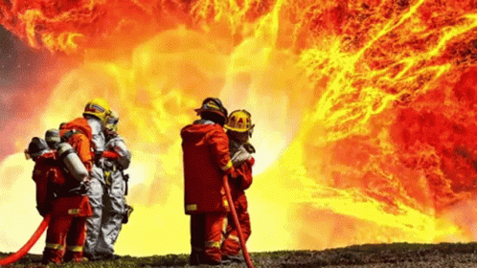
Revision for the previous lesson :
Who are they?
Where do they work?
What do they do?
They are firefighters.
They put out fires.
In the fire station .

Slide 6




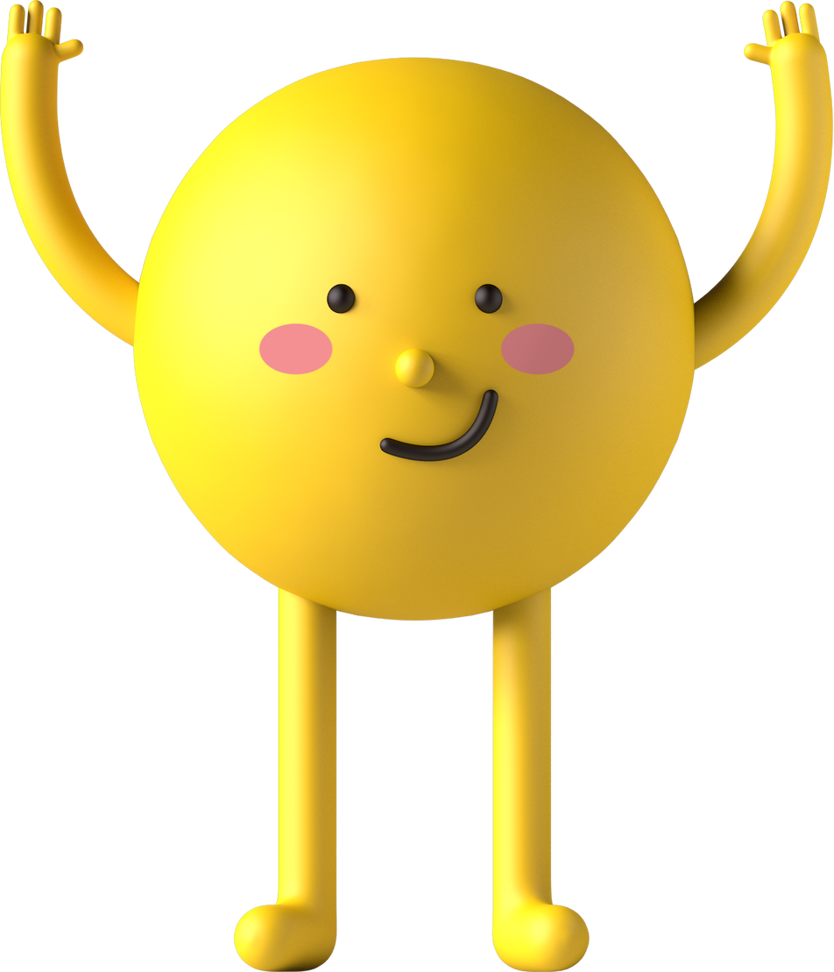
PAGEs 46 , 47

Slide 7
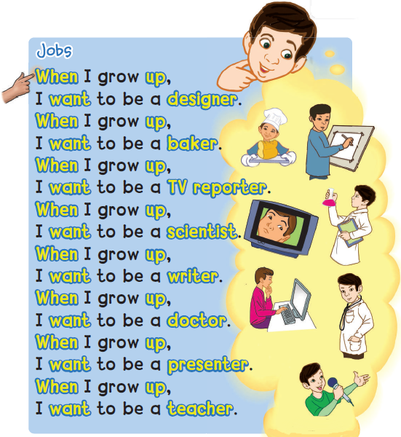

1
Listen, chant and do.
PAGE 46

Slide 8


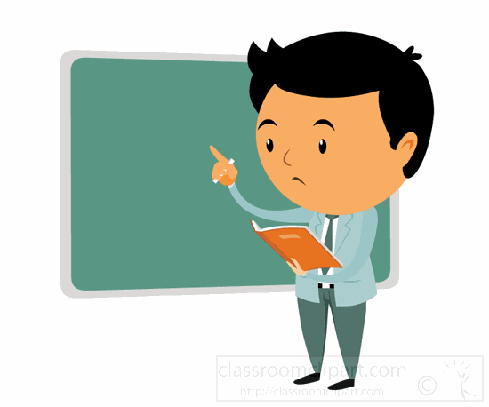


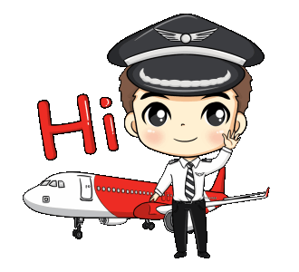
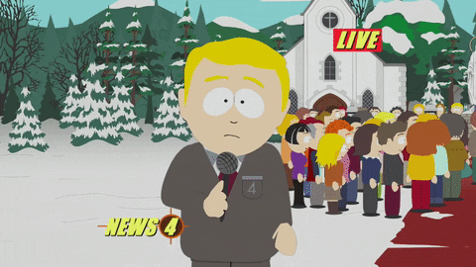
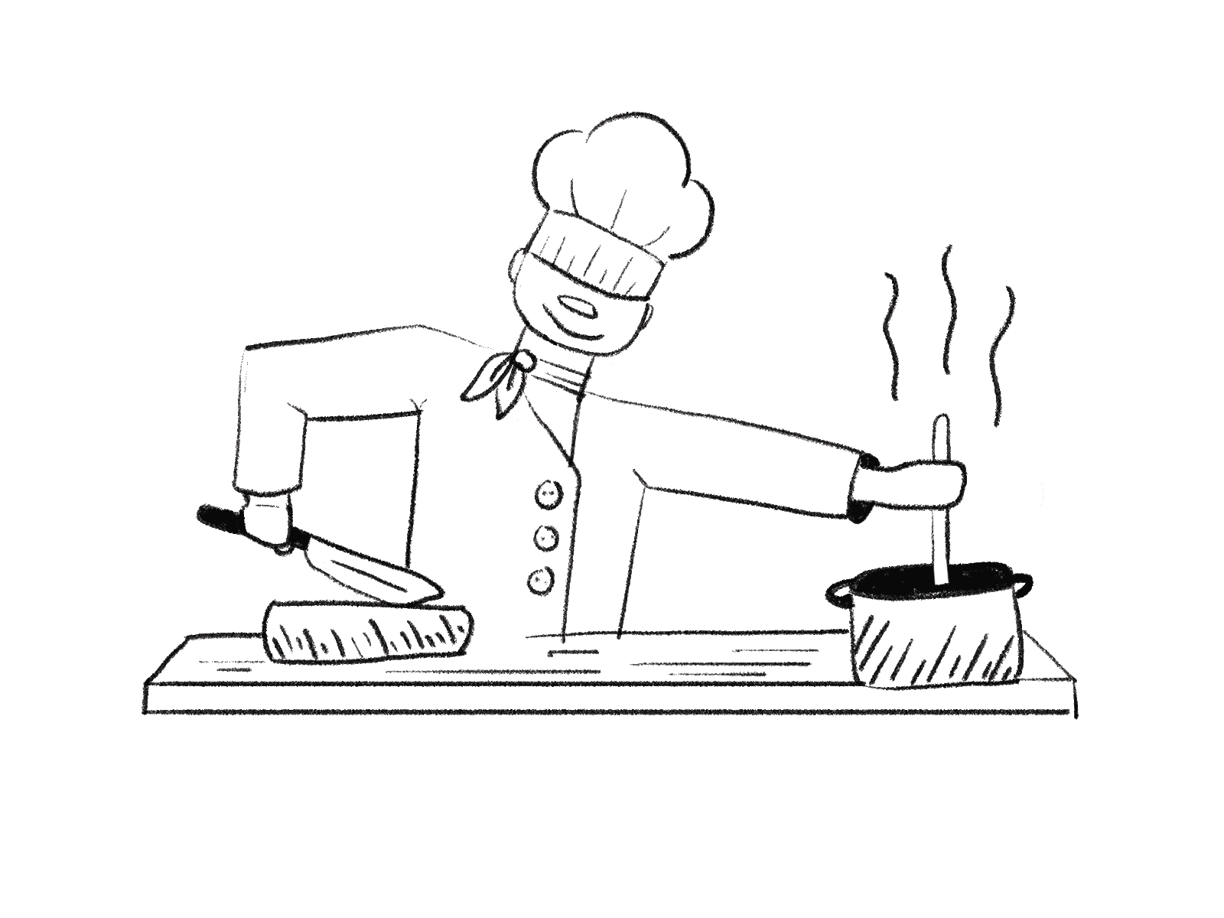
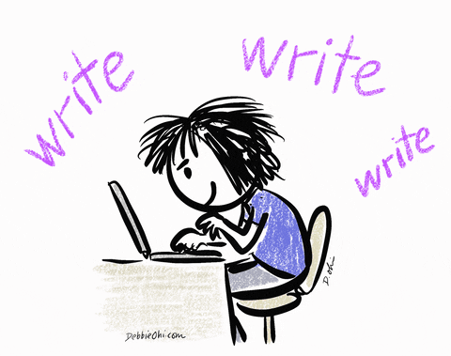

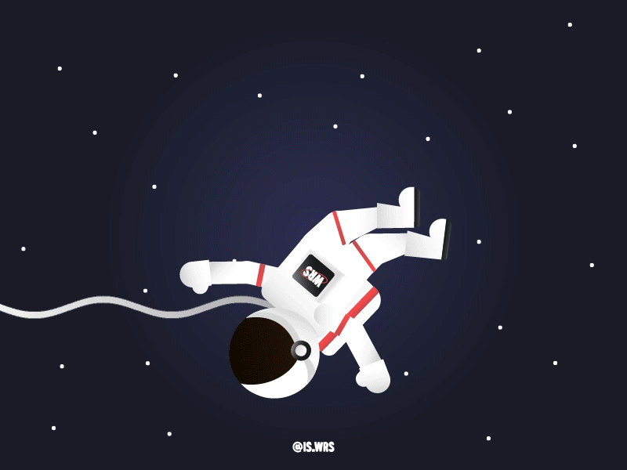
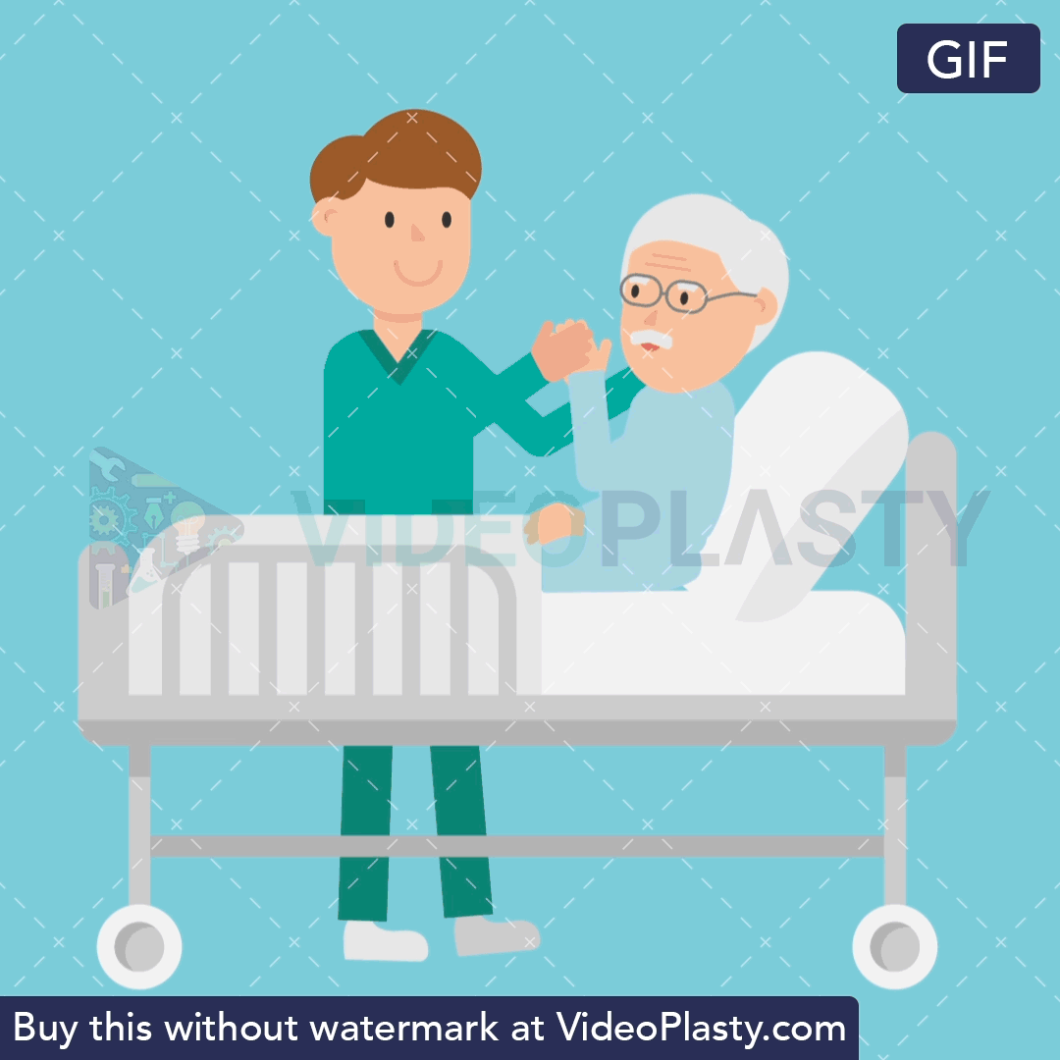

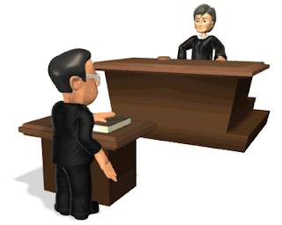

What do you want to be when you grow up ?

Slide 9





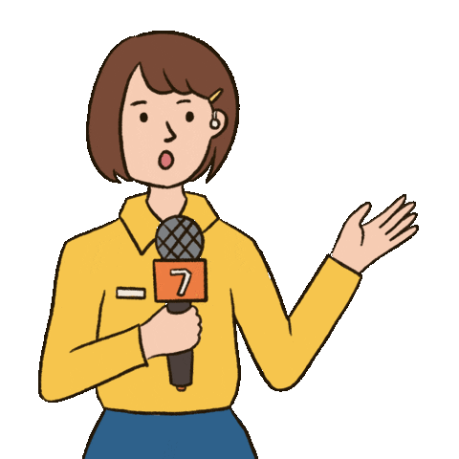
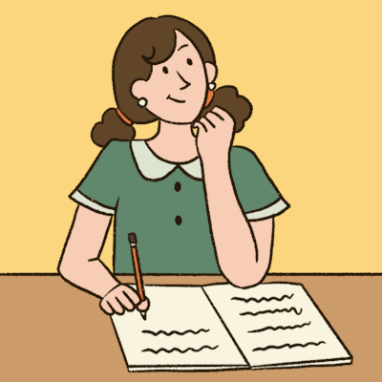
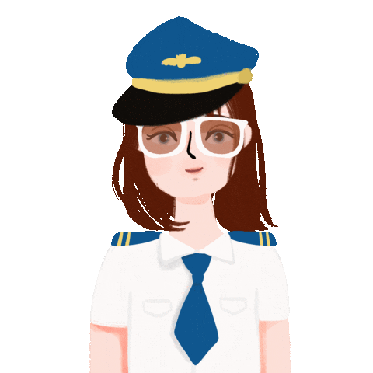


What do you want to be when you grow up ?
فكرة الشريحة يختار الطالب الوظيفة ينطقها بشكل صحيح نضغط على الصورة مرتين وتختفي

Slide 10
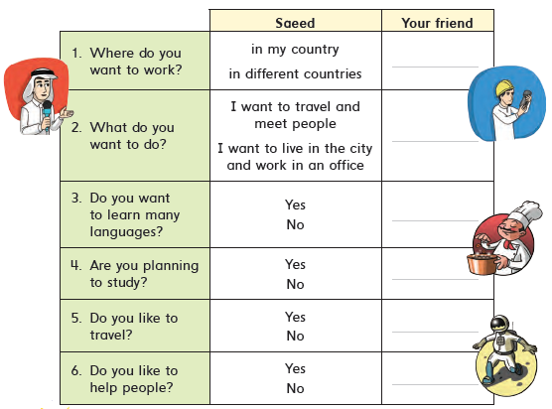
Job guessing game لعبة احزر المهنة
Listen, circle the answers, and guess what Saeed wants to be. Ask and answer with a partner .
3
PAGE 47

Slide 11



https://wordwall.net/resource/21596184

Slide 12


Open your workbook
Pages 115 , 116

Slide 13
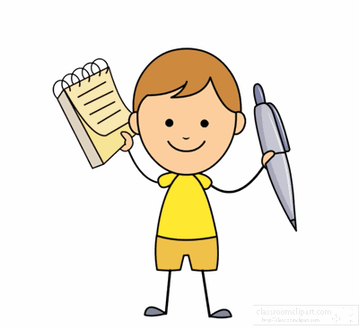

Home work at

Slide 14


