Slide 1
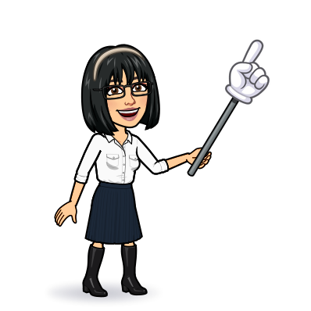
9 writing 10 project 11 form, meaning & function
Today:
Date:
- -
Page 62
By: Dalal Al-Juaid

Slide 2
use the comparative & superlative form of adjectives
find places in the text
Warm up
use perconal pronouns correctly
Write about your neighborhood

Slide 3
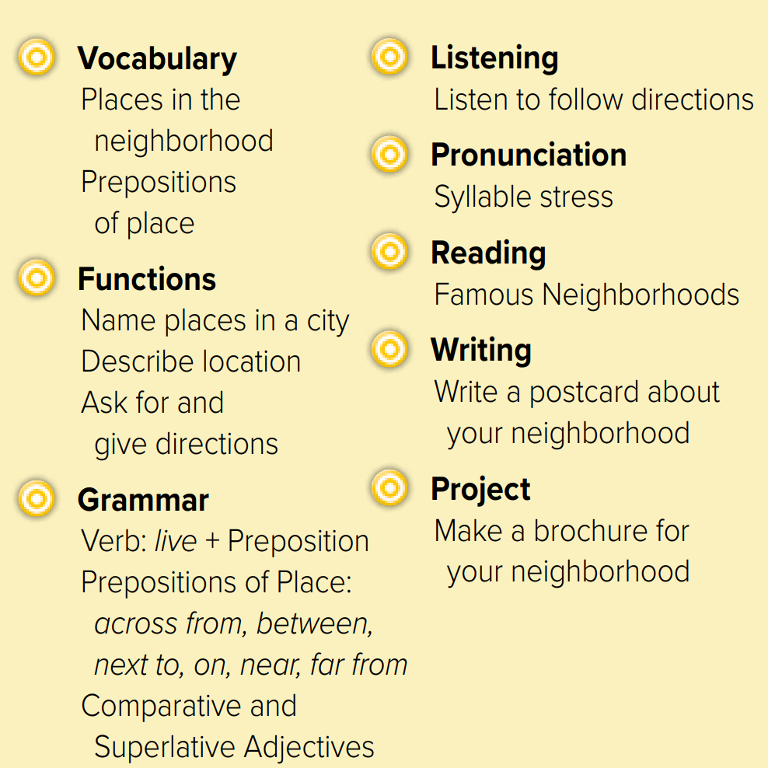

Slide 4
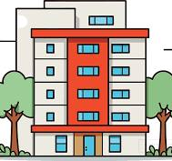
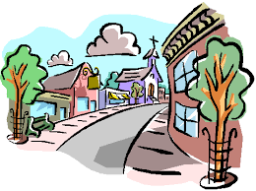
Revision
Where is the school?
Where is the bank?
…..
…..
…….
#
Turn left
..........

Slide 5
Where can you buy books?
x-o game
What’s opposite of ( turn left)?
……. a place to take a walk.
Bank is ……. the park & the school
Warm up
We live …… Taif
You can’t miss = …
Brooklyn is in ( Mexico city – New York)
What’s the opposite of ( here )?

Slide 6
Page 62
Warm up
Give examples

Slide 7
Page 62
What are the buildings like?
Is the school near Robert’s house?
What does the palace have?
Do people walk or take the bus?
What are the people like?
Warm up

Slide 8
Page 62
……..
Warm up

Slide 9
Page 63
Warm up

Slide 10
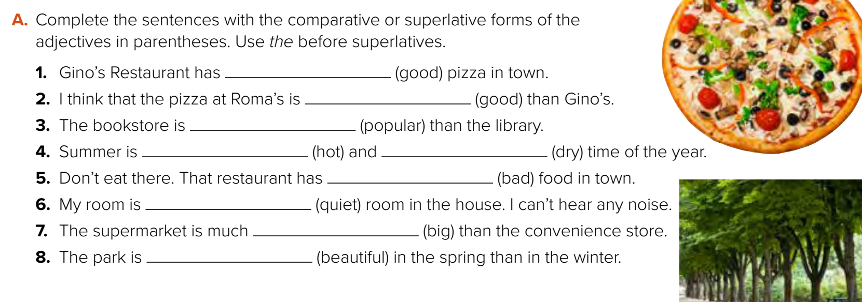
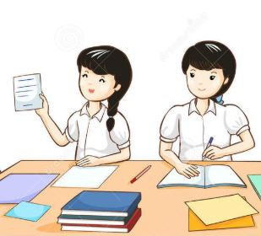
the best
better
more popular
the hottest
the driest
the worst
the quietst
bigger
more beautiful
Warm up
Think pair share

Slide 11
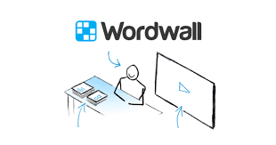
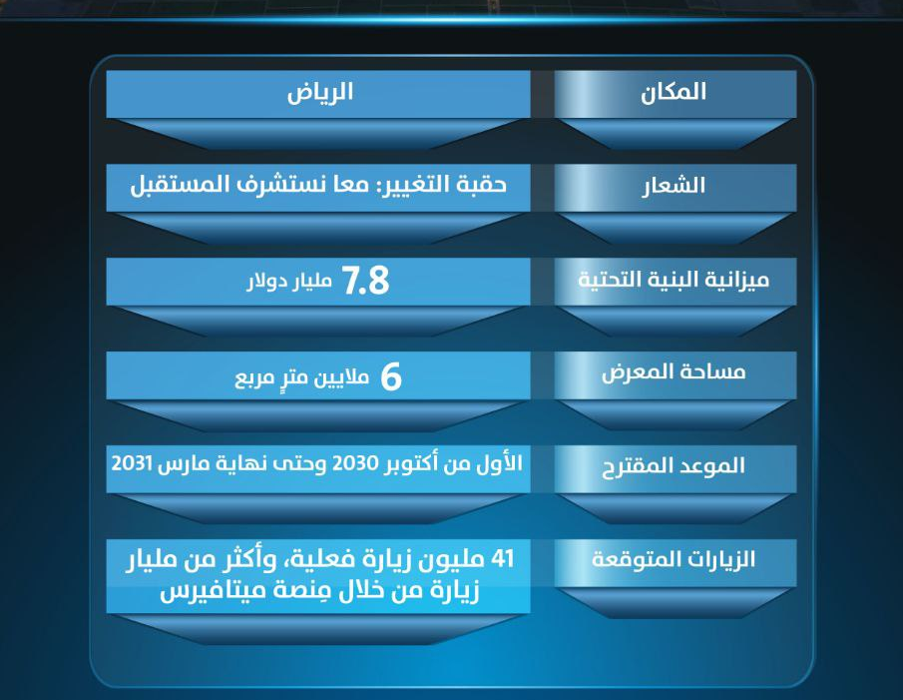
Lets play
What’s this?
Warm up
Surprise game

Slide 12
Write in your notebook
Like final test أسئلة للاختبار النهائي
Choose:
Mmmmmmm ………. mmmmmmm
( ssss – ssss – sssss)
Make a question
It’s shorter
They’re slower
It’s noisier

Slide 13
page 216 Ex(H - I )
for practice writing
Warm up

Slide 14
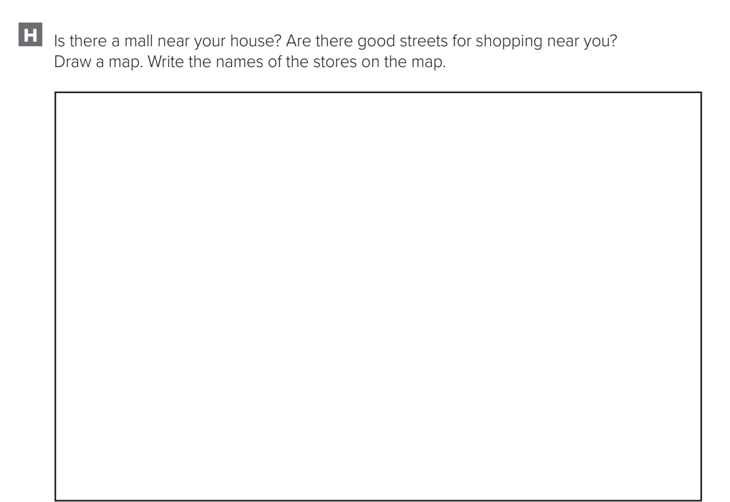
p.216
Warm up

Slide 15
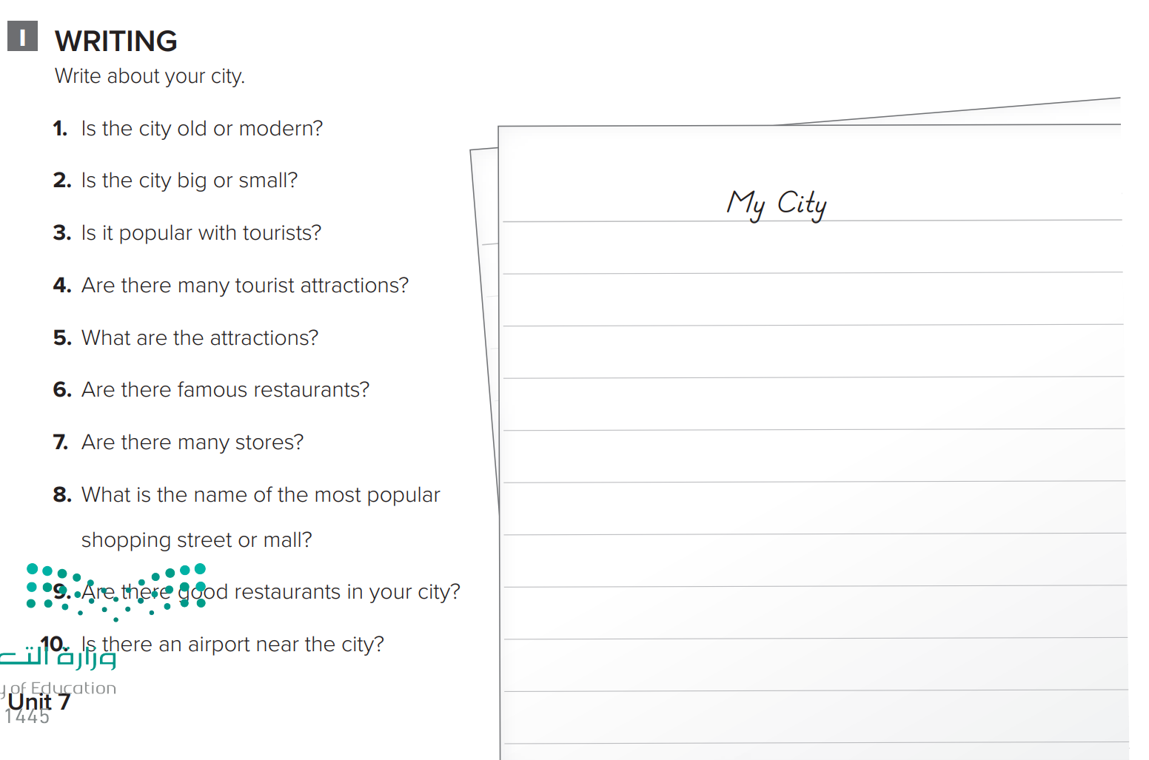
p.216
My city is very old. It is a small city. It is popular with tourists. There are a lot of tourist attractions. There are a lot of museums. There are more than a 100 stores in my city. There are shopping malls. There are very good restaurants in the city. Al-Baik is a good famous restaurant. There is an airport, but it is far from the city.
Warm up

