Slide 1
3 grammar
Today:
Date:
- -
Page 58
By: Dalal Al-Juaid

Slide 2
use prepositions with the verb LIVE
describe location using prepositions of place
Warm up
use imperatives to give directions
Match question with answer

Slide 3
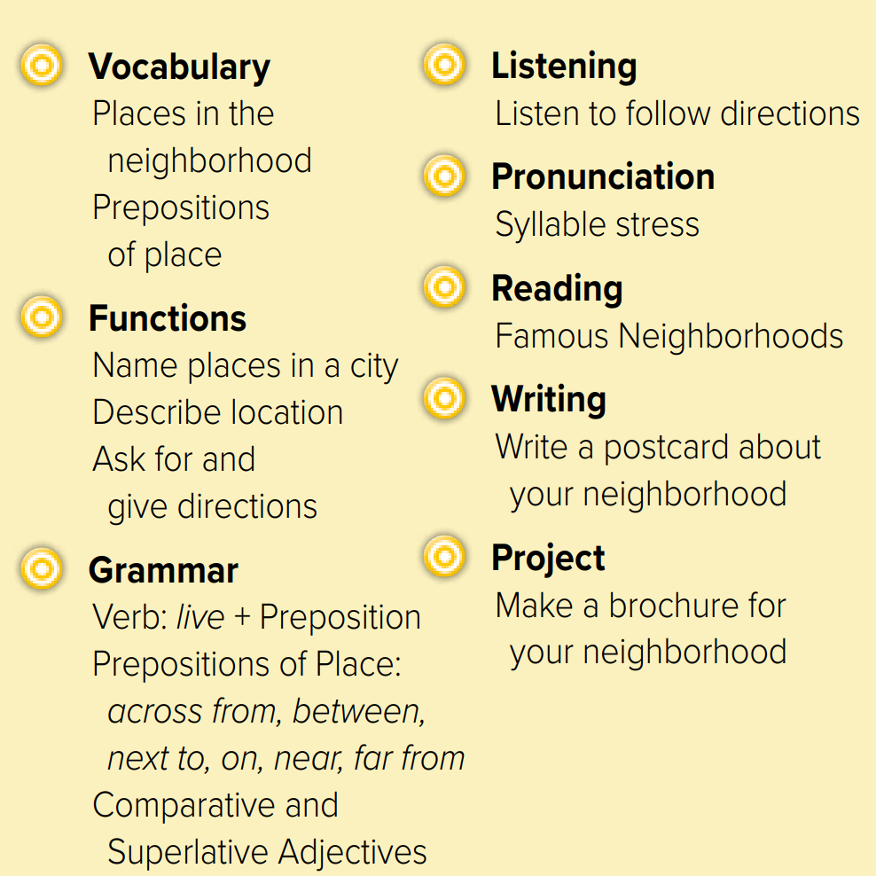

Slide 4
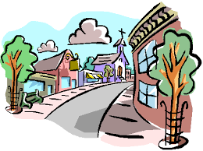
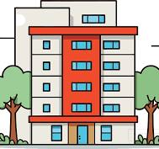
Revision
Where is the subway station?
…..
…..
…….
#
Turn left
..........

Slide 5
Where is our school ?
Answer with emoji
Warm up
supermarket
restaurant
bookstore
mall
pharmacy

Slide 6
Page 58
city
in
on
Building
street
Warm up
Choose:
She lives ………. 1st floor ( in – on)
She lives ………. Taif ( in – on)
She lives ………. 50th street ( in – on)

Slide 7
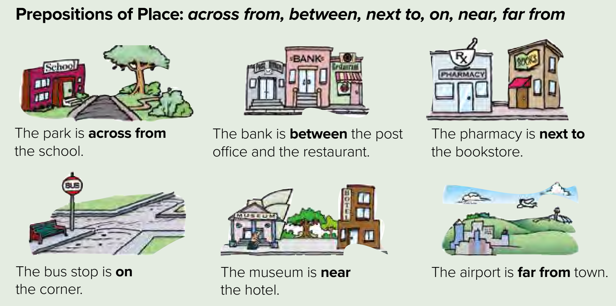
Remember?
Page 58
How about Mariam?
Warm up

Slide 8
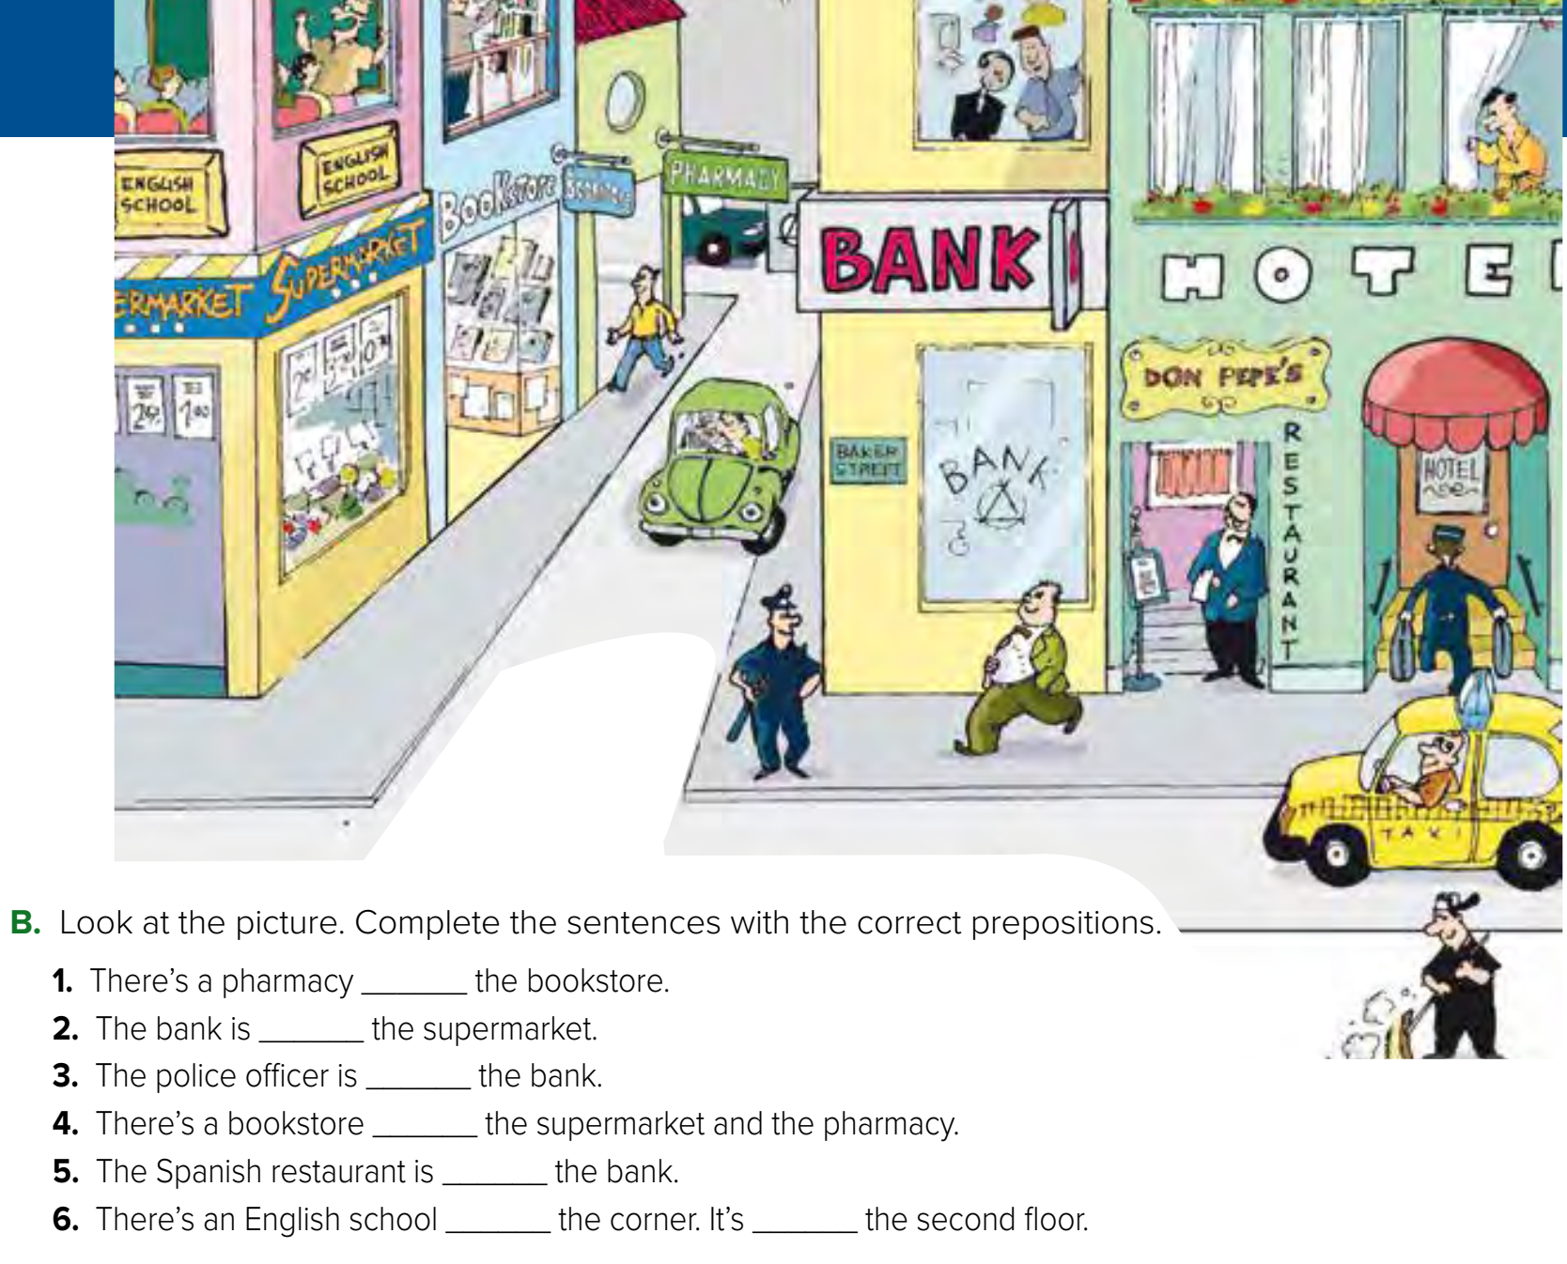
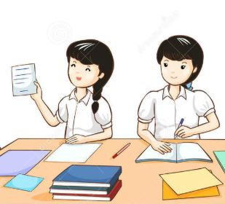
Page 59
Think pair share
Warm up
next to
across from
near
between
next to
on
on

Slide 9
Where is Makkah?
Warm up

Slide 10
Role paly
Is there… ➔ Yes, there is / No, there isn’t
d
e
f
Warm up
c
a
b

Slide 11
Lets play
Warm up

Slide 12
Write in your notebook
Like final test أسئلة للاختبار النهائي
Choose:
Mmmmmmm ………. mmmmmmm
( ssss – ssss – sssss)
Make a question

Slide 13
page 214 Ex(C-D-E)
for practice grammar
Warm up

Slide 14
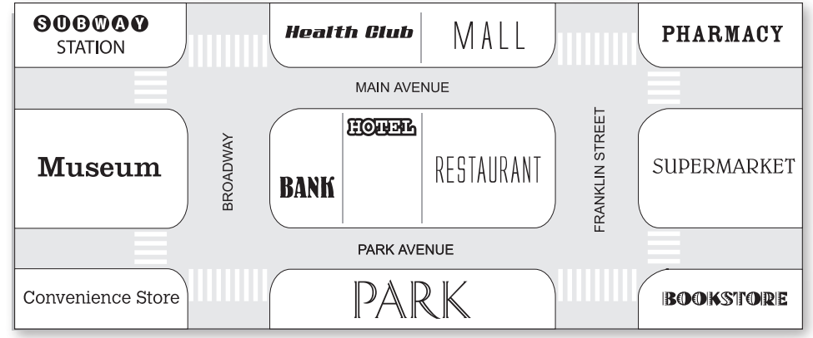

Slide 15
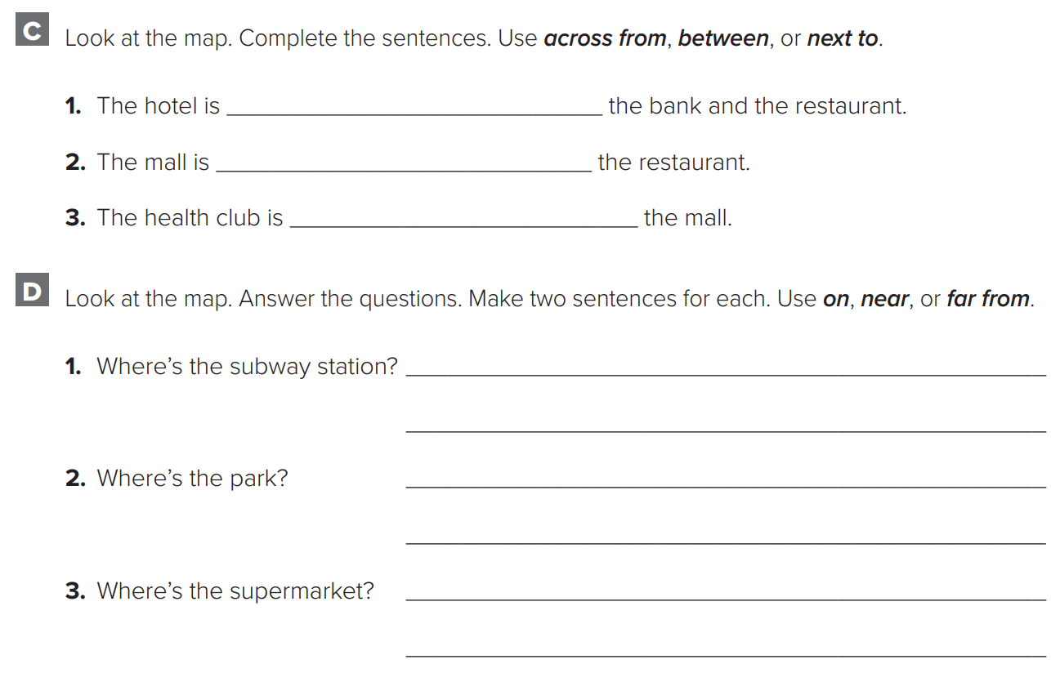
p.214
between
across from
next
The subway station is far from the bookstore.
The subway station is on Main Avenue.
Warm up
The park is near the bank.
The park is on the Park Avenue.
The supermarket is far from the museum.
The supermarket is near the bookstore.

Slide 16
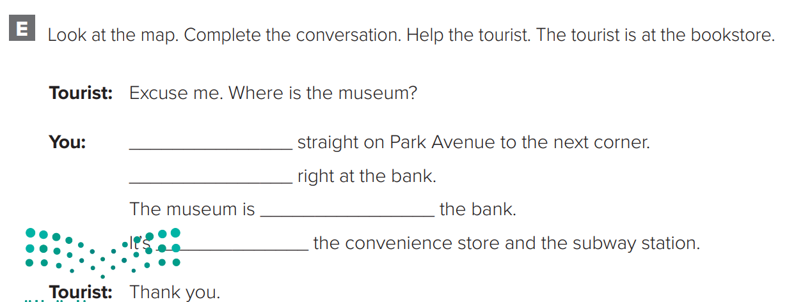
p.214
Warm up
Go
Turn
across from
between

