Slide 1














Slide 2



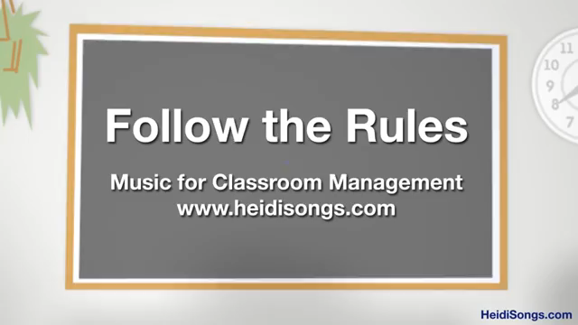
Head, shoulders action chant
Clap along
Singing walrus action chant
Follow the rules

Slide 3




Slide 4








Thick
clock
back
spring
wing
swing
ink
drink

Slide 5








Slide 6
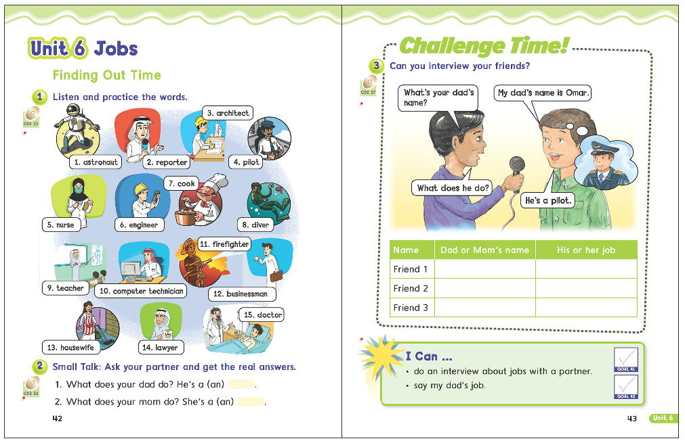
42
43

Slide 7
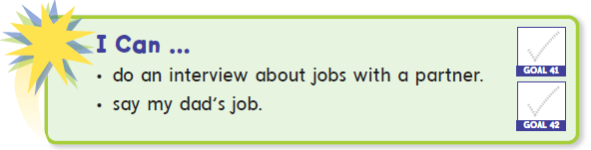

Slide 8


Slide 9

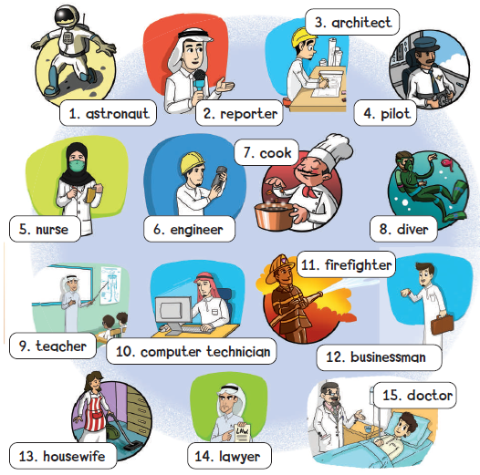




Slide 10




Slide 11




Slide 12


Riyadh Expo 2030 provides many job opportunities so that tomorrow will be better for us and so that we can look forward to the future together

Slide 13




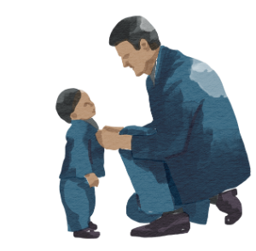



Slide 14

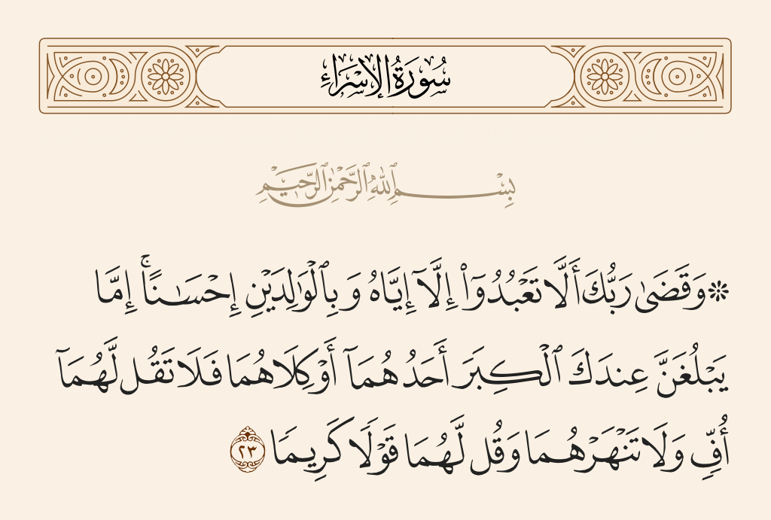

Slide 15


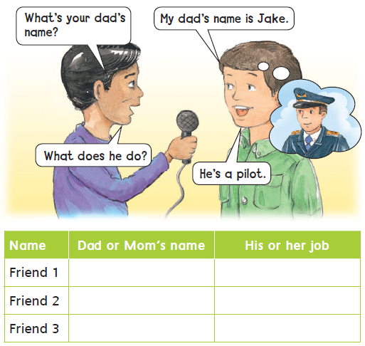

Slide 16


Slide 17


Slide 18
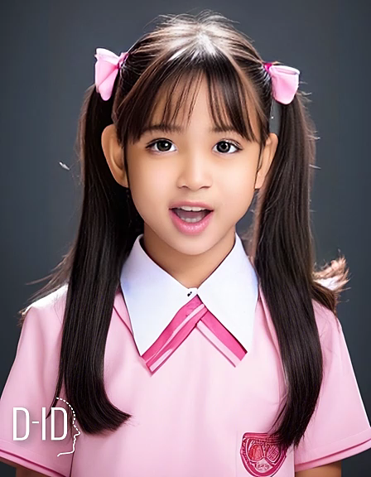


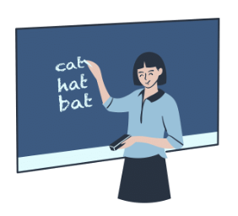

Slide 19


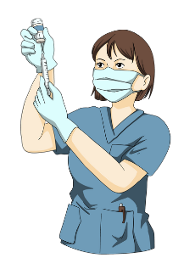

Slide 20




Slide 21


Slide 22


Slide 23
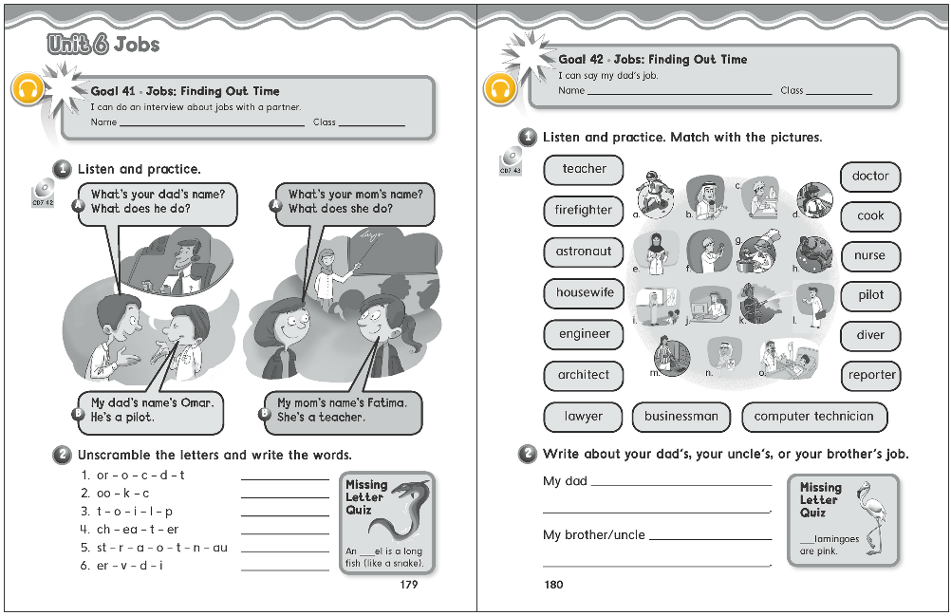
179
180

Slide 24
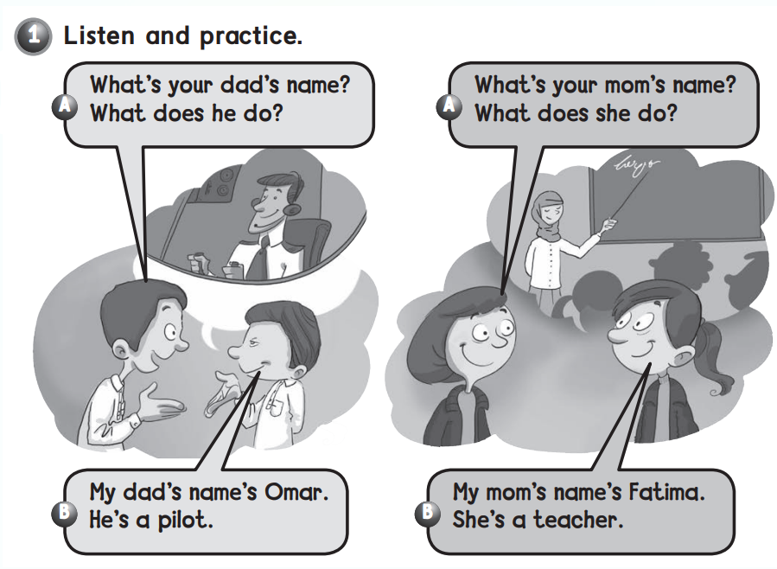

Slide 25
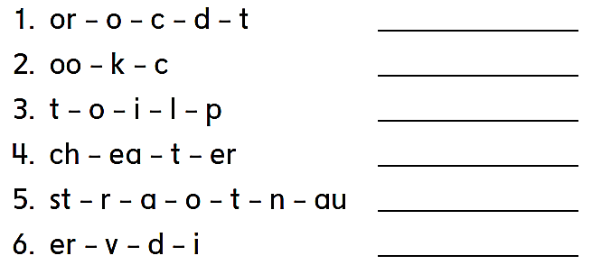
doctor
cook
pilot
teacher
astronaut
diver

Slide 26
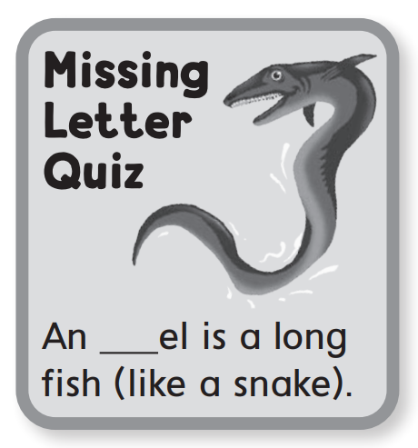


e

Slide 27
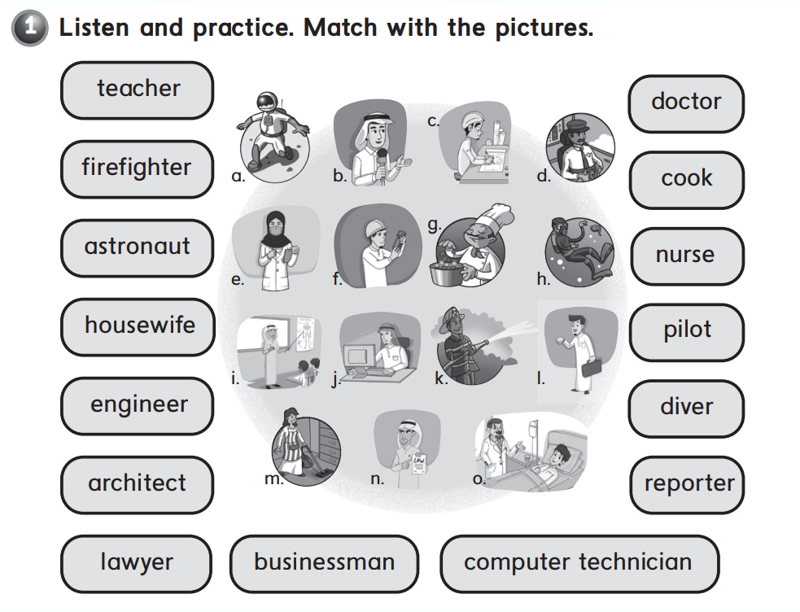
i
o
k
g
a
e
m
d
f
h
c
b
l
j
n

Slide 28
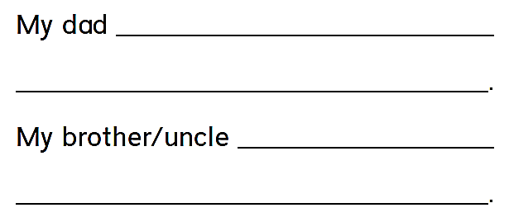
is a doctor .
He helps sick people .
is a pilot .
He flies planes .

Slide 29
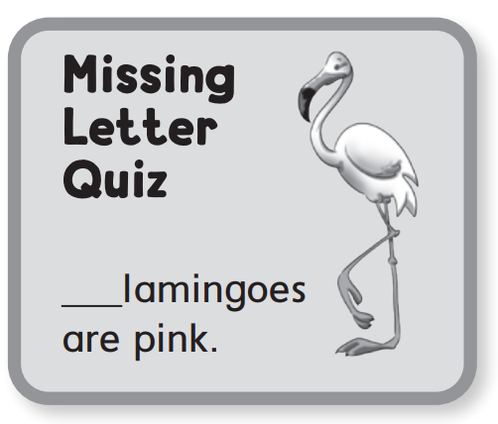
f

Slide 30
Thank you!

