Slide 1
HELLO

Slide 2
MG2.2 U2 l3 Grammar
GRAMMAR CLASS!
Gerunds After Verbs
&
Infinitives After Verbs
18

Slide 3
At the end of the lesson students will be able to:
CLASS OBJECTIVES
01
Use the gerunds after the correct verbs.
02
Use infinitives after the correct verbs.
03
Rewrite a sentence using gerund or infinitive.

Slide 4
WATCH THIS VIDEO

Slide 5
Gerunds
are the -ing form of a verb.
act like nouns
answer the question what.
We use gerunds after certain verbs, such as:
advise enjoy intend quit
begin finish keep recommend
can’t stand go like start
consider hate love stop
continue imagine prefer suggest

Slide 6
YOUR TURN
Give an example
We use gerunds after certain verbs, such as:
advise enjoy intend quit
begin finish keep recommend
can’t stand go like start
consider hate love stop
continue imagine prefer suggest
recommend What?!
The sentence | Verb | Gerunds
I recommend turning off the lights when you leave the room.
Our class enjoys learning about ways to help the environment.
enjoy What?!
recommend
turning
enjoys
learning

Slide 7
An infinitive
is to + base form of a verb.
acts like nouns
answer the question what.
We use infinitives after certain verbs, such as:
agree continue intend offer start ask* decide learn plan try attempt expect* like prefer want* begin forget love promise can’t stand
hate need* remember

Slide 8
We use infinitives after certain verbs, such as:
agree continue intend offer start ask* decide learn plan try attempt expect* like prefer want* begin forget love promise can’t stand
hate need* remember
YOUR TURN
Give an example
forget What?!
The sentence | verb | infinitive
Don’t forget to reuse that plastic container.
Do they intend to buy a hybrid car?
forget
to reuse
intend
to buy
intend What?!

Slide 9
* verbs can be followed by an object before the infinitive.
ask - expect - want - need
They want to plant a garden.
They want us to plant a garden.
YOUR TURN
Give an example

Slide 10
* See NOTE
* Verbs can be followed by either a gerund or infinitive
continue start prefer like love
begin hate can’t stand
YOUR TURN
Give an example
I hate using a lot of water.
I hate to use a lot of water.
Notes:
some verbs can be followed by either an infinitive or a gerund.
The meaning of sentences with these verbs is almost the same with either the gerund or the infinitive.
We can say, for example, either
I love studying or I love to study.
(One slight difference is that the person is more likely to use the gerund at the moment of doing the activity.)

Slide 11
Which sentence has a GERUND?
Present progressive
Be + v-ing
We’re eating more organic fruits now.
I prefer eating organic foods.

Slide 12
Open your book page number 18-19

Slide 13
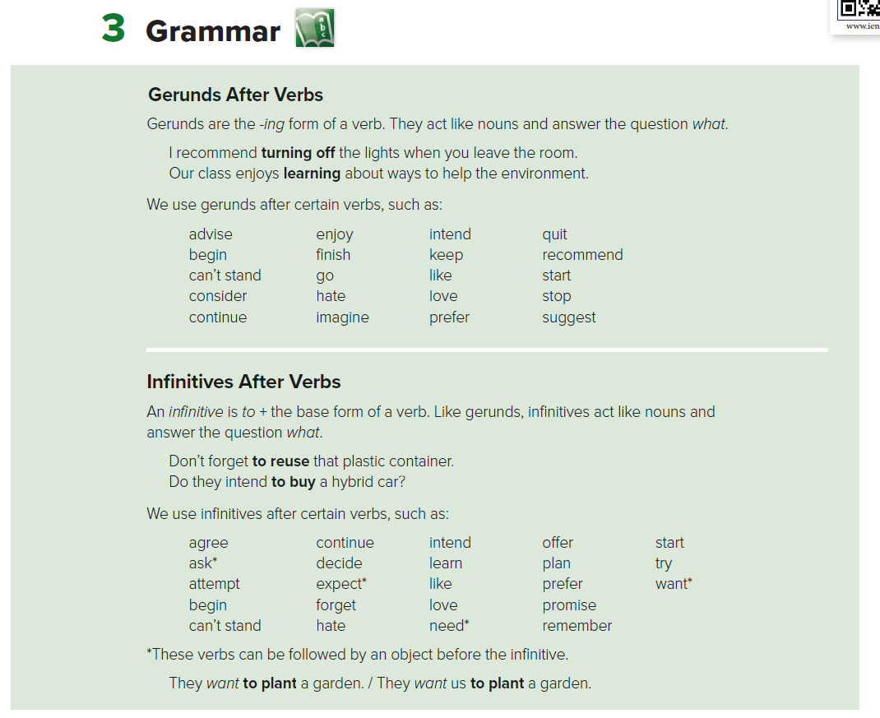
18

Slide 14
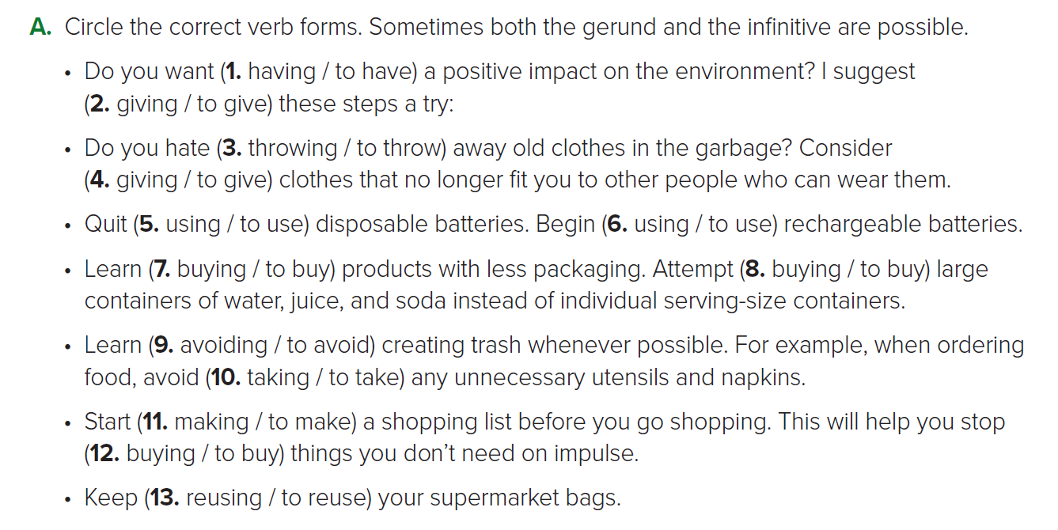
18

Slide 15
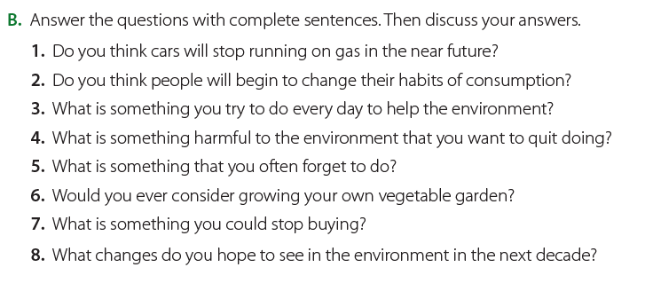
19

Slide 16
19
1. I think that in the near future cars will stop running on gas.
2. I think that people will begin to change their habits of consumption.
3. Every day I try to remember to recycle trash.
4. I would like to quit smoking.
5. I forget to turn the TV off before going to bed.
6. I would consider growing my own vegetable garden.
7. I could stop buying water in bottles.
8. I hope to see energy consumption, waste, and pollution reduced.

Slide 17
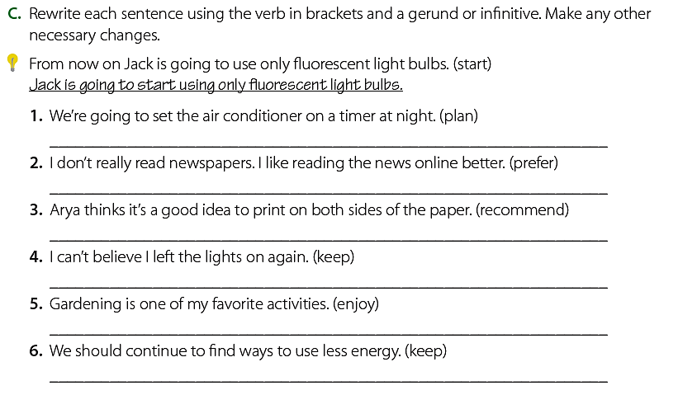
19
We plan to set the air conditioner on a timer at night.
I prefer reading the news online to reading newspapers.
Arya recommends printing on both sides of the paper.
I can’t believe I kept leaving the lights on.
I enjoy gardening.
We should keep finding ways to use less energy.

Slide 18
HOMEWORK - workbook 88 - 89
Do you have any question?

Slide 19
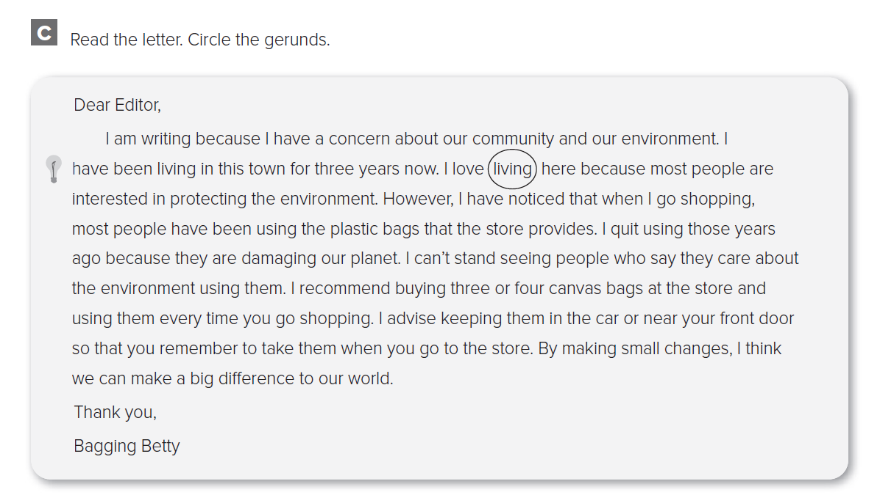
88

Slide 20
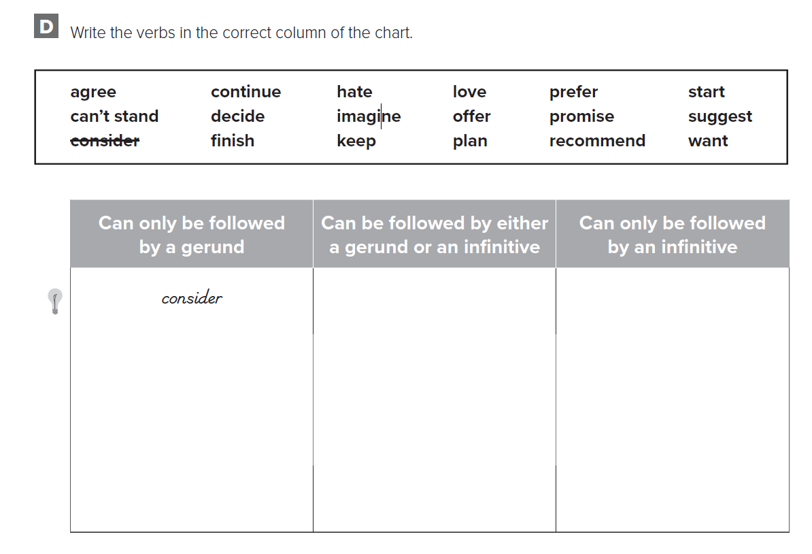
88
Can’t stand
Continue
hate
Love
Prefer
start
agree
decide
offer
Plan
Promise
want
Finish
imagine
Keep
recommend
suggest

Slide 21
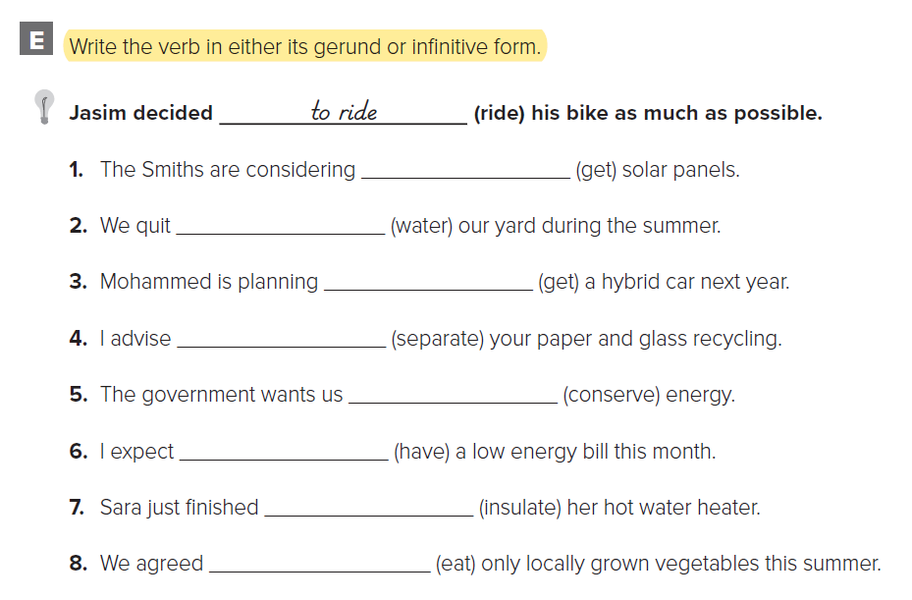
89
getting
watering
to get
separating
to conserve
to have
insulating
to eat

Slide 22
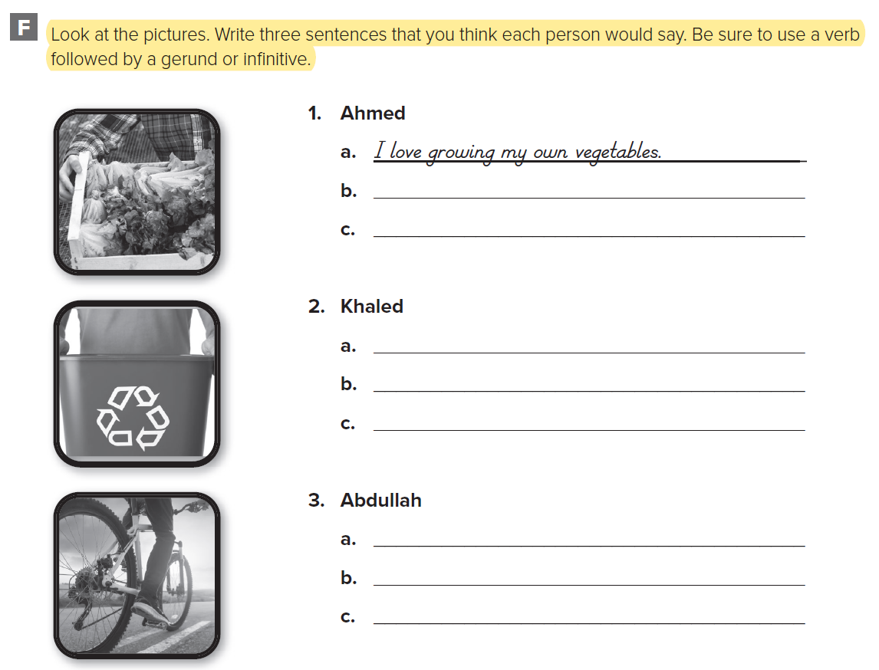
89
I recommend eating fruits and vegetables every day.
I like eating organic vegetables.
I attempt to recycle everything possible.
I recommend getting two recycle bins.
I like knowing that I’m helping the earth.
We like biking to work
We hate paying for parking in the city.
We prefer to bike to work on rainy days

Slide 23
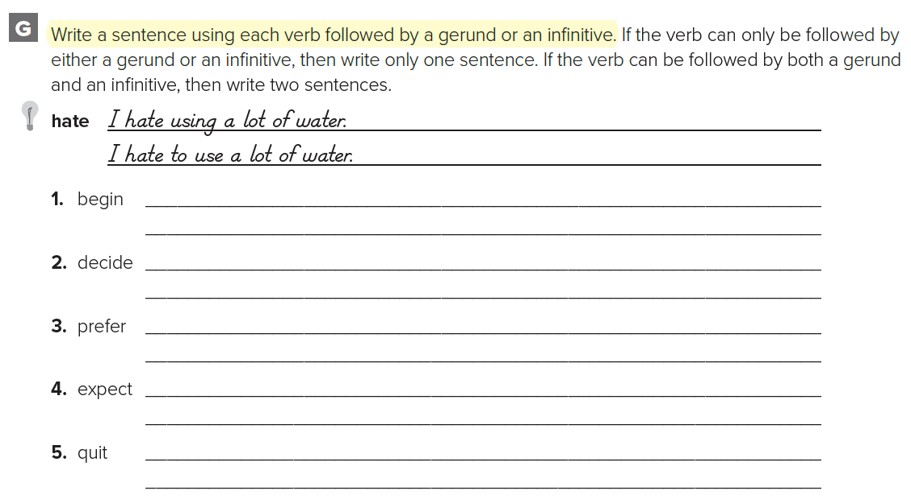
90
The farmer began to use organic methods
The farmer began using organic methods
We decided to get solar panels.
I prefer eating organic food.
I prefer to eat organic food.
We expect to see her soon.
She quits smoking.

Slide 24
Thank you amazing students
Have a nice day

