Slide 1
We can 1
hello

Slide 4
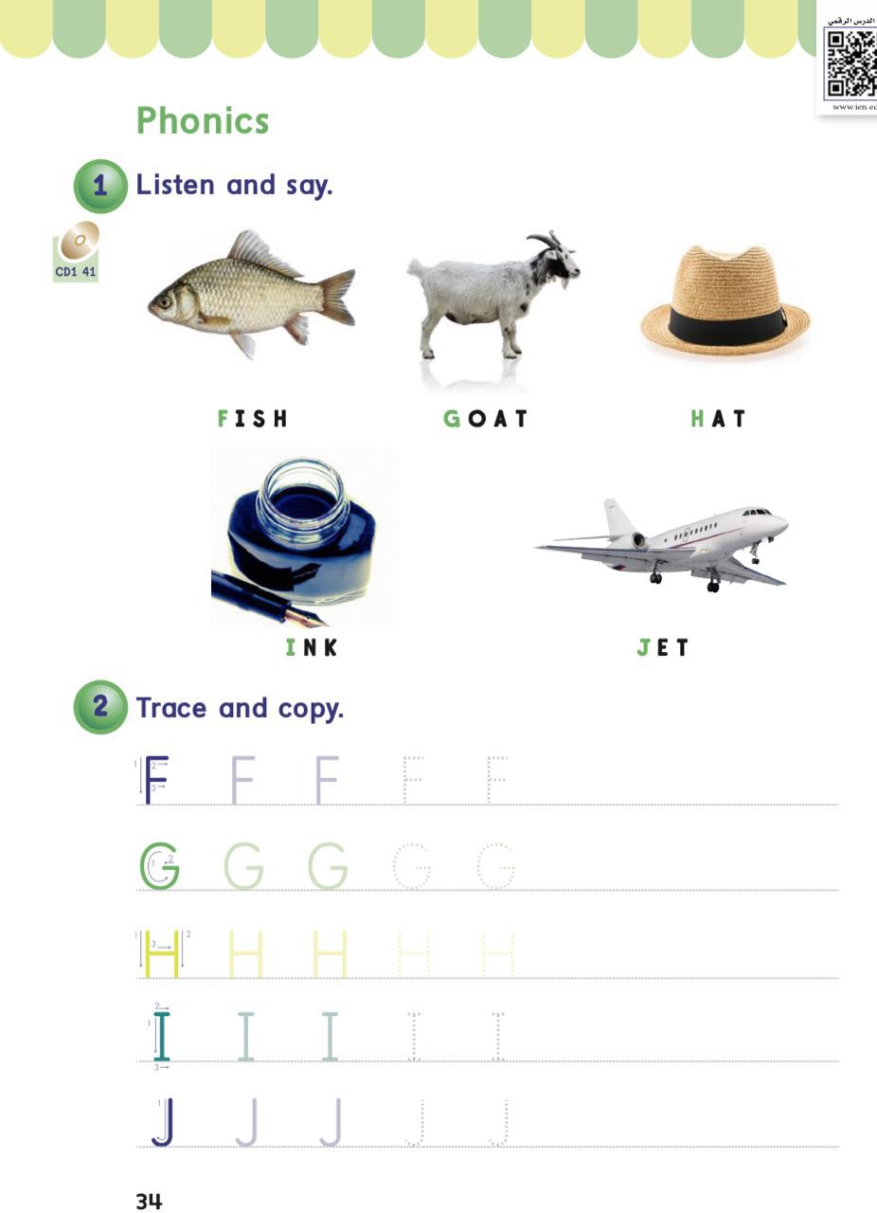
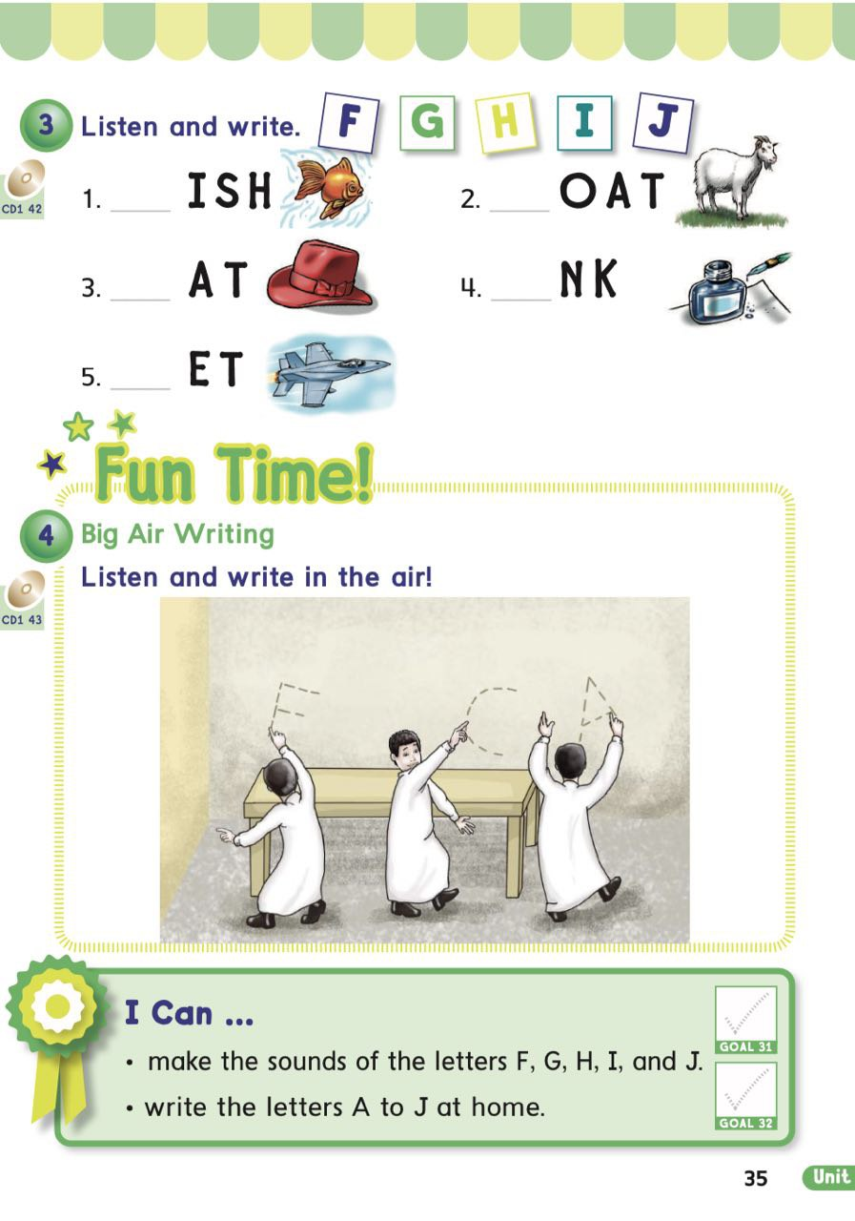

Slide 6
shapes

Slide 10
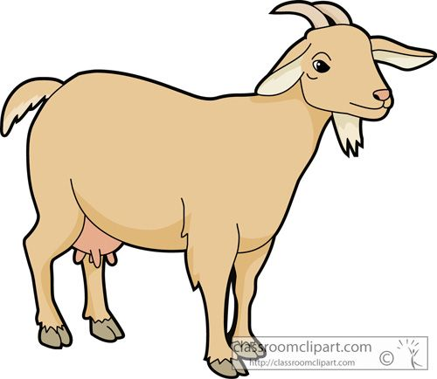

Slide 18
Press at one shape

Slide 19
What’s the first letter of the word

Slide 20
What’s the first letter of the word

Slide 21
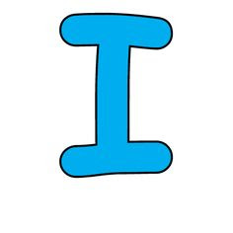
What’s the first letter of the word

Slide 22
What’s the first letter of the word

Slide 23
What’s the first letter of the word

Slide 31
Open your book pages 93&94

Slide 32
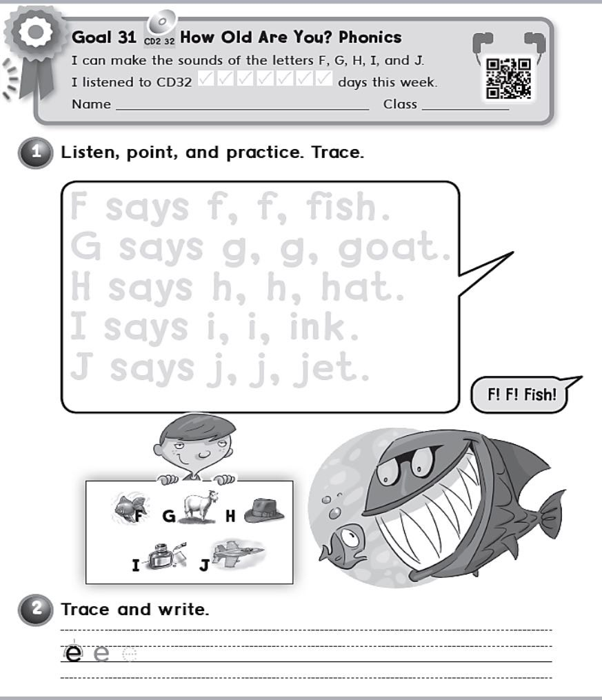

Slide 33
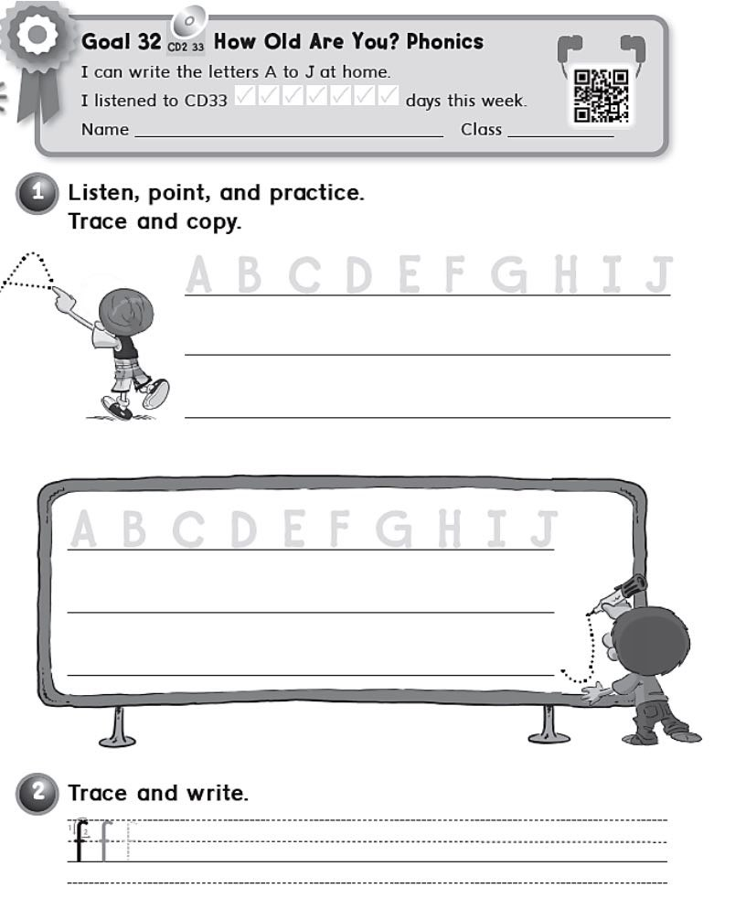

Slide 34
Home work at

