Slide 1






3 grammar
Today:
Date:
- -
Page 66
By: Dalal Al-Juaid

Slide 2


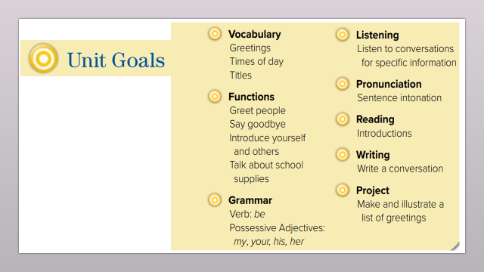
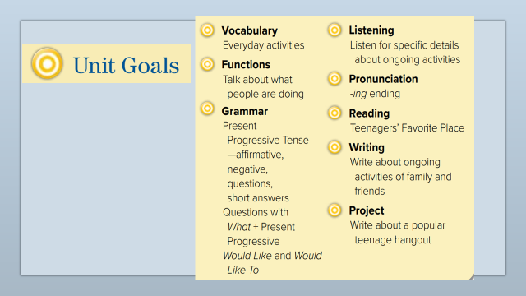
use present progressive(affirmative & negative) form
ask short answer questions in the present progressive form
Warm up
1-Listen
Form a wh-question (what) in the present progressive
New words
Quick check
Use contraction (short form)
2-Pair work

Slide 3
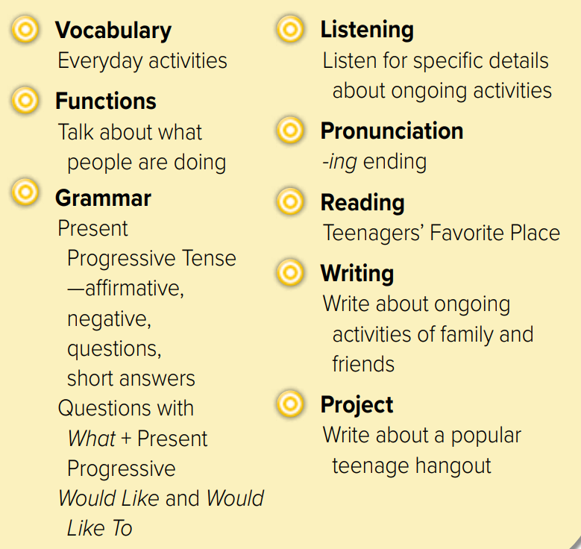
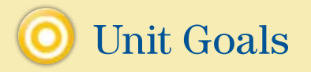

Slide 4
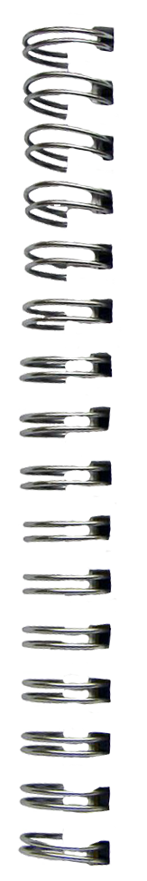
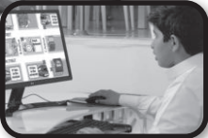



Revision
What ………… doing?
…..
Hot line to ask questions
…….
#
break
..........

Slide 5










Answer with emoji
Warm up
1-Listen
Send e-mail
New words
Work online
A magazine
Quick check
helpline
A break
2-Pair work

Slide 6

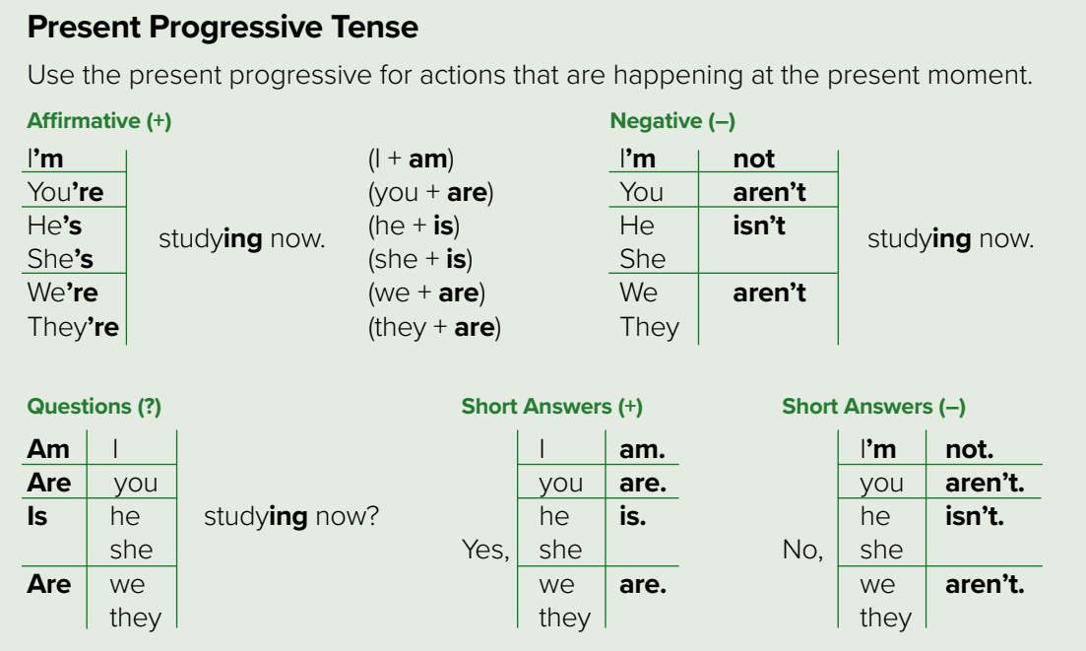




She isn’t reading
S + am + V-ing
is
are
Page 66
Warm up
1-Listen
Change into negative:
New words
She is reading
Quick check
We are eating
We aren’t eating
2-Pair work

Slide 7








Page 66
Warm up
1-Listen
New words
am + S + V-ing
is
are
Quick check
2-Pair work

Slide 8
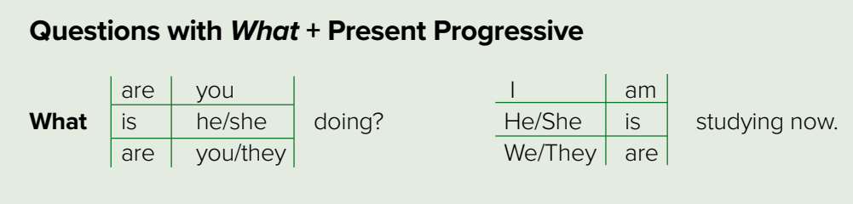
Page 66
Wh – Q
words
am + S + V-ing
is
are
Warm up
1-Listen
New words
Quick check
2-Pair work

Slide 9
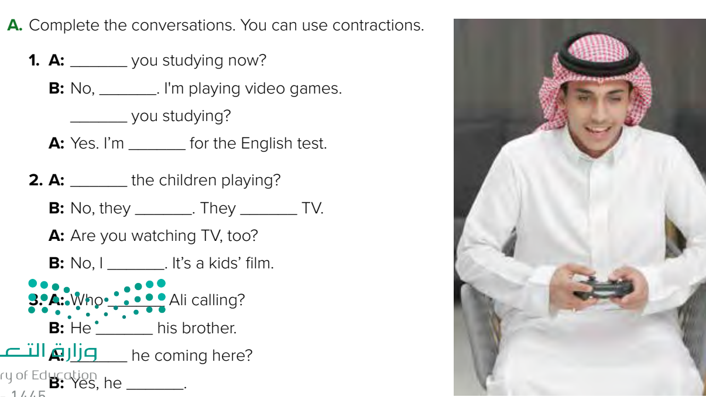

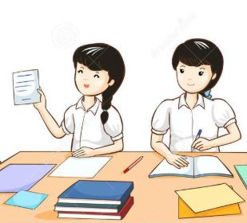

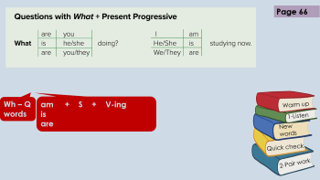
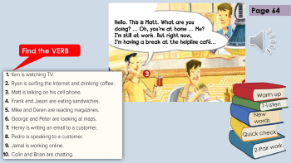
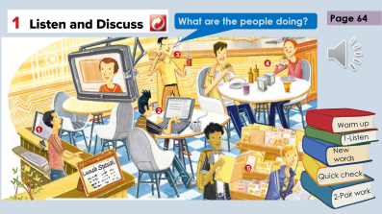
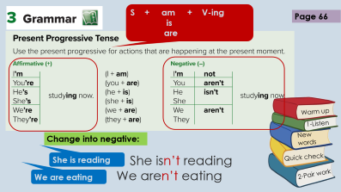
Are
I’m not
Are
studying
Are
aren’t
are
watching
Think pair share
am not
Warm up
is
1-Listen
is
calling
New words
Is
Quick check
is
2-Pair work

Slide 10

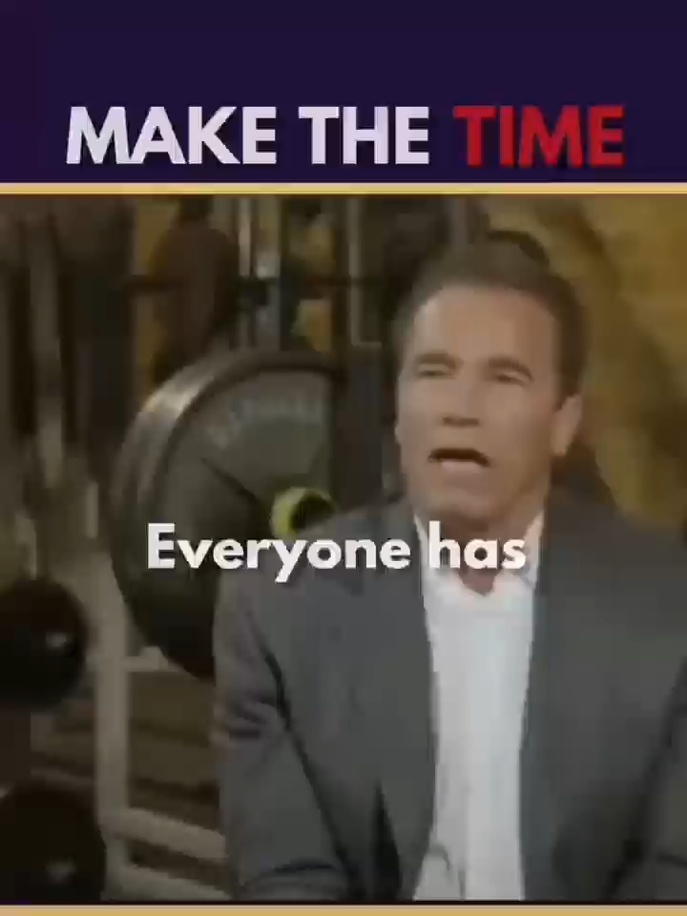

Lets play
Warm up
1-Listen
New words
Quick check
2-Pair work

Slide 11

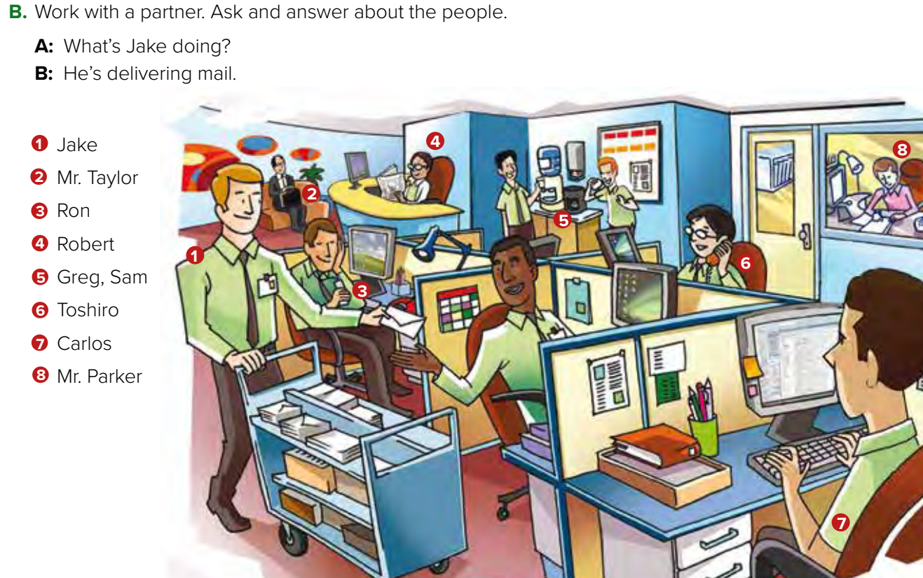
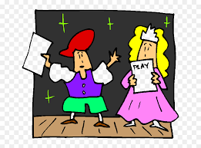

Page 67
Role paly
Warm up
1-Listen
New words
4. What is Robert doing?
He is reading a newspaper.
Quick check
2-Pair work

Slide 12
Write in your notebook
Like final test أسئلة للاختبار النهائي
Choose:
Mmmmmmm ………. mmmmmmm
( ssss – ssss – sssss)
Make a question

Slide 13





page 218 Ex(B)
for practice grammar
Warm up
1-Listen
New words
Quick check
2-Pair work

Slide 14
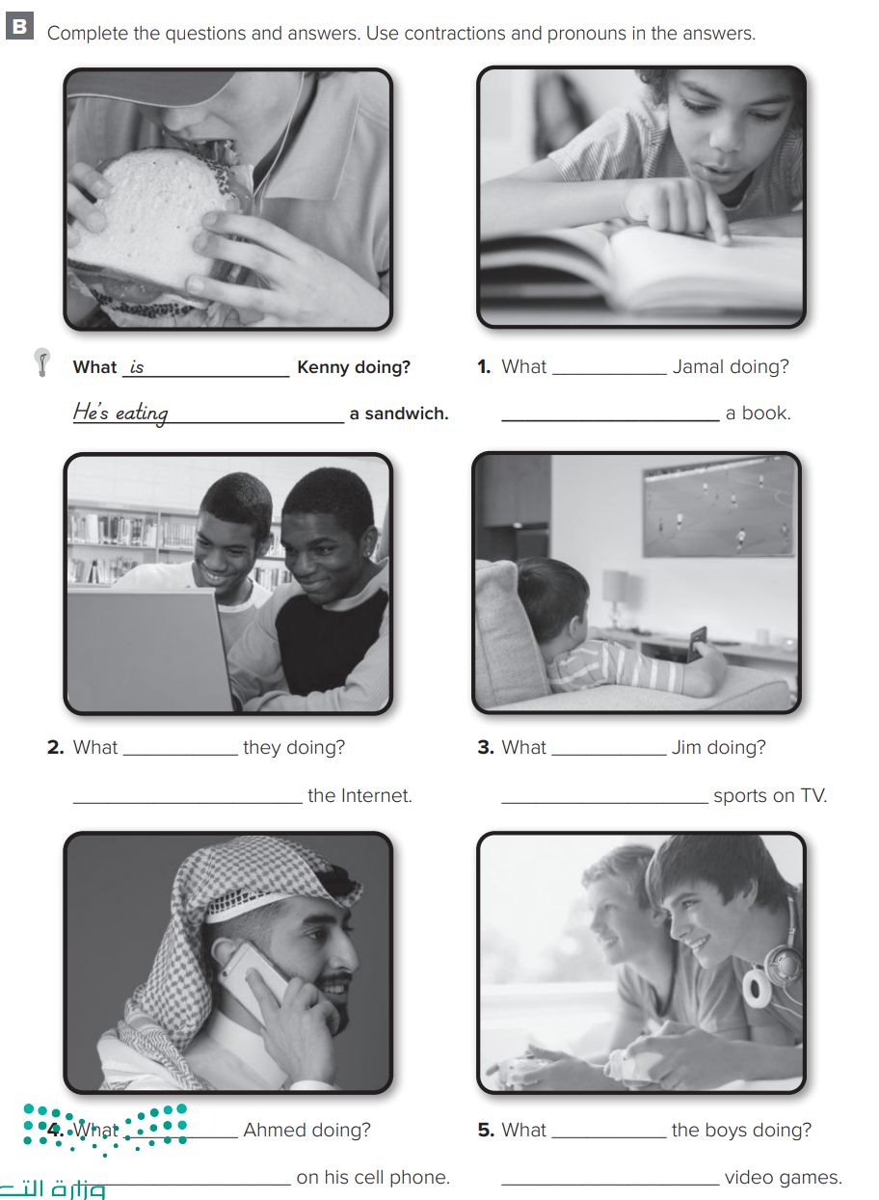
p.218
is
are
He’s reading
They’re surfing
Warm up
1-Listen
New words
Quick check
is
is
are
2-Pair work
He’s watching
He is talking
They’re playing

