Slide 1




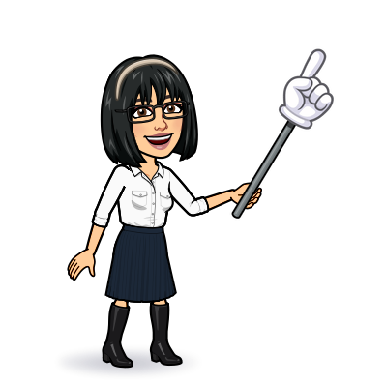

4 listening
5 pronunciation
6 conversation
7 about you
Today:
Date:
- -
Page 67
By: Dalal Al-Juaid

Slide 2


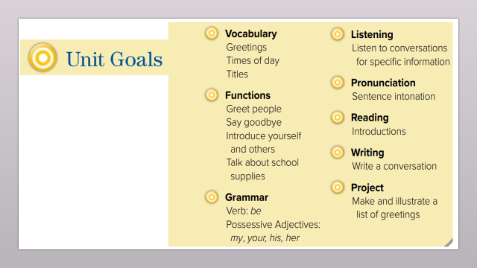
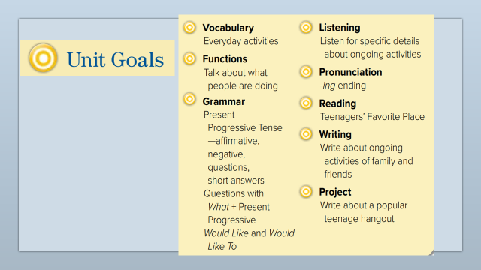
complete a chart from a listening material
answer questions about a conversation
Warm up
1-Listen
answer questions about films
New words
Quick check
Use Real Talk correctly in sentences
2-Pair work

Slide 3
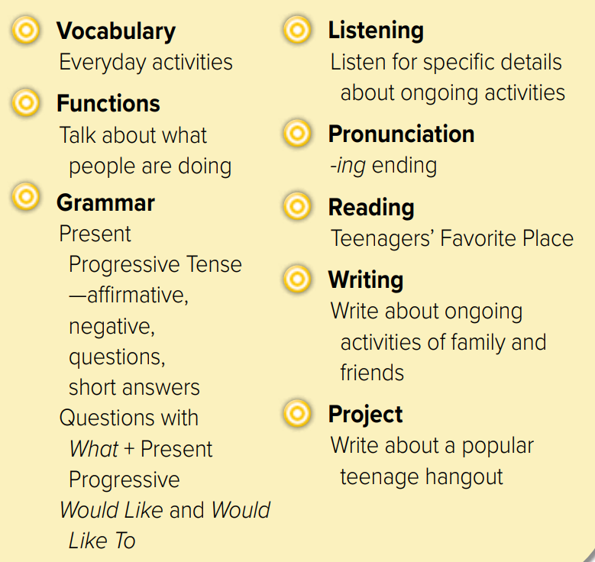
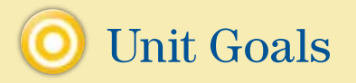

Slide 4
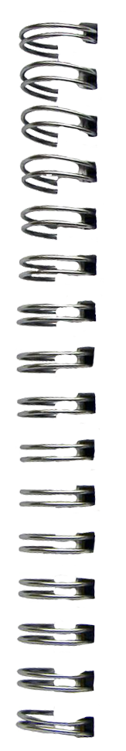
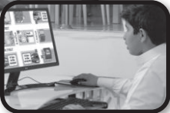



Revision
What ………… doing?
…..
Hot line to ask questions
…….
#
break
..........

Slide 5










Answer with emoji
Warm up
1-Listen
Send e-mail
New words
Work online
A magazine
Quick check
helpline
A break
2-Pair work

Slide 6
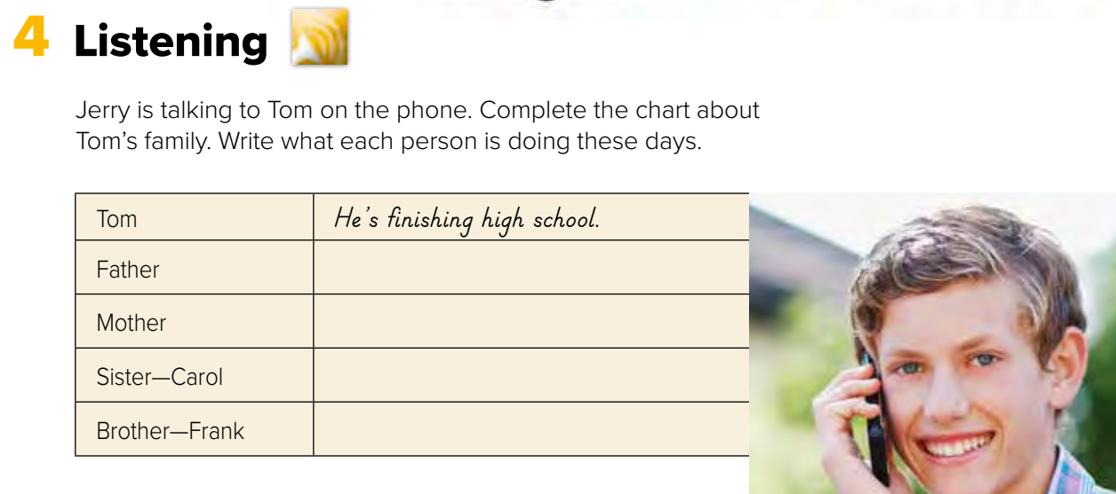




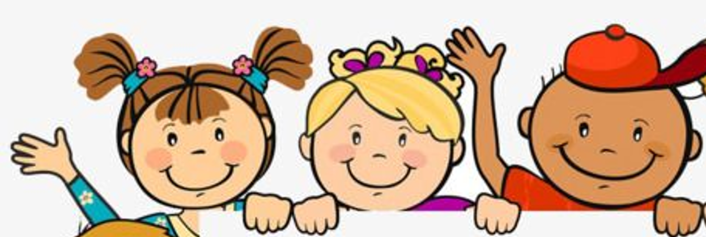
Page 67
He’s working in a bank
She’s watching a baby
She’s working at a hospital
Warm up
He’s studying at a college
1-Listen
New words
Quick check
Think pair share
2-Pair work

Slide 7
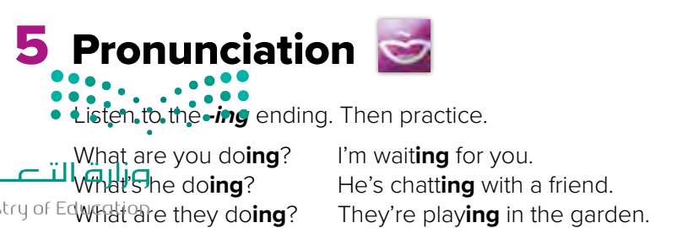

Page 67
am + S + V-ing
is
are
Warm up
Listen
1-Listen
New words
repeat
Quick check
2-Pair work

Slide 8
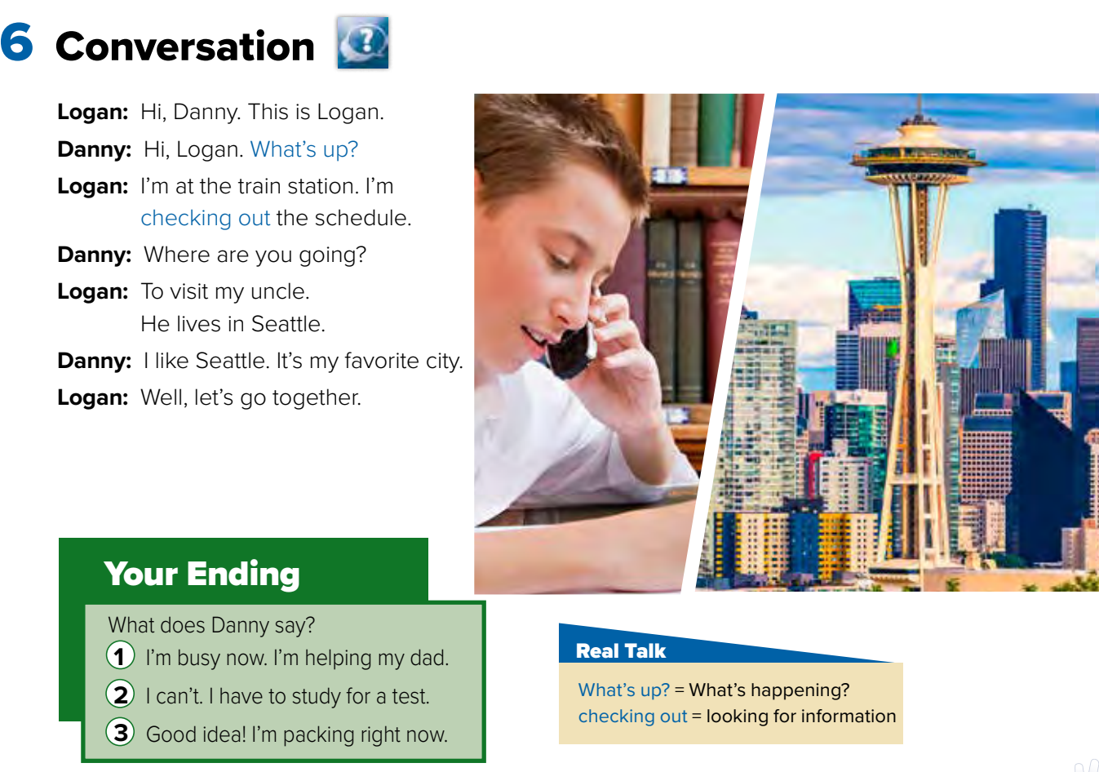
What’s the boy doing?
Page 68
Where is Logan going?
Warm up
1-Listen
New words
Does Danny like Seattle?
Quick check
2-Pair work

Slide 9
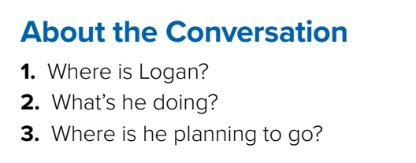

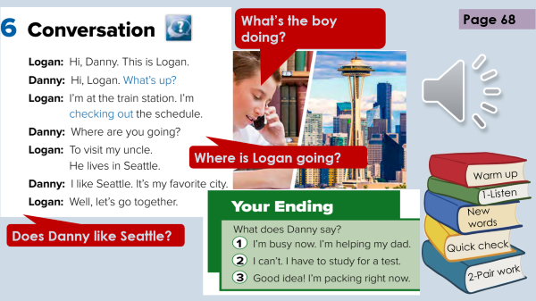

Informal=
With friends only
Think pair share
At the train station
Warm up
Checking out the schedule
1-Listen
To Seattle
New words
To visit his uncle
Quick check
2-Pair work

Slide 10



Lets play
Warm up
1-Listen
New words
Quick check
2-Pair work

Slide 11




New Words
Train station
Check out
Look for
schedule
packing
Put clothes in bags for traveling
busy
#
free

Slide 12
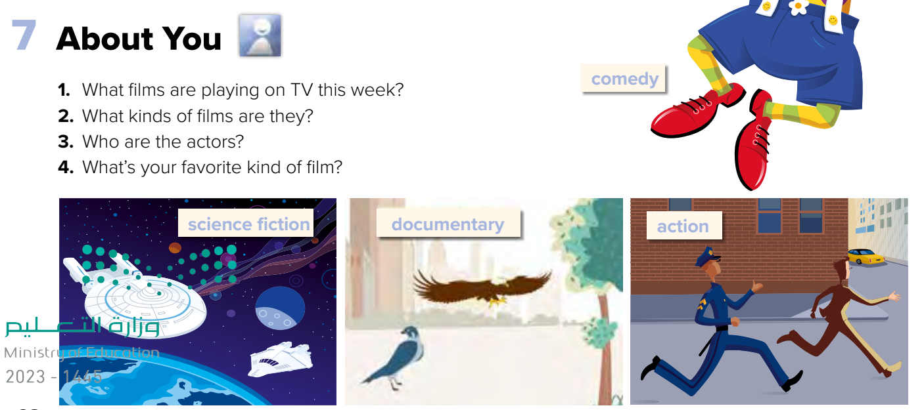
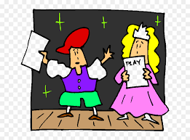

Role paly
Warm up
1-Listen
New words
Quick check
2-Pair work

Slide 13
Write in your notebook
Like final test أسئلة للاختبار النهائي
Choose:
Mmmmmmm ………. mmmmmmm
( ssss – ssss – sssss)
Make a question

Slide 14





page 219 Ex(C)
for practice grammar
Warm up
1-Listen
New words
Quick check
2-Pair work

Slide 15
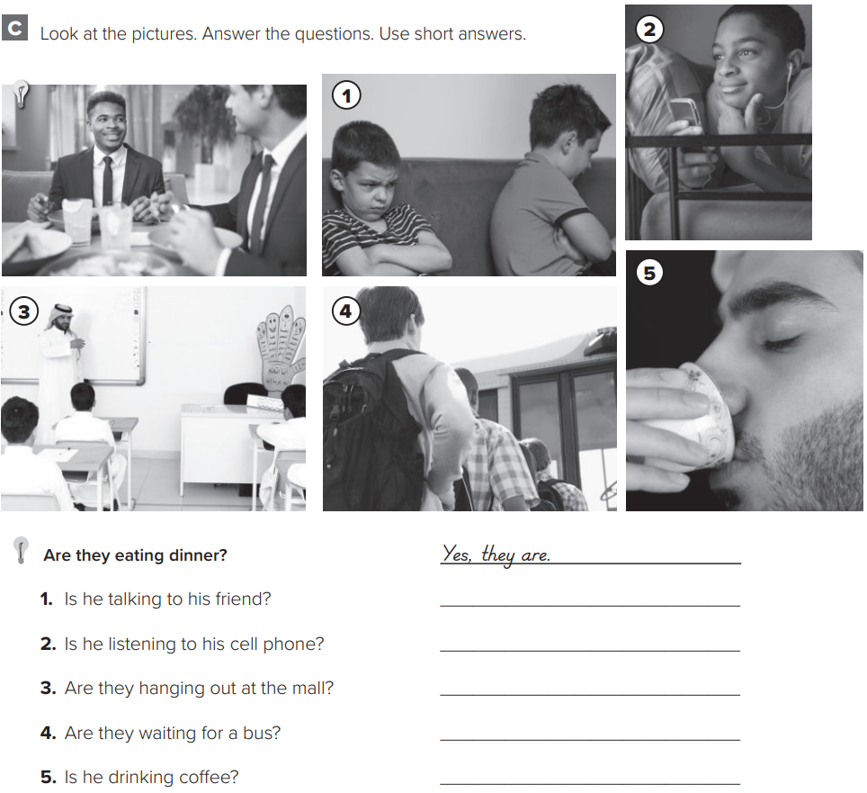
p.219
Warm up
1-Listen
No, he isn’t.
New words
Yes, he is.
No, they aren’t.
Quick check
Yes, they are.
2-Pair work
Yes, he is.

