Slide 1
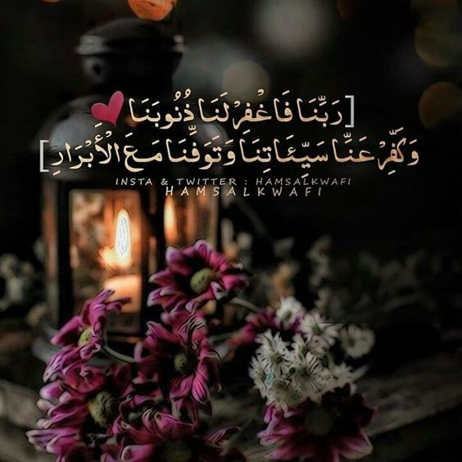

Slide 2


Slide 3
Unit 8
What are you doing ?

Slide 4

Today’s lesson :
1 .Listening & discuss
2 .Pair work .

Slide 5
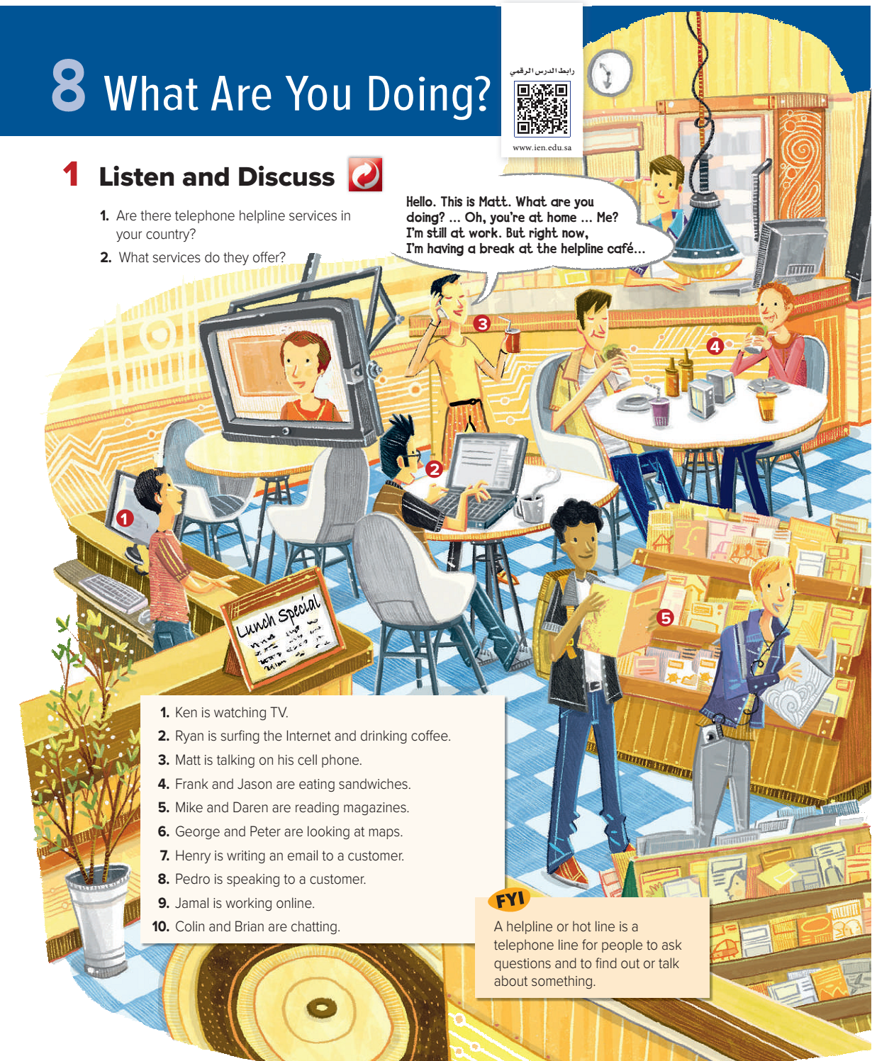
Page: 64

Slide 6
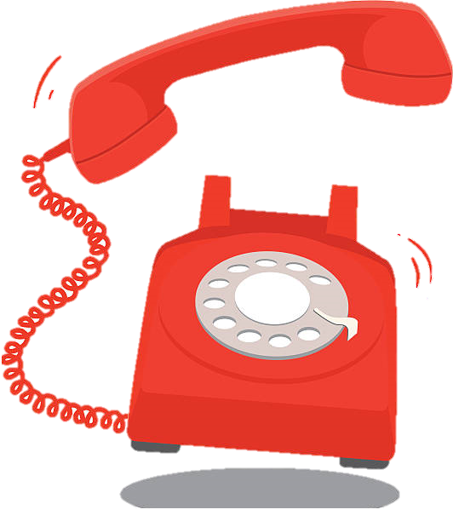
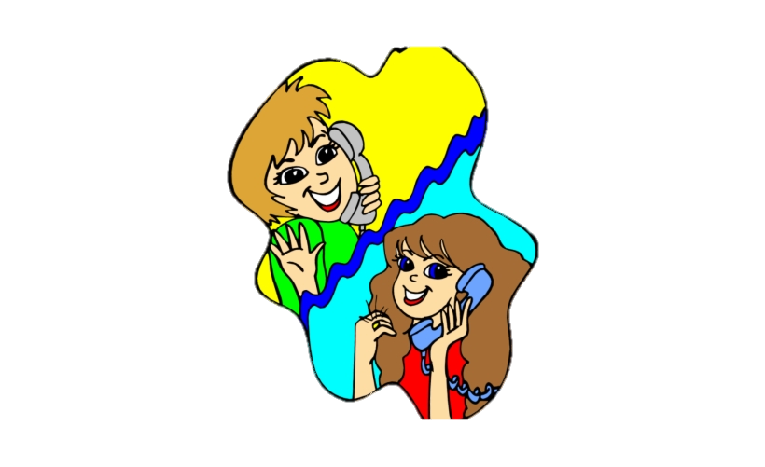
Page: 64

Slide 7

Page: 64

Slide 8
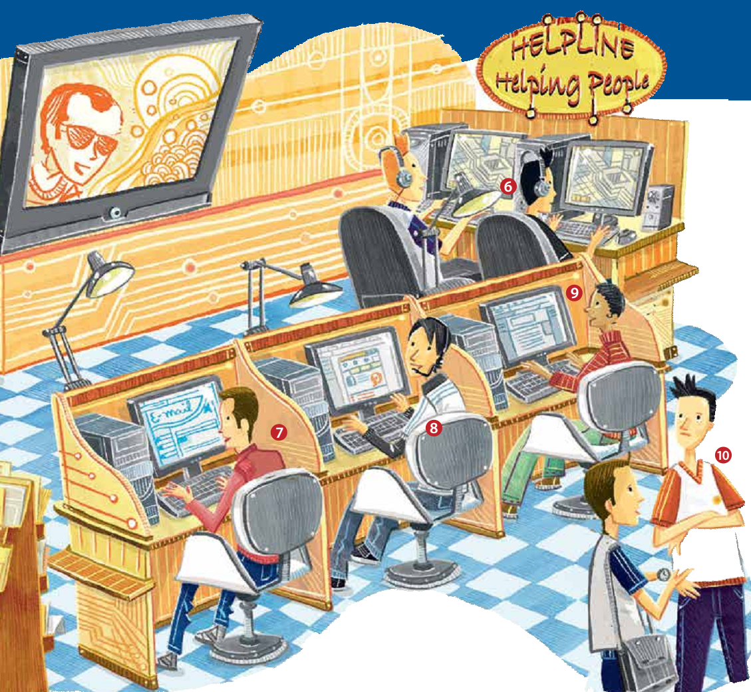
Page: 65

Slide 9
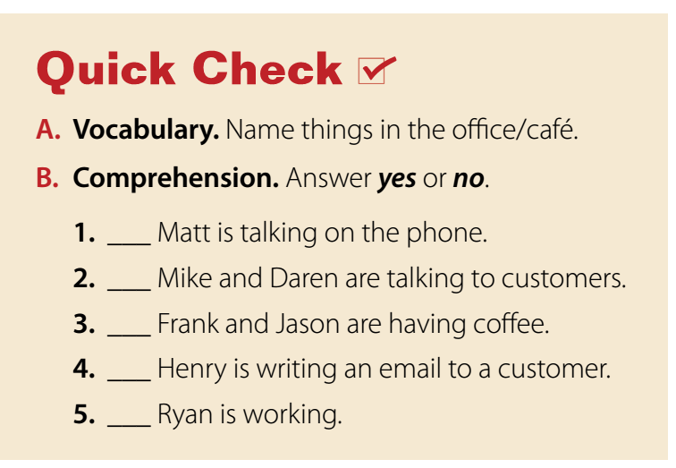
computers, food, drinks, lights/lamps, headphones, tables, chairs, a TV, magazines, a plant, a headset, cell phone
Page: 65

Slide 10
computers, food, drinks, lights/lamps, headphones, tables, chairs, a TV, magazines, a plant, a headset, cell phone
Yes
No
No
Yes
No
Page: 65

Slide 11
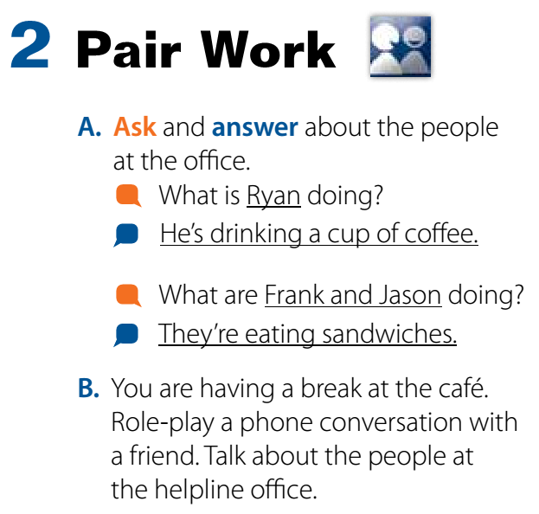
Page: 65

Slide 12
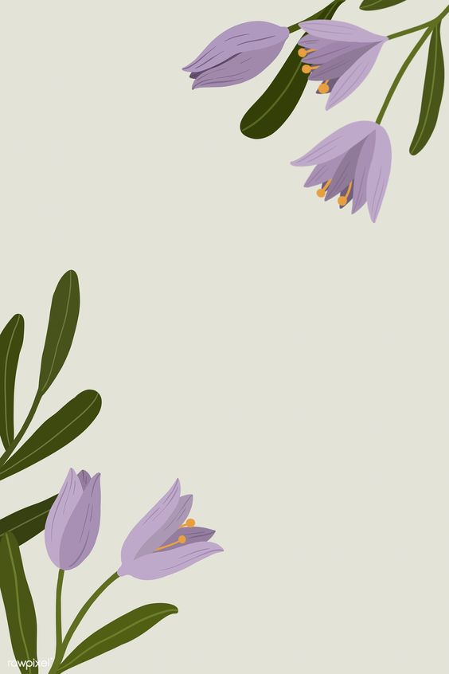
Homework
Workbook page : 119
( A )

Slide 13
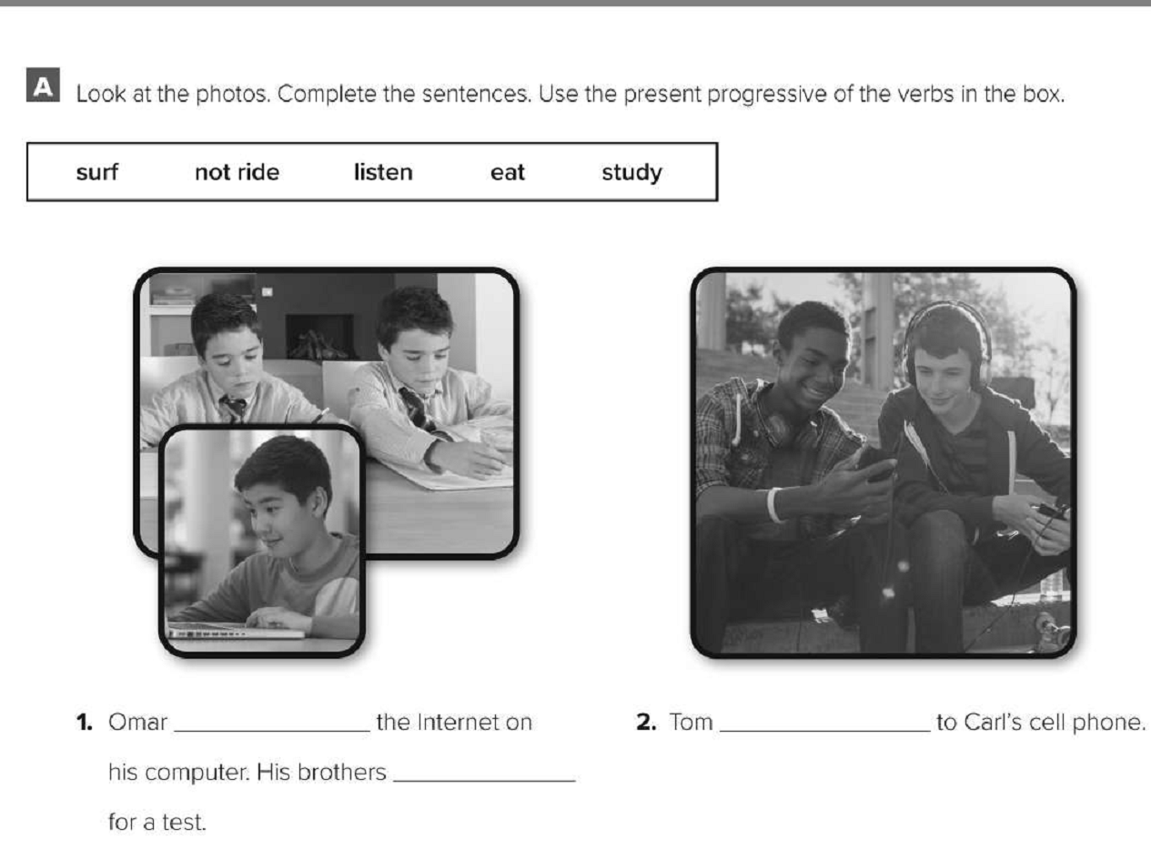
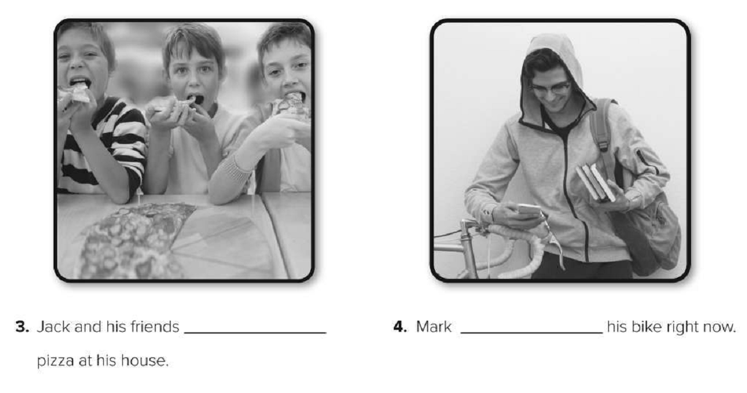
Workbook page: 119
are eating
isn’t riding
is surfing
is listening
are studying

Slide 14
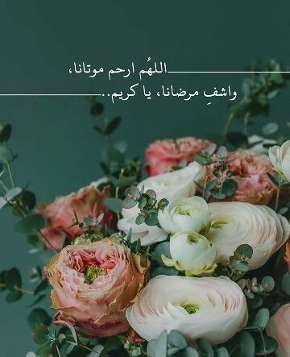

Slide 15
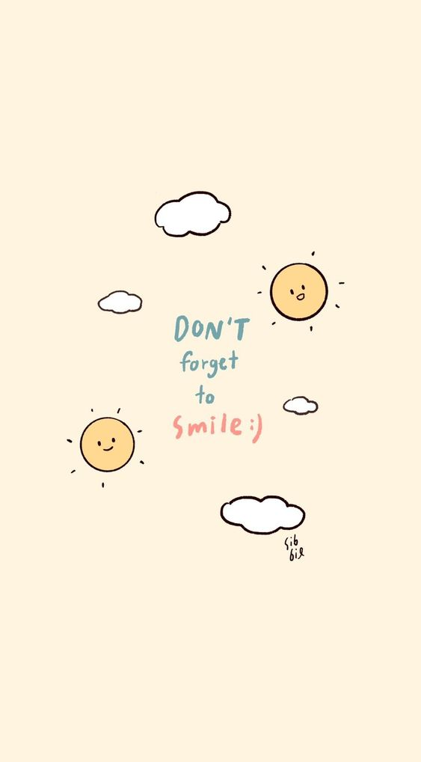

Slide 16
Today’s lesson :
3. Grammar .

Slide 17
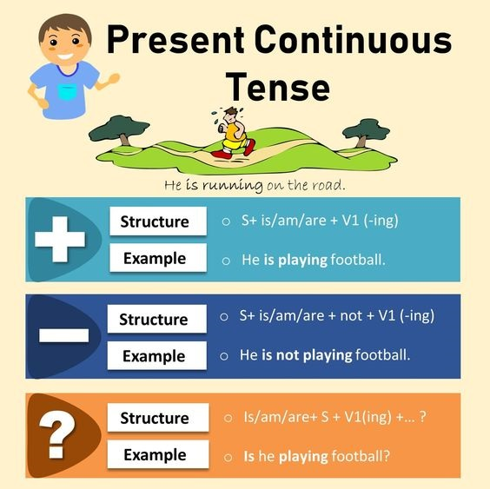

Slide 18
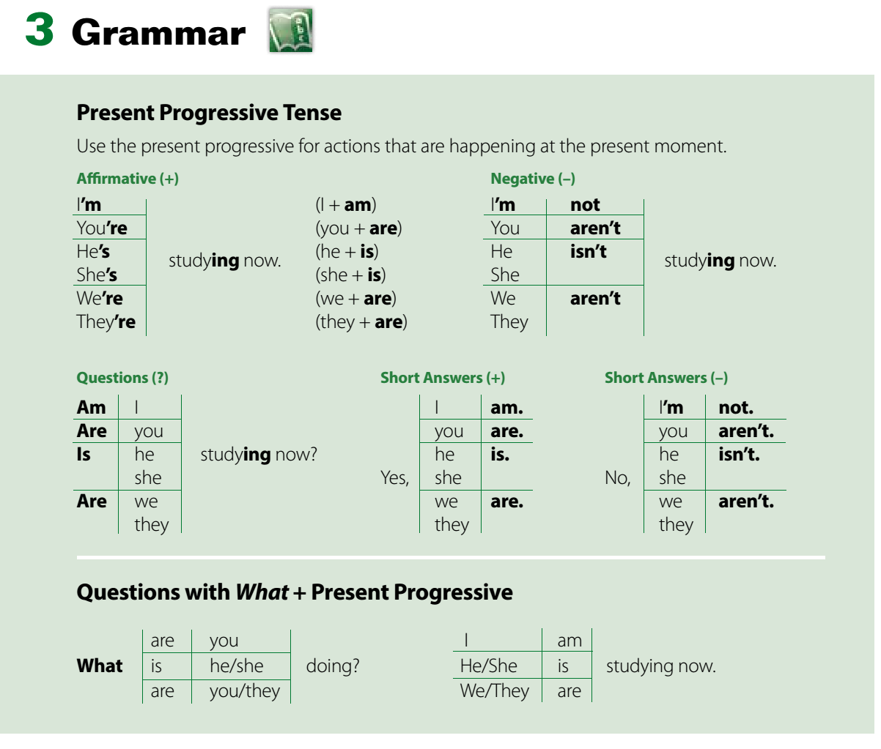
Page: 66

Slide 19
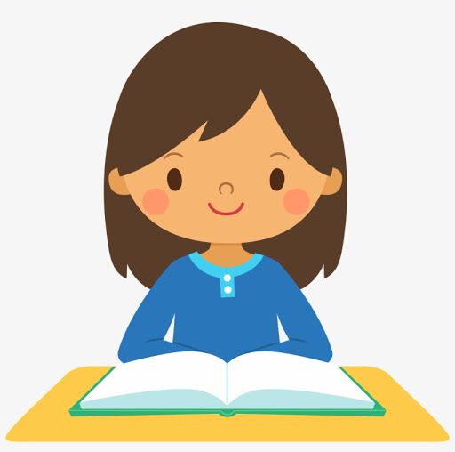
She is reading .
She’s reading .
What is she doing now?

Slide 20
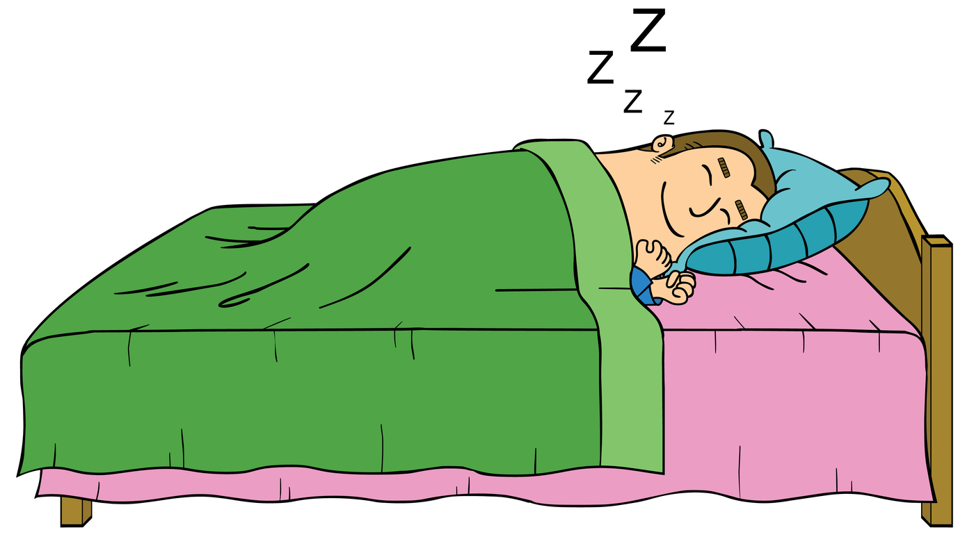
He is sleeping .
He’s sleeping .
What is he doing now?

Slide 21
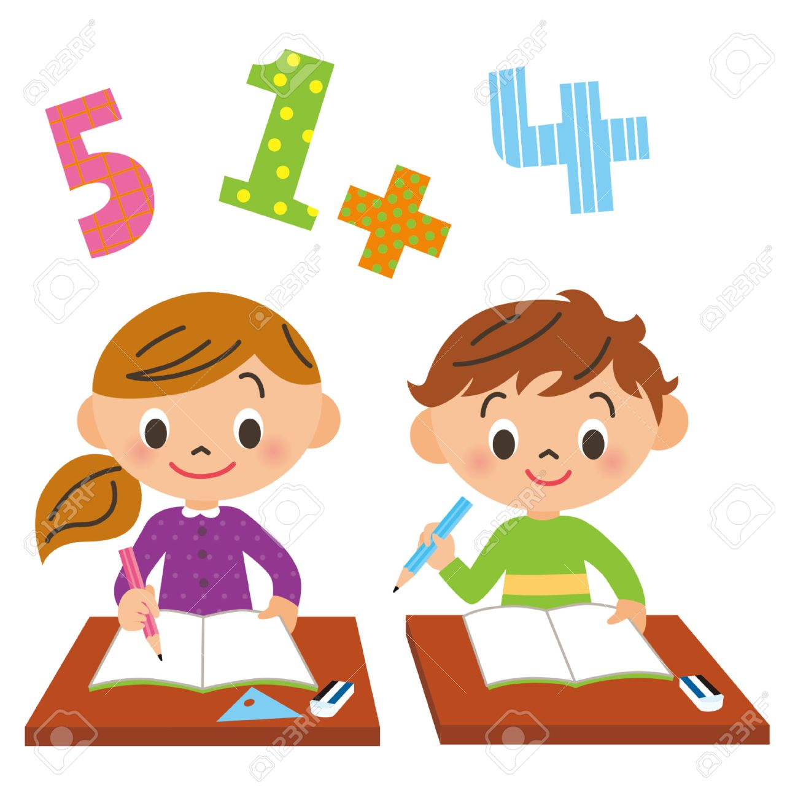
They are studying .
They’re studying .
What are they doing now?

Slide 22
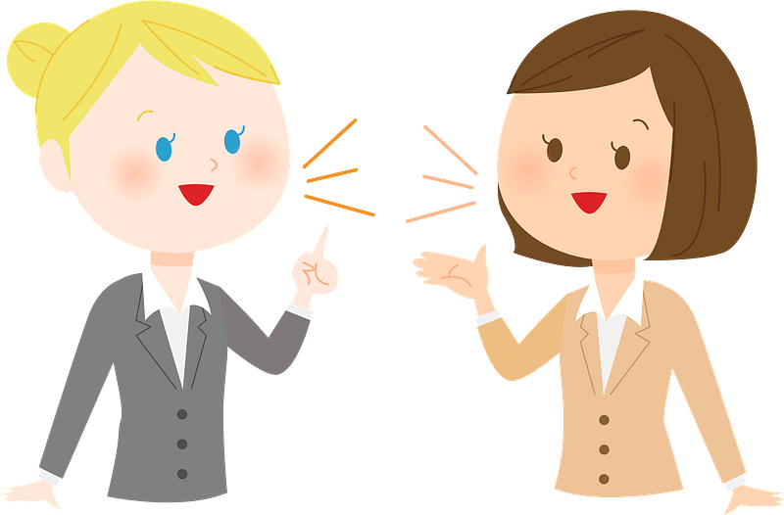
We are talking .
We’re talking .
What are they doing now?

Slide 23
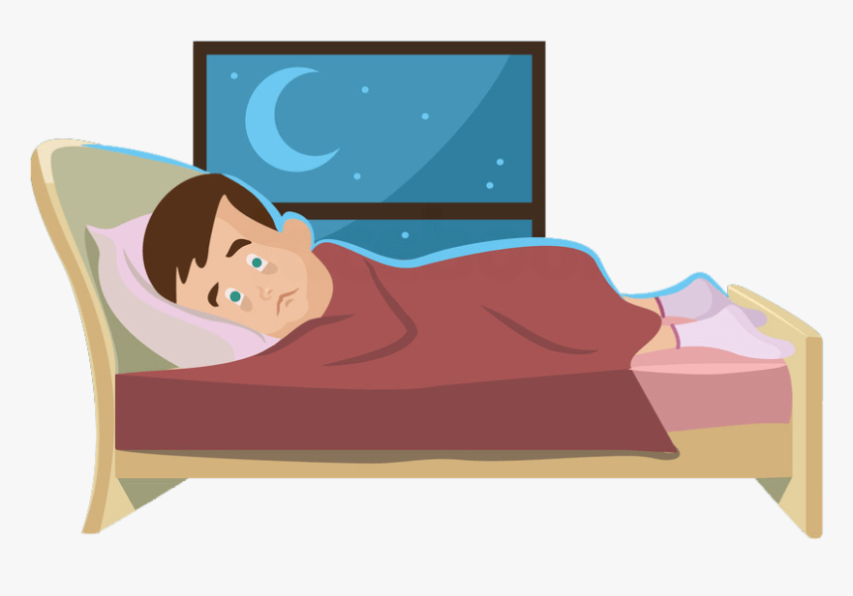
He is not sleeping .
He isn’t sleeping .

Slide 24
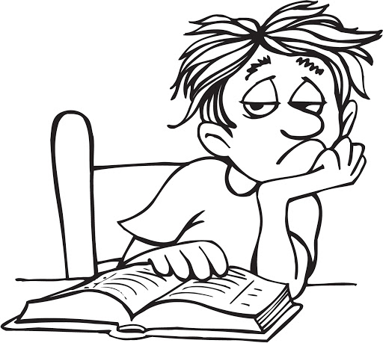
He isn’t studying .

Slide 25
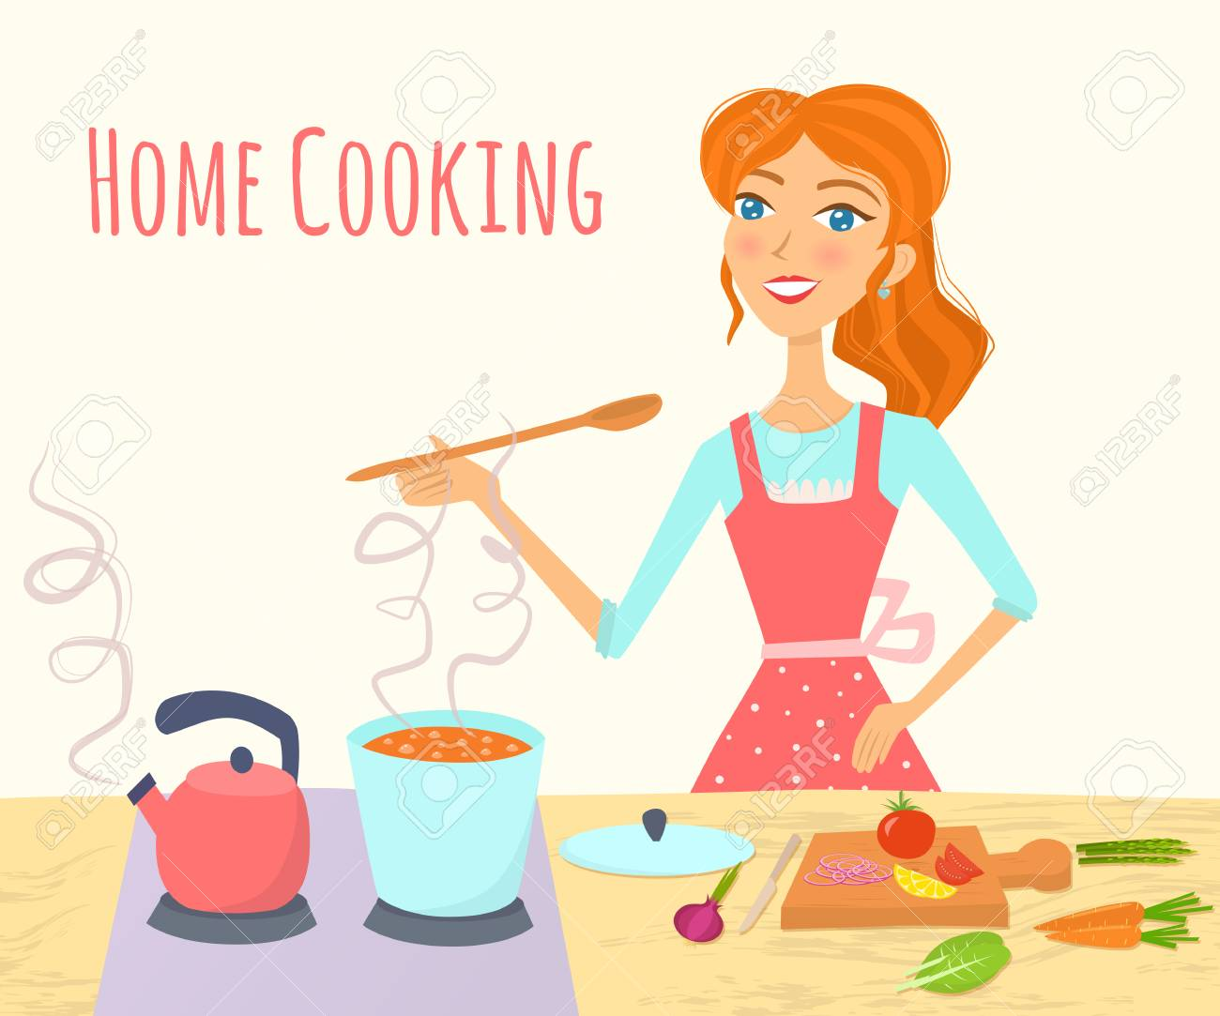
She is reading .
Is she reading ?
No , she isn’t.

Slide 26
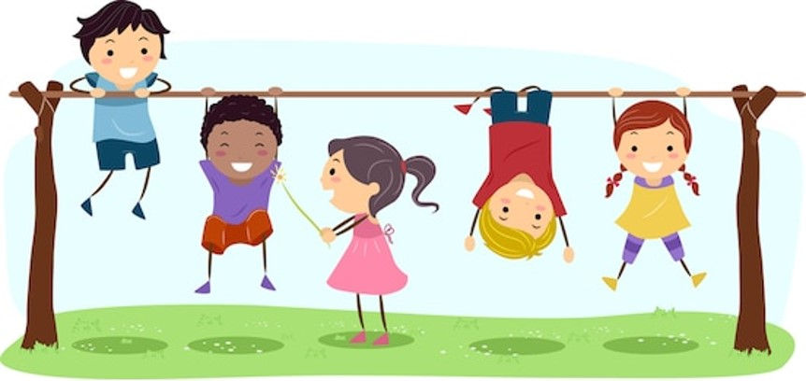
They aren’t studying .
They’re playing .

Slide 27
They are playing .
Are they playing ?
Yes , they are.

Slide 28
He is sleeping .
Is he sleeping ?
Yes , he is.

Slide 29
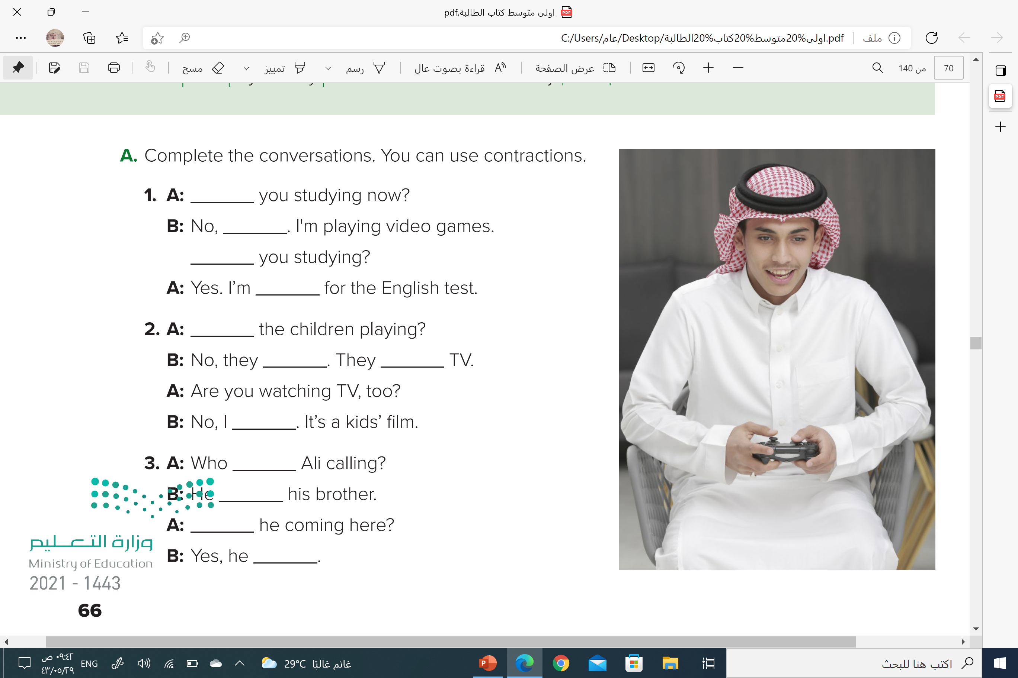
Are
I’m not
Are
studying
Are
aren’t
are watching
’m not
is
’s calling
Is
is
Page: 66

Slide 30
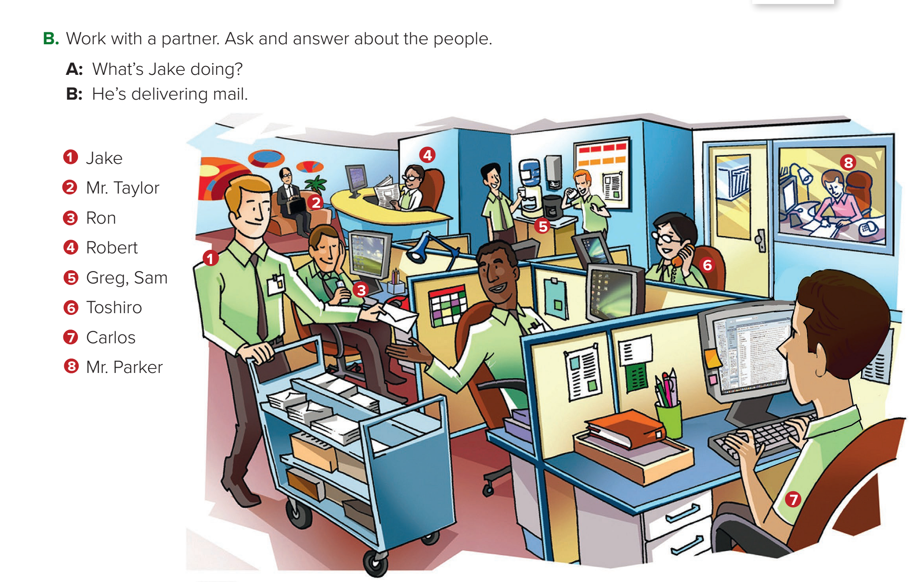

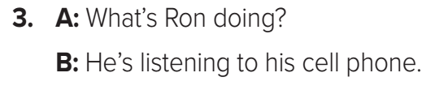
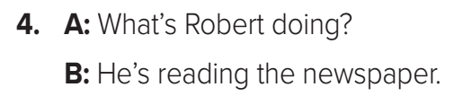
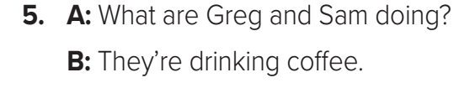

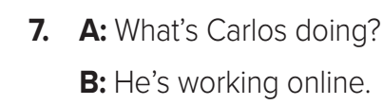

Page: 67

Slide 31
Homework
Workbook page : 120
( B )

Slide 32
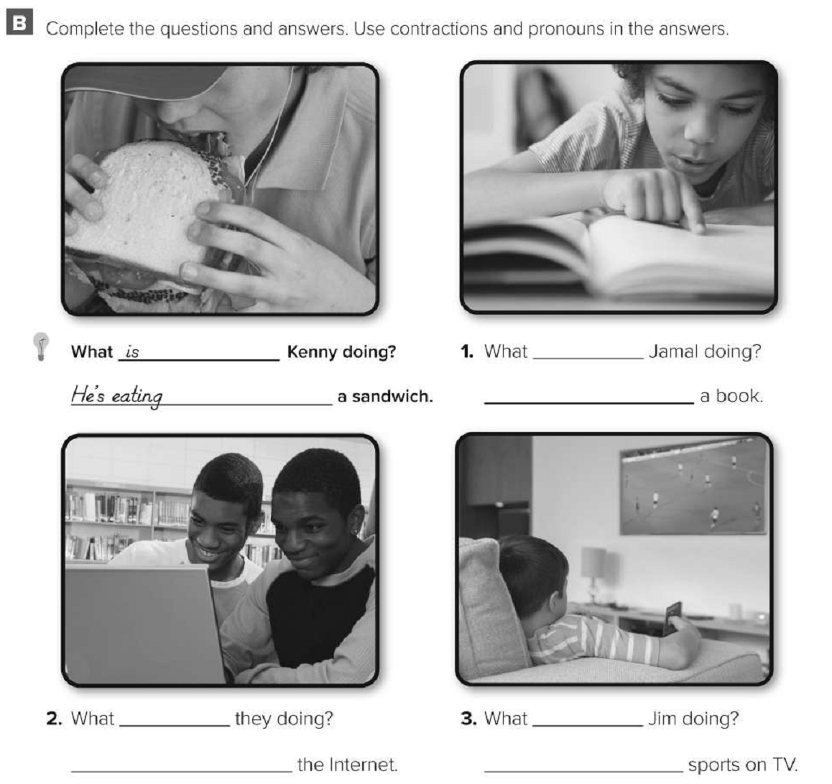
Workbook page: 120
is
He’s reading
are
is
They’re surfing
He’s watching

Slide 33
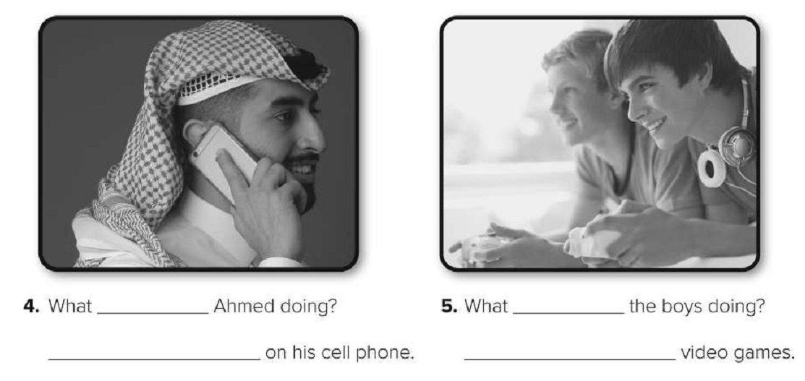
Workbook page: 120
is
are
He’s talking
They’re playing

Slide 34
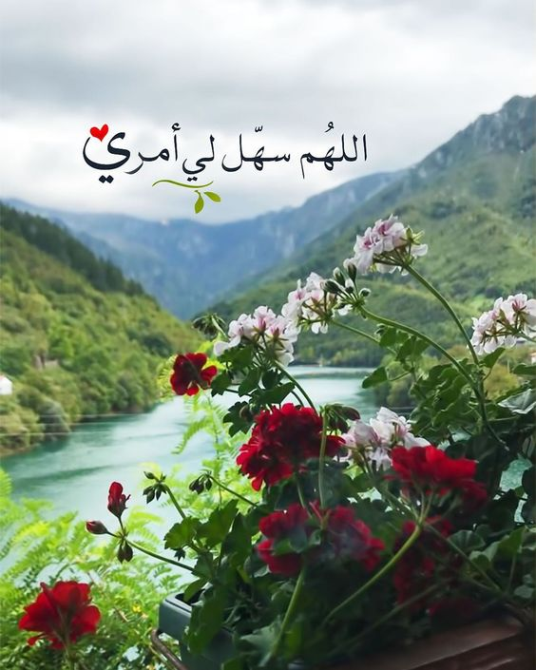

Slide 35


Slide 36
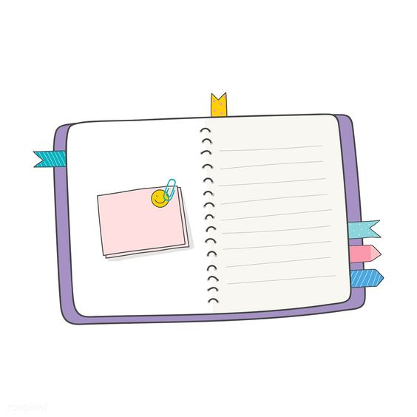
Today’s lesson :
4. Listening.
5. Pronunciation .
6- conversation .

Slide 37
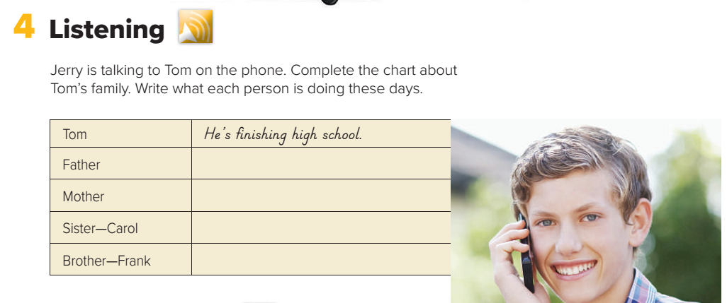
Page: 67
He’s working in a bank.
She’s watching Carol’s baby.
She’s working at a hospital.
He’s studying computers at college.

Slide 38
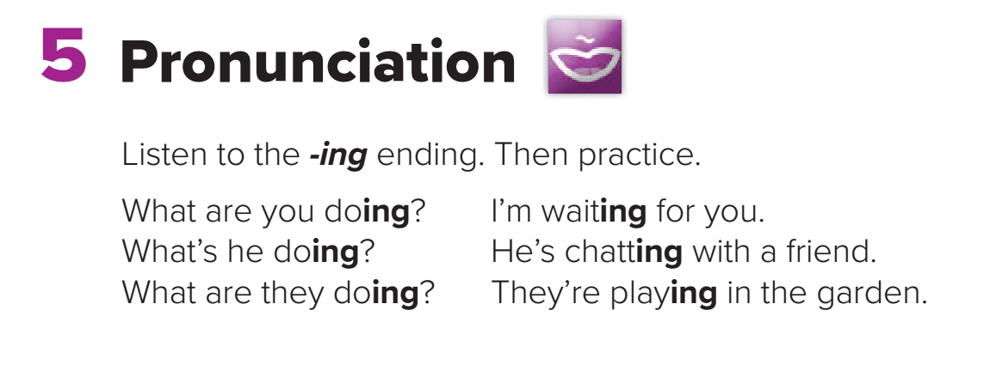
Page: 67

Slide 39
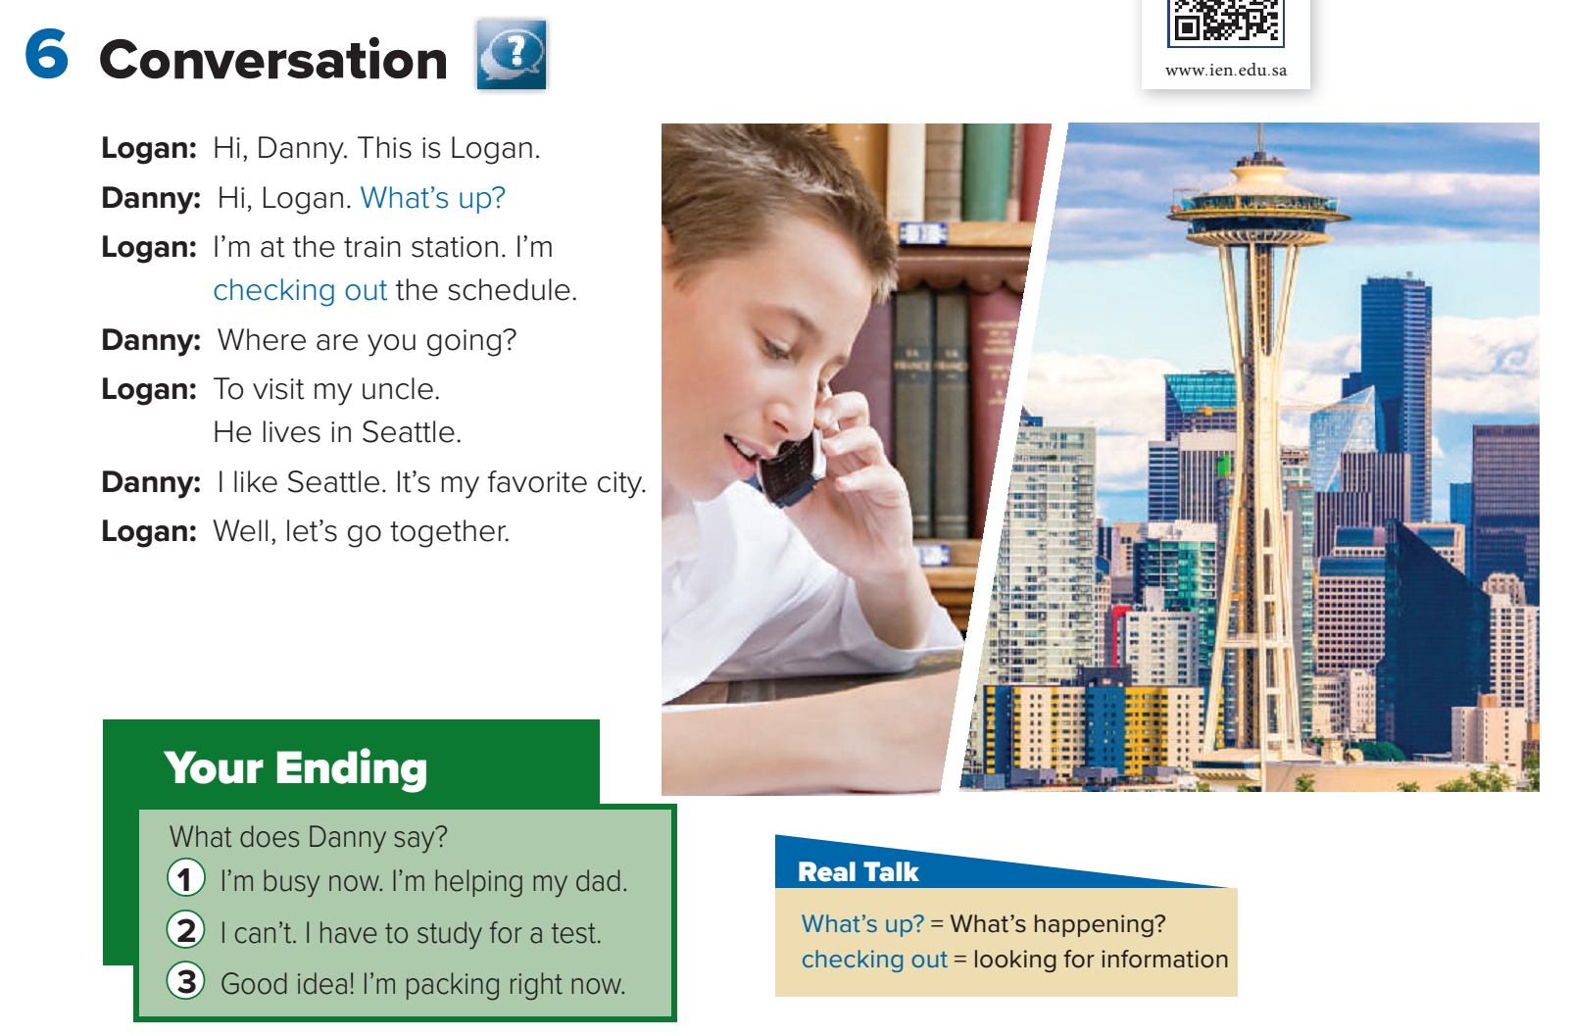
Page: 68

Slide 40
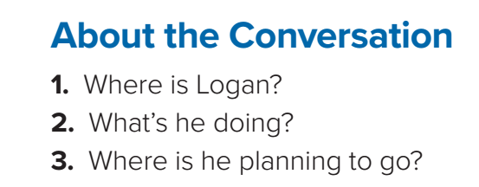
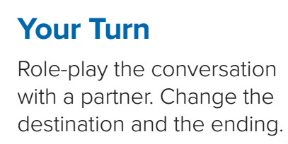
He’s at the train station.
He’s checking out the train schedule.
He’s planning to go to Seattle.
Page: 68

Slide 41
1
2
Page: 68

Slide 42
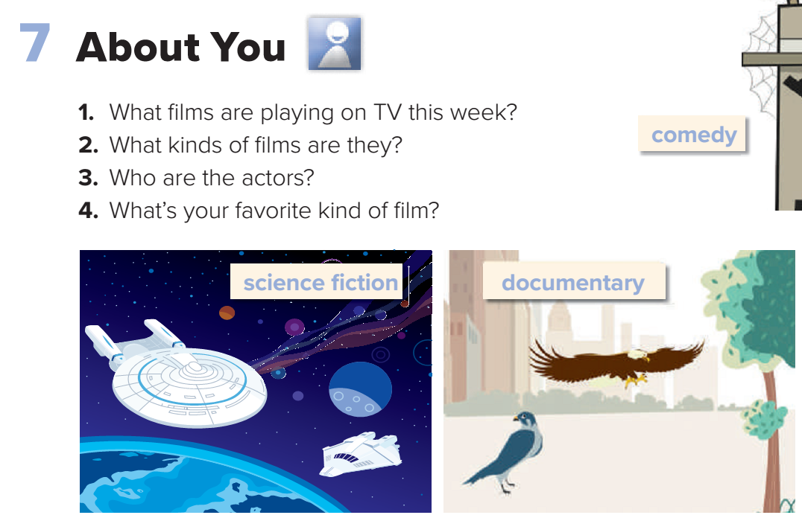
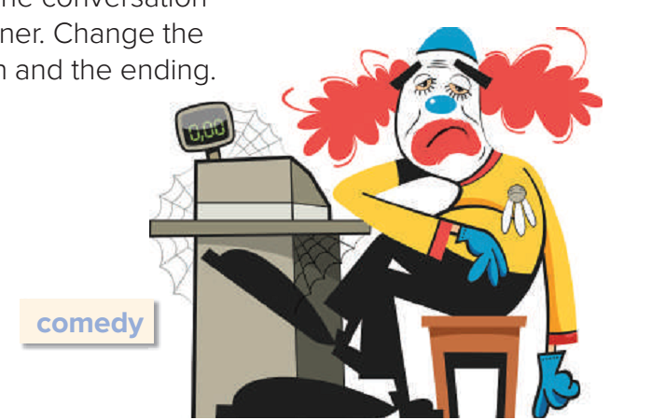
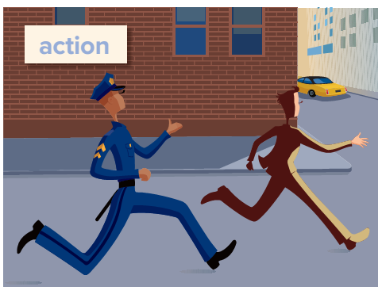
Page: 68

Slide 43
Homework
Workbook page : 121
( C , D )

Slide 44
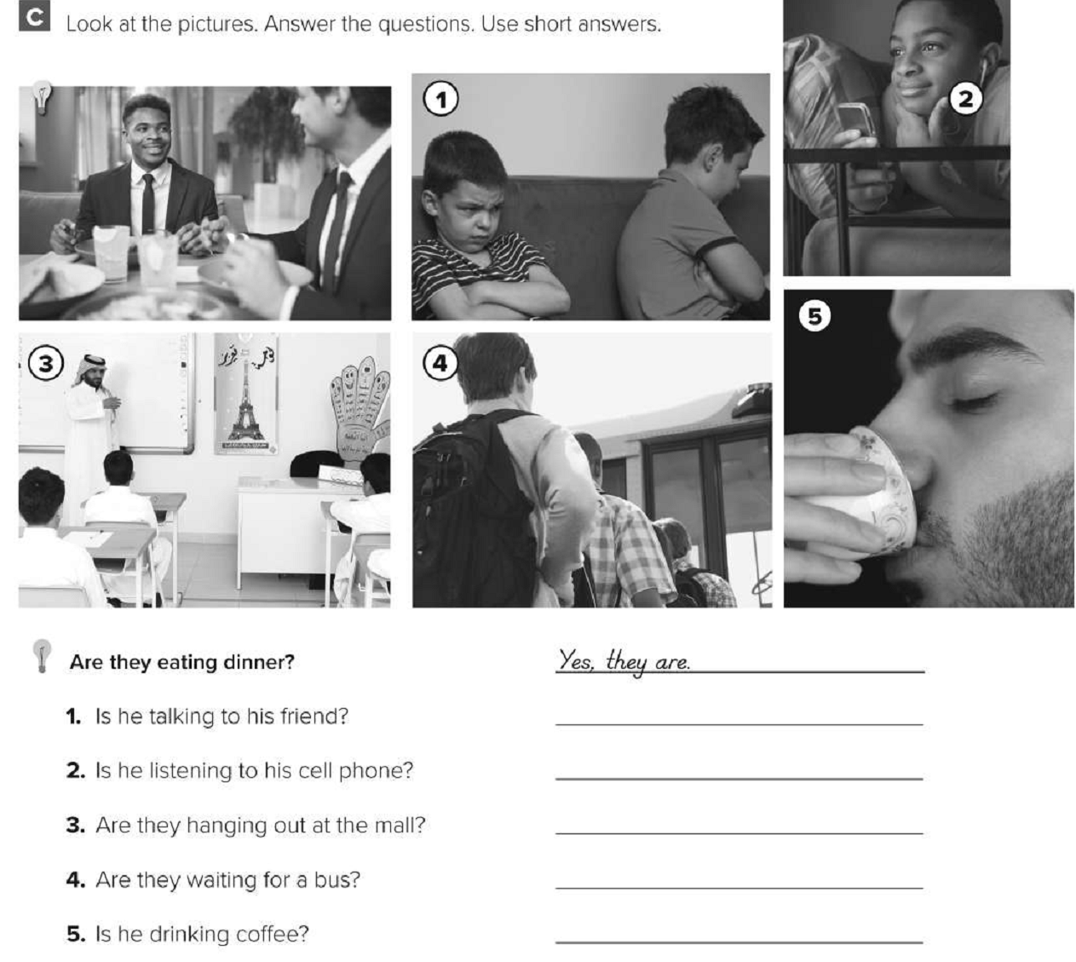
Workbook page: 121
No, he isn’t.
Yes, he is.
No, they aren’t.
Yes, they are.
Yes, he is.

Slide 45
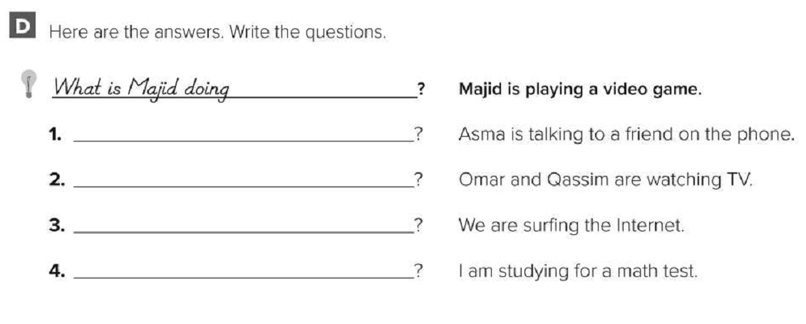
Workbook page: 121
What is Asma doing
What are Omar and Qassim doing
What are you doing
What are you doing

Slide 46


Slide 47


Slide 48
Today’s lesson :
8. Reading.

Slide 49
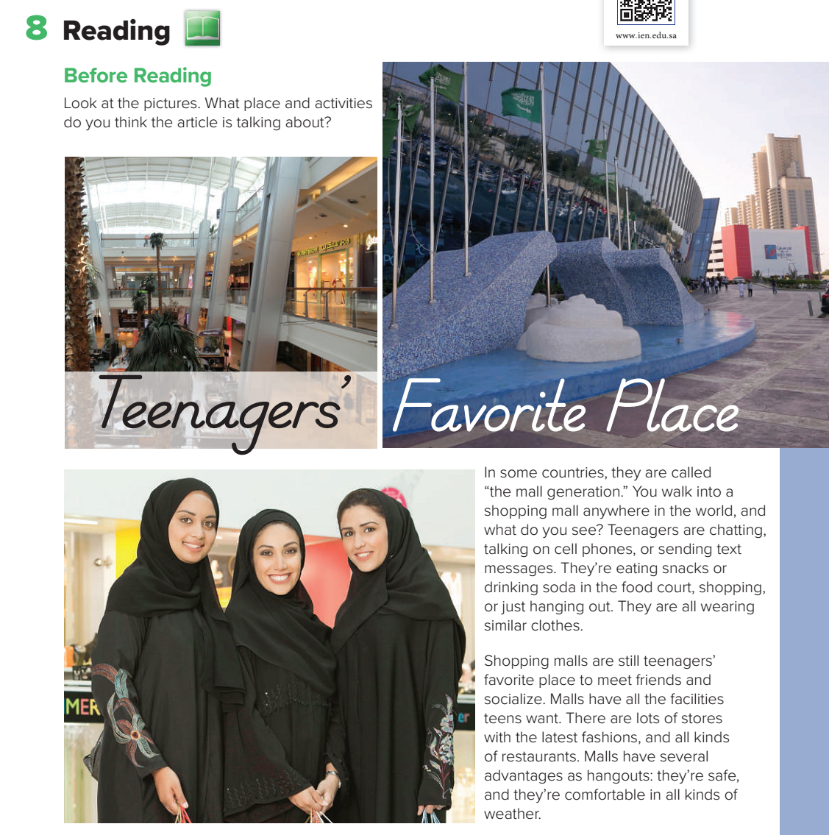
Page: 69

Slide 50
Page: 69

Slide 51
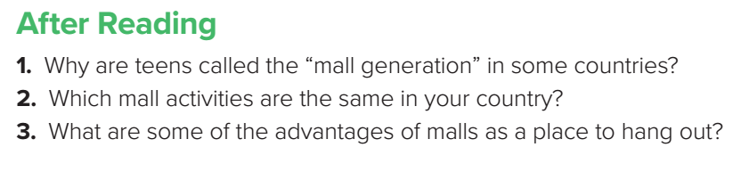
Because teenagers’ favorite place to meet friends and socialize is the mall.
Malls are safe, and they’re comfortable in all kinds of weather.
Page: 69

Slide 52
Page: 69
1
2

Slide 53
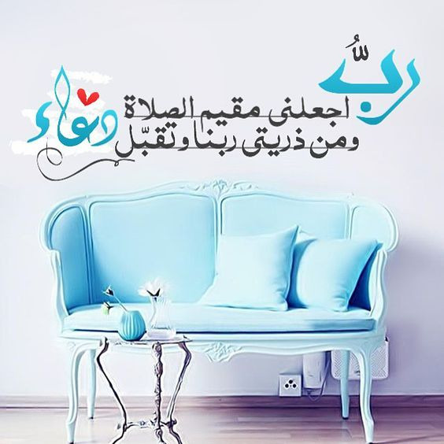

Slide 54
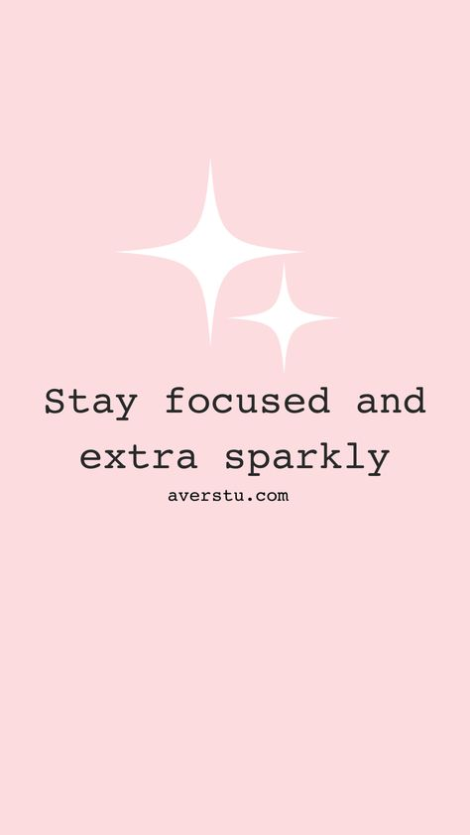

Slide 55
Today’s lesson :
9. Writing .

Slide 56
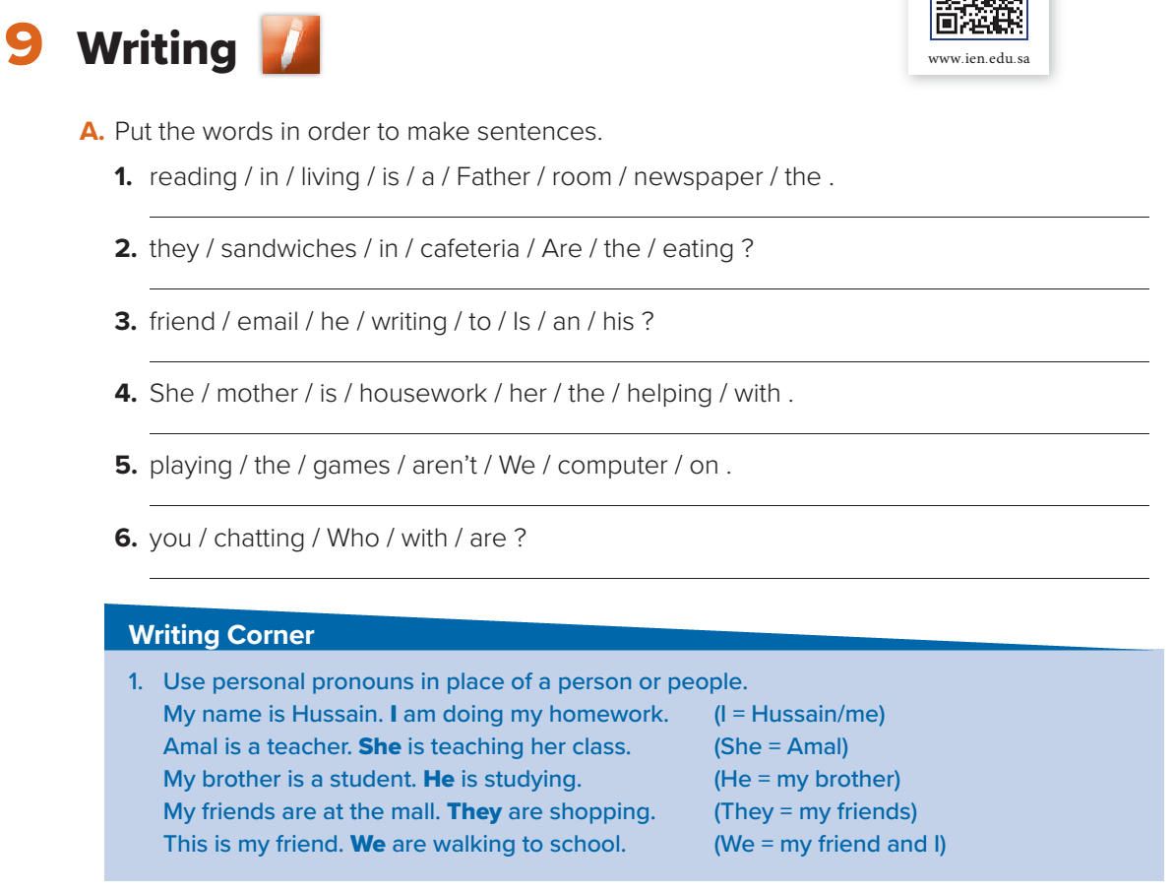
Page: 70
Father is reading the newspaper in the living room.
Are they eating sandwiches in the cafeteria?
Is he writing an email to his friend?
She is helping her mother with the housework.
We aren’t playing games on the computer.
Who are you chatting with?

Slide 57
Page: 70

Slide 58
Amal is a teacher. Amal is teaching her class.
Amal is a teacher. She is teaching her class.
Personal pronoun .

Slide 59
My brother is a student. My brother is studying.
Personal pronoun .
My brother is a student. He is studying.
My friends are at the mall. My friends are shopping
Personal pronoun .
My friends are at the mall. They are shopping

Slide 60
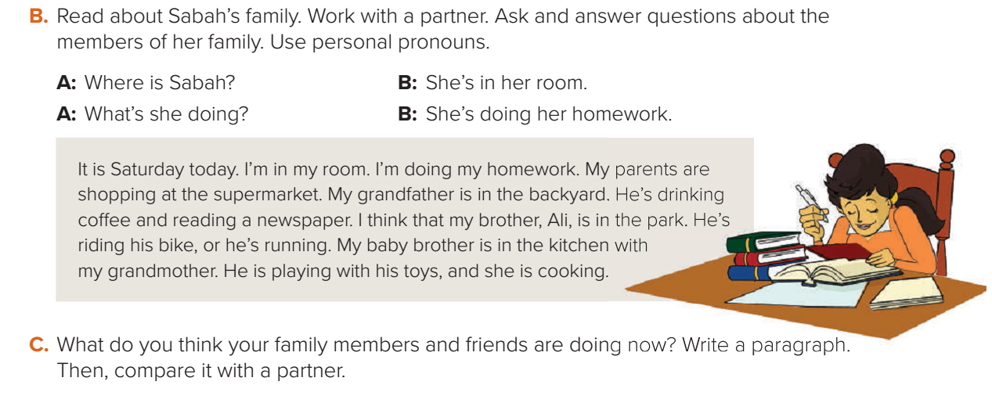
Page: 70

Slide 61
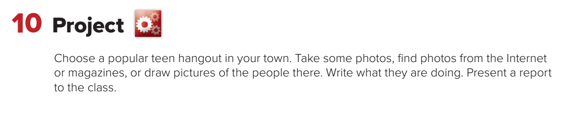
Page: 70

Slide 62
Homework
Workbook page : 122
( F )

Slide 63
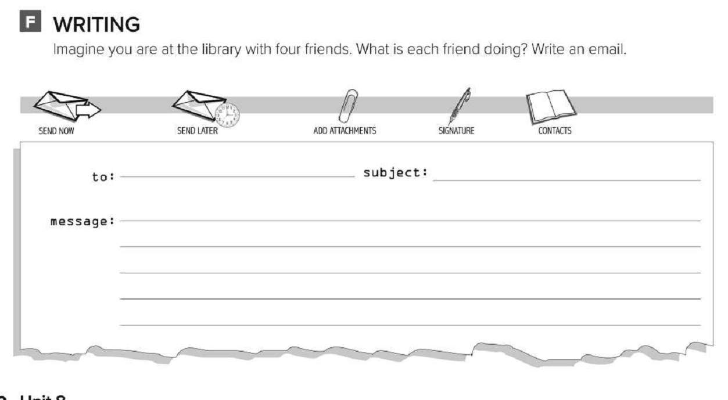
Workbook page: 122

Slide 64


Slide 65


Slide 66
Today’s lesson :
11. Form , Meaning,
Function.

Slide 67

Page: 71

Slide 68


What would you like?
I would like a pizza.

Slide 69

What would you like?
would you like a salad ?

Slide 70

would you like to watch TV?

Slide 71

I would like to……………..

Slide 72


Slide 73

I would you like to go to Spain .
Where would you like to go ?

Slide 74

When would you like to go ?
I would you like to go at 7: 00.

Slide 75

would you like to
I’d like to
I’d like to
would you like to
I’d like to
Would you like to
I’d like
I’d like
Page: 71

Slide 76
Homework
Workbook page : 128
( E )

Slide 77

Workbook page: 122

