Slide 1
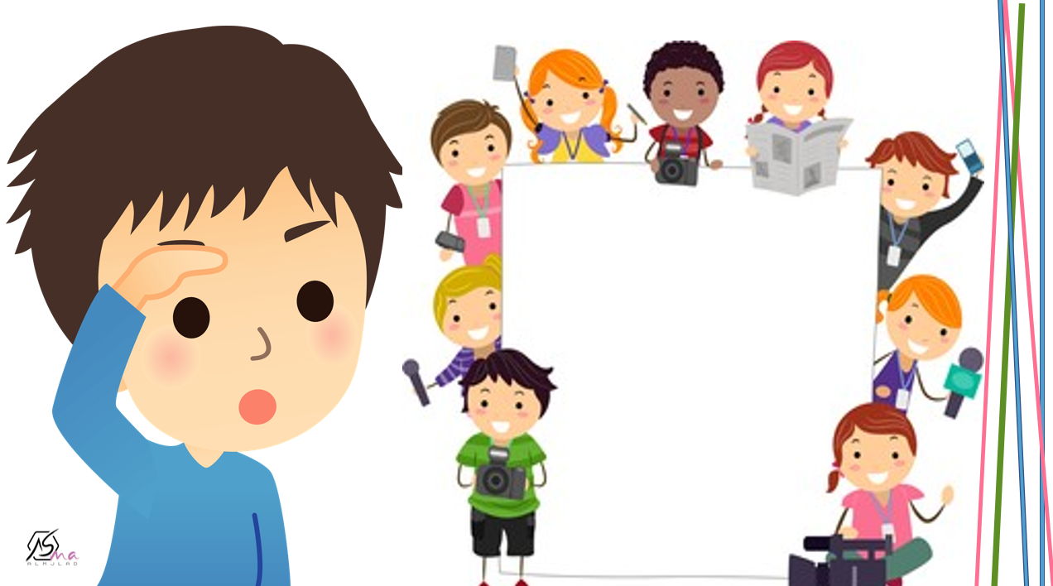

What are you doing ?
Grammar

Slide 2
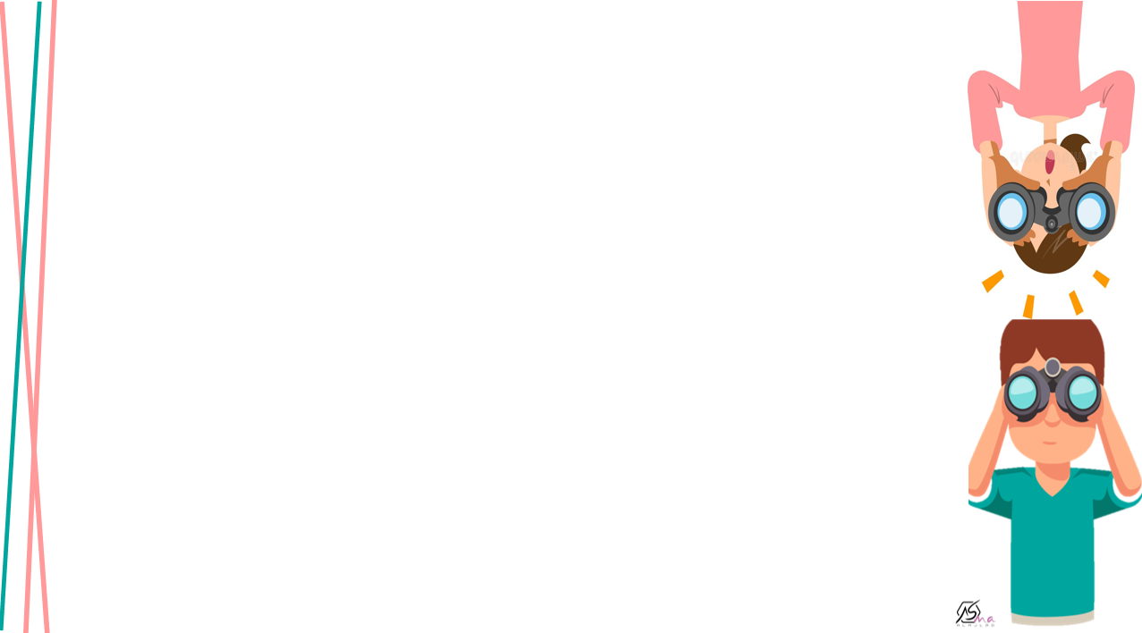

Use present progressive in a affirmative and negative form
Ask short question in the present progressive form
Answer the question in the book

Slide 3
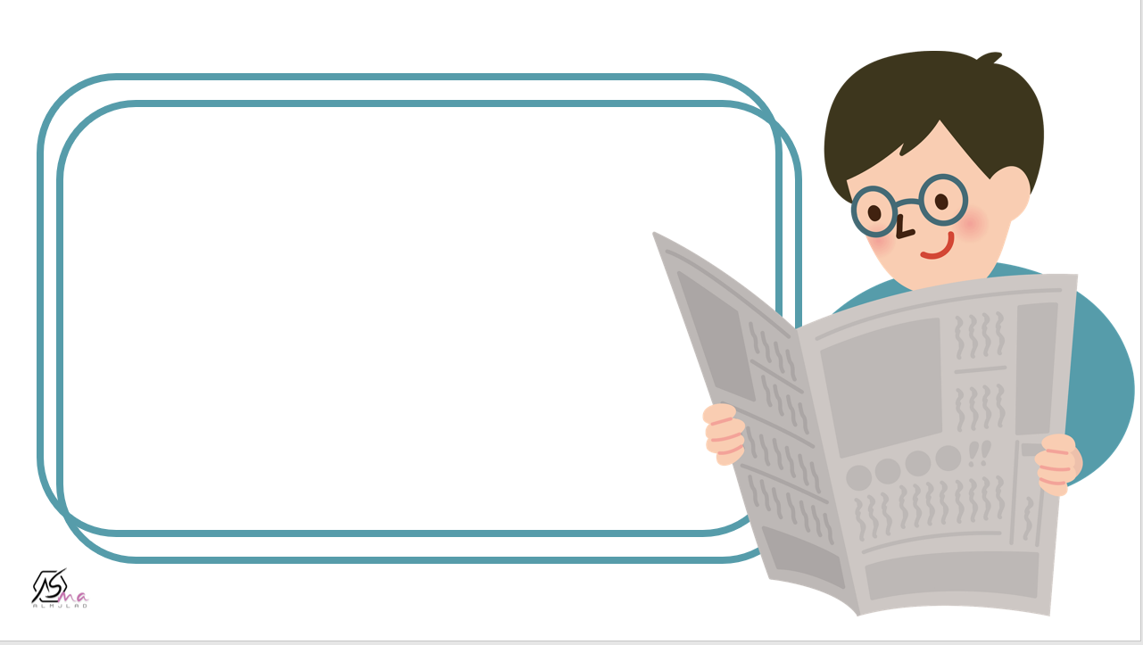
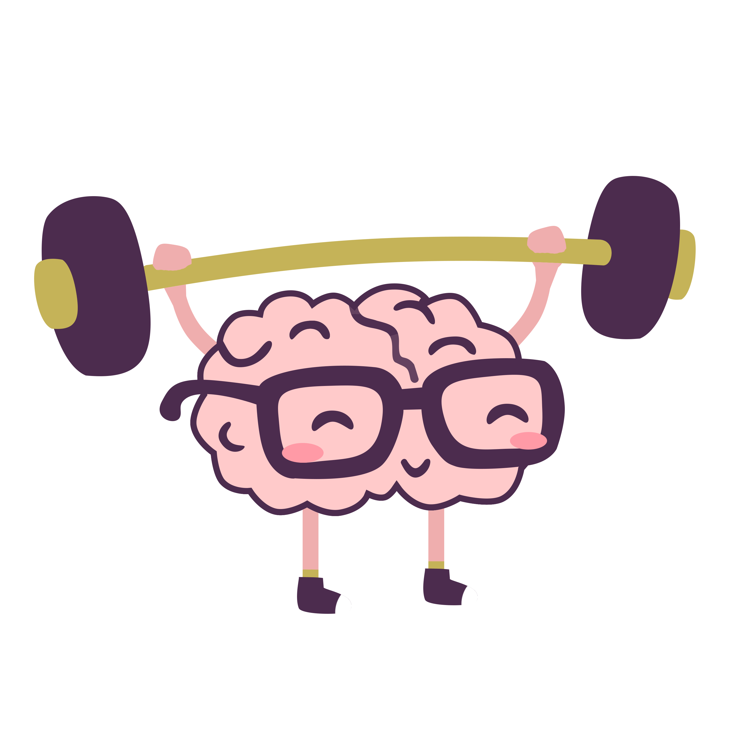
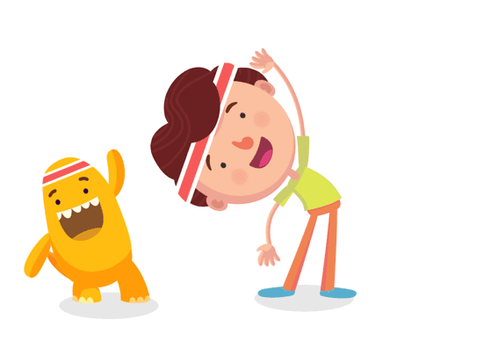


Slide 4
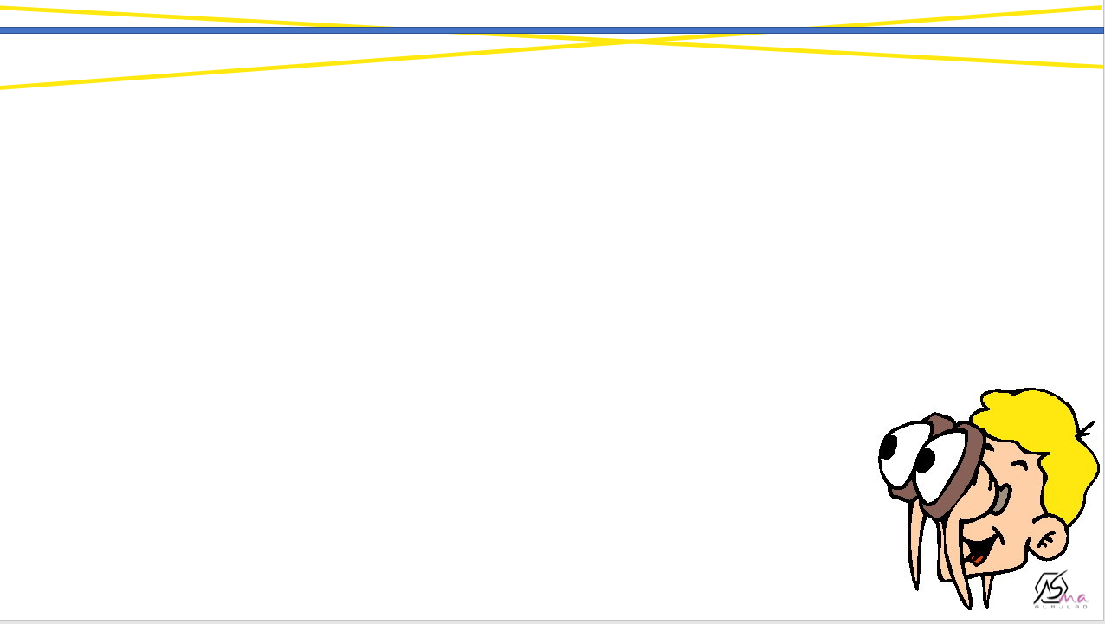

What are they doing ?

Slide 5
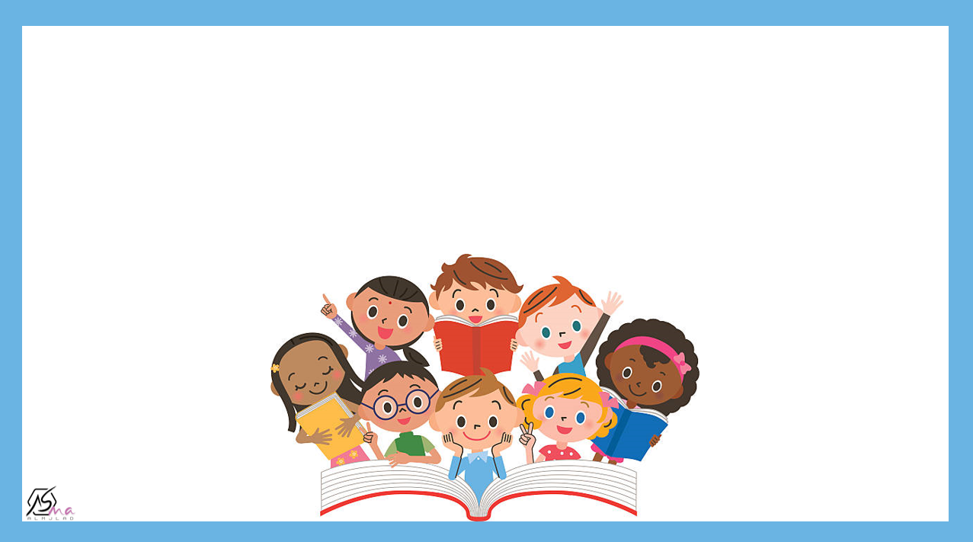

What is he doing ?

Slide 6

What is he doing ?

Slide 7
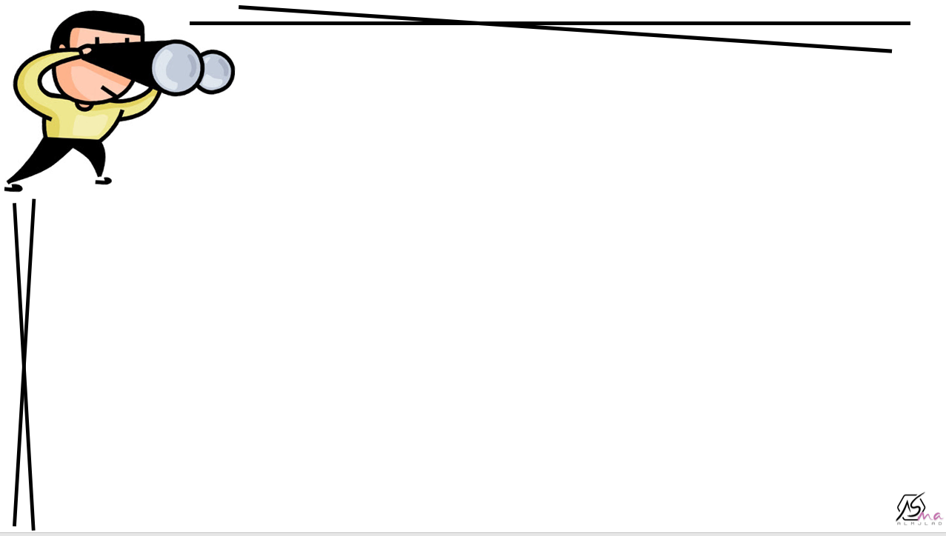
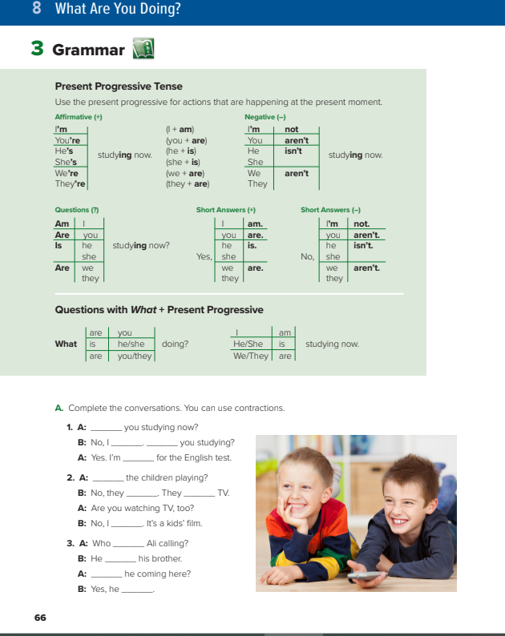
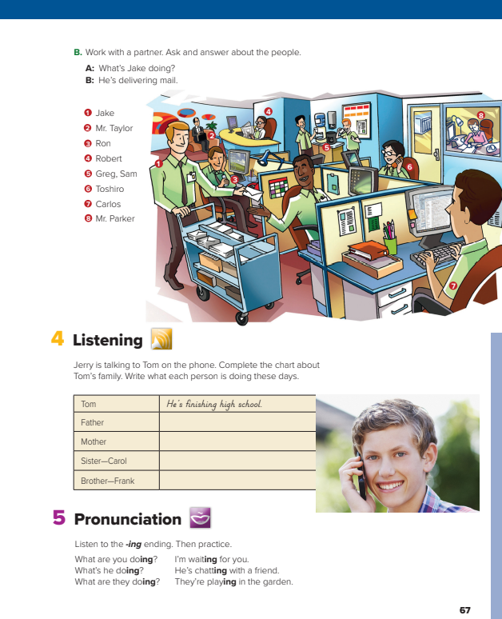

@page 66+67

Slide 8
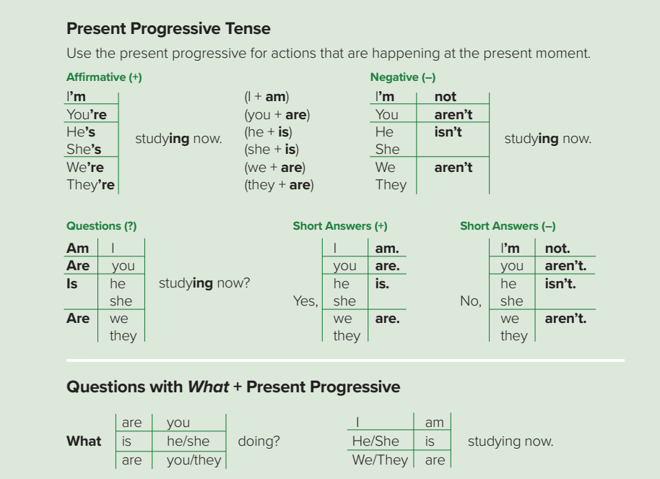

Slide 9
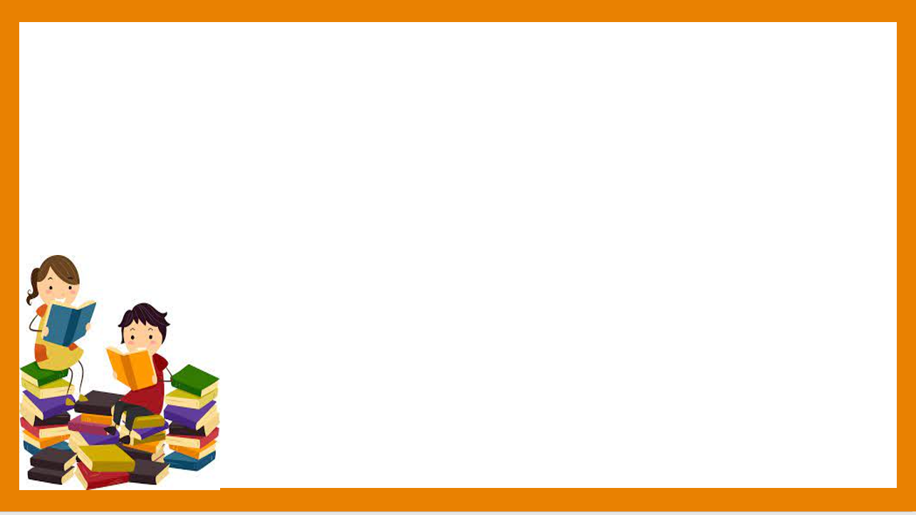


What is she doing ?
She is walking now
She isn’t cooking now

Slide 10

What is Ali doing ?
He is writing the lesson now.
He isn’t playing now.

Slide 11

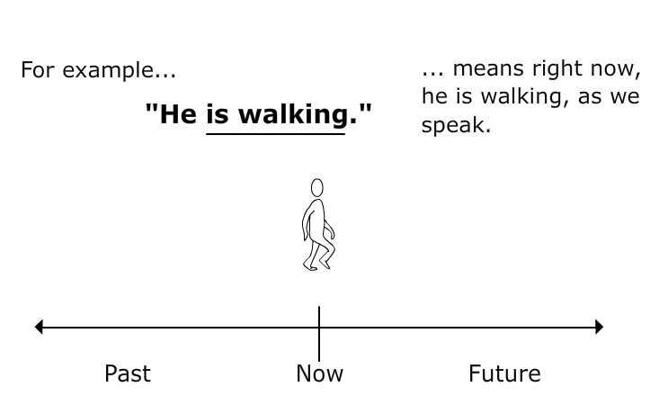
Present progressive
we use the present progressive
for things that are happening at the moment of speaking

Slide 12
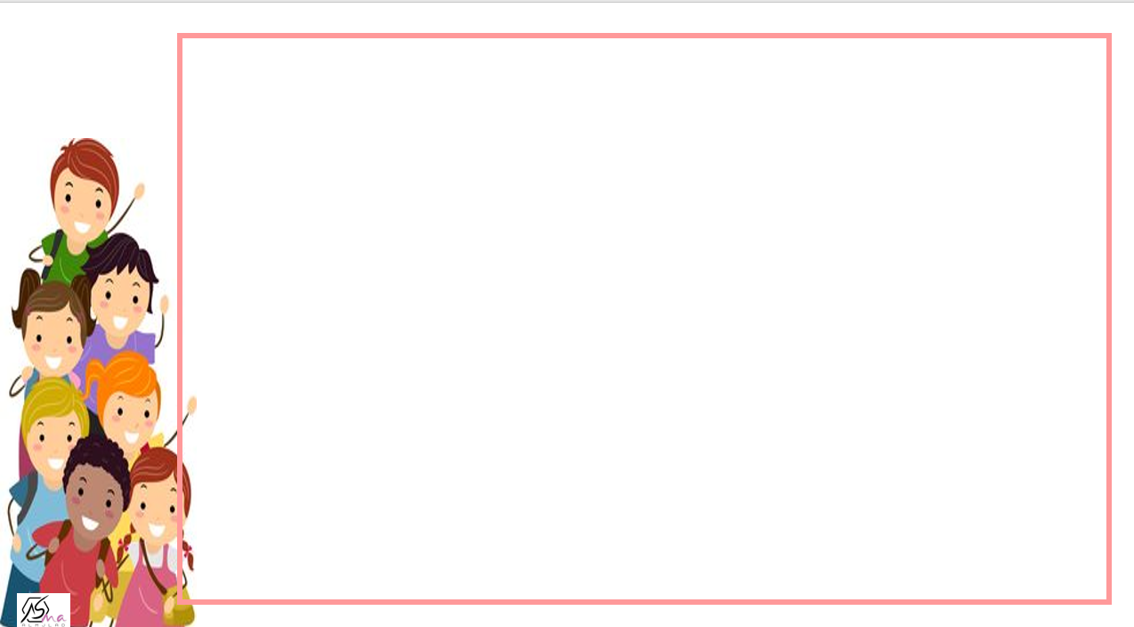
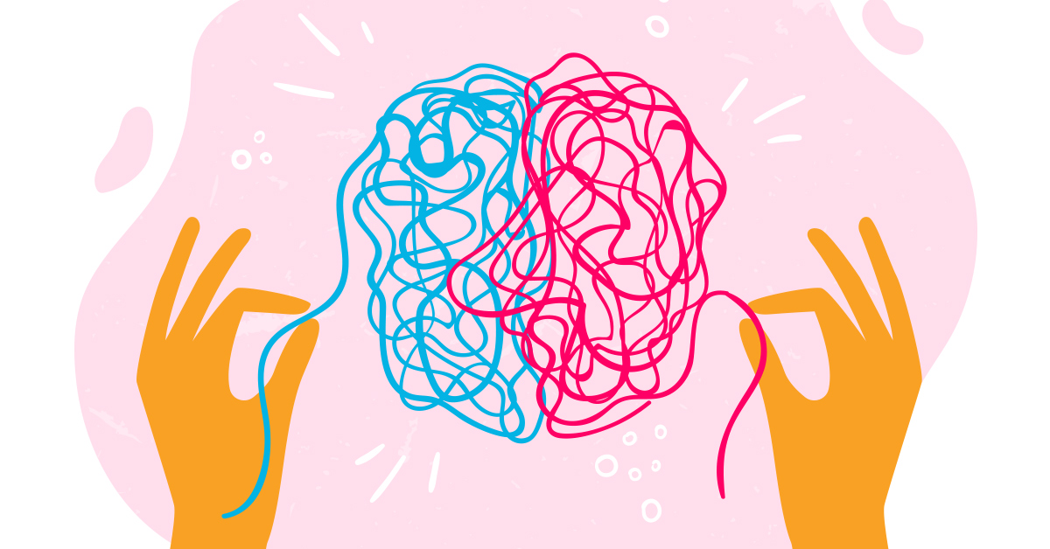

She
He
it
Present progressive
Is (n’t)
I
am (n’t)
V+ ing
They
We
you
are (n’t)

Slide 13

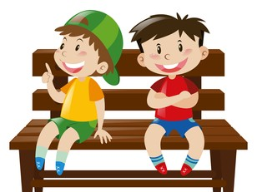


Are they sitting now ?
Yes , they are .
Are they talking now ?
No , …………………………………….

Slide 14


She
He
it
Is
am
V+ ing
I
Is he sleeping ?
Are they studying ?
They
We
you
are
Yes or No question

Slide 15
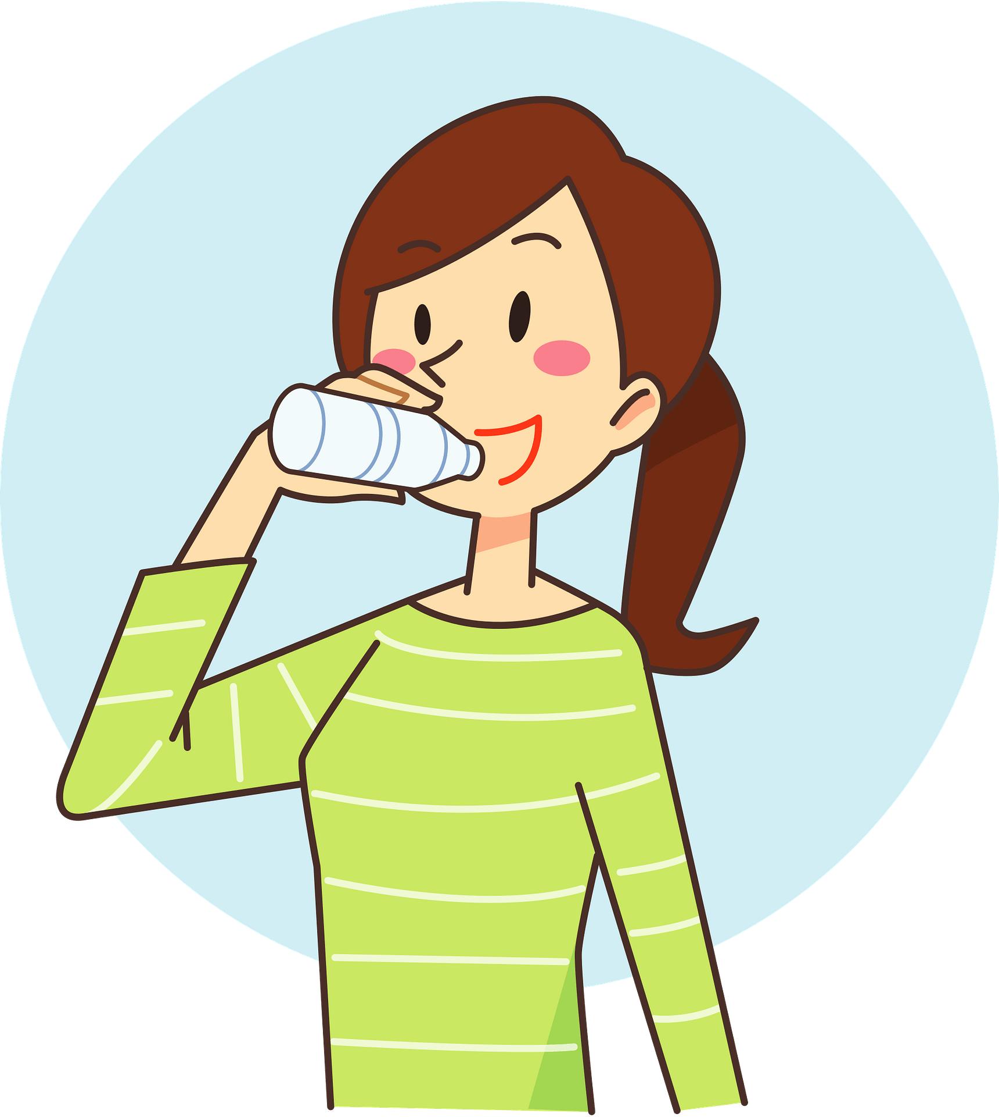
Is she eating ?
No, she is not .
What is she doing ?
She is drinking water now.

Slide 16
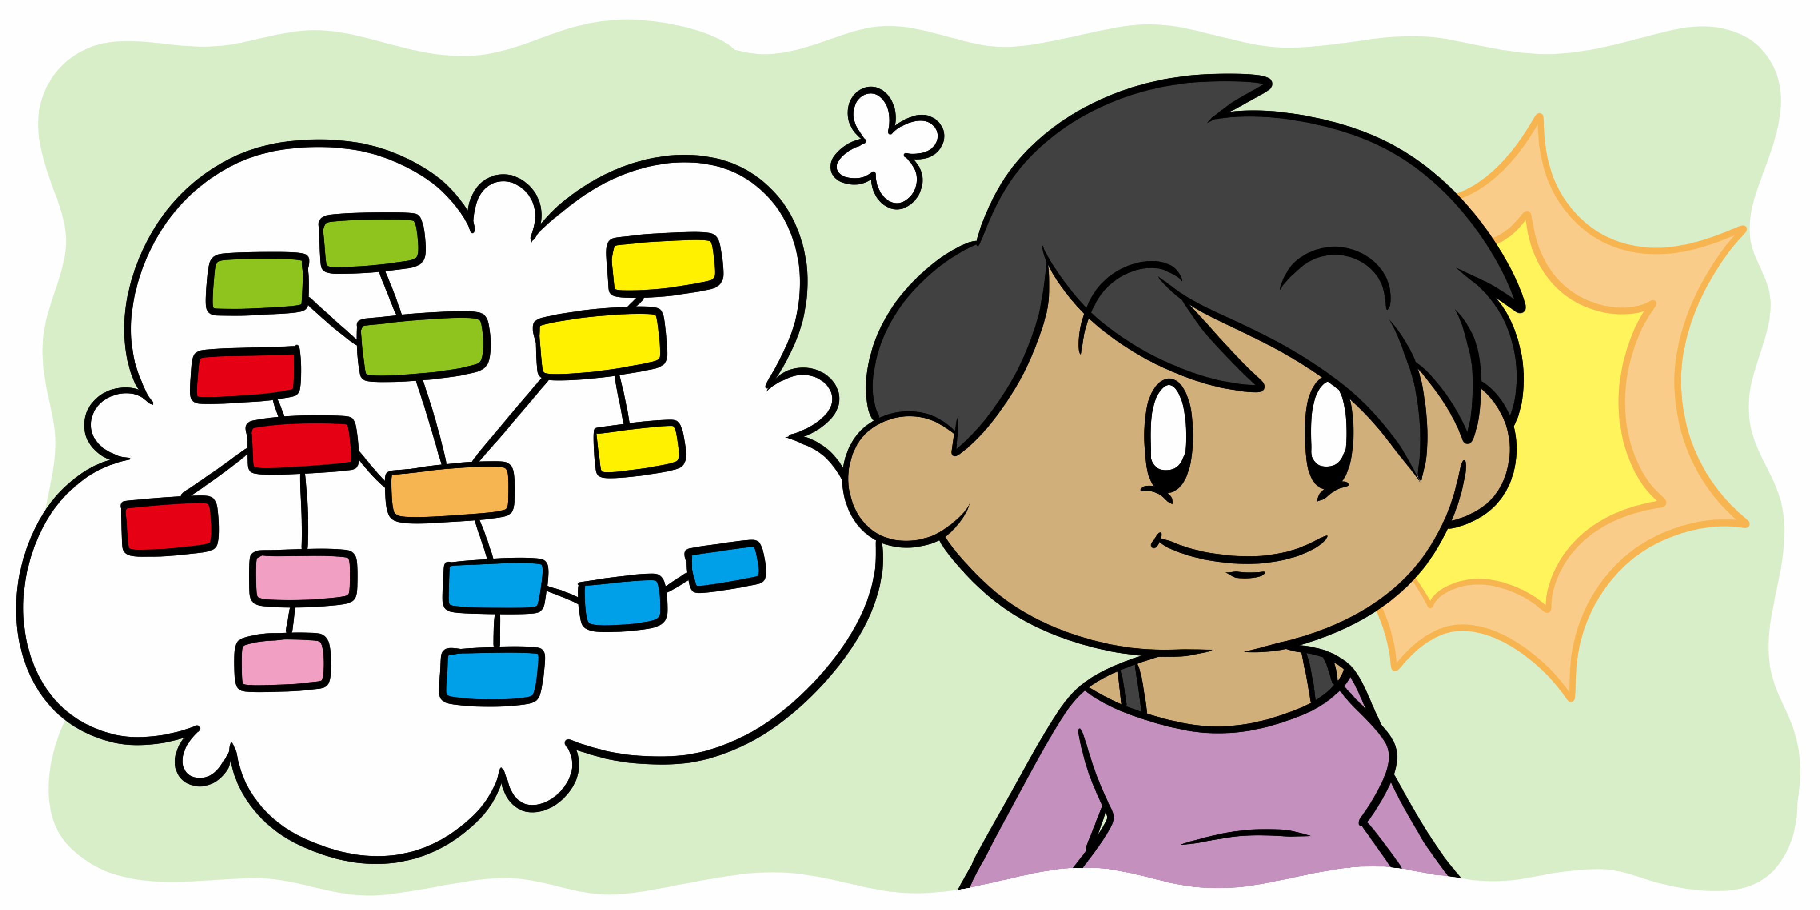
Information question
Is
Wh
word
am
S
V+ ing
…..?
are
What are you doing ?

Slide 17
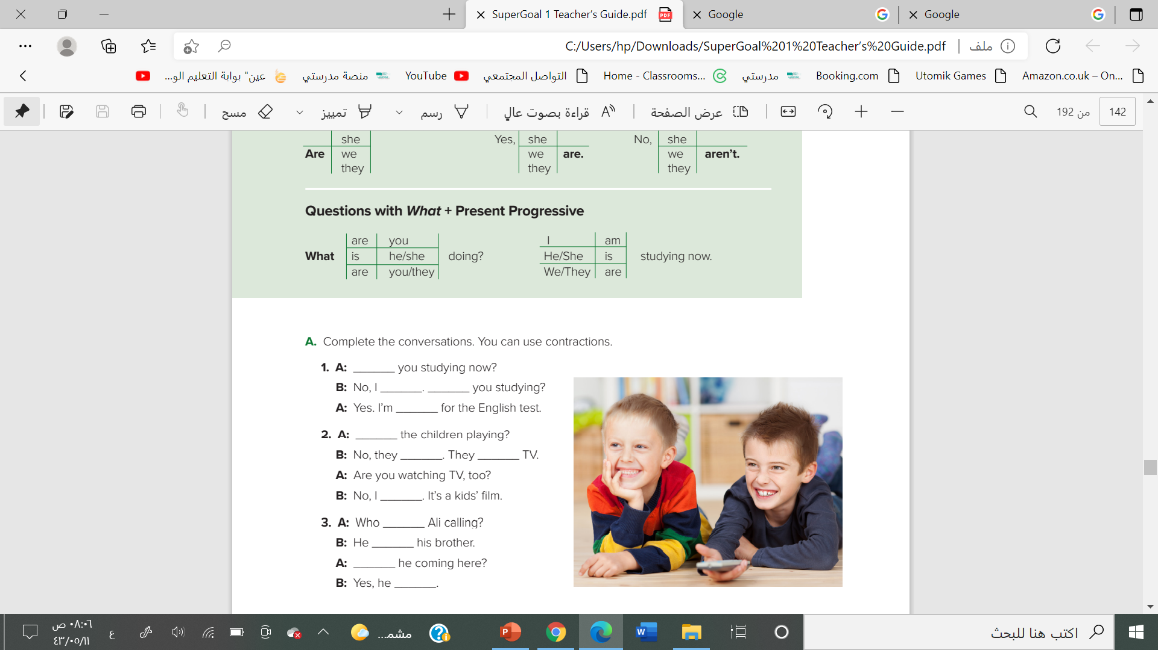
What word completes the question?
are
am n’t
are
studying
are
aren’t
‘re watching
--
’m not
is
’s calling
is
is

Slide 18
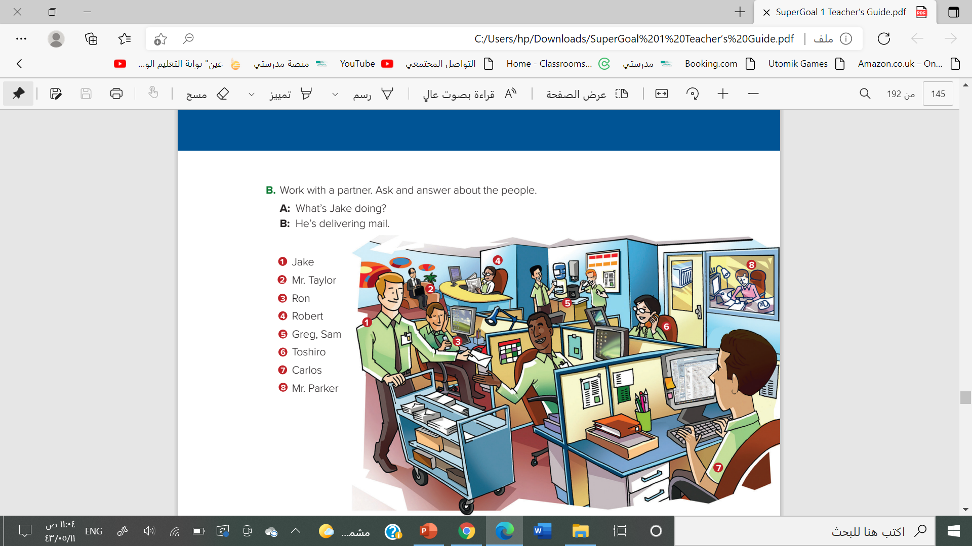
2. A: What’s Mr. Taylor doing?
B: He’s waiting in the reception area
3. A: What’s Ron doing?
B: He’s listening to his cell phone.
4. A: What’s Robert doing? B: He’s reading the newspaper.
5. A: What are Greg and Sam doing? B: They’re drinking coffee.
6. A: What’s Toshiro doing?
B: He’s talking on the phone.
7. A: What’s Carlos doing?
B: He’s working online
8. A: What’s Mr. Parker doing?
B: He’s working in his office.

Slide 19
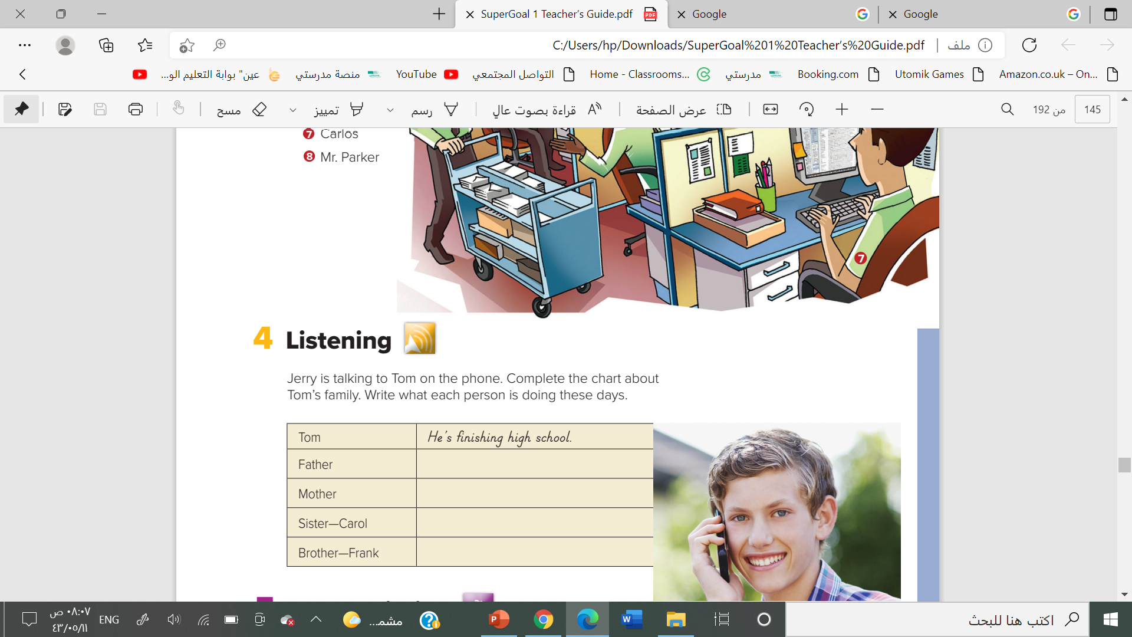


listen
He’s working in a bank.
She’s watching Carol’s baby
She’s working at a hospital
He’s studying computers at college

Slide 20
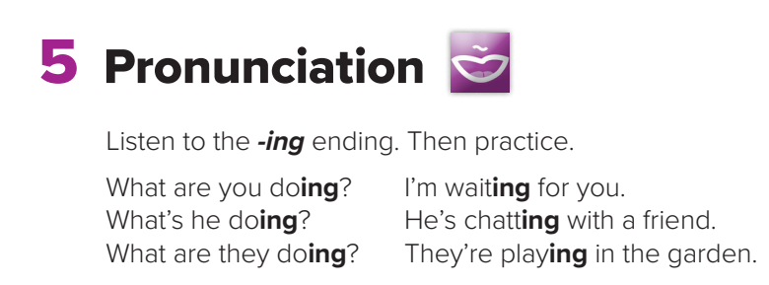

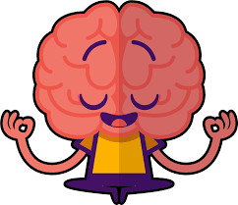

Slide 21

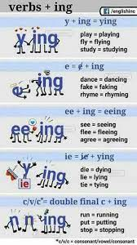

Slide 22
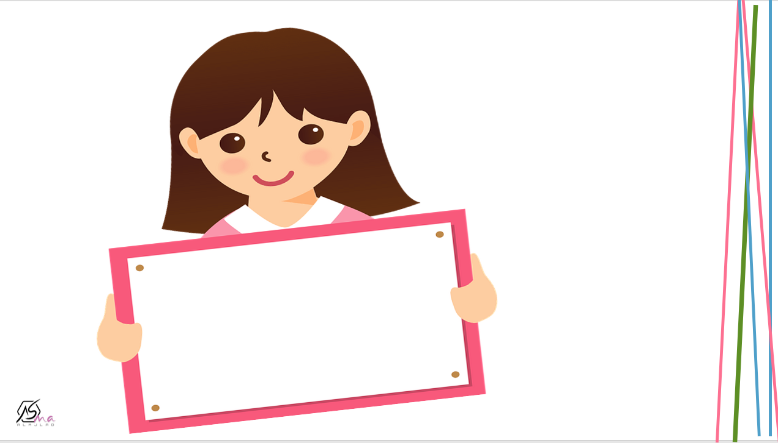

Work
book

Slide 23
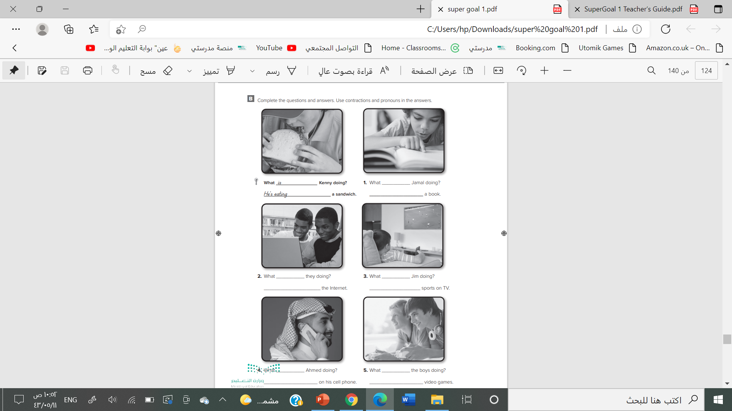


is
He is reading
are
is
They are surfing
he’s watching
is
are
He’s talking
They are playing

Slide 24
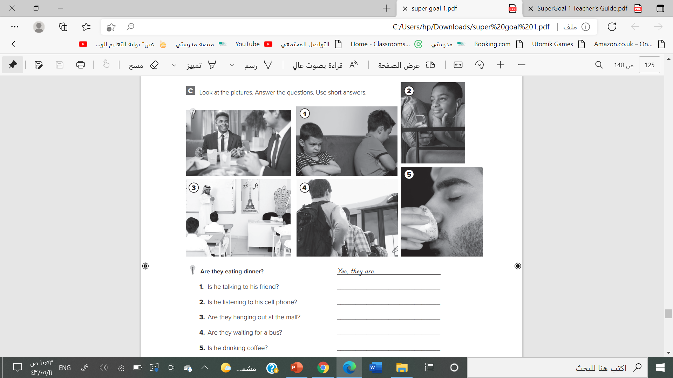
No, he isn’t.
Yes, he is.
No, they aren’t
Yes, they are
Yes , he is

Slide 25
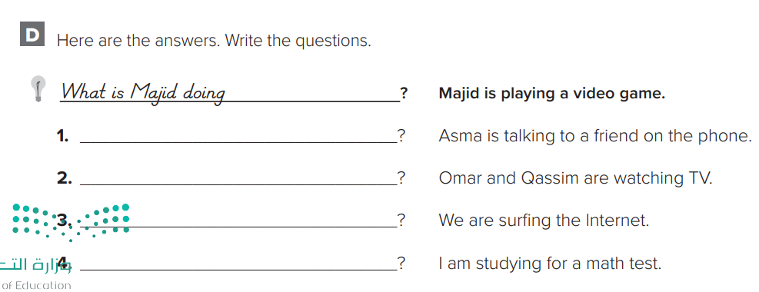

What is Asma doing?
What are Omar and Qassim doing?
What are you doing?
What are you doing?

Slide 26



Slide 27
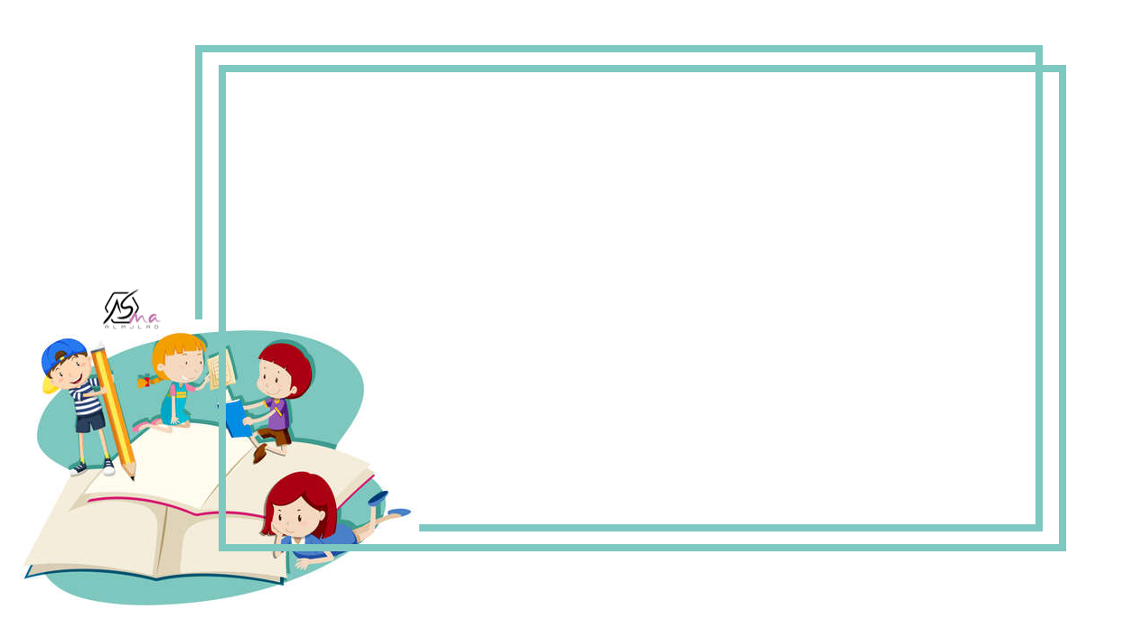



Slide 28
