Slide 1
We can 1
hello

Slide 2
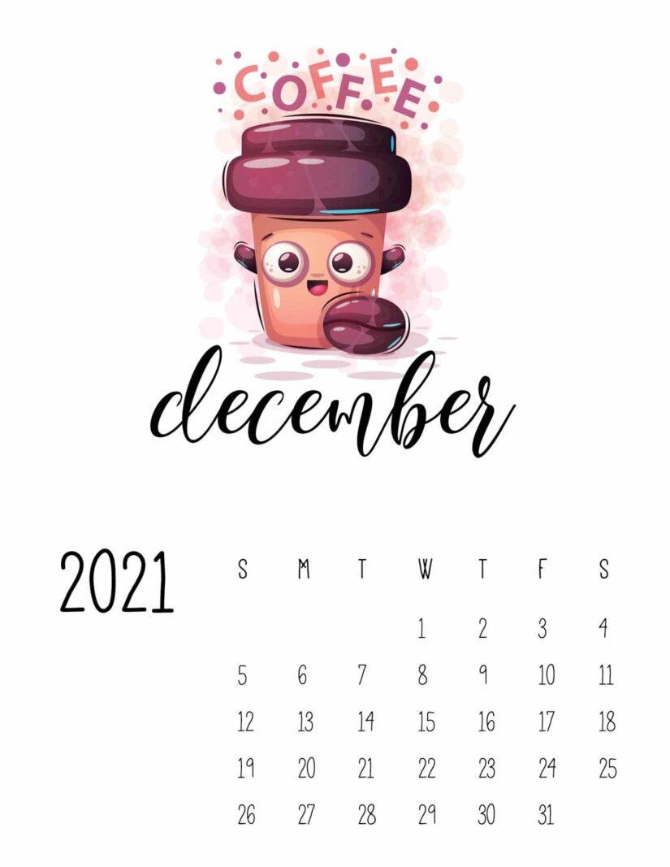

Slide 3




Slide 4

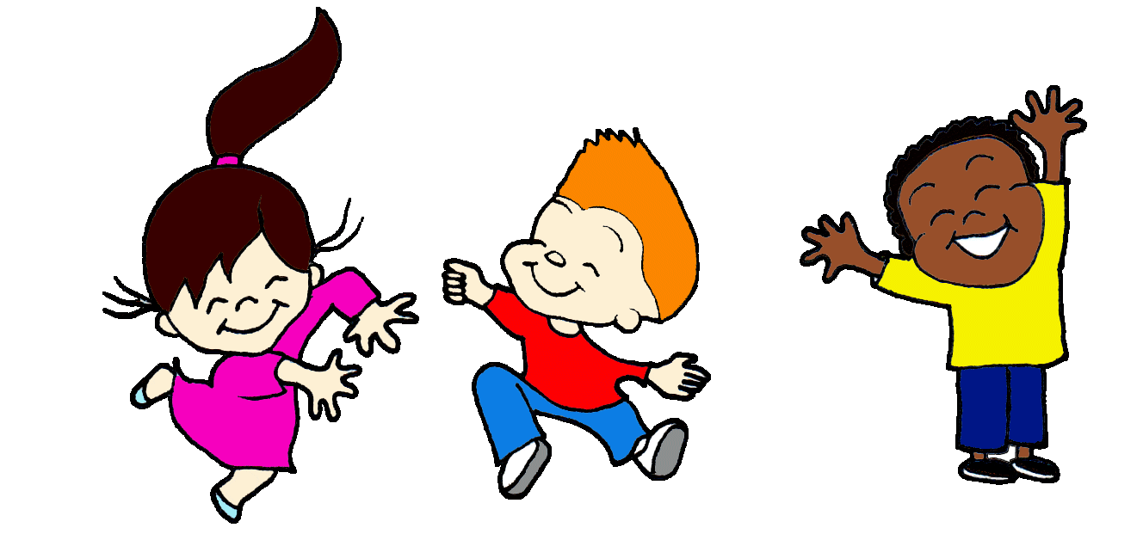
Unit 5
Lesson 3

Slide 5
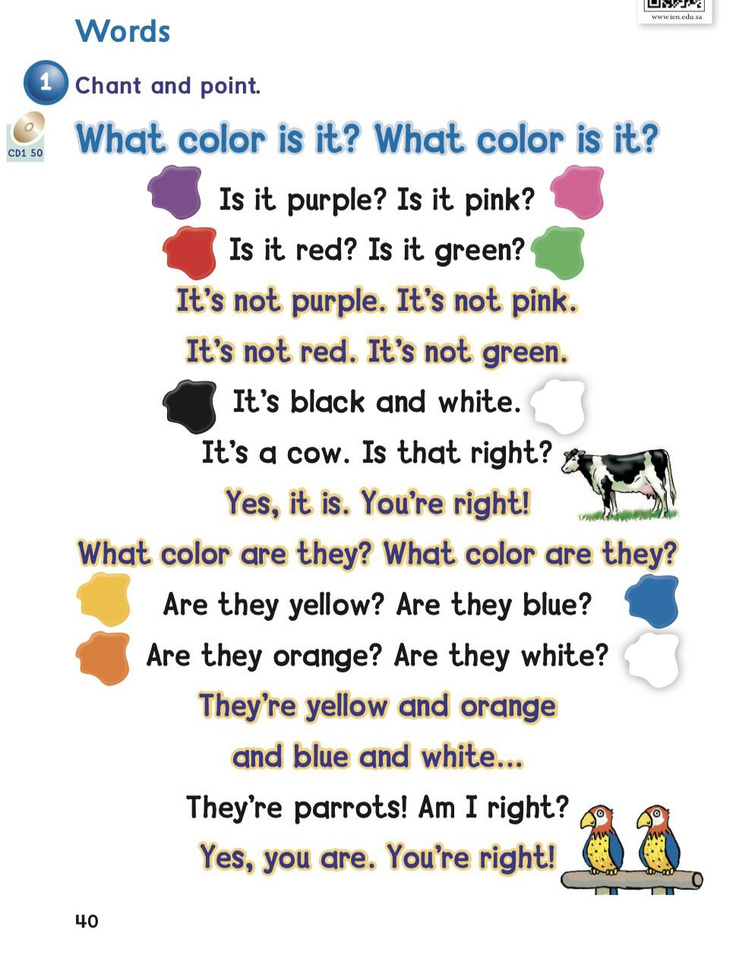
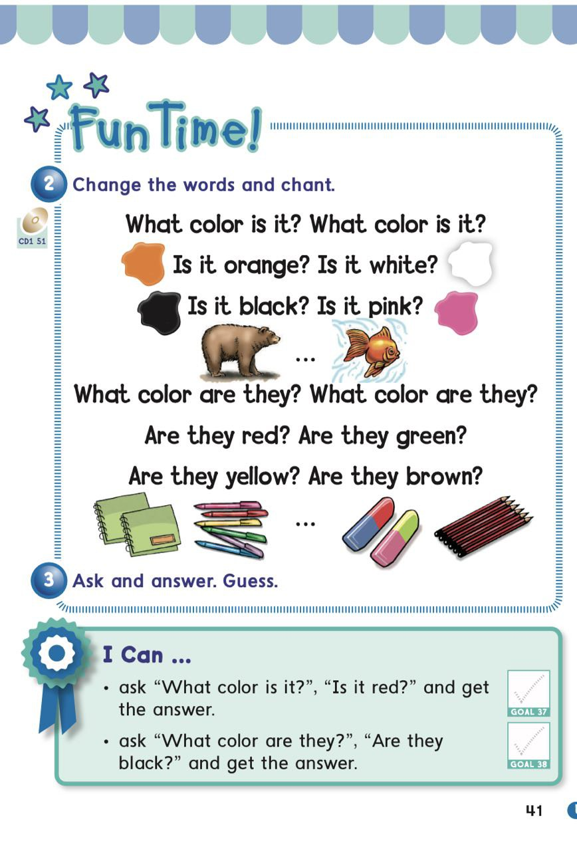

Slide 6

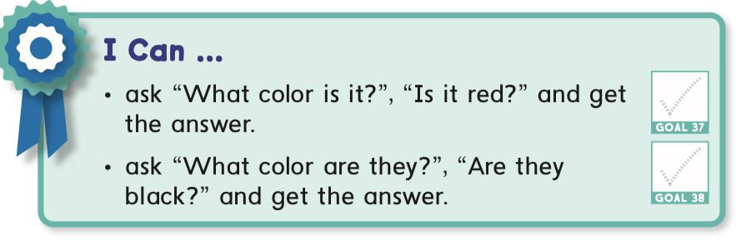

Slide 7


Slide 8

It’s a pen

Slide 9
They’re pens

Slide 10

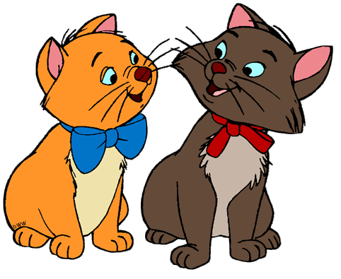

1 2
It is
They are

Slide 11
1 2
It is
They are
Is it ……?
Are they ……?

Slide 12
1 2
Are they orange and brown?
Is it grey?
yes , they are .
Yes , it is .

Slide 13
1 2
Are they orange and black?
Is it pink?
No , it is not .
No , they are not.

Slide 15
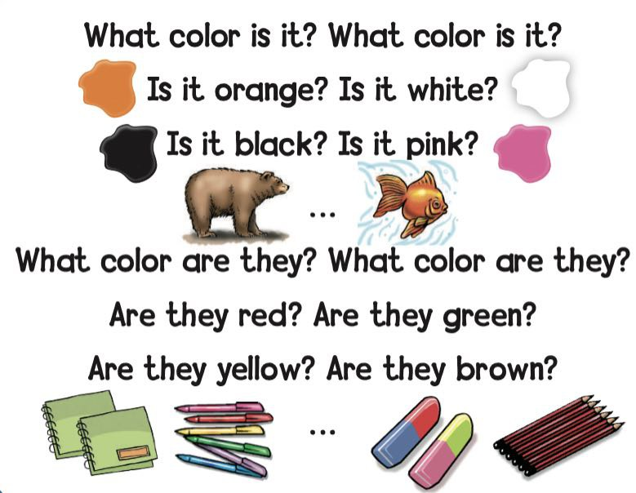

Slide 16

Is it yellow ?
Yes, it is

Slide 17
Is it blue ?
no, it is not

Slide 18

Are they pink and yellow ?
yes, they are.

Slide 19
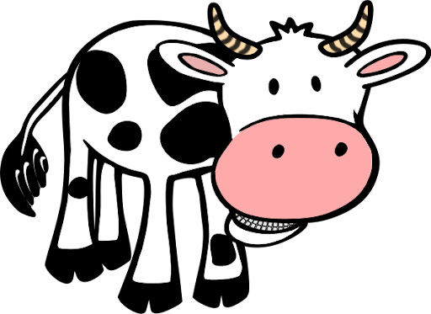
Are they black and white?
Yes , they are .

Slide 20


Slide 21

Are they pink and blue?
No , they are not
Yes , they are .

Slide 22

Is it green?
No , it is not .
Yes , it is .

Slide 23
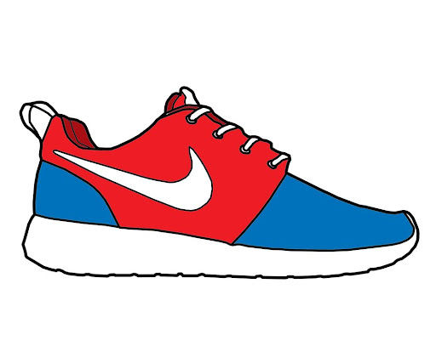
Are they blue ,red and white?
Yes , it is .
Yes , they are .

Slide 24
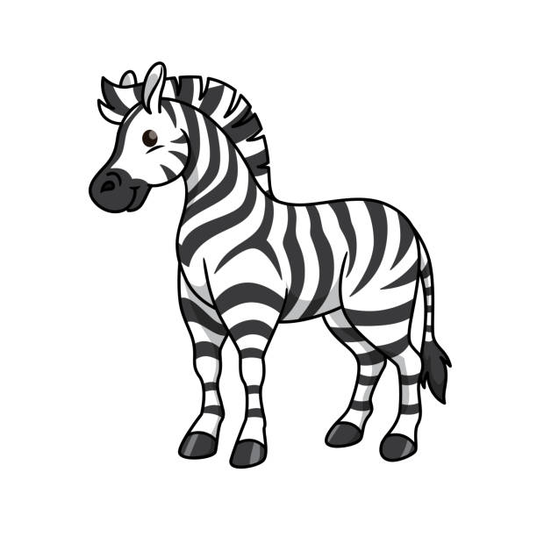
Are they black and white?
Yes , they are
Yes , it is .

Slide 25
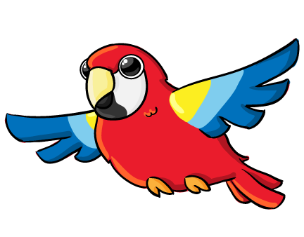
Are they red ,yellow and blue?
Yes ,they are .
Yes , it is .

Slide 26

Is it green?
No , it is not .
Yes , it is .

Slide 27

Are they orange , green ,blue and red?
Yes ,it is.
Yes , they are .

Slide 28
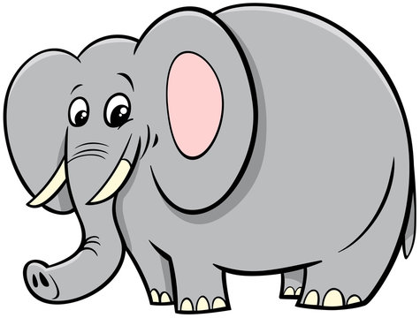
Is it yellow?
Yes , it is
No , it is not .

Slide 29



Slide 30



Slide 31


Slide 32

Open your book pages 99&100

Slide 33

Home work at

