Slide 1

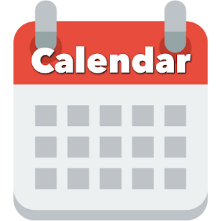


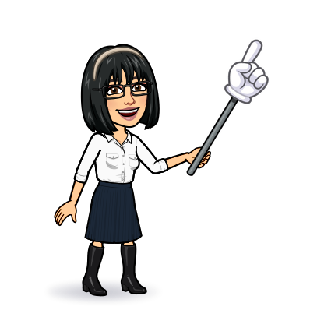

8 reading
Today:
Date:
- -
Page 69
By: Dalal Al-Juaid

Slide 2


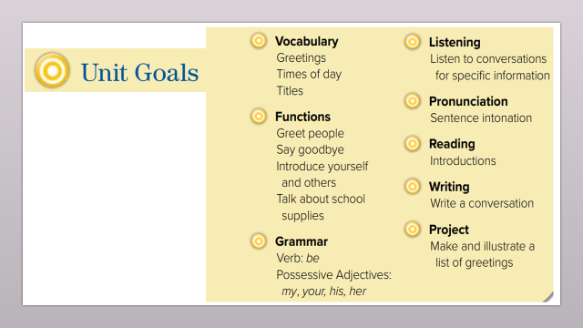
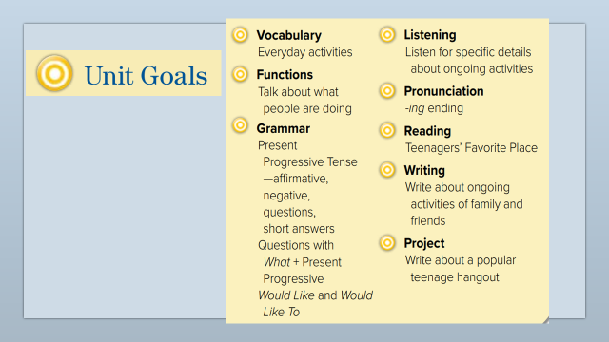
answer questions from reading
create a report about a popular teen hangout
Warm up
Use new words correctly

Slide 3
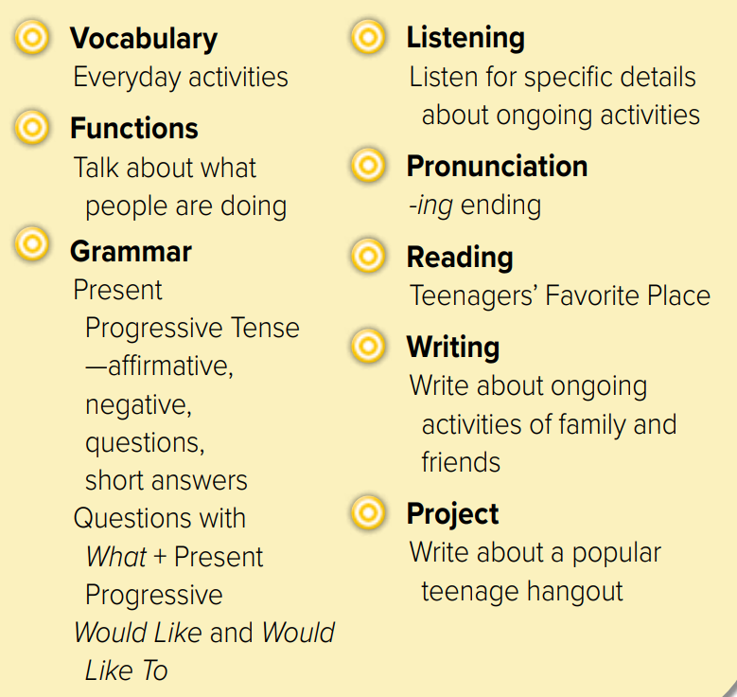
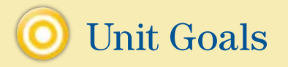

Slide 4
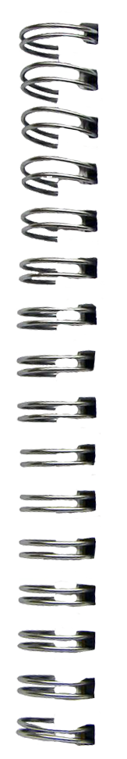
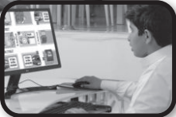
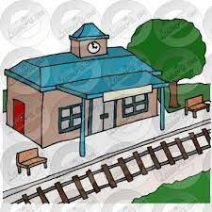
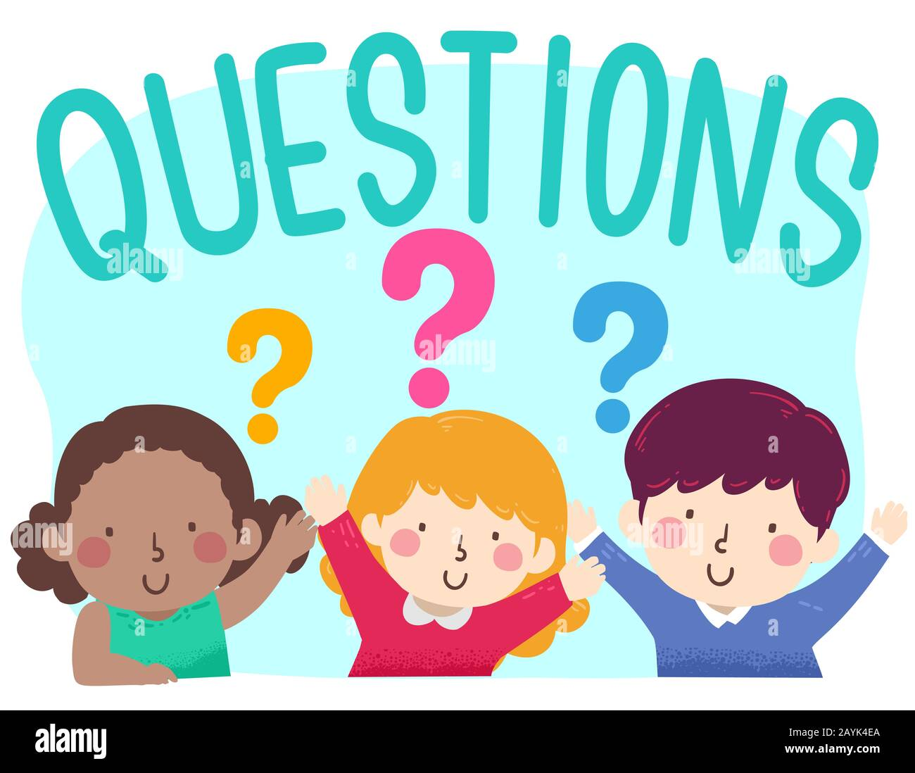
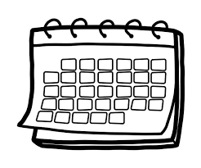
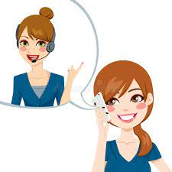

Revision
What ………… doing?
…..
Hot line to ask questions
…….
#
busy
..........

Slide 5










Answer with emoji
Warm up
Send e-mail
Work online
A magazine
helpline
A break

Slide 6
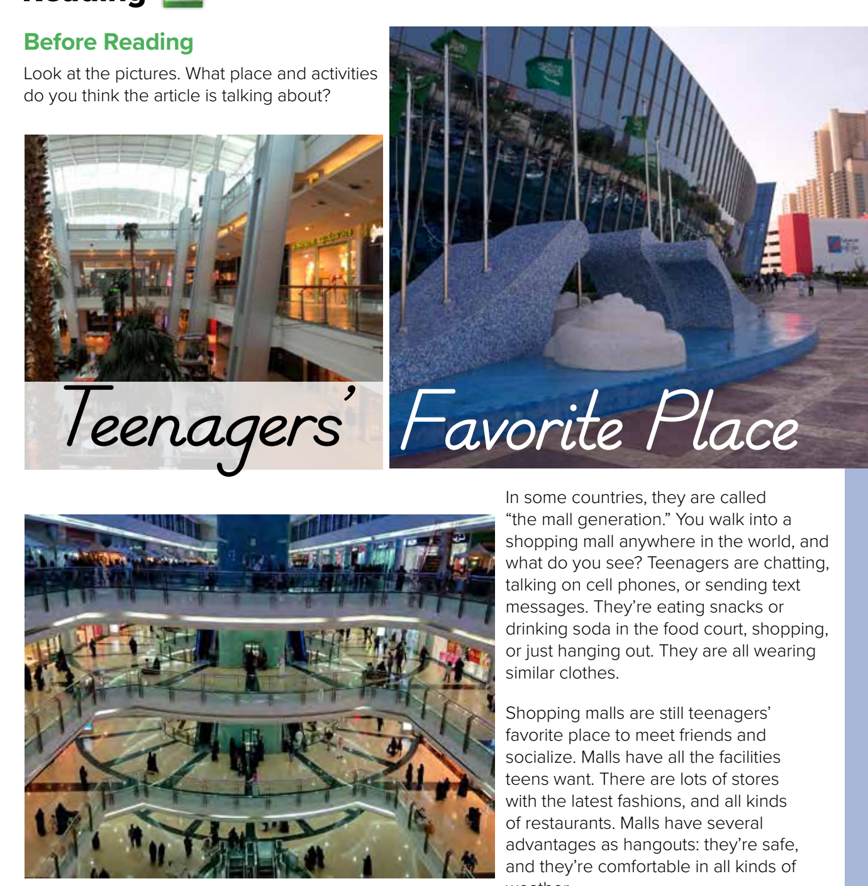


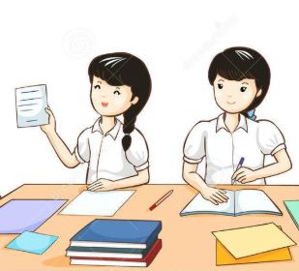

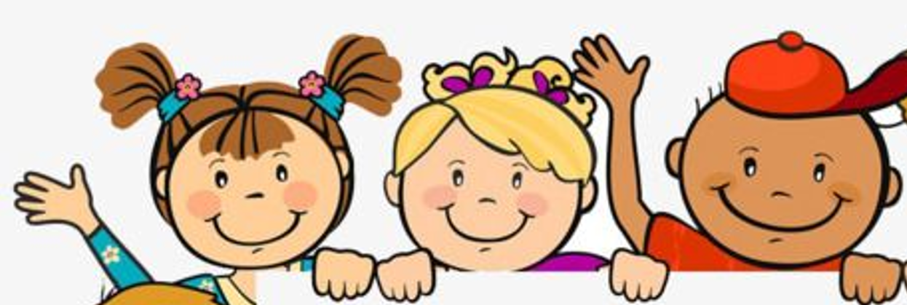
Page 69
shopping, buying,
talking,
walking,
looking,
hanging out
What are they doing?
Warm up
Where do you think the people are?
Think pair share

Slide 7
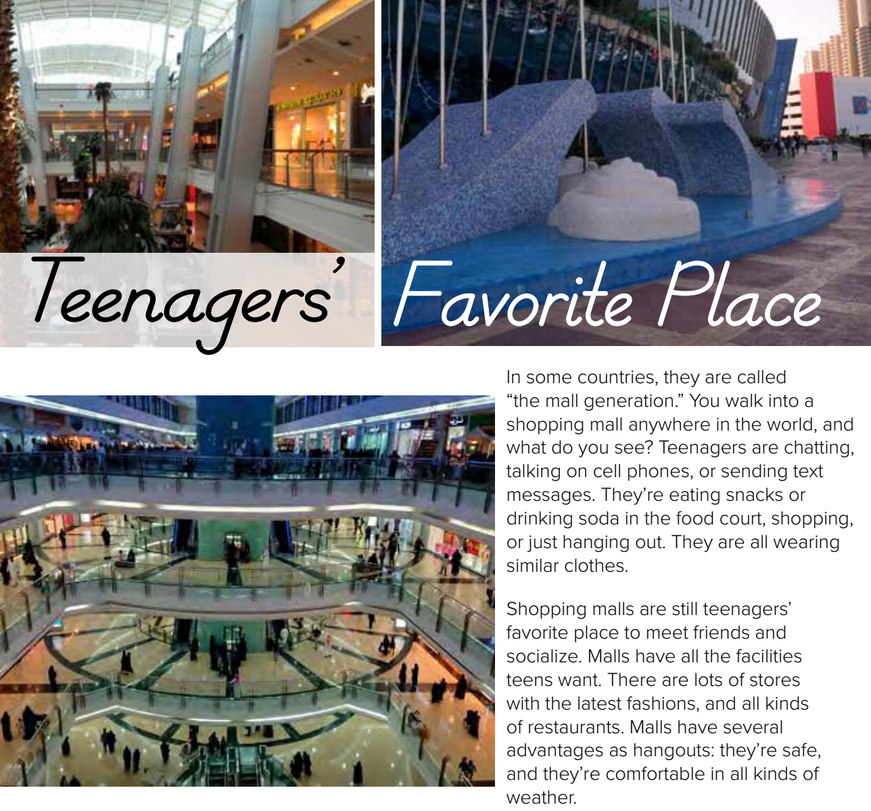


Page 69
Warm up

Slide 8
What do the teenagers in the reading do in malls?
shopping, buying,
talking,
walking,
looking,
hanging out
eat,
drink,
talk,
shop,
chat,
hang out,
socialize,
Warm up

Slide 9
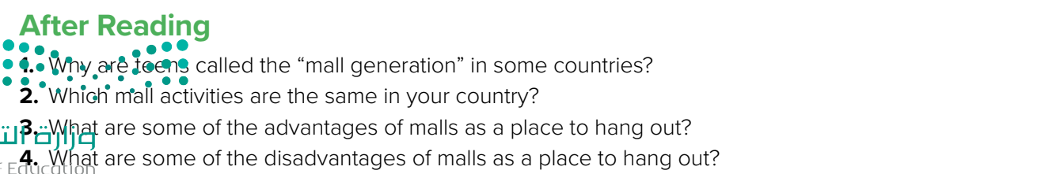

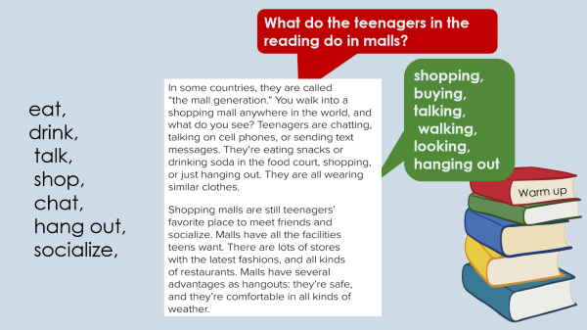
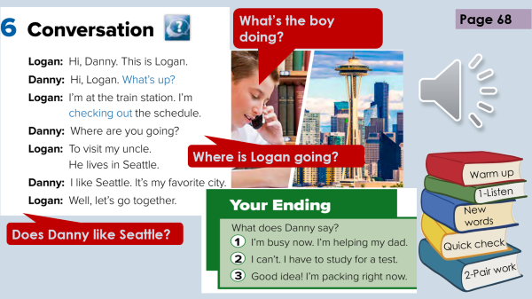
Think pair share
Because it’s their favorite place to meet friends
shopping, eating, playing
Safe & comfortable
Warm up
What’s your favorite mall in Taif?

Slide 10


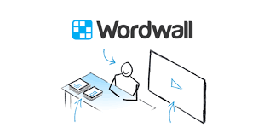
Lets play
Warm up

Slide 11
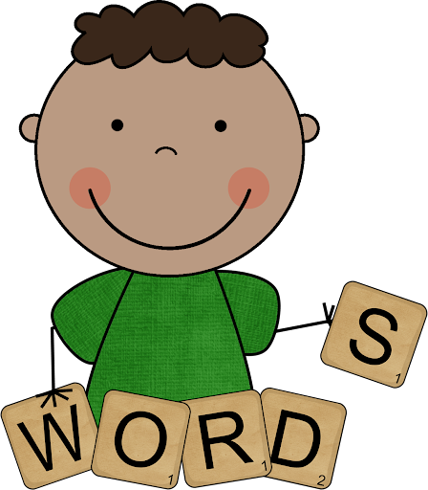
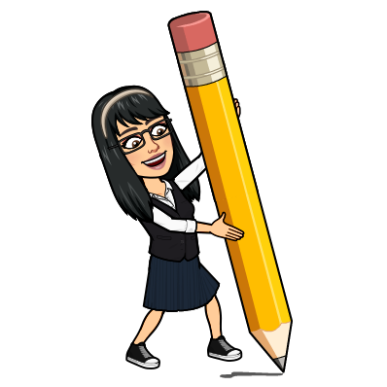
New Words
teenager
13 -18 years old
generation
جيل
Hang out
walk
socialize
Meet friends
advantages
Good things
latest
#
old

Slide 12
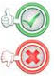

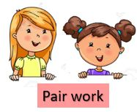
 | 1- they’re called (school generation)
 | 2- in malls , teenagers are chatting
 | 3- teenagers don’t use phones
 | 4- they’re eating snacks in stores
 | 5- they’re wearing same clothes
 | 6- Malls are teenagers favorite place
 | 7- the stores in malls have old fashions
 | 8- you can meet friends in malls
 | 9- malls have all kind of restaurants
 | 10- malls are safe & comfortable
3 class group
Warm up

Slide 13
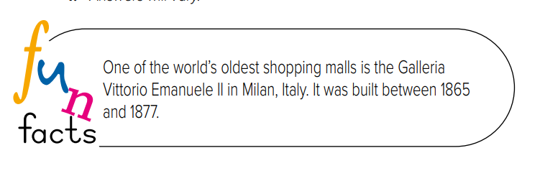
Write in your notebook
Like final test أسئلة للاختبار النهائي
Choose:
The ………. are people from 13 – 18 years old
( generation – socialize – teenagers)
Where do think the first mall was built?
Make a question

Slide 14





page 219 Ex(D - E)
for practice grammar & reading
Warm up

Slide 15
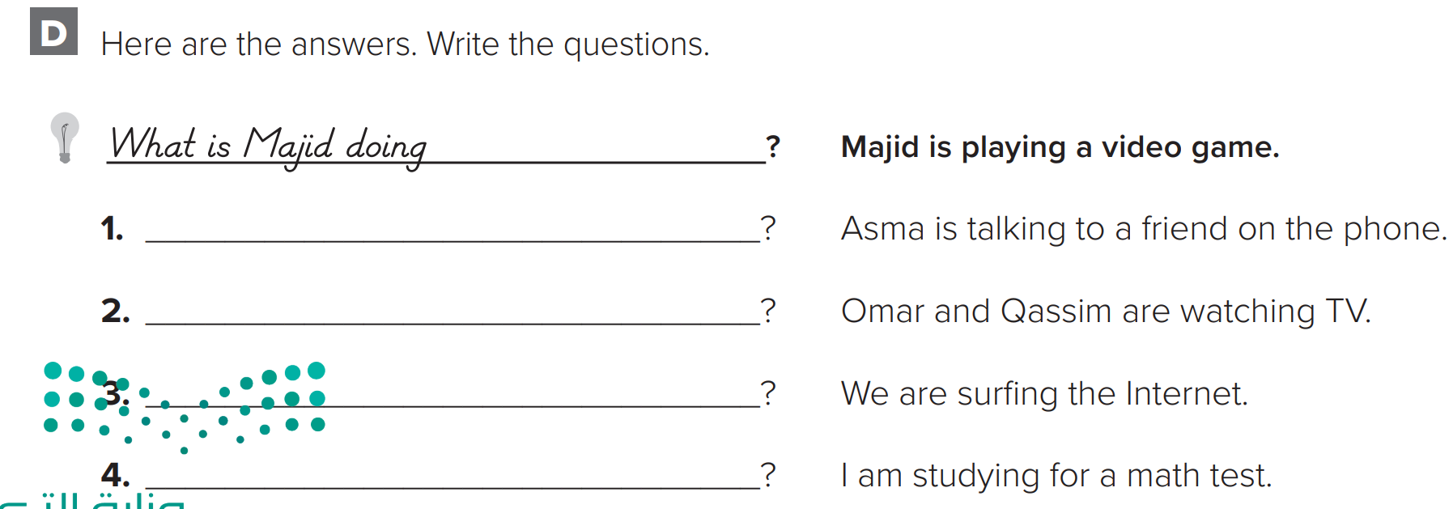
p.219
What is Asma doing
What are they doing
What are you doing
Warm up
What are you doing

Slide 16
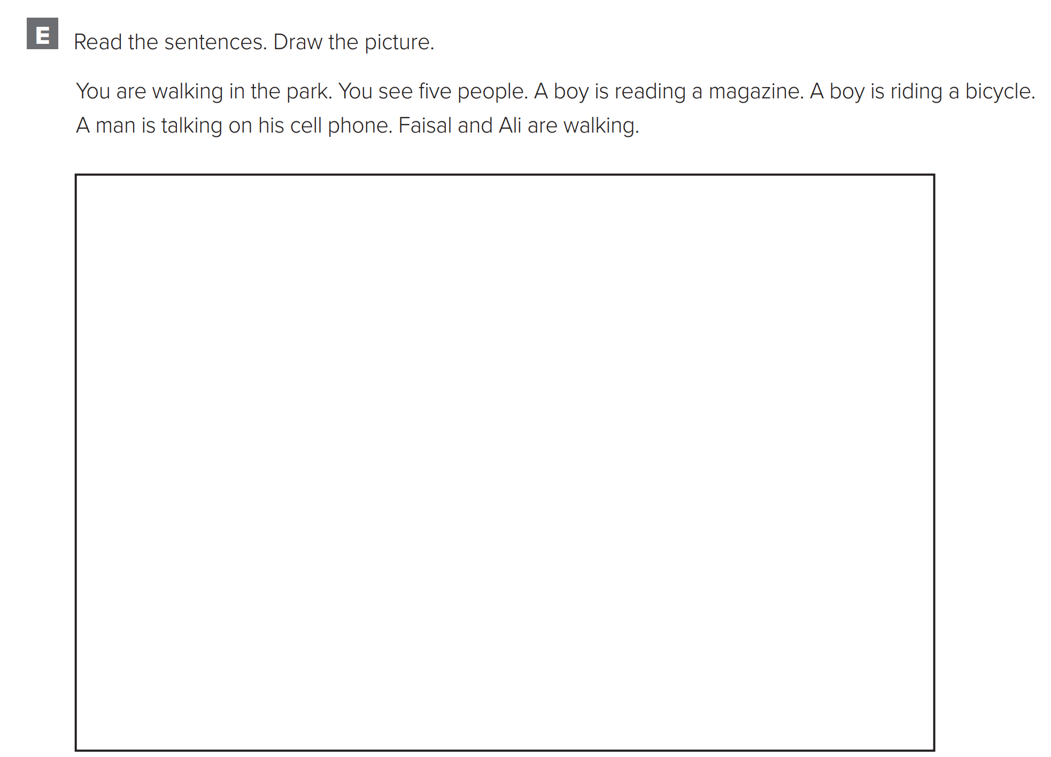
p.220
Warm up

