Slide 1

It’s Nice to Meet you
Unit 1
Finding out Time
Prepared by: Dr. Nadia Al-Ghamdi

Slide 2
Day:
بسم الله الرحمن الرحيم
Date:

Slide 3
Learning Goals
Practice a conversation with a colleague about personal information
Match the correct information to the right person according to the audio
Relate each subject pronoun to its right verb TO BE

Slide 4

Warm Up

Slide 5
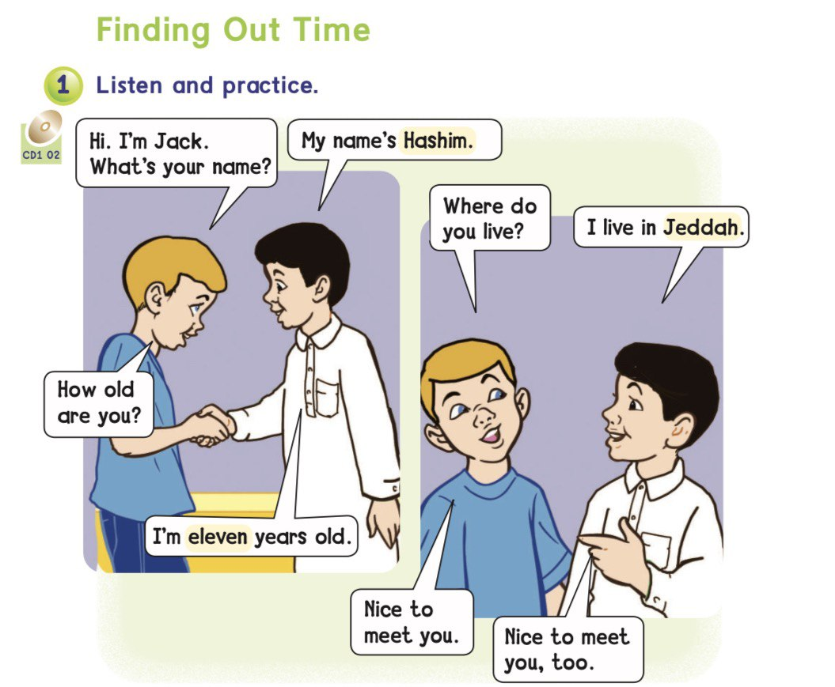

Page 2

Slide 6
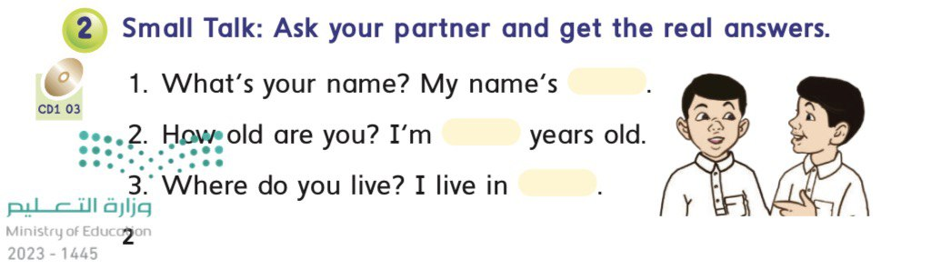
Page 2

Slide 7
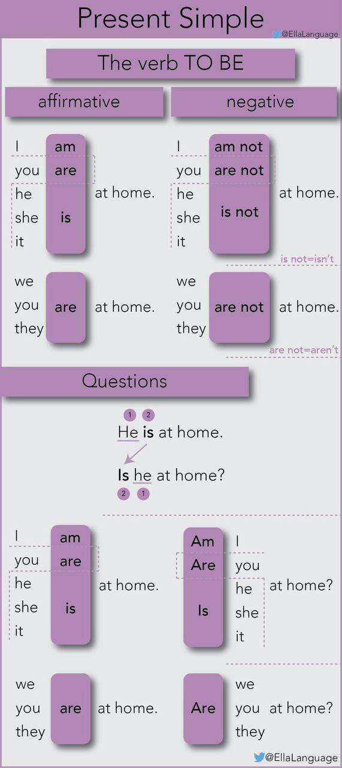
Verb to be

Slide 8
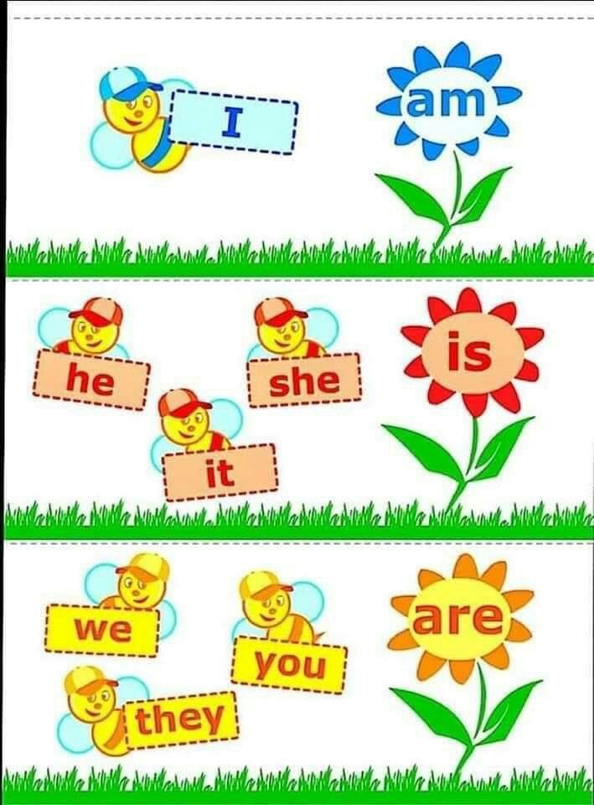
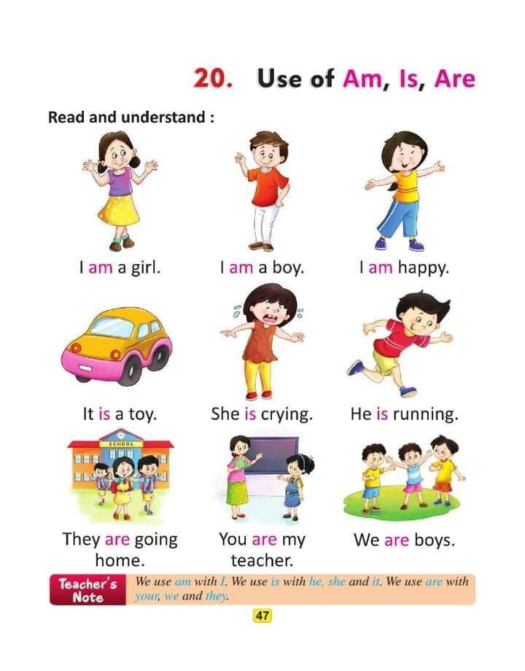

Verb to be
Am I Ben?

Slide 9
Verb to be
Is it a dog?

Slide 10
Verb to be
Are you special?

Slide 11
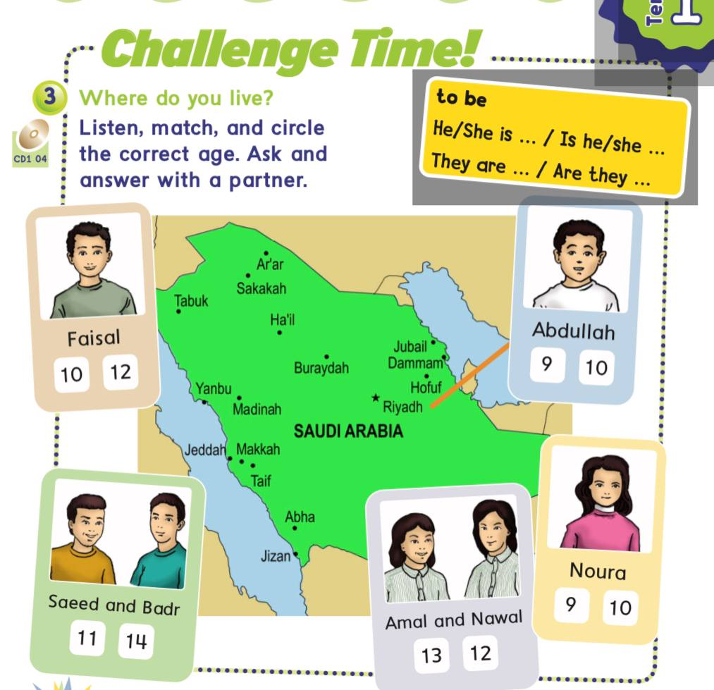
Page 3

Slide 12
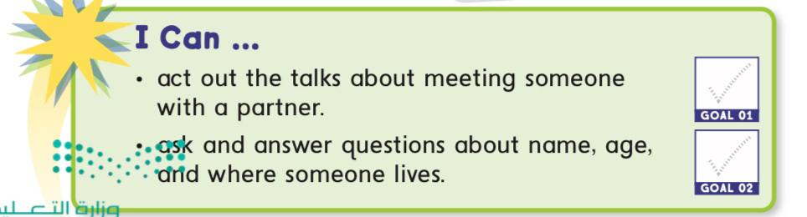
Goal Check
Page 3

Slide 13

Practice

Slide 14
Homework
Page 139 & 140

Slide 15
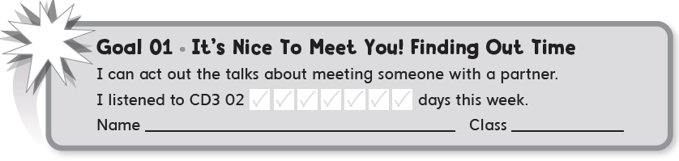

Slide 16

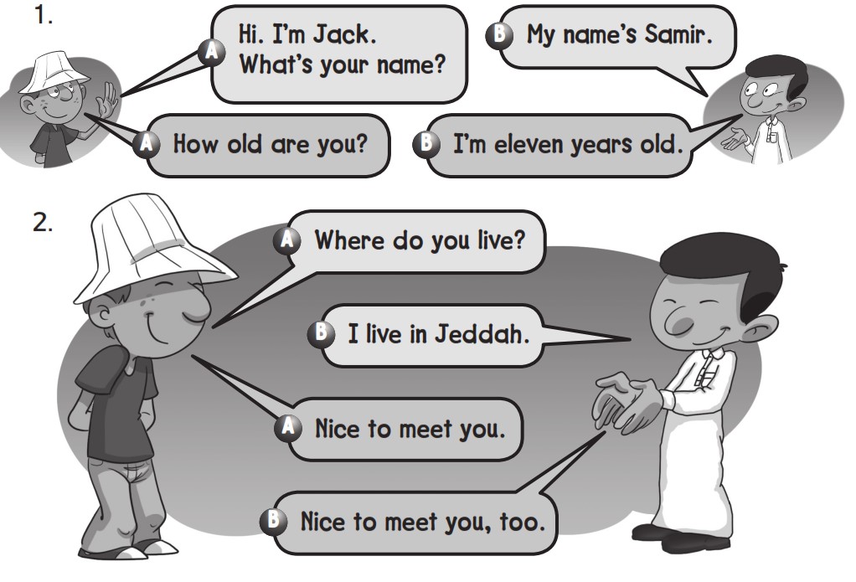

Slide 17
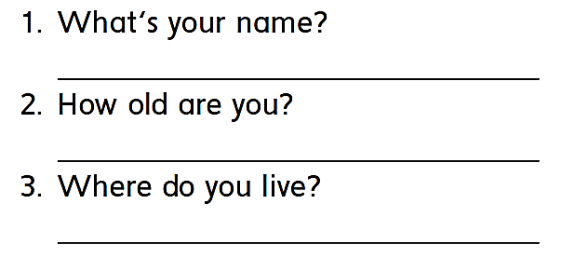
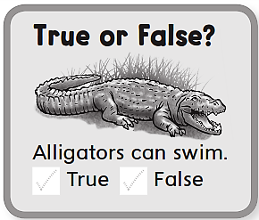

My name is …………………
I’m 12 years old
I live in ………………

Slide 18
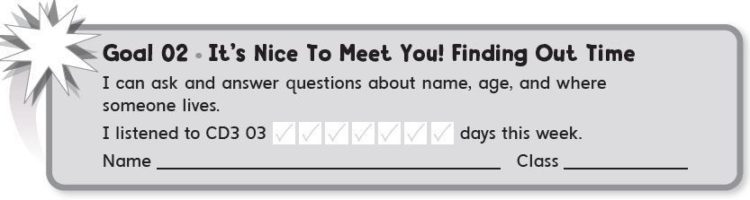

Slide 19

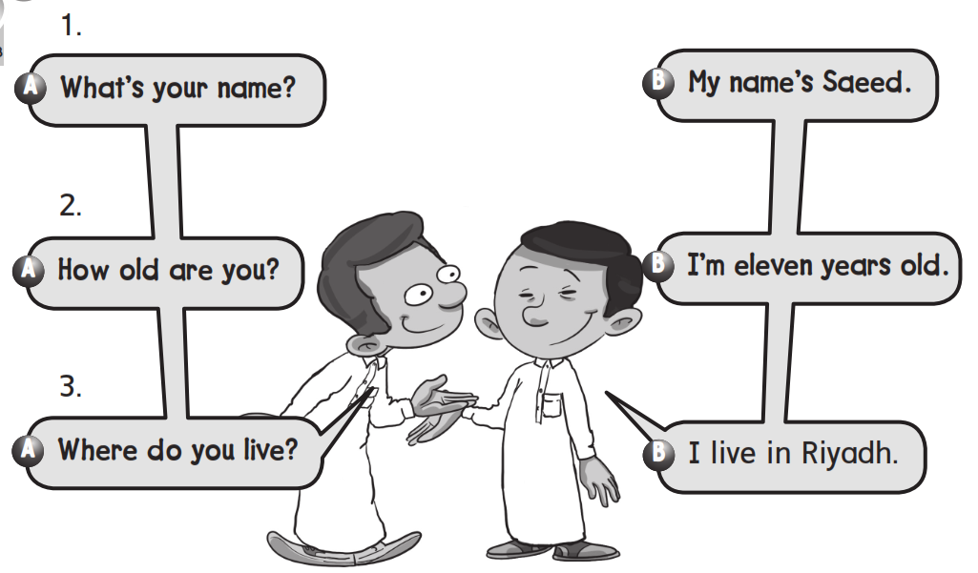

Slide 20
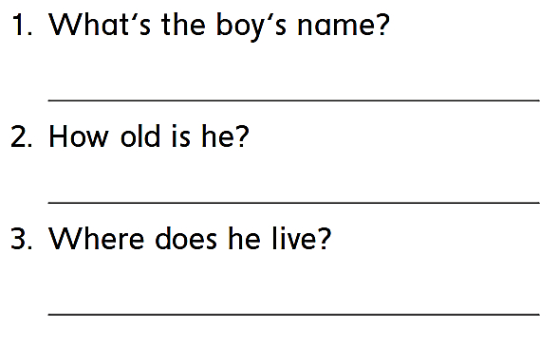
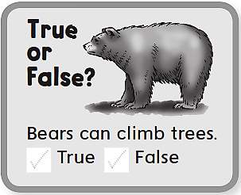
His name is Saeed
He is 11 years old
He lives in Riyadh

Slide 21
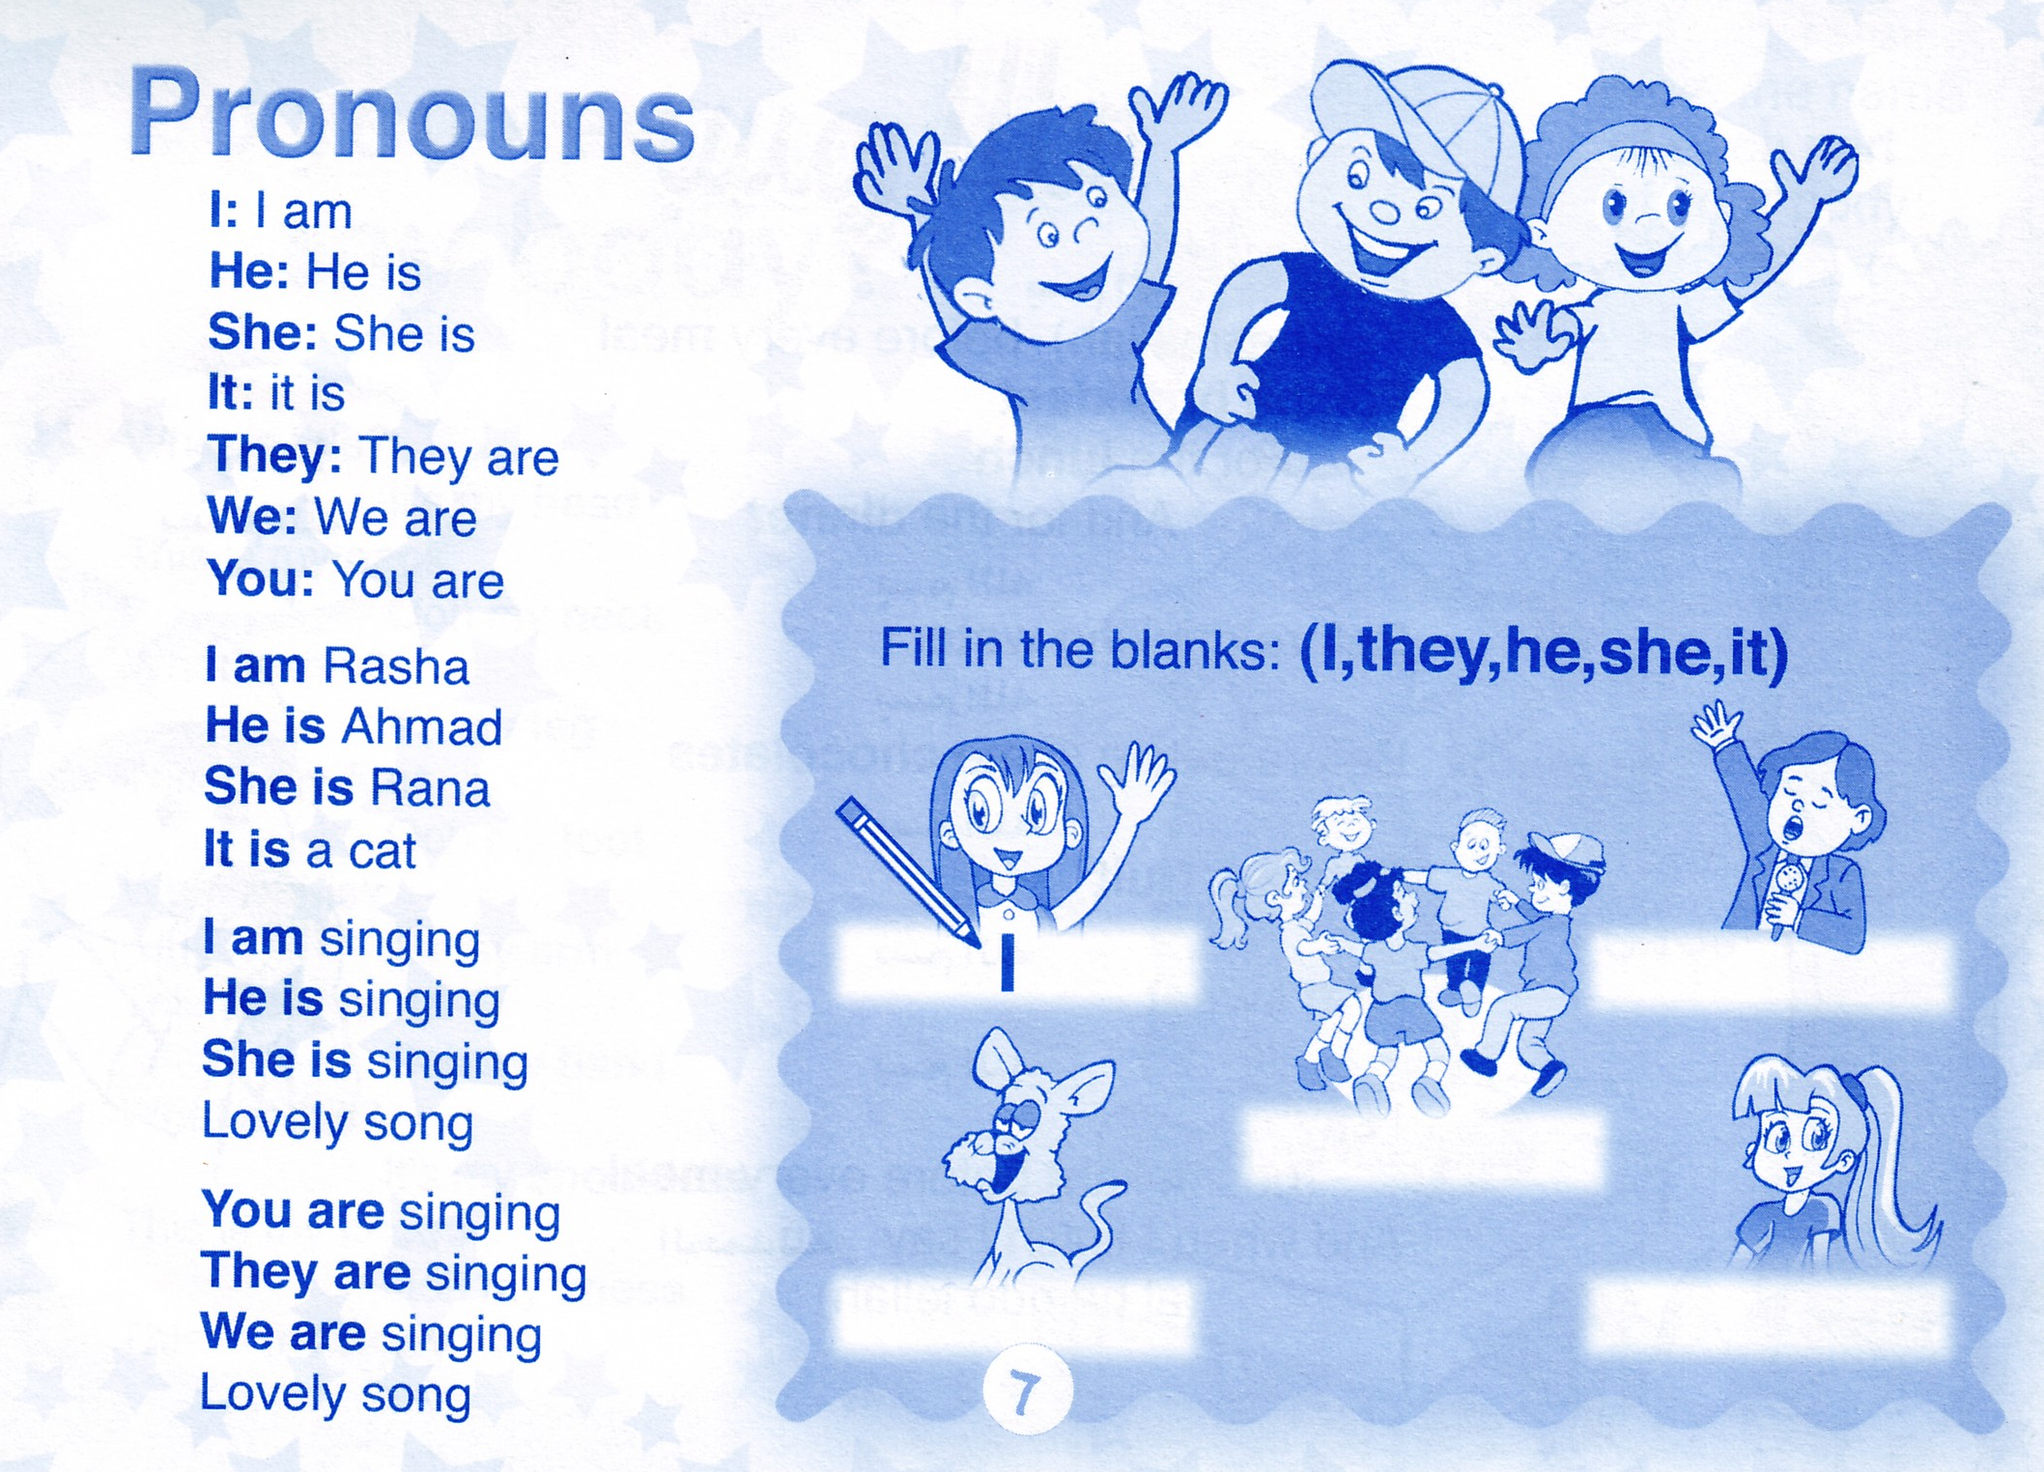
Time filler

