Slide 1
Good morning
Welcome to our class
with
Teacher\ salwa alshammari

Slide 2

Date\ 11.6.1445 Day\sunday

Slide 3

silent vidue

Slide 4



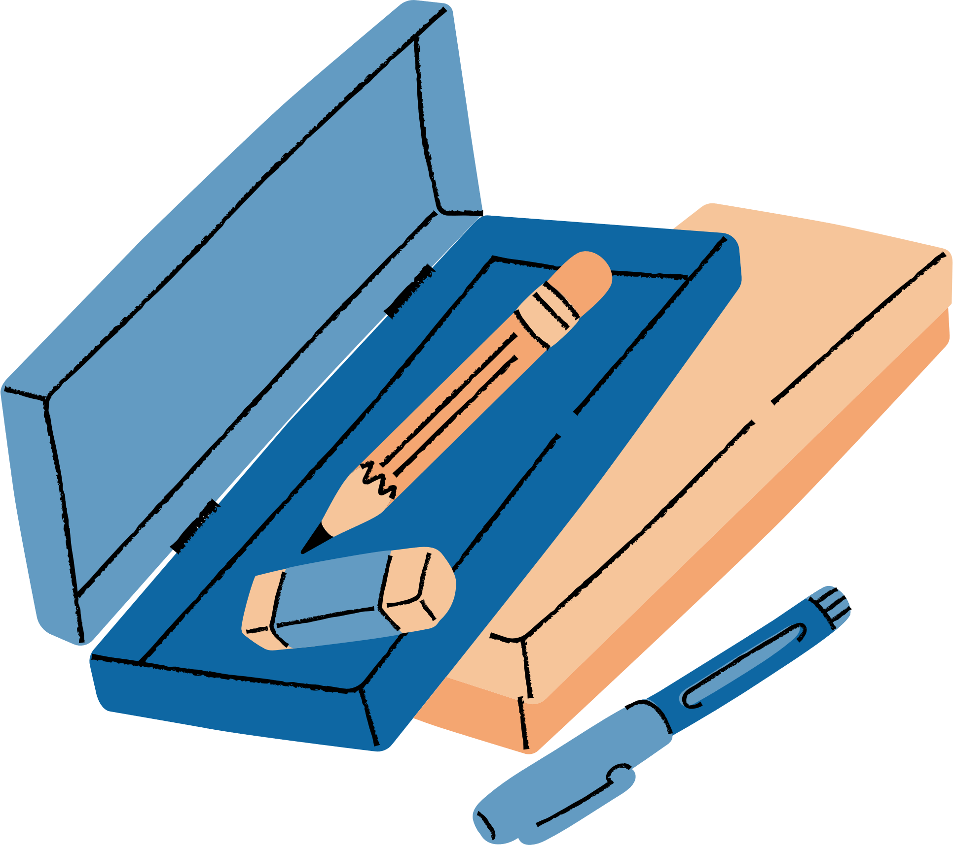


Unit 7
Fun on the Weekend

Slide 5







Lesson 2
Grammar in Action

Slide 6

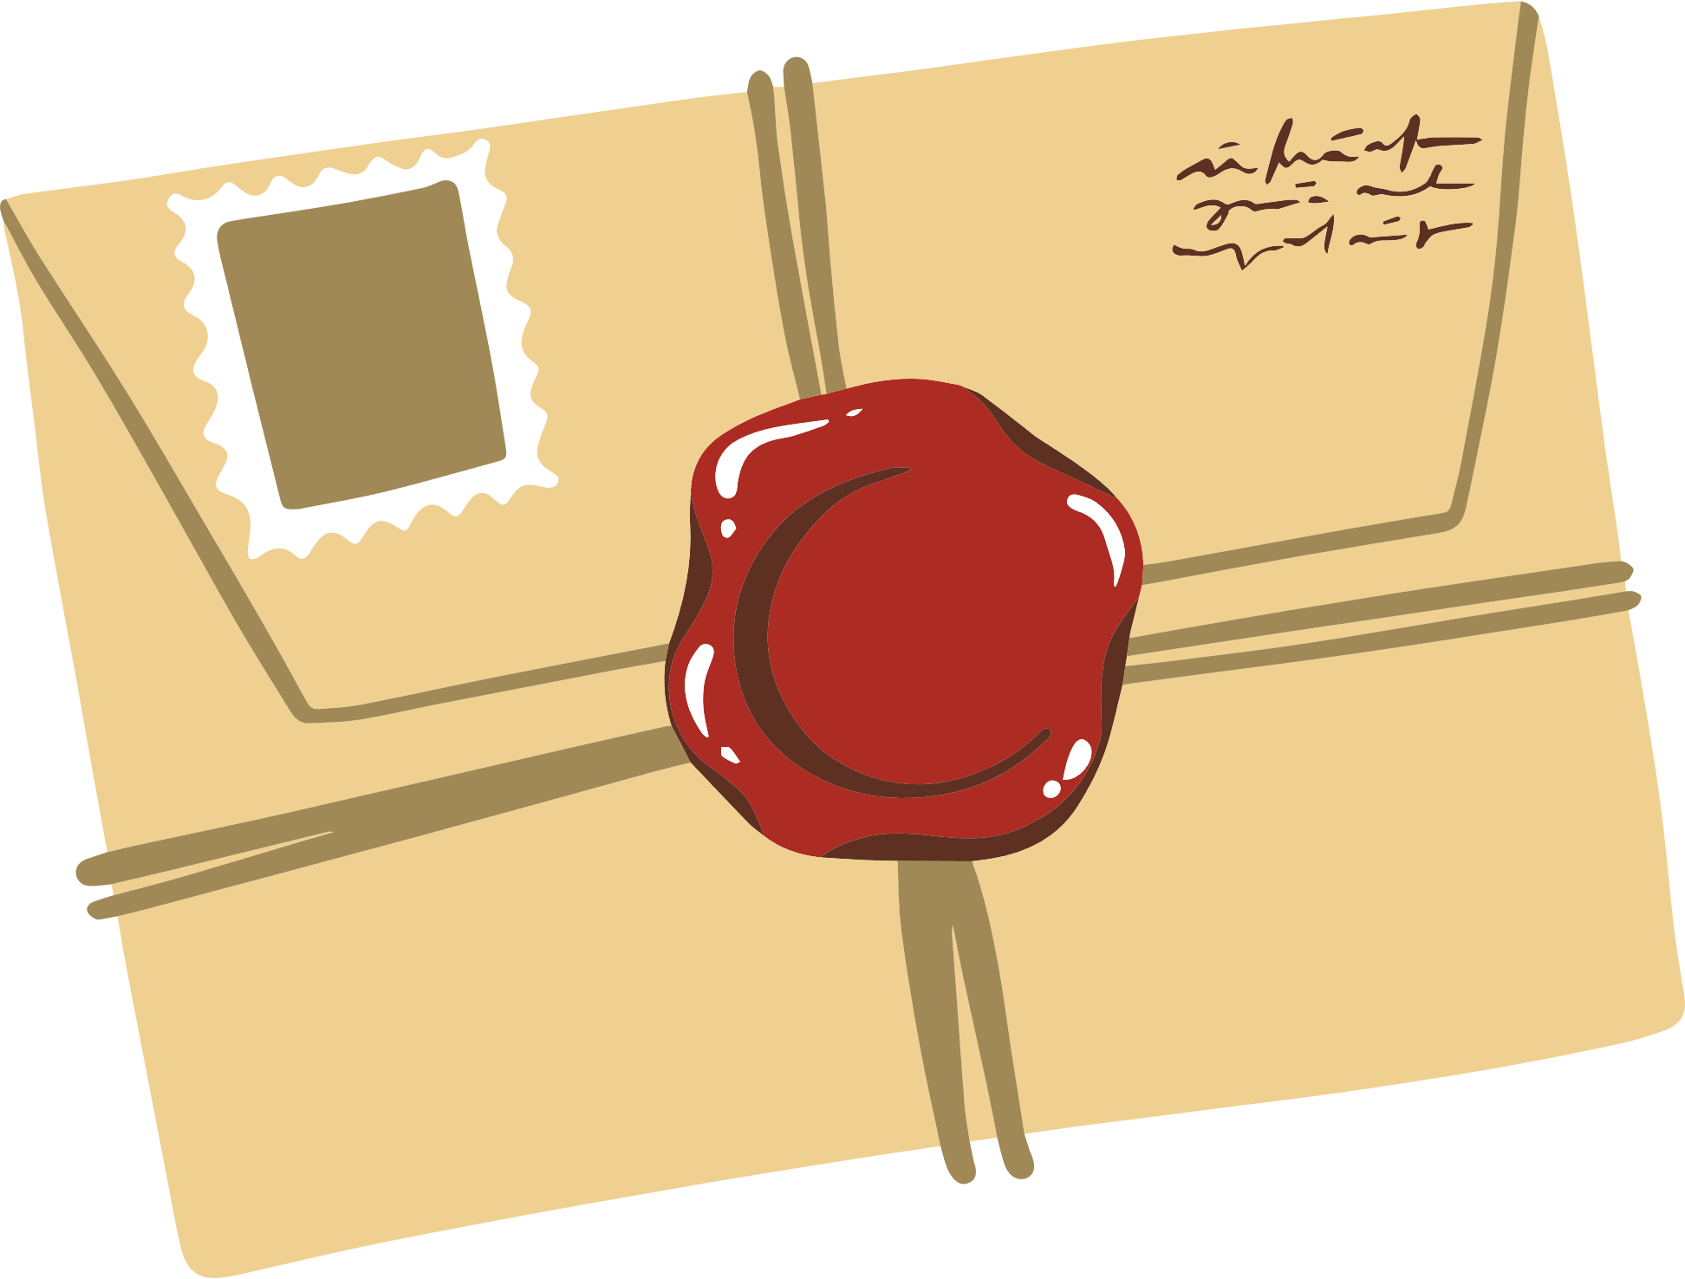






1
Listen and practice
CD3 04

Slide 7
We practiced | I practiced
You practiced | You practiced
They practiced | He / She practiced

Slide 8
2
Listen and chant Past Tense Regular Verb Chunks
CD3 05

Slide 9


Slide 10

1. practiced, practiced I practiced my English.
2. watched, watched You watched a DVD.
3. cooked, cooked She cooked breakfast.
4. kicked, kicked He kicked a ball.
5. cleaned, cleaned They cleaned the house.
6. stayed, stayed We stayed at home.
7. played, played You played outside.
8. studied, studied You studied a little.

Slide 11
3
Listen and practice. Then do it in pairs.
CD3 06

Slide 12

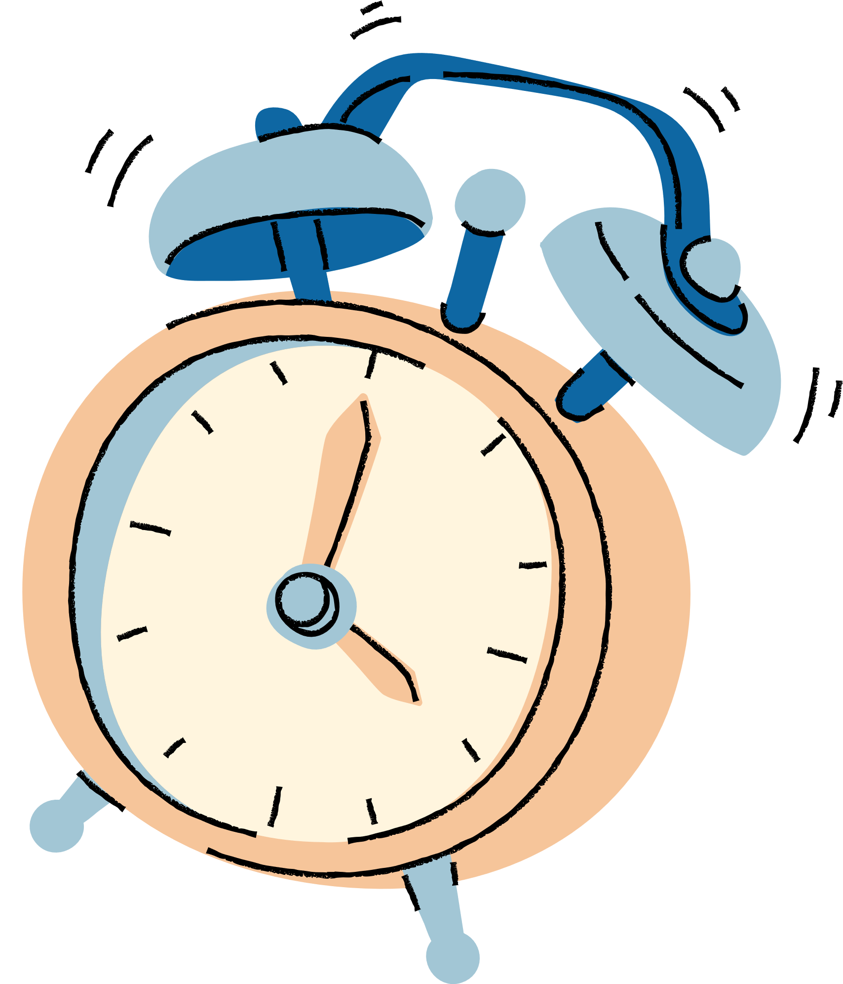
Challenge Time!

Slide 13
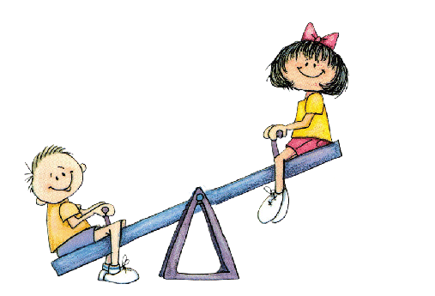
Can you write and play the Verb Game and beat a partner?

Slide 14
4
Verb Game

Slide 15
CD3 07
Verb Game 1 (practice)
played | practiced | cooked
studied | kicked | watched
stayed | cleaned

Slide 16


Slide 17
Verb Game 2
CD3 08

Slide 18
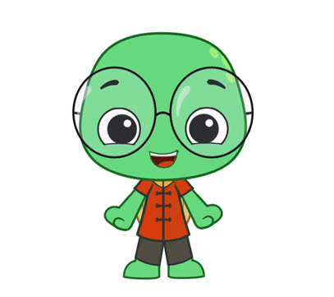

I Can…

Slide 19
say the past form of six regular verbs.
✓
GOAL 51
say two things that I did over the weekend.
✓
GOAL 52

Slide 20
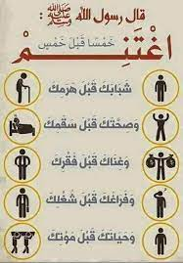
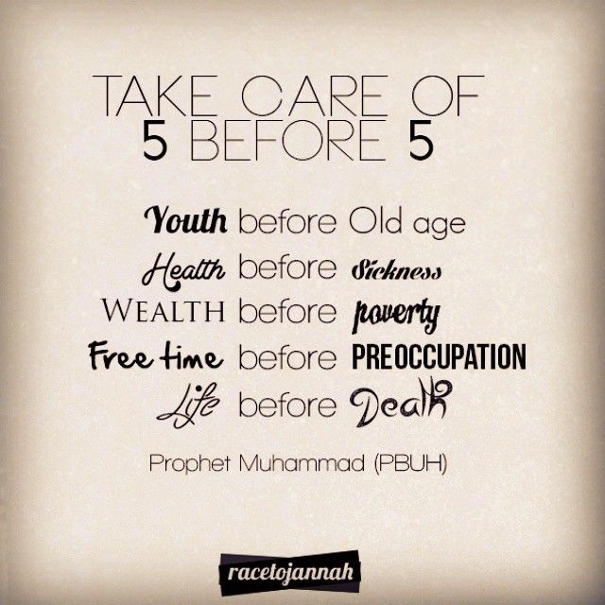
قال الرسول
(صلى الله عليه وسلم)

