Slide 1
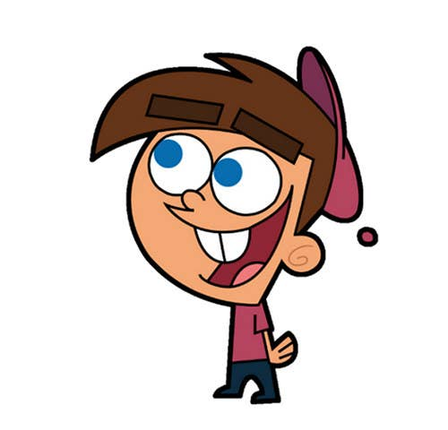


Welcome to class
T.
Mohamad
Zaid

Slide 2
Day
Sunday
Date
30th Jun 2022
Subject
We can 6
Unit
Fun on the Weekend
Lesson
3 Reading and Writing

Slide 3

Revision for the previous lesson :
Say the past tense of the following verbs :
kicked
kick
play
played
cook
cooked
study
studied

Slide 4





PAGEs 6 , 7 , 8 & 9

Slide 5


PAGES 6 , 7
Objectives
By the end of this lesson I can :
ask and answer questions with How many and How much and make sentences with
some and any.
read an English menu and order at a restaurant.

Slide 6


Slide 7

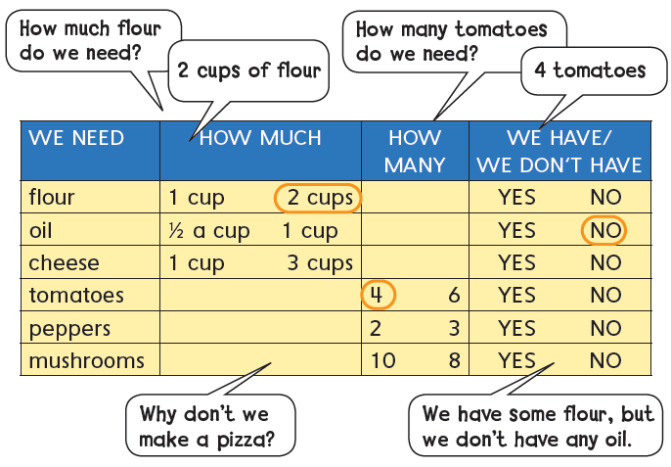

Listen and read . Circle the answers in the chart .

Slide 8

Listen and circle YES or NO in the chart. Practice in pairs.

Slide 9
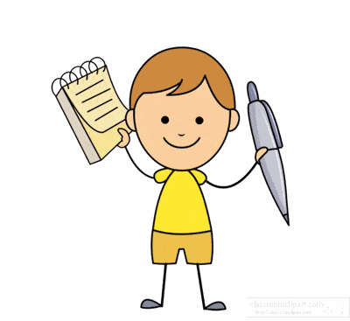
Write two sentences with some , any , and but
some
any
We have ___________ tomatoes but we don't have________ peppers
We have ______ cheese but we don’t have ________ mushrooms
some
any

Slide 10
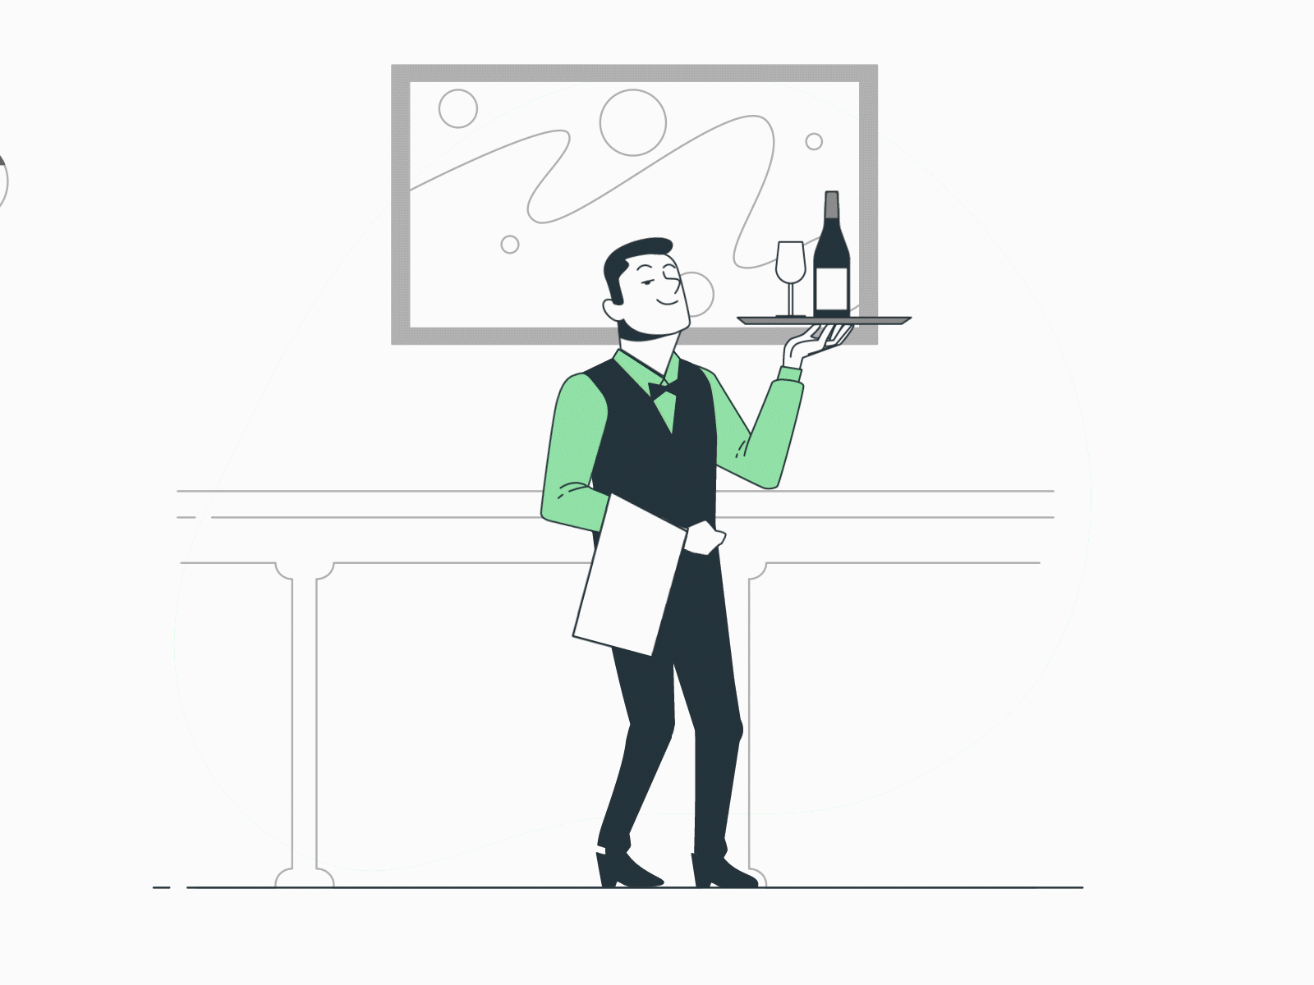
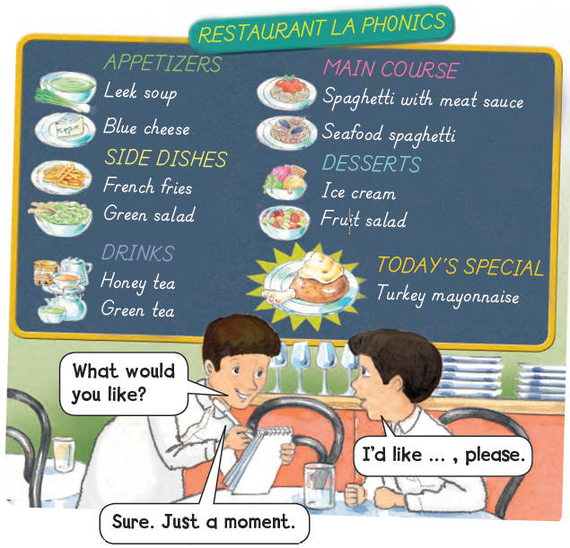

Can you be a waiter or waitress and take an order from a partner?

Slide 11



Goal Check

Slide 12

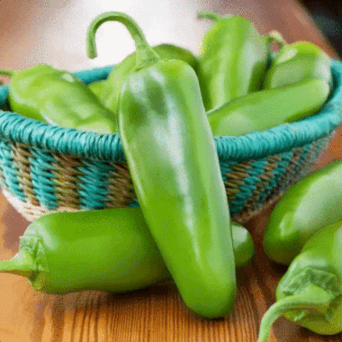
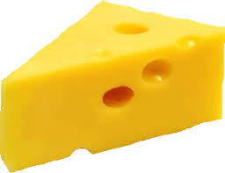
Complete with some or any :
1.I have ______ peppers
some
2. I don’t have ________ cheese .
any

Slide 13


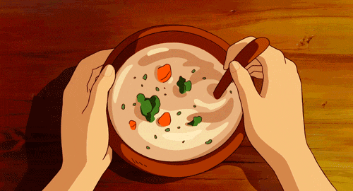

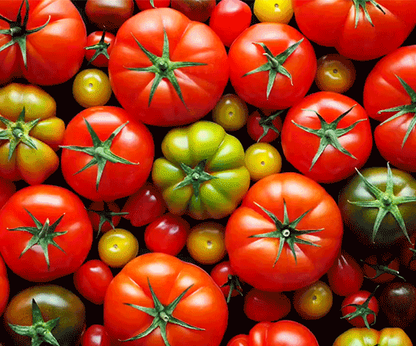
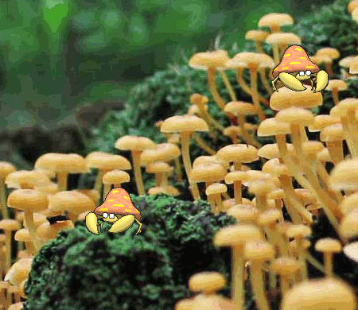
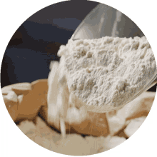
Ask with How many ? or How much ?

Slide 14



https://www.liveworksheets.com/di1542576rj
https://www.liveworksheets.com/vd1542610ja

Slide 15


Open your workbook
Pages 75 , 76

Slide 16


Home work at

Slide 17

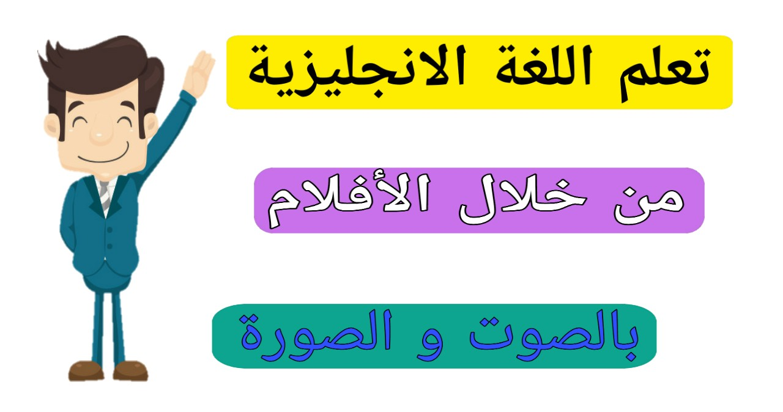
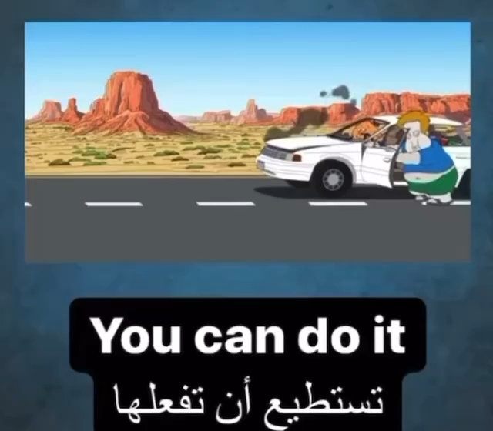
إنتاج معرفي
Let’s learn a sentence or more DAILY

Slide 18


Slide 19
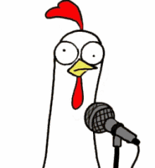


Slide 20



