Slide 1
7 Everyone Makes Mistakes
Grammar
p. 98 +99

Slide 2
Lesson Content
1
+
2
Modals in the past
Passive Modals in the Past

Slide 3
Modals in
the Past

Slide 4
Let’s Brain storm!
Write down as many as modal verbs you know.
Now give examples of full sentences!

Slide 5

Insert your multimedia content here

Slide 6
01
02
03
04
What are Modals in the Past?
May have/ Might have
Could have
Must have
Should have
05
Was/were supposed to

Slide 7

Let’s study their form and function!

Slide 8
Form
May have/ Might have
Could have
Must have
Should have
Was/were supposed to
+
Past Participle
+
Base Form

Slide 9
Function
May have/ Might have + P.P
Used to suggest uncertainty or possibility about the past.
I lost my cell phone. I may have left it at school.
You might have dropped it at the restaurant.
Something you are not sure about.

Slide 10
Function
Could have + P.P
Used in two ways:
to talk about the past with uncertainty,
to talk about an option in the past that was not taken.
Do you think I could have left my cell phone at your house?
He could have been a doctor if he hadn’t made the mistake of dropping out of school.

Slide 11
Function
Must have + P.P
Used for drawing conclusions about the past.
I got lost on the way here. I must have taken a wrong turn somewhere.
The cat has escaped. You must have left the door open.

Slide 12
Function
Should have + P.P
Used to talk about mistakes made in the past or expectations that have not been met.
You should have apologized for your mistake.
They should have arrived by now.
Giving advice about the past to someone else.
Or regretting what you did or didn’t do

Slide 13
Function
Was/were supposed to + base form
Used to express that an expected action didn’t happen.
The football game was supposed to start at 1:00, but it was postponed because of the rain.
Where were you last night? You were supposed to help me with my essay.

Slide 14
Let’s search!
turn back to pages 96 and 97.
Find and underline examples of past modals in the stories.

Slide 15
(The telephone)
Orton could have made one of the best deals in
business history.
Instead, he may have made the worst business
mistake in history.
(The Titanic)
Yet incredibly, this tragedy could have easily
been avoided.
The operator was supposed to give the message to the captain.
If it had, the Titanic tragedy might never
have happened.

Slide 16
(Alaska)
The Russians couldn’t have known how wrong
they were.
The Russians must have regretted that mistake for
many, many years.
(Coca -Cola)
Coca-Cola executives must have been surprised!

Slide 17
Passive Modals in
the Past

Slide 18
Form
subject + modal + have been + past participle.
Function
Used to give opinions about events and situations that happened in the past.
Examples
The money could have been given
to the poor.
The package should have been sent
a week ago.

Slide 19
Time to Practice!

Slide 20
Circle the correct modal in the past to complete each sentence.
1. I have a sore throat. I (should have / may have) caught your cold.
2. He (wasn’t supposed to / shouldn’t have) know about the business deal, but he found out by accident.
3. You have a big smile on your face in all the vacation pictures. You (should have / must have) had a great time.
4. I don’t know where she is, but she was very tired. She (should have / may have) gone to bed.

Slide 21
Circle the correct modal in the past to complete each sentence.
5. I (must have / should have) paid more attention in English class. Now I’m completely confused about the grammar.
6. I (must have / shouldn’t have) ordered that new laptop. It was way too expensive.
7. Did you get the package? It (was supposed to / must have) arrive by today.
8. You (may not have / should not have) said that. Now you’ve hurt your friend’s feelings.

Slide 22
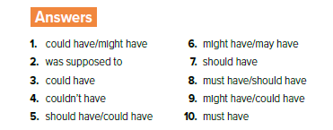
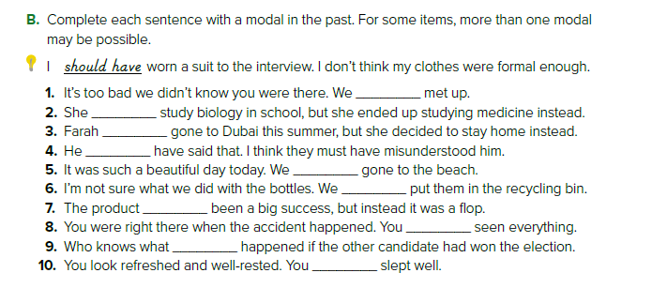

Slide 23
Exit Ticket!

Slide 24
Write
Write
Three thing you fully understood.
One thing you didn’t fully understand.

Slide 25
Thank you for being superb!

