Slide 1
U8
ثاني متوسط

Slide 2
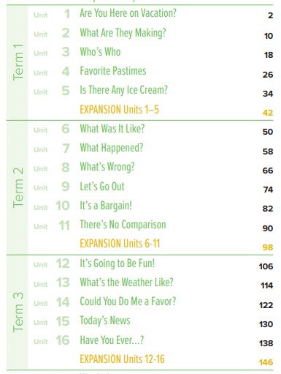
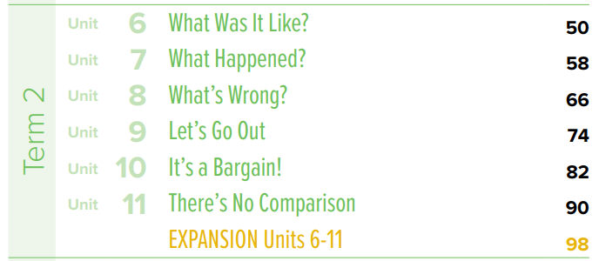
book contents
ثاني متوسط
T.Noureyah Alghamdi

Slide 4
off

Slide 5
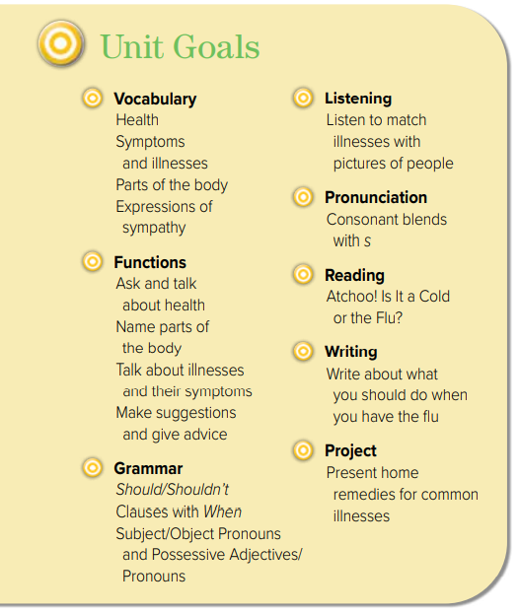

Slide 9
Instilling
values
To put a feeling, idea, or principle gradually into someone's mind, so that it has a strong influence on the way that person thinks or behaves.

Slide 11
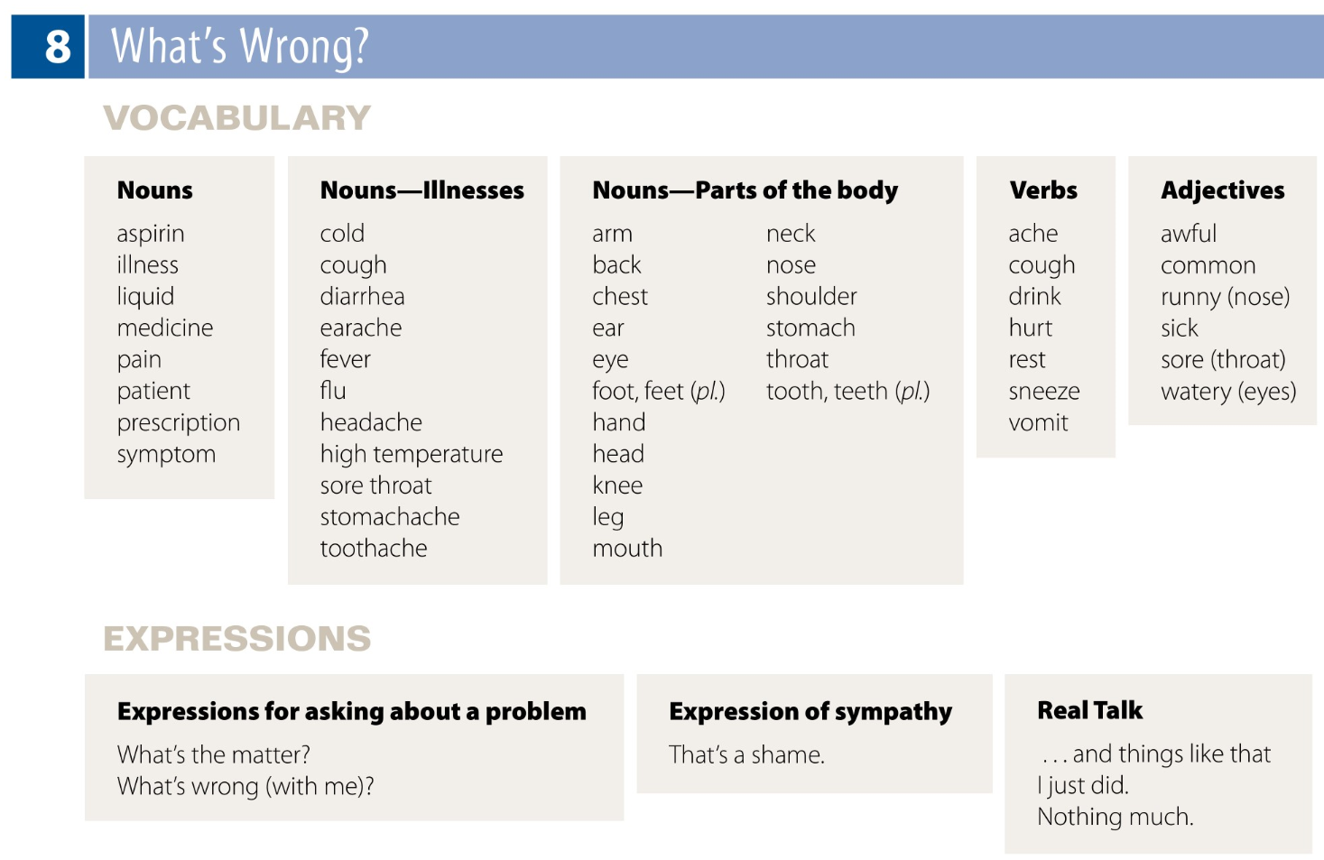
Page 158
الرجاء اختيار 4 أعمدة من الكلمات
وكتابة 4 كلمات من كل 4 أعمدة
في كل وحدة دراسية

Slide 13
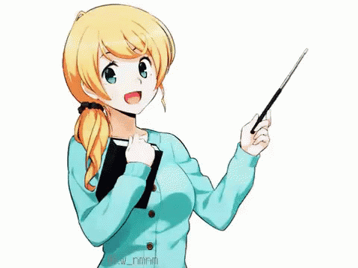
SG2 U8
Page 66 and 67
Today: Wednesday
Date:
10-4-2442 H
November 26th \ 2020
everyone,
How is everything going?

Slide 14
☺
♥
SG2 U8
Page 66 and 67
Ask for health advice
Find the illness of each student
Ask about someone's health condition
Match body parts with illnesses

Slide 15
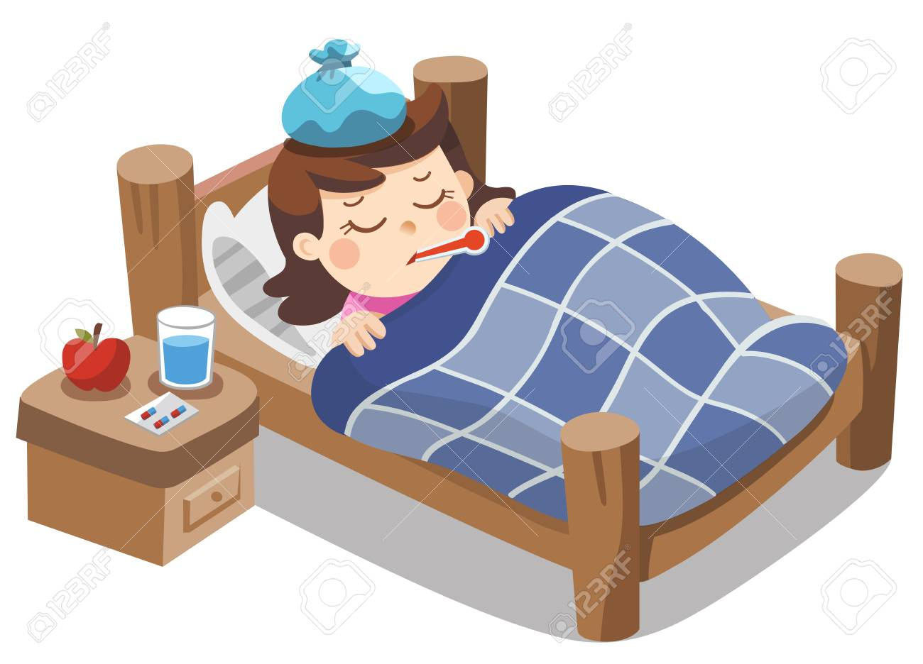
SG2 U8
Page 66
Last month I had the flu. I had a headache and a stomachache. I also had a sore throat and a cough. It was terrible.
Did you ever have a sore throat/the flu/a stomachache/a cough?

Slide 16
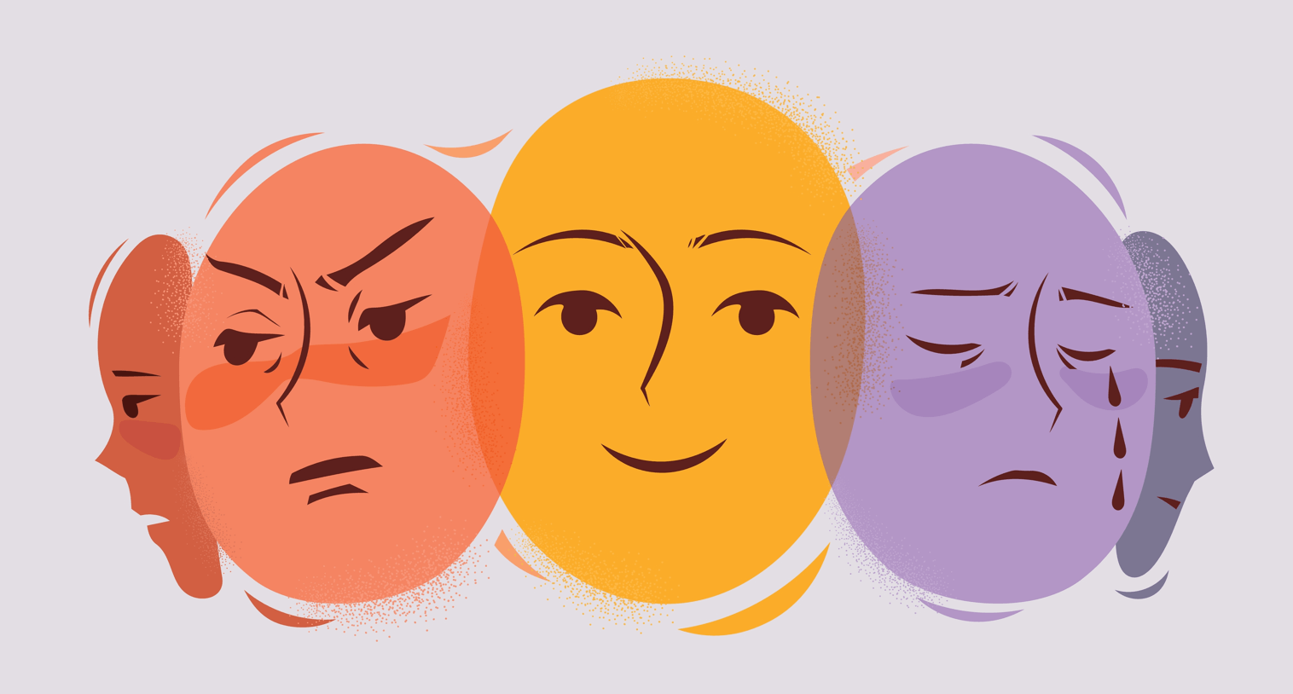
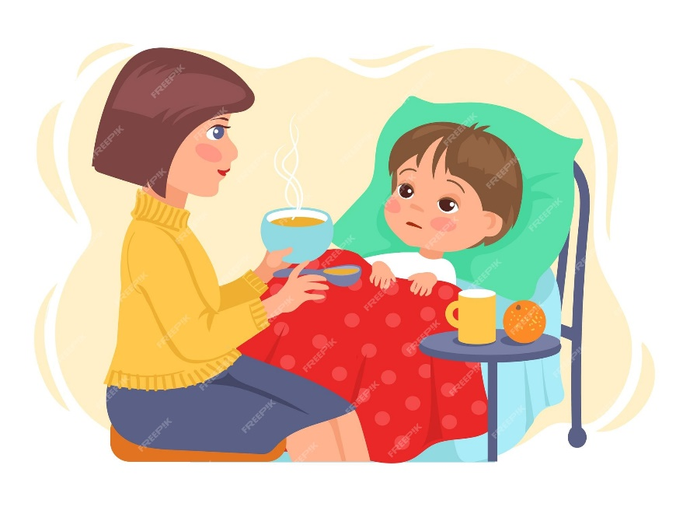
SG2 U8
Page 66
Emotional Map Strategy
The mother is taking care of her son.
The boy is feeling unwell.
What do you think?
What do you feel?
Give a sentence describing the picture:
……………………………………………………………………………………………………….
……………………………………………………………………………………………………
Most people go to the doctor when they're sick or have a problem.

Slide 17
😐 mm
SG2 U8
Page 58
Use popcorn strategy
😐 mm
Write two symptoms of a cold
😐mm
😐 mmm
a runny nose.
a sore throat.
headaches.
muscle aches.
coughs.
sneezing.
a raised temperature.
pressure in your ears .

Slide 18
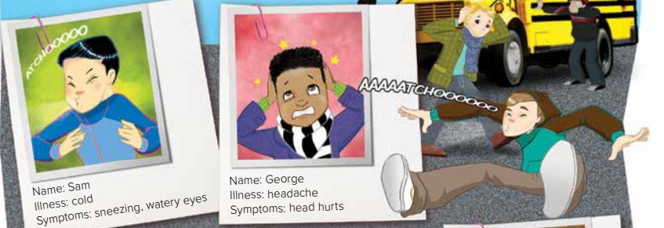
Unit:8
Friday 24\4\1444H
18th November 2022
Listen and Discuss What’s wrong SG2 page 66 & 67
Anticipation guide
Listen and Discuss
Before Reading |  | Statement | After Reading
Agree | Disagree |  | Agree | Disagree
 |  | Sonia has a sore throat.
 |  | Sam has cold.
 |  | Charles has fever, and runny nose.
 |  | George has headache.
https://www.liveworksheets.com/zt3260259rf
T. Noureyah Alghamdi

Slide 19
SG2 U8
Page 66
a substance which is not solid but which flows
a substance, such as water, that is not solid or a gas and that can be poured easily

Slide 20
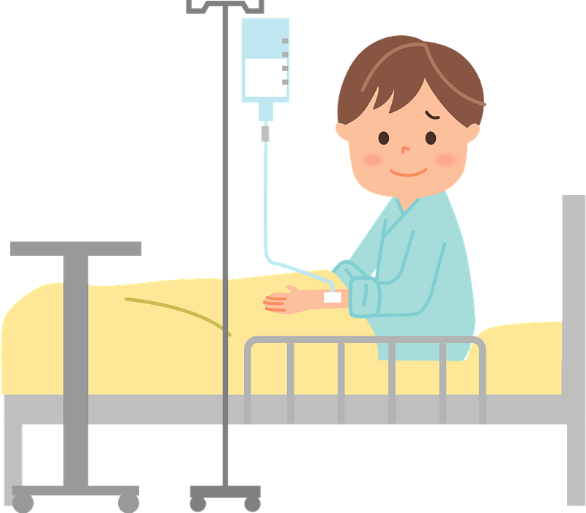
SG2 U8
Page 66
a a person who is receiving medical care
a person who is under medical care or treatment

Slide 21
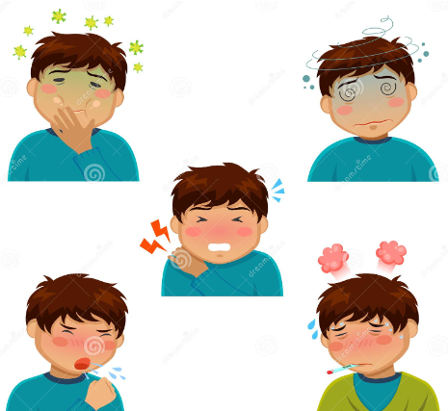
SG2 U8
Page 66
any feeling of illness that is caused by a particular disease
something wrong with your body or mind that is a sign of the illness

Slide 22
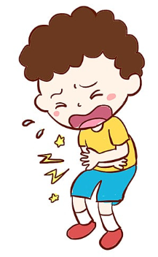
SG2 U8
Page 66
pain in your stomach
you have a pain in your stomach

Slide 23
https://www.liveworksheets.com/zt3260259rf

Slide 24
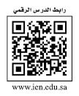
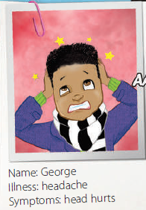
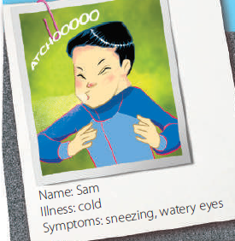
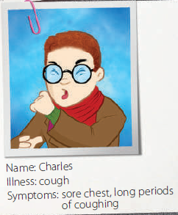
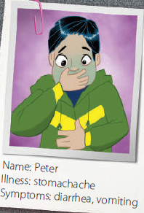
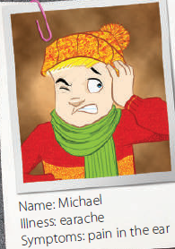
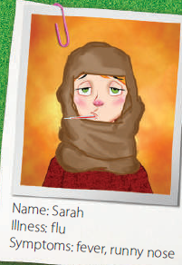
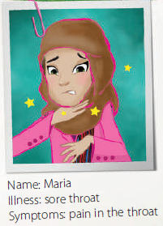
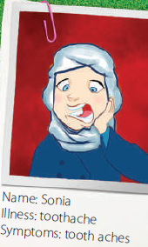
SG2 U8
Page 66
Who has a toothache?

Slide 25
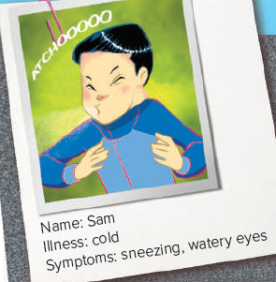
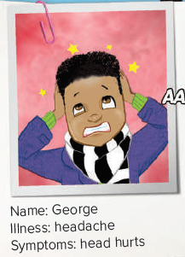
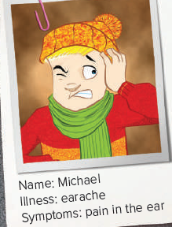
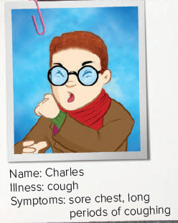
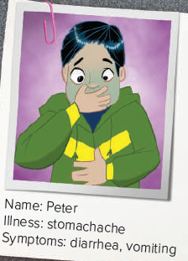
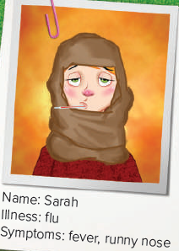
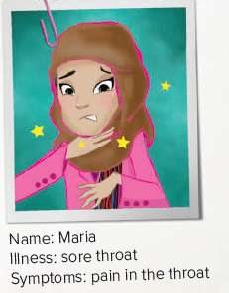
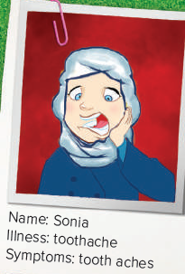
SG2 U8
Page 66

Slide 26
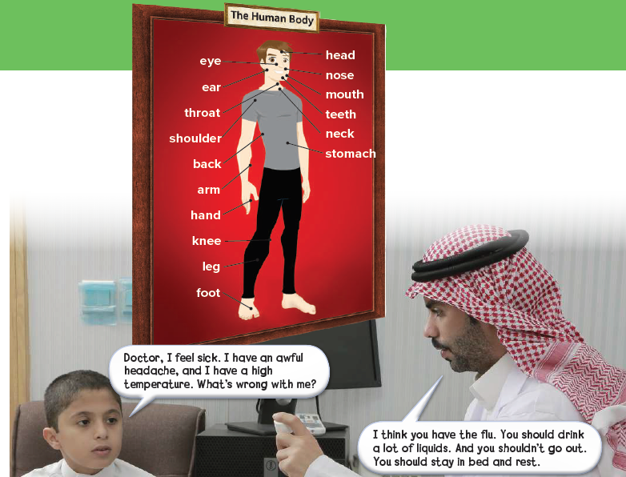
SG2 U8
Page 67

Slide 27
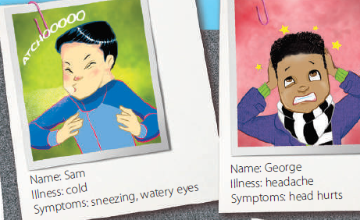
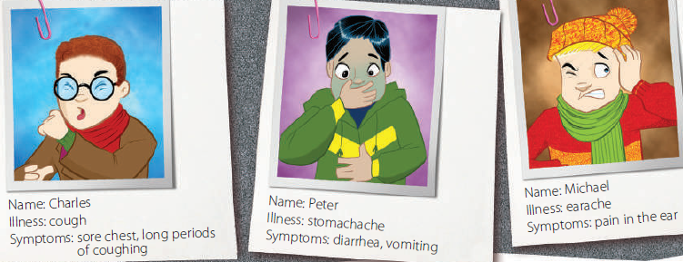
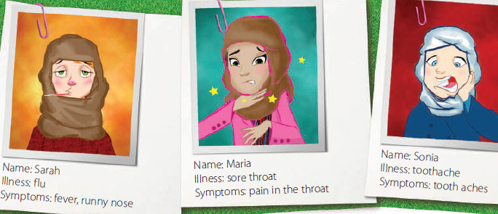
SG2 U8
Page 66
Where are the people?
(in a doctor’s office)
What are they probably talking about? (the patient’s illness)
You: It’s part of your head. You see with it.
Student: Eye.
Symptoms = any feeling of illness
Underline the patient’s symptoms (an awful headache and a high temperature) and
the illness. (the flu)
☺high temperature is similar in meaning to fever.
What does the doctor suggest? (The patient should drink a lot of liquids, shouldn’t
go out, and should stay in bed and rest.)

Slide 28
SG2 U8
Page 67
head — headache, fever
eyes — watery eyes, cold
mouth — toothache
throat — sore throat
ear — earache
stomach — stomachache, diarrhea, vomiting
chest — cough

Slide 29
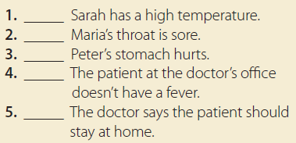
SG2 U8
Page 67
yes
yes
yes
no
yes

Slide 30
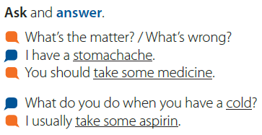
SG2 U8
Page 67

Slide 31
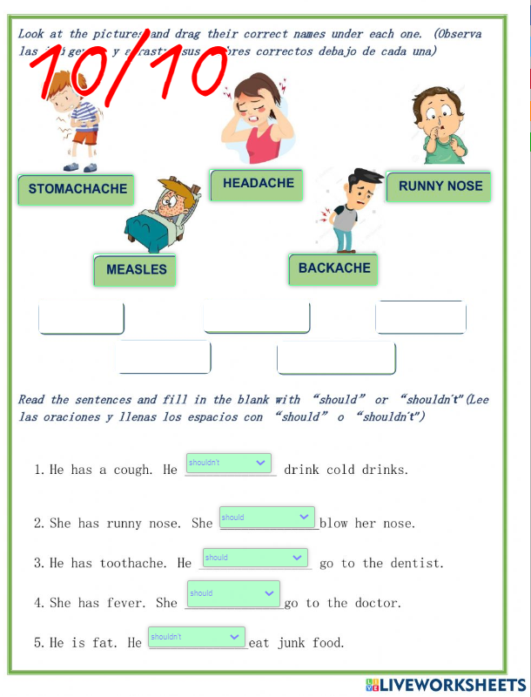
SG2 U8
Page 66
بعد حل ورقة العمل
يتم ارسال صورة لذلك
في قسم الإثراءات
على المنصة
https://www.liveworksheets.com/ct1849929lv

Slide 32
بعد حل ورقة العمل
يتم ارسال صورة لذلك
في قسم الإثراءات
على المنصة
Do the live Worksheet Exercise
then upload the photo of the completed activity.
live worksheet\
يكتفى بصورة واحدة لتمرين واحد فقط☺

Slide 33
Platform
واجب المنصة
للتذكير

Slide 34
بعد حل الواجب
يتم ارسال صورة لذلك
في قسم الأنشطة
على المنصة
Page 217\ A
يكتفى بصورة واحدة لتمرين واحد فقط☺

Slide 35
Assign page 217 for practice with the vocabulary of
the unit.
Ex A

Slide 36
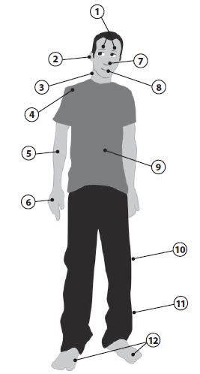
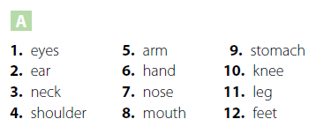
Page 217

Slide 38
أتمنى الاهتمام بمتابعة الدروس في قنوات عين الرسمية من وزارة التعليم
T.Noureyah Alghamdi
The end

Slide 39
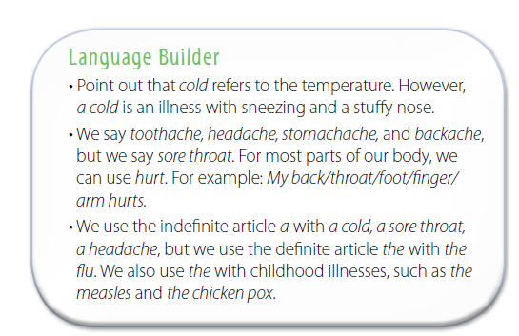
SG2 U8
Page 67

Slide 40
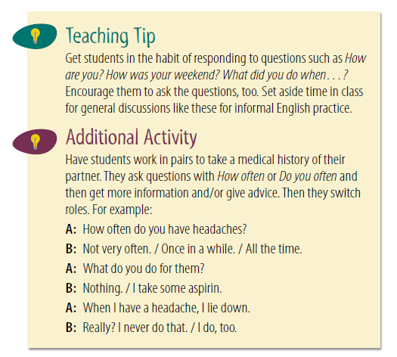
SG2 U8
Page 67

Slide 41
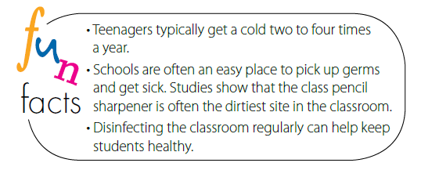
SG2 U8
Page 67

Slide 42
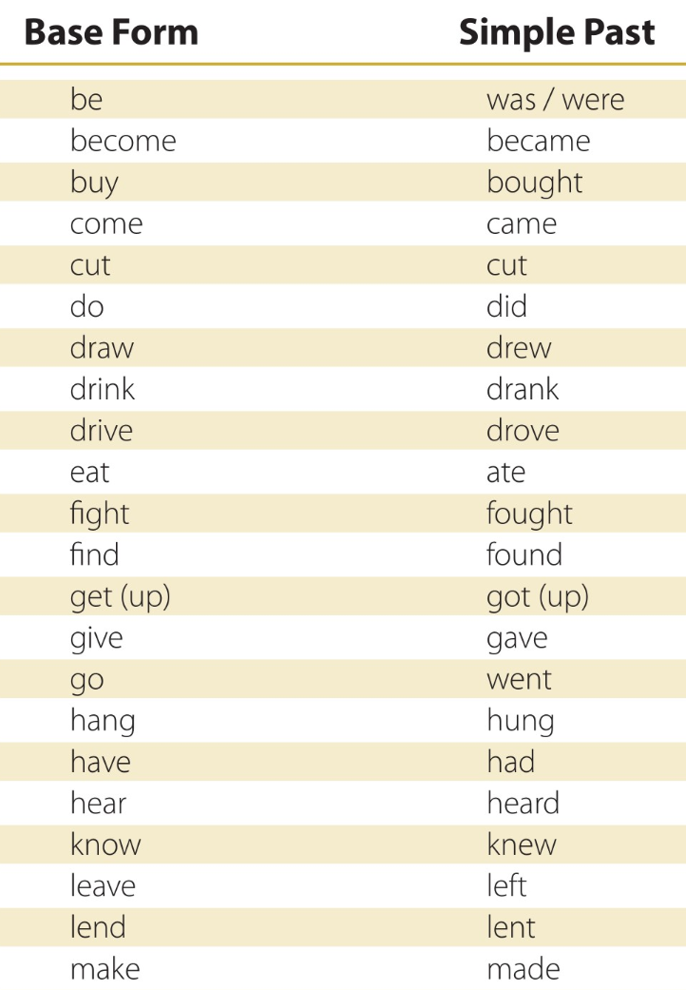
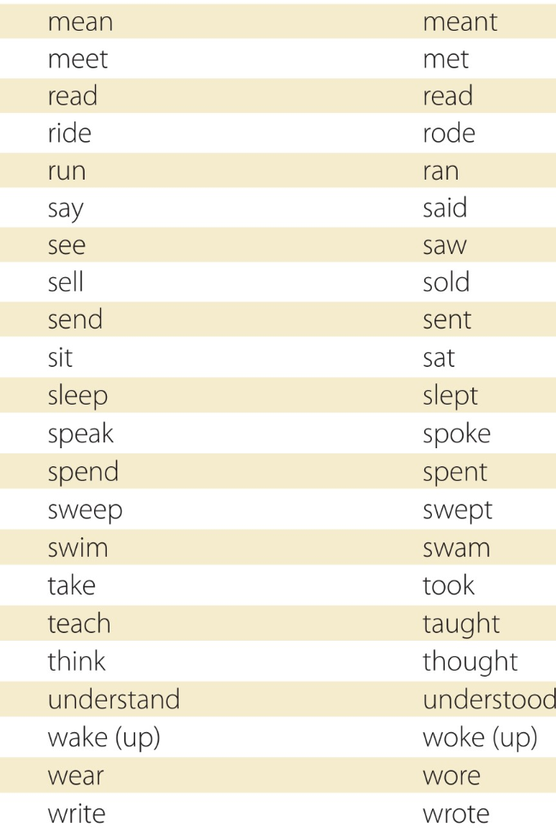
Page 180

