Slide 1


Teacher : Hanan ALQurashi

Slide 2
Super goal 5
Unit 5
Since when ?
Reading

Slide 3







Class rules

Slide 4
Objectives :
Students will be able to ...
1- Identify words related to special effects .
2- Find the meaning of the new words through the text .
3- Answer questions about the text through scanning a reading text .

Slide 5
Strategy:
1- skimming and scanning

Slide 6
Revise
th Previous lesson

Slide 7

40
50
Collect the points
30
10
20

Slide 8

What have you been up to? = What are you doing these days?
Right
Wrong

Slide 9
Congratulations! = get married
Right
Wrong

Slide 10


Right answer

Slide 11
Sorry
Wrong answer

Slide 12
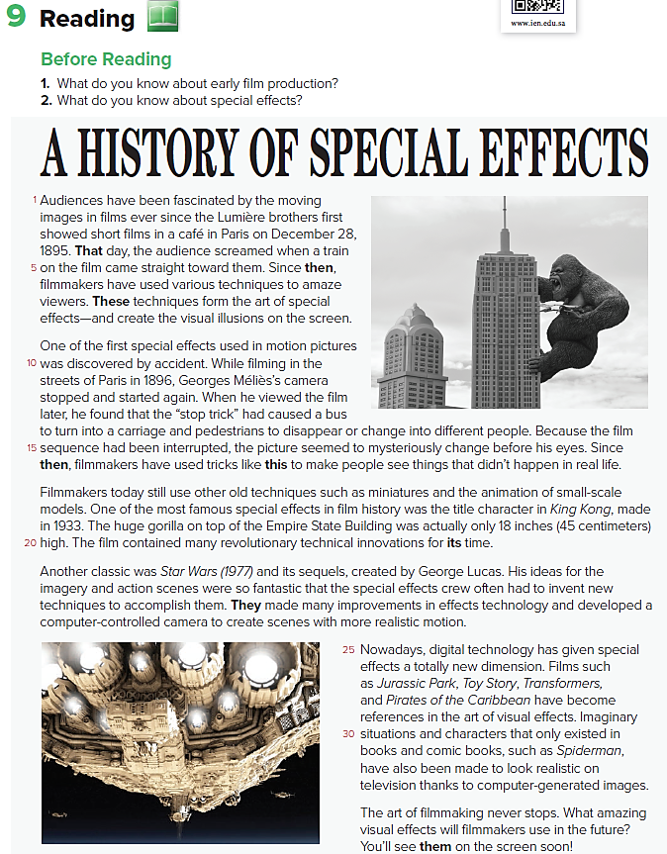
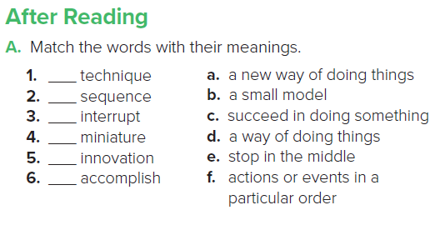

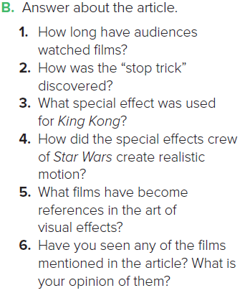
d
f
e
b
a
c
Q:1
Q:2
Q:3
Q:4
Q:5

Slide 13
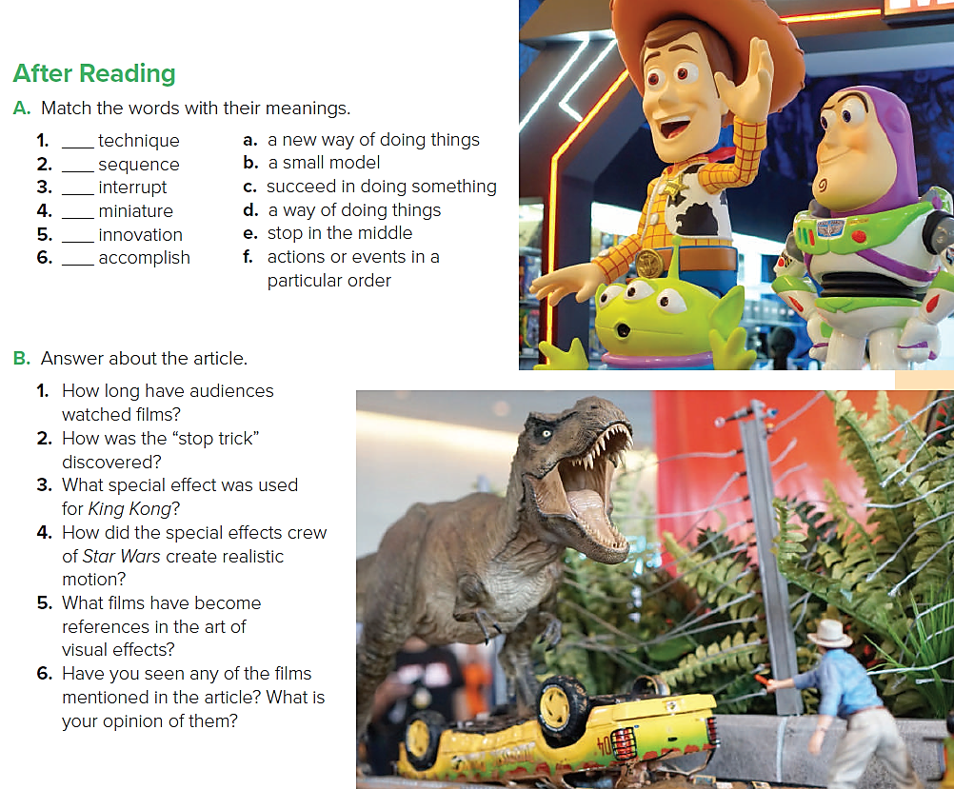
d
f
e
b
a
c
1-Audiences have watched movies since 1895/for
more than 115 years.
2-The “stop trick” was discovered by accident.
3-A small model of a gorilla was used, but in the film
it looked large.
4-They used a computer-controlled camera to create scenes with more realistic motion.
5-Jurassic Park, Lord of the Rings, Toy Story, and Avatar.

Slide 14
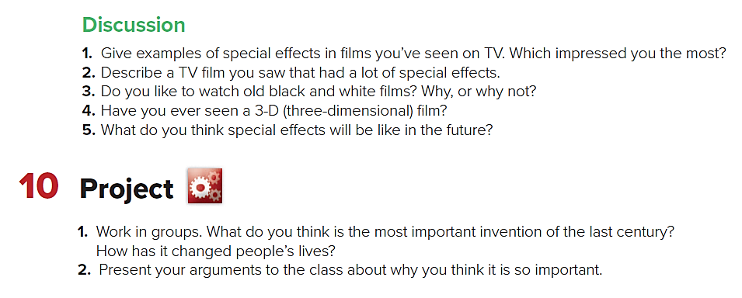

Slide 15


Proud to be Saudi

Slide 16


How Cinema help to introduce stories about many characters in Islam

Slide 17



2 Questions in Madrasti platform.

