Slide 1
We can
3
hello

Slide 2
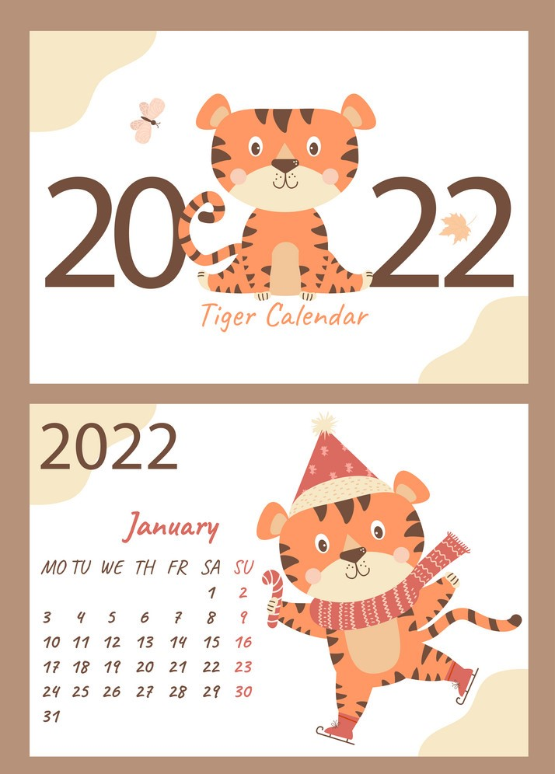
Day :
Date :

Slide 3
8
&
9

Slide 4






I can ……
-Say, read and write
words ending in nd and nt.
-Read English store signs in town.

Slide 5


Slide 6
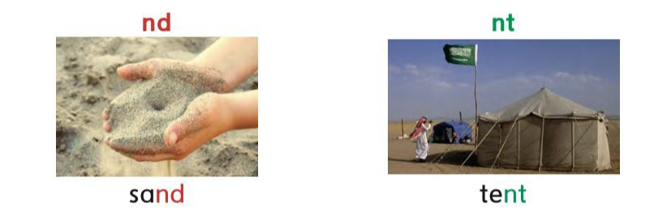

Slide 7


Slide 8

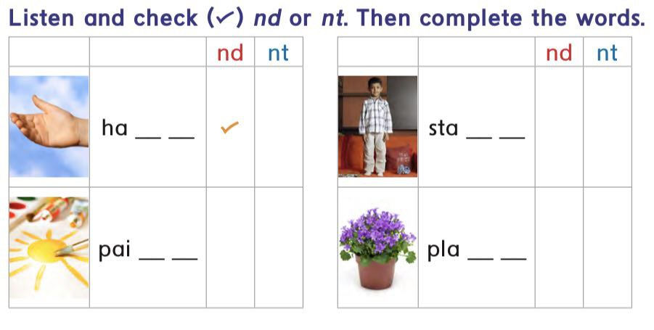

nd
nt
nt
nd

Slide 9

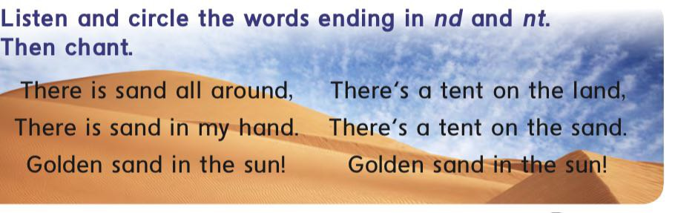

Slide 10
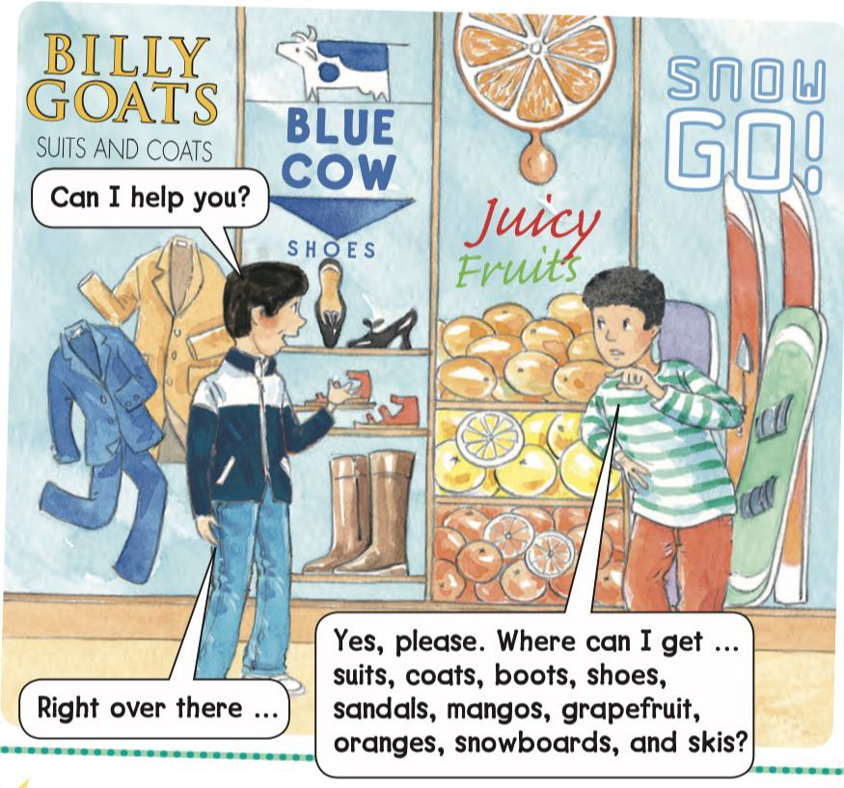

Slide 11

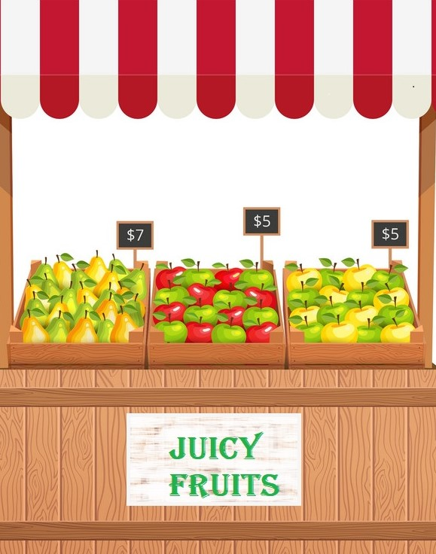


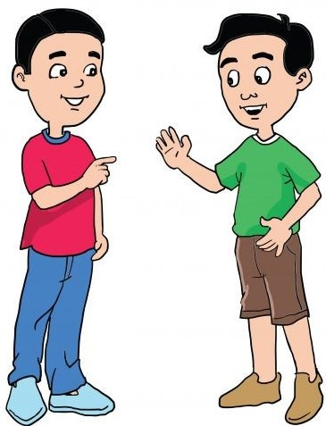
Billy
goats
Blue cow
Press at the sign to get in
Snow
go
Let’s inter to see what’s in ?
Juicy
fruit

Slide 12
Press here

Slide 13
Press here

Slide 14
Press
here

Slide 15
Press
here

Slide 16


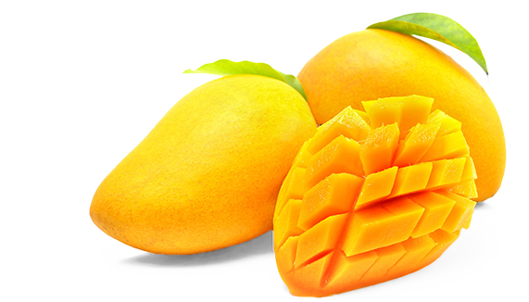
orange
grapefruit
mango

Slide 17


ski
snowboard

Slide 18
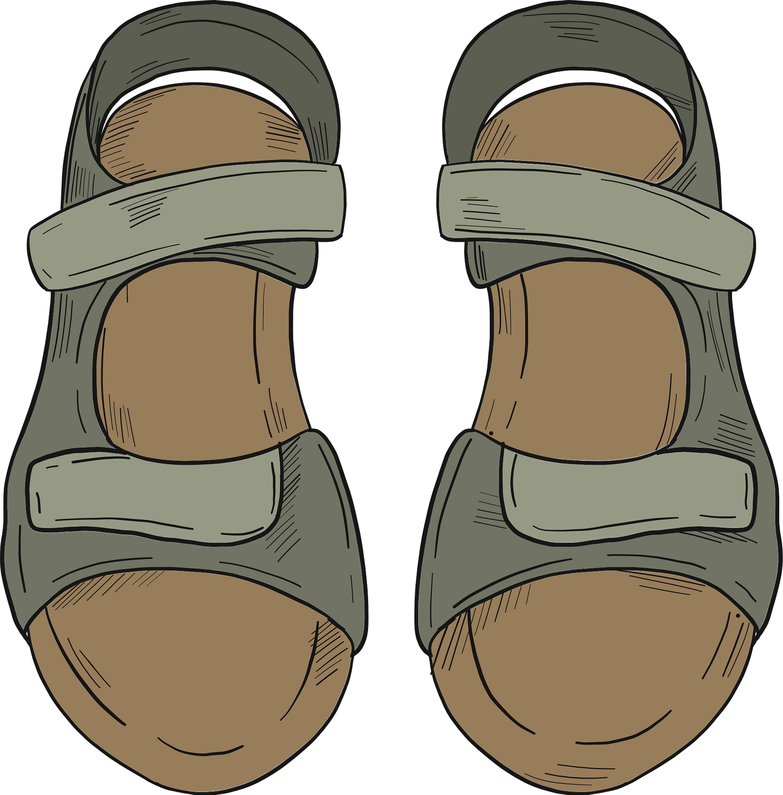


sandal
shoe
boot

Slide 19
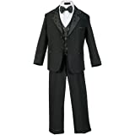


coat
suit
dress

Slide 20


Slide 21

1
nd
2
nt

Slide 22

1
nd
2
nt

Slide 23
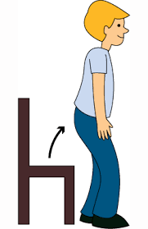
1
nd
2
nt

Slide 24

1
nd
2
nt

Slide 25

1
nd
2
nt

Slide 26

1
nd
2
nt

Slide 27

1
nd
2
nt

Slide 28

1
nd
2
nt

Slide 29

1
nd
2
nt

Slide 30



Slide 31



Slide 32


Home work at

