Slide 1
Mega goal.3.2
The Gender Divide.
Grammar

Slide 2
Objectives:
Use the auxiliary verbs after (and-but)
Write sentences with the passive tense
Write the suitable verb according to the sentence meaning
Express things that they remember
Express their point of view of being in 3rd grade

Slide 3
Verbs + Infinitives or Gerunds with Different Meanings
Passive Forms of Infinitives and Gerunds
Auxiliary Verbs after But and And

Slide 4
Verbs + Infinitives or Gerunds with Different Meanings

Slide 5
Infinitives or Gerunds
Some verbs can be followed by either a gerund or an infinitive, These verbs are
remember
regret
forget
stop
try

Slide 6
remember
verb + infinitive
verb + gerund
He remembers sending gifts last year.
He always remembers to send his grandparents a gift on special holidays
remember having done something in the past
remember to do a task

Slide 7
forget
verb + infinitive
verb + gerund
She sometimes forgets calling
She sometimes forgets to call
not remember having done something in the past
not remember to do a task

Slide 8
regret
verb + infinitive
verb + gerund
I regret to tell you that I have a secret
I regret telling you my secret
wish it were possible to undo something done in the past
wish it were not necessary to do something

Slide 9
stop
verb + infinitive
verb + gerund
We stopped watching the sunset
We stopped to watch the sunset
stop doing something
stop doing something in order to do something else

Slide 10
try
verb + infinitive
verb + gerund
I tried reaching them by email
I tried to reach them, but they didn’t answer the phone
make an attempt to do something
try a specific method to reach a goal

Slide 12
Passive Forms of Infinitives and Gerunds

Slide 13
The passive form of an infinitive is
to + be + past participle
Everybody wants to be respected by somebody
The passive form of a gerund is
being + past participle
Being asked to settle an argument can be awkward

Slide 14
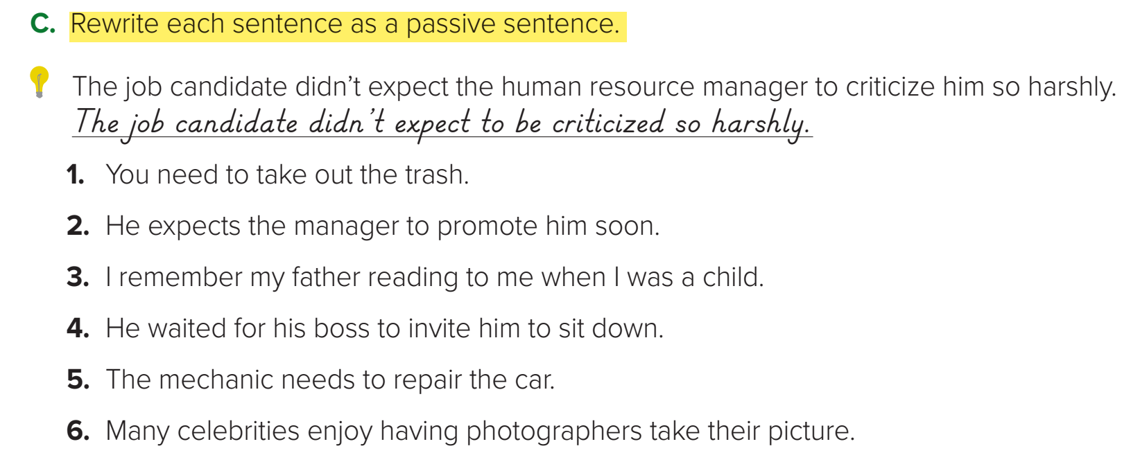
1.The trash needs to be taken out.
2. He expects to be promoted soon.
3. I remember being read to as a child.
4. He waited to be invited to sit down.
5. The car needs to be repaired.
6. Many celebrities enjoy having their picture taken

Slide 15
Auxiliary Verbs after But and And

Slide 16
When an addition is made to a statement with but or and, often the main verb is not repeated. Instead, it is replaced with an auxiliary verb.
Auxiliary verbs.
do, does, did
Is , are , am
was ,were
have, has , had

Slide 17
but + subject + auxiliary
My sister isn’t good at remembering special occasions, but my mother is.
John doesn’t get frustrated easily, but Sam does

Slide 18
and + subject + auxiliary + too
He enjoys outdoor activities, and his son does too
and + subject + auxiliary + either
We don’t like going for walks in this heat, and he doesn’t either

Slide 20
Quick Check

