Slide 1



WE CAN 4
Unit 1 lesson4
Phonics
2nd Term 2021
Tr.Hanan Allaheeb

Slide 2
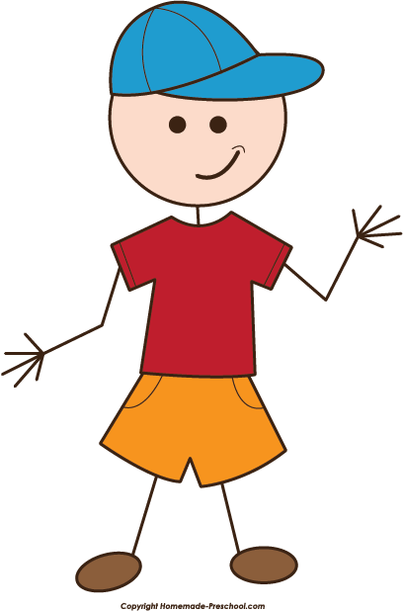

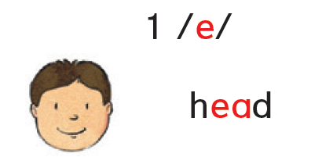

Listen and Say

Slide 3




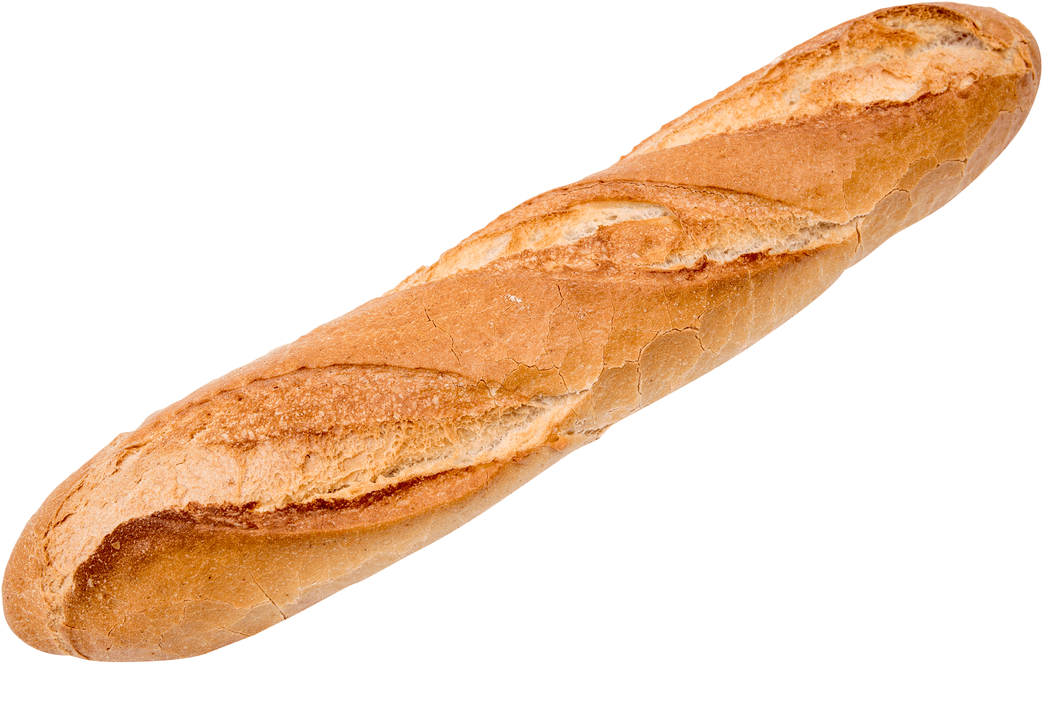

Read and Number 1 or 2
1 /e/
2 /i/
head
read
feather
peach
meat
bread
1
2
2
1

Slide 4


Slide 5
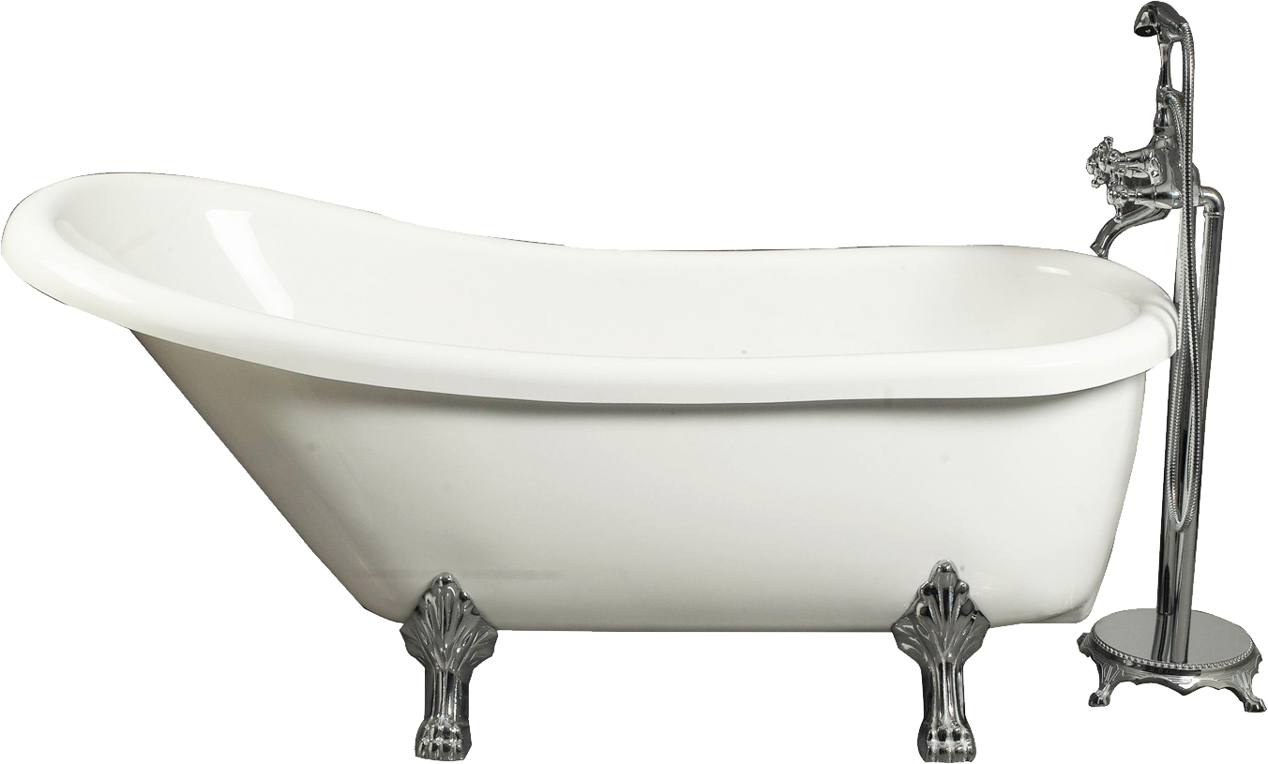

Listen and Say
u
u_e
tub
tube

Slide 6



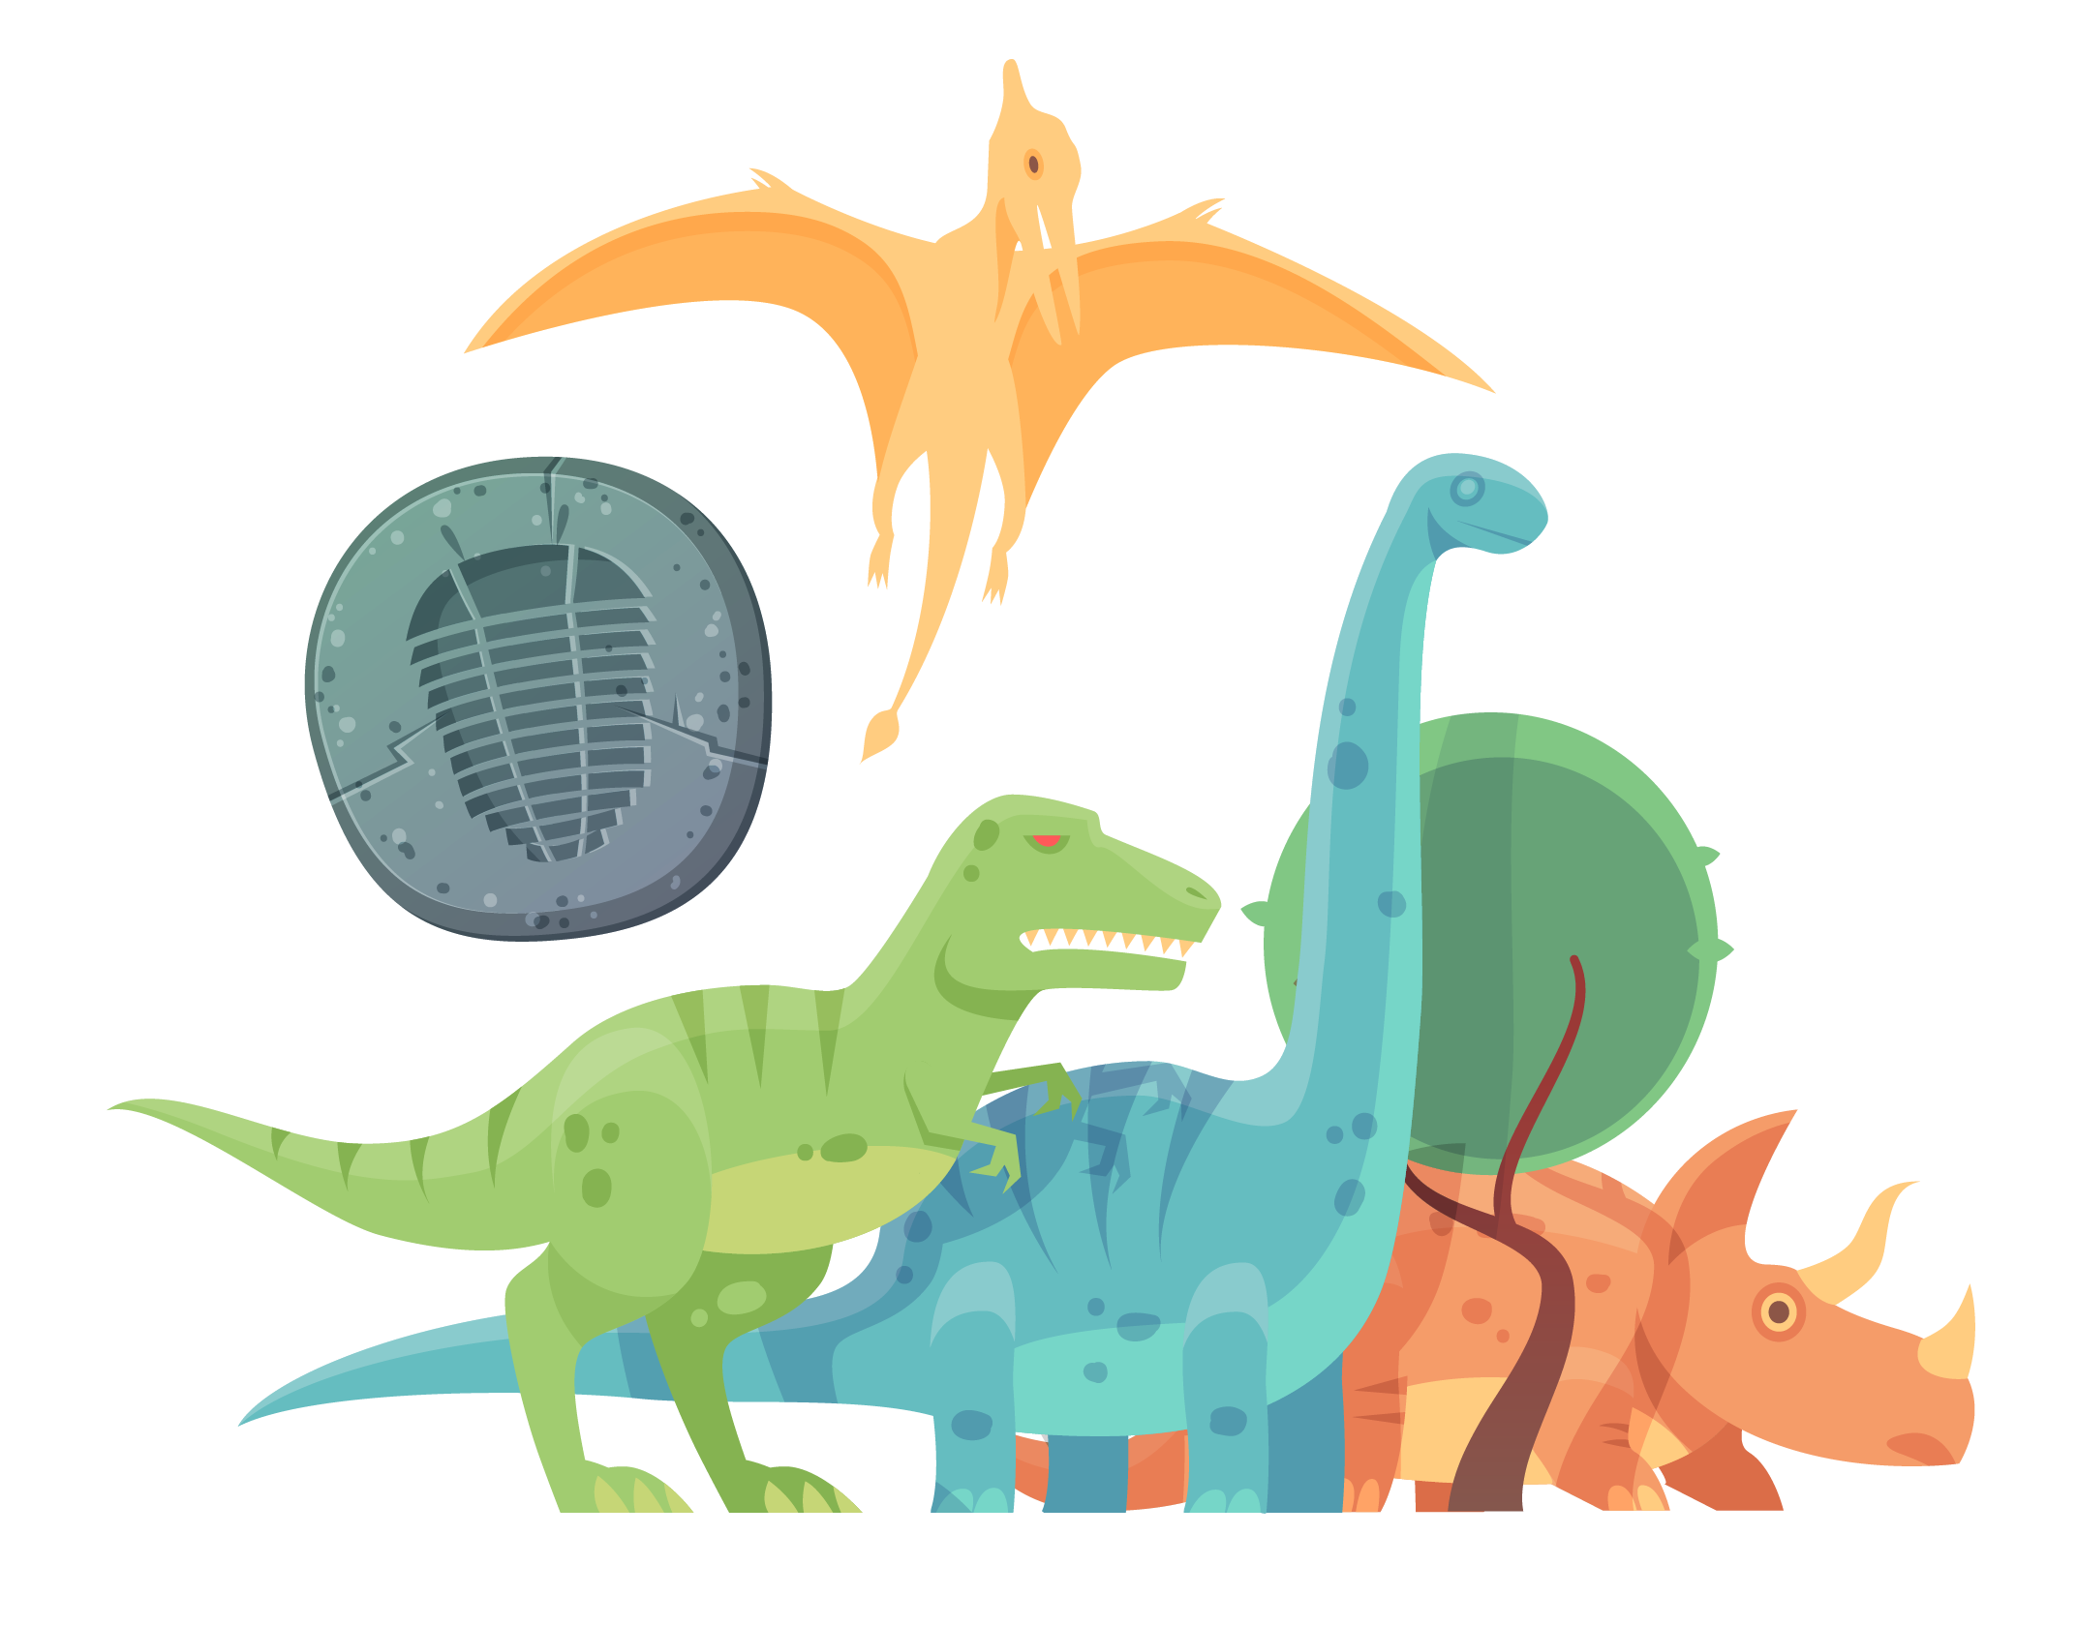









Listen then match
duck
cube
u
cup
huge
u_e
uniform
bus

Slide 7

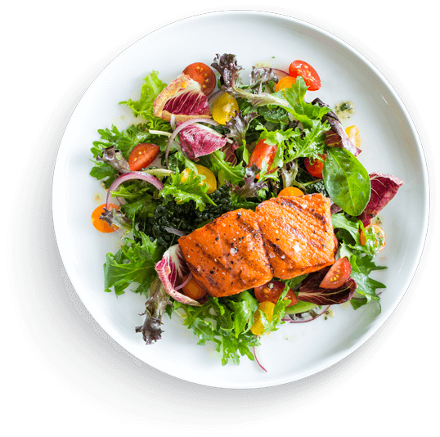





Digraph oo and oo
short oo
long oo
food
book

Slide 8

Let`s watch the video

Slide 9


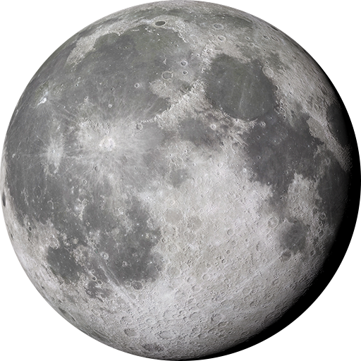





Listen ,say and match
boot
moon
book
food
foot

Slide 10
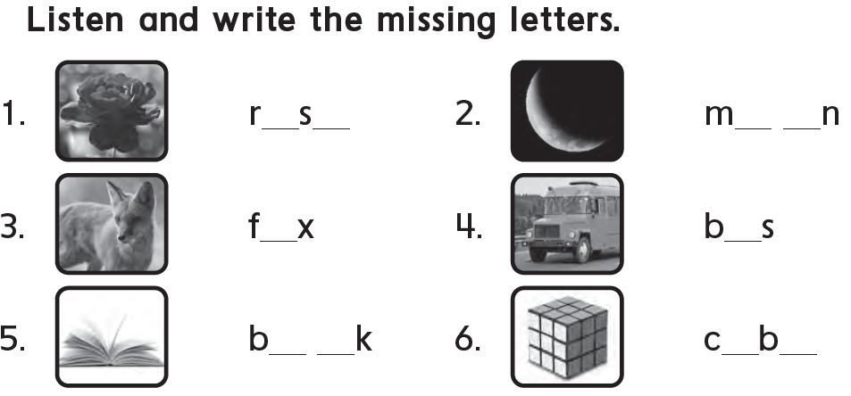
























Slide 12
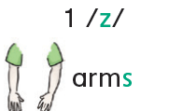
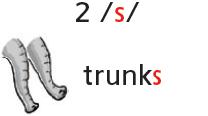
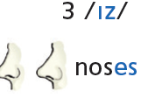
Listen and Say

Slide 13









Listen, Read and Number 1 , 2 or 3
1 /z/
2 /s/
3 /iz/
hippos
crocodiles
snakes
elephants
dresses
faces
1
1
2
2
3
3

